Slide 1
Like Herding Cats: Managing Workflows and Complex Projects
Sarah Ponichtera, Sheridan Sayles, Alexandra deGraffenreid

Slide 2
Coordinating collection renumbering across platforms when ArchivesSpace is the "record of record"
Sarah Ponichtera, PhD, Assistant Dean for Special Collections and the Gallery

Slide 3
Archival Systems at Seton Hall
Archivesspace is the system of record for archival collection description
Digitized collection materials reside in Preservica and the Institutional Repository
One folder synced with Archivesspace, separate folders for web crawls and emails
Social media crawls in Conifer/Webrecorder
We are in the midst of a collections shift so there is a working spreadsheet tracking interim locations of collections called the “Vault inventory”
Control files both physical and digital
Digital exhibit citations

Slide 4
Where to Start?
As the system of record, Archivesspace itself must come first
Two phases - one for simple collections, one for merged collections
This automatically updated the synced collections in Preservica
But then we had to also renumber the unsynced collections in Preservica
Other locations fell into categories: urgent, stable, or in flux
Urgent: working document with locations, collections we are actively working with (i.e. web archives), control files
In flux: physical boxes, web archives in Conifer. These can be updated as they are worked with
Stable: digital exhibits and assets in the Institutional Repository

Slide 5
Recommended order
ArchiveSpace
Actively used locations
Mid-process locations
Stable locations

Slide 6
Using scaffolded learning as a model to incorporate graduate archival interns into creating and updating finding aids using ArchivesSpace
Sheridan Sayles, Technical Services Archivist
Ad-hoc Internship Coordinator

Slide 7
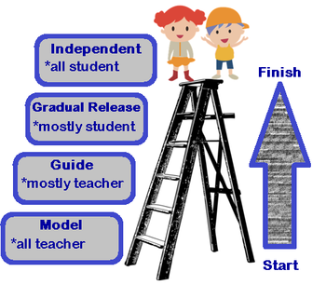
What is Scaffolding?
Gradually introduce both ideas and agency to learners
First steps determined by existing knowledge student brings to project
Benefits:
Works to build confidence
Controlled introduction of content makes it easier to check work
Scaffolding. (2021, February 18). [Illustration]. Study.Com. https://study.com/academy/lesson/scaffolding-student-knowledge-in-mathematics.html

Slide 8
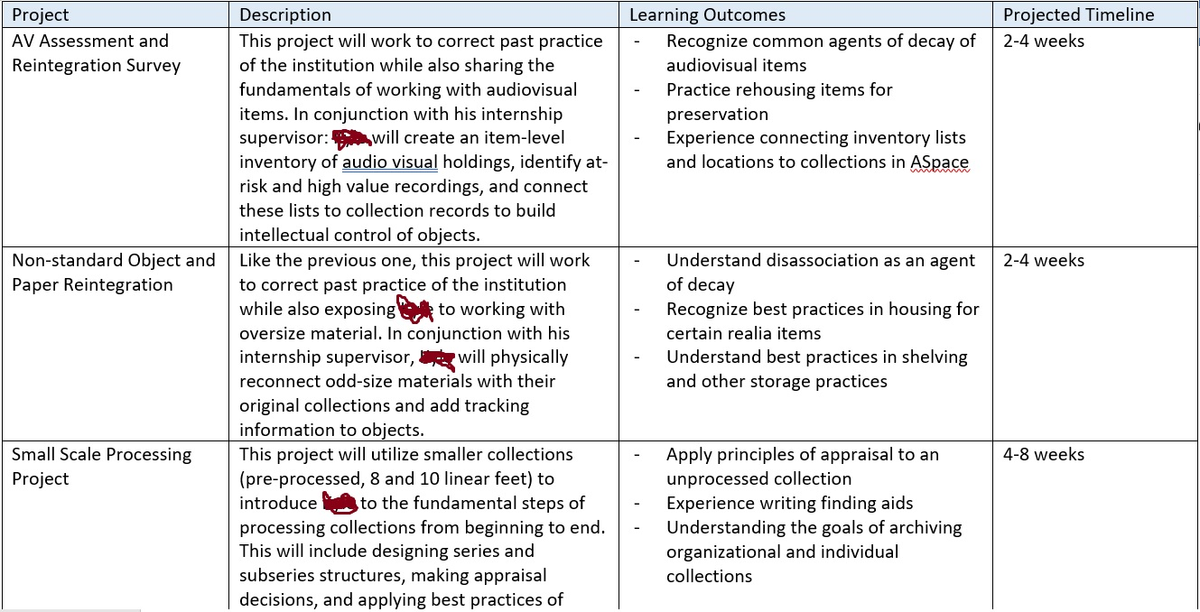
Scaffolding in Archival Internships
Start simple, then gradually introduce difficulty
Work through complex ideas with student
Make training tools widely available
Ask probing questions often

Slide 9
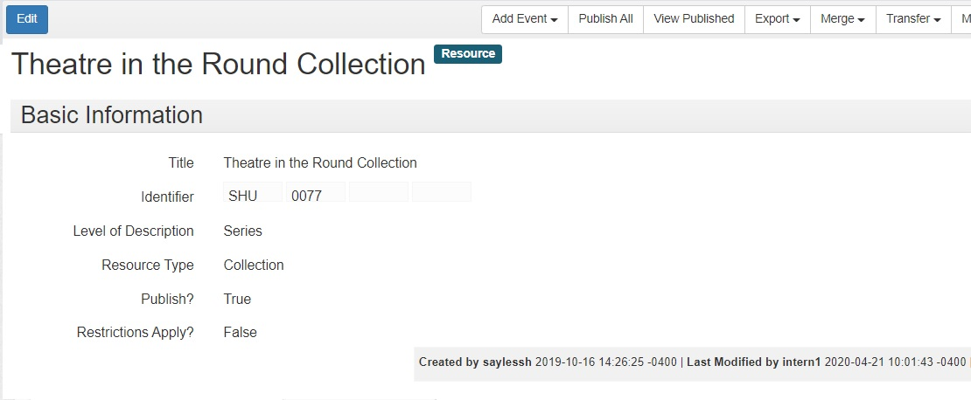
Projects in ASpace for Graduate Students
Identify subject headings; controlled vocabulary
Link accession records to finding aids
Write notes, whole finding aids
Ingest collection inventories using excel upload function

Slide 10
Embedding standardized ArchivesSpace data requirements into processing workflows to facilitate large collaborative processing projects with staff and volunteers
Alexandra deGraffenreid, Interim Co-Head of Collections Services & Processing Archivist, Penn State University

Slide 11
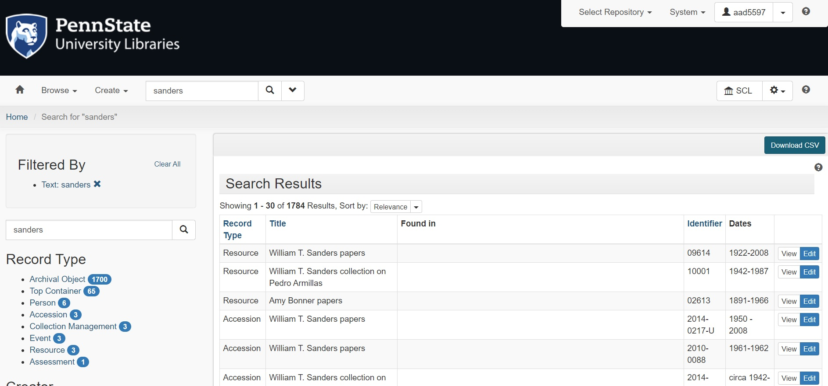
ArchivesSpace at Penn State

Slide 12
Managing Expectations
Expectations for understanding ArchivesSpace are different for staff, students, and volunteers.
Staff:
Require more in-depth training and read/write access of ArchivesSpace.
Students & Volunteers:
Require less formal training of ArchivesSpace. May be introduced to ArchivesSpace, but not given read/write access.
As all archival description is housed in ArchivesSpace, our local ArchivesSpace data standards must be incorporated into all aspects of the Arrangement & Description Workflow.

Slide 13
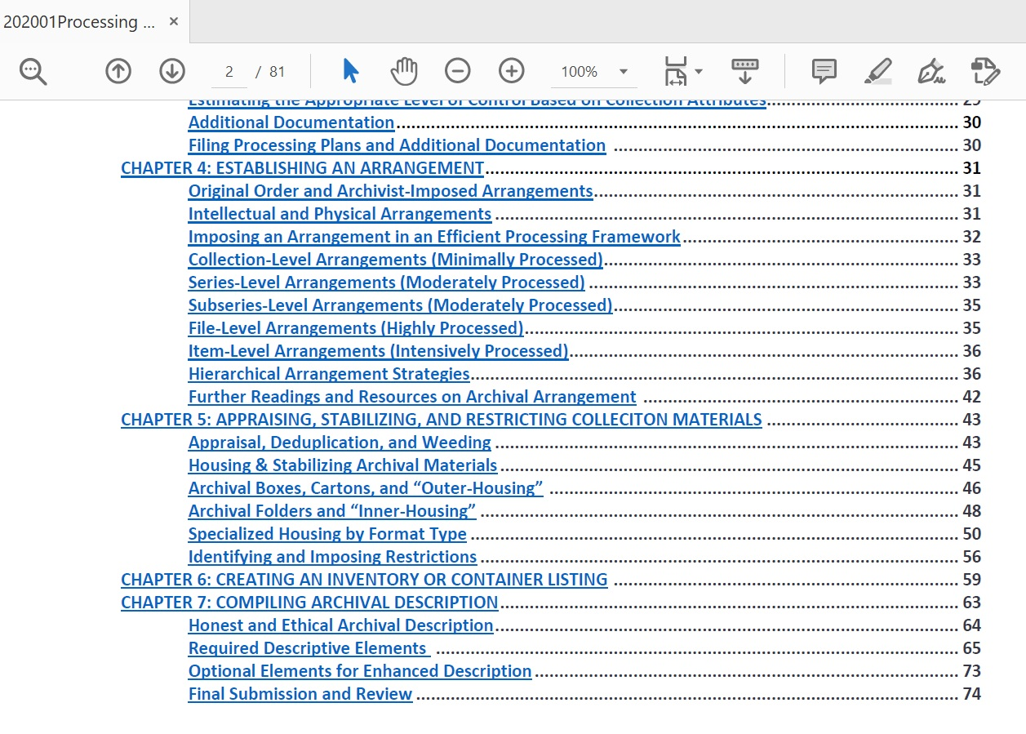
Embedding into Workflows: Processing Manual
Chapters for different stages of processing
Designed both as a reference and training tool
Scaffolded training and application
All chapters are tied to three themes:
Archival theory (traditional and critical theories)
Local standards
ArchivesSpace data needs
Forthcoming: Style Guide for Inclusive Description

Slide 14
Embedding into Workflows: Inventory Templates
Separate templates for staff and students/volunteers.
Staff:
Edited template. Incorporates required and most commonly used columns.
Assumes greater understanding of ArchivesSpace & can be uploaded once complete.
Students/Volunteers:
Minimal template. Incorporates only required columns. Additional information (such as EADID) added later by archivist.
Templates are extensible and dependent on project needs.
Sample templates are extremely useful.

Slide 15
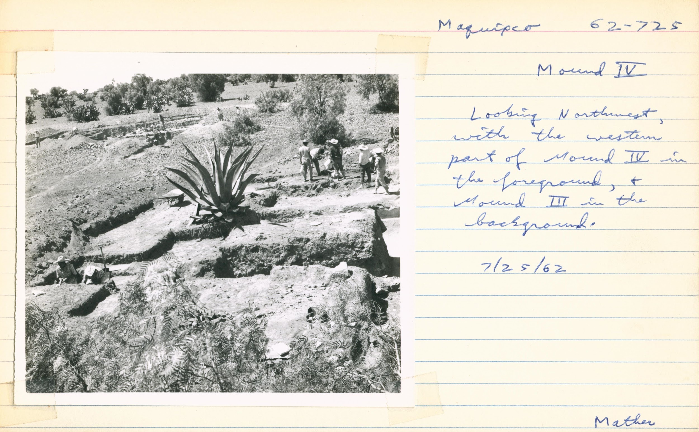
Case Study: William T. Sanders papers
Volunteer (faculty member).
Collaboration between archivist & volunteer.
Volunteer inventoried the collection using the chapter on compiling inventories and the staff template.
Archivist compiled remainder of description.

Slide 16
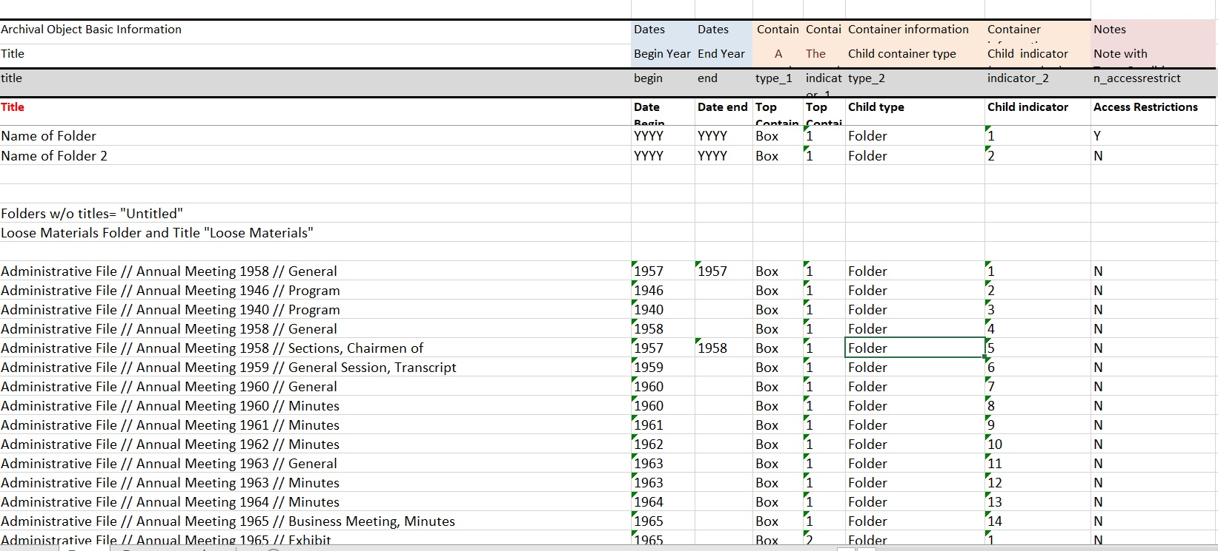
Case Study: American Sociological Association

Slide 17
Questions?
Alexandra (Lexy) deGraffenreid, aad5597@psu.edu
Sheridan Sayles, sheridan.sayles@shu.edu
Sarah Ponichtera, sarah.ponichtera@shu.edu

