Slide 1
Implementing & Integrating Penn State's ArchivesSpace Public User Interface
Alexandra (Lexy) deGraffenreid
Kevin Clair

Slide 2
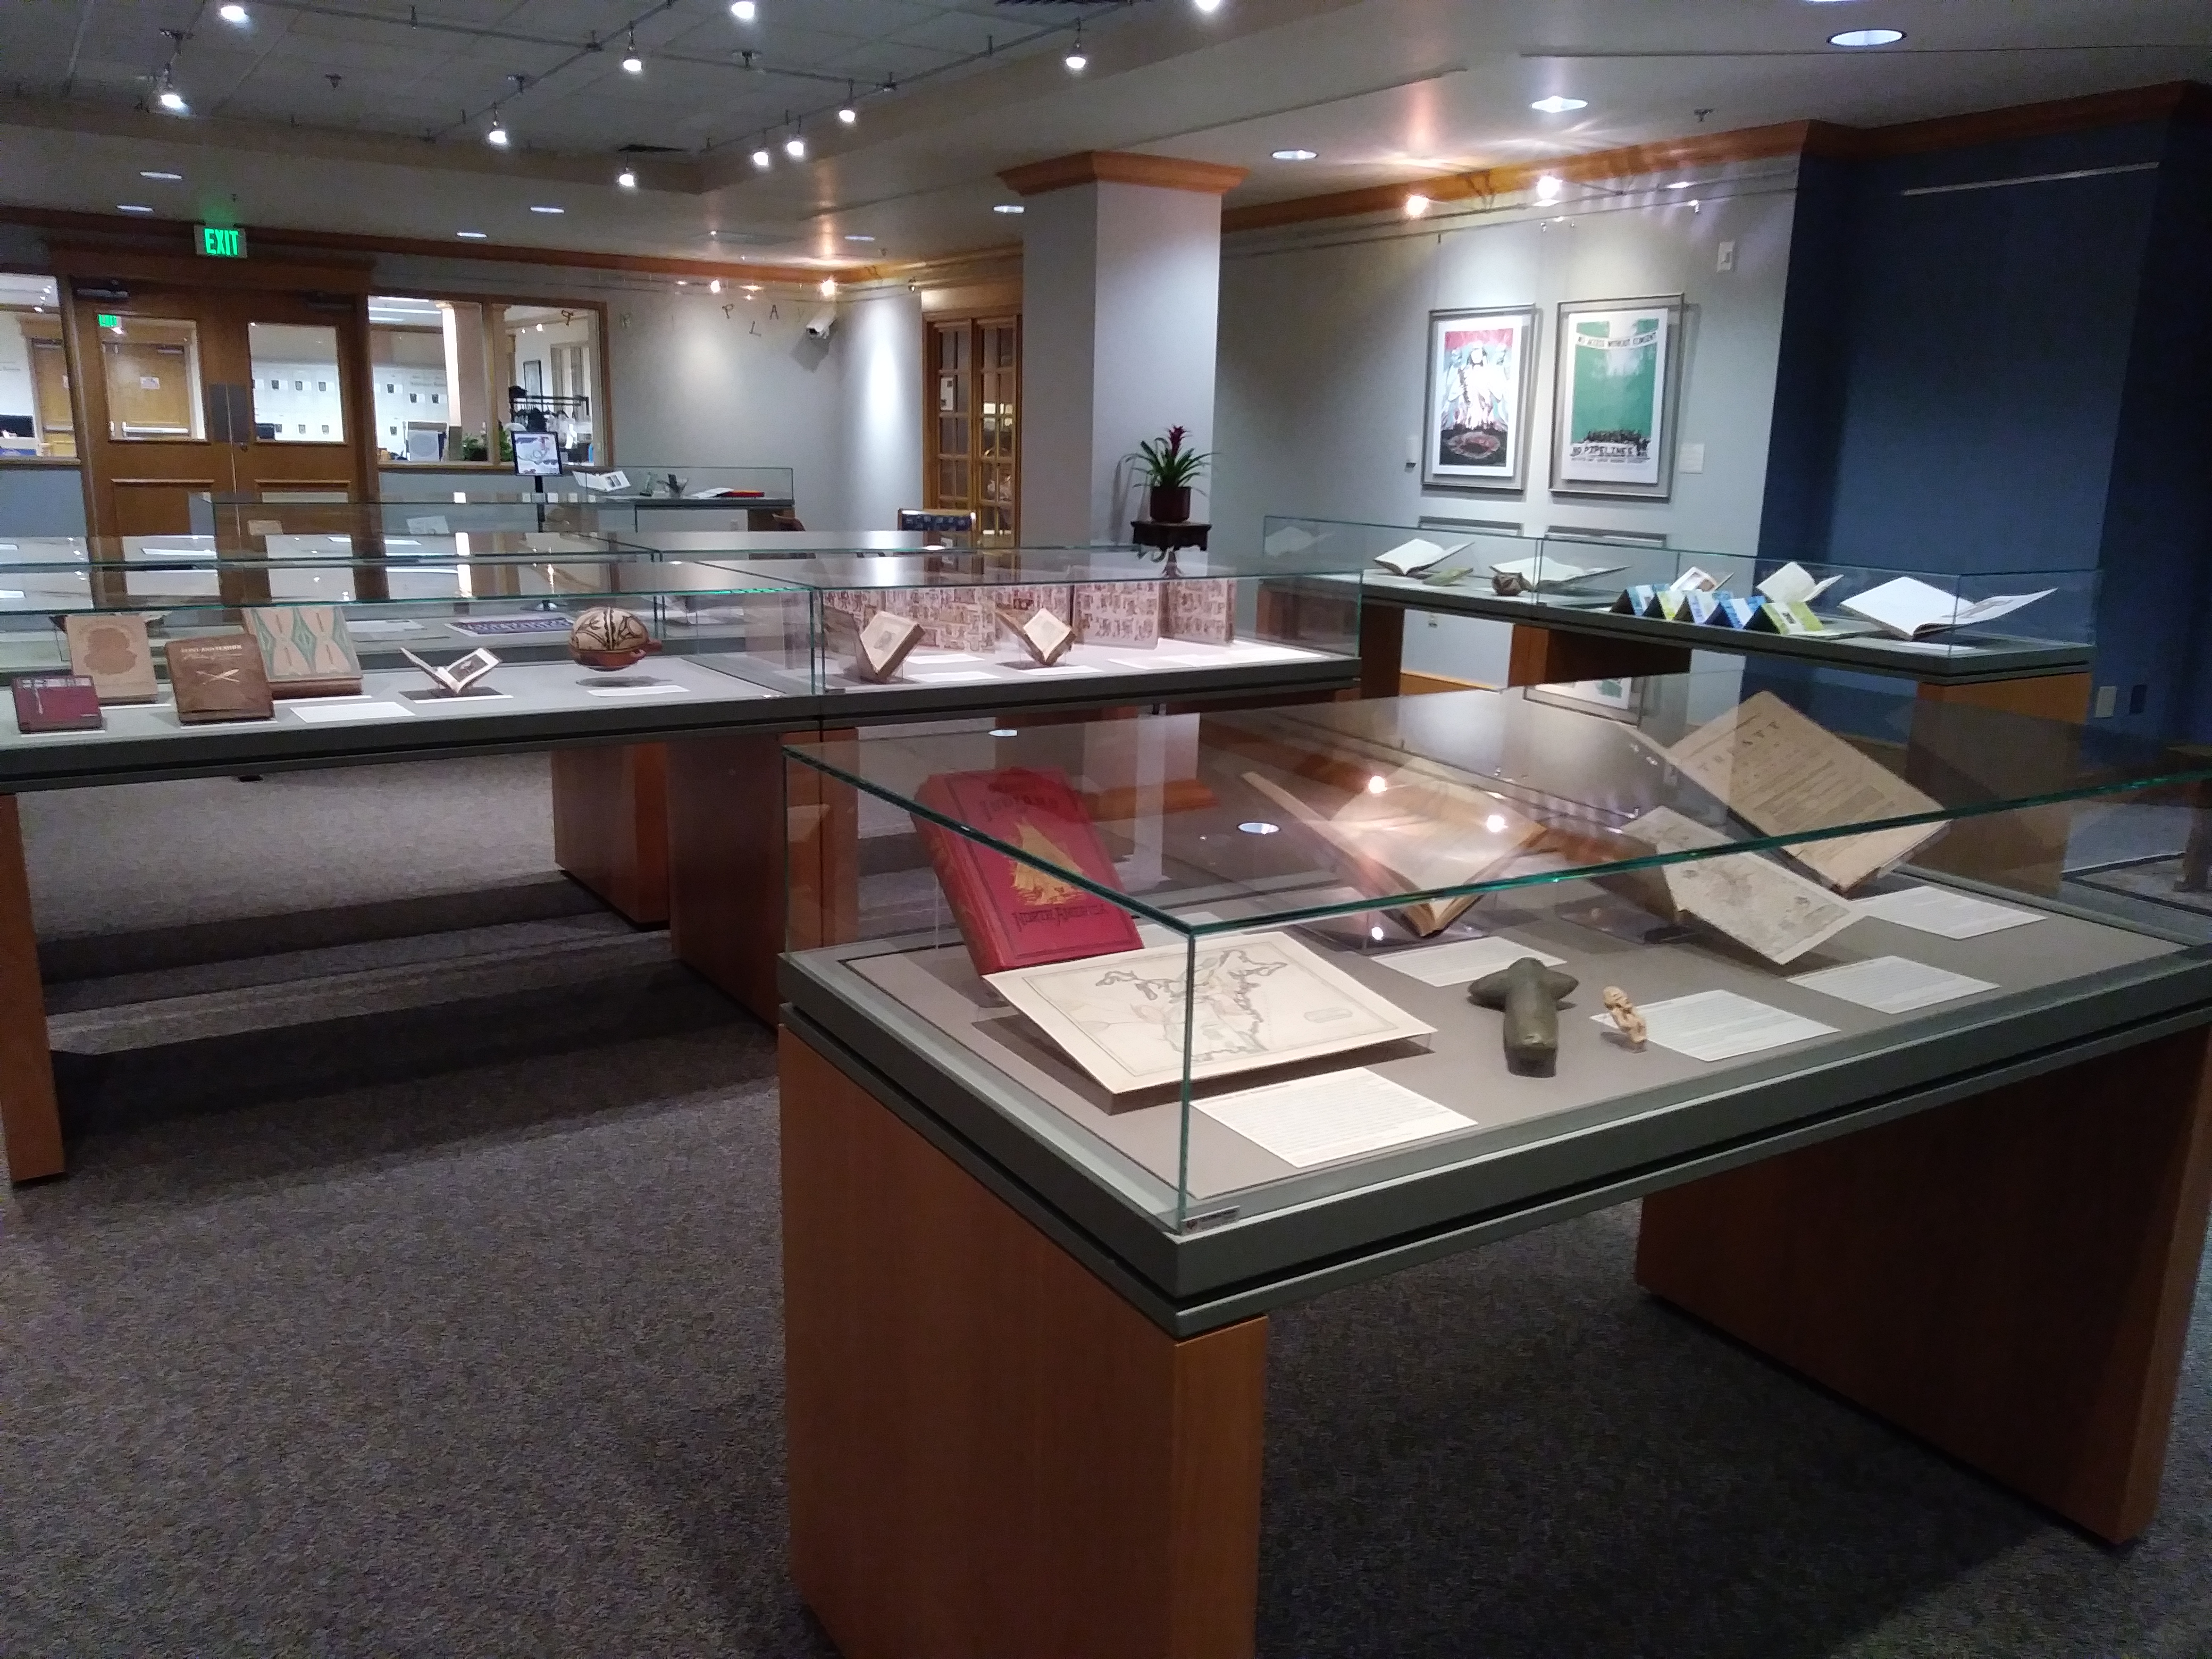
Eberly Family Special Collections Library
Notes:
About PSU/birds-eye view. Old ArchivesSpace Finding Aids site- static HTML

Slide 3
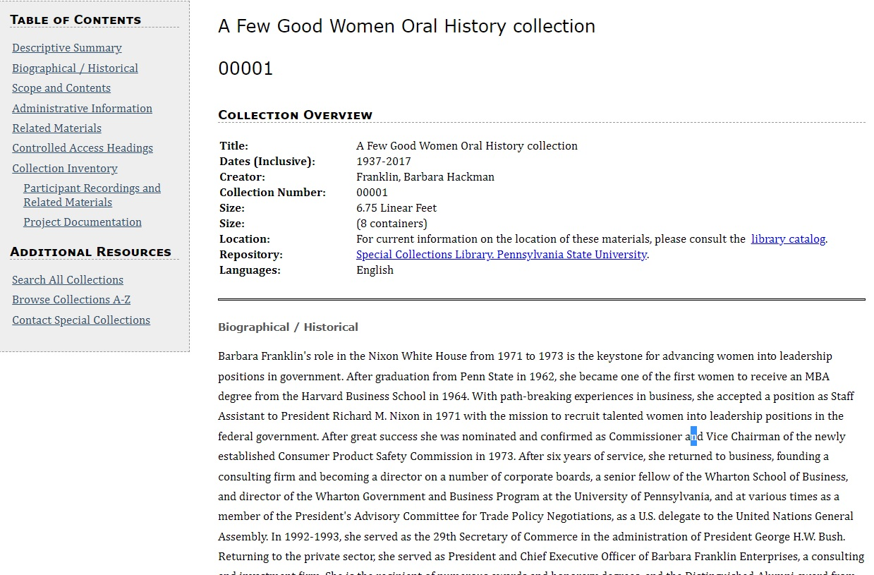
Old Finding Aid Website

Slide 4
2020 Finding Aids Audit
In what ways & to what extent is our data messy?
High-level audit of 2,275 Resource Records
Completeness: Does this meet minimum DACS & Local Standards
Offensiveness & obfuscation: Is harmful or offensive language present in the collection-level notes? Do these notes obscure the existence of marginalized voices?
Results: Not Great

Slide 5
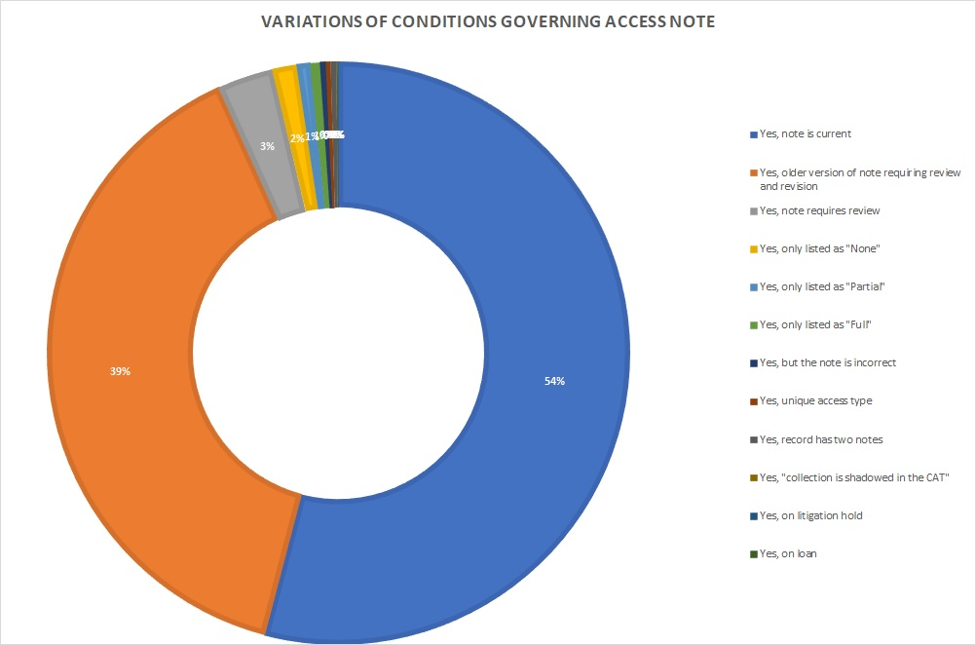
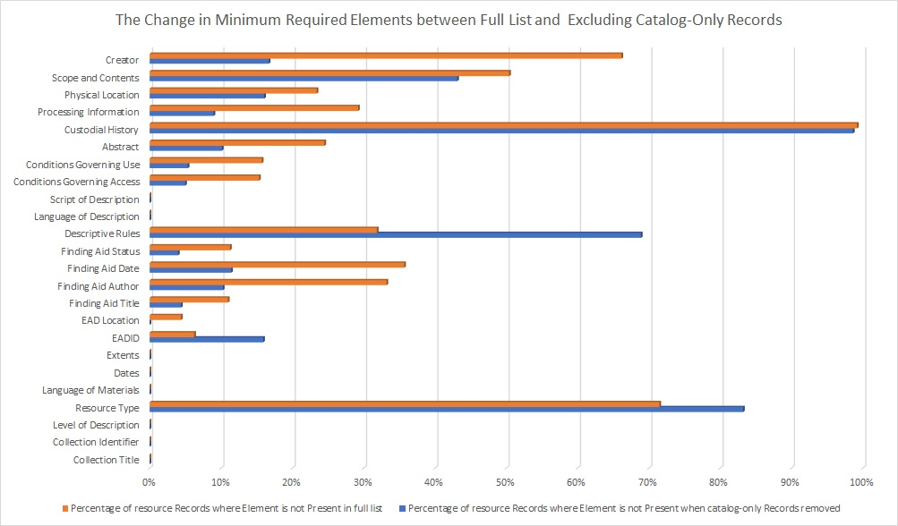
Making Sense of Our Mess

Slide 6
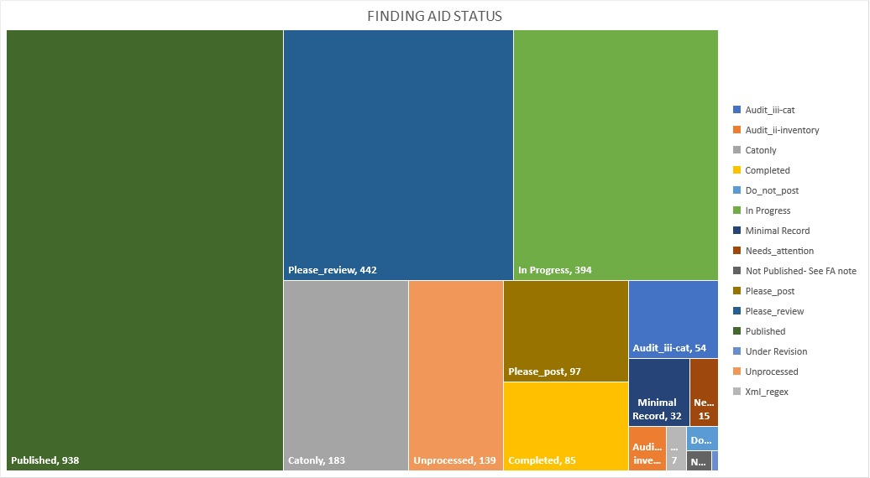
2021 ArchivesSpace Data Cleanup
Achieving “Golden Minimum”
Updating standardized notes to current standards
Updating Finding Aid Statuses to simplify & identify “Cat-only” materials
**Special thanks to graduate student Ben Mitchell

Slide 7
Data Cleanup (so far) Outcomes
Published in ArchivesSpace PUI: 1,927 finding aids
Statuses Published: Published, Minimal Record, Unprocessed
Updated ~650-750 Resource Records to current minimum standard
To be done:
Cleanup Resource Records with “Published” finding aid status
Address records with status “Needs Attention” and “Do not Post”
Further assessment at Archival Object level & to address description accuracy
Suppress CAT-only Resource Records

Slide 8
ArchivesSpace PUI Outcomes
Cross-collection (and cross-repository) searching
Integrate with Aeon for requesting materials
Connect with digital collections
Share a visual language with other discovery systems

Slide 9
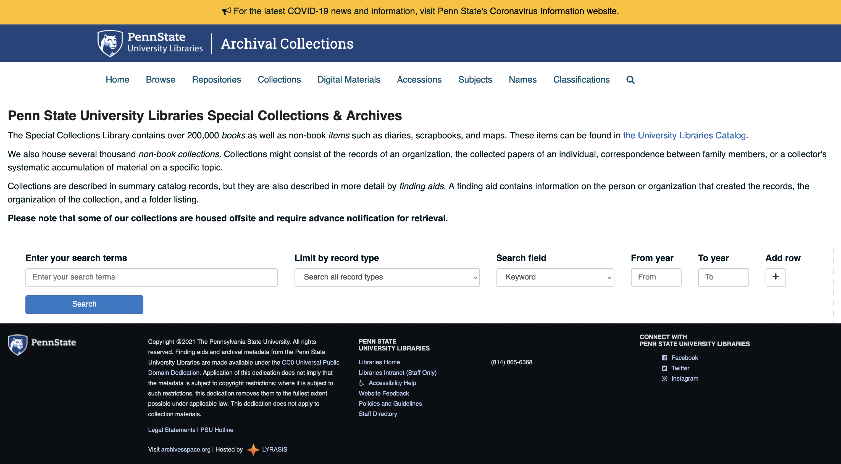
Public Site Launch

Slide 10
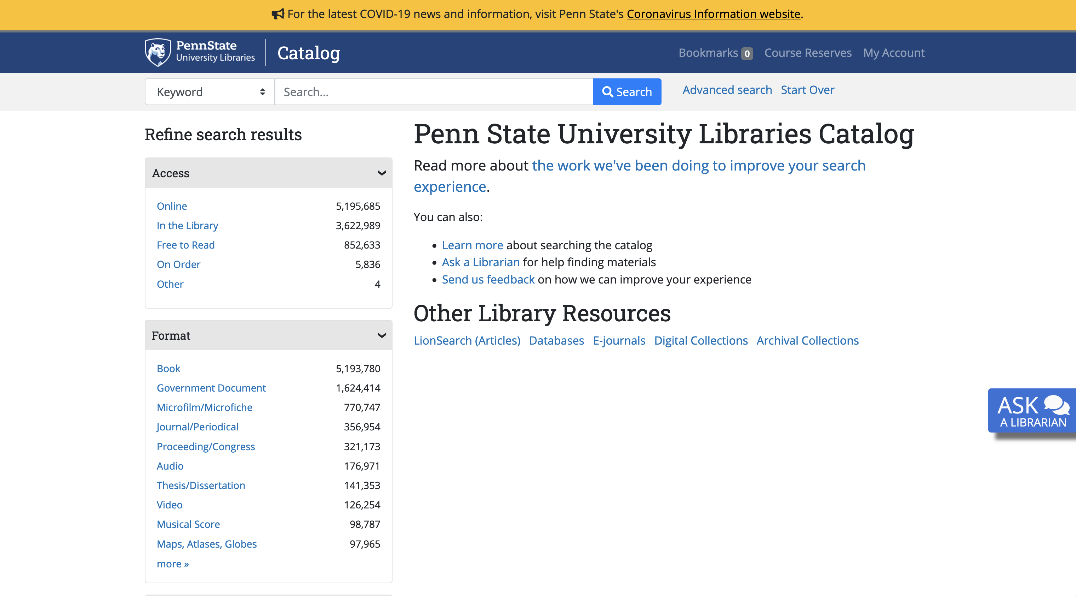
...compared to catalog

Slide 11
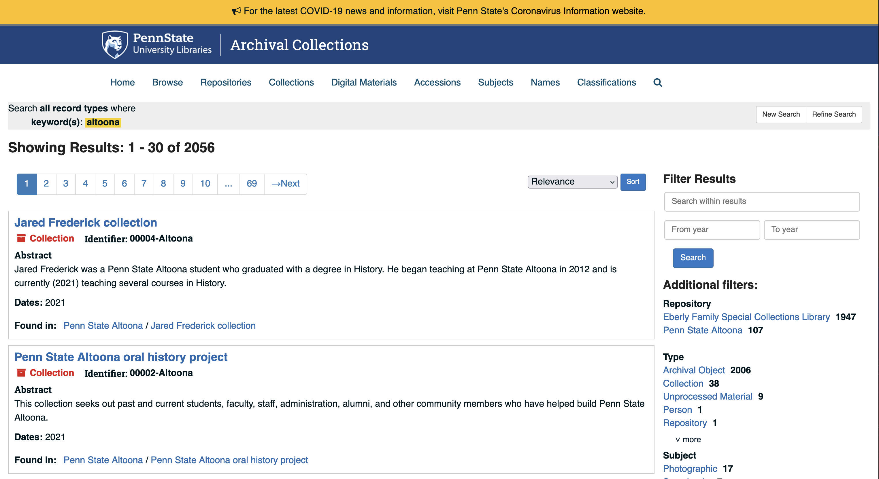
Cross-campus searching

Slide 12
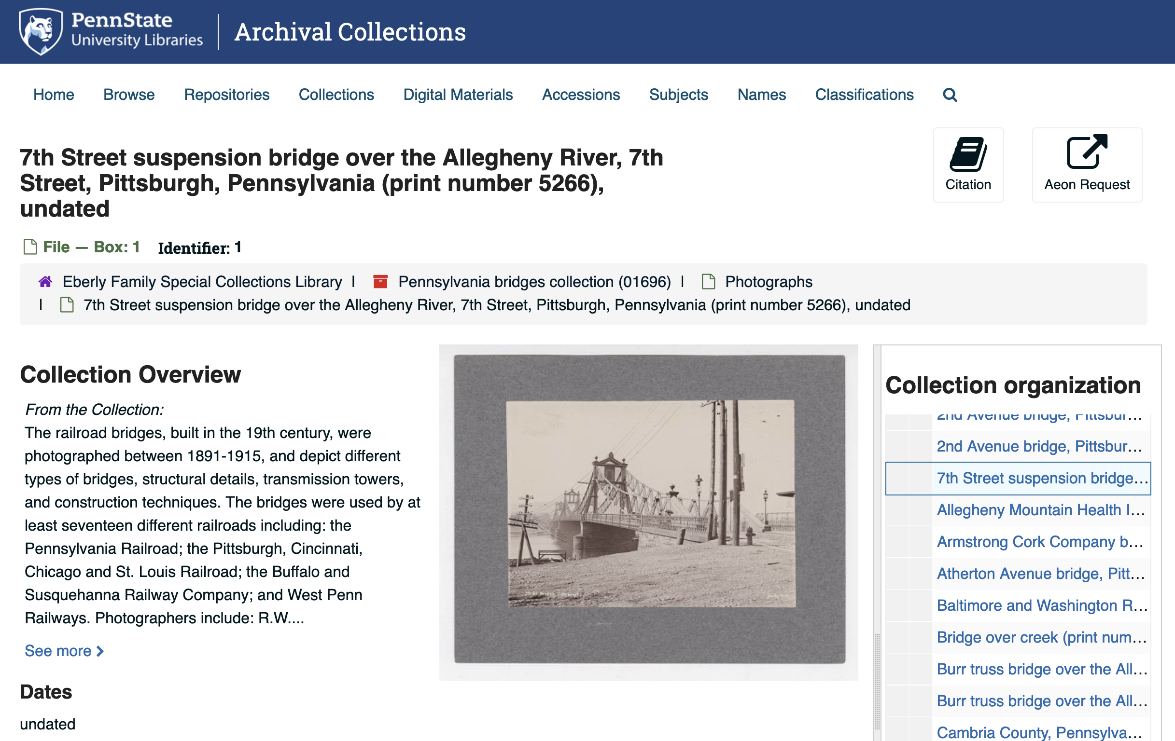
Integration with digital collections

Slide 13
Aeon integration (a work in progress)

Slide 14
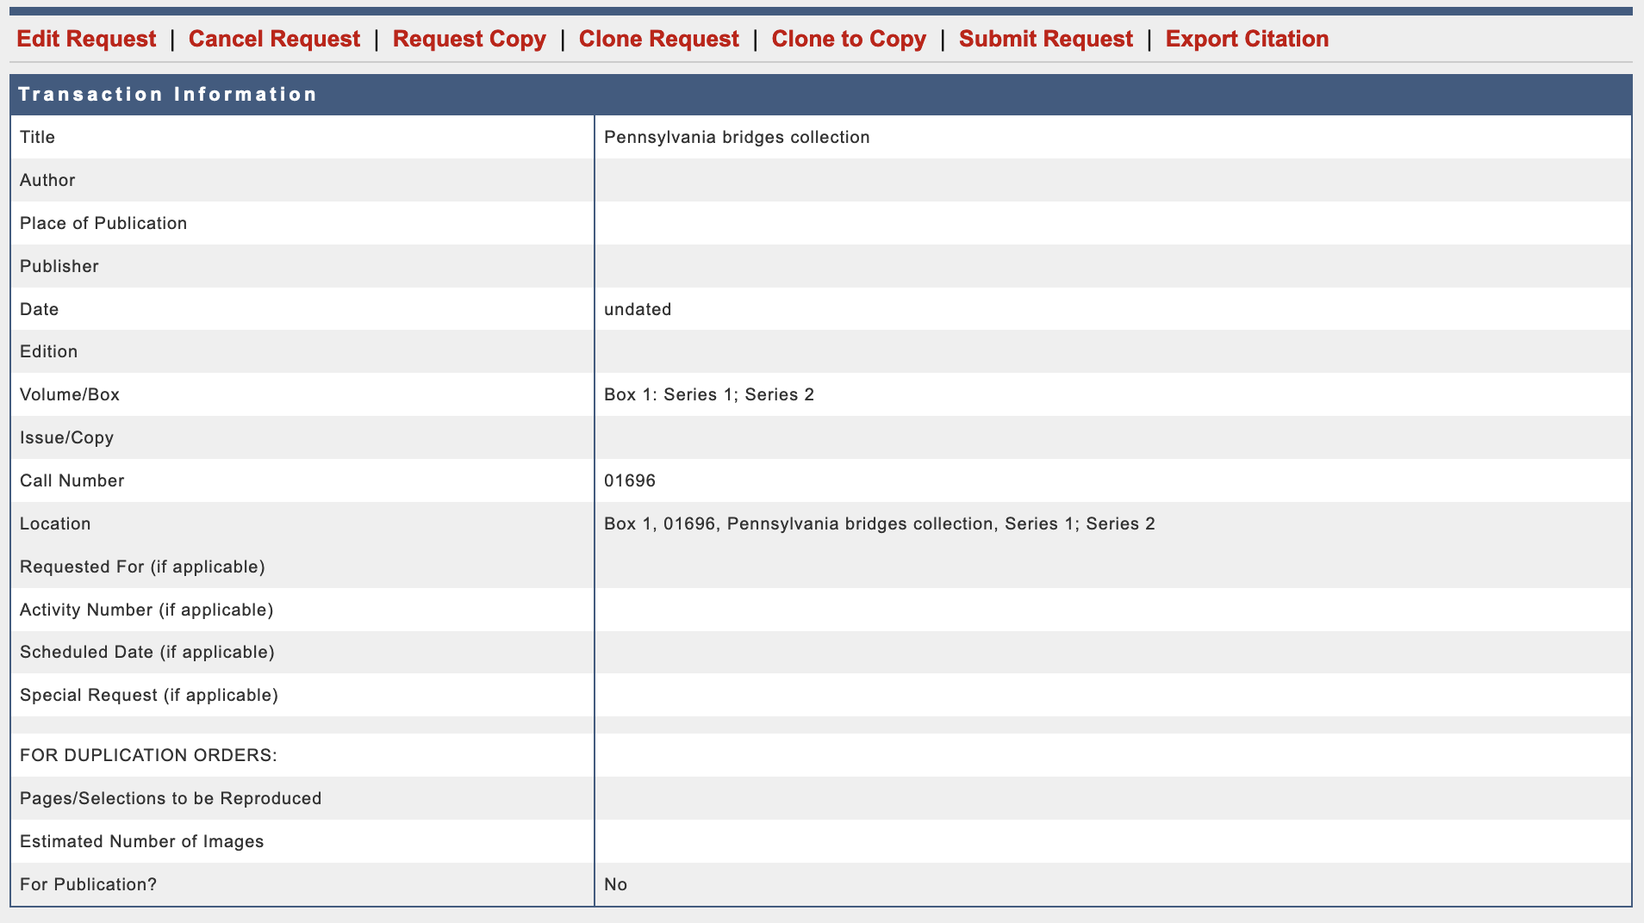
Aeon integration (a work in progress)

Slide 15
Links
PUI customizations on GitHub
Penn State Archival Collections
Penn State library catalog
Penn State University Libraries digital collections

