Slide 1
A Farewell to Archon ArchivesSpace Members Forum Portland State University July 25, 2017
Benn Joseph
Northwestern University Libraries
benn.joseph@northwestern.edu

Slide 2
ArchivesSpace timeline—charter membership through now
June 2013: Charter membership
August 2015: Still implementing Alma—maybe Atlas could host?
February 2016: Teams formed, contract review starts for Atlas hosting
July 2016: ArchivesSpace Best Practices Team first meets
December 2016: Archon frozen; no new content added
January 2017: Final database created on local instance of AS v1.5.1, database sent to Atlas for hosting

Slide 3
ArchivesSpace implementation
Preliminary Data cleanup (pre-migration)
Revisit processing and cataloging workflows
NUL Best Practices guide for ArchivesSpace
Iterative migration from Archon; final database given to Atlas

Slide 4
ArchivesSpace: data cleanup (more interesting ones)
Fixed by upgrading our version of ArchivesSpace,
Fixed by our developer who would create a plugin or write some kind of script to manipulate the MySQL tables,
Fixed by us by hand.

Slide 5
Fixed by upgrading our version of ArchivesSpace

Slide 6
Fixed by a developer

Slide 7
Fixed by a developer

Slide 8
Fixed by us by hand
ampersands in <note> or <unittitle> fields.
create standard note order for resource records, still need to apply.
add locations to resource records.
project to merge Agent and Subject records from Creator Manager and Subject Manager in Archon.

Slide 10
Training
Two day ArchivesSpace Basics training workshop (with ArchivesSpace trainers)
NUL-focused ArchivesSpace Best Practices training:
Session 1: Overview and Basics of ArchivesSpace Best Practices at NUL
https://bluejeans.com/s/BJVJN/
Session 2: Creating Accession Records in ArchivesSpace
https://bluejeans.com/s/nihAv/
Session 3: Creating Resource Records and Archival Objects in ArchivesSpace
https://bluejeans.com/s/bWM0o/
Session 4: Authorities Management in ArchivesSpace
https://bluejeans.com/s/qKUWa/

Slide 11
MySQL queries
Need to set up ODBC connection to Atlas
Queries run in Excel
Shelf list by collection/Top Container
Archival Object Status
Accessions

Slide 12
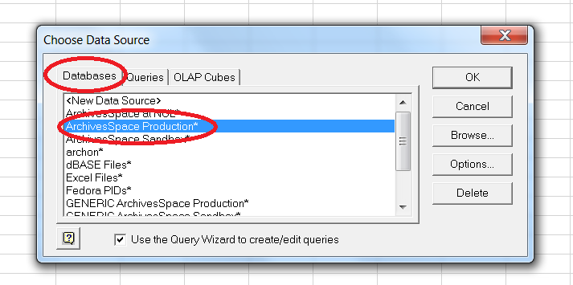
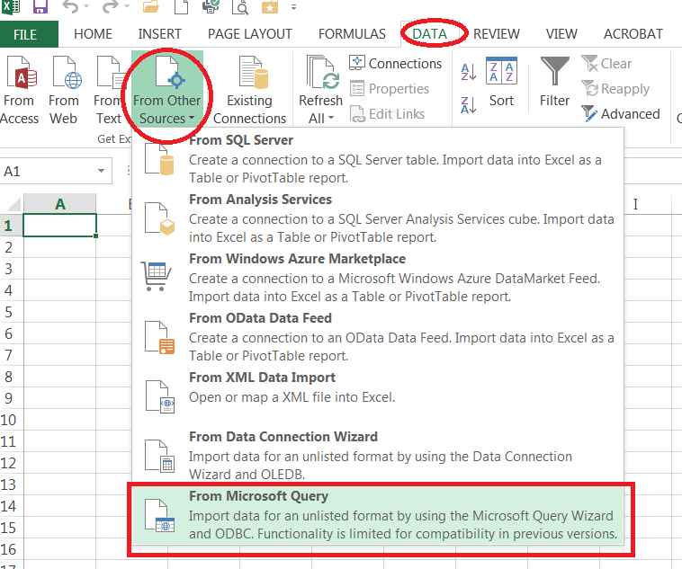
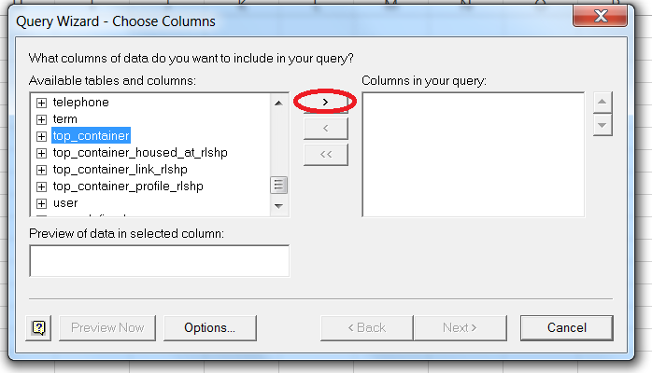

Slide 13
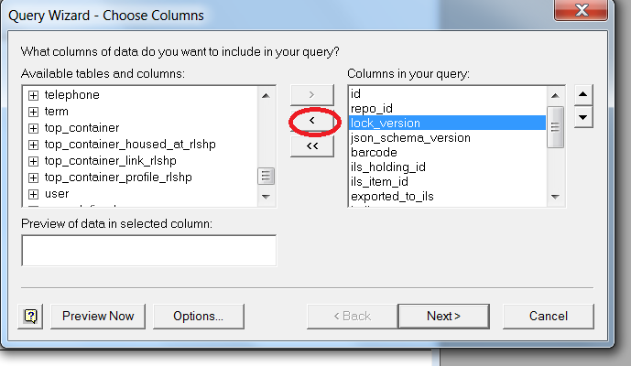
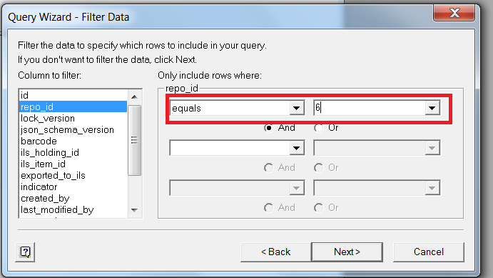
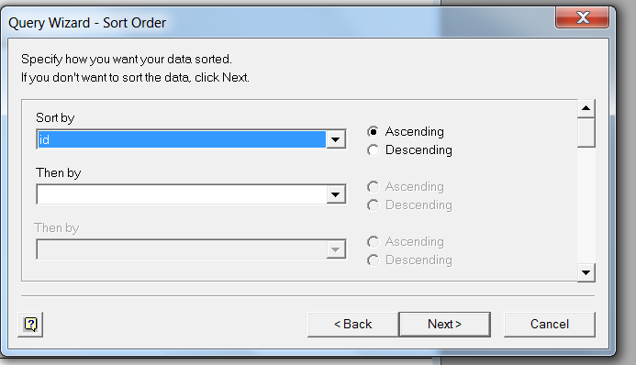
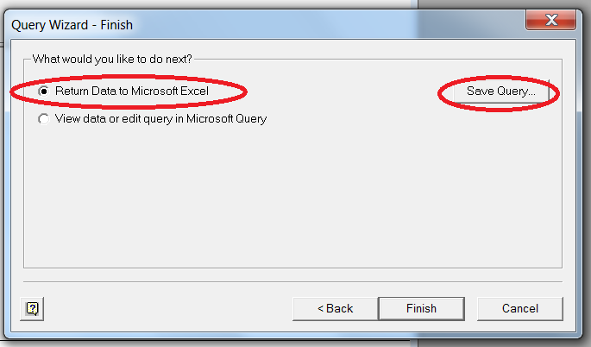

Slide 14
Thanks!
Benn Joseph
Northwestern University Libraries
benn.joseph@northwestern.edu

