Slide 1
Wow! We get authority control too?
Miloche Kottman (mkottman@ku.edu)
University of Kansas Libraries
ArchivesSpace Member Forum – July 25, 2017

Slide 2
Brief History of EAD at KU
Started use Encoded Archival Description (EAD) in 2004/2005
Retrospective conversion project
Scanned paper finding aids (over 2,500)
Inserted into template created in NoteTab Pro
Work done primarily by students
XML file created in NoteTab Pro
Converted to HTML (2004-2008) for website
Currently use XTF (2009- )
Notes:
I’ll start with a brief history of EAD processing at the University of Kansas. We began encoding finding aids in EAD starting in late 2004 and developed two workflows, one for newly processed collections and the other was a project to convert the existing paper finding aids into EAD.
For new collections, staff & students used the EAD Cookbook in NoteTab Pro to create xml files that were then converted to HTML and published on our website. We implemented XTF in 2009 which allowed us to skip the convert to HTML step (but no time was actually saved since we also started assigning handles and using version control software)
The retrospective project involved scanning the paper finding aids and saving as a Word document. Using a macro in NoteTab Pro to step through each section, students copy/pasted information from the Word document to build an EAD record.
As you can imagine, this project resulted in a lot of bad data due to poor OCR scans, lack of standardization, students pasting information in the wrong fields or not pasting information at all, etc.
We currently have 3,536 finding aids on our website and more than 2,000 of the records are from the recon project.

Slide 3
Authority Control?
Newly processed materials -- Used LC subject and name headings set up and/or verified by a cataloger
EADs are converted to MARC for addition to OCLC
Recon Project – Paste whatever was in the finding aid
Similar to card catalog
Headings valid at the time of entry
Text strings, not links – increase in potential typos
No cross references
EAD records filled out by students and staff not familiar with MARC encoding
Notes:
Rather than training Processing staff and students in the intricacies of AACR2, MARC, LCSH and now RDA, for newly processed collections we have a monograph cataloger create a MARC record and add it to OCLC. As part of this process, she sets up the headings suggested by the processors following LCSH, and RDA guidelines. For the retrospective project, the students just pasted whatever was in the paper finding aid.
In theory, the heading may have been valid at the time the finding aid was created (if the typist didn’t introduce any typographical errors) but no ongoing authority maintenance was ever performed on them.
<click> Since in both workflows, the records are created by people unfamiliar with MARC, encoding errors were introduced that didn’t make a noticeable difference in how the records display on our website but they do make a significant difference when importing into ArchivesSpace For instance in this example, though technically a subject, the heading Lawrence (Kan.)—Social life and customs is actually a place name subdivided by a topical heading. This was encoded as a 650 rather than a 651.

Slide 4
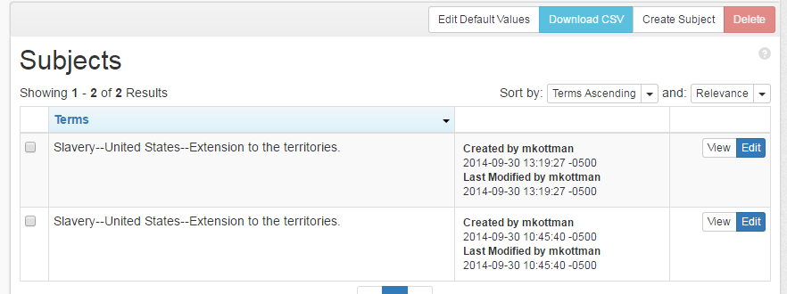
Importing into ArchivesSpace
Imported EADs over multiple versions of software
Early versions did not recognize when duplicate headings were created
Duplicates assumed if source, type and term the same
Notes:
In 2014, we stated migrating our legacy data into ArchivesSpace using the import EAD functionality; however, like most institutions, we had a lot of data to cleanup first. We worked on this cleanup in batches so the importing of our EADs was spread out over several versions of ArchivesSpace. The earliest versions of ASpace created new agent and subject records regardless of if there was a matching record already in the system.
<click> Fortunately, ASpace added duplicate checking before we imported the bulk of our records.

Slide 5
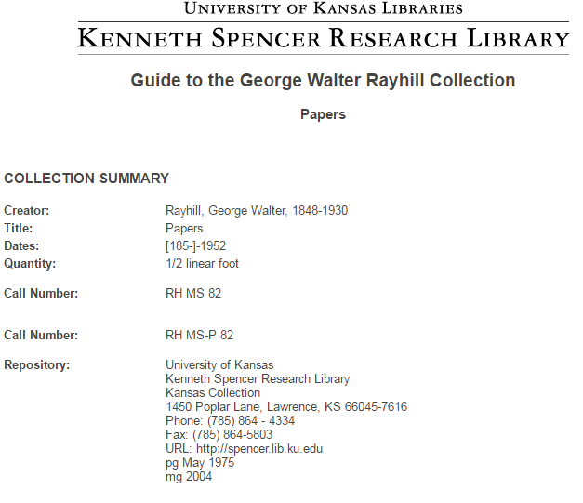
Project to review legacy records
Most records converted from paper finding aids
Merging of 3 departments
Different description standards
Did someone say standards?
Container issues exposed when upgraded to version 1.5
Notes:
Due to the record massaging we had to do to get the recon records into ArchivesSpace, we knew that our legacy records needed to be reviewed one of these days. When the paper finding aids were created, there were three different processing areas: Kansas Collection, Special Collections and Archives. Each department had their own way of describing materials, and the individual processors had their own styles for recording information.
<click> For example, this is a record from our Kansas Collection which has the very generic title of “Papers” and the Quantity is listed as ½ linear foot rather that the decimal value .5 that we prefer.
Due to some additional issues with how we handled containers that were exposed when we upgraded to ASpace version 1.5, the “one of these days” record review became a “how ‘bout now” record review. We only want to do this review once so we want to fix everything possible that doesn’t require us to actually pull the collection, including updating agent and subject records. So that we could assign as much of this cleanup as possible to students, I looked for a way to review subjects and agent records post-processing similar to what we do for our print collections.

Slide 6
Bad data!
http://www.newsusa.com
Notes:
To see how bad our subject and agent data was, I used Microsoft Access with an ODBC connection to our ArchivesSpace backend to get a list our subject and agent records. More about how to do this is covered later in the presentation. We had 10,735 agent records and 4,825 subject records.

Slide 7
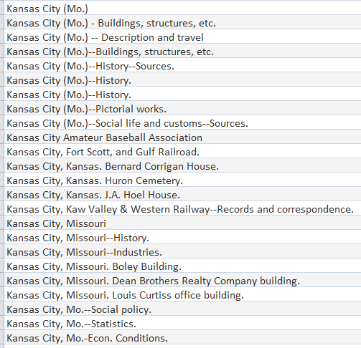
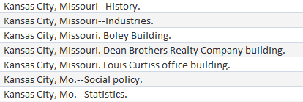
Data review
Agents as Subjects (600/610s as 650s)
Abbreviations of subdivisions
Obsolete headings
Punctuation
Notes:
As you can see from this example of subject headings that start with “Kansas City”, our data could definitely benefit from a thorough review and regular authority maintenance. Our subject authorities maintenance person was looking for a project so I showed him how to use the agent and subject record functionality in ArchivesSpace, mapped out some terminology differences, e.g. think bib record when you see resource record and gave him an Access table listing the subject records in ArchivesSpace.
Some of the errors he encountered as he worked through the 4,825 headings included:
<click> 670 headings that should have been agents
<click> abbreviated headings like you would have seen on card catalog cards and obsolete subdivisions like “Description – Views” or Industries used after place.
<click> Of course, the most glaring issue is the lack of standardization. In this example we have Missouri spelled out or abbreviated when it should be abbreviated and enclosed in parenthesis.
The manner in which he reviewed and edited the ASpace records was very similar to how we handle authority maintenance in our ILS. Basically he searched the heading in our Voyager cataloging module to determine the appropriate form of the heading and then updated the ASpace subject record accordingly. He’s able to search our ILS rather than LC/OCLC because we have all of LC’s Name and Subject authority records plus our locally created records in our catalog.

Slide 8
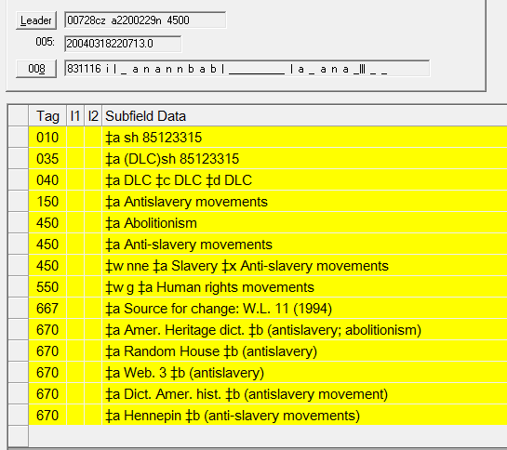
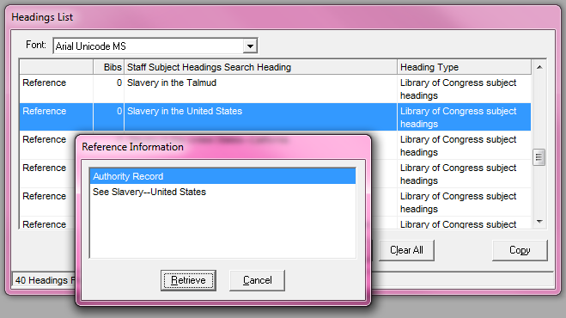
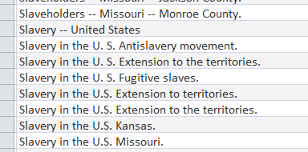
Search Voyager
Notes:
In this example the heading being fixed is: Slavery in the U.S. Antislavery movement.
<click>Thanks to cross-references, the search reveals that Slavery in the U.S. should be Slavery—United States.
<click> Slavery—Antislavery movements is a cross-reference under Antislavery movements which can be subdivided geographically so the correct heading would be Antislavery movements—United States.

Slide 9
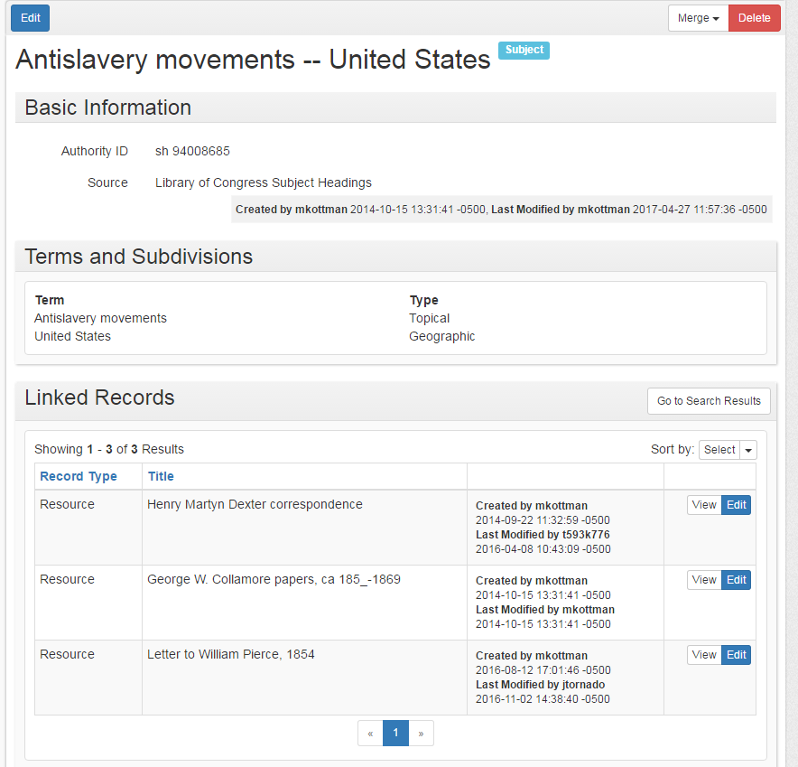
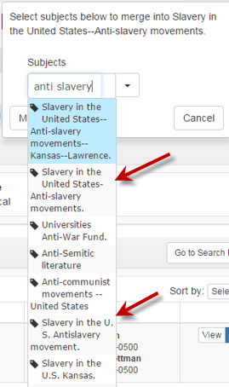
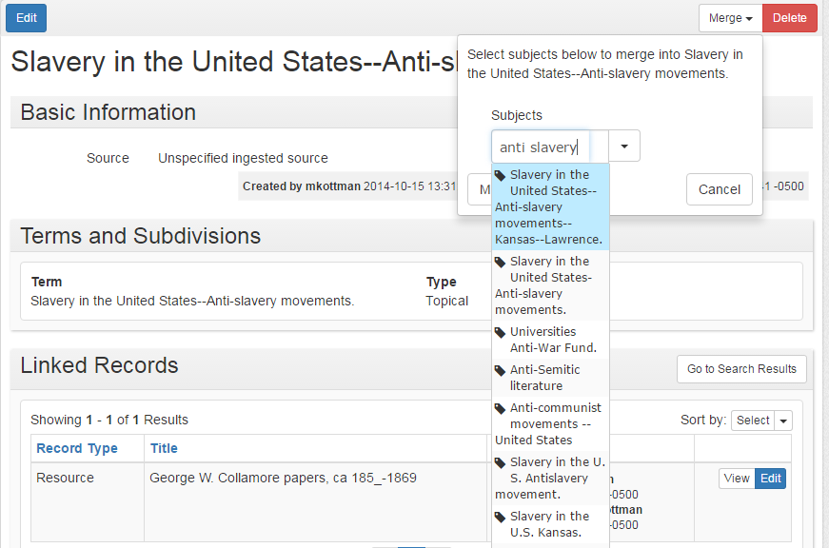
Duplicates
Notes:
Since we know there are a lot of duplicates and fuzzy matches we added a step to check for them as part of validating each heading. This was done using the Merge function in ASpace. With a heading record open, clicking on the merge button opens a search box that provides a
<click> type-ahead result list so that you can quickly see if there are multiple duplicates for your search. In this example, searching for anti-slavery finds two additional subject headings that need to be merged into the already open record.
<click> Merging records will automatically re-link the finding aid records using the merged subject headings to the remaining corrected subject heading record, so that you don’t have to do it manually. So in this illustration the original heading Slavery in the U.S. Antislavery movement had one resource record attached. After the merge the corrected heading Antislavery movements—United States has three records attached.

Slide 10
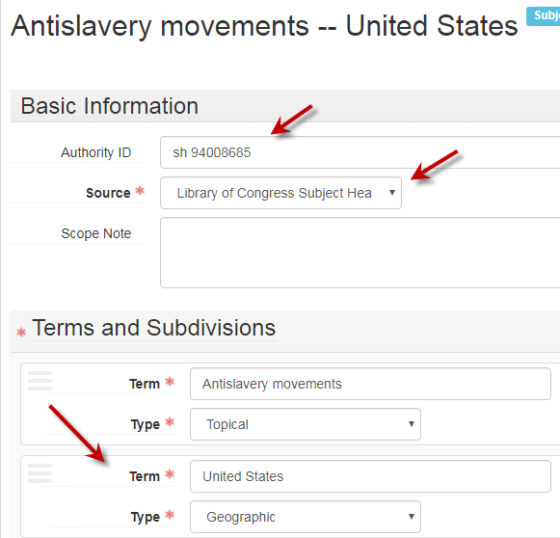
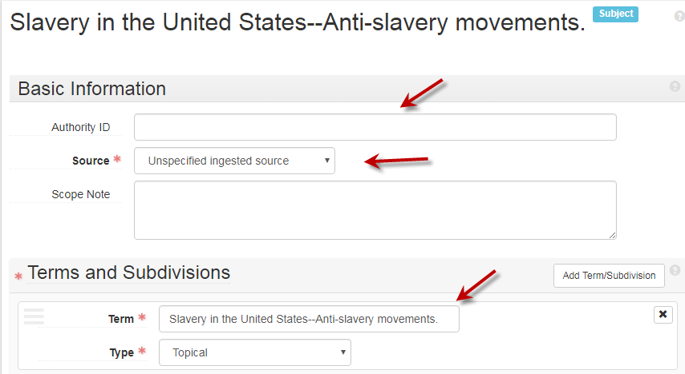
Additional cleanup
Change heading to authorized form per LCSH
Change Source field to Library of Congress Heading
Add 010 field to Authority ID field if SAF record exactly matches
Parse heading into appropriate term and subdivision fields
Notes:
In addition to changing the heading to the authorized LCSH form, we updated the Source field, added the Library of Congress Control Number to the Authority ID field when there was matching LC subject heading record and put each element of the heading in separate fields with the appropriate term type indicated.
<click> Here’s what the record looked like before… unspecified ingested source indicates it was created when the EAD record was imported and the heading is a single text string
<click> This is the record after it was updated with source filled out and the subdivision in its own field.

Slide 11
MS Access Queries
Notes:
More about the Access queries

Slide 12
Determine which tables have data you need
Notes:
I already have Oracle installed on my computer since I use it to run similar reports for Voyager and Aeon. So, all I needed to do was to install a MySQL connector and set up the ODBC connection to our server (once I pried server access information from our IT folks). Due to differences in terminology between what is in the backend vs. the user side of the database, I usually open the tables I’m considering using to see what data is actually in each field.
<click> The subject table has a bunch of id fields and dates
<click> along with the list of subject headings that I was looking for. Here’s an example of why you need to look at the field names in the table… the subject headings are in a field called “title” which is not what you’d expect.

Slide 13
MS Access queries – Subject Headings
SELECT subject.title, subject.authority_id, subject.id INTO _subjects_20170309
FROM subject
ORDER BY subject.title;
Notes:
Here’s the query I used to create the list of subject headings to fix. It uses the subject table to create a table of all the subjects records in ASpace, reagardless of whether the heading is linked to a record or not. The SQL view of the query is in the upper right that you can copy/paste into Access when you review the slides after you get home.
<click> This box shows all the fields you can include in your table. I used the title field, the authority_id and the subject_id field.

Slide 14
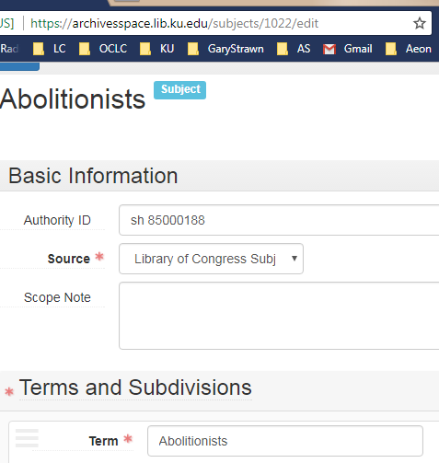
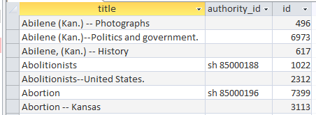
Results -- Example
Notes:
This is a section of the resulting table. The title Abolitionists is the same as the Term field in the ASpace record. Authority_id is the same as the Authority ID
<click>and the id field number that I included in the query is part of the URL for the record which can be used to call up the record if needed.

Slide 15
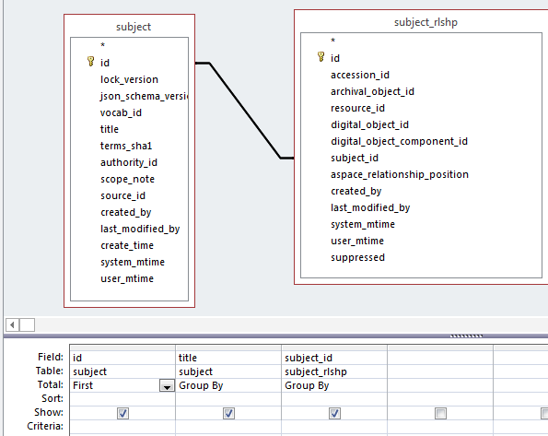
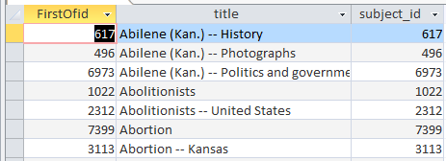
Query = Subjects actually USED on a record
SELECT First(subject.id) AS FirstOfid, subject.title, subject_rlshp.subject_id INTO [Subjects with relationship]
FROM subject INNER JOIN subject_rlshp ON subject.id = subject_rlshp.subject_id
GROUP BY subject.title, subject_rlshp.subject_id;
Notes:
The previous query creates a table of all the subject headings in ASpace, regardless of whether the heading is actually used on an accession, resource or digital objet record.
In some cases during the cleanup, the fix was to remove the incorrect subject heading from the resource record altogether. So the next step of the cleanup was to find these extraneous incorrect headings and delete them.
The subject table has all of the subject headings in ASpace, the subject_rlship table contains the IDs of all subject headings that are linked to an accession, resource or digital object record. Since the same heading can be linked to multiple records, the query includes a grouping of “First” in the id field to avoid duplicates. The subject table is linked to the subject_rlshp table by the matching entities, subject_id.
The type of Join shown here will give me all the subject headings that have a relationship, i.e. the query will include rows where the fields are equal.
<click> Here are the results of this query. Notice that the data in the FirstOfid and subject_id columns are equal.

Slide 16
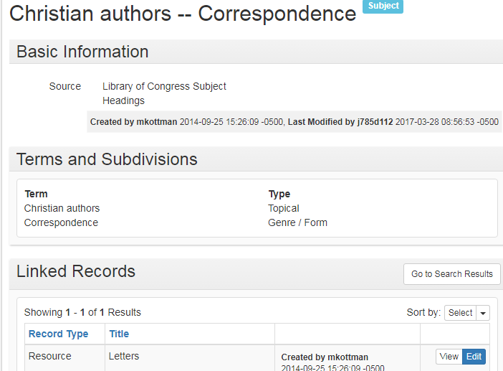
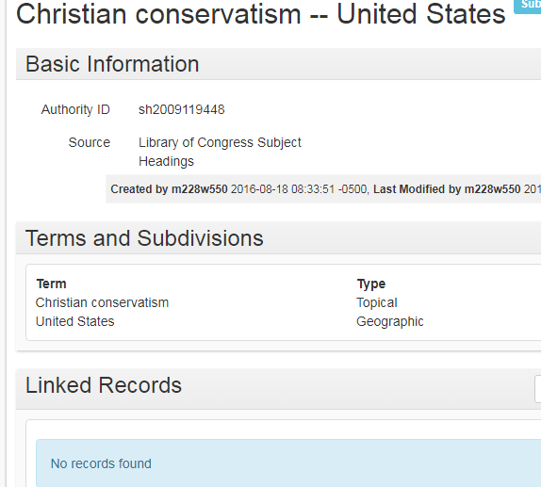
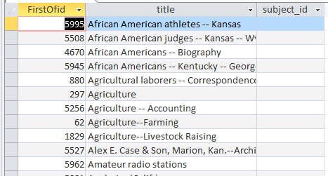
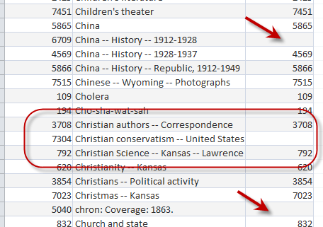
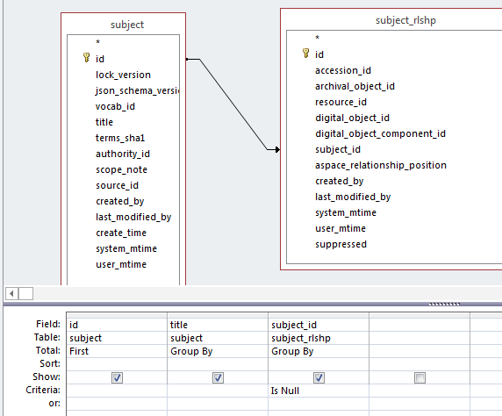
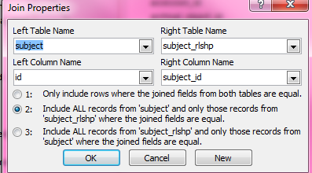
Query = Subjects NOT USED on a record
Notes:
But I want the headings that are no longer used on a record. Tweaking the Join properties so that all of the subject records are included and only those headings where the joined fields are equal will result in a list where the subject id column will have a matching id field if there is a record linked to the subject heading and a blank subject id column when there isn’t a linked record.
<click> Here’s what it would look like. Christian authors—Correspondence has an id number in both the id column and the subject id column so it is linked to another record, however Christian conservatism—United States does not have anything in the subject id column so it is not linked to another record
<click> Just in case you don’t believe me, here’s what the ASpace records look like. Christian authors has one record listed under Linked records and Christian conservatism has no records.
<click> But wait, there’s more! If you add “Is null” to the subject_id criteria, you’ll narrow the results to only the records that are not linked to another record.

Slide 17
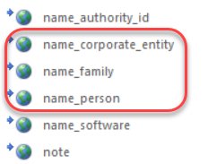
Agent records
We haven’t started on these yet
Lack of staff resources (will be hiring in August for a new person)
Waiting to see if agent refactoring will require “fixing” of existing headings
Queries a little more challenging
Separate tables for corporate, person, family (and software)
Notes:
We haven’t started fixing the agent records yet for a couple of reasons. We are in the process of hiring a new person for the authority maintenance unit who will work on personal names. This will free up some time for others in the unit to work on special projects like this one. Since we only want to fix these headings once, I want to find out if the agent refactoring work ASpace is planning, is likely to require any manual editing on our part to update our headings before beginning work on this project.
<click> And the queries themselves are a little more challenging because the title/terms are in separate tables

Slide 18
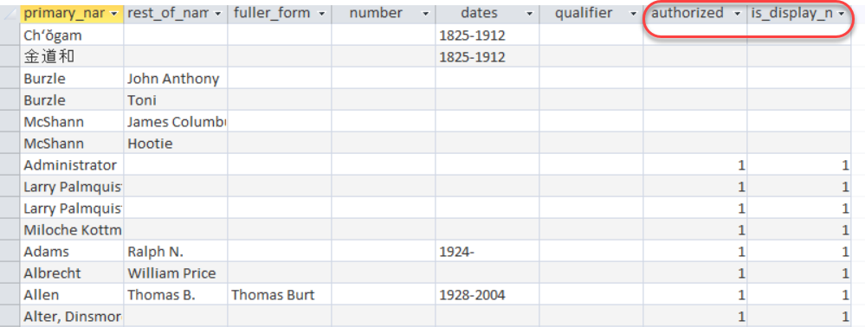
Agent queries
Personal Names
Corporate Names
Notes:
and there’s also a lot more fields you’ll need to include in your query, e.g. primary name, rest of name, subordinate name, date, etc.
<click> And this table includes the both the authorized form of the name AND all the cross references. Here’s a tip: If the authorized or is display name column is blank, the heading is a cross reference, if it’s a 1, the heading is the authorized access point, or 1xx field.

Slide 19
Questions?
Contact Information:
Miloche Kottman | mkottman@ku.edu | University of Kansas Libraries

