Slide 1
Reports and Reports Workarounds
ArchivesSpace Member Forum, July 25, 2017
Nancy Enneking and Laney McGlohon

Slide 2
Status of Reports in ASpace
ASpace 2.1.0
Removed reports that didn’t work/were duplicative; removed xsl and improved json and csv formats
Jasper Reports code has been removed thanks to Hudson Molonglo
Reports in the module will actually run and not crash the system
Some reports still have invisible assumptions, but some problems have been corrected (using accession date rather system date)
We have a few parameter options (locations report, for example) but need more

Slide 3
What’s Coming?
Developing more canned reports emphasizing csv output over static, formatted pages; further refinement of csv
Improving transparency of all reports (stored procedures, improved documentation, invisible assumptions)
ASpace reports subteam currently working on specifications and ideas for more thorough programmatic development including the possibility of “pick your own fields” report functionality and a report preview
Improved testing

Slide 4
What’s Holding Things Up??
Major culprit: Other legitimate priorities have taken precedence
Examples – system performance, updating core code base, new public interface; components reordering themselves; etc.
Lack of dedicated programming staff time
Current timeline is ……… see the roadmap
https://archivesspace.atlassian.net/wiki/spaces/ADC/pages/18710568/Road+Map

Slide 5
What can you do in the meantime?
Your data is your own and you can get to it
Caveat - if you are hosting, you need to check with your hosting provider to see if these methods can be used
Database information
  86 tables
  64 stored procedures used for querying the database for information to include in the reports
Data Dictionary started – a json file with the tables, fields, keys, and constraints can be found here: https://drive.google.com/file/d/0B8Eo4CXKaPWrSU5FTENRd05PUmc/view?usp=sharing

Slide 6
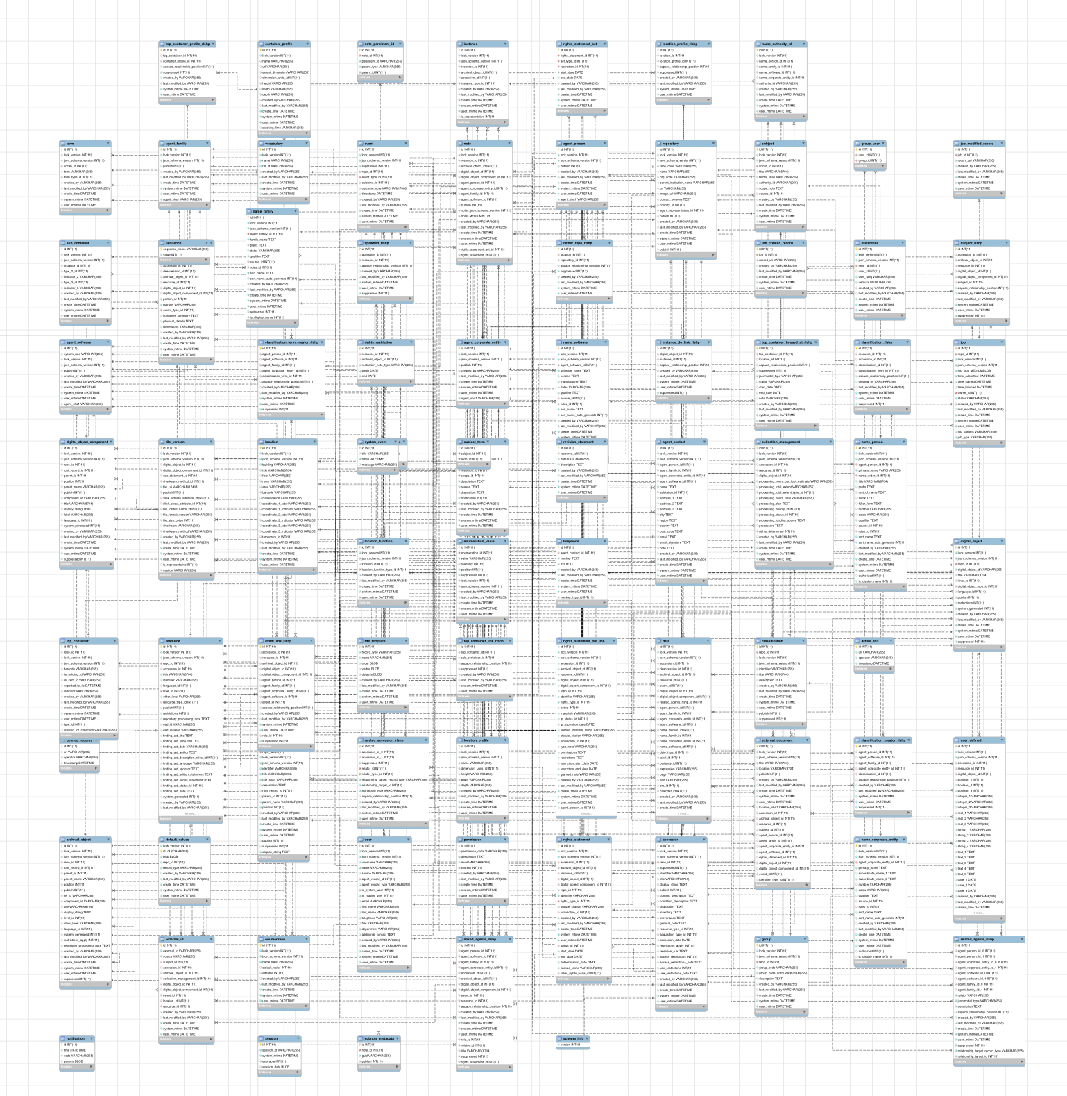

Slide 7
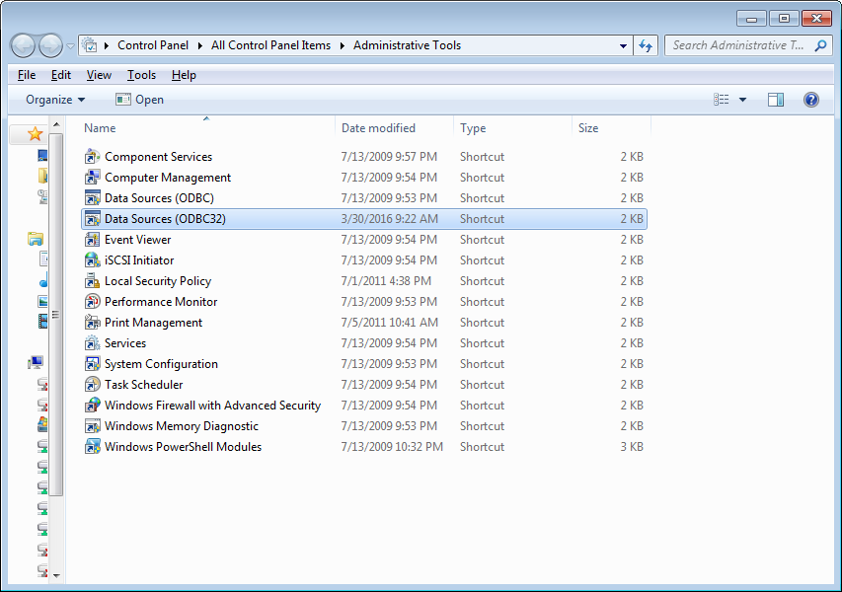
Establishing an ODBC connection with the server

Slide 8
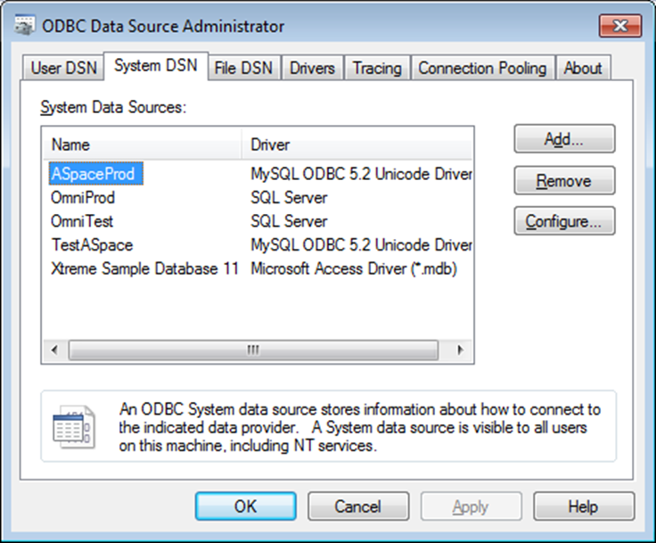
Choose the System DSN tab
Add a new source

Slide 9
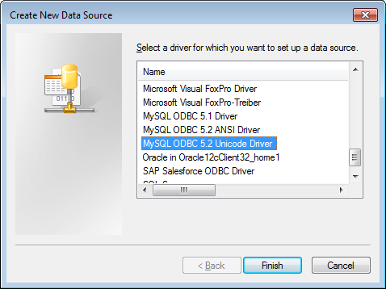
Select a MySql Unicode driver
If you don’t have one you can search for a MySQL ODBC driver and download for free.

Slide 10
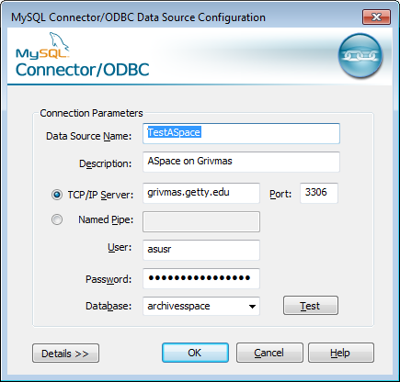
Fill out the resulting screen with information from your IT staff.

Slide 11
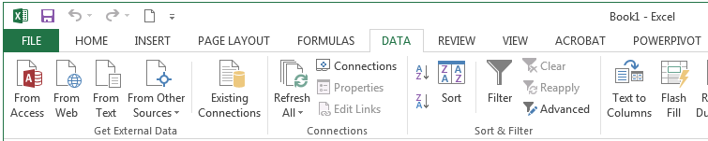
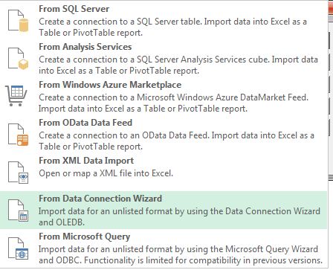
Connecting with Excel

Slide 12
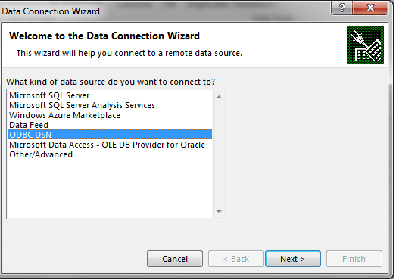
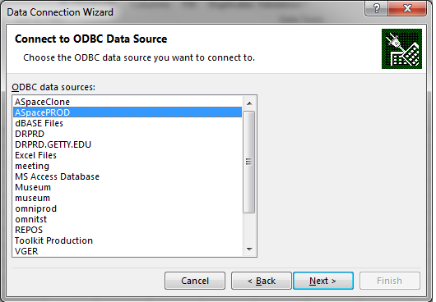

Slide 13
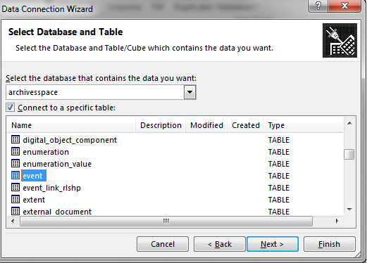
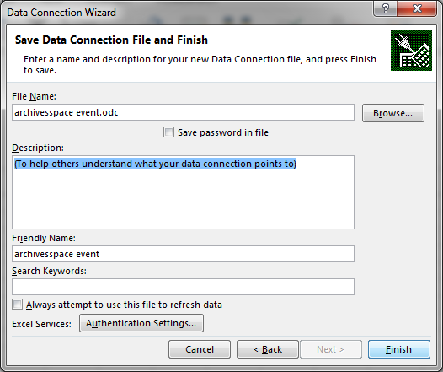

Slide 14
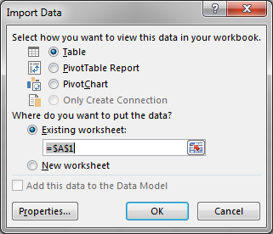
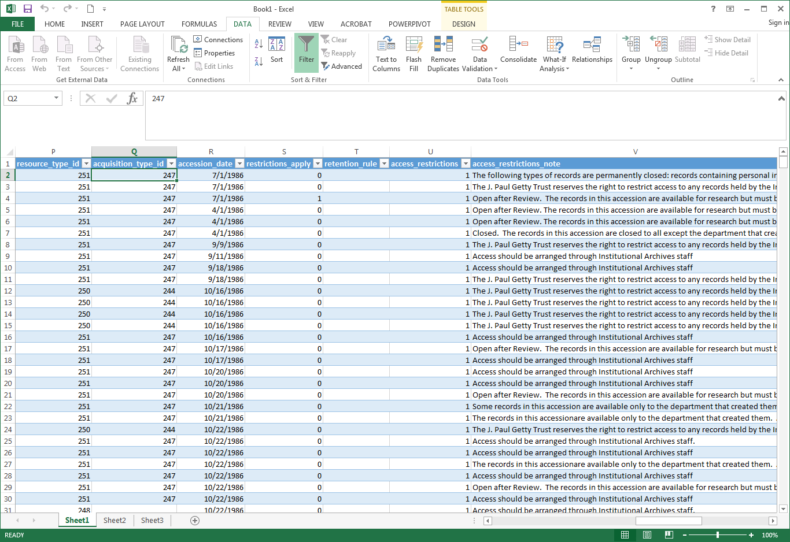

Slide 15
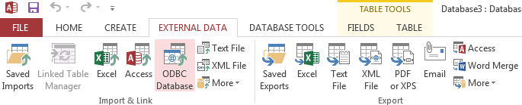
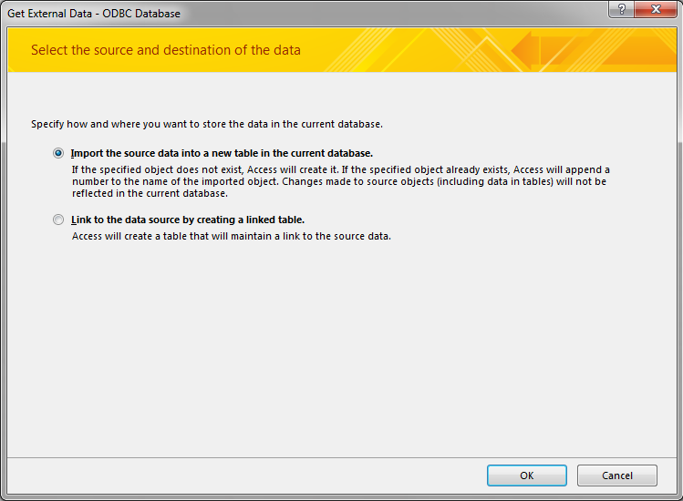
Connecting with Access

Slide 16
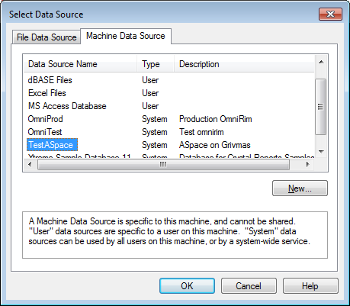
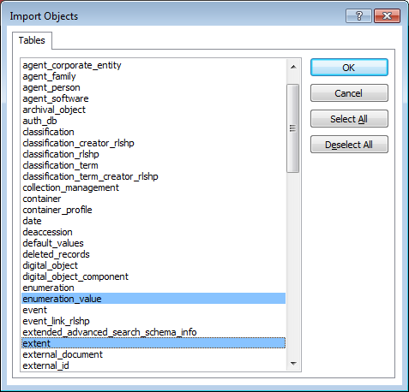

Slide 17
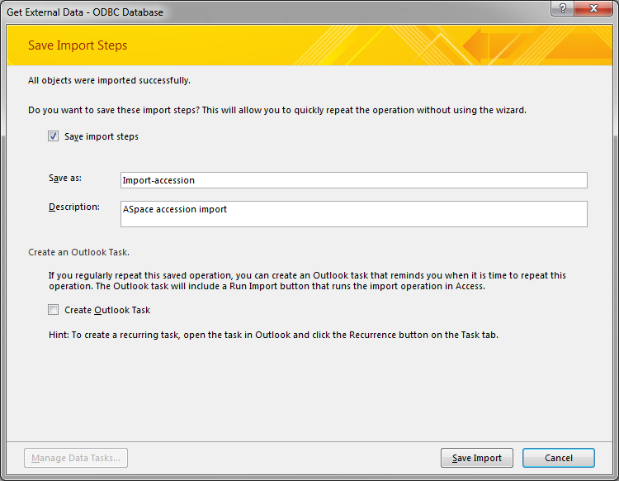

Slide 18
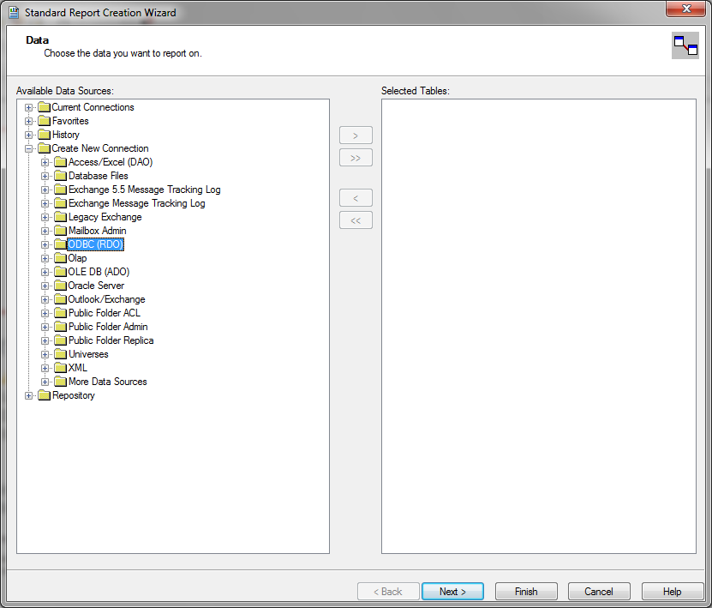
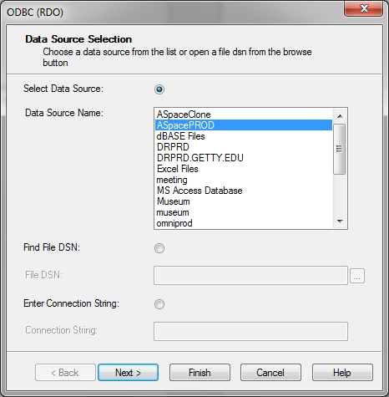
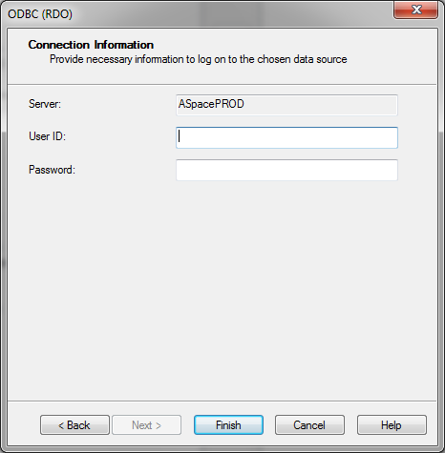
Connecting with Crystal Reports

Slide 19
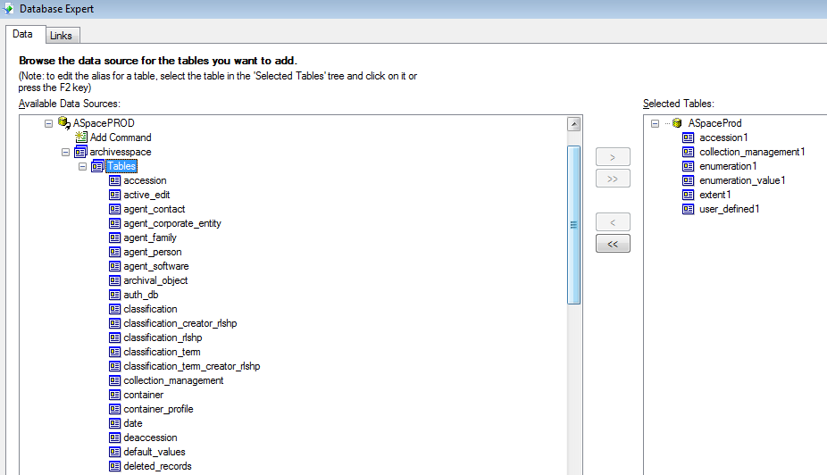
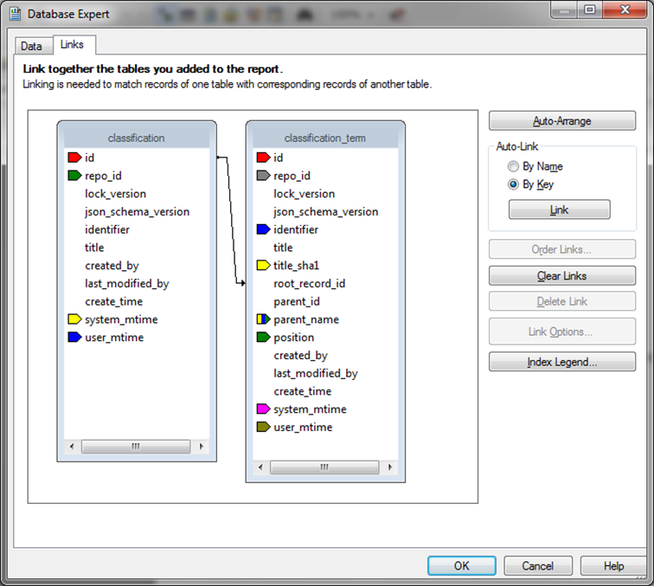

Slide 20
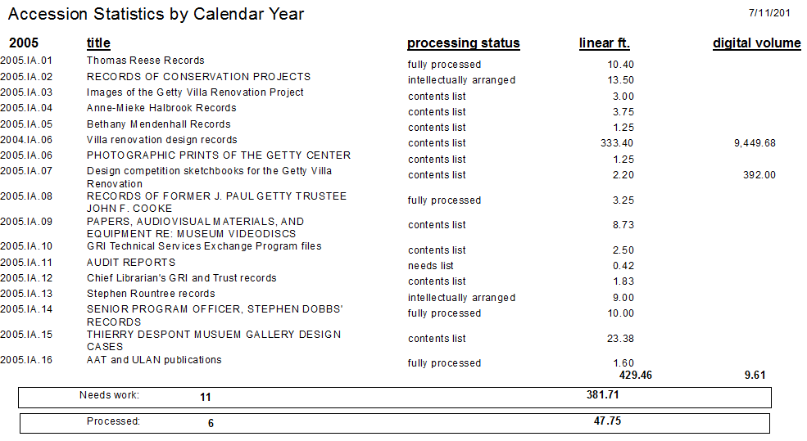
Results…..

Slide 22
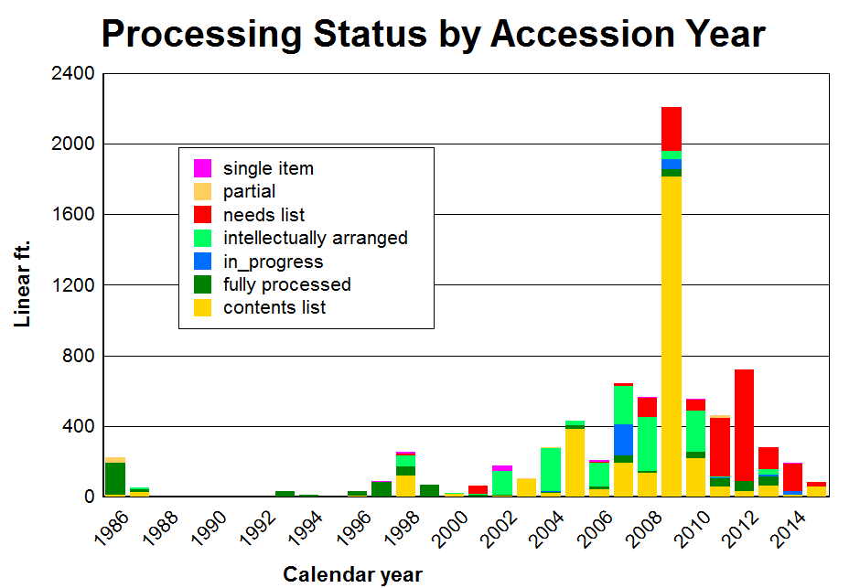

Slide 23
Talking points!
When setting up your connections – make sure you cannot write data back to the database!!
You will need to explore, get to know the tables, and how they link together. Be prepared for trial and error.
No existing Data Dictionary. You can create your own list of tables using MySQL Workbench; obviously, tables can evolve as the system evolves.
Don’t forget the “Enumeration value” table! It translates the id numbers into text. In my data: Extent_type_id “277” = linear feet

Slide 24
Group Discussion
Where would you like to see reports go?
What types of reports are a priority?
Are our assumptions correct? Preference to manipulate data over static formatted reports?
How can we help you with DIY situations?
Anything else?

Slide 25
Reports Subteam Members
Description: This sub-team contributes to advancing the ArchivesSpace reports module by defining reports conceptually and technically, documenting how to use the reports module, and suggesting enhancements to the report processes.
Roster:
Carolyn Runyon, University of Tennessee at Chattanooga, Leader
Nikki Lynn Thomas, University of North Carolina, Charlotte
Jasmine Jones, Smith College
Alston Cobourn, Texas A&M University-Corpus Christi
*ex-officio – Nancy Enneking, Getty Research Institute

Slide 26
Contact Information
Nancy Enneking – nenneking@getty.edu
Laney McGlohon – laney.mcglohon@lyrasis.org

