Slide 1
Easy Custom Reports for ArchivesSpace
July 25, 2017

Slide 2
Why?
Reporting function not yet fully functional in ArchivesSpace
Jasper reports a steep learning curve
Needed data that was not available through standard reports

Slide 3
How
Read the documentation
Fail a lot
Throw your hands up and ask your Systems Department for help
Set up a Putty connection to connect to a read only version of the database

Slide 4
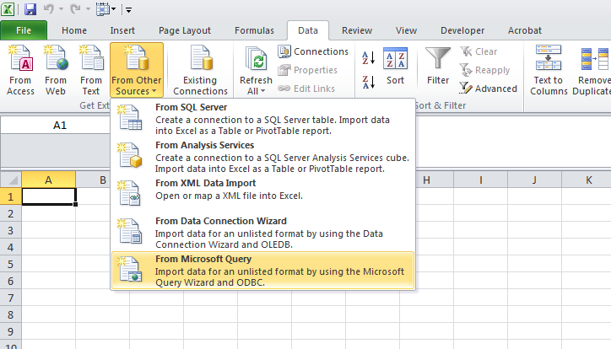
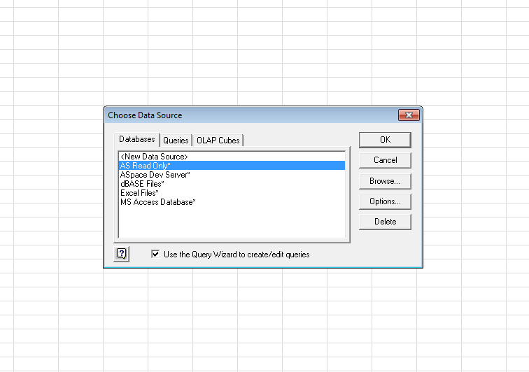
Connecting in Excel

Slide 5
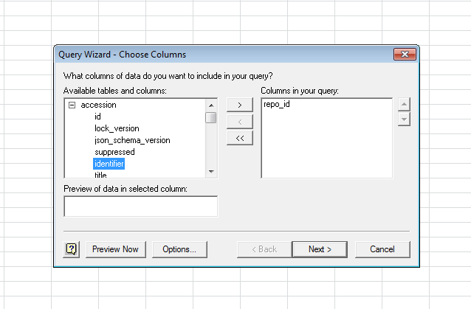
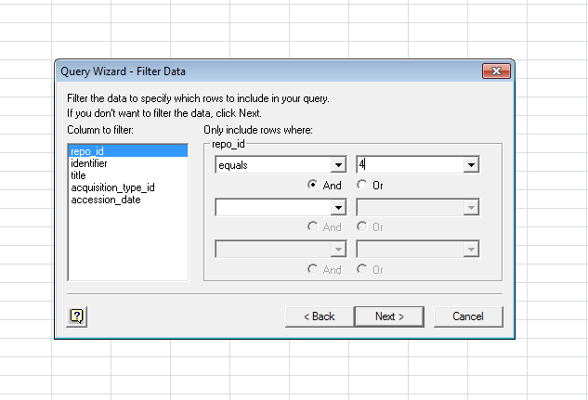
Setting Up Queries

Slide 6
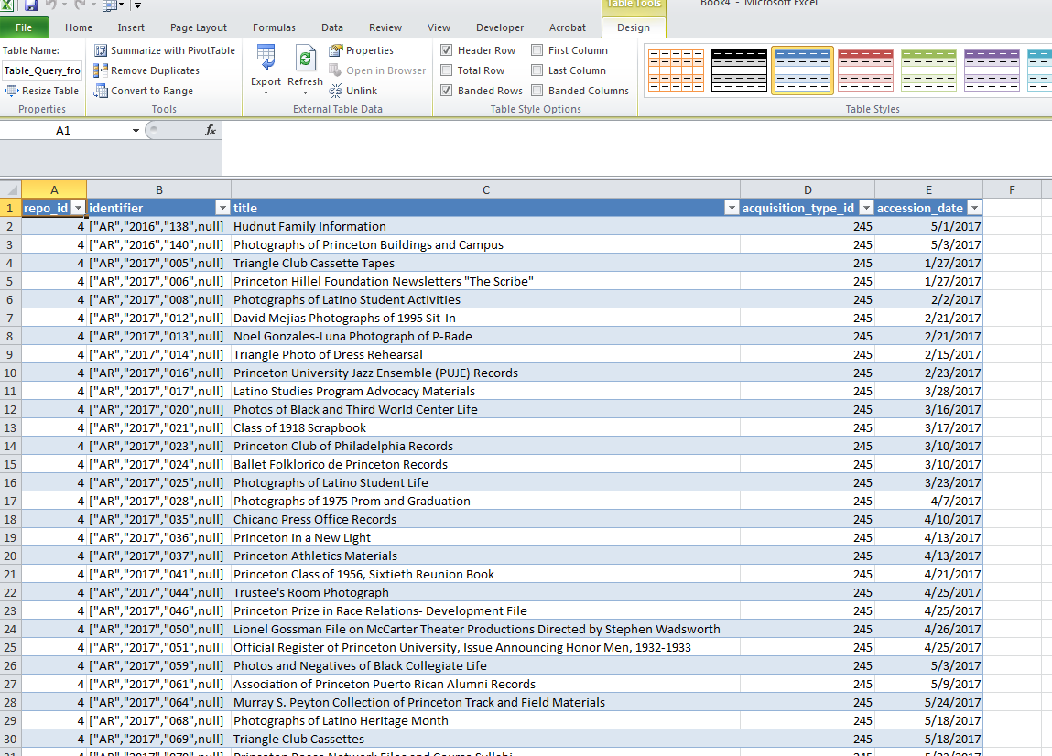
Getting Results

Slide 7
Tips
You’ll need to know a little bit of SQL
You’ll need to figure out what the codes for various fields are in ArchivesSpace to limit results to only those that meet certain conditions
For more complex queries the Microsoft Query editor is helpful
You’ll probably have to ask for help at some point

