Slide 1
ArchivesSpace
Public User Interface
Feature Highlights
Mark Custer, Yale
Susan Pyzynski, Harvard
ArchivesSpace User Forum, SAA
July 25, 2017

Slide 2
Timeline, part 1
2014 Halloween
Chris Prom distributes the Illinois Report to ArchivesSpace members
2014 December 1
Mark Custer starts a flurry of emails with Brad Westbrook and Chris about the possibility of enhancing the PUI and Staff Interface
2015 May 7
The first request goes out for volunteers to serve on the PUI enhancement team.
2015 June 25
The PUI Design Working group has its first meeting, led by The Cherry Hill Company.
2015 August – September
Usability tests conducted at Harvard, Rice, and Yale on the original ArchivesSpace Public Interface
2015 December 21
The PUI enhancement report is submitted by Cherry Hill

Slide 3
Timeline, part 2
2016
The first year of development, led by Brian Hoffman and Bobbi Fox
2016 May 20
The first sprint development call was kicked off, Brady-bunch style.
2016 October – November
Usability tests conducted by Harvard on the new ArchivesSpace Public Interface
2016 November
Accessibility test conducted by WebAIM on the new ArchivesSpace Public Interface
2017 January – July
Last round of development, led by Hudson Molonglo
2017 July 18
ArchivesSpace 2.1, which comes packaged with the new public interface, is released.

Slide 4
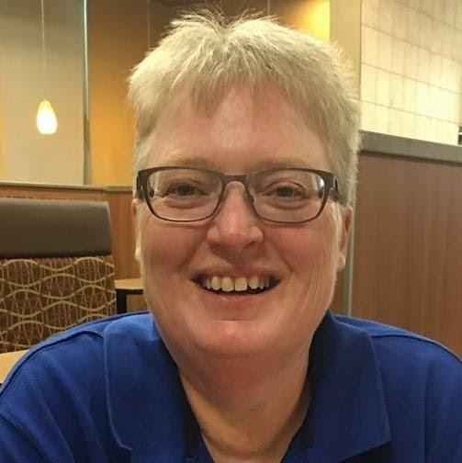
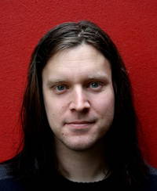
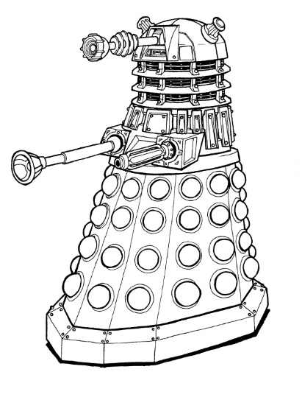
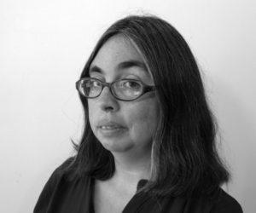
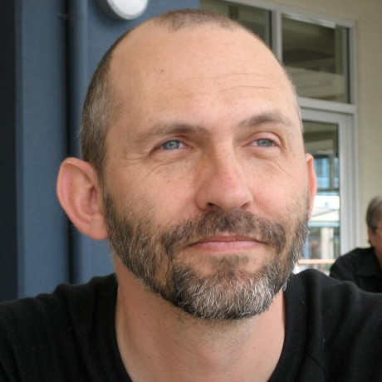
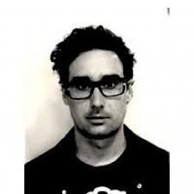
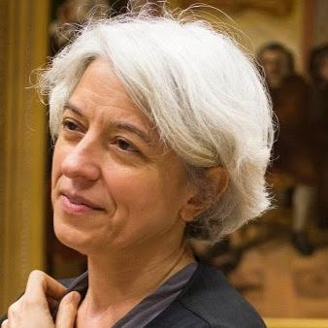

Slide 5
Selected Highlights of the New PUI
Front page
Searching
Navigating in a collection record
Collection overview, collection organization, container inventory
Citation, Request, Print PDF
Archival object and inheritance
Front page navigation bar
Repository pages
Digital image

Slide 6
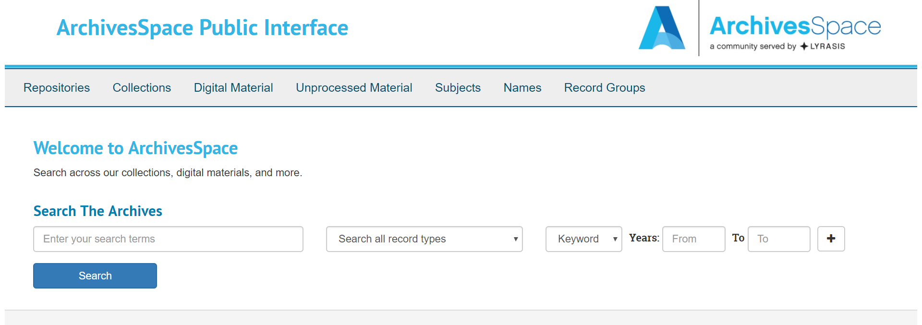

Slide 7
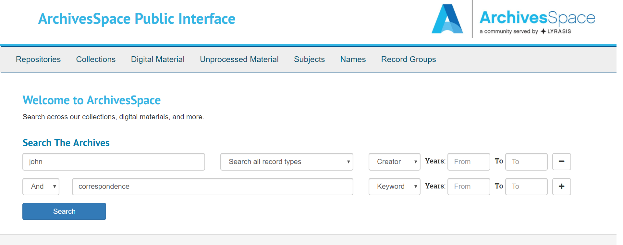

Slide 8
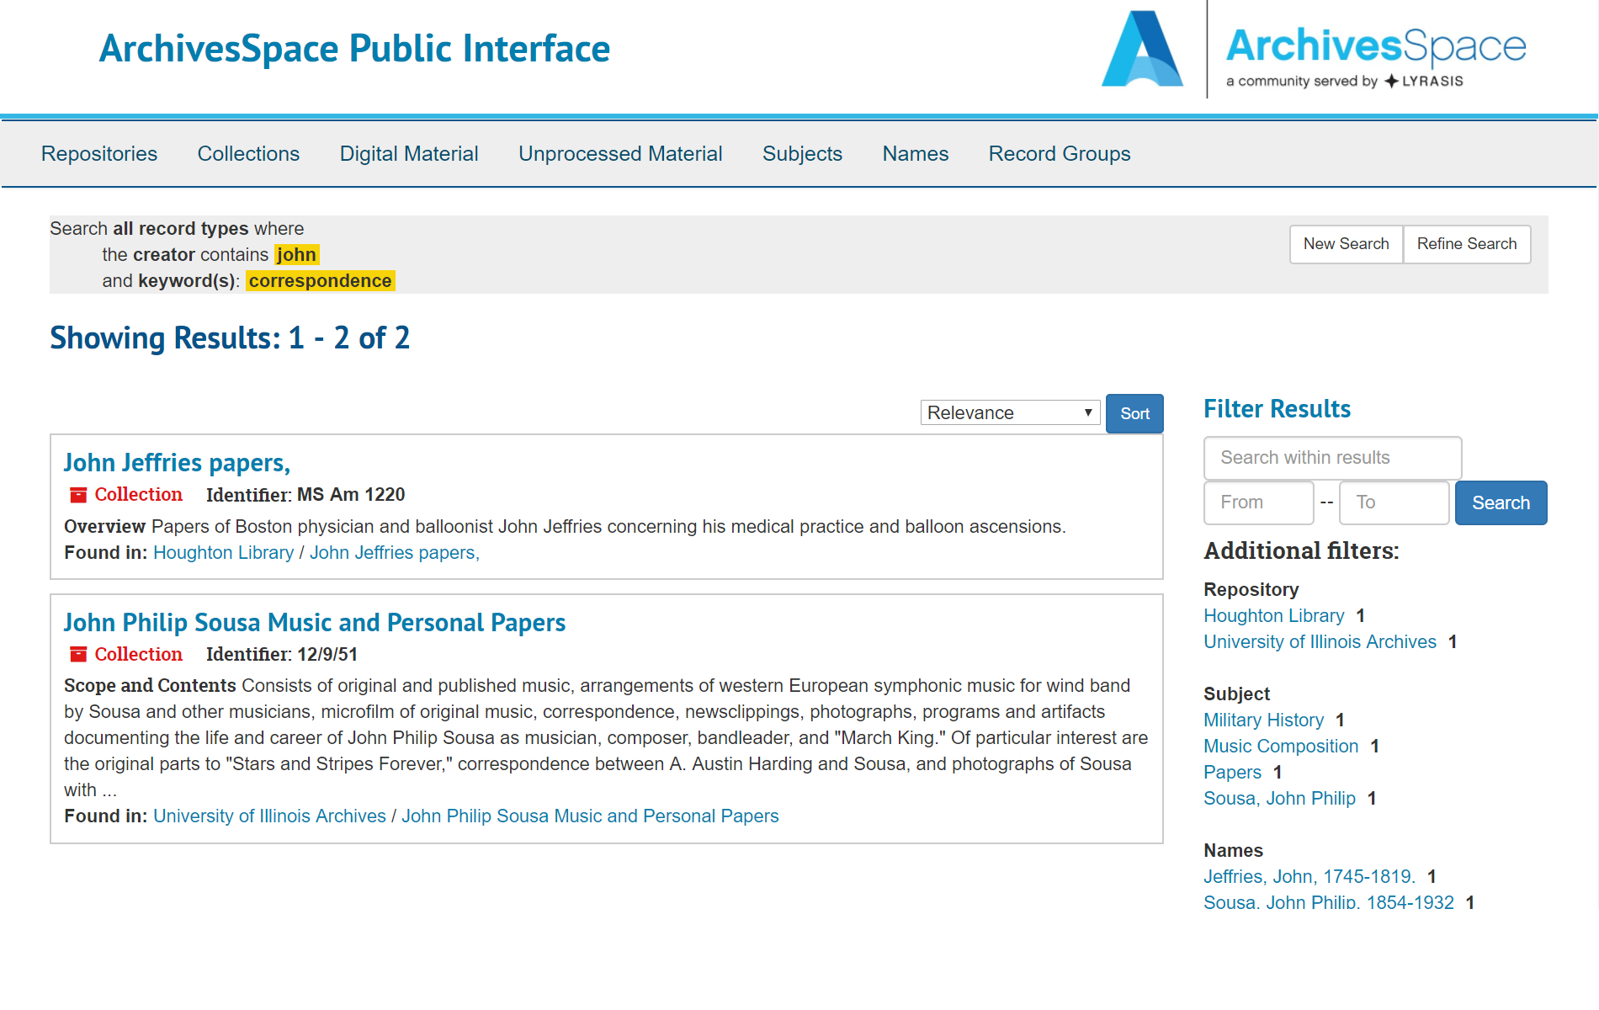

Slide 9
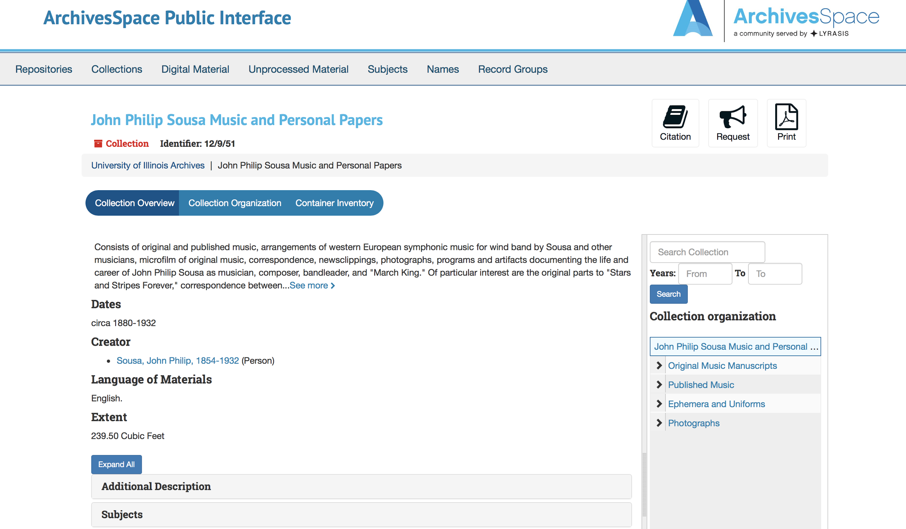

Slide 10
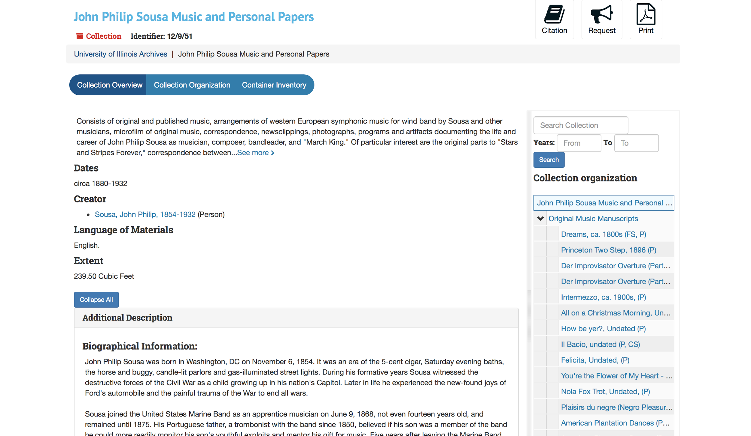

Slide 11
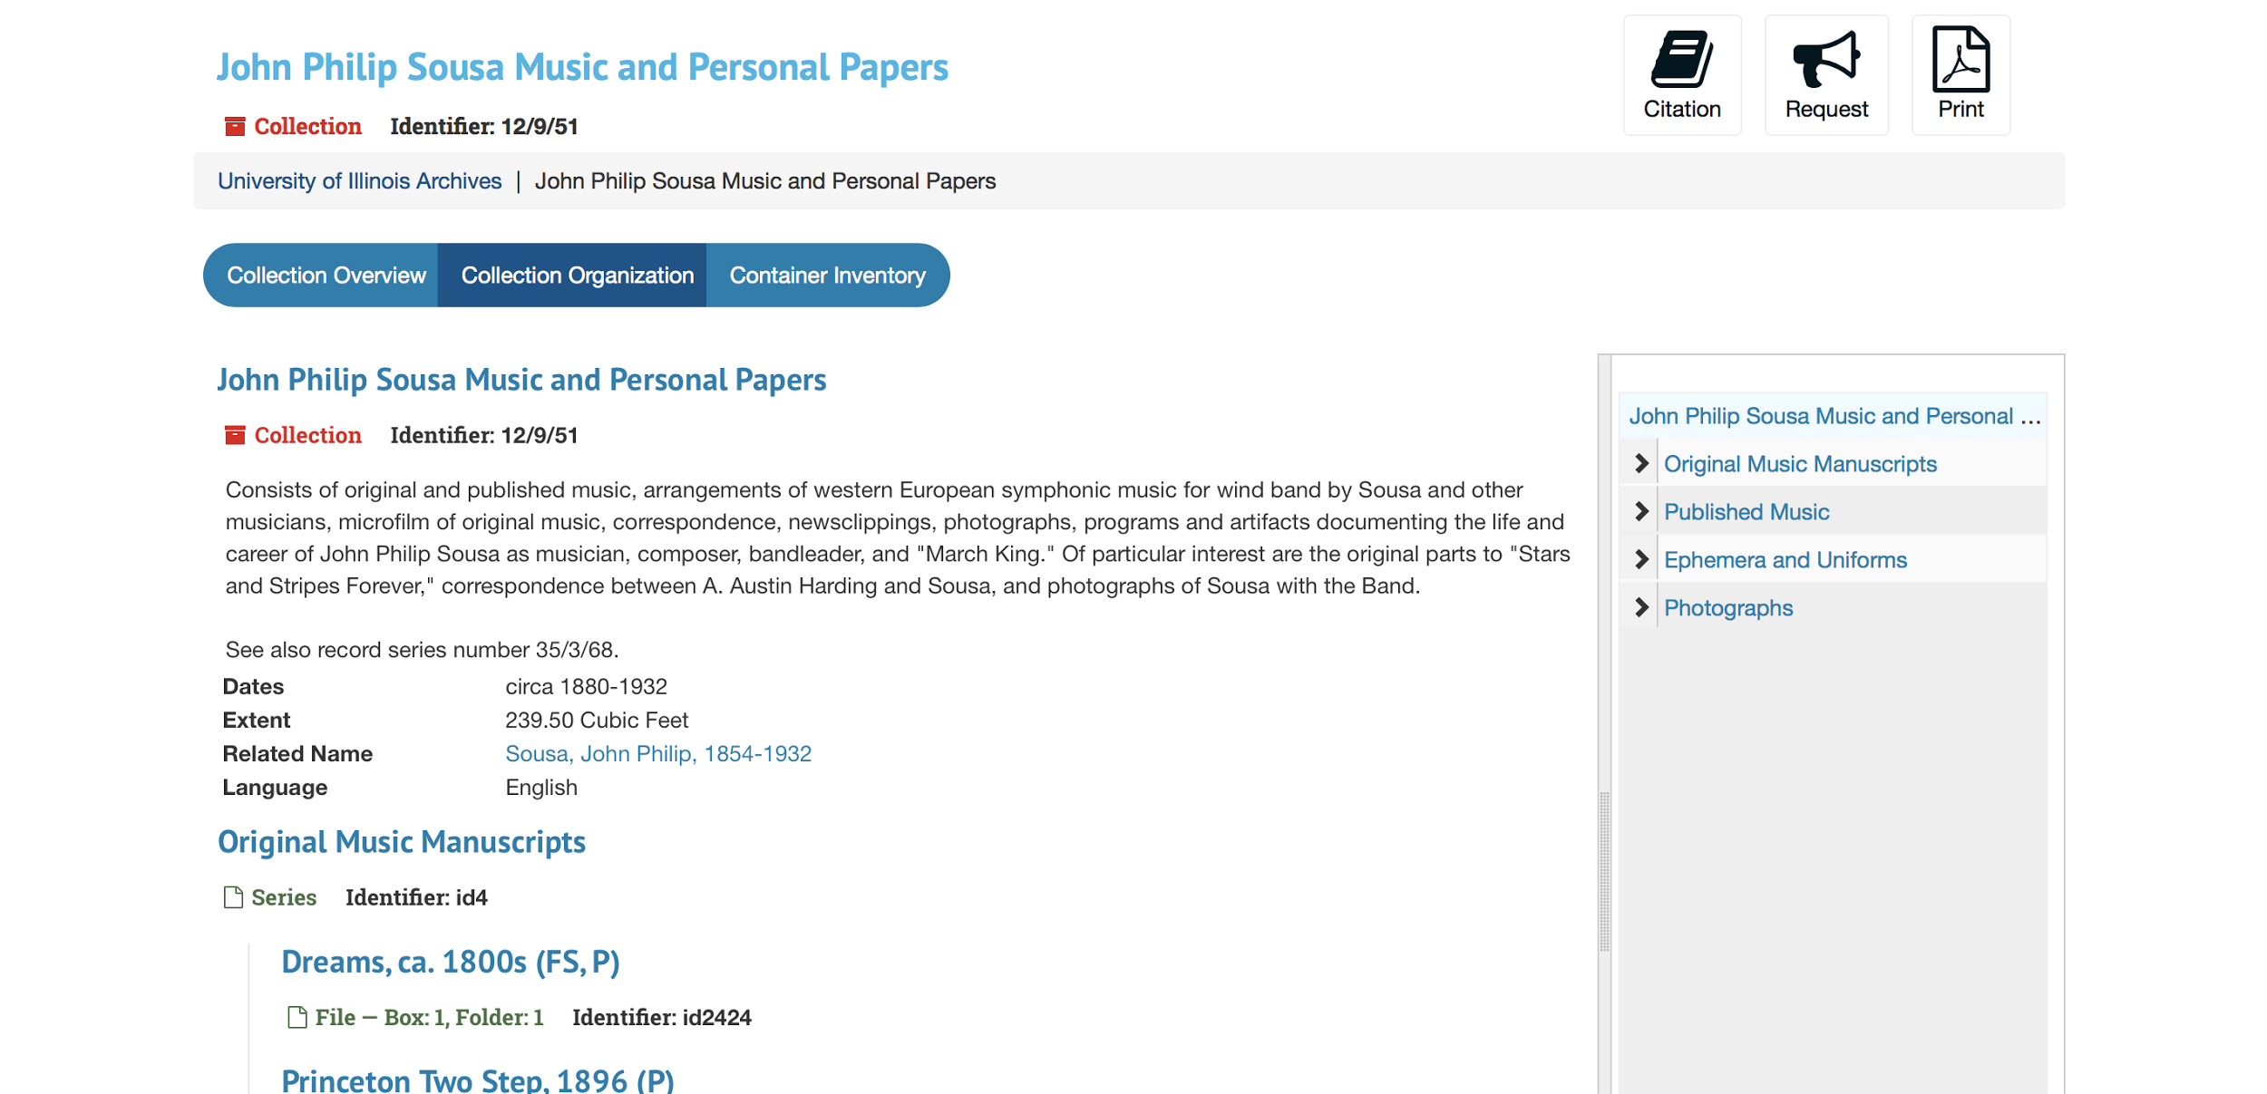

Slide 12
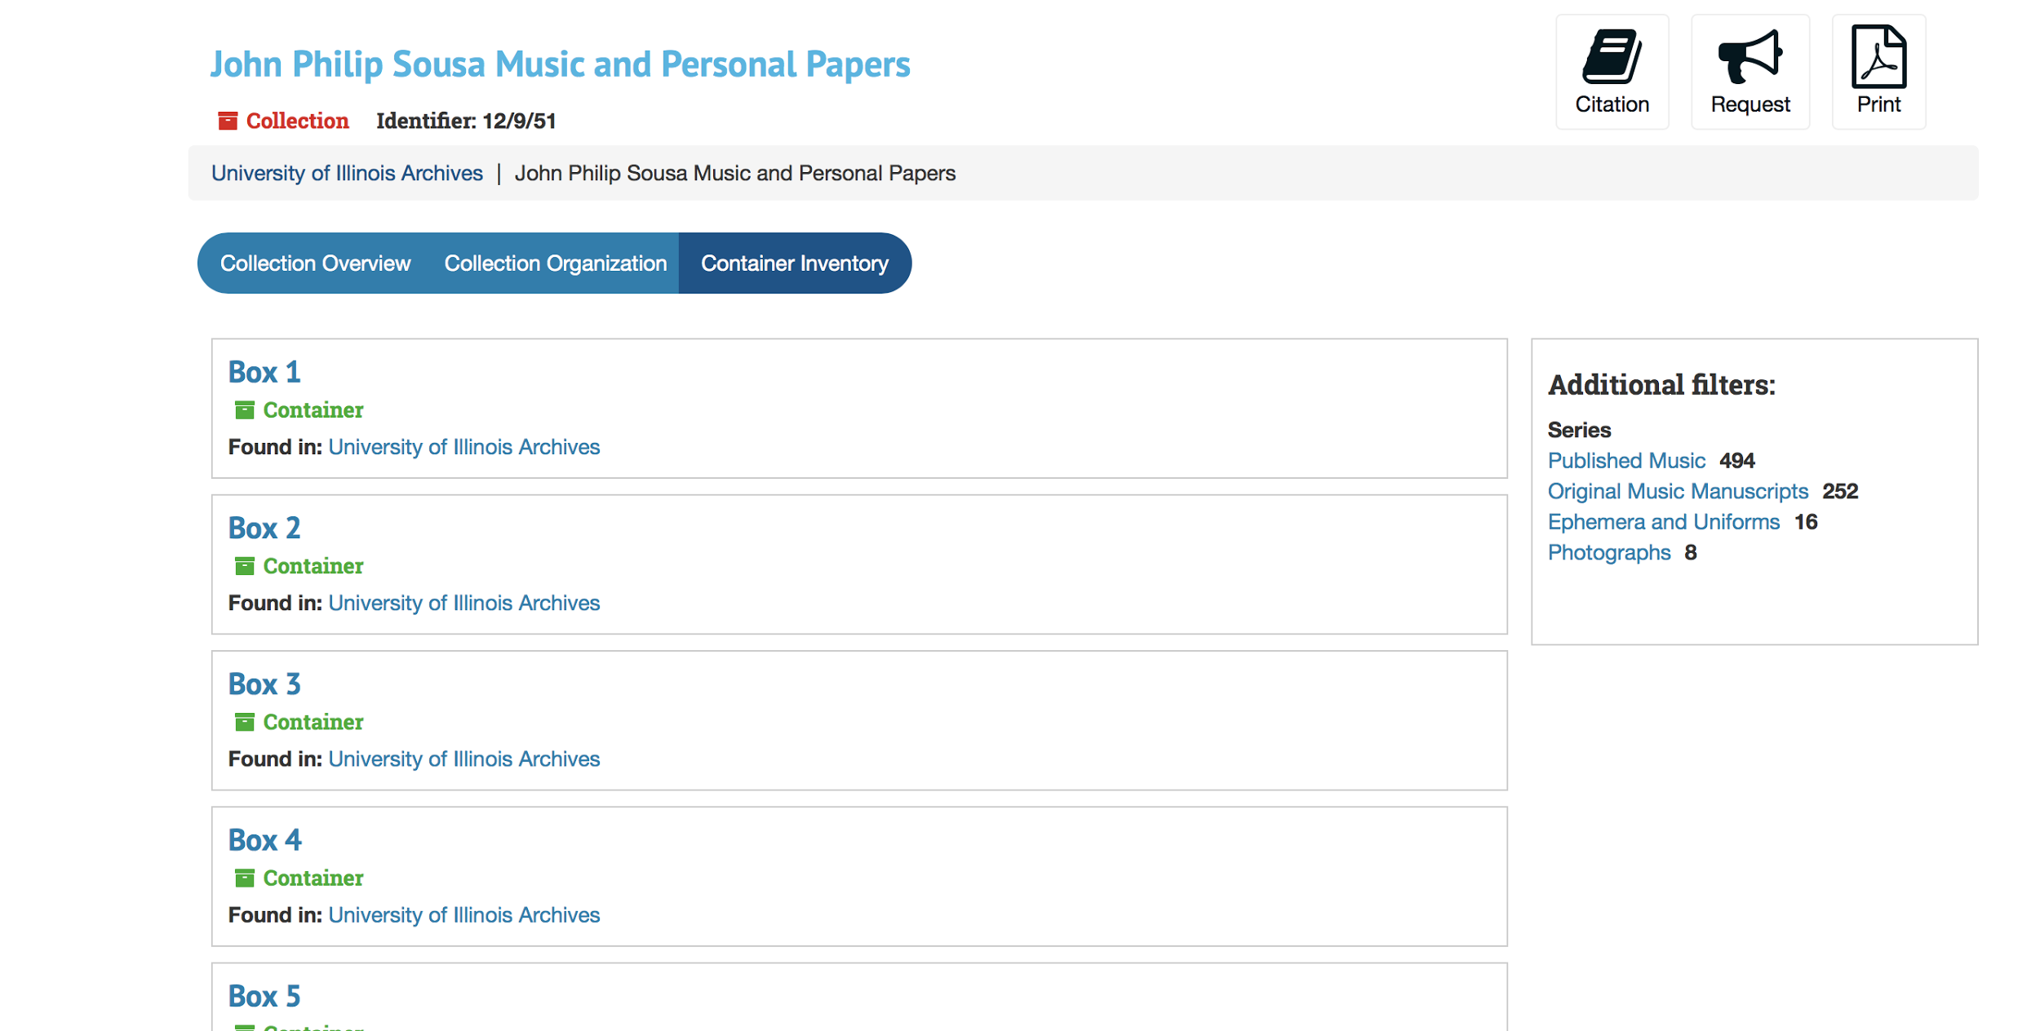

Slide 13
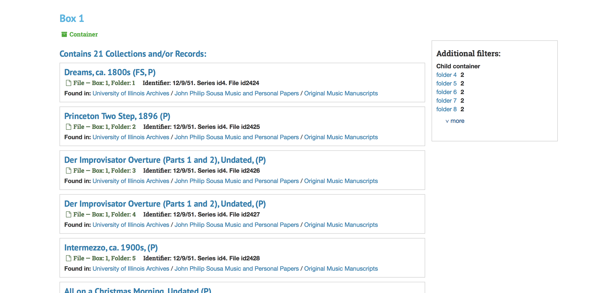

Slide 14
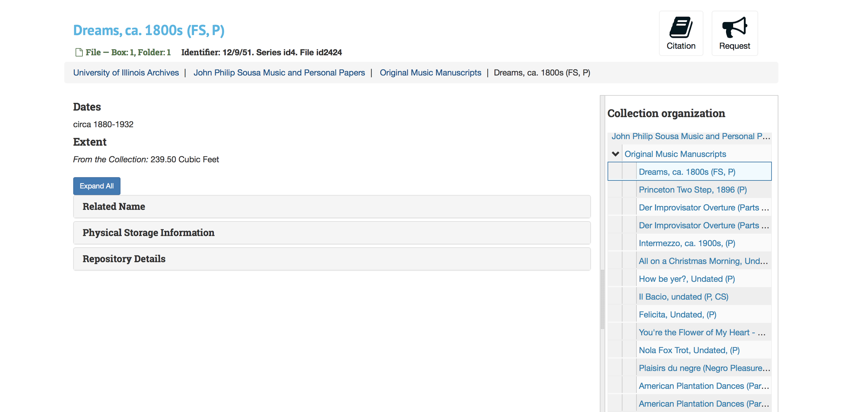

Slide 16
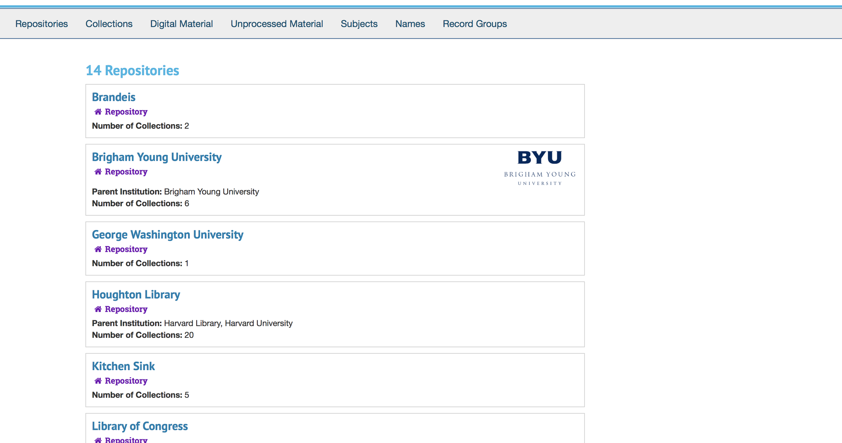

Slide 17
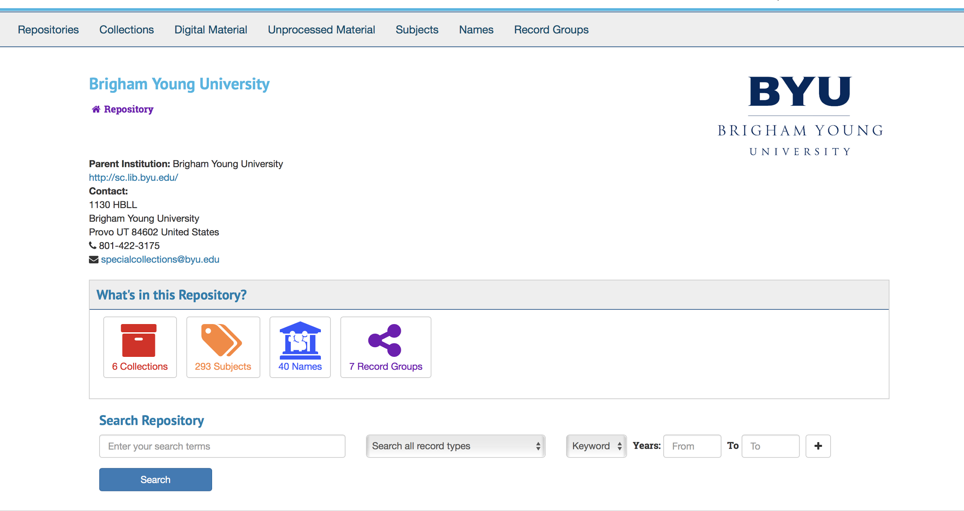

Slide 18
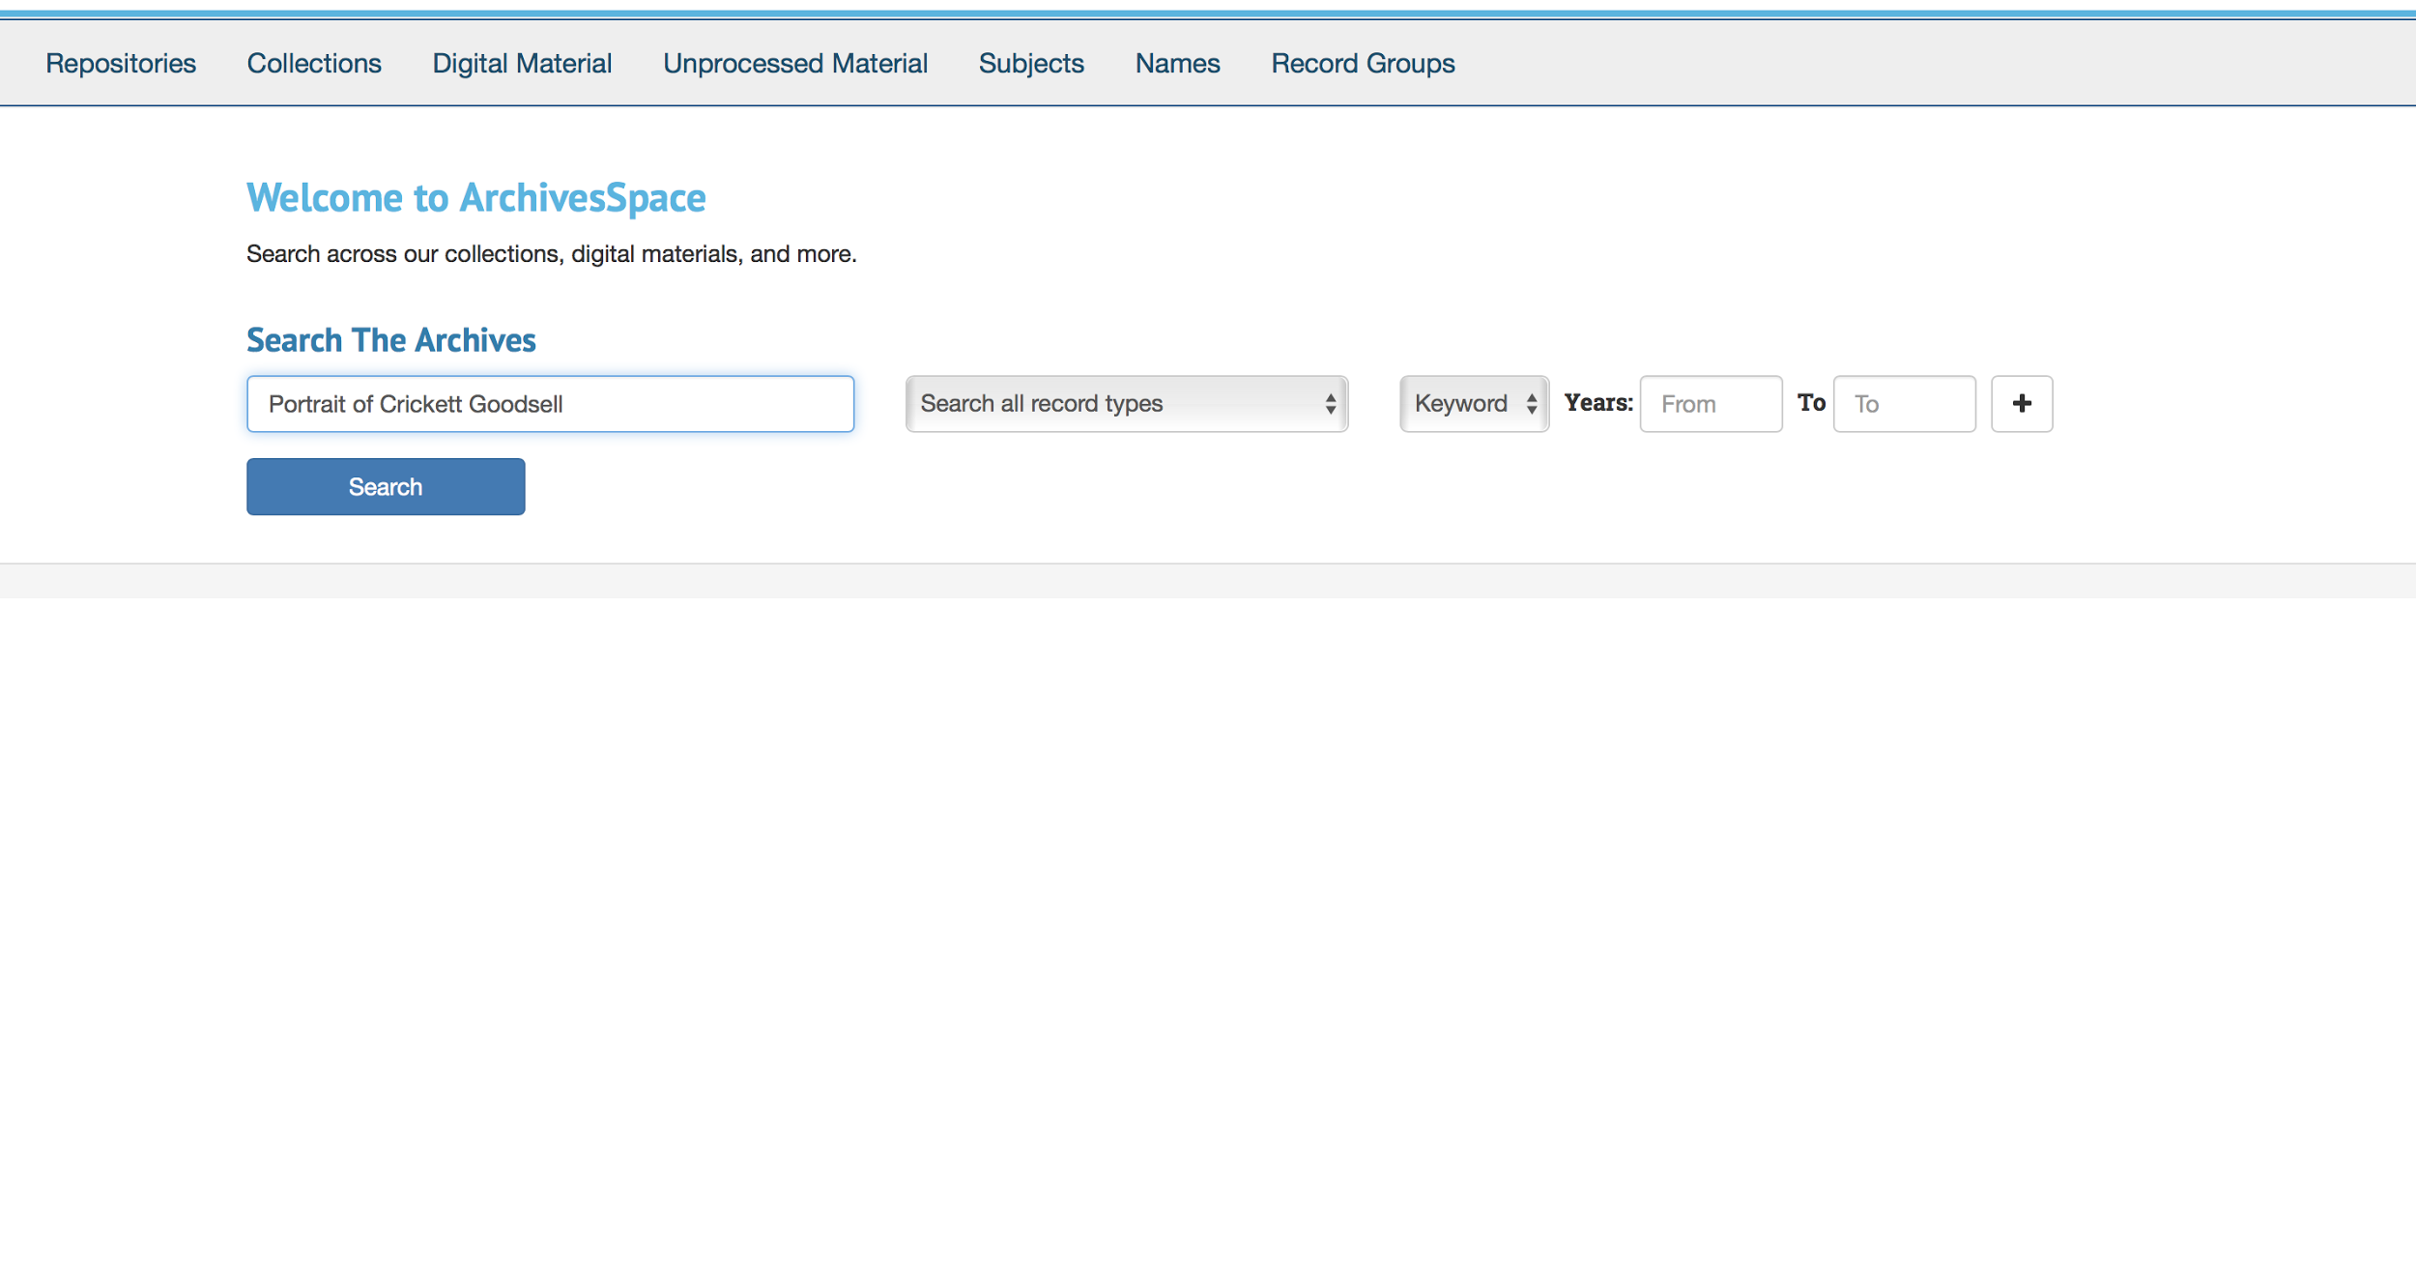

Slide 19
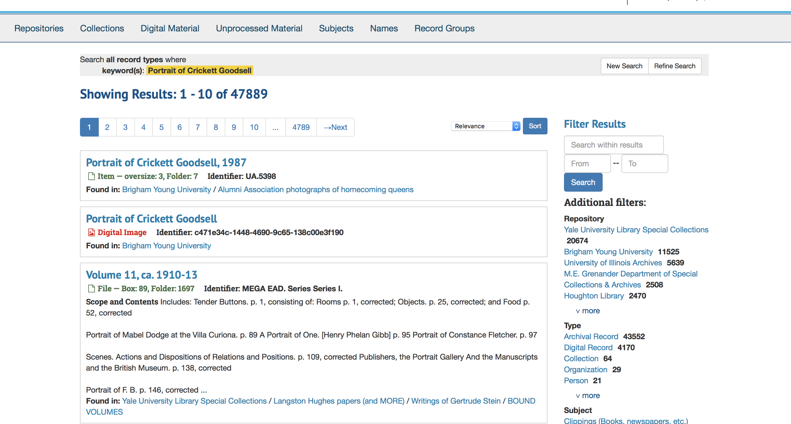

Slide 20
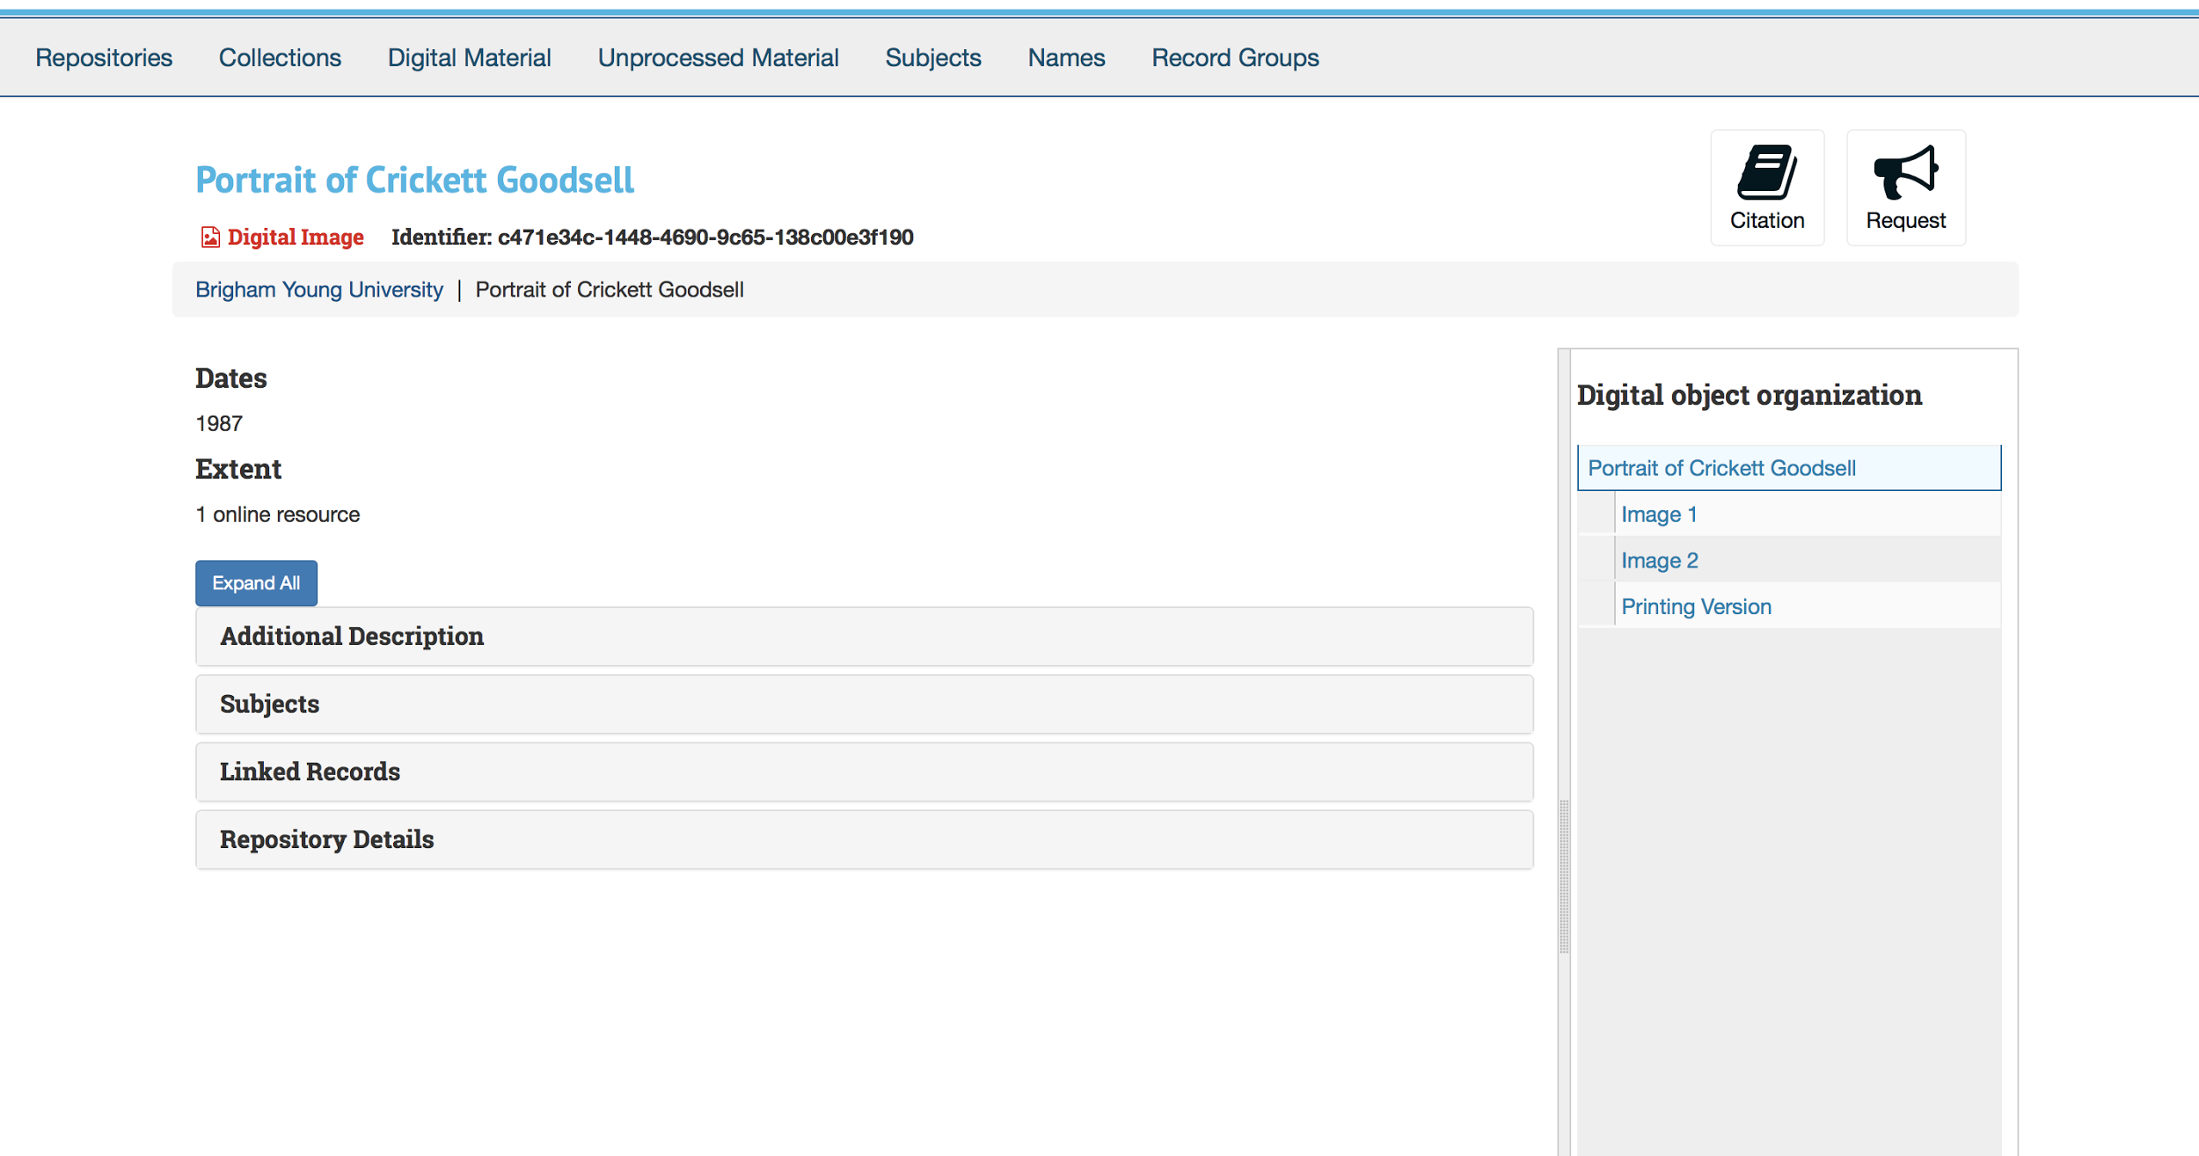

Slide 21
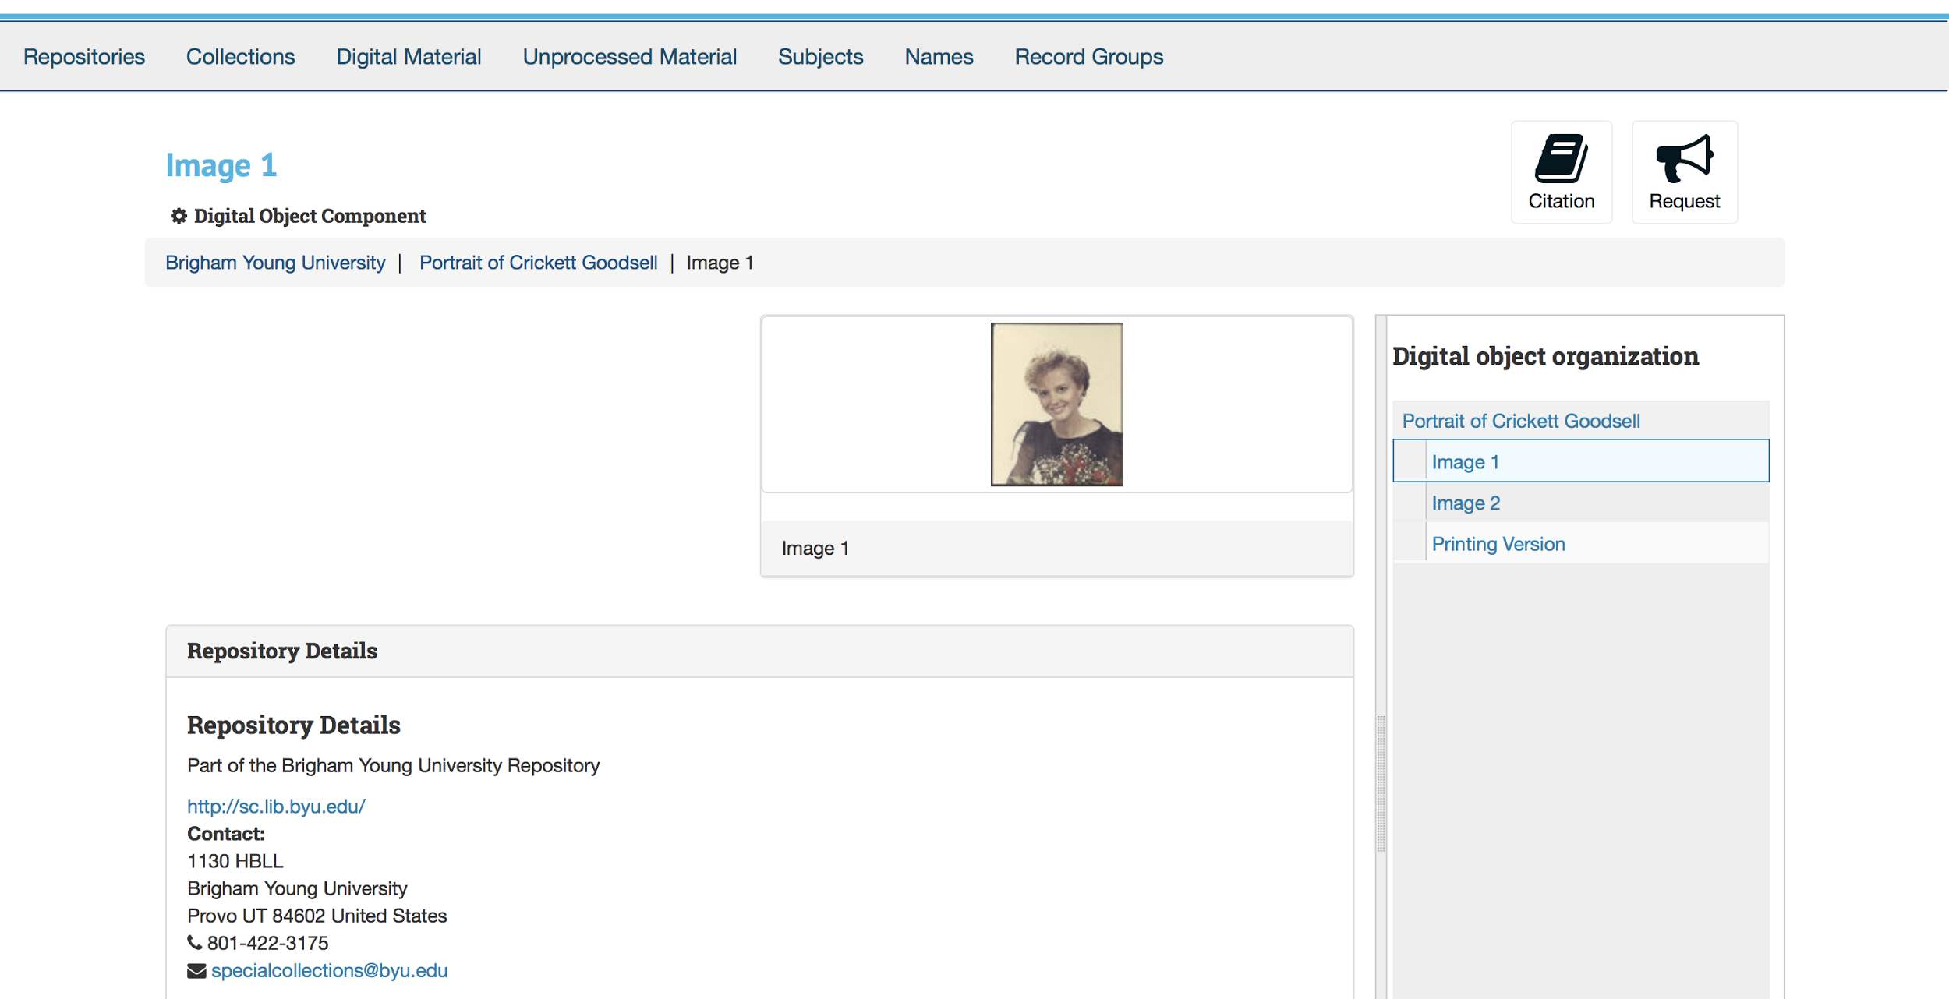

Slide 22
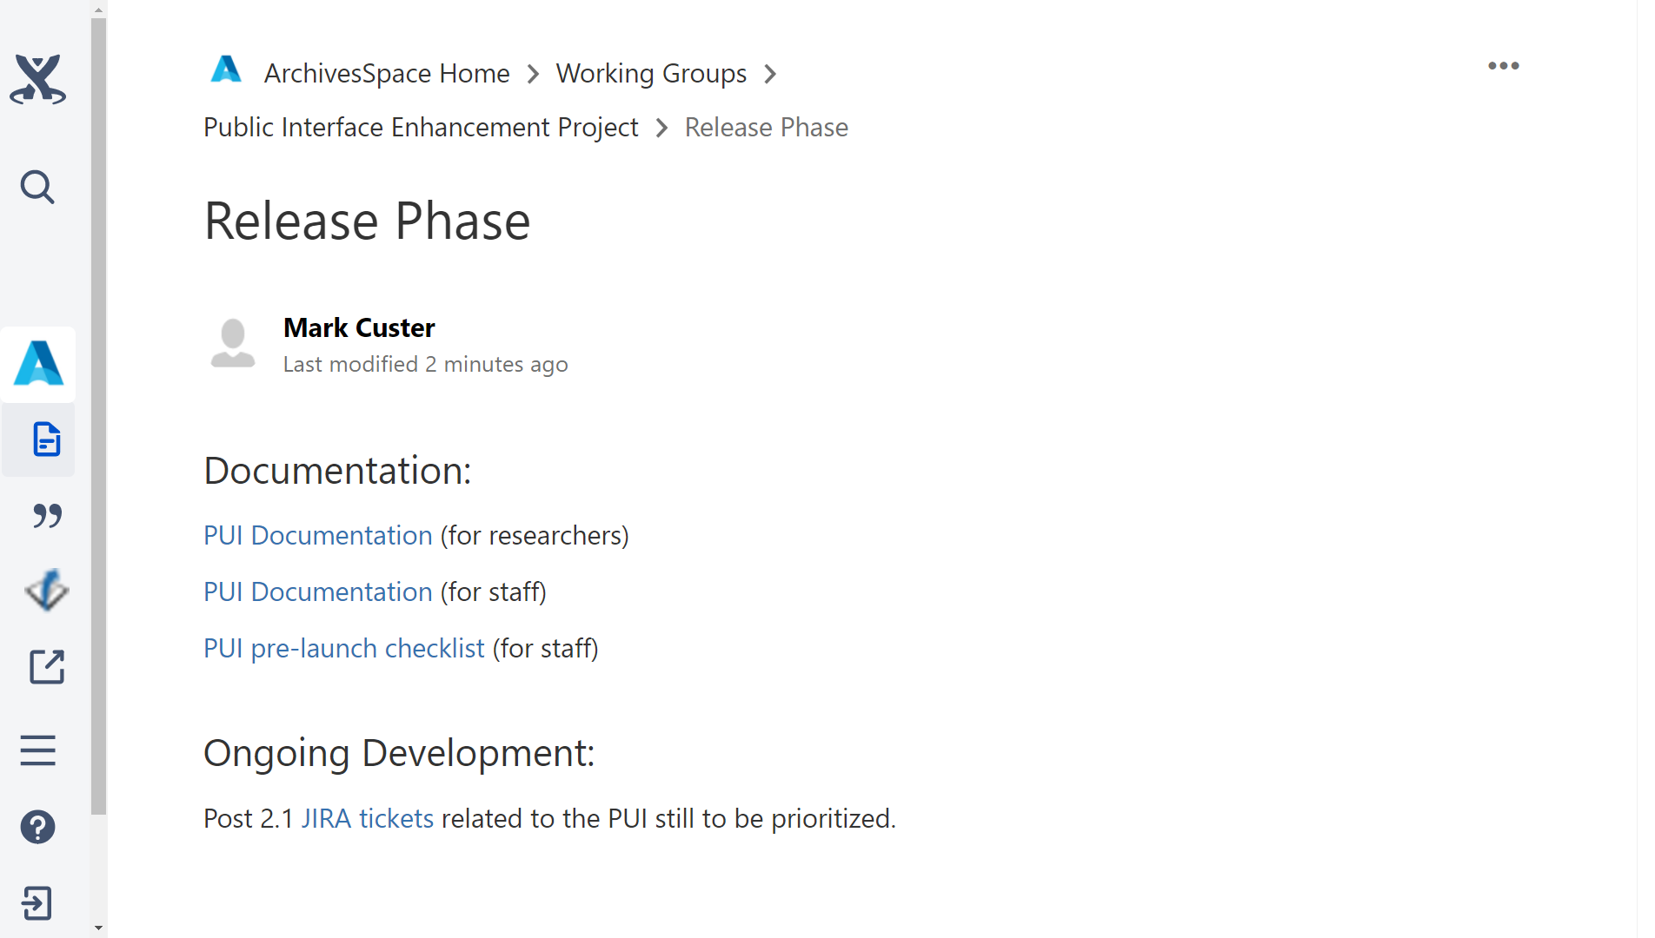

Slide 23
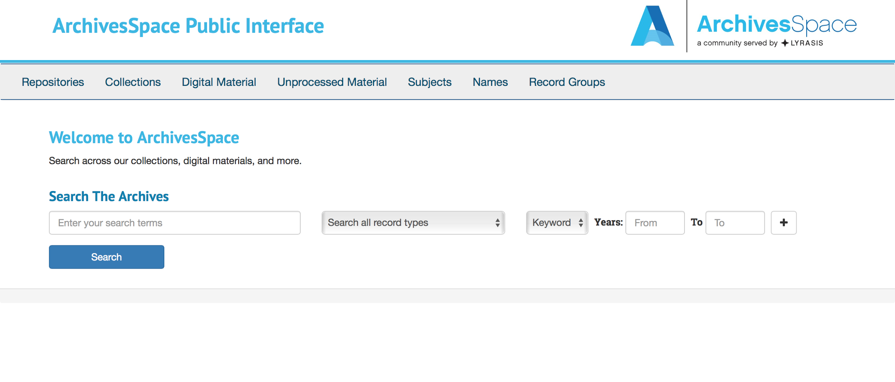

Slide 24
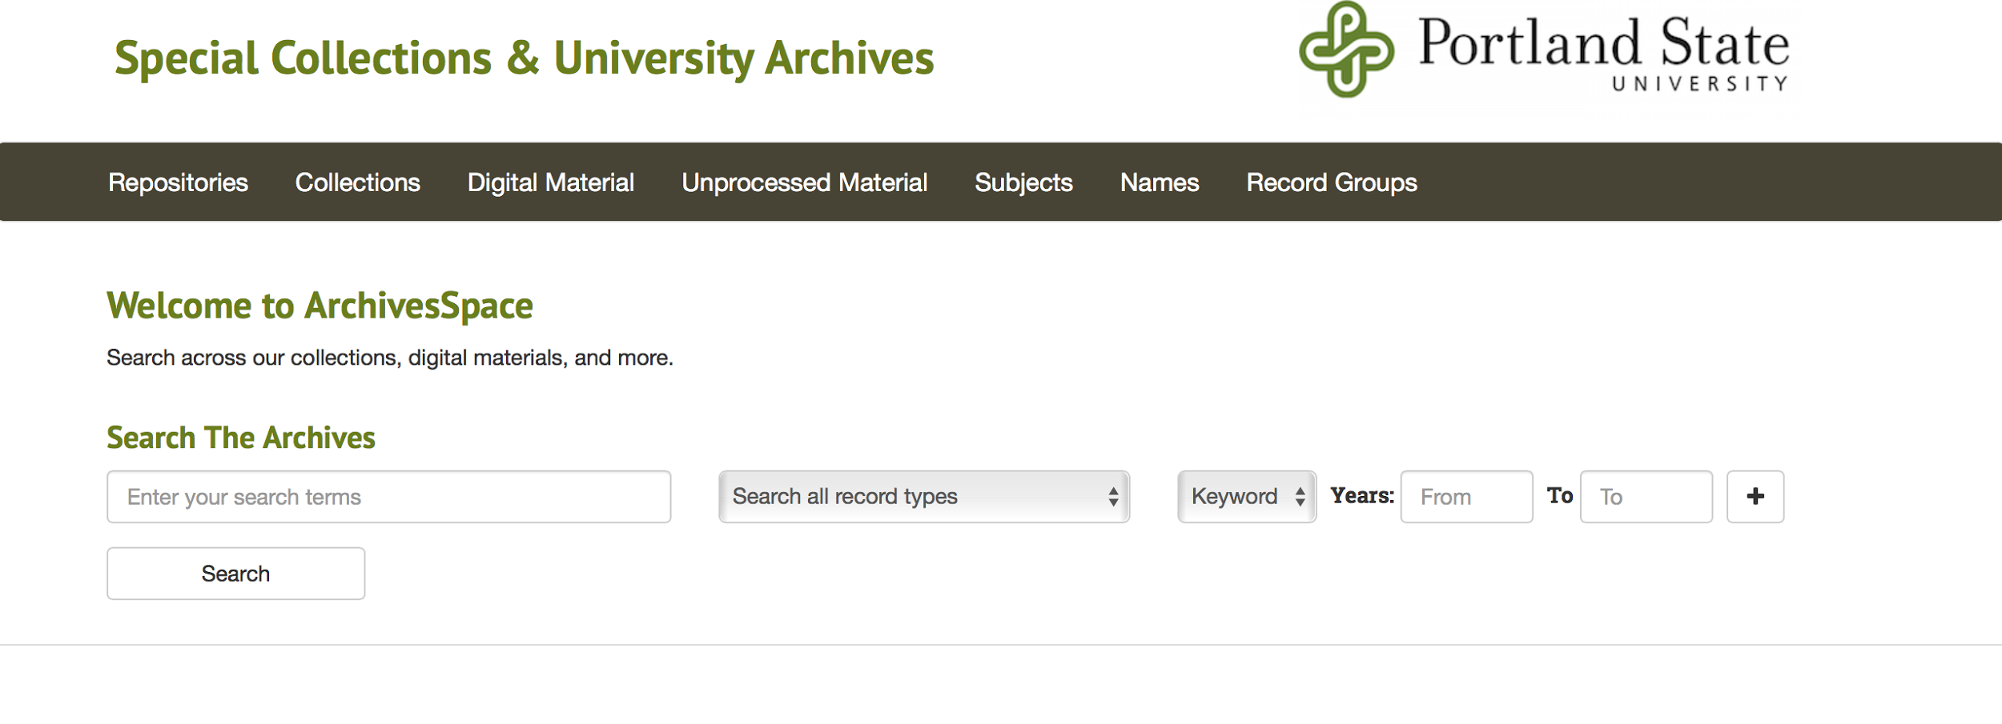

Slide 25
Thanks To
Tom Adams
Laurie Gemmill Arp
Jungleen Bae
Melissa Barton
Richard Boursey
James Bullen
Lisa Calahan
Maureen Callahan
Maura Carbone
Mark Cooper
Jessica Dowd Crouch
Mark Custer
Amy Deschenes
Kate Donovan
Molly Dotson
Krista Ferrante
Moira Fitzgerald
Chris Fitzpatrick
Dara Flinn
Bobbi Fox
Matt Francis
Payten Giles
Matthew Gorham
Emilie Hardman
Linda Hocking
Brian Hoffman
Eric James
Tommy Keswick
Bill Landis
Francis Lapka
Susan Luftschein
Robin McElheny
Laney McGlohon
Rain Michaels
Cory Nimer
Elisa Piccio
Cate Putirskis
Susan Pyzynski
Mike Rush
Scott Schwartz
Martha Smalley
Mariella Soprano
Anna Speth
Claryn Spies
Angela Spinazzè
Kalee Sprague
Randy Stern
Amanda Strauss
Lydia Tang
Mark Triggs
Brad Westbrook
Melissa Wisner

Slide 26
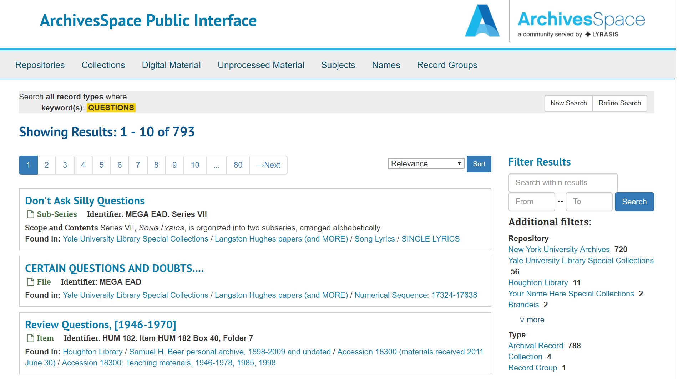
Questions?

