Slide 1
processing workflows
Lisa Calahan
Head of Archival Processing
University of Minnesota Libraries

Slide 2
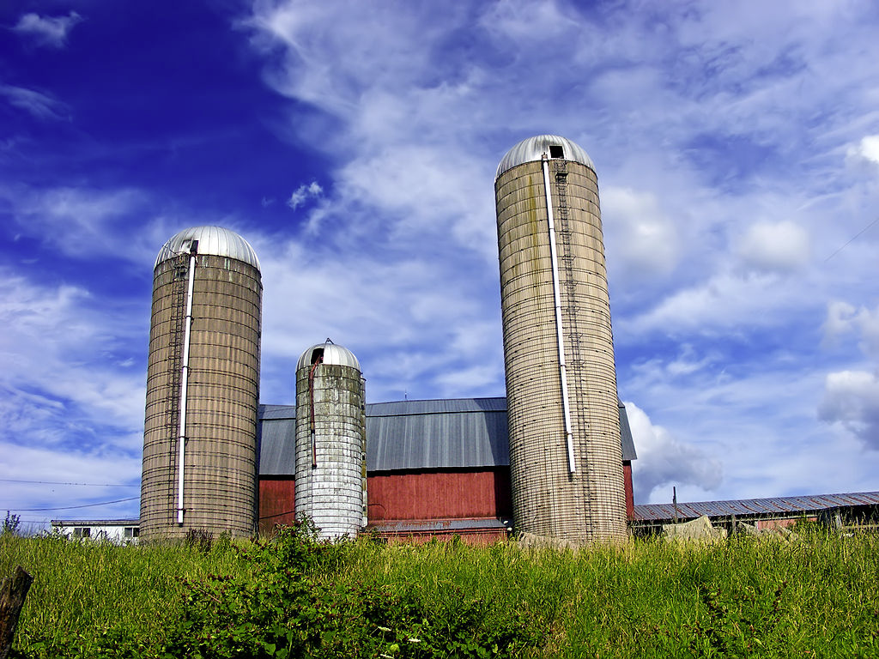
Distinct Collecting Entities
1960s-2000
By Nicholas from Pennsylvania, USA - Silage, CC BY 2.0, https://commons.wikimedia.org/w/index.php?curid=11067985

Slide 3
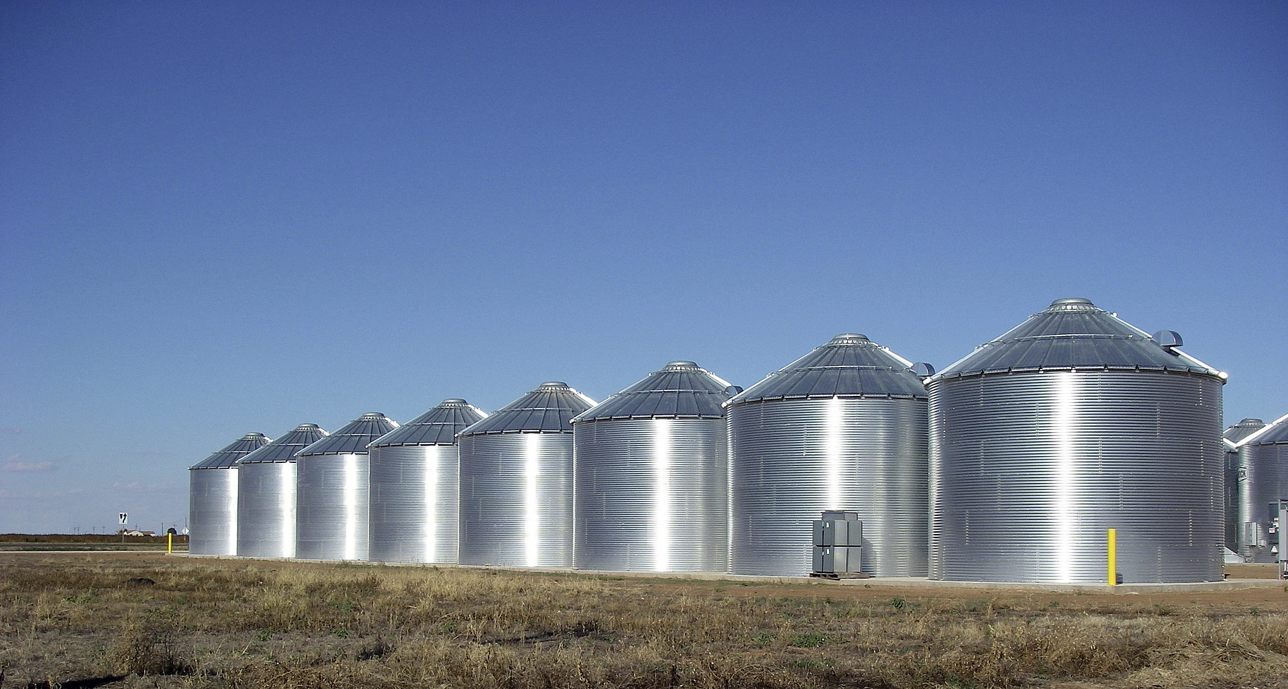
Elmer L. Andersen Library
2000-Present
By Leaflet - Own work, CC BY-SA 3.0, https://commons.wikimedia.org/w/index.php?curid=11770851

Slide 4
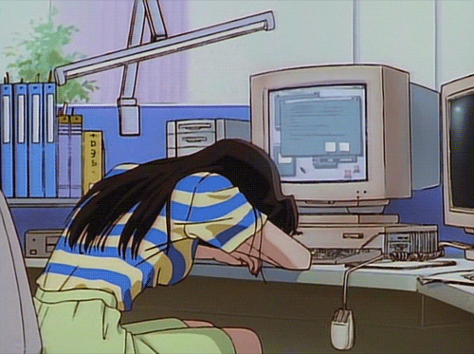
Hand coding =
Das Die-Welt-hasst-mich-Gejammer. gif: giphy. https://media.giphy.com/media/jAe22Ec5iICCk/giphy.gif

Slide 5
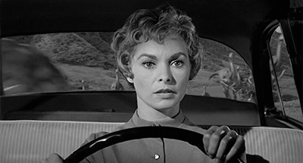
Changing Landscape
Before archivesspace
unattributed. gif: giphy. https://media.giphy.com/media/8hvb1Ok0hJ2OQ/giphy.gif

Slide 6
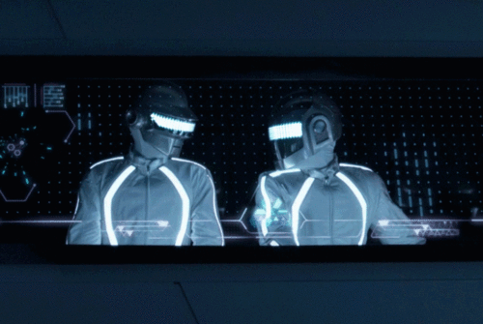
Changing Landscape
AFTER archivesspace
Untitled. http://68.media.tumblr.com/35d4ef4447e0112f776b629bffd99188/tumblr_mk4gf8zvyC1s567uwo1_500.gif

