Slide 1
Preparing for Accessioning in ArchivesSpace with User Stories
Devon Proudfoot
Project Archivist
Bentley Historical Library
University of Michigan
Notes:
Introduction

Slide 2
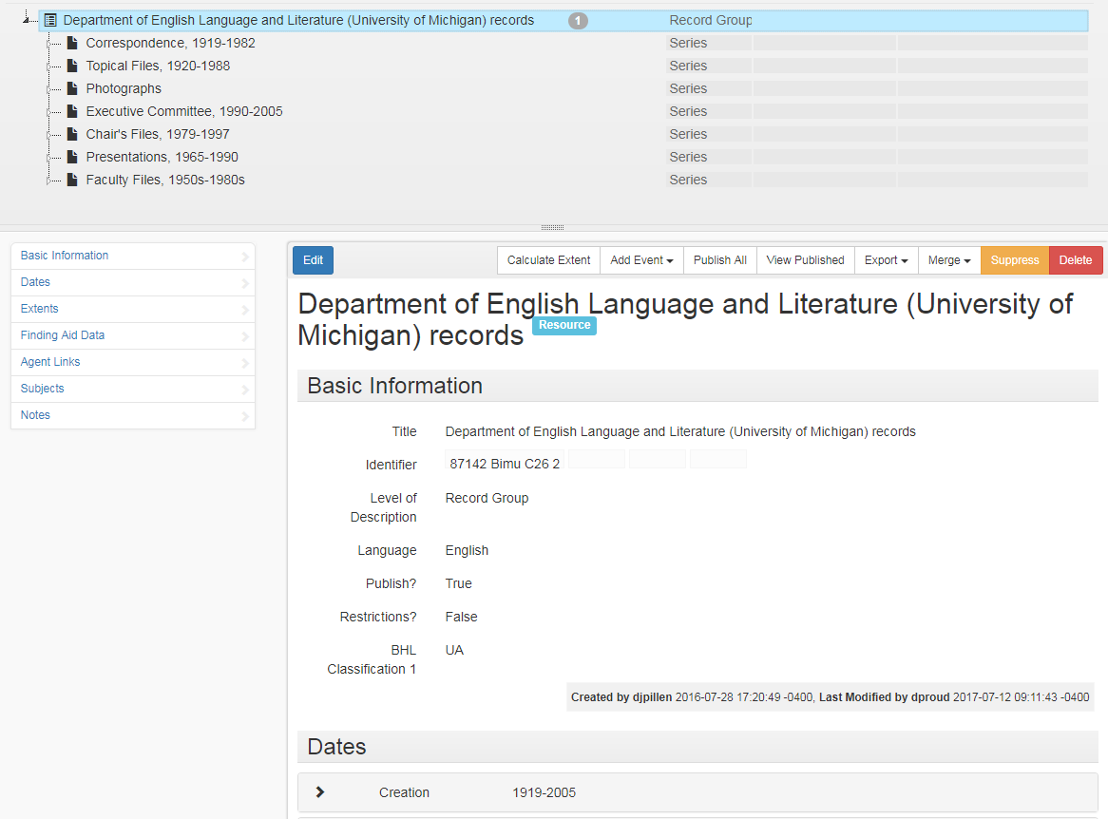
Background
During summer 2016, the Bentley began using ArchivesSpace for the creation of Finding Aids
This past year we have worked towards getting our accessions in ASpace
Notes:
The Bentley has been successfully using ASpace for creating finding aids for almost a year, moving onto accessioning these past few months
We have a number of archivists and students creating and editing collections within ASpace
We need accessions in ASpace so we can eventually use it for collections management/tracking locations
We also wanted to perform our accessioning process to archivesspace
DIFFICULTIES
Accessioning was done by more people, beyond the curation staff
We wanted to take their ideas into account
Implementation team was all curation staff, wanted to extend beyond this

Slide 3
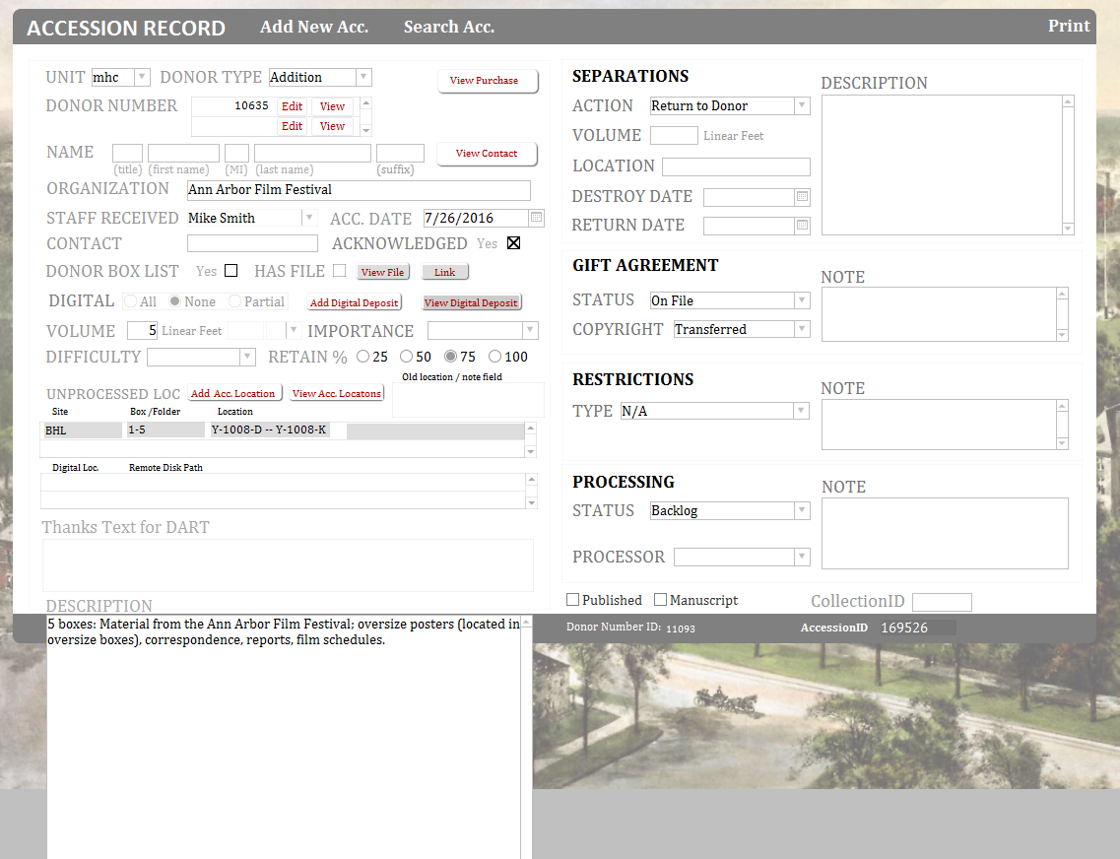
Beal, our FileMaker Pro Database
Previously used a FileMaker database for our accessions
Our team interviewed:
Processing Archivists
Accessioning Archivists
Field Archivists
Development
Notes:
Our old FileMaker database
This is how we would create accession records before
All the classics are there: donor, description, restrictions
Worked well for us, outside of a few quirks
We began by interviewing staff members outside of our ASpace team
Curation staff: People who used Accession records for background when processing
Field Archivists/Records Managers: Bringing in material to the Bentley and accessioning them
Development: Reporting donor (and donation) information to the University
Focused on needs of the users, rather than replicating fields from old FileMaker database
We didn’t have existing accessioning documentation so that we could start new
Figure out what information they needed to include, rather than to fit them into an existing field

Slide 4
User Stories
As a processing archivist, I need to know the donor so that I can establish provenance.
As a _______,
I need to ________,
So that I can _______.
Notes:
Used those interviews to create “User Stories”
Typically used by developers to think about what the end user might need to use, our case: the accessioning archivist
These are used for JIRA issues in the ArchivesSpace development
As a ______, I need to ______, so that I can ______.
We have a blog post on it

Slide 5
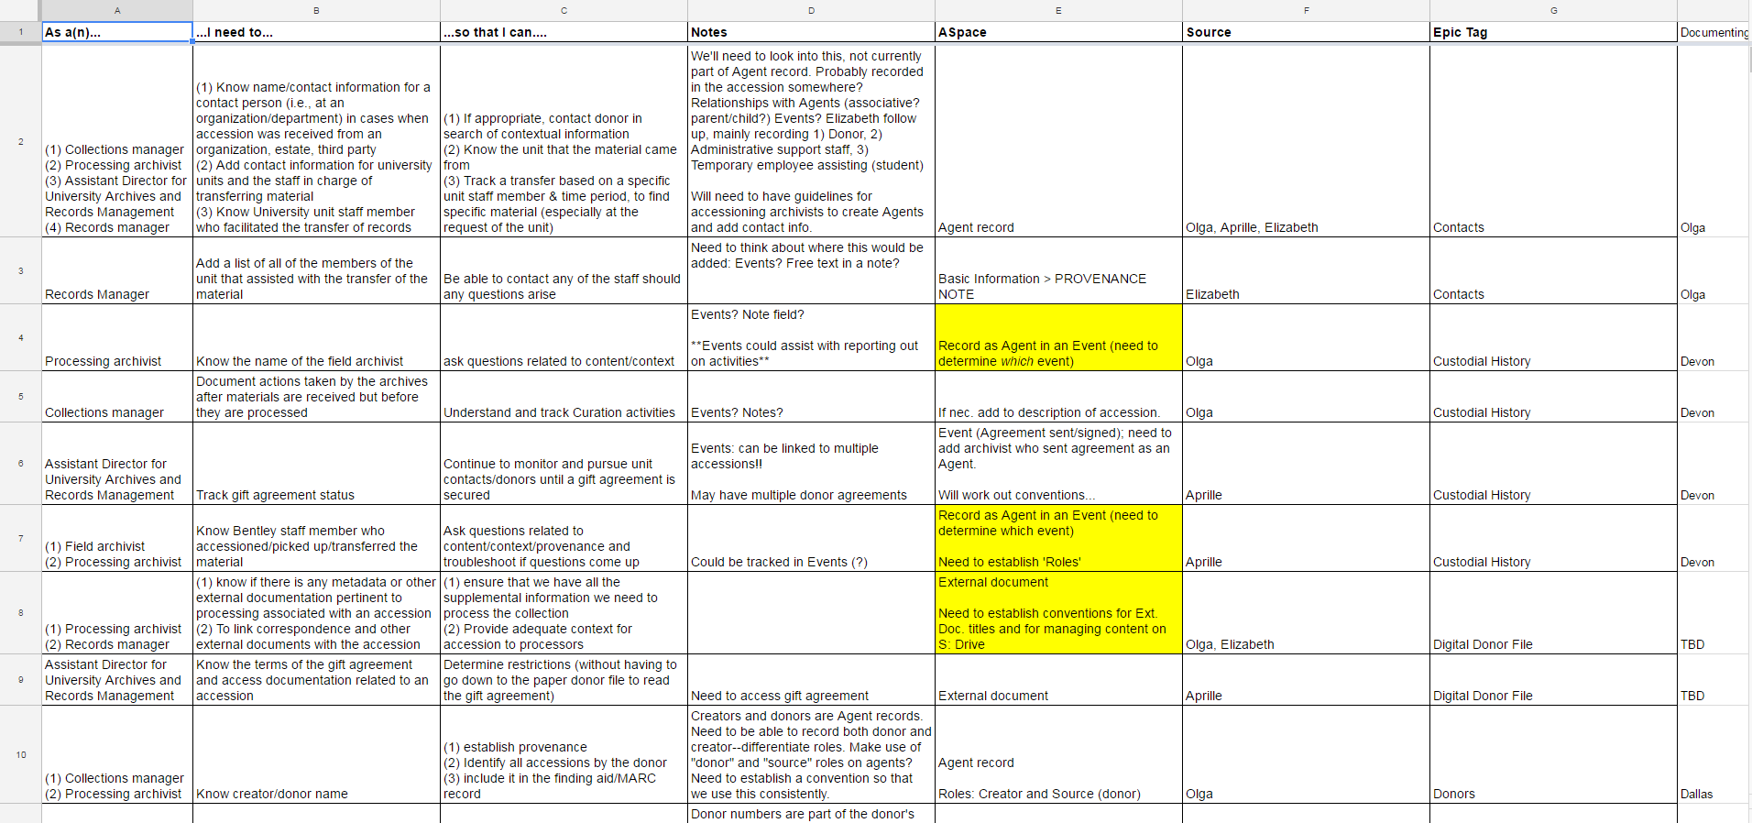
User Stories
http://archival-integration.blogspot.com/2015/05/as-blogger-i-need-post-on-user-stories.html
Notes:
Categorized these needs into sections. Each dealt with a different step in accessioning process or accessions in general (see spreadsheet above)
Donors/Contact info
Extent
Reports
Created a big spreadsheet with user stories, potential ASpace fields to use, and then the sections

Slide 6
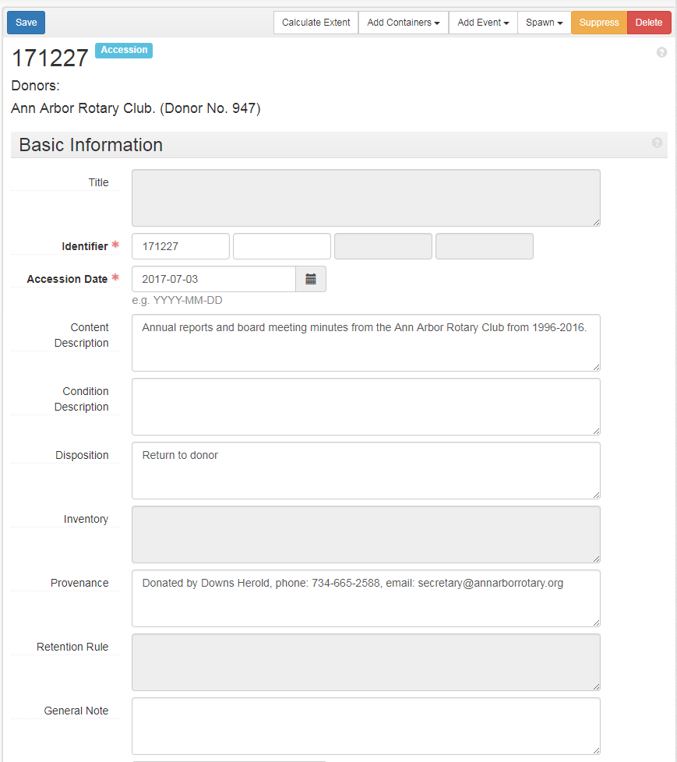
Notes:
New view of our accessions
More fields than in our past accessions database
We had to move legacy data to new fields, and decide if we wanted to use any other new features

Slide 7
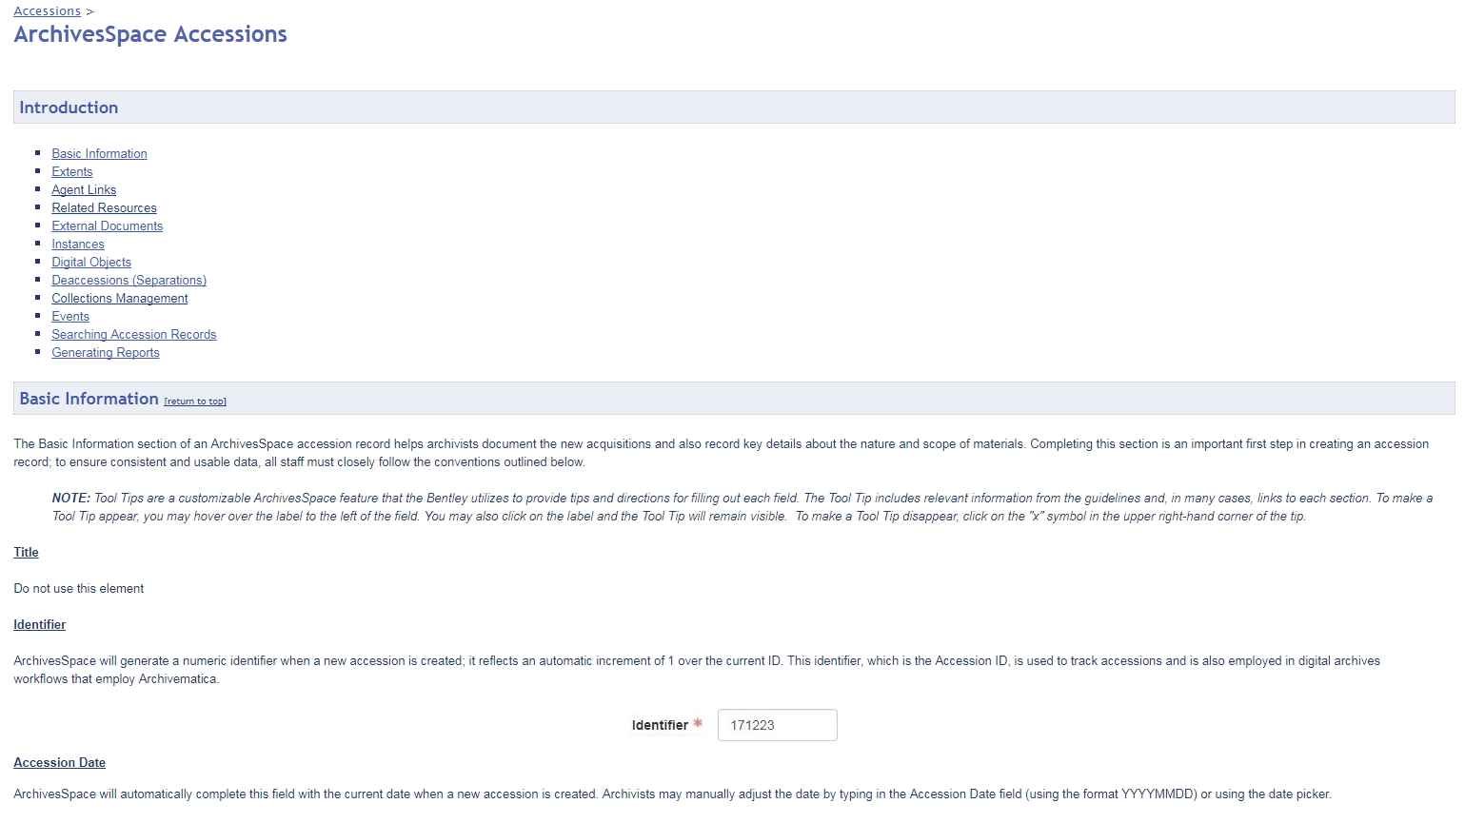
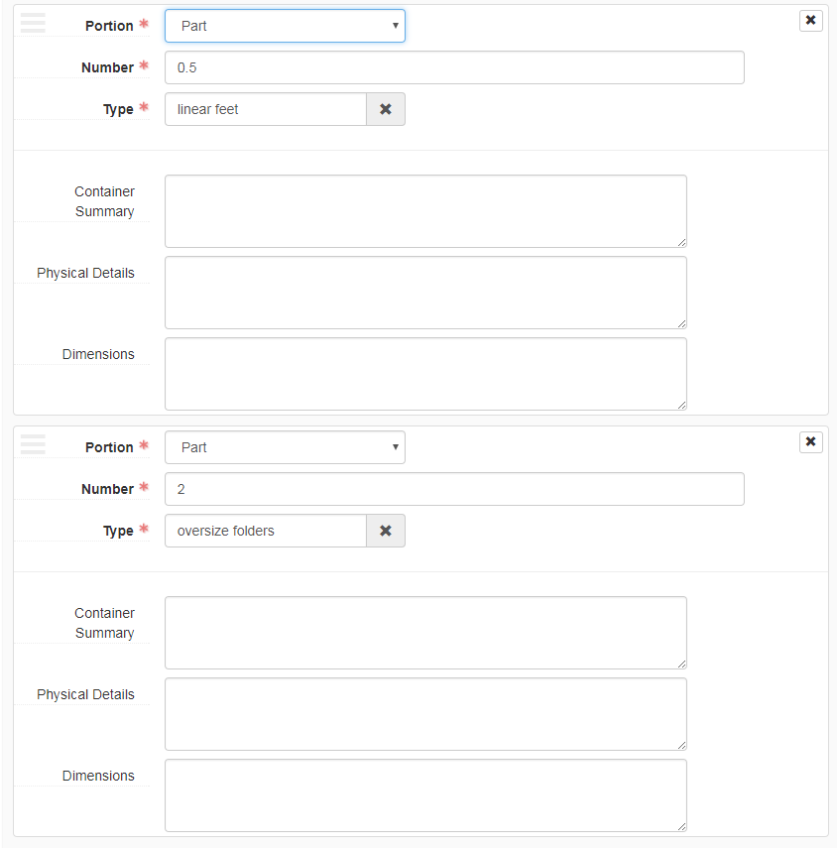
Notes:
[General information about ASpace accessions]
General features of ASpace that we were able to adopt for accessioning
Able to link multiple extents, physical and digital, for better intellectual control over accessions (linear feet, folders, volumes)
On a similar note, ability to link multiple donors to the same accession

Slide 8
Results?
As a records manager I need to add a list of all of the members of the unit that assisted with the transfer of the material so that I can contact any of the staff should any questions arise
Notes:
The results were that we were able to add fields and create data entry conventions that would be helpful for other Bentley Staff
EX: Top picture: University collectors requested an area to note administrative assistants/other employees that assisted in transfers
ASpace contains more fields than our Filemaker database; we can use these in new ways
Capture new or different information
Better tracking/reporting for who brought what material in
In some case we found a simple solution like a free text field was sufficient!
Other examples were using the External Documents to note inventories or other notes
Using the “Custody Transfer” event to track Field Archivist, as opposed to the accessioning archivist noted elsewhere

Slide 9
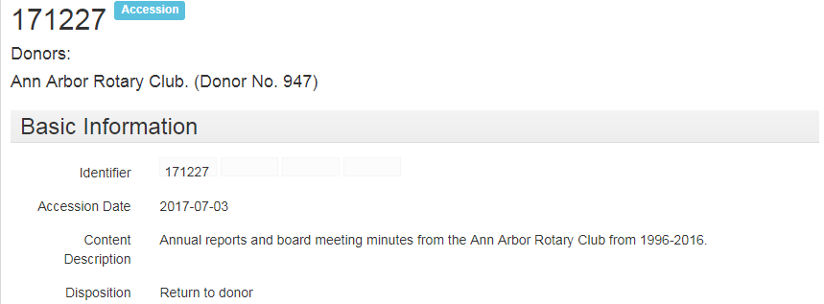
Other impacts
These user stories affected more than just the accessioning process
Creating reports
Changing some display settings in ASpace
Managing search methods
Training sessions
Notes:
Impacts more than just accessioning process
Figure out what kind of reports to create
Changing some display settings - example
Figuring out new methods of search methods
Organizing training sessions
Following our training sessions, we had verbal feedback
Offers a feedback cycle for our ASpace team
Staff can comment on interface, documentation, and methods.
Example: Copy donor information to the top of the page
Change classifications to a user field
User stories gave us a much more structured method for planning, kept us on track

Slide 10
Questions?
dproud@umich.edu

