Slide 1
Supporting Internal Workflows with Plugins at the Bentley Historical Library
Dallas Pillen
Archivist for Metadata and Digital Curation
University of Michigan Bentley Historical Library
djpillen@umich.edu

Slide 2
Why Focus on Internal Workflows?

Slide 3
ArchivesSpace Does a Lot!
Accessions
Resources
Controlled vocabularies
Container/location management
Reports
Rapid Data Entry
Import/export

Slide 4
The Community Does a Lot!
Staff Interface Enhancement Working Group (SIEWG)
Public User Interface enhancement
Dev. Pri.
Yale container management plugin
Harvard Excel import plugin
Systems integrations
User and Technical Advisory Councils

Slide 5
And yet...
Generalizable ArchivesSpace core code improvements and community projects can’t support all local needs
BHL identified several needs during and since implementation that are very local
Interviewed users of the application
Turned results into user stories
Evaluated whether or not users’ needs were supported by default application functionality, community-supported enhancements, or local modifications

Slide 6
Why Plugins?

Slide 7
Plugins are Powerful
ArchivesSpace has a robust plugin architecture
http://archivesspace.github.io/archivesspace/user/archivesspace-plug-ins/
Can modify most aspects of the application
Plugins can benefit all users, regardless of technical ability or system-specific expertise
ArchivesSpace API is also powerful, but requires specialized knowledge and technical ability

Slide 8
Important Caveats
Plugin development itself requires specialized knowledge and technical ability
Depending on what you want to do, might require: Ruby, JavaScript, HTML, CSS, SQL
New ArchivesSpace releases might be incompatible with existing plugins
If possible, adapt local practice to match default functionality and use plugins for small, specific, non-critical functionality

Slide 9
Identifying and Supporting Local Needs

Slide 10
As a collections manager/processing archivist I need to know the donor number so that I can identify all accessions by a donor/reference the donor file/include the donor number in a finding aid/catalog record

Slide 11
As a development officer I need to update agent records with a unique identifier from the university’s donor relations database

Slide 12
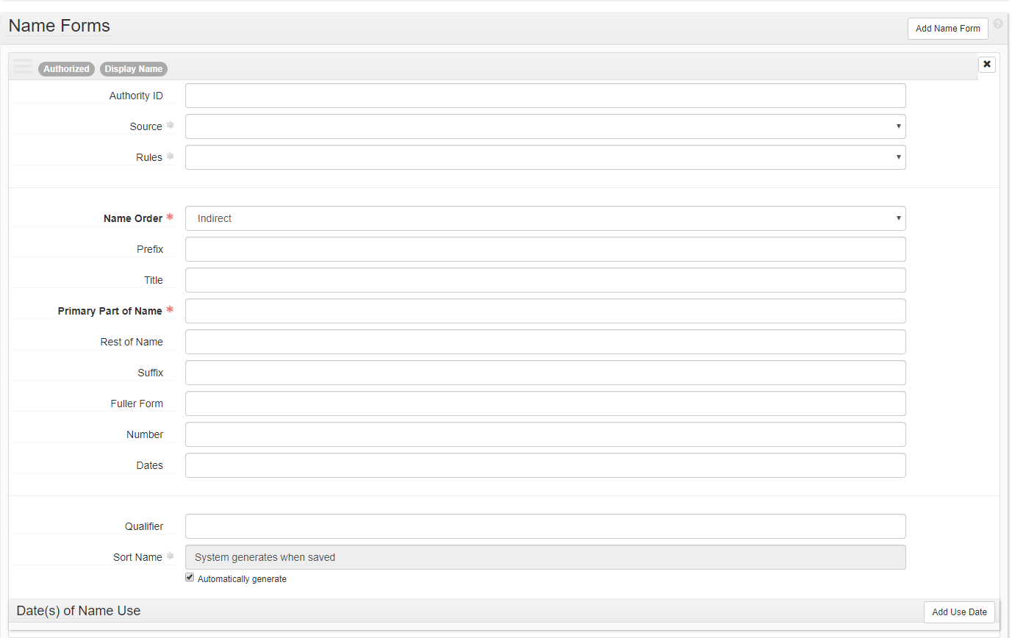

Slide 13
Donor Details Plugin
https://github.com/bentley-historical-library/donor_details
Adds 3 unique identifiers for donors of archival materials
Donor number
Local unique identifier. Corresponds to donor files with gift agreements, correspondence, etc.
DART LID
U-M Donor Alumni Relations Tool identifier
BEAL Contact ID
Legacy accessions/donor management system

Slide 15
As a collections manager I need to search/view specific fields within an accession record so that I can find specific material and types of material

Slide 16
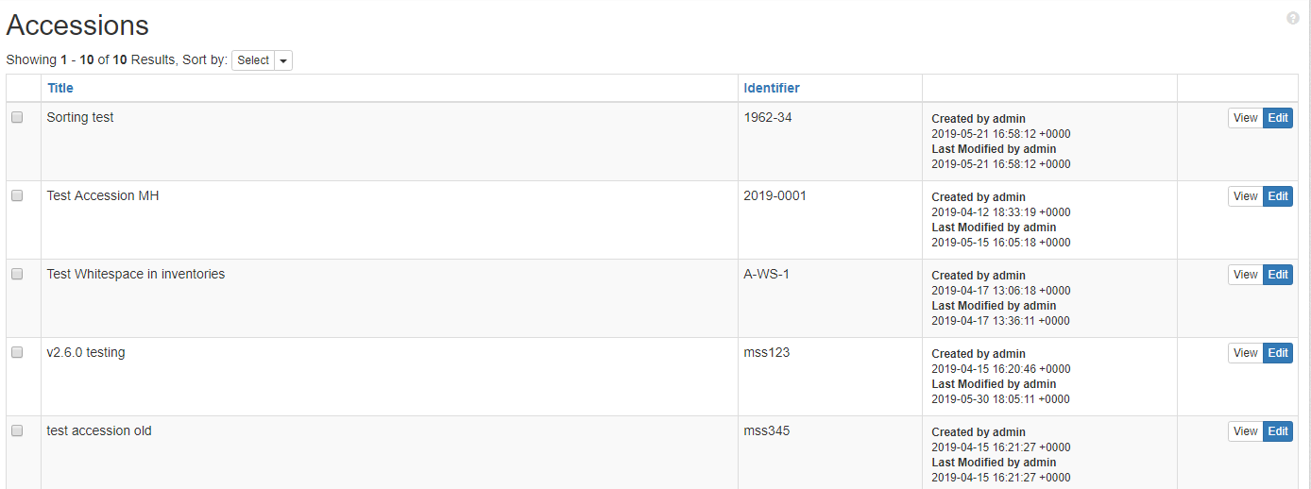

Slide 17
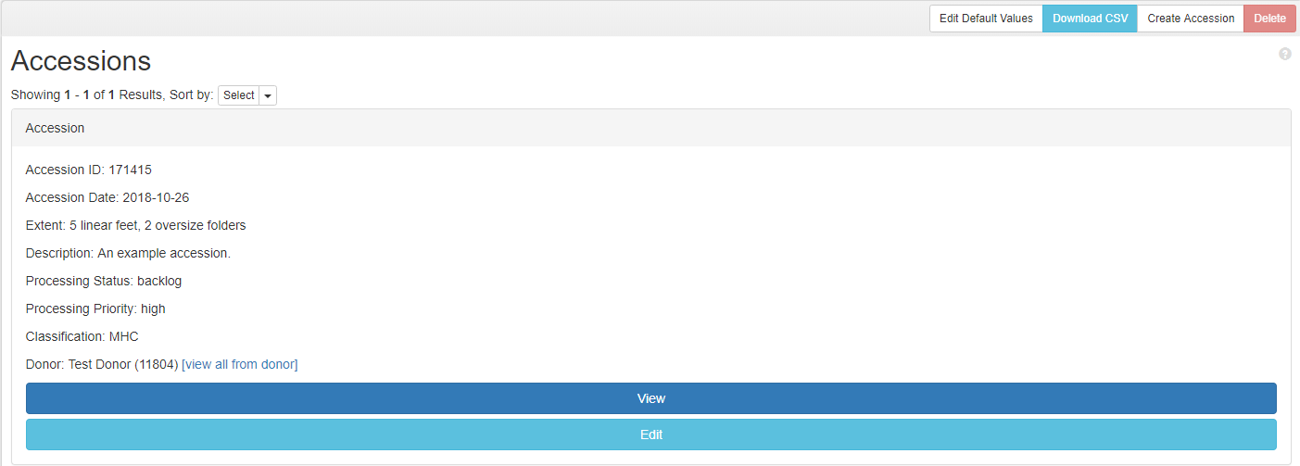
BHL Accession Search Results
https://github.com/bentley-historical-library/bhl_accession_search

Slide 18
As a field archivist/processing archivist I need to know the staff member responsible for accessioning/transferring material so I can generate reports for materials accessioned by a particular field archivist/ask questions related to content, context, and provenance

Slide 19
Accession Events
Legacy system had a “staff received” field
Uncontrolled, free text field
Decided to use an ArchivesSpace Event linked to staff member’s user agent record
Desire was expressed to streamline the creation of those Events
Accession events plugin: https://github.com/bentley-historical-library/accession_events
Fork of https://github.com/hudmol/accession_events
Automatically creates specified Events when a new Accession record is created

Slide 20
As an accessioning/processing archivist, I need to know that I am entering all required, locally preferred, and optional information correctly so that I can make sure I do not leave out pertinent information

Slide 21
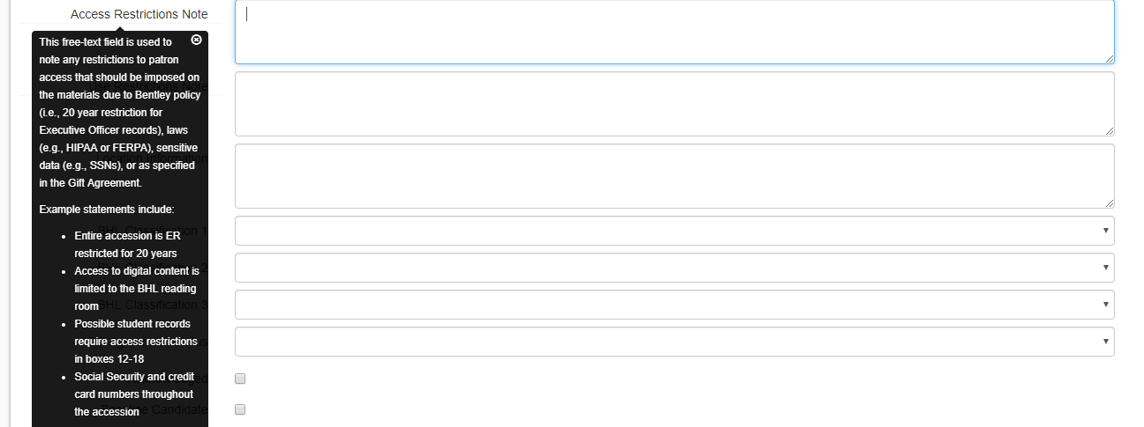
General Interface Modifications
BHL ASpace Translations: https://github.com/bentley-historical-library/bhl_aspace_translations
Modifies field names and tool tips to match BHL’s local documentation

Slide 22
General Interface Modifications
User Defined in Basic: https://github.com/bentley-historical-library/user_defined_in_basic
Fork of https://github.com/hudmol/user_defined_in_basic
Moves specified user defined fields into the Basic Information section
BHL Accession Read Only Fields: https://github.com/bentley-historical-library/bhl_accession_readonly_fields
Makes unused legacy fields read only

Slide 23
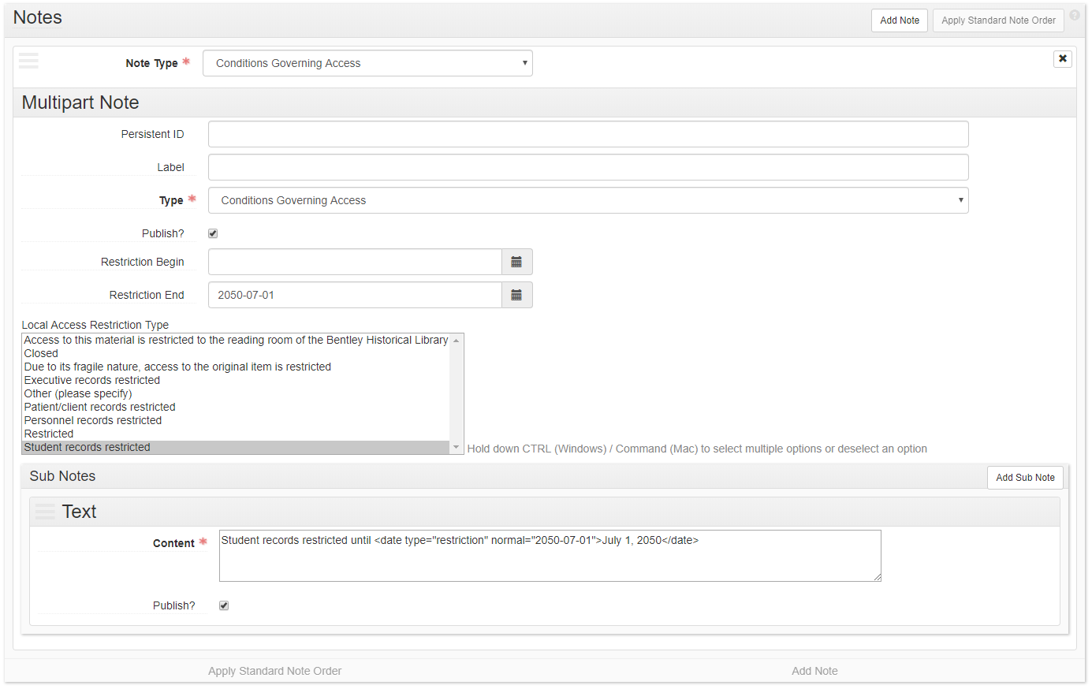
General Interface Modifications
BHL ASpace accessrestrict Text: https://github.com/bentley-historical-library/bhl_aspace_accessrestrict_text
Populates Conditions Governing Access note based on Local Restriction Type/Restriction End

Slide 24
As a field/university archivist I need to aggregate accession data for a given donor/university unit by donor number so that I can track and compile multiple accessions for a given donor/university unit
As a field/university archivist I need to aggregate accession data for general collecting areas so that I can prioritize and manage the backlog and generate statistics for business intelligence purposes
As a development officer I need to produce reports from ArchivesSpace to add information to the university’s donor relations database

Slide 25
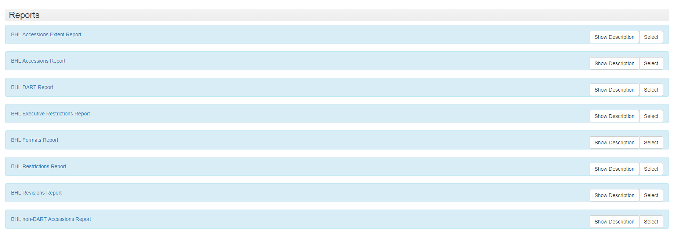
Reporting
BHL ASpace Reports: https://github.com/bentley-historical-library/bhl_aspace_reports

Slide 26
Select Other Plugins
BHL EAD Importer: https://github.com/bentley-historical-library/bhl-ead-importer
For migrating legacy EADs
BHL EAD Exporter: https://github.com/bentley-historical-library/bhl-ead-exporter
Modifies EADs for BHL’s finding aid platform (DLXS)
BHL Barcode: https://github.com/bentley-historical-library/bhl_barcode
Adds several API endpoints to return information for Aeon and digitization workflows
BHL Browse Pages: https://github.com/bentley-historical-library/bhl_browse_pages
Updates list of finding aids on BHL’s WordPress site
BHL ASpace Print Template: https://github.com/bentley-historical-library/bhl_aspace_print_template
Modifies print stylesheet for accession records
Heavily influenced by https://github.com/YaleArchivesSpace/print

Slide 27
Final Thoughts
We’re using a lot of plugins!
We also have a lot of justifications:
We’ve identified specific local needs
Most plugins do one small, specific thing
Most plugins are not supporting critical functionality or modifying the ArchivesSpace data model, but make the application generally easier for BHL staff to use
Important to document what plugins are being used, how they work, which aspects of the core application they modify

