Slide 1
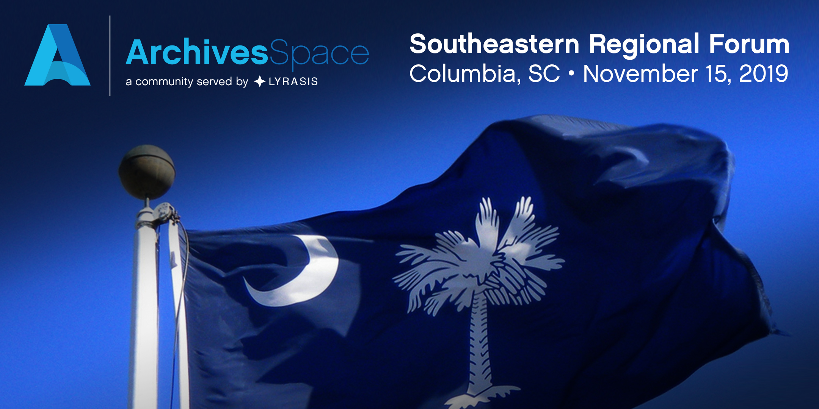


ArchivesSpace Southeastern Member Forum
Hollings Special Collections Library
University of South Carolina
November 15, 2019

Slide 2

WiFi
Network Name: Hollings Library
Network Password: 12345678

Slide 3
Thank you!
Working Group Members
Brenda Burk, Clemson University
Matt Hodge, University of South Carolina
Joshua Minor, College of Charleston
Brittany Newberry, Atlanta University Center
Krista Oldham, Clemson University

Slide 4
Presenters
Taryn Cooksey, University of South Carolina
Georgette Mayo, College of Charleston
William Hardesty, Georgia State University
Dawne Lucas, University of North Carolina, Chapel Hill
Ann Merryman, University of South Carolina, Upstate
Joshua Minor, College of Charleston
Patricia Mitchell, TN State Library and Archives
Brittany Newberry, Atlanta University Center
Krista Oldham, Clemson University
Jennifer Randles, TN State Library and Archives
Will Thomas, TN State Library and Archives
Workshop Instructors
Christine Di Bella, ArchivesSpace
Kelly Spring, East Carolina University

Slide 5
Code of Conduct
We seek to provide a welcoming, fun, and safe conference experience and ongoing community for everyone. We do not tolerate harassment in any form. Discriminatory language and imagery (including sexual) is not appropriate for any event venue, including talks, or any community channel such as the chatroom or mailing list.
Harassment is understood as any behavior that threatens another person or group, or produces an unsafe environment. It includes offensive verbal comments or non-verbal expressions related to gender, gender identity, gender expression, sexual orientation, disability, physical appearance, body size, race, age, religious beliefs, sexual or discriminatory images in public spaces (including online), deliberate intimidation, stalking, following, harassing photography or recording, sustained disruption of talks or other events, inappropriate physical contact, and unwelcome sexual attention.
- CodeofConduct4Lib (Short link: http://bit.ly/coc4lib)

Slide 6

Legacy Finding Aids and ArchivesSpace (Re)implementation
Taryn Cooksey
(She/Her)
South Caroliniana Library
University of South Carolina
cookseyt@mailbox.sc.edu

Slide 7
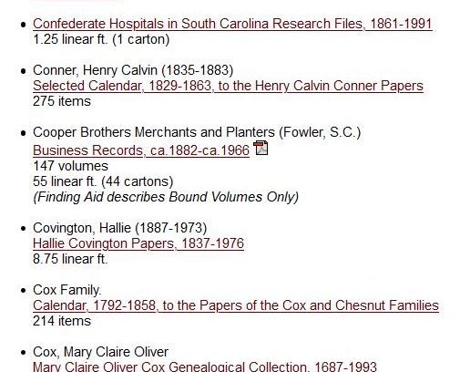
Before ArchivesSpace
Finding aids stored as a list of links on library website.
Actual finding aids exist in a variety of formats with few standards and little uniformity.
Spring 2018 website update prompts a return to ArchivesSpace.

Slide 8
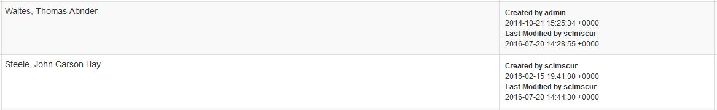
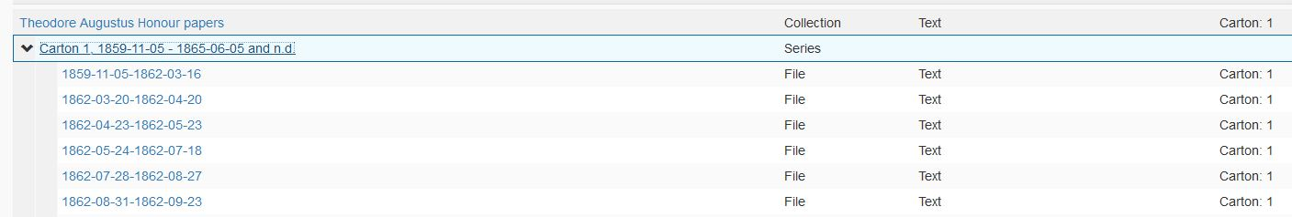
Inheriting a Previous Implementation
A prior effort to use ArchivesSpace created just over 540 resource records.
Did not follow DACS formatting.
Included very small collections that would not normally get a finding aid.
Duplicated records that were available in our catalog, with no new information.

Slide 9
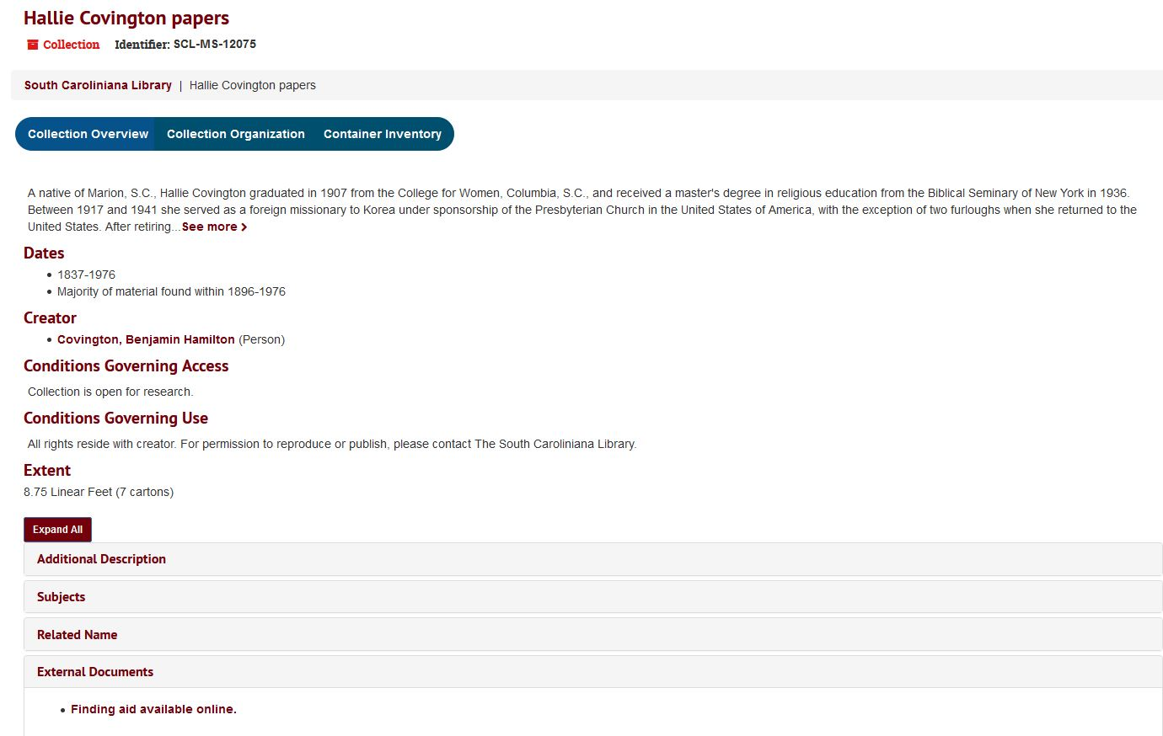
Cleaning Up ArchivesSpace
University Libraries implements plan to link pdf finding aids as external documents.
Creates way to make information accessible, while updating legacy finding aids from the old website.
Converting those pdf finding aids into full ArchivesSpace records.

Slide 10
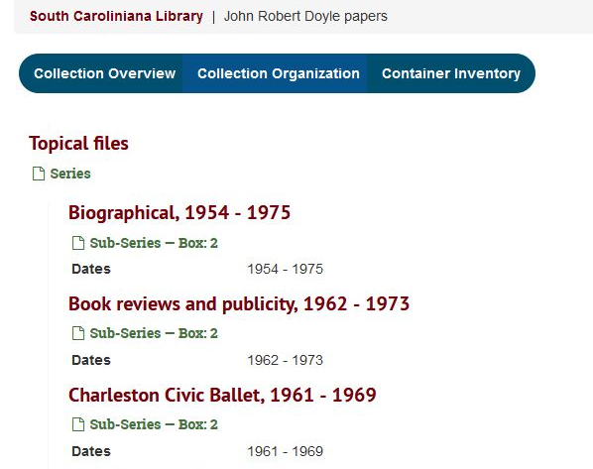
Clean Up Continued
Removed over 300 redundant or unneeded resource records.
Updating remaining records for DACS compliance and clarity.
Only records with specialized formats will need to be linked as an external document.

Slide 11
Show us Your Implementation:
Wilson Special Collections Library
Dawne Howard Lucas
Regional ArchivesSpace Forum
Columbia, SC
15 November 2019
Notes:
Good morning! My name is Dawne Howard Lucas and I’m a Technical Services Archivist at the University of North Carolina at Chapel Hill’s Wilson Special Collections Library. I’m excited to talk to you about our recent…and ongoing…ArchivesSpace implementation.

Slide 12
About Us
Five different collecting units,
  North Carolina Collection
  Southern Historical Collection
  Southern Folklife Collection
  Rare Book Collection
  University Archives & Records Management Services
~50 FTE
10,000+ accession records
7,000+ archives/manuscript collections
1 ArchivesSpace repository
3 software developers working on implementation
Notes:
First I want to give you a very quick overview of Wilson Library just so you understand the scale of our organization. We have five different collections, about 50 full-time employees, plus students on top of that, and we have more than 10,000 accession records and more than 7,000 archives and manuscript collections. Since we are trying to break down the silos that exist between the collections, all of this information is part of one repository profile instead of 5 different repository profiles. There are 3 software developers involved in the implementation, with a fourth person serving as an advisor and strategist

Slide 13
Collection Management History
Accessions
  Launched ArchivesSpace on 2 October 2019
  Archivists’ Toolkit: 2011-October 2019
  Microsoft Access: pre-2011
Finding aids
  Created stub resource records in Archivists’ Toolkit
  Finding aids created using NoteTab and Oxygen
  Version control managed via GitLab
Notes:
Before 2011, our accessions information was tracked in a Microsoft Access database. Information from that database was imported into Archivists’ Toolkit in 2011. We used Archivists’ Toolkit from 2011 until last month for accessions information only. We did not use the other AT modules in any sort of consistent or robust way. As of last month, we are using ArchivesSpace to record and track accessions information. It’s really exciting!
We did create stub resource records in AT, but we have never used AT to generate finding aids. We create finding aids using EAD templates in NoteTab and Oxygen, and we manage version control via GitLab.

Slide 14
Implementation Phase 1
Phase 1: Accessions
  Migrated from Archivists’ Toolkit October 2019
  Relatively painless
  Working with Software Development staff based on received feedback
    DONE: Created a local plug-in to see “Processing Status” and “Extent” fields on the browse screen
    DONE: Added plug-in for enhanced search options (Built off Hudson Molonglo's Extended Advanced Search plugin)
    TO DO: Create a drop down for the first component of the unique identifier; autogenerate second and third components of the unique identifier
    KNOWN ISSUE: Agent links do not always appear
  Exploring the best way to use Events and Agent records
Notes:
Now to our implementation. Importing accessions information was Phase 1 of our implantation process. We did the final data migration from AT to ArchivesSpace last month. It was a relatively painless process, although we pretty quickly realized that we needed enhanced browse and search capabilities. One of our developers created a local plug-in to see the processing status and extent fields on the browse screen. Not being able to see the processing status information on the browse screen was by far the #1 complaint when we launched. We also added an existing plug-in in order to have more advanced search options.
Our developers are also working to create a drop-dowm for the first component of our unique identifier, and autogenerating the second part of the identifier based on the date.
I’ve noticed that agent links don’t always appear. We’re not sure why, but have received feedback that we’re not the only people experiencing this problem.
We are exploring the best way to use event records. I’d like to learn more about them while I’m here.

Slide 15
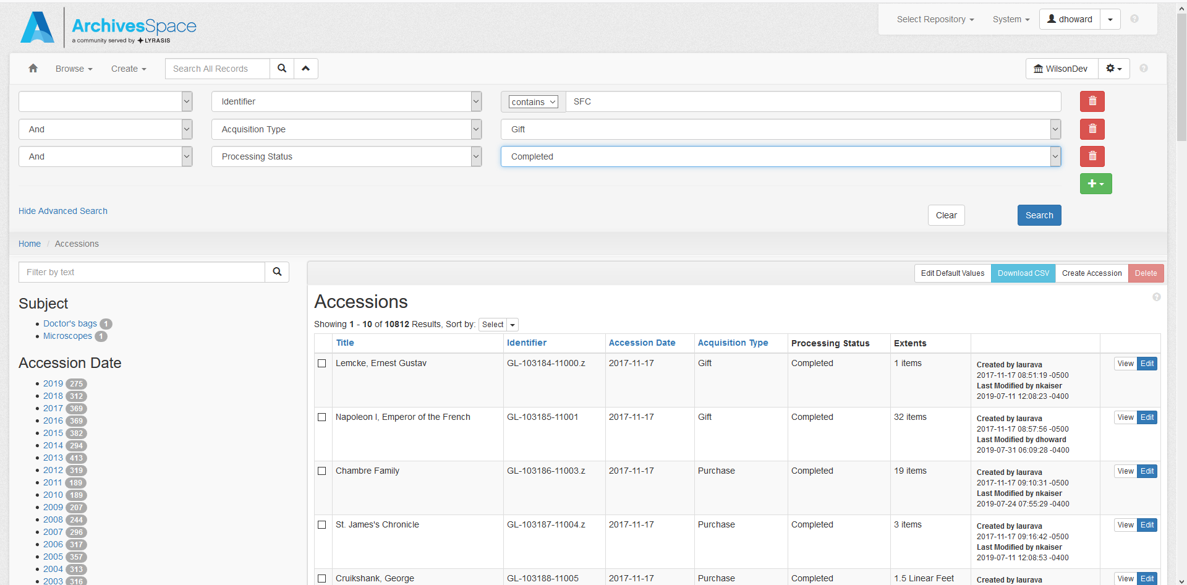
Notes:
Here’s an example of the plug-ins we’ve added. You can see the “Processing Status” and Extent fields,” as well as some of the enhanced search options at the top of the screen.

Slide 16
Implementation Phase 2
Phase 2: Collection Locations
  Collection location information currently kept in a massive Microsoft Access database
    No one likes this database
  Working plan is to add top containers to stub resource records
  Research room staff will have read-only access
  Proof of concept demo has received positive feedback
  This isn’t as easy as migrating the accessions!
    Easy to create locations in ArchivesSpace, but gathering the information is cumbersome
    Software Development is strategizing the best way to map from Access to ArchivesSpace
Notes:
The next phase is to import all of the information from our massive Microsoft Access locations database into ArchivesSpace. We know this will be more difficult than importing the accessions information, because we have A LOT of locations and instances, and how we record and present this information has changed over time. For example, we used to record locations at the folder level; now we record locations at the box level.
Right now our working strategy is to add top containers to those stub resource records I mentioned earlier. Upon reviewing these slides, our software developers asked me to stress that this plan is still very much a work in progress and implementation details are not set in stone.
Our research room staff have read-only access, so they can find locations for paging purposes. I’ve received positive feedback from my brief proof of concept demo, which I’ll show you now.

Slide 17
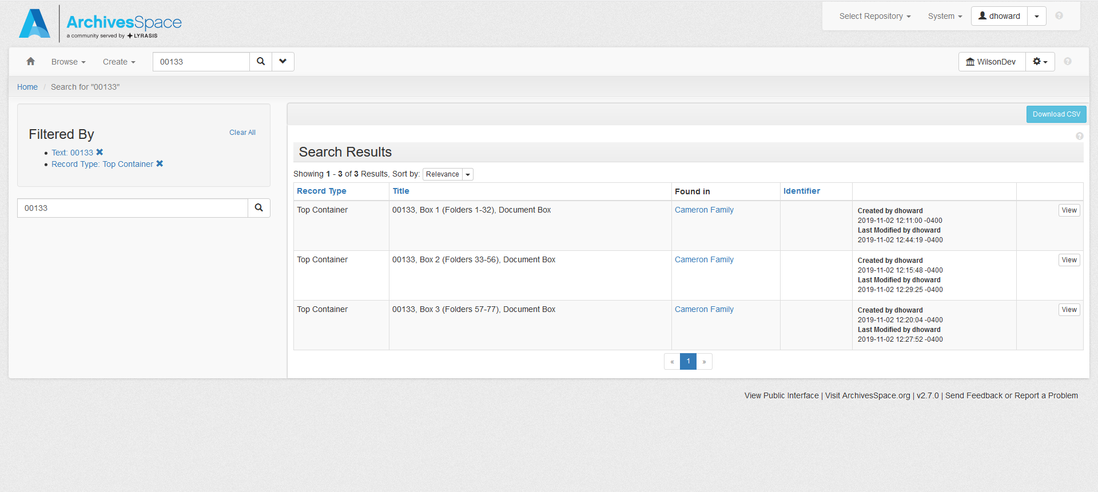
Notes:
Here’s the proof of concept example. This collection actually has more than 100 boxes, but I thought 3 was sufficient to get the point across. I searched for the collection and then filtered down to the top containers.

Slide 18
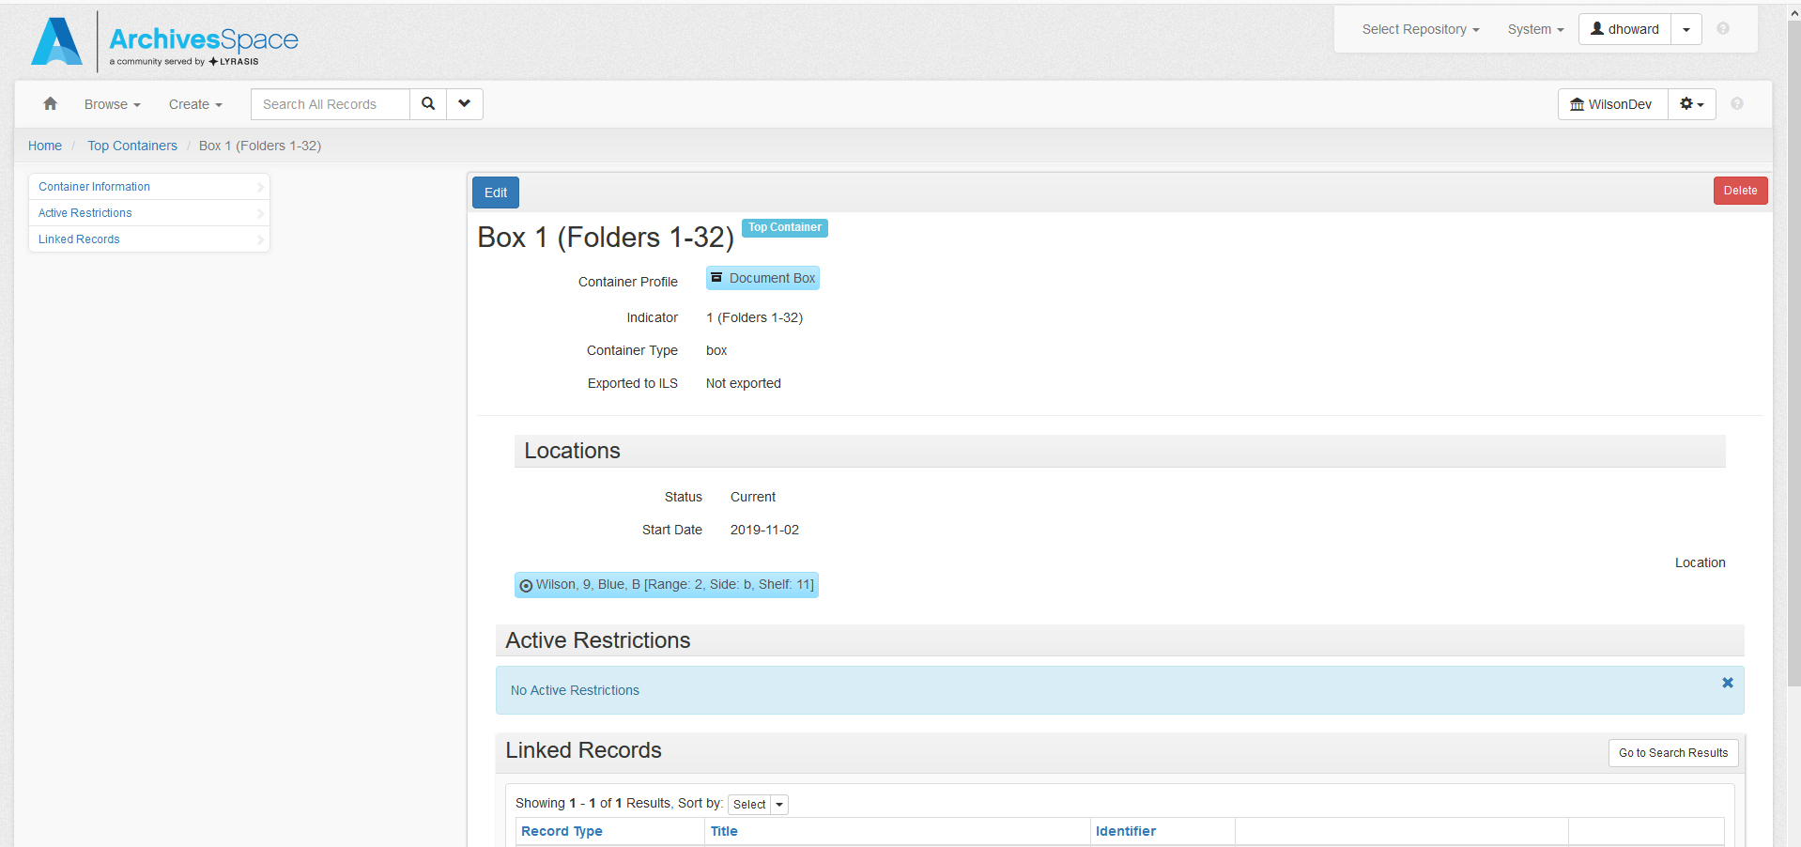
Notes:
And then you can see the location by clicking on whichever box you need to page.

Slide 19
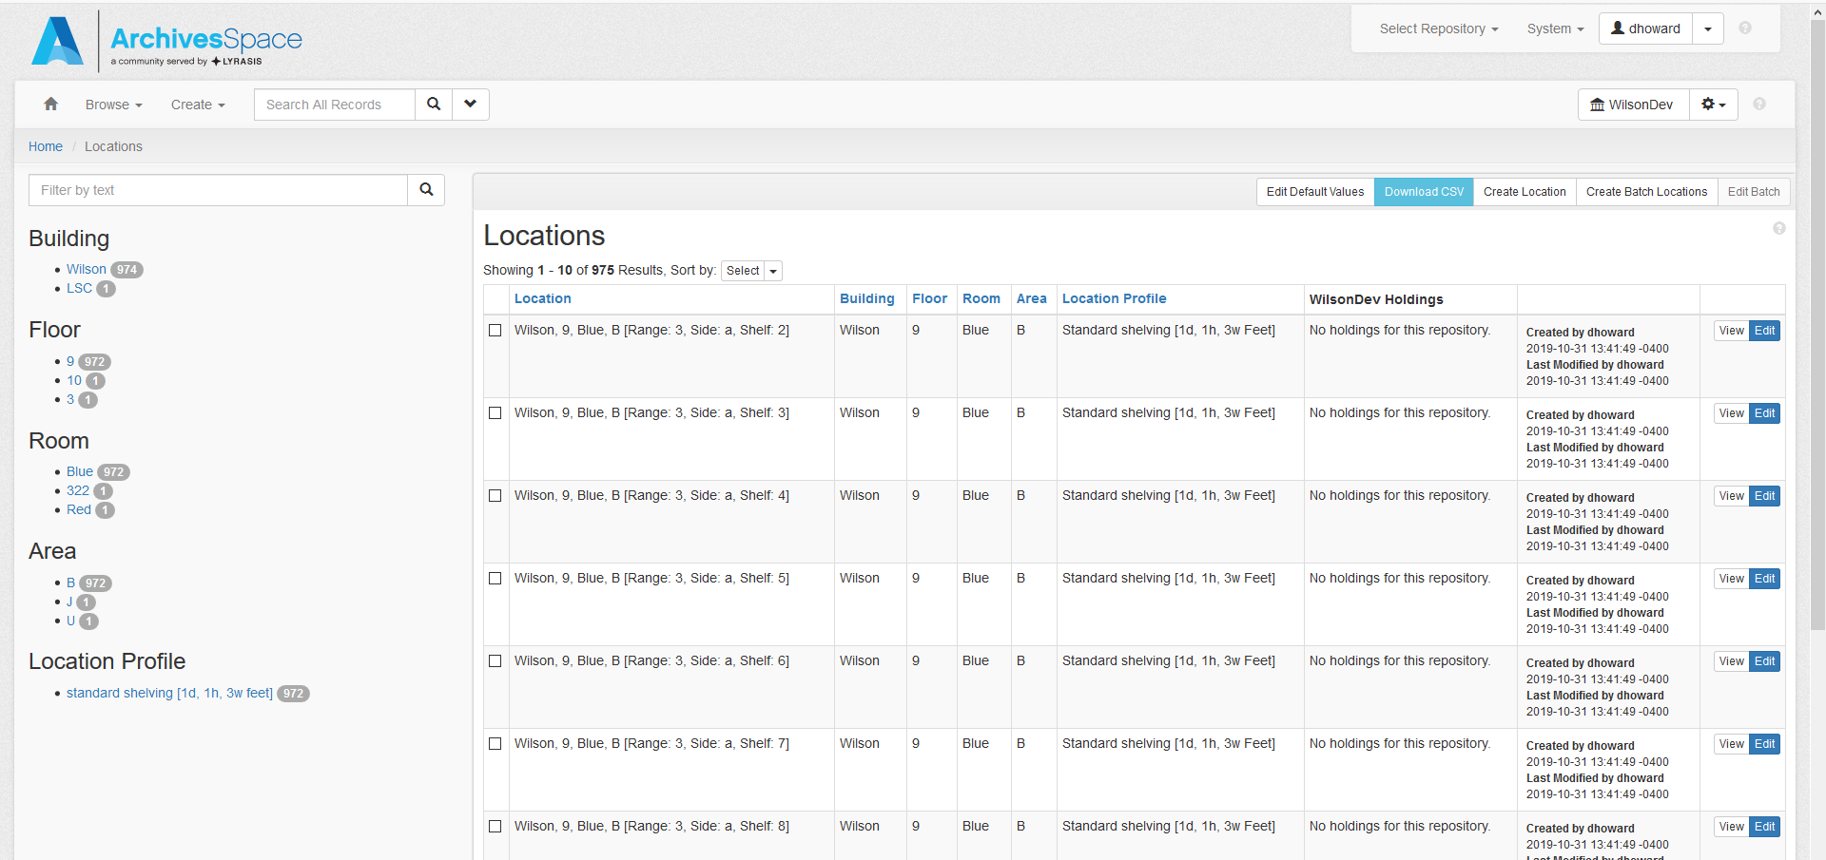
Notes:
I am in the process of entering all of our shelf locations. You see here that there are 975 locations. That is a very small percentage of our total locations. I am trying to make sure upfront that they are all entered correctly, so it’s taking more time than I thought it would.

Slide 20
Implementation Phase 3
Phase 3: Finding aids/PUI
  We have been hand-coding finding aids using EAD since the 1990s!
  This will be hard for many reasons
    Major workflow shift
    Anticipate lots of legacy data clean-up
    Need to determine the best way to display our digital content
  Anticipated plug-ins/integrations
    Aeon
    We like a lot of Yale’s plug-ins
  Haven’t decided whether we will use the out of the box PUI or ArcLight
Notes:
Phase 3 will be importing our finding aids and implementing the PUI. Since we’ve have been hand-coding finding aids using more or less the same procedure for more than 20 years, this will be a major workflow shift. We anticipate that there will be a lot of necessary legacy data cleanup, and we need to determine the best way to display or digital content. [go to next slide]
We know we will want ArchivesSpace to communicate with Aeon, particularly to print locations information on the callslips without having to look it up manually. That will make all of our lives so much easier.
We haven’t yet decided if we’re going to use the out of the box PUI or ArcLight, but we don’t need to make that decision yet.

Slide 21
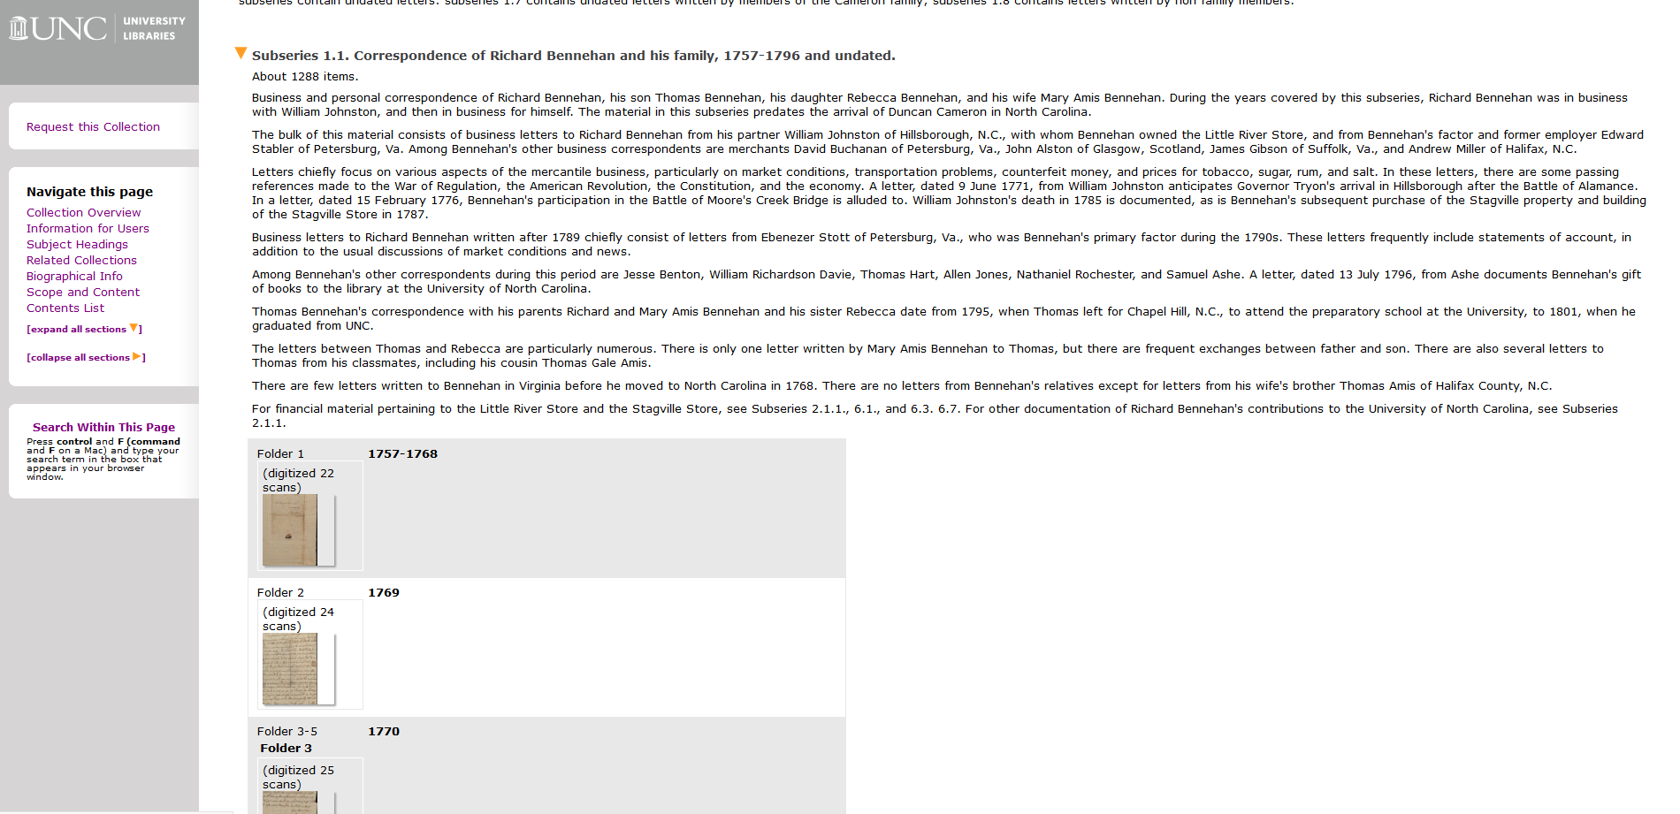
Notes:
Here’s an example of some of our digital content linked from our finding aids.
[go to next slide]

Slide 22
Implementation Phase 3
Phase 2: Finding aids/PUI
  We have been hand-coding finding aids using EAD since the 1990s!
  This will be hard for many reasons
    Major workflow shift
    Anticipate lots of legacy data clean-up
    Need to determine the best way to display our digital content
  Anticipated plug-ins/integrations
    Aeon
    We like a lot of Yale’s plug-ins
  Haven’t decided whether we will use the out of the box PUI or ArcLight
Notes:
We know we will want ArchivesSpace to communicate with Aeon, particularly to print locations information on the callslips without having to look it up manually. That will make all of our lives so much easier.
We haven’t yet decided if we’re going to use the out of the box PUI or ArcLight, but we don’t need to make that decision yet.

Slide 23
Questions? Advice?
Contact me!
dawne_lucas@unc.edu
(I have a Twitter account, but I don’t check it.)
Thanks!
Notes:
Please feel free to contact me if you have questions or words of wisdom. Just note that although I do have a Twitter account I never check it, so don’t contact me that way.
Thanks!

Slide 24
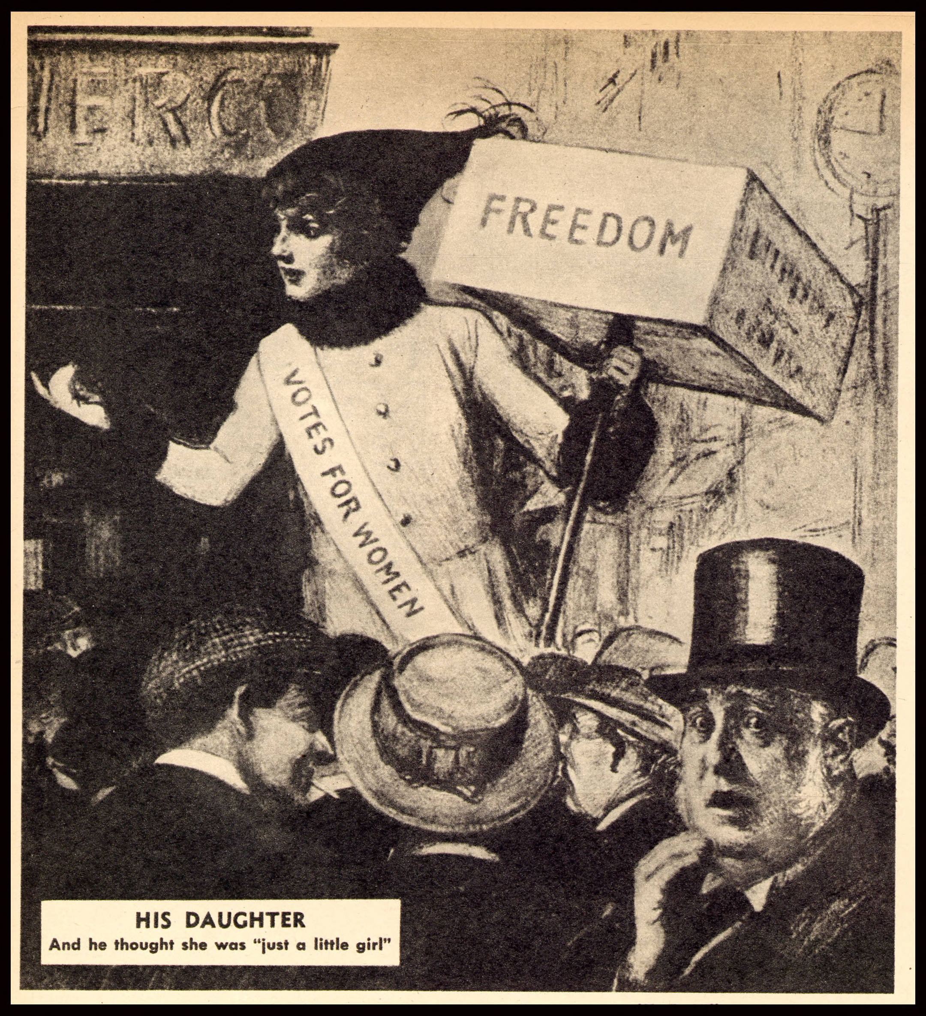
Beginner’s pluck
Implementation of ArchivesSpace at the Tennessee State Library and Archives
Patsy Mitchell, Jennifer Randles, Will Thomas

Slide 25
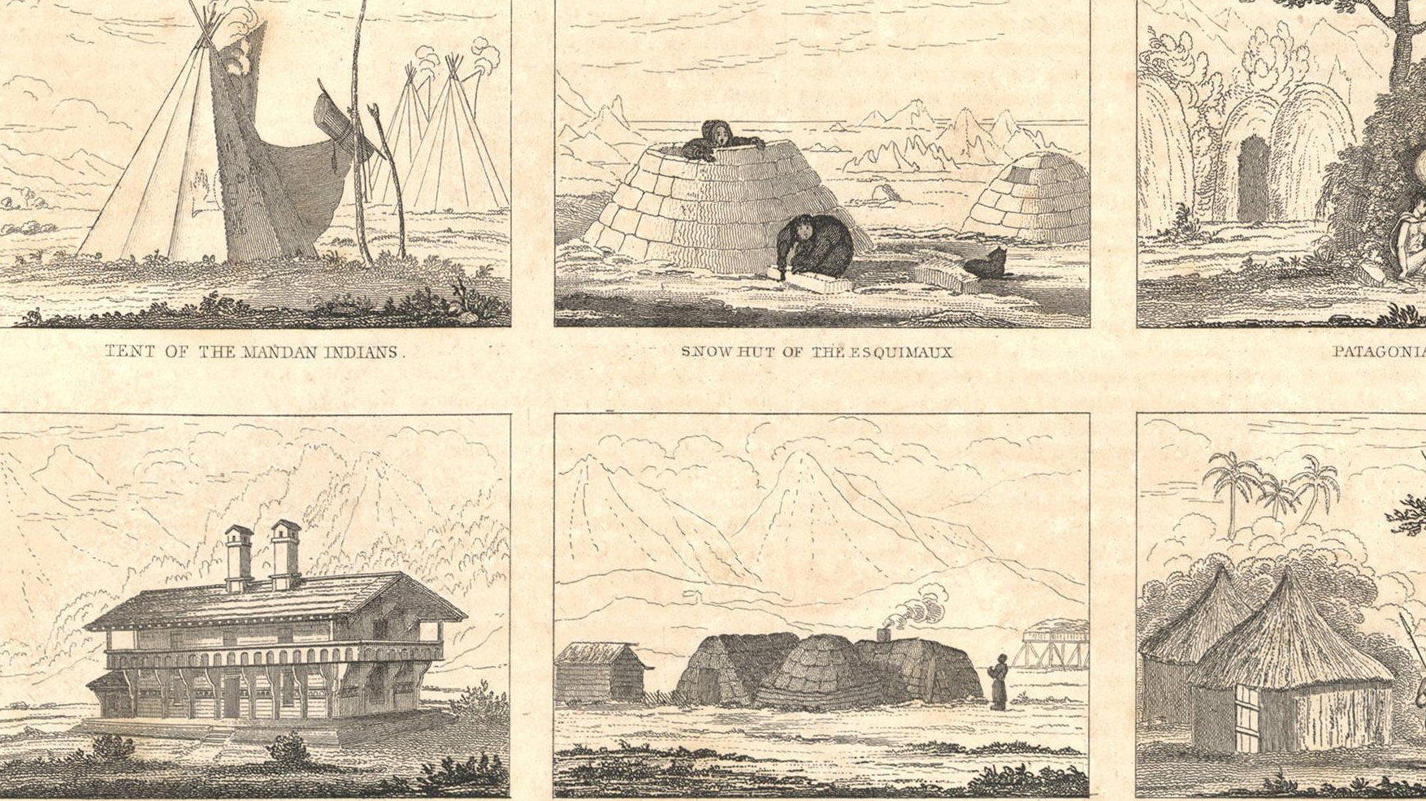
Introductions
Patsy Mitchell, Electronic Records Archivist
Will Thomas, Archivist
Jennifer Randles, Digital Materials Librarian
All images from: https://teva.contentdm.oclc.org/digital/collection/p15138coll23/id/9469/

Slide 26
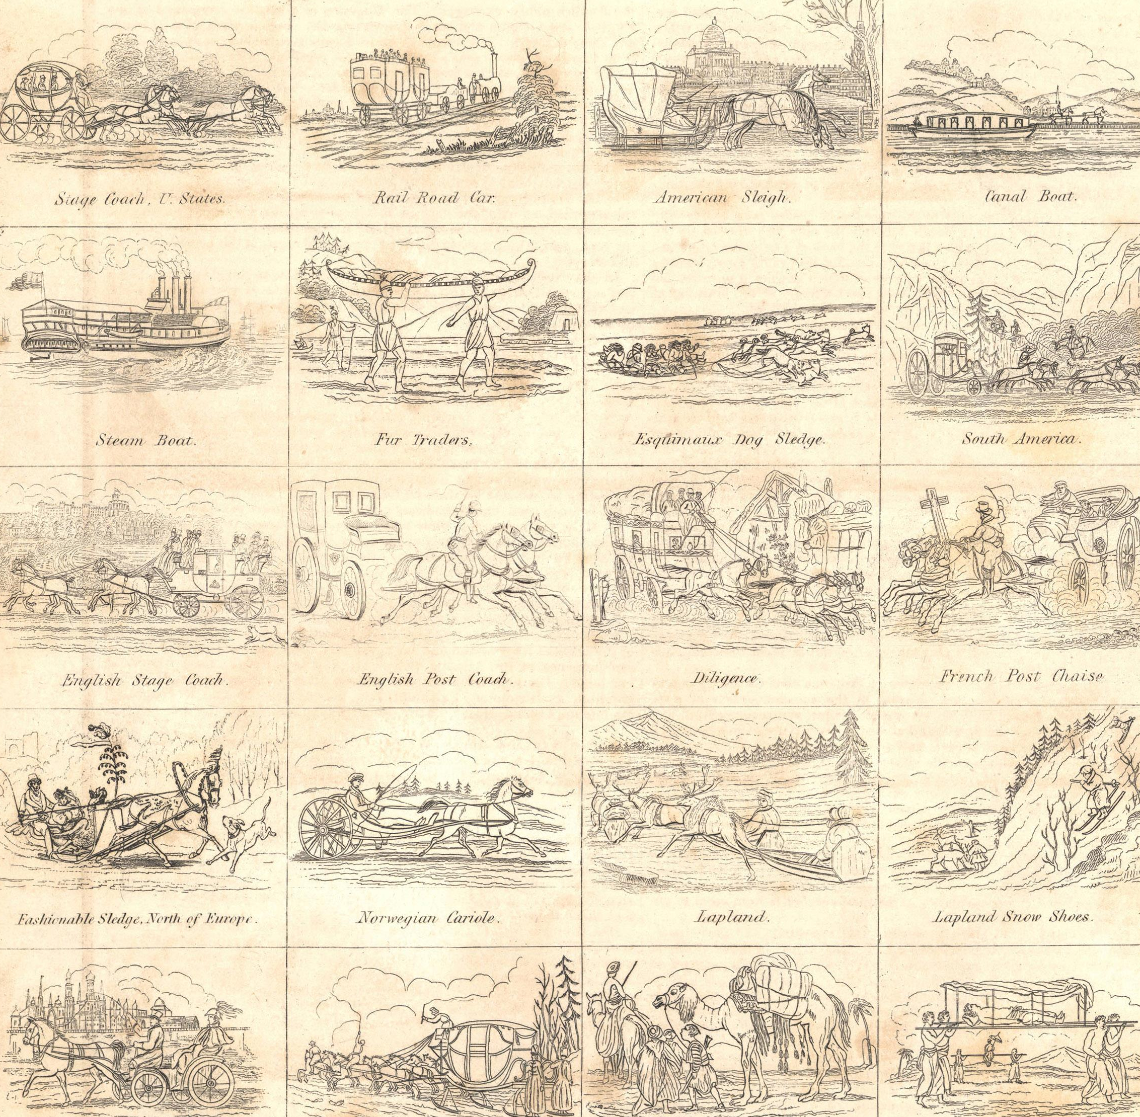
Implementation
Migrate legacy data
Accession new acquisitions (test phase)
Migrate finding aids (third party)
Create new finding aids (later phase)
Link digital objects (tentative, based on previous stages success)

Slide 27
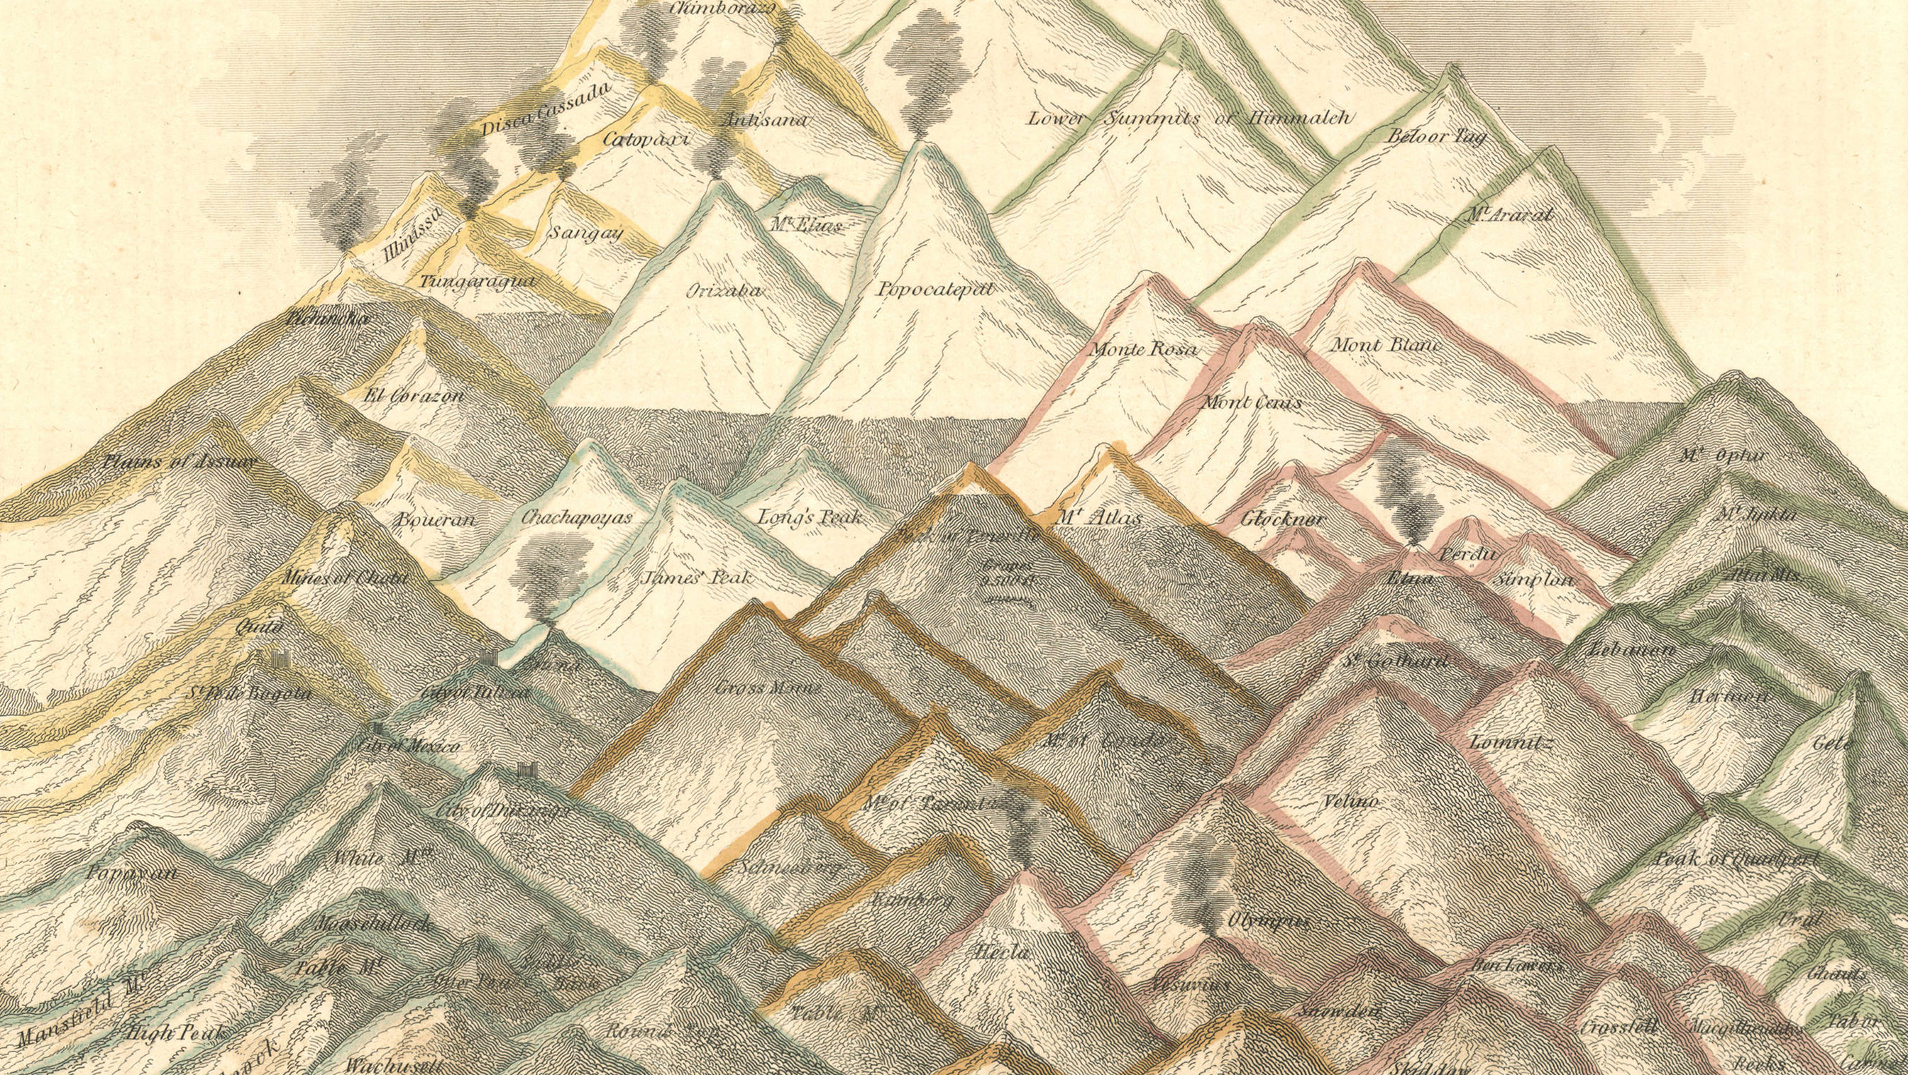
Issues
Legacy Data
  Multiple agents (creator and donor )
  Multiple extents (cubic feet and volumes)
  Inconsistency in data (OpenRefine)
New Accessions
  Changing our process
  Customizing ArchivesSpace
Finding Aids
  Inconsistency in finding aid format
  Steep learning curve
Digital Objects
  May use for digital object records based on this implementation
  Currently in CONTENTdm & Drupal

Slide 28
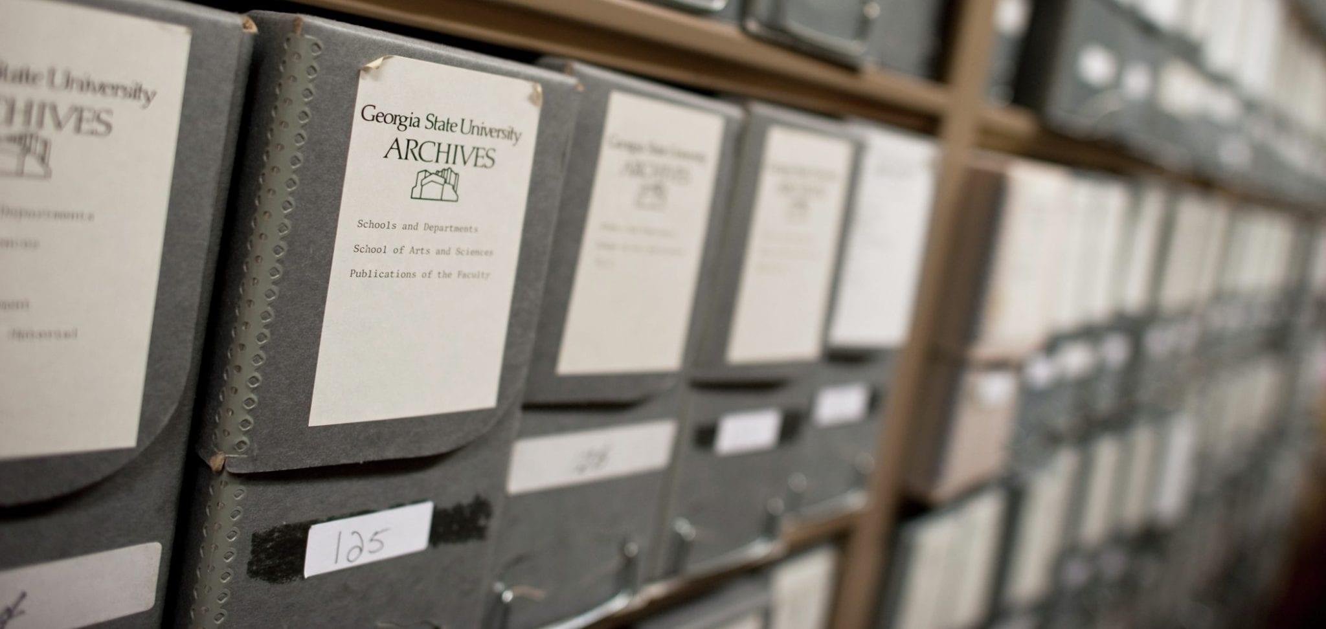
ArchivesSpace at Georgia State University Library
Bill Hardesty
Coordinator of Archival Collections Management

Slide 29
Georgia State University
Special Collections and Archives
GSU is an R1 located in Atlanta
GSU Special Collections contains about 20,000 linear feet of material – University Archives, 5 manuscript collecting areas and an extensive photograph collection
GSU Library has a very active digitization program

Slide 30
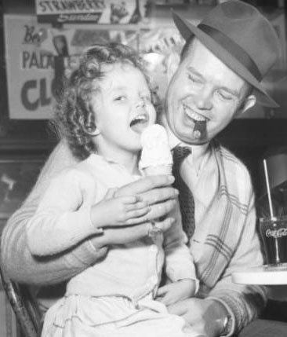
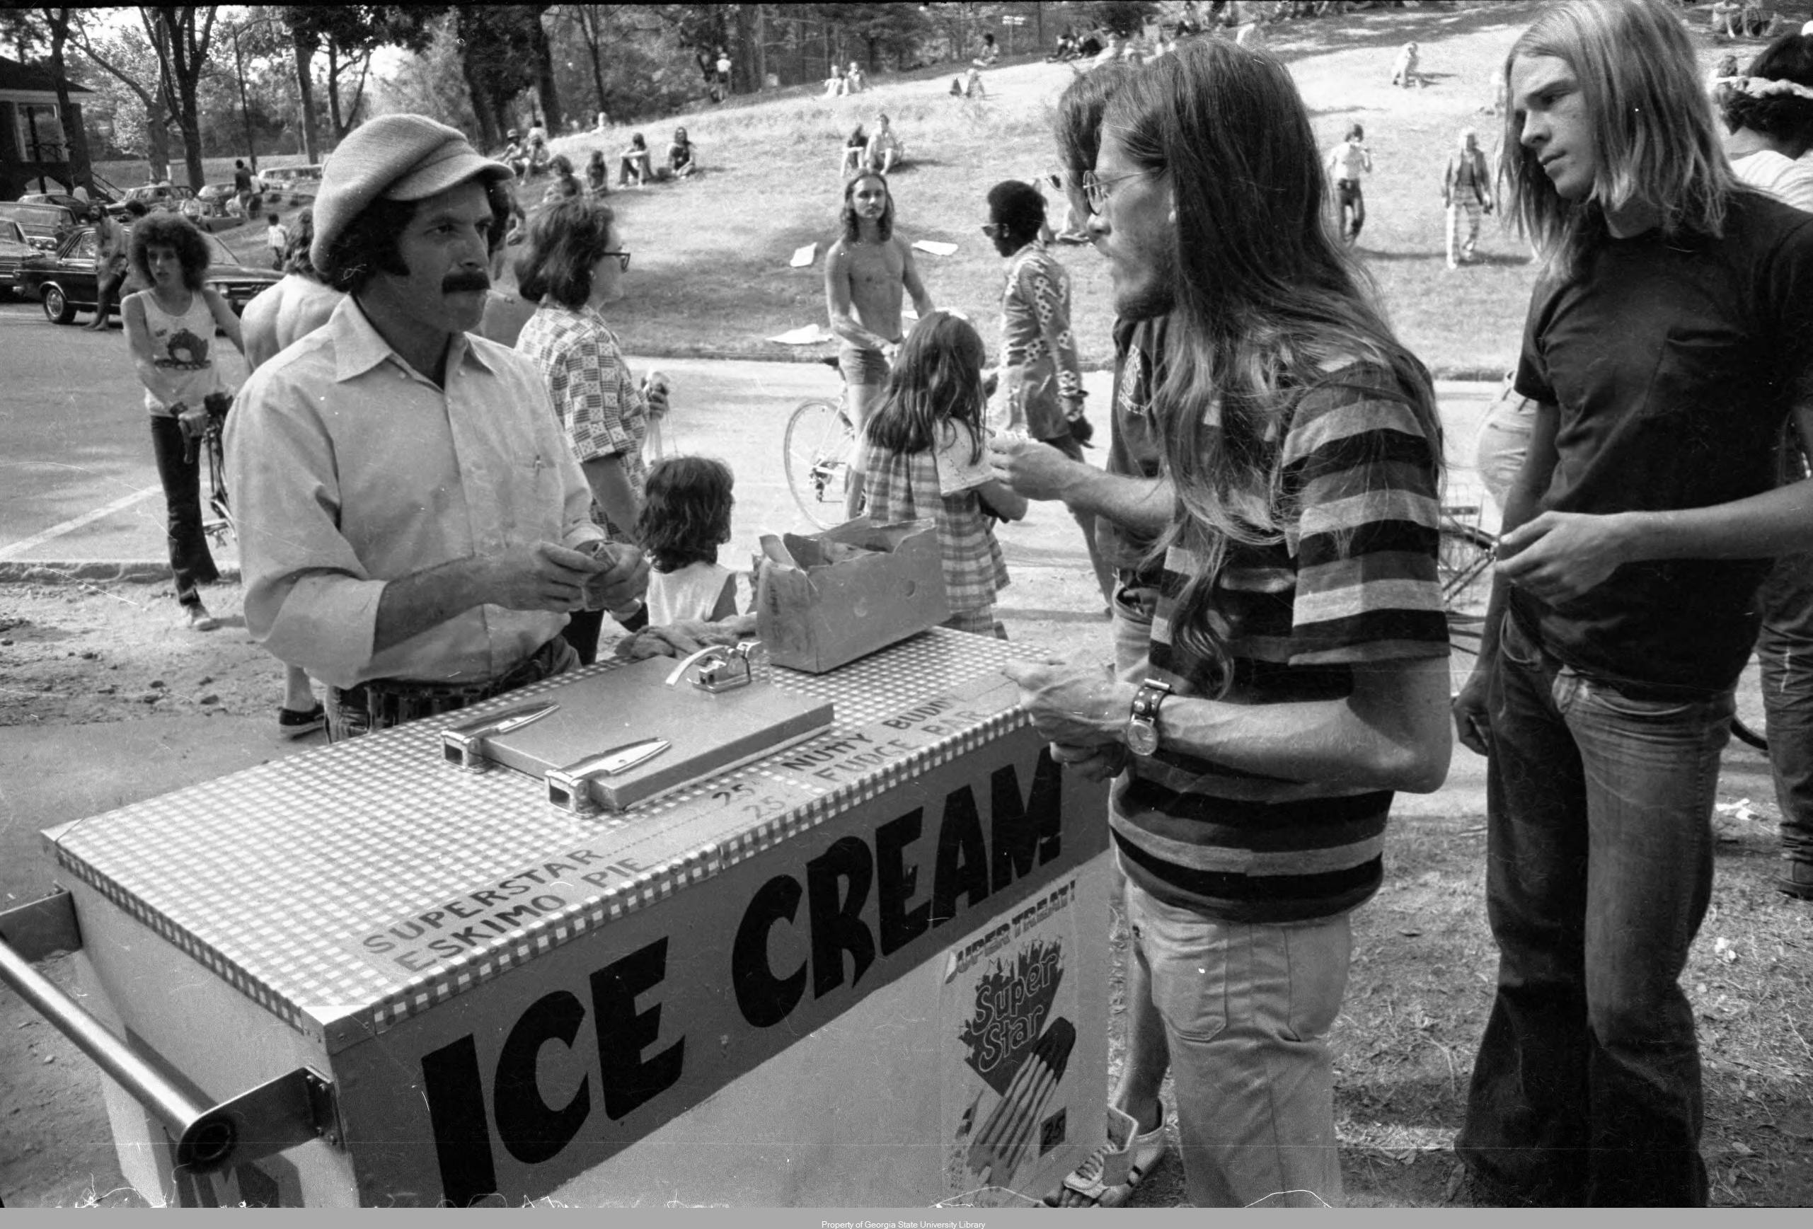
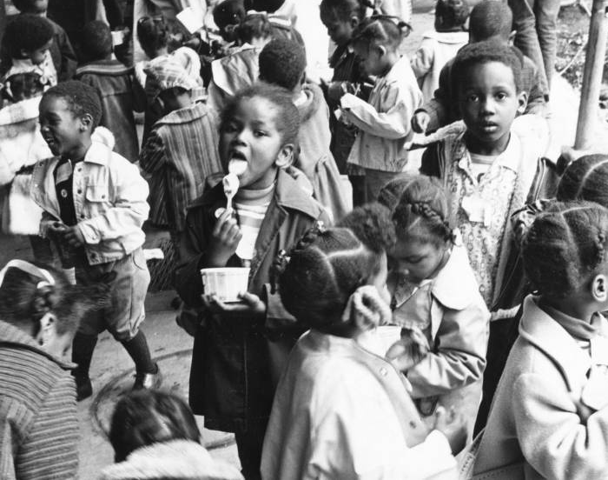
GSU ArchivesSpace
Atlanta Journal-Constitution Photographic Archive (left and top), Tom Coffin Photographic Collection (right), Special Collections and Archives, Georgia State University Library.

Slide 31
Background
Georgia State created EAD as its primary descriptive format from 2001; adopted Archivists’ Toolkit in 2008
Created finding aids in AT and displayed them in a CONTENTdm instance from 2012
An anticipated DAMS migration (orphaning our finding aids) was the deciding factor in moving to ASpace
Committed to migration and became ASpace members in 2017; full implementation in 2018

Slide 32
Preparation for migration
Started to assess and edit AT data for a future ASpace migration in 2014
Two tracks with legacy descriptions:
  Special Collections data (entirely EAD) and name/subject files edited extensively in AT prior to migration – very little post-migration cleanup needed in ASpace
  University Archives data (fewer full finding aids) was structured in accession data form outside the database, and ingested in ASpace post-implementation – in order to make use of the PUI’s features to enhance access
Shameless plug: William W. Hardesty, ”Linear to Granular: Preparing Descriptions for an ArchivesSpace Migration,” Archival Issues 39, no. 2 (2019)

Slide 33
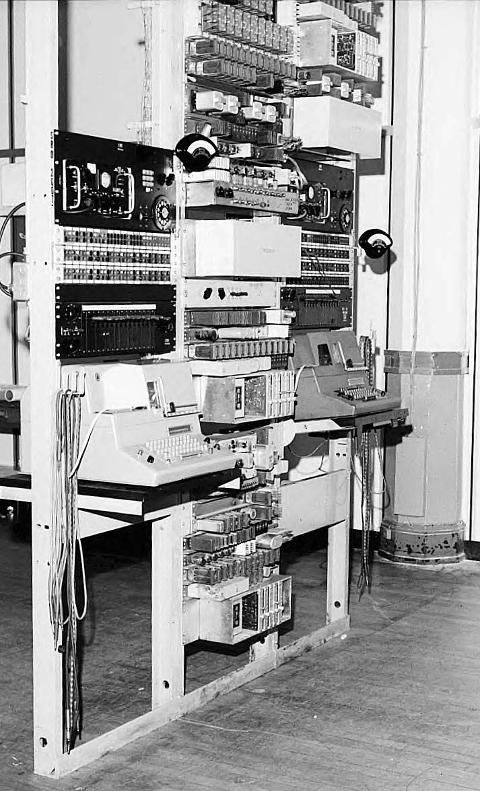
Technical administration
Lane Brothers Commercial Photographers Collection, Special Collections and Archives, Georgia State University Library.

Slide 34
Technical administration
Installed on GSU server and administered by Library IT staff
Keep a version running on the Library’s development server, to test updates and (occasional) fixes
Running one plug-in and no plans for others or for integrations

Slide 35
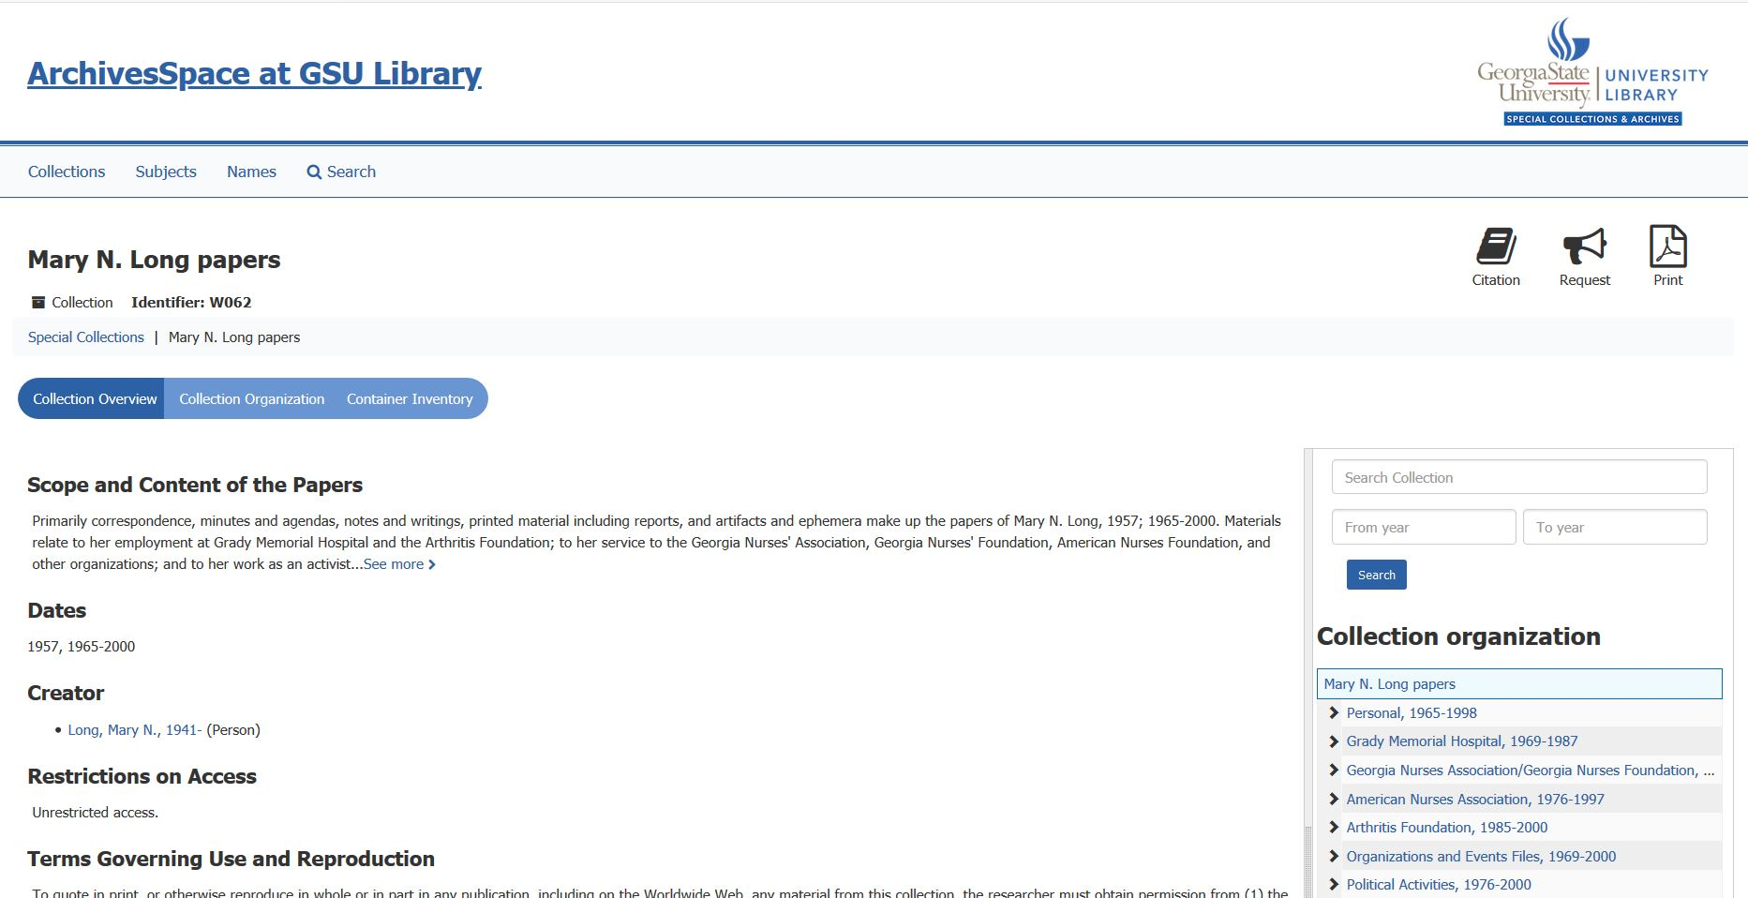
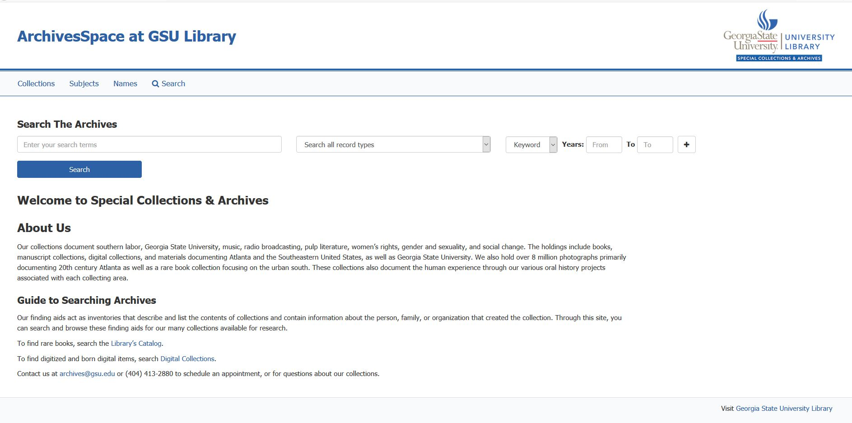
User experience

Slide 36
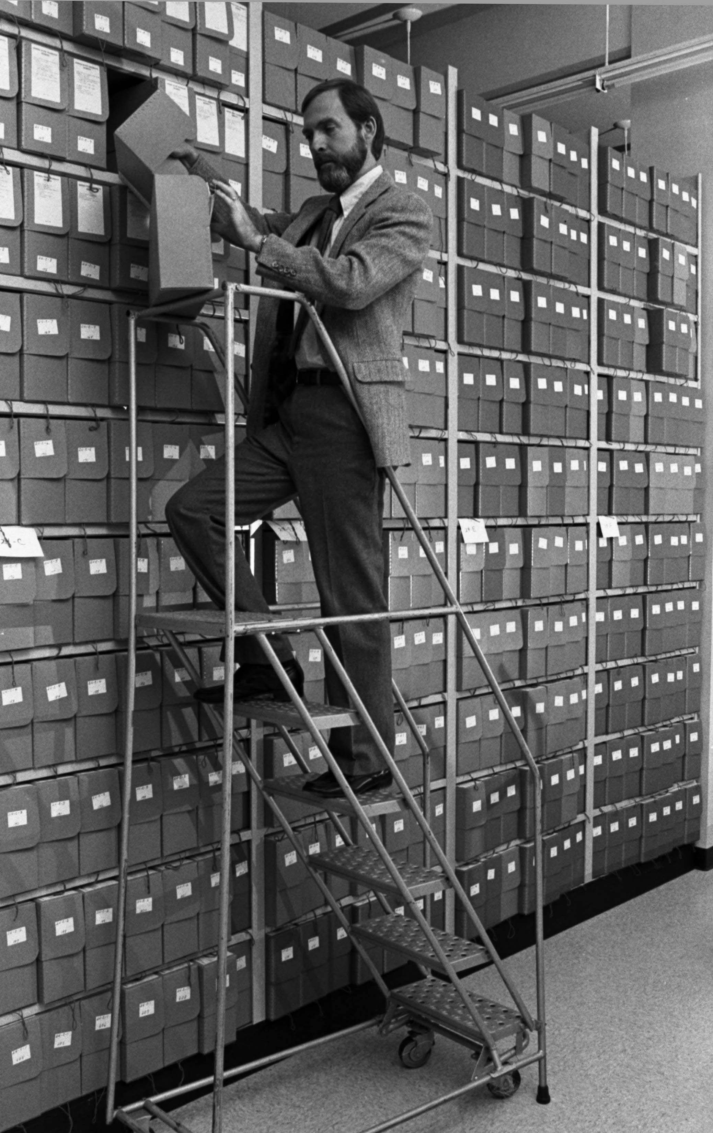
Archivists’ experience
GSU Special Collections, 1983. Records of the Department of Public Information, University Archives, Special Collections and Archives, Georgia State University Library.

Slide 37
Archivists’ experience
Whole department consults ASpace for finding aid and accession information
ASpace is integral to our reference service
- YET -
We have fewer staff members actively creating records and editing information in the system than we had as AT users

Slide 38
Future projects and lessons learned
Control of digital objects will be a major future need for us
Still working on space control and ASpace container management
The “Harvard plug-in” has transformed our workflow
Planning for incremental implementation has paid off

Slide 39
archivesspace.library.gsu.edu

Slide 40

Show Us Your Implementation

Slide 41

ArchivesSpace Past
Inheritance
  Archives Toolkit
Migration
Upgrades
  Understanding changes
Education
https://images.app.goo.gl/HijNC26jTE18g8BY7

Slide 42
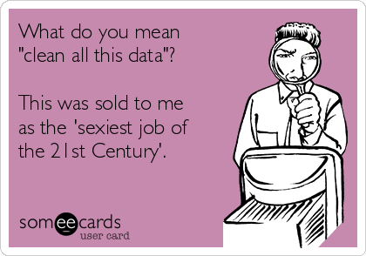
ArchivesSpace Now
3 ArchivesSpace instances
Developed input guidelines
Barcoding/location project
Devising a strategy for data cleanup
Chris_Pearson_BigCloud

Slide 43
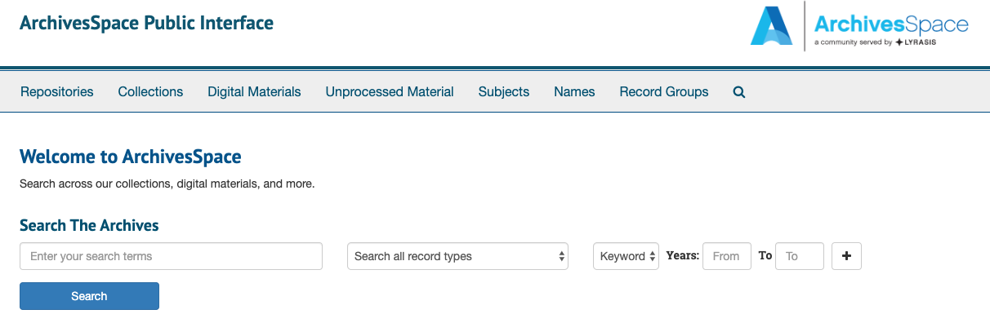


ArchivesSpace in the Near Future

Slide 44

Lessons Learned
Communication is key!
Training is a must- Don’t make assumptions that people will know how to use the system
Seek technology help or be able to build capacity among staff to get the most out of the system

Slide 45
Questions
ArchivesSpace at Clemson University
Brenda Burk
Head of Special Collections and Archives
bburk@clemson.edu
Krista Oldham
University Archivist
kristao@clemson.edu

Slide 46

Utilitarian not Utopian:
Implementing ArchivesSpace in a Lone Arranger environment at USC Upstate

Slide 47
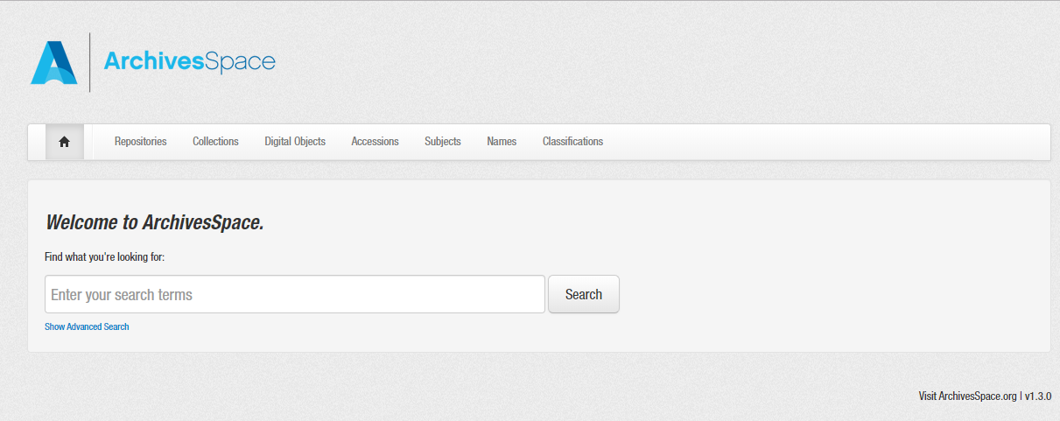
Main Challenges at USC Upstate
No dedicated IT for library
Lone Arranger
Almost no records
No finding aids

Slide 48
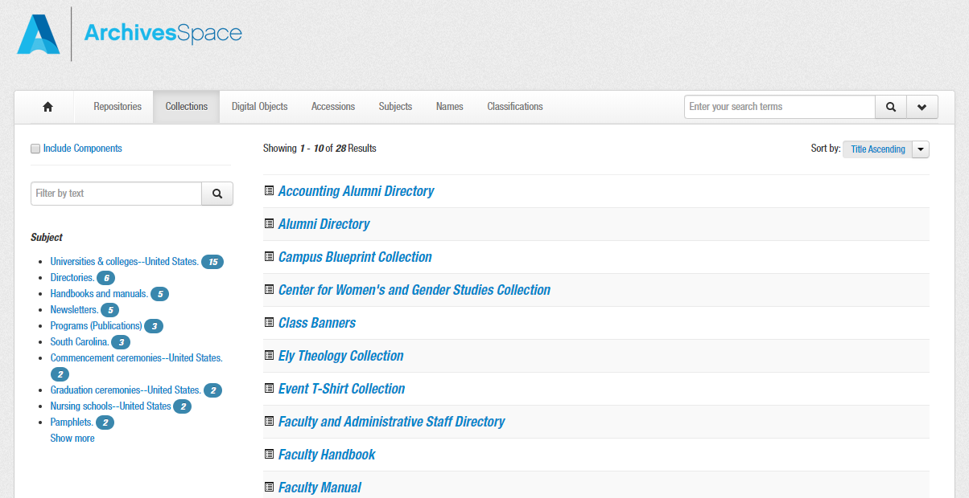
v1.3.0 – It’s not pretty, but it gets the job done…

Slide 49
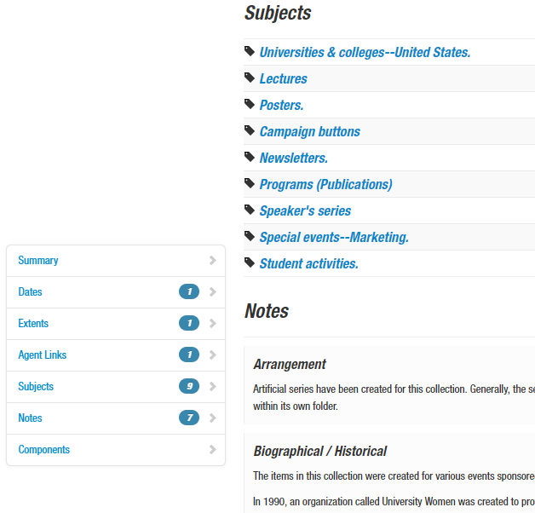
Beyond required elements
Finding Aid Data
Agents and Subjects - LofC
Notes
  Arrangement
  Biographical / Historical
  Conditions Governing Access
  Immediate Source of Acquisition
  Physical Description
  Preferred Citation
  Scope and Contents
**Rights Statement (not showing up?)

Slide 50
Need input from the Hive Mind…
Updating to newest instance…what are the common issues?
Customizing Header with no IT support
Rights Statements - not appearing on public view?
Digital objects / collections…how to link? Should I link?
Thank You!
Ann E. Merryman, Coordinator of Archives and Special Collections
USC Upstate, Spartanburg SC
amerryman@uscupstate.edu

Slide 51

ArchivesSpace at the AUC
Brittany Newberry
Processing archivist
Atlanta university center

Slide 52
Decision to Implement - 2015
Possible benefits to stakeholders
Future development
Costs
  Staff
  Training
  Time
  Upkeep/updates
Ease of use for staff
Adoption by the archival community
Administrative support
Notes:
a lot of conversation around the idea to migrate from AT to ArchivesSpace. AT seemed to meet our needs. We were using AT to create finding aids and using XTF software to display our finding aids online, and all of this seemed adequate. Finding aid could easily be made available to our researchers, everyone was familiar with the software, but whenever adoption for new software takes place, there has to be conversation about how will this eventually help lead us into the future. Are there upcoming needs that new software will help us to better support our stakeholders and what will continue to keep us up-to-date and be able to ultimately provide the best access possible.
Like many of you have done and will continue to do when you are considering new software adoption, we considered the basic impact it would have on our stakeholders, our staff, and our budget. While our main concern as far as stakeholders go was access to our finding aids and our collections online, we wanted to make sure we are considering the ease of access, the ease of use for staff, the adoption by the archival community and our admin support for the change
We realized that implementing Aspace, especially in this early phase would take a collaborative effort. Only a few institutions had made the migration and let’s be honest, it’s open source software and was still very much a work in progress and still is and when you’re considering making this investment in resources, it’s harder without a well established community of users
We chose to implement and become ASpace members – based on the factors listed on the screen – AT fitted our needs at the moment but ASpace has allowed us to expand and better fulfill the needs of the archives and our stakeholders
During implementation, we created the ASpace Working Group at the AUC which had members from different departments in the library – this group worked with/consulted with other groups in the Atlanta area – Atlanta Area Digital Archivists; Georgia ASpace phone meetings;
This group helped with implementation and decisions around ASpace

Slide 53
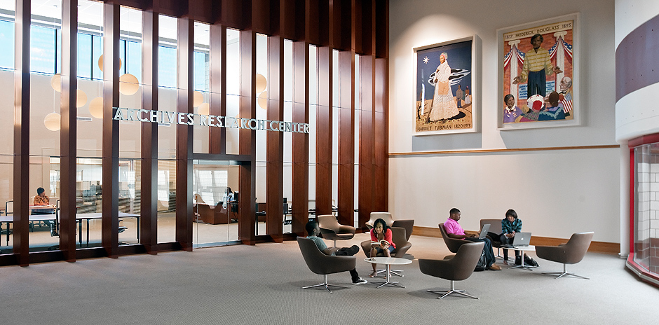
Migrating from Archivists’ Toolkit
Hired Contractor for Migration
Hosted Locally
Data Clean Up/Quality Control
Notes:
In order to migrate from AT, we decided to hire a contractor
The migration from AT at the time required minimal qc and data clean up after wards
There were some funky things that happened but they were not major
Our instance is also hosted locally – which was a decision made before implementing
Our IT department supports the functions of ASpace – they can do troubleshooting
And our digital services department manages our instance
Our hired contractor for the migration stays on as a contractor for upgrades and fixes that can’t be done by IT or our digital services department

Slide 54
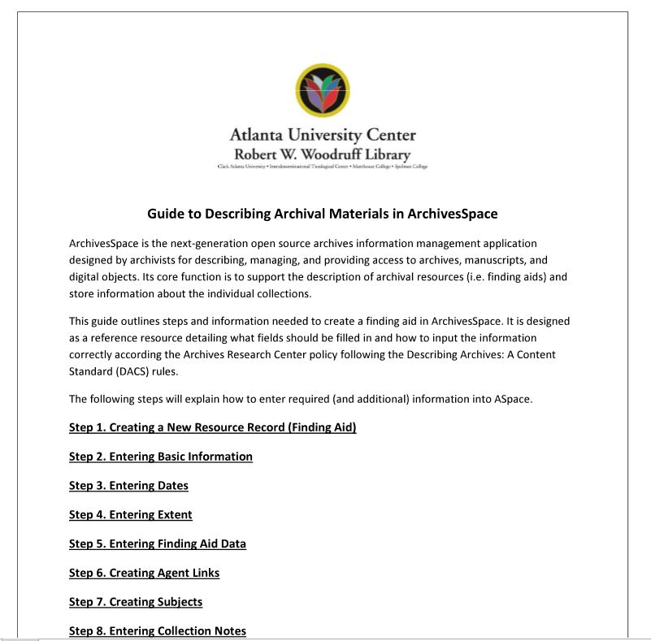
Using ArchivesSpace
Notes:
To begin with, ASpace for us for solely used for the creation of finding aids; added digital objects
All the archives department has been trained on using ArchivesSpace – mainly used by processing archivists and part time staff for creating finding aids
From the beginning wanted it to be the one place for intellectual control over our collections
Creation of a institutional manual – updated regularly to reflect upgrades to application
Decided to continue to use XTF for our online finding aids website rather than use ASpace - the PUI at that time did not support our users needs
Required us to export EAD and upload to XTF

Slide 55
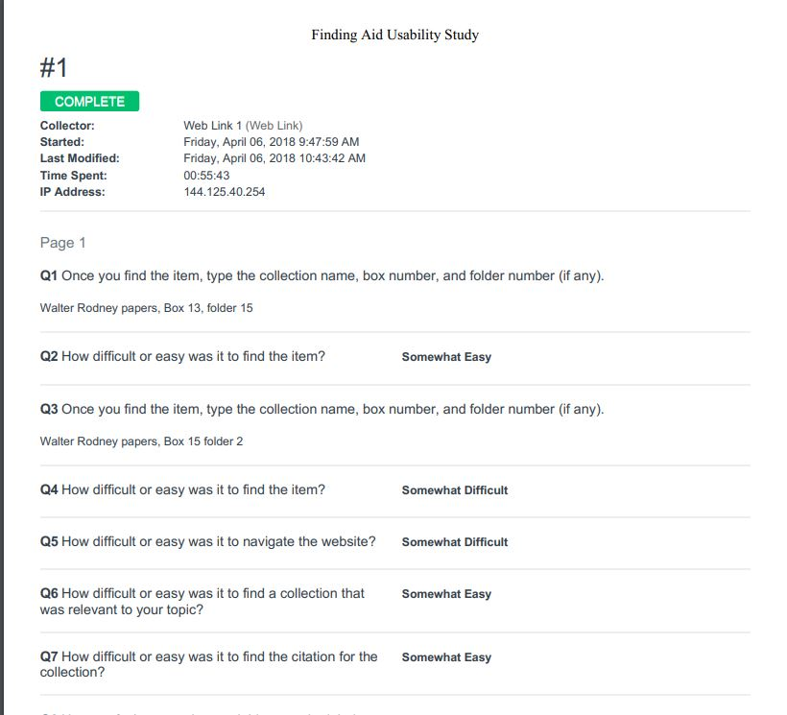
PUI User Study - 2018
Compared ASpace PUI and XTF
Wrote Script and Survey
Focus Groups of Students and Library Staff
Data Analysis
  Searching
  Browsing
  Look and Feel
Recommendation Report
Notes:
With the release of v2.1.0 that included the updated PUI – we decided to investigate which interface would work best for our users/stakeholders
XTF not supported by a community since 2012
I along with a member of the digital services department worked together to create a user study comparing XTF and ASpace
We didn’t customize ASpace for this study, we just made sure all finding aids were published and available for the testing and had updated to v2.3.0
Used a mixed-method study – included a survey, focus group discussion, and user observation.
We created a focus group with a script and with a survey that asked attendees to do various tests in each interface
We did pre-testing with archives staff
We wanted to get in the moment observations as well as written down responses
Same tests in each interface in order to compare the two – specific item to search for and then topic search and ask for something that should be in both such as a citation to see which was easier to find
We also asked about the look of the sites and what they found to be helpful
We got demographic data in order to know experience with finding aids
I acted as moderator who asked the questions
And my partner from digital services worked as an observer who would write down what people said during the testing
We had several groups that included library staff and students
We analyzed the data and saw common themes in terms of searching browsing ease of use and the look and feel of both
Compared to XTF – ASpace was easier to use, had better searching and browsing and had a better overall look and feel
Submitted a recommendation report with our analysis and recommended using ASpace going forward

Slide 56
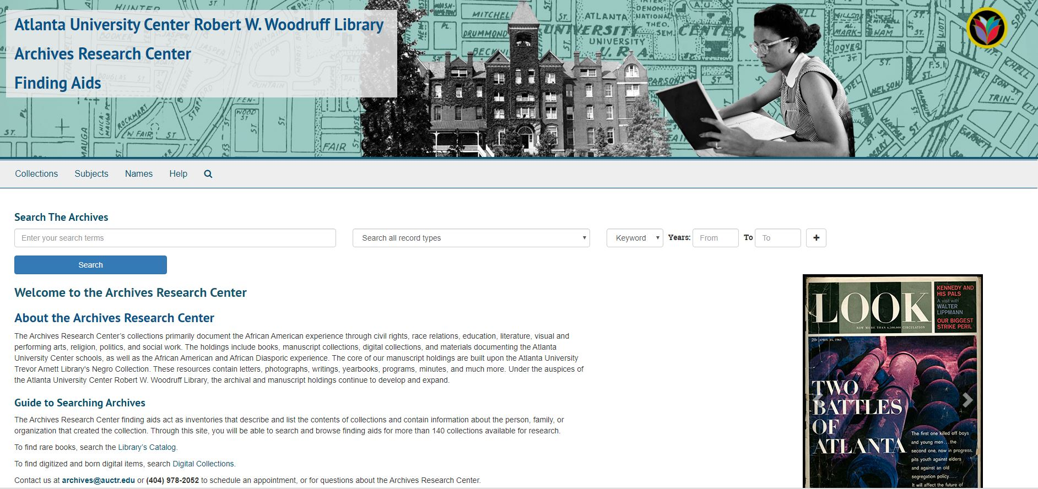
Customizing the PUI
AUC Finding Aids Site
Notes:
With the recommendation, we moved to ASpace PUI officially in August 2018
Before moving we customized the home page
Now I will show you our finding aids site and the customization that we have done since moving to the PUI

Slide 57
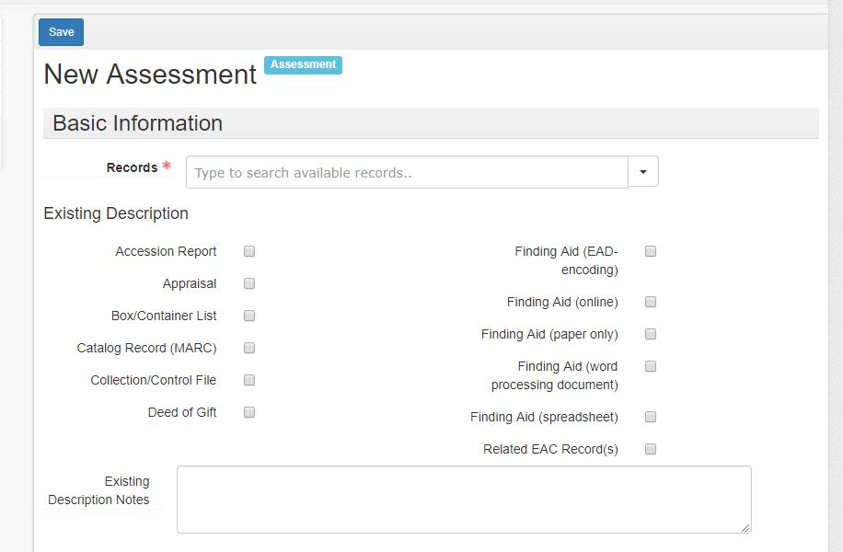
ArchivesSpace Now at the AUC
Accession Records
Assessment Records
Digital Objects
Location Management
Regular Updates

Slide 58
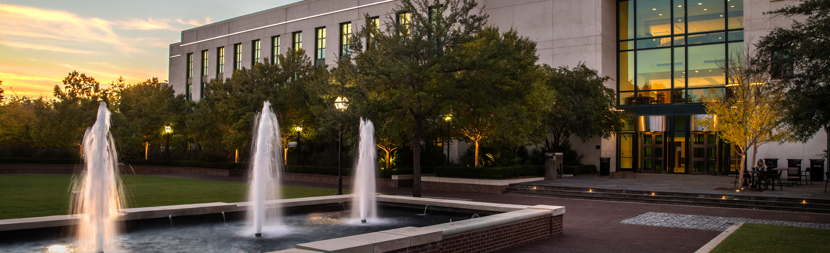
ArchivesSpace and Special Collections
Addlestone Library

Slide 59
ArchivesSpace and Special Collections
College of Charleston became member of ArchivesSpace in October of 2017
Special Collections migration schedule
  Accession data
  EAD finding aids
  HTML finding aids
Accession data
  Started April 2018
  Finished November 2019
EAD finding aids
  Preliminary cleanup started November 2019 using php script
HTML
  TBD

Slide 60
Current Challenges, Lessons Learned, and Goals
Challenges
Accession migration and cleanup
  Duplicate Agent records created due to misspelling of name or change of address information from multiple accruals.
EAD
  Dates are contained in the <unittitle> tag. Wrote PHP script to correct and wrap date in <unitdate> tag .
  Subject are contained in the <list> formatting element. Remove so Subjects import properly.
HTML finding aids
  Who knows? Transform using XSLT? Input manually?
Lessons
  Just because your EAD validates doesn’t mean it will import correctly.
  Data consistency and pre-migration cleanup - It’s important! Especially in early stages.
  Have a dev and production instance.
  Make sure you have the time (and space) you need.
Goals
  Get all our data into ArchivesSpace!
  Get comfortable with the ArchivesSpace API.
  Use migration as an opportunity to add data and improve consistency in our accession records.
  Use to further implement best practices in arrangement and description in our finding aids.

Slide 61
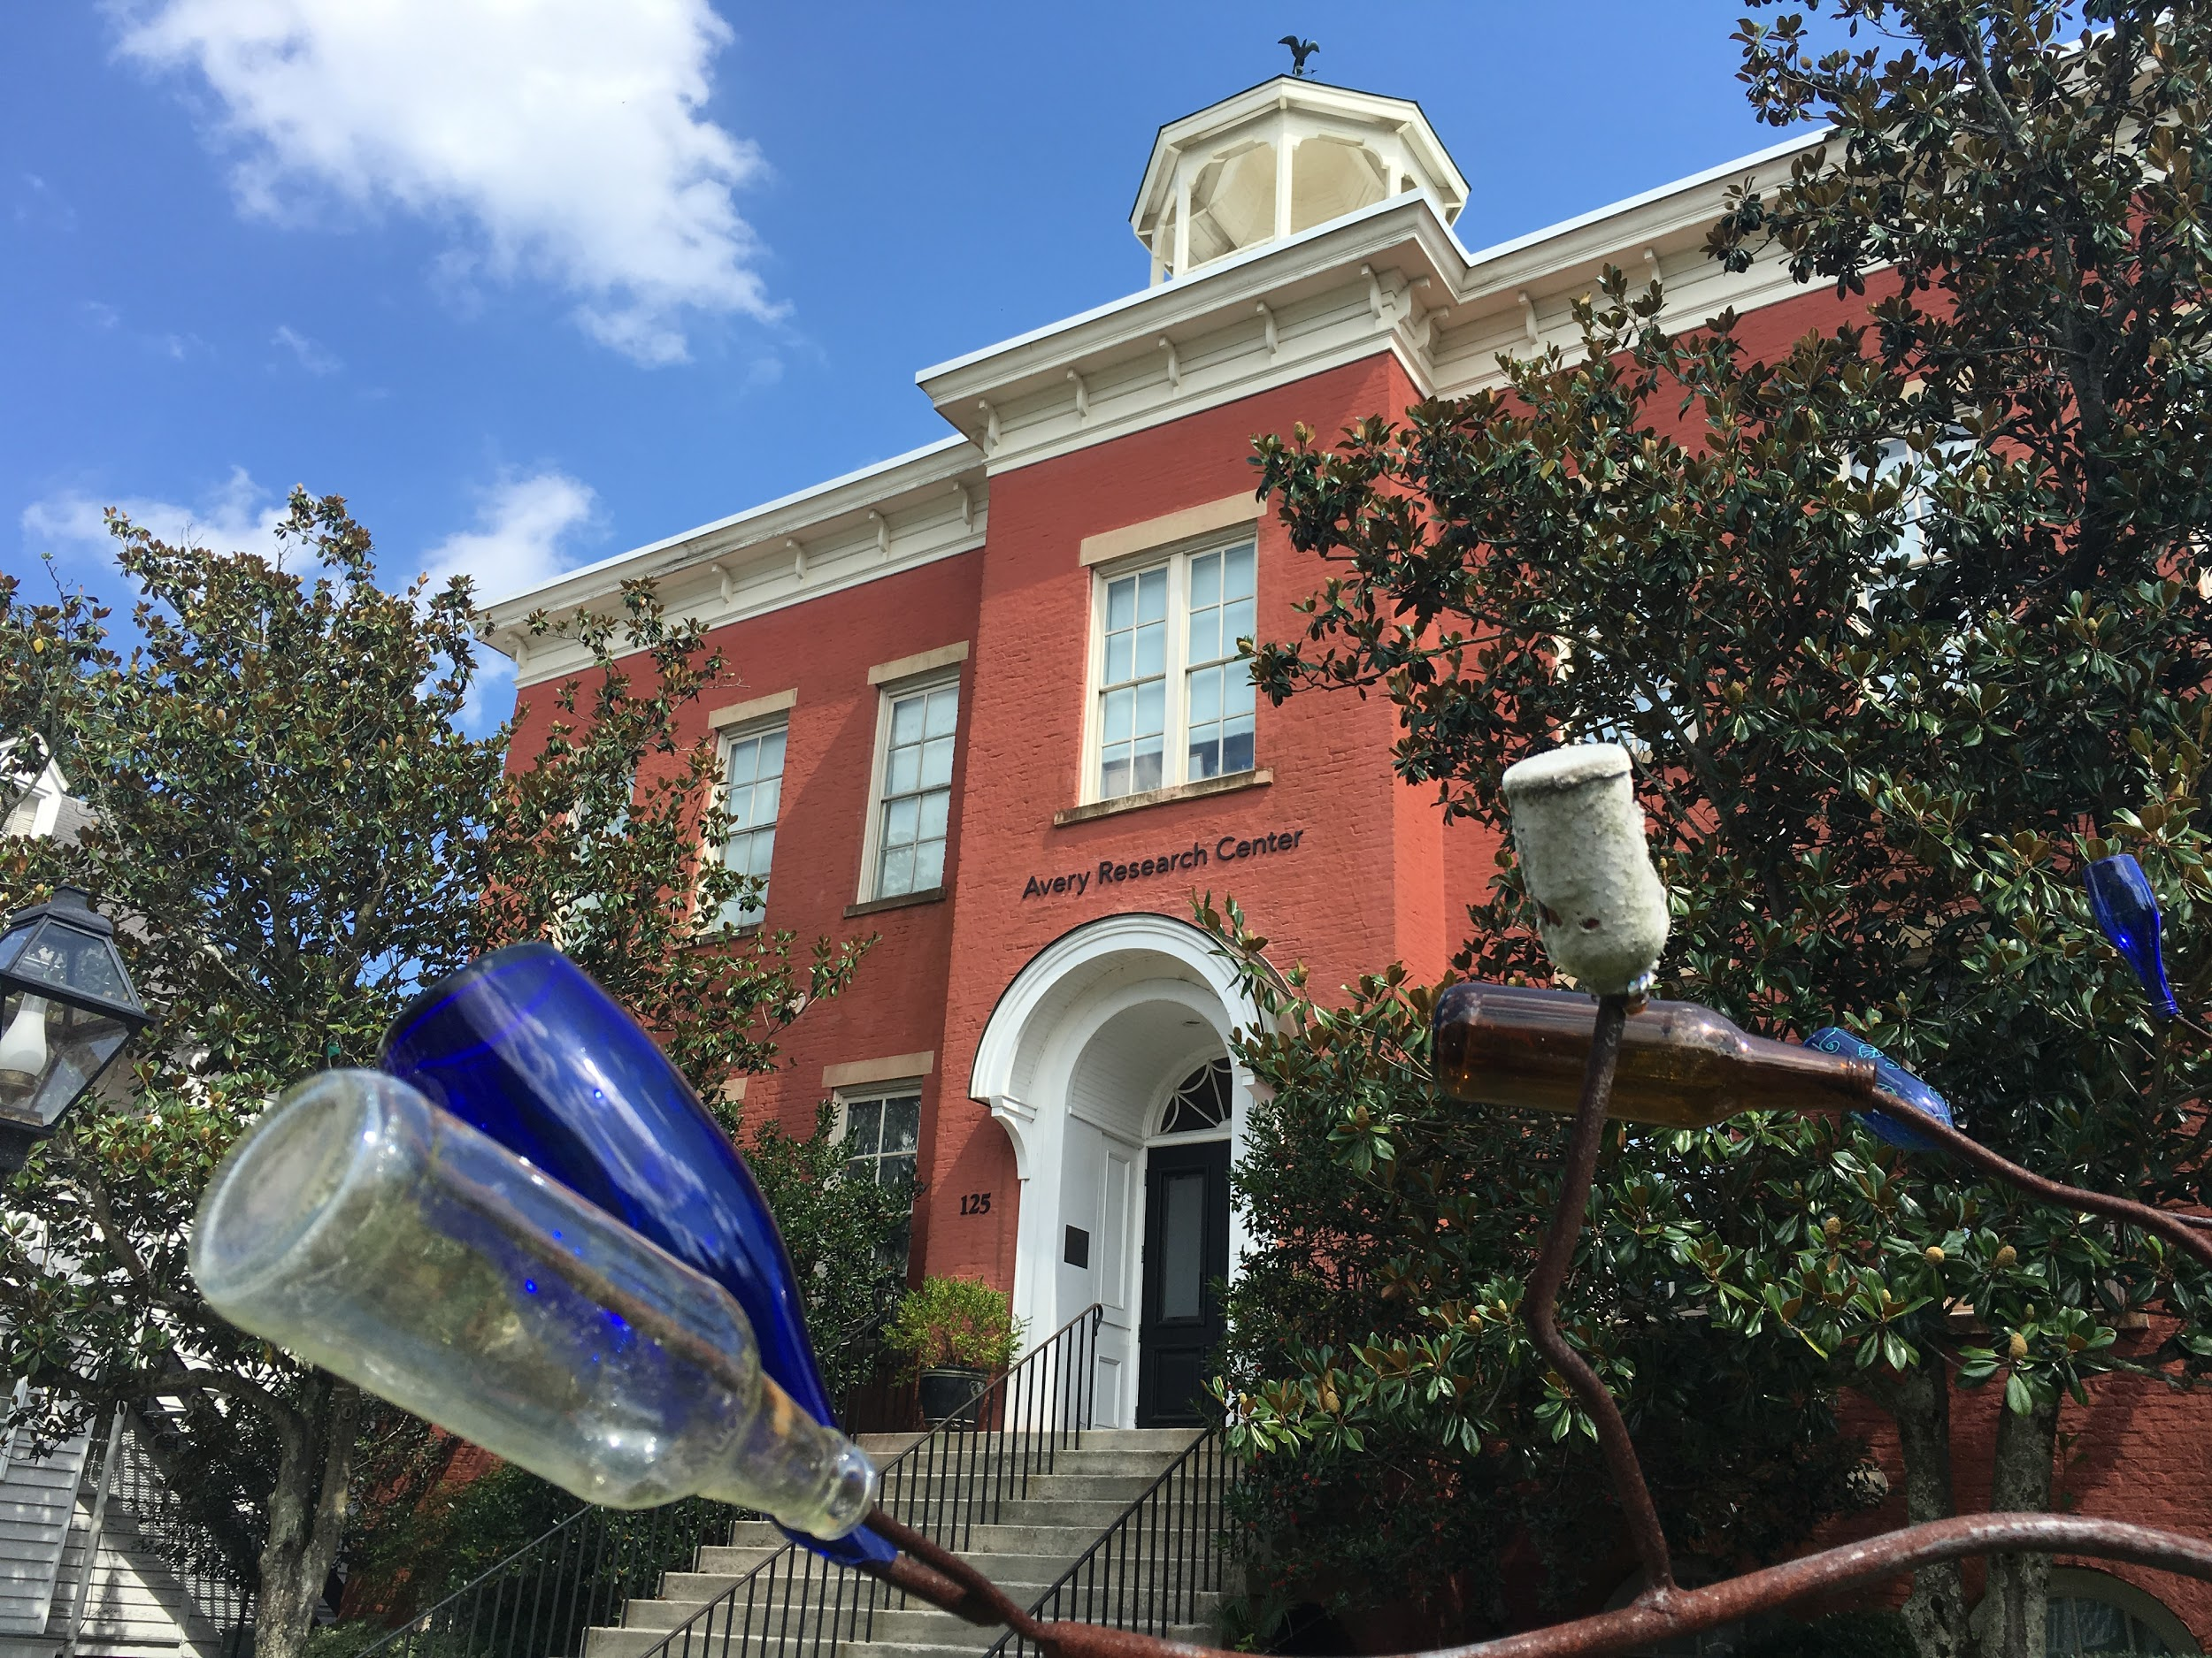

The Avery Research Center for African American History and Culture
The mission of the Avery Research Center for African American History and Culture is to collect, preserve, and promote the unique history and culture of the African diaspora, with emphasis on Charleston and the South Carolina Lowcountry. Avery’s archival collections, museum exhibitions, and public programming reflect these diverse populations as well as the wider African Diaspora.

Slide 62
Avery Overview
Opened in 1990
First Director: Dr. Myrtle Glascoe
Selected Early collections: Jenkins Orphanage, Esau Jenkins, Guy and Candie Carawan, Sweetgrass Baskets
Numbers
  Collection date range, 1800-2019; Bulk collections, 1930-2000
  Collections: 4000 linear feet
  3 floors
  4 staff members
  3 Graduate Assistants
  3 Student workers
Types of materials
  Textiles
  Manuscripts/Documents
  Paintings
  Newspapers
  Audiovisual (music, oral histories, photograph, and videos)
  Born-digital files
  Artifacts
  Secondary Source (journals, books, etc.)
  Maps
  Blueprints
Collection Listing: https://avery.cofc.edu/archives/collection_list.php

Slide 63
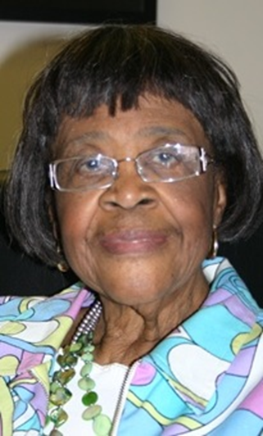
The Lucille Simmons Whipper Papers
80.02 linear feet (Approximately 182 archival boxes; 3 oversize boxes
Originally processed in Archivist Toolkit in 2015; re-entered the collection in ArchivesSpace, completed 2018

Slide 64
ArchivesSpace Southeastern Member Forum
Hollings Special Collections Library
University of South Carolina
November 15, 2019

