Slide 1
Plug In Show and Tell:
Enhancing ArchivesSpace Spawn Functionality
Karla Irwin
Special Collections and Archives Technical Services Librarian
ArchivesSpace Member Forum
Austin, Texas · August 2, 2019

Slide 2
Background
Began ASpace implementation in April 2014
currently using v 2.5.1
No previous collection management system
diverse sources of legacy metadata: hand-written logs, typed print-only inventories, homegrown and proprietary databases, electronic docs...
3,000+ individual oral history interview records
Batch create accession records
export legacy collection-level description from homegrown databases as CSV
transform and map CSV to ASpace accession import
batch import CSV as accession record

Slide 3
Goals
Represent all our holdings in ArchivesSpace
Backlog Elimination Project 2017-2020
prepare for new DAMS (soft launch early 2020)
spawn resources from legacy accessions
Improve workflow efficiencies
Standardize legacy metadata (DACS compliant)
Plugin function goals
Batch spawn resources from accessions
spawn multiple resources (rather than one at a time)
auto-populate several required note fields upon spawn
spawn all content in accession record

Slide 4
ArchivesSpace Default Spawn | Additional Fields to Spawn/Autopopulate
Title | Identifier
Date | Level of description
Extent | Restrictions
Related Accession | General Note
Agent(s) | Conditions Governing Access
Scope and Contents | Conditions Governing Use
Subject | Subject*
Classification | Classification*
Physical Description | EAD ID
 | Finding Aid Date
 | Finding Aid Author
 | Description Rules
 | Language of Description
Notes:
* Included in default spawn but UNLV did not add subjects or classifications to its accession records. UNLV has the plugin to add one subject and one classification with spawn from accession record to resource record.

Slide 5
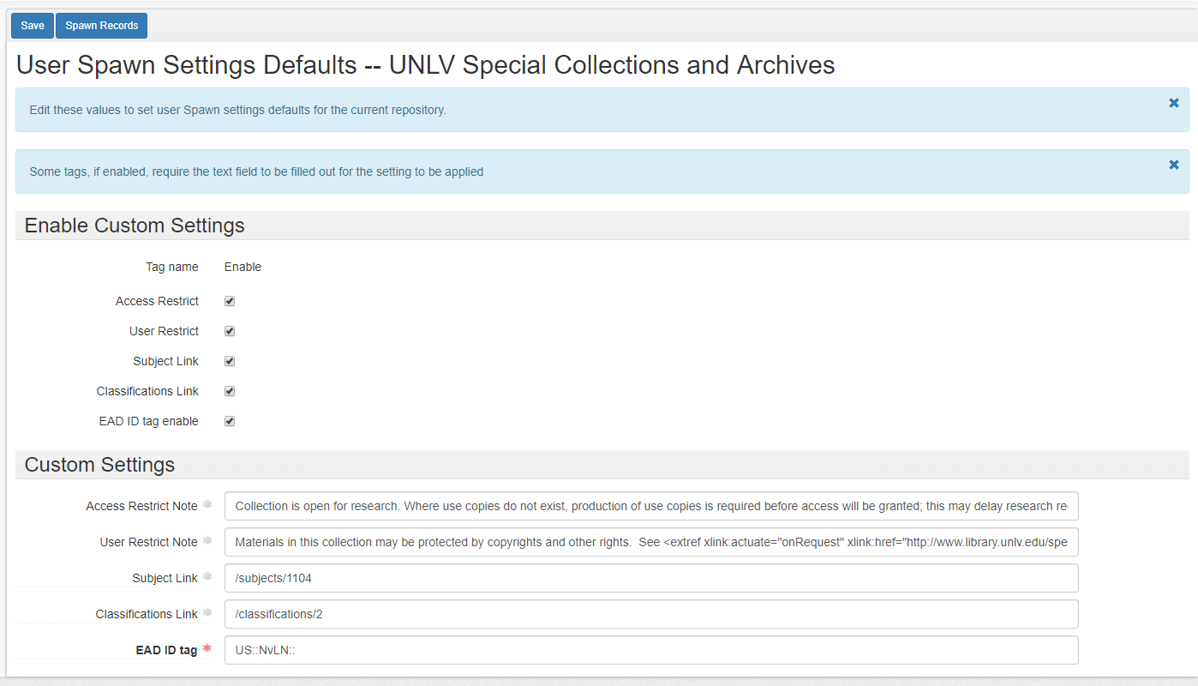

Slide 6
Notes:
Demo

Slide 7
Further Information
Code shared through GitHub:
https://github.com/UNLV-Libraries/ArchivesSpace-authority-project
Open-Source Opens Doors: A Case Study on Extending ArchivesSpace Code at UNLV Libraries
http://bit.ly/osodunlv
Contact us:
karla.irwin@unlv.edu
seth.shaw@unlv.edu

