Slide 1
Reports Refactored
July 31, 2018 – Webinar

Slide 2
Presenter
Sarah Morrissey
ArchivesSpace

Slide 3
Reports Refactored
Notes:
Thanks for attending
Been working on reports and want to tell you a little about what I’ve done and using reports

Slide 4
Outline
Goals for refactoring
Demo – canned reports
Brief technical overview
Demo – custom reports proof of concept
Questions
Notes:
Here’s an overview of what I’ll go over

Slide 5
Goals for Refactoring
Reports should run reliably
All formats should have same data
Useful data – recommendations from reports sub team
Maintainability – easy to add new reports
Looking to the future - Custom Reports to offer flexibility
Notes:
First and foremost actually be able to run reports – sounds minimal but has not been the case in the past
Same data no matter what format you run
Data should be what archivists need – got ideas from reports subteam
Maintainable because inevitably what is needed will change
Feature not ready yet - will need a lot of testing – but do have a proof of concept - New custom reports useful for when you want something slightly different – can’t create canned report for every single scenario

Slide 6
Demo – Canned Reports
Notes:
Demo of the canned reports which are predefined
Look for these updates in the next release!

Slide 7
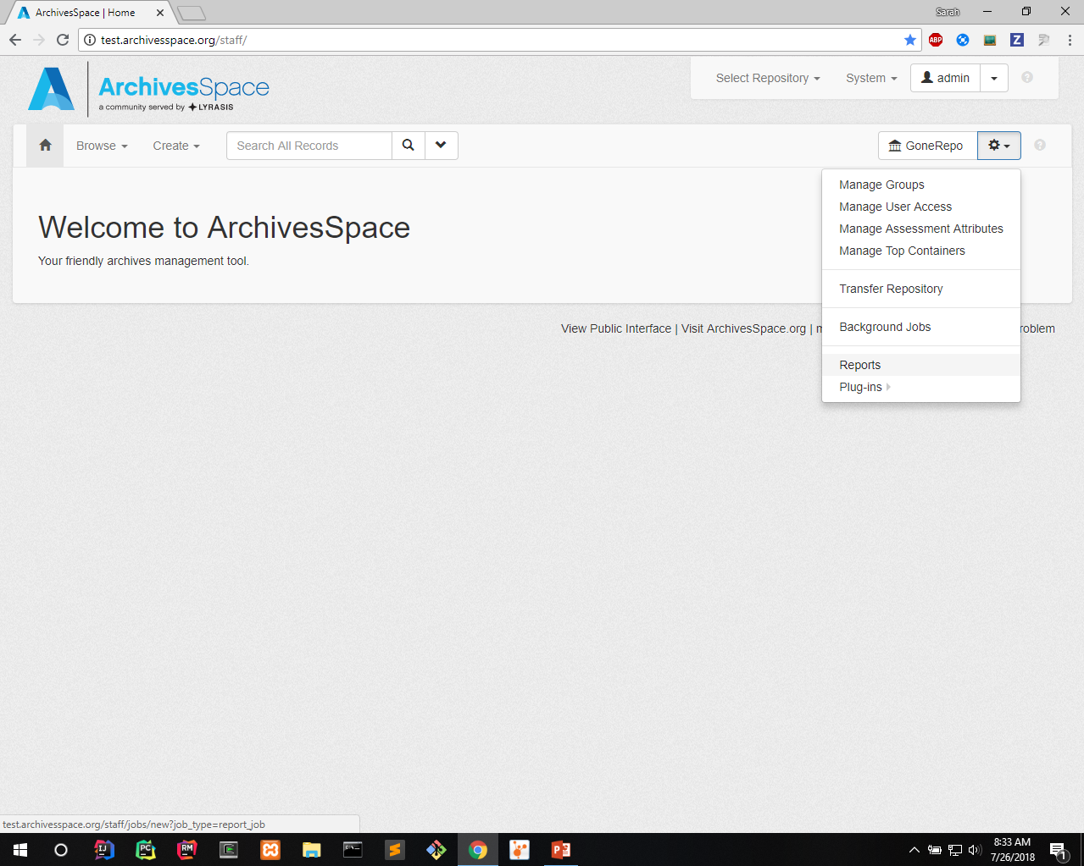
Notes:
Select reports from gear dropdown

Slide 8
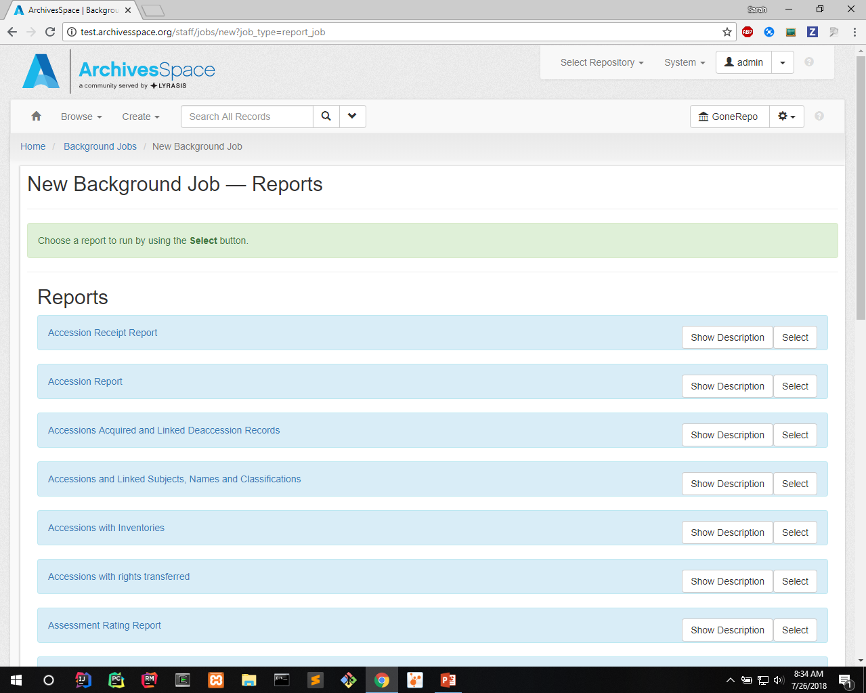
Notes:
Brings you to page with list of all report types

Slide 9
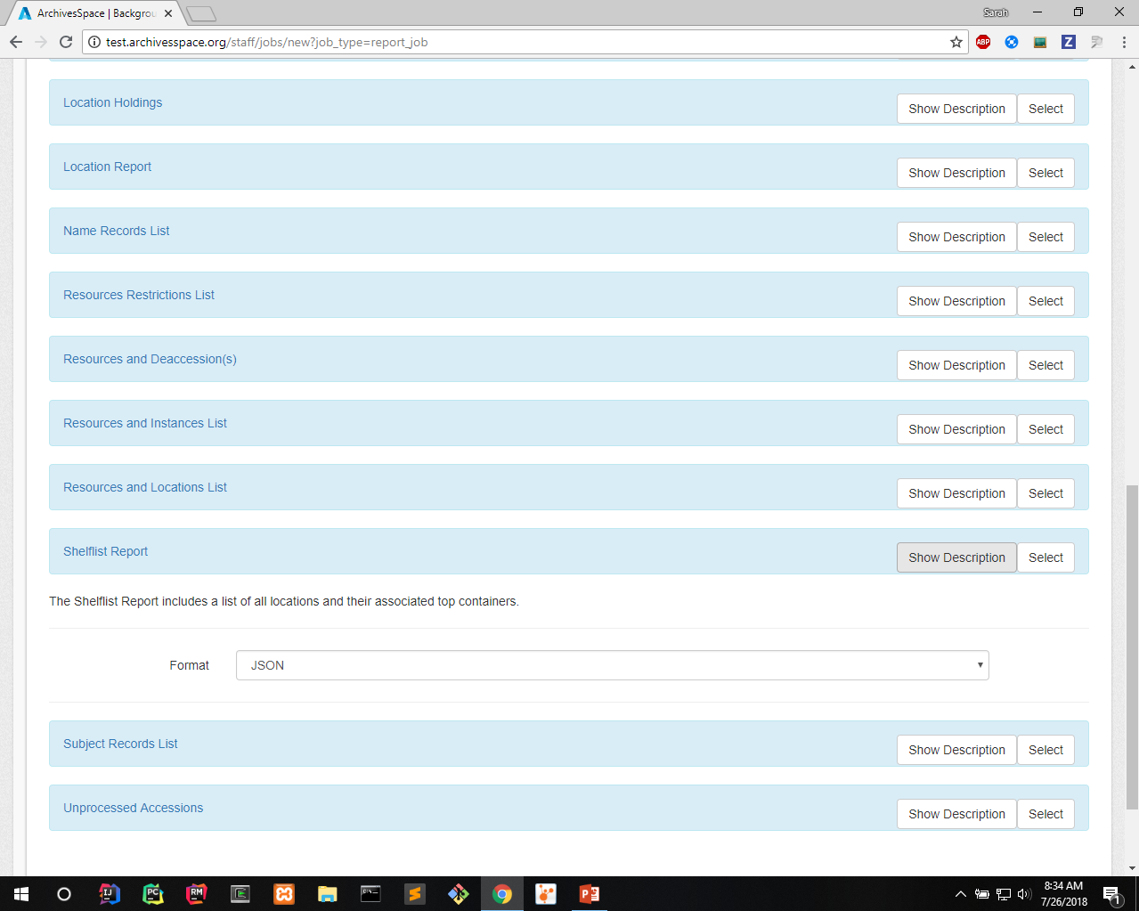
Notes:
Show description toggles showing brief description of report, parameters – always format, sometimes others like date

Slide 10
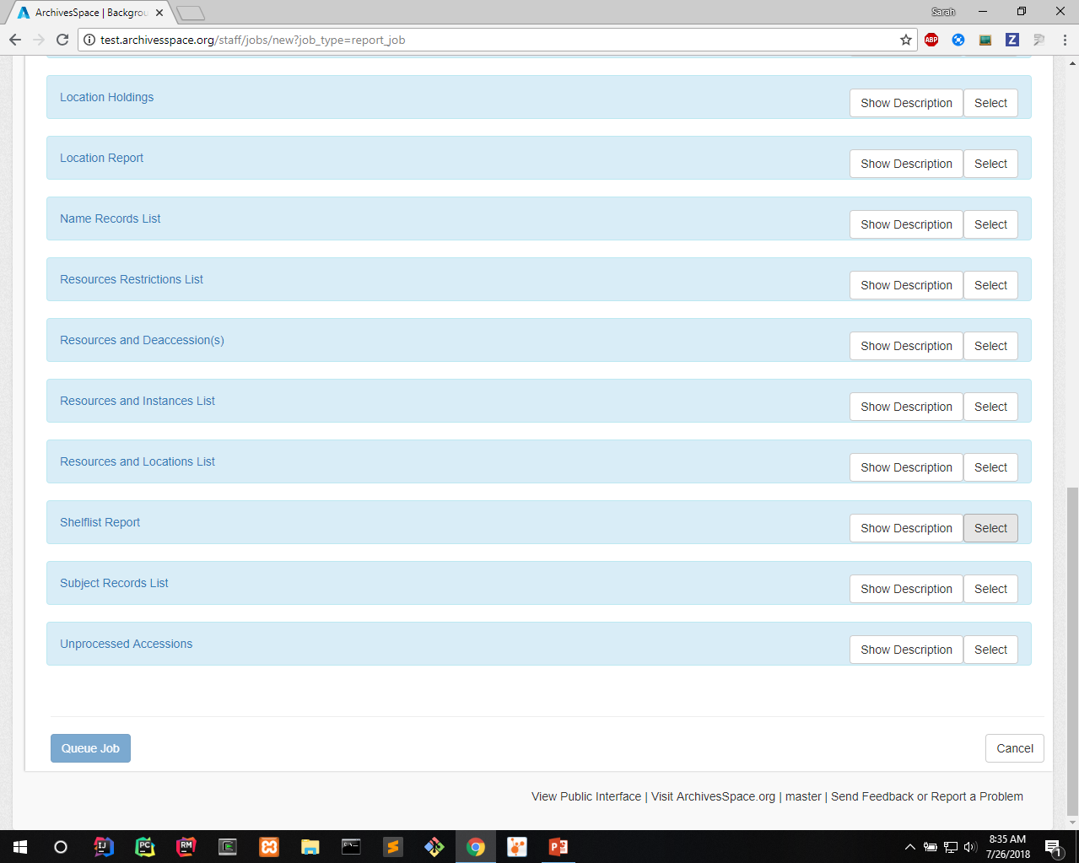
Notes:
Select report you want to run

Slide 11
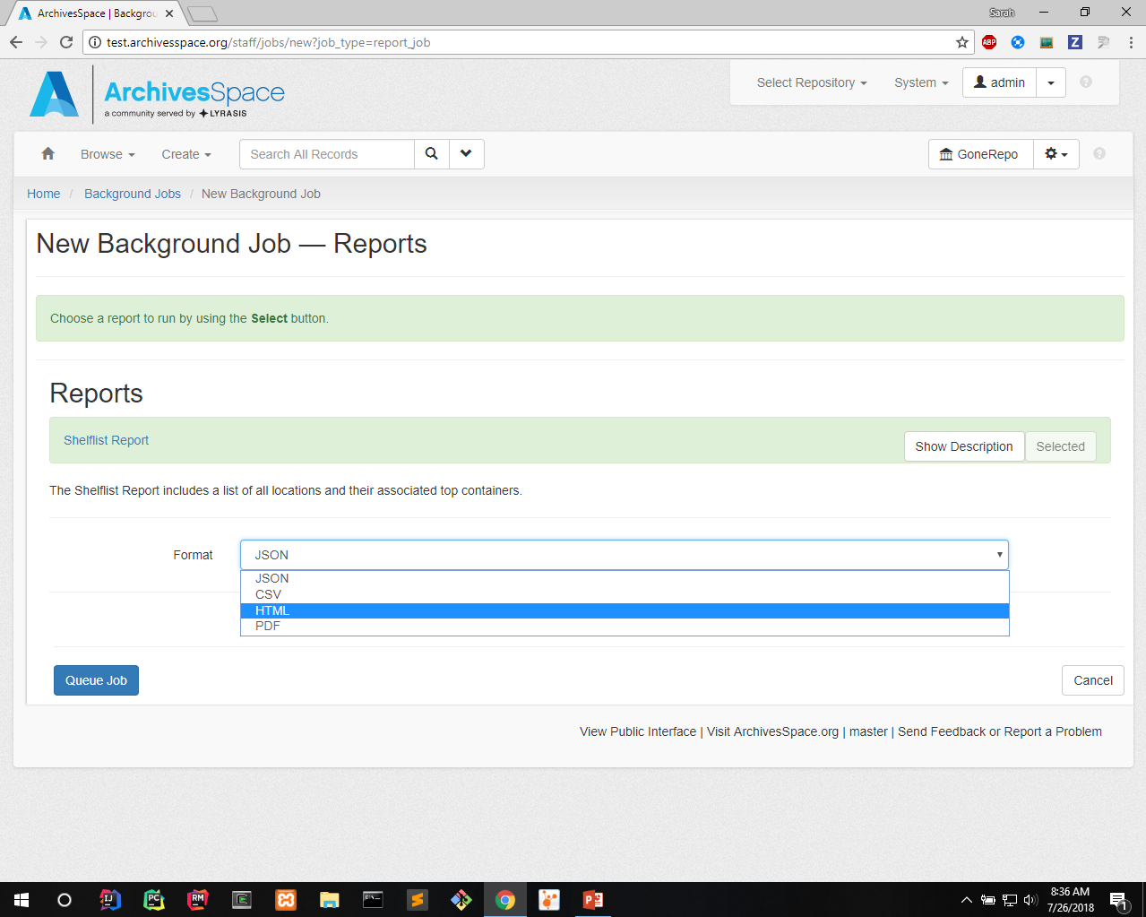
Notes:
Select format – and any other parameters

Slide 12
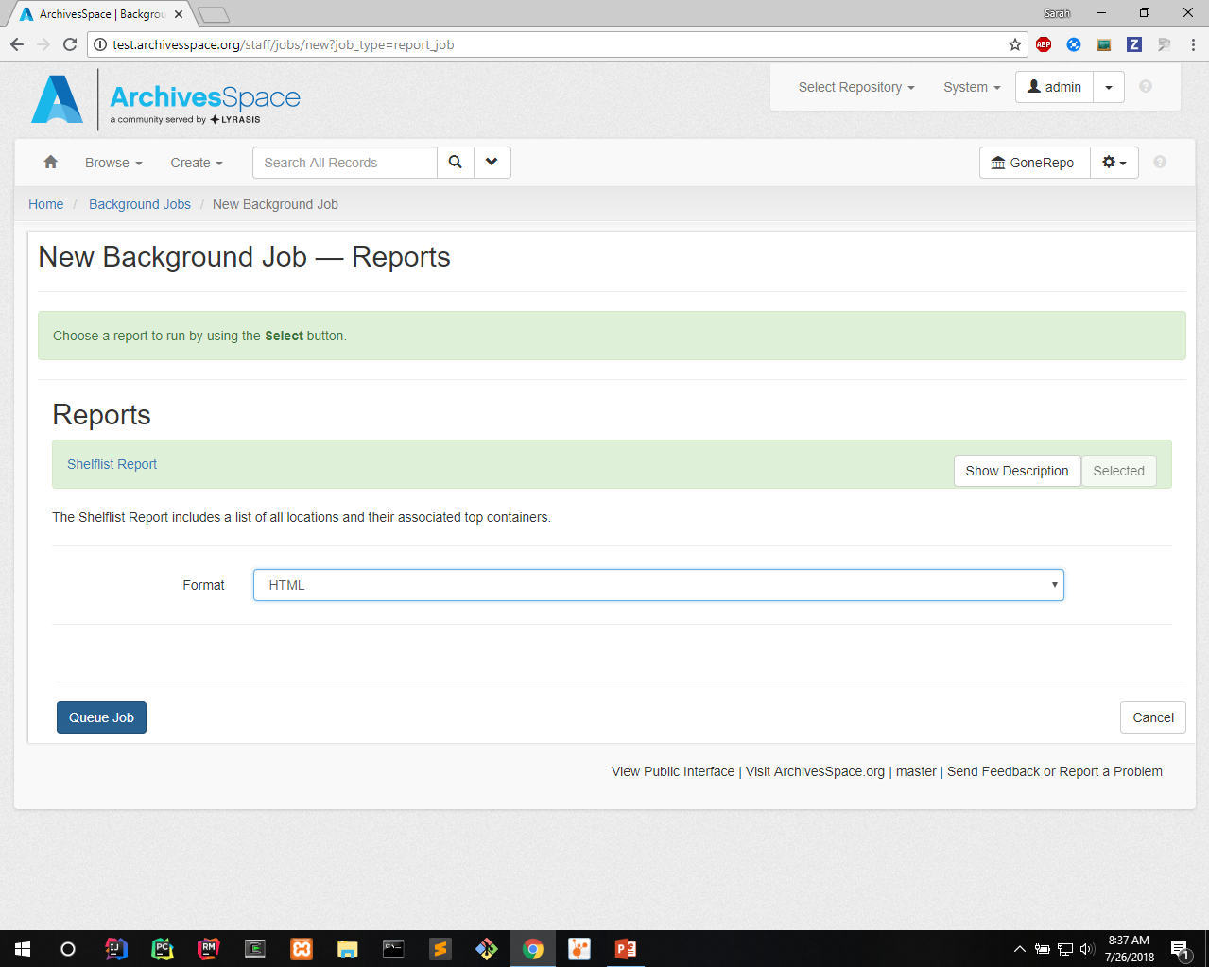
Notes:
Queue job

Slide 13
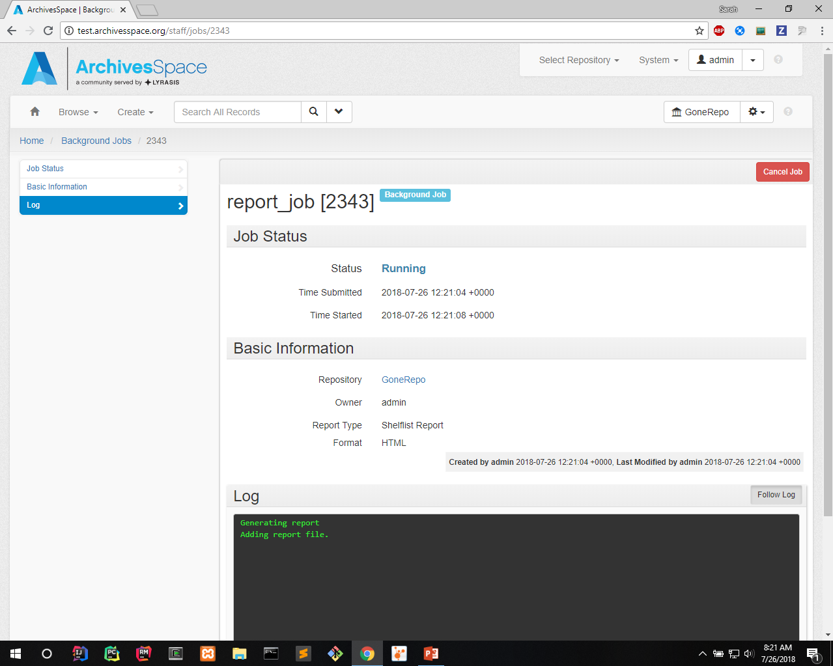
Notes:
Wait…

Slide 14
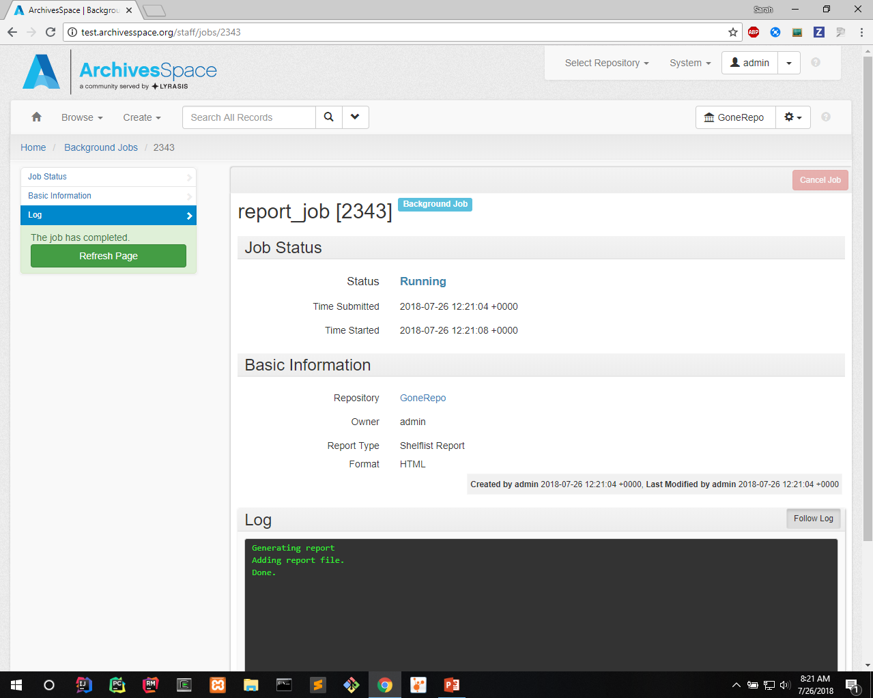
Notes:
Prompts refresh page when done
May take a several minutes for some reports

Slide 15
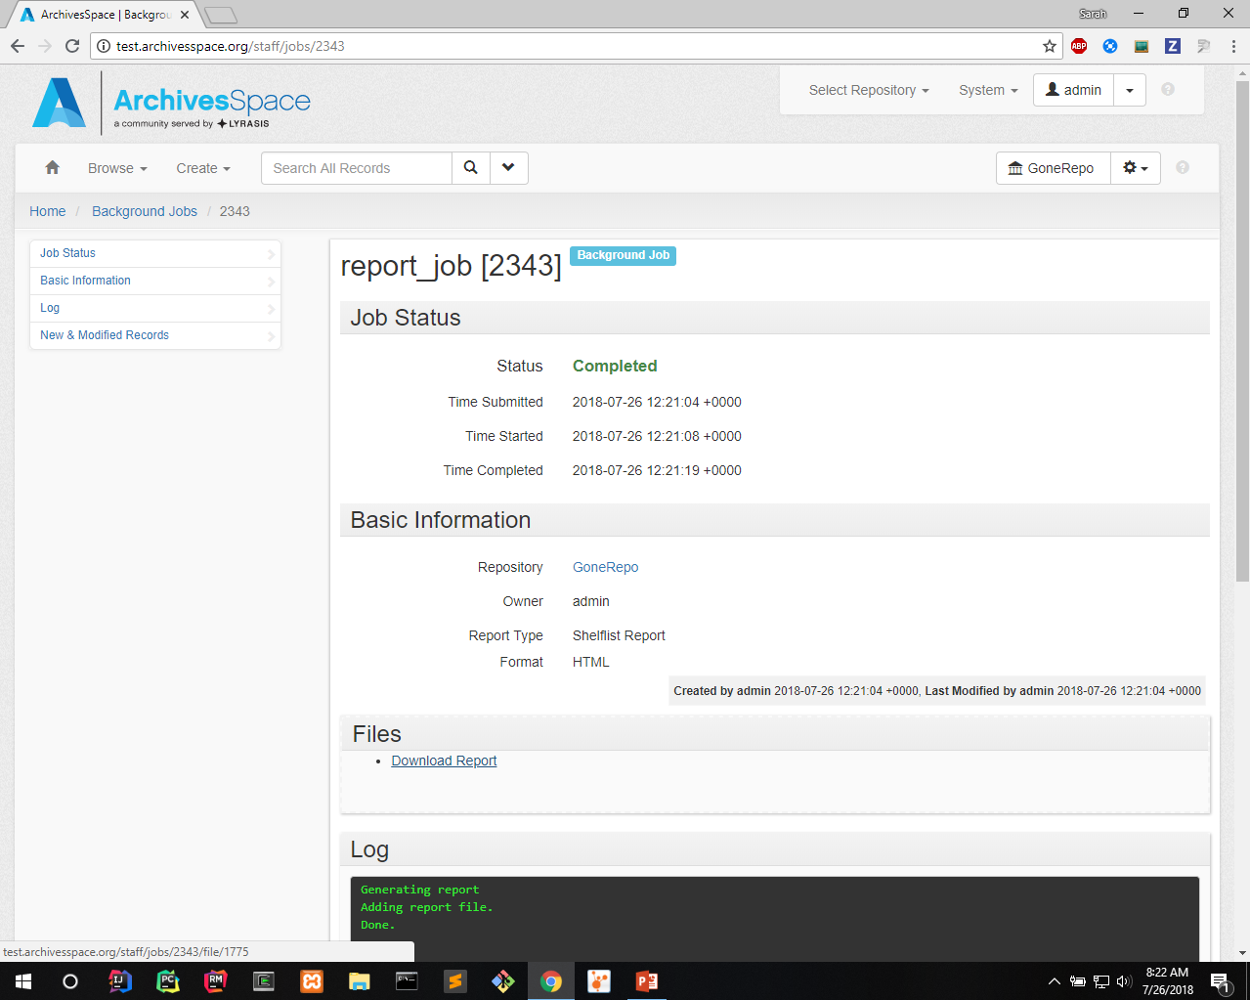
Notes:
Download report file

Slide 16
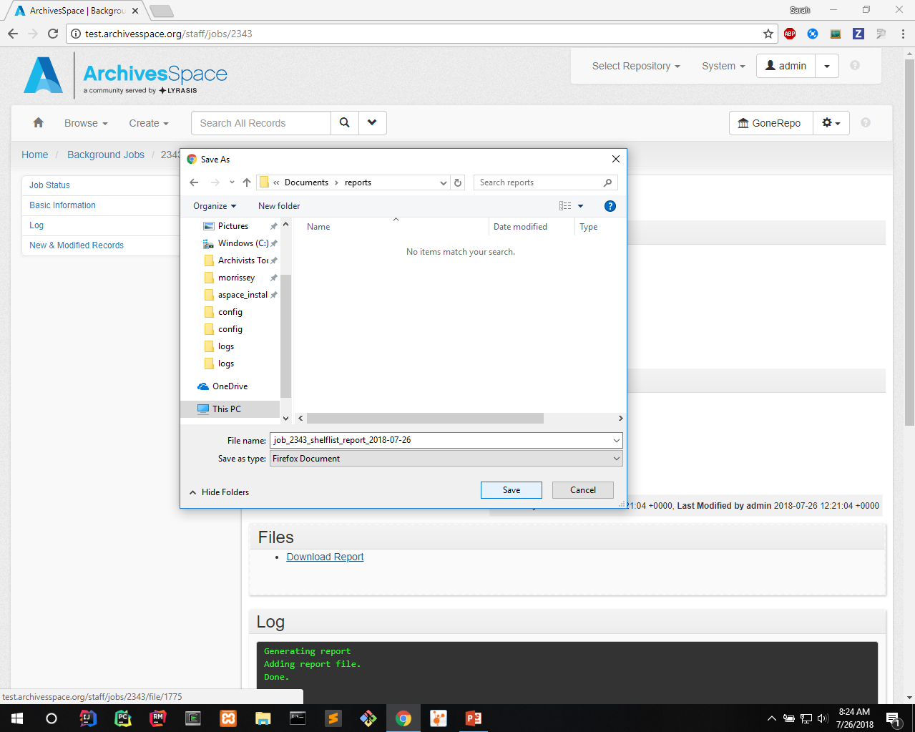
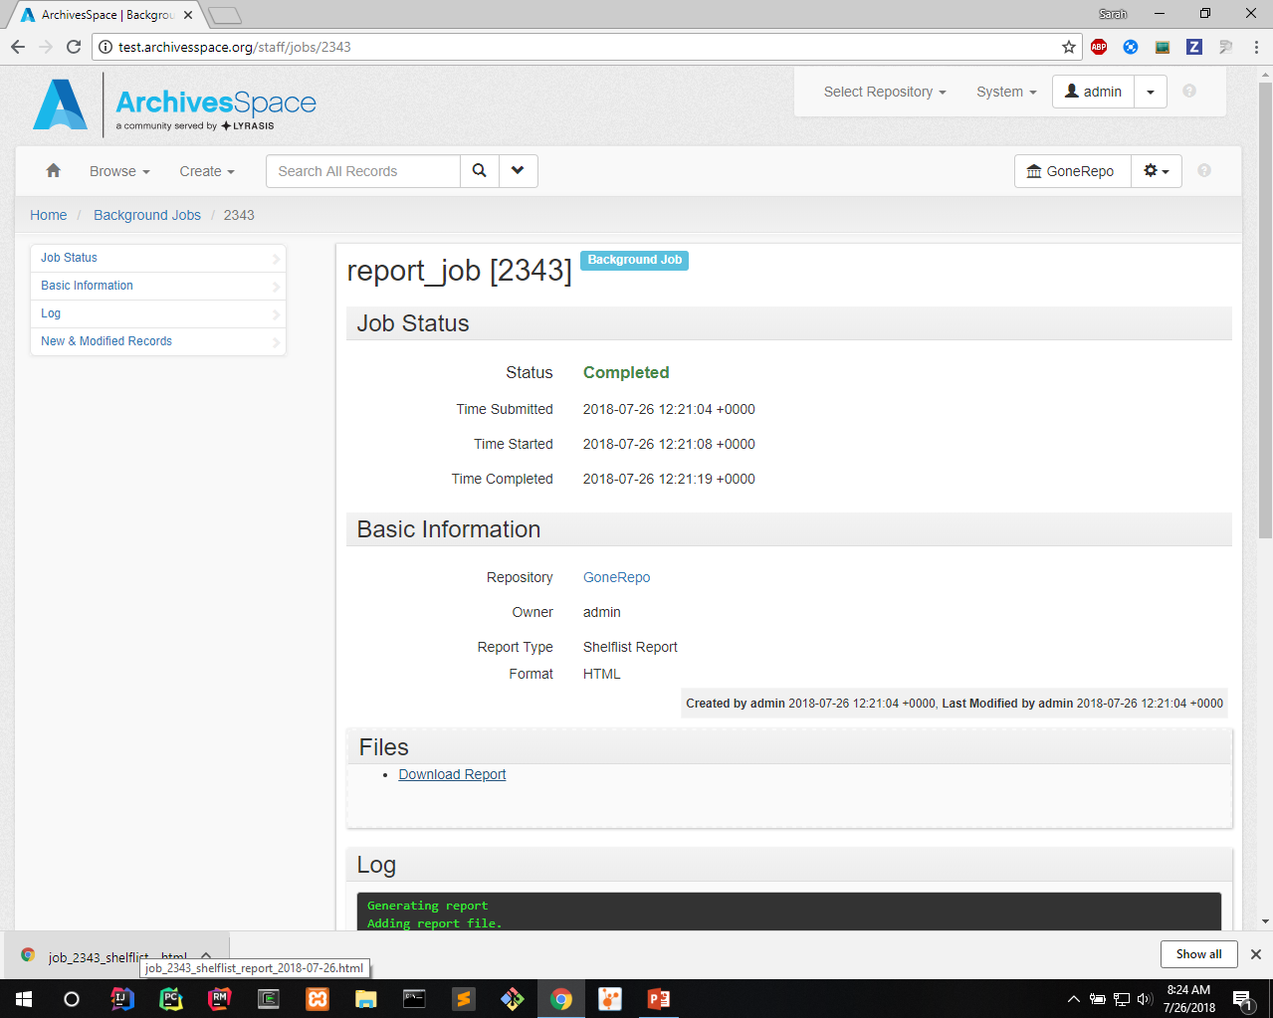
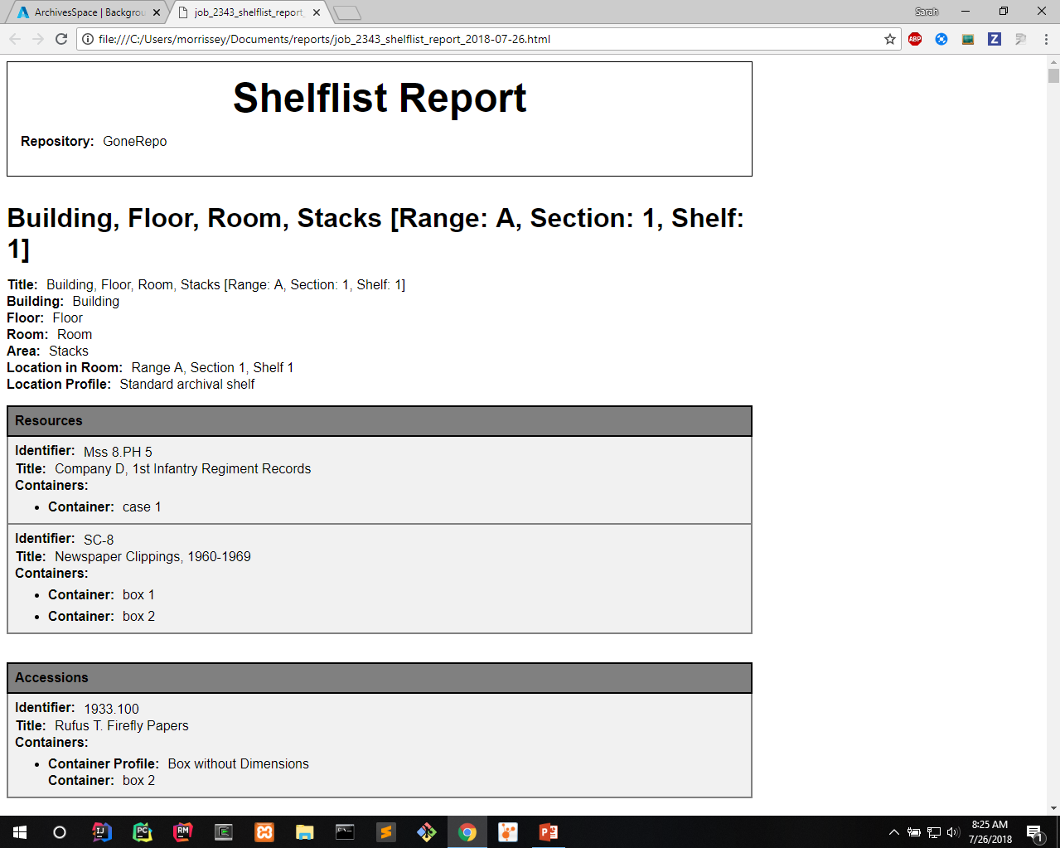
Notes:
Title section at top with metadata – repository, sometimes record count, total extent, params, etc.

Slide 17
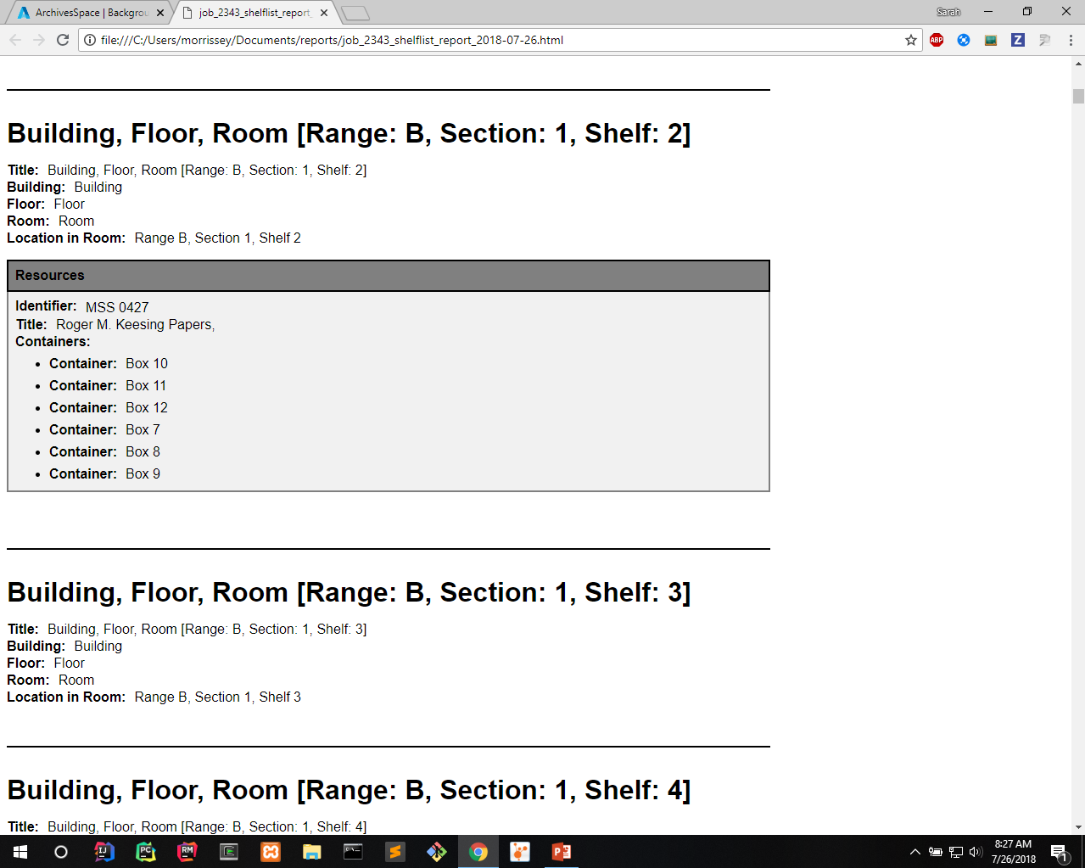
Notes:
Some samples of what it looks like

Slide 18
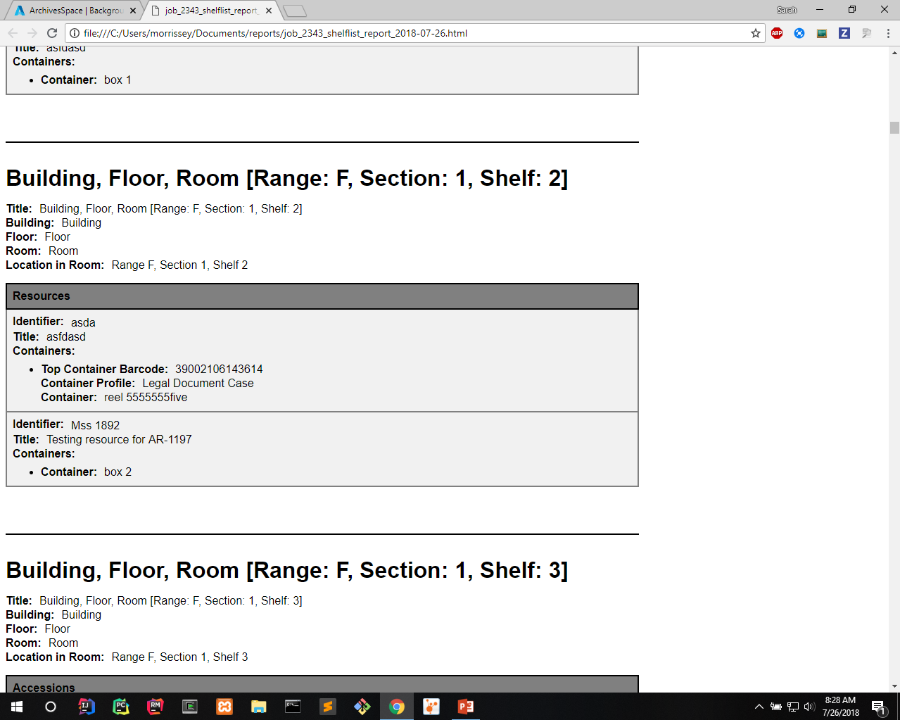

Slide 19
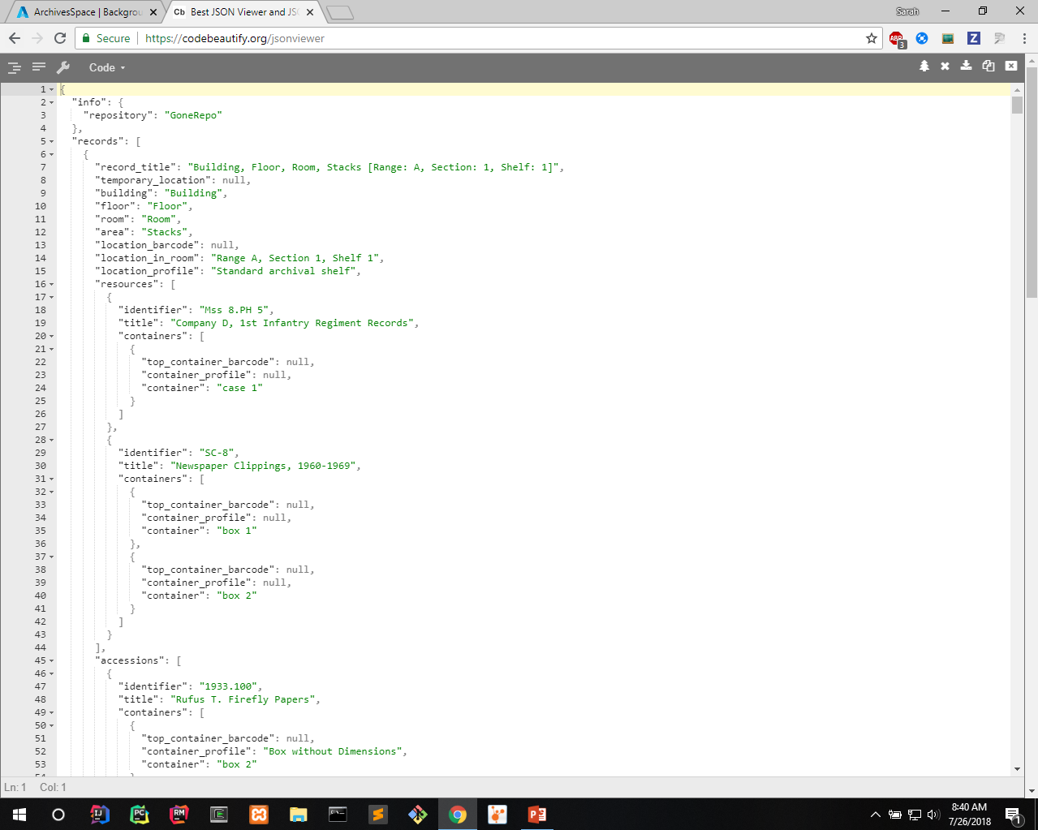
Notes:
Samples of other formats
JSON

Slide 20
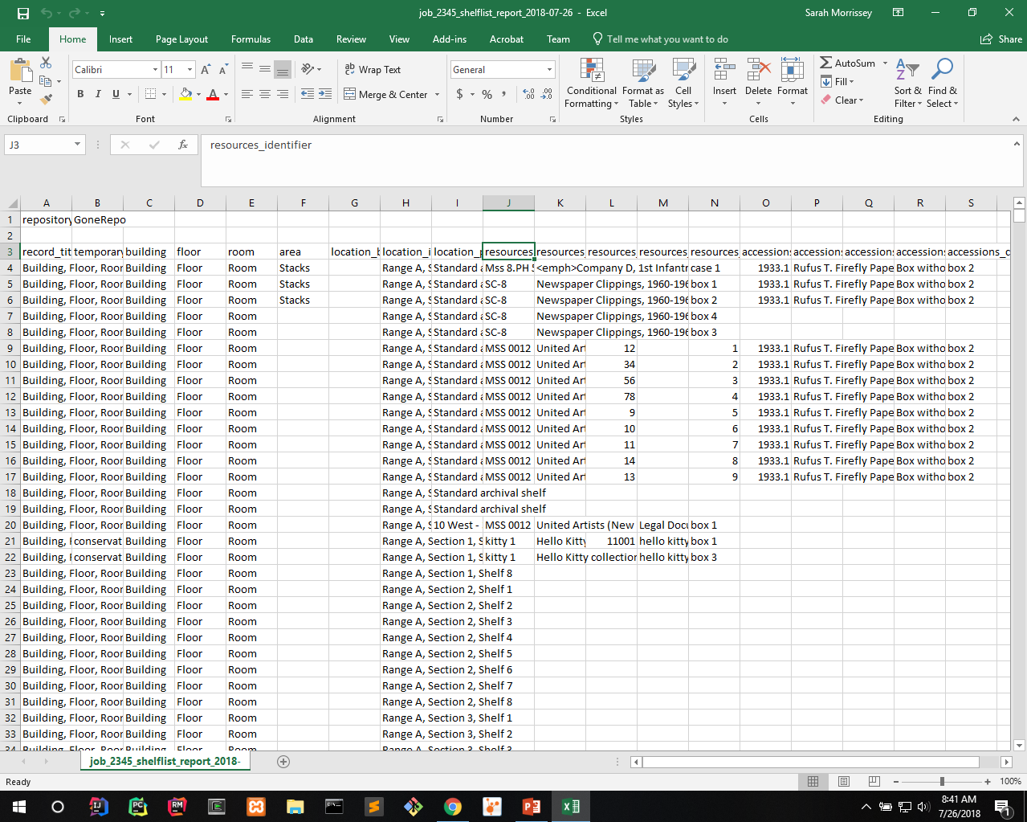
Notes:
CSV
2 CSV options

Slide 21
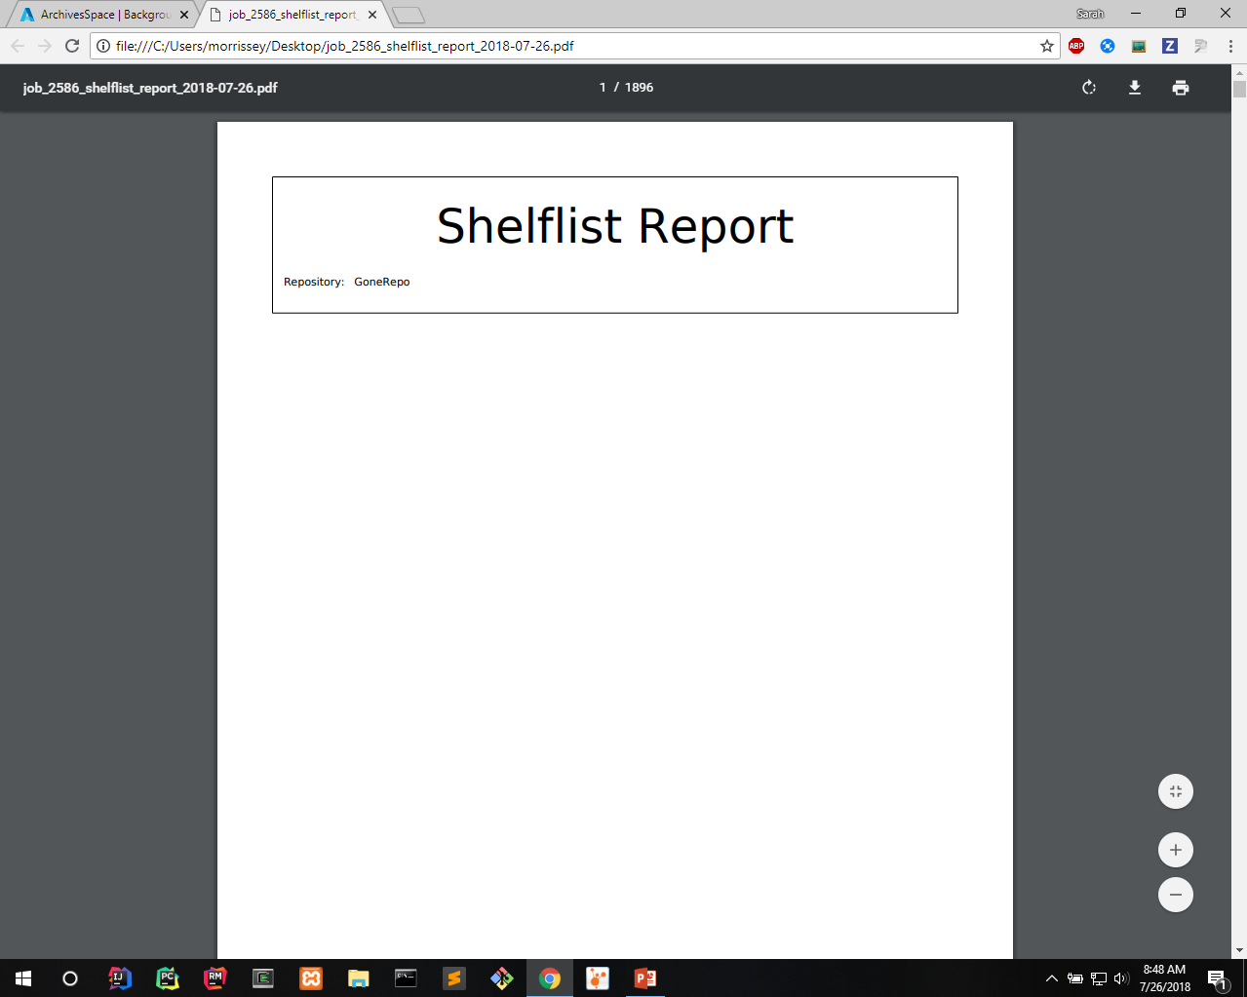
Notes:
Pdf sample

Slide 22
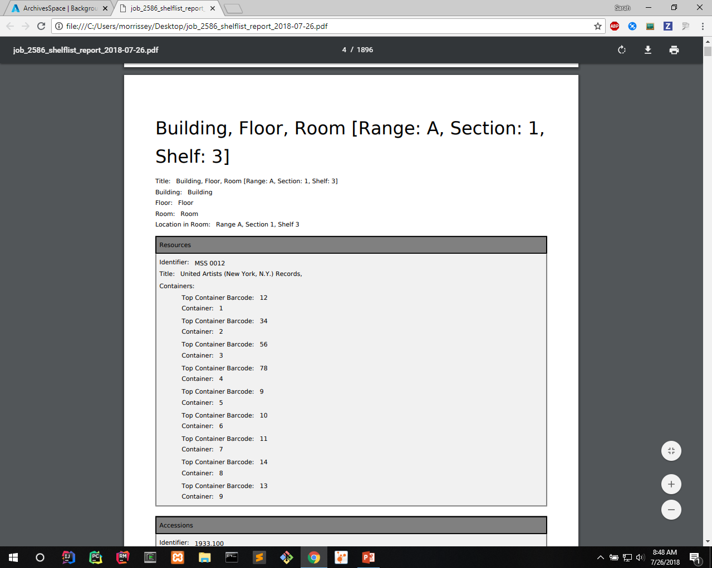

Slide 23
Brief Technical Overview
Each report defines raw SQL query
May also do some data cleanup and add sub reports for each result
Minimal responsibility makes adding new reports simple
Sub reports may be potentially infinitely nested
Notes:
Raw SQL used so it is clear to developer and easy to add with minimal background
May clean up the data to make it prettier
Add subreports – i.e. the records that are linked like subjects to a resource
Subreports also define a raw SQL query usually with id param for record they are linked to
Subreports may have nested subreports – ex. Accession and resource subreports for location can have a nested container subreport
One generic template used to generate html/pdf formats for all report types – much easier than having to add a special one for each new report
Minimal responsibility but maximum flexibility

Slide 24
Demo – Custom Reports
Notes:
Demo for custom reports
Reiterate – these aren’t ready yet – will not be in next release

Slide 25
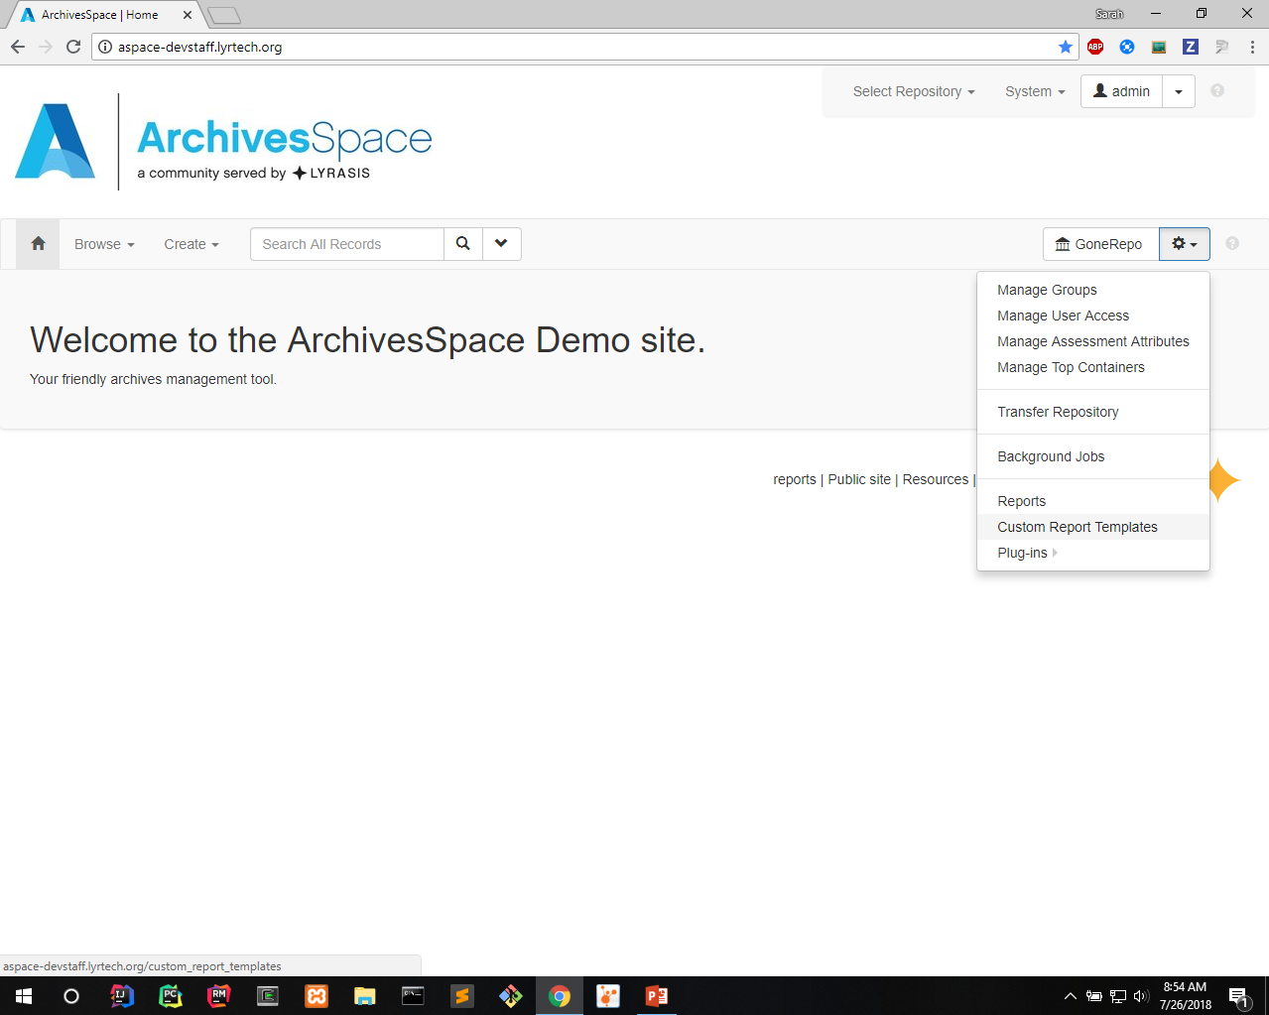
Notes:
First you need to create a template
Select custom report templates from gear dropdown

Slide 26
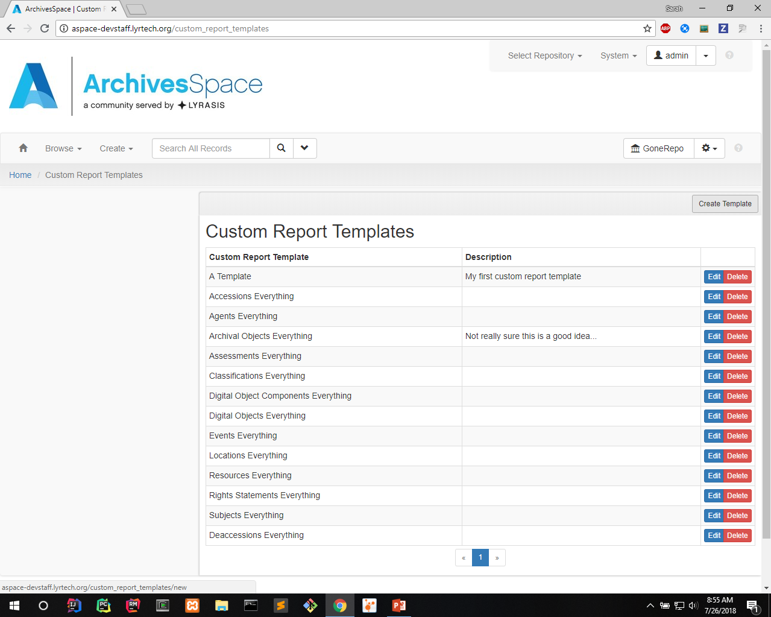
Notes:
See a listing of templates
You’re able to edit/delete
May want to delete a template after running to avoid clutter if it won’t be used again/often
Select create template

Slide 27
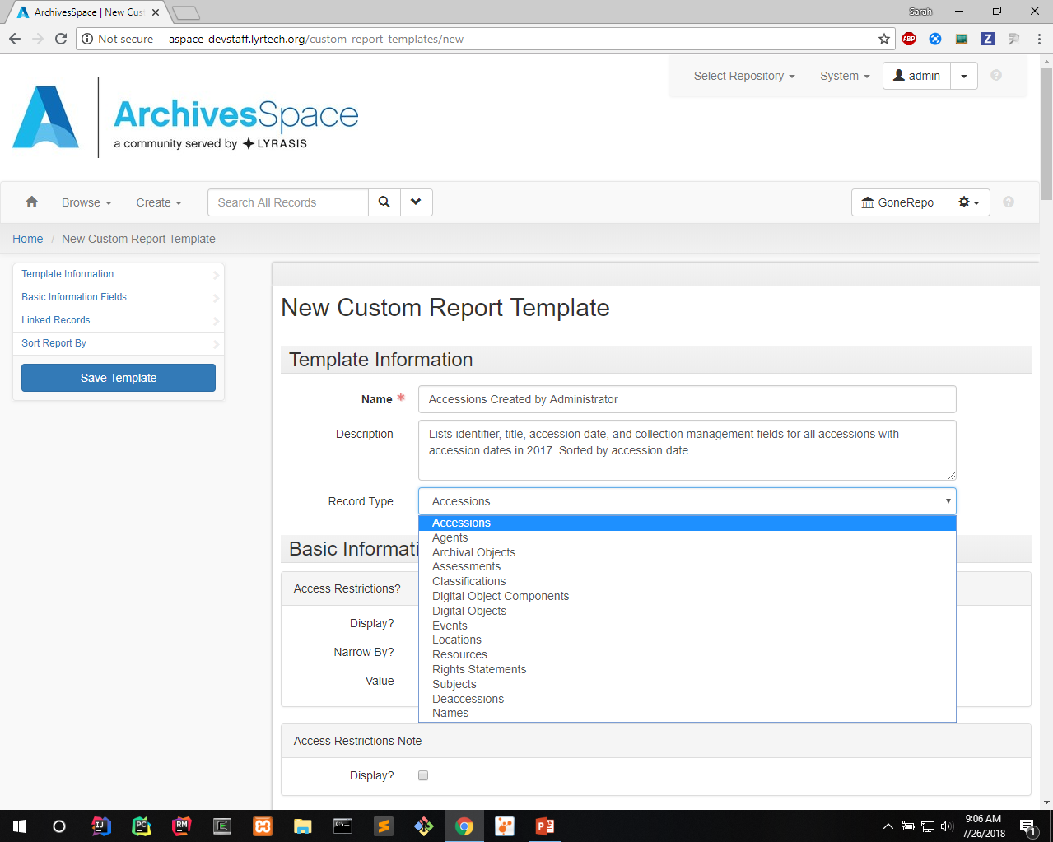
Notes:
In this case, we want to show some info for accession records created by a particular user with accession dates over a timespan
Fill in name, description
Select record type – affects options for other fields

Slide 28
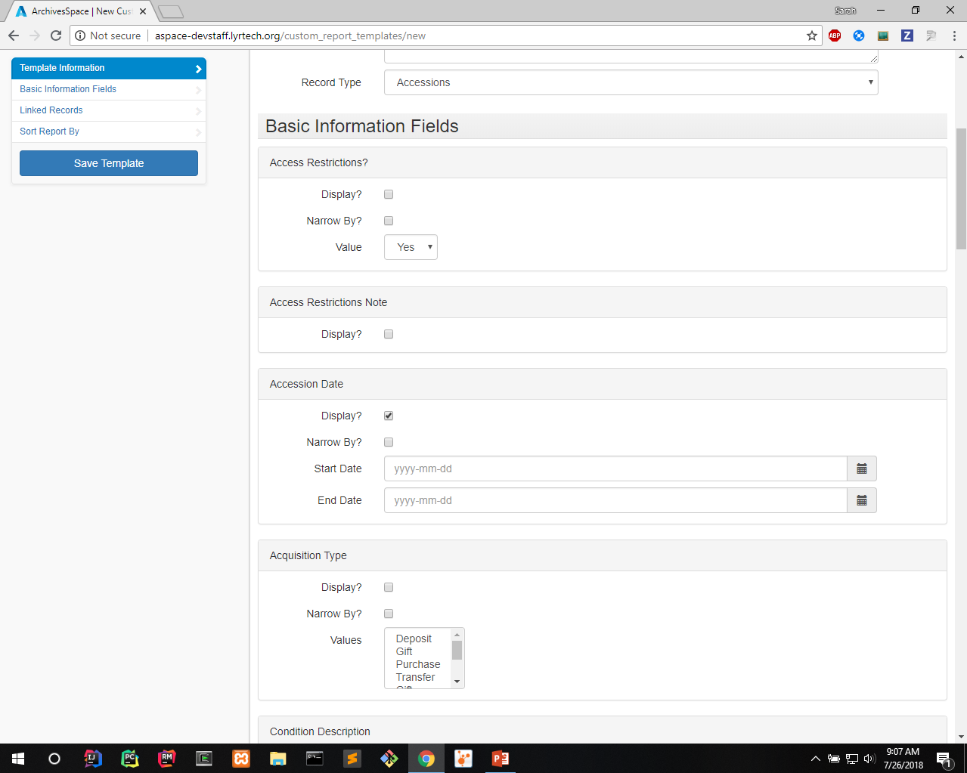
Notes:
- Select to display accession date in report

Slide 29
Notes:
- Select to narrow results by accession date

Slide 30
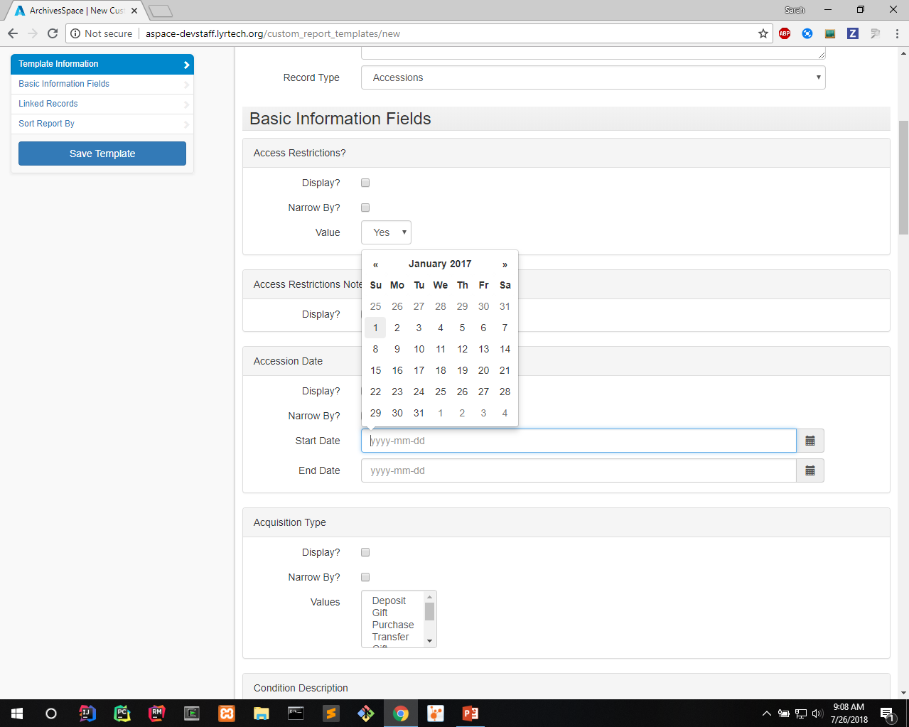
Notes:
- Select start of date range

Slide 31
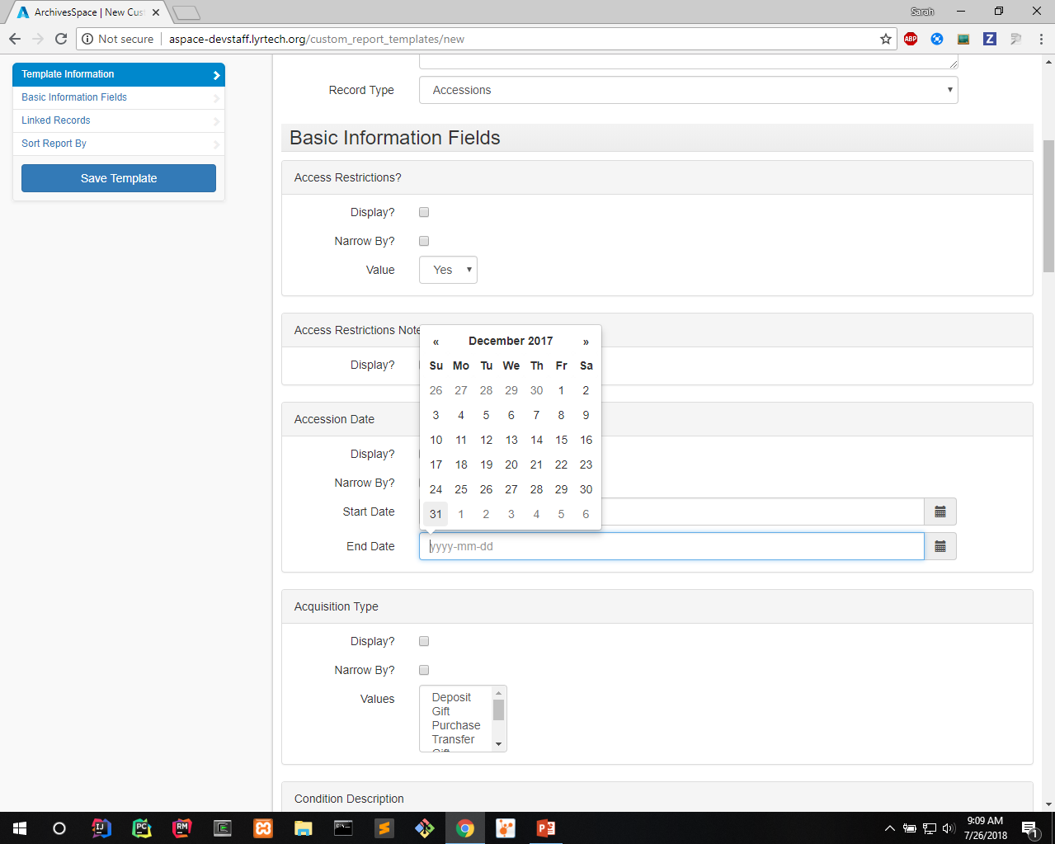
Notes:
- Select end of date range

Slide 32
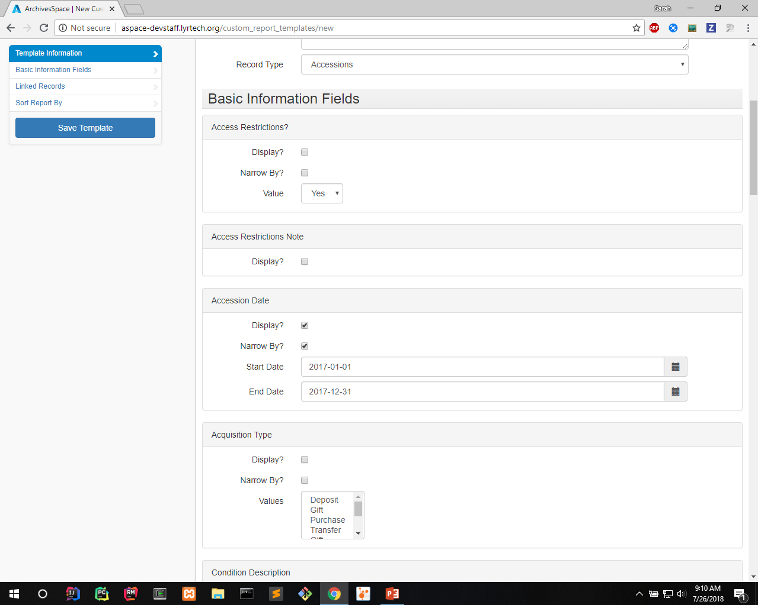
Notes:
- Results will be narrowed to accessions with accession dates in 2017

Slide 33
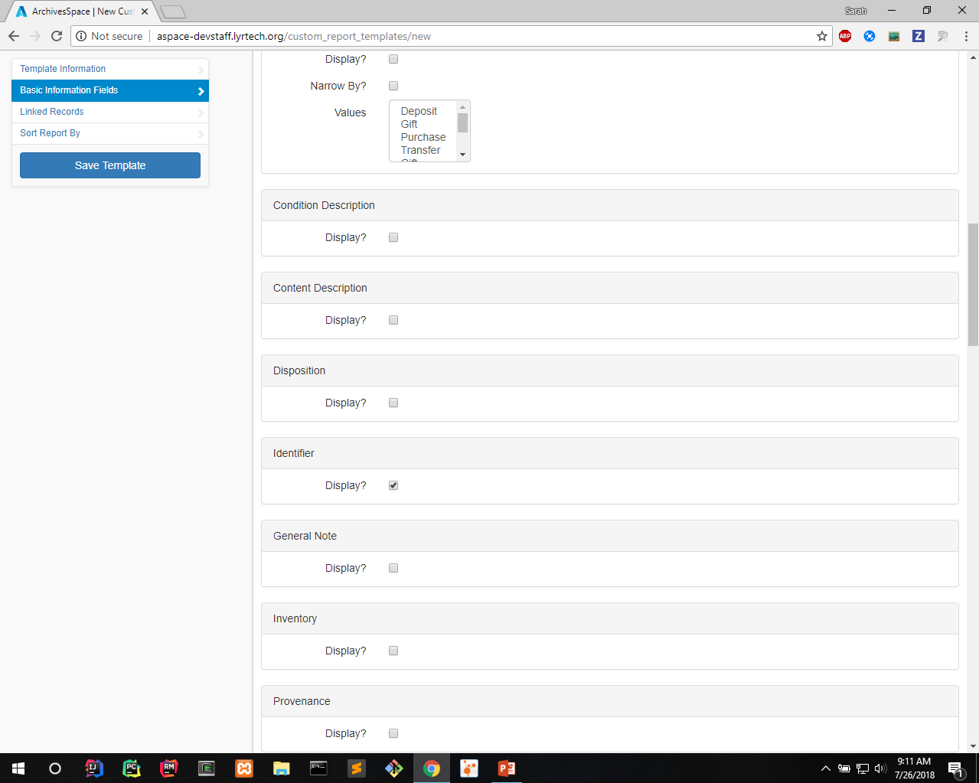
Notes:
- Want to show the identifier

Slide 34
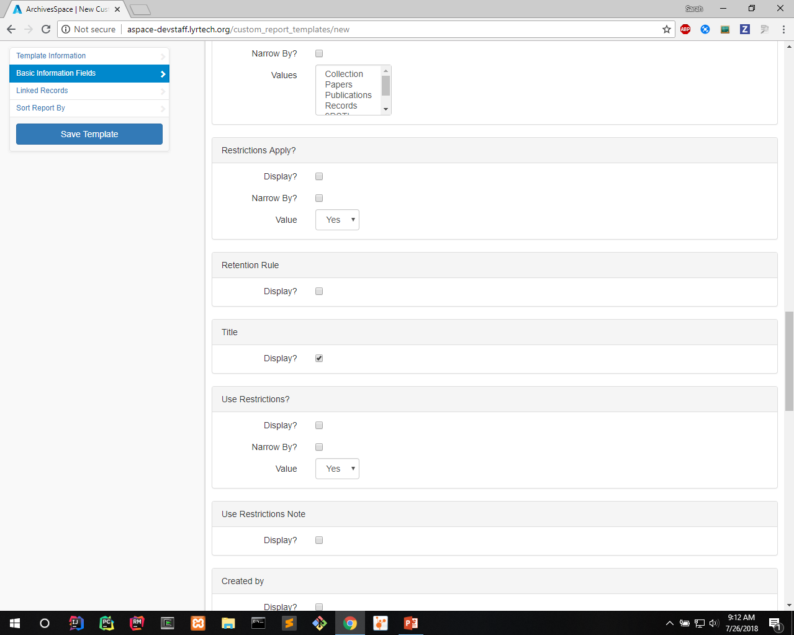
Notes:
- Want to show the title

Slide 35
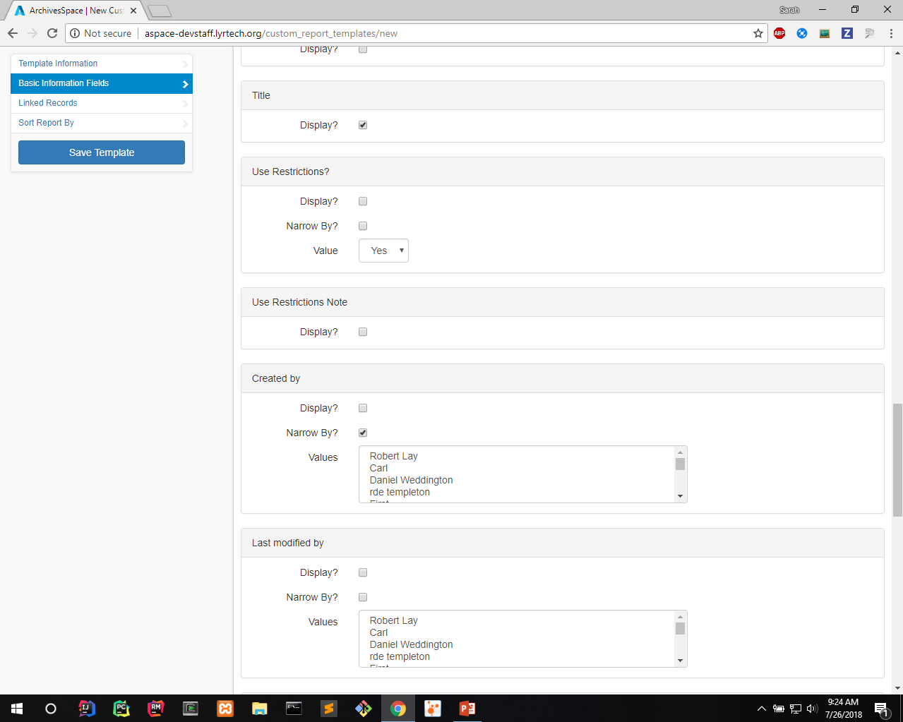
Notes:
We want to narrow results based on who created

Slide 36
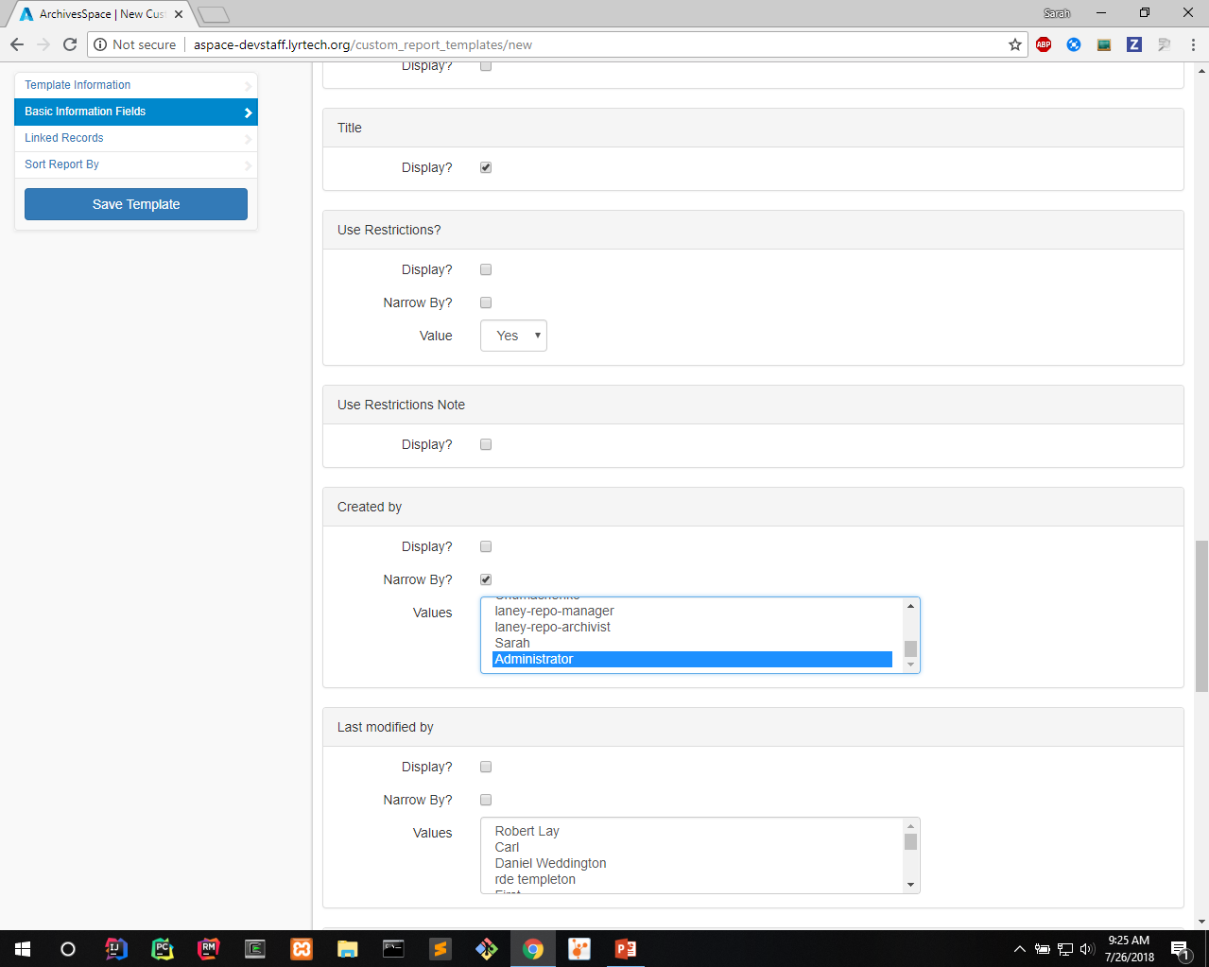
Notes:
Let’s narrow to accession records created by user Administrator
Could select multiple users
Don’t really need to display created by in report since we know it’s administrator

Slide 37
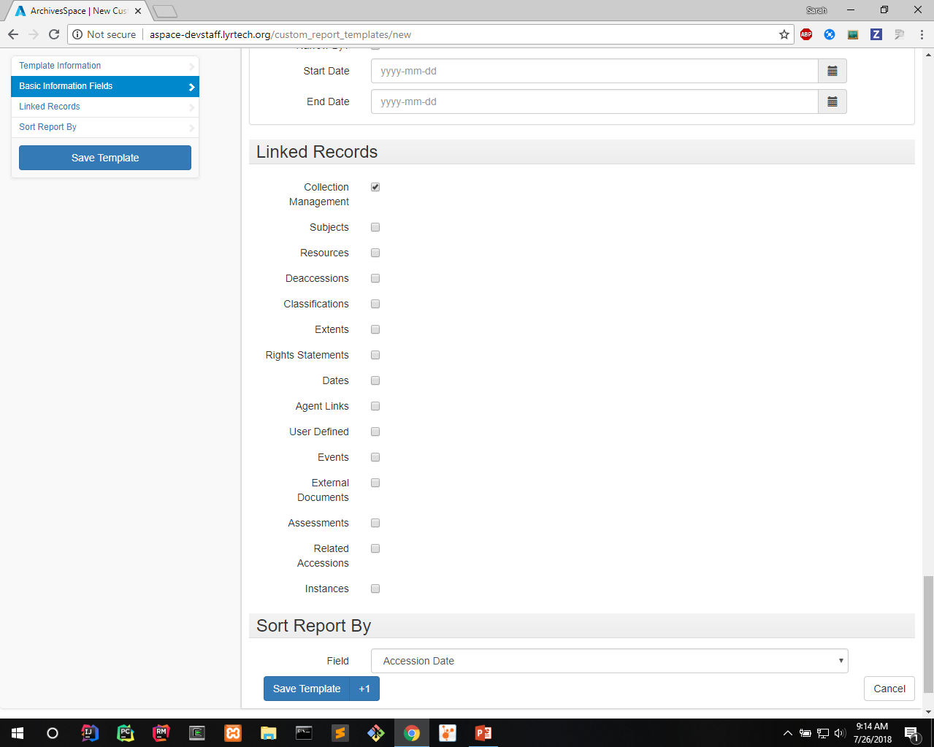
Notes:
Also have options to show linked records
We’ll show collection management fields

Slide 38
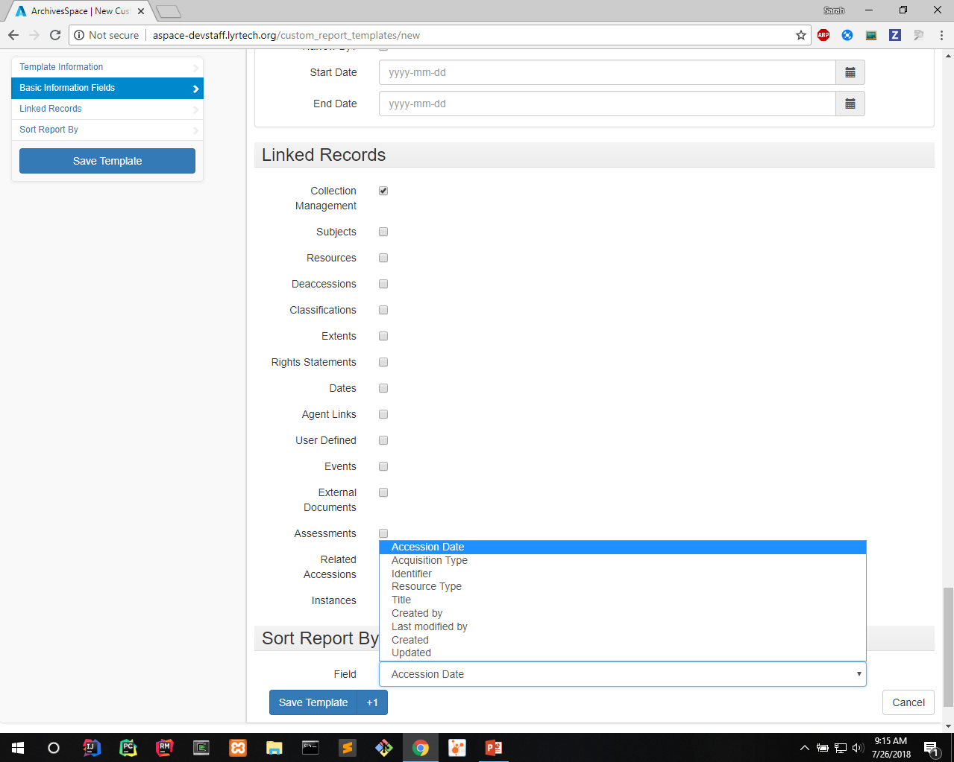
Notes:
- We’ll sort report by the accession date

Slide 39
Notes:
- Save the template

Slide 40
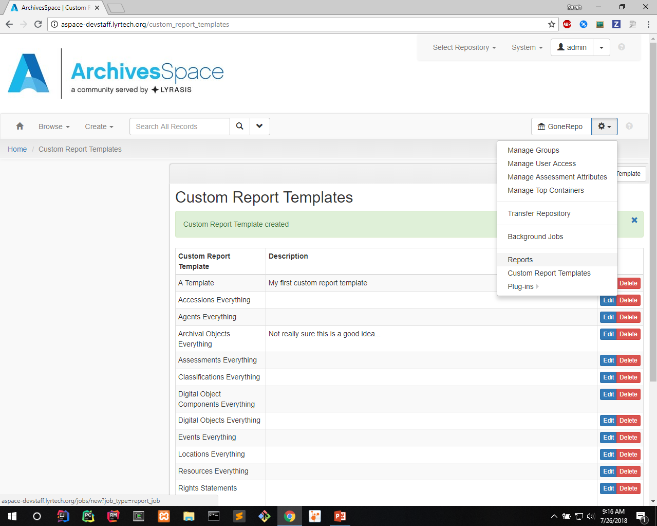
Notes:
Brings you back to listing page
Go to the reports page

Slide 41
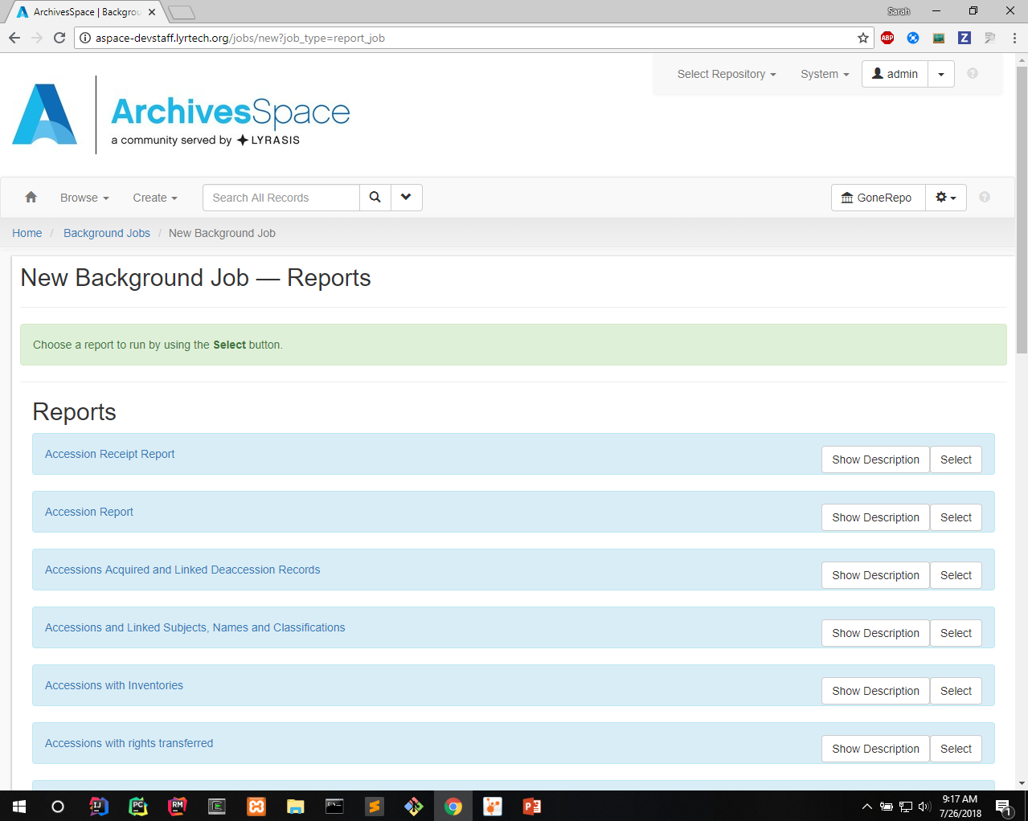
Notes:
- Custom report is listed as a report type

Slide 42
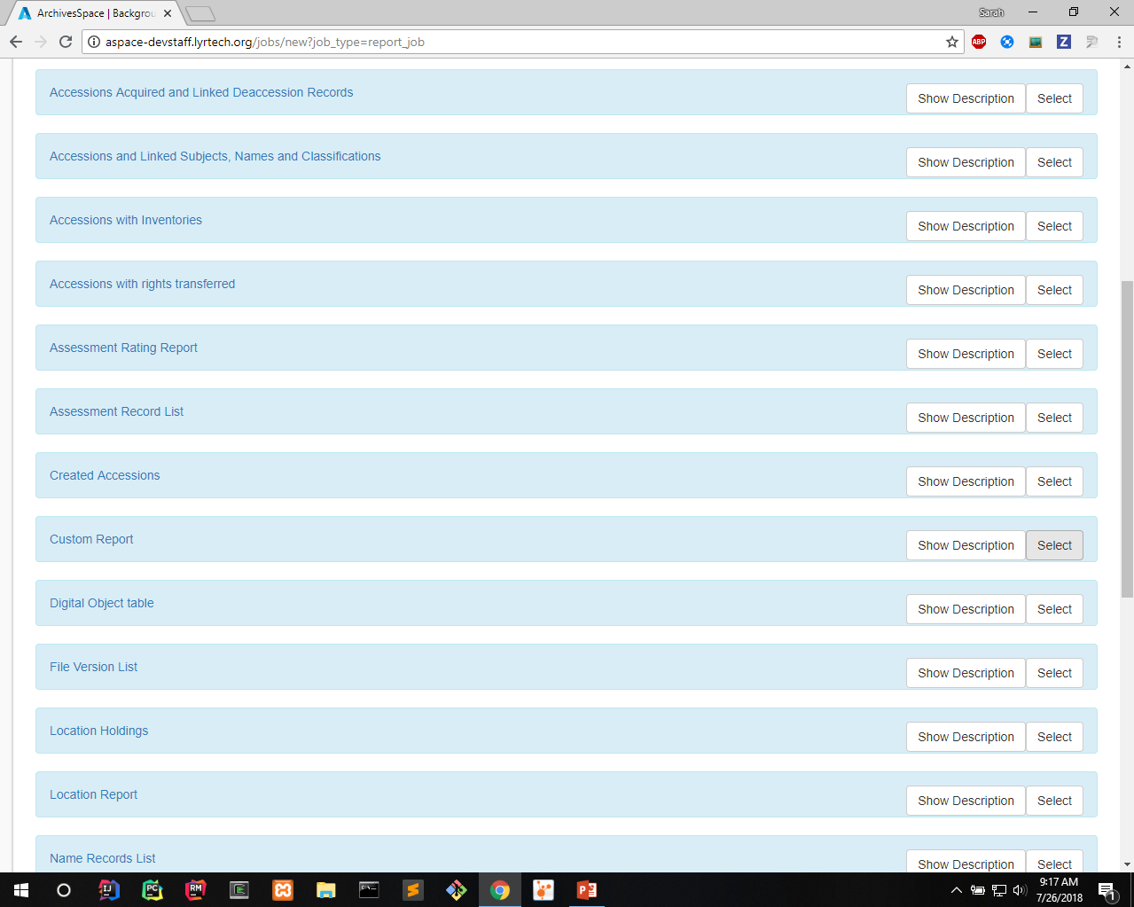
Notes:
Scroll down till you find custom report
Select it

Slide 43
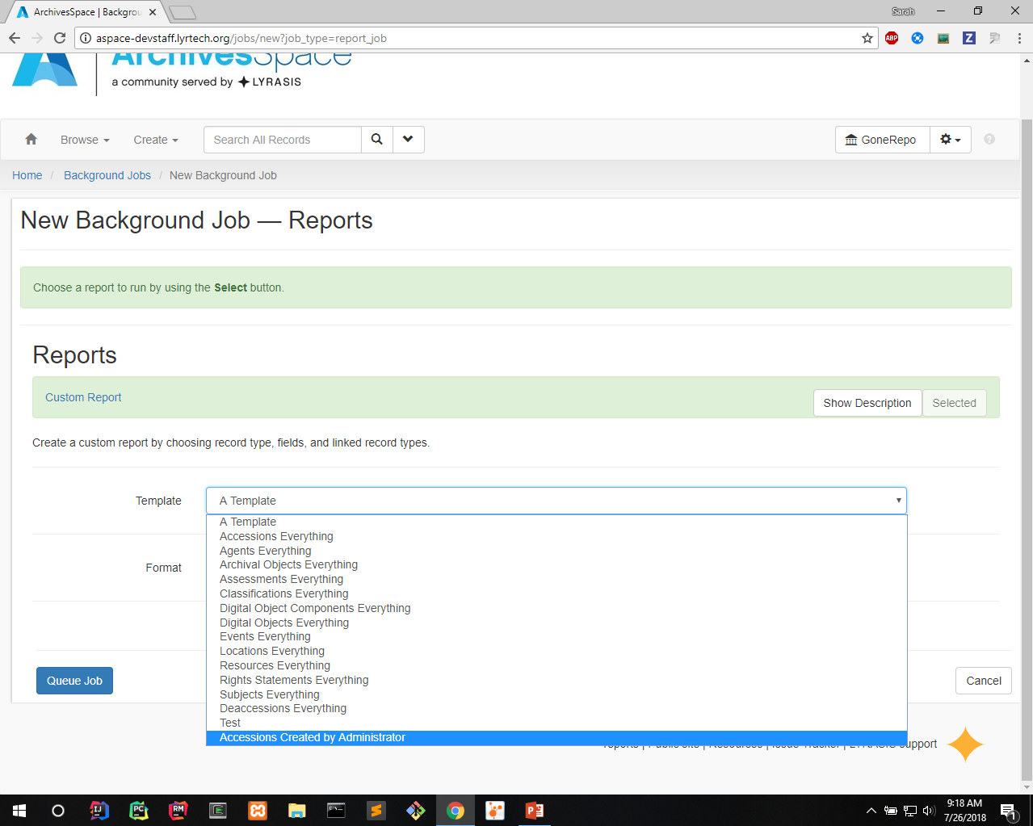
Notes:
For template select the template you want to run
In this case, we select the one we just created

Slide 44
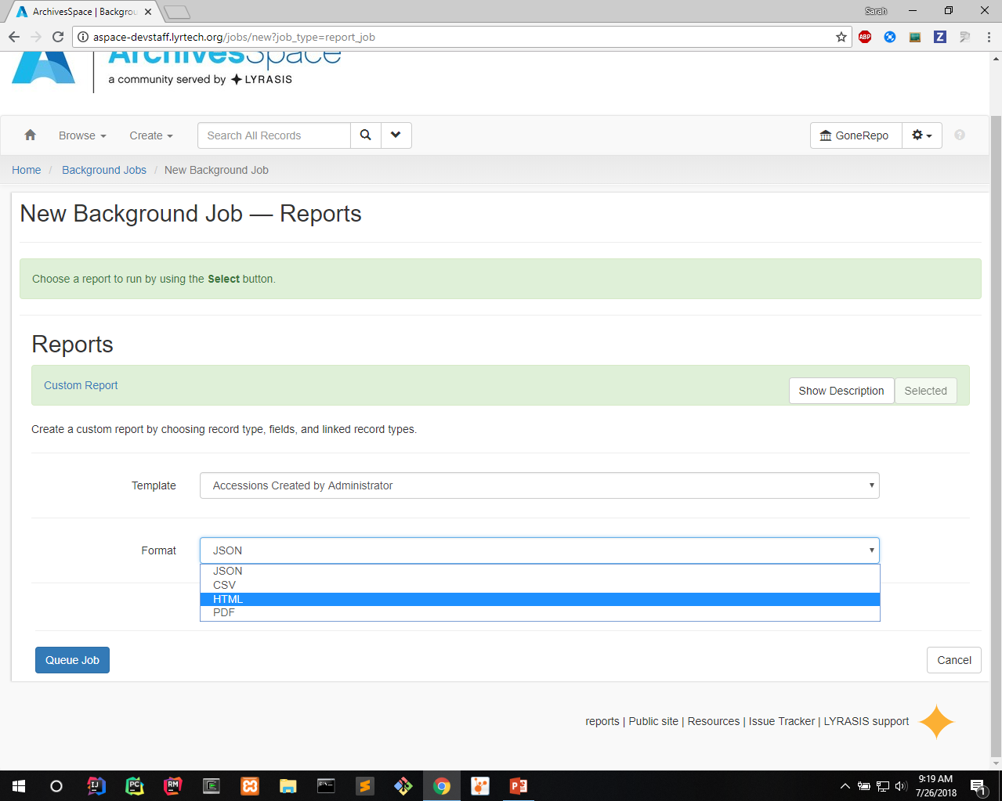
Notes:
- Select format

Slide 45
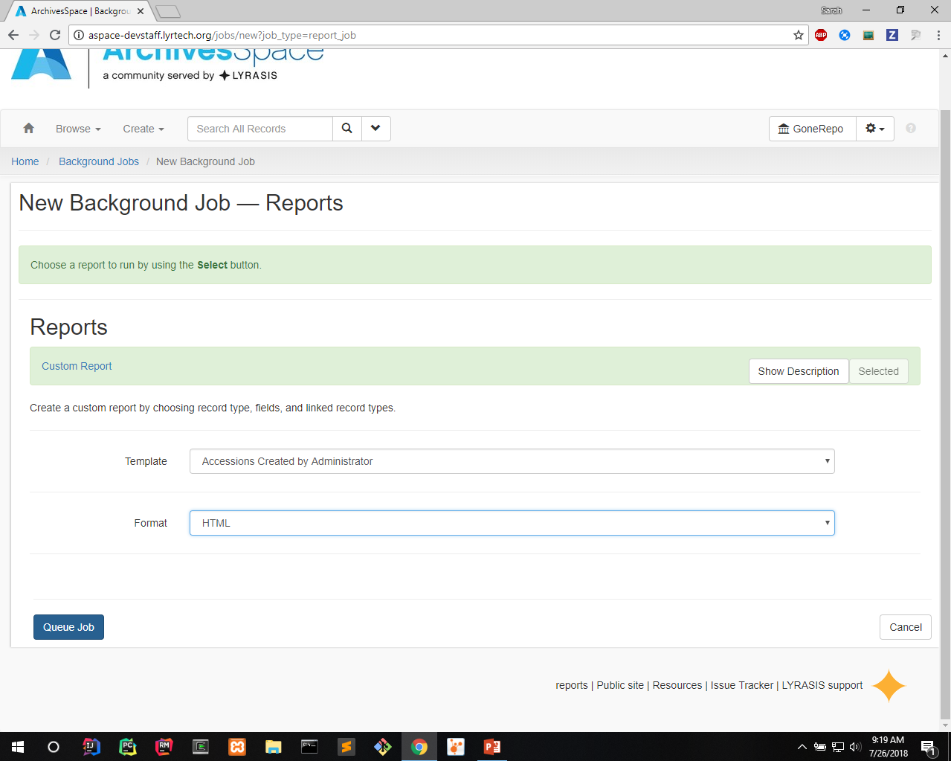
Notes:
- Queue job

Slide 46
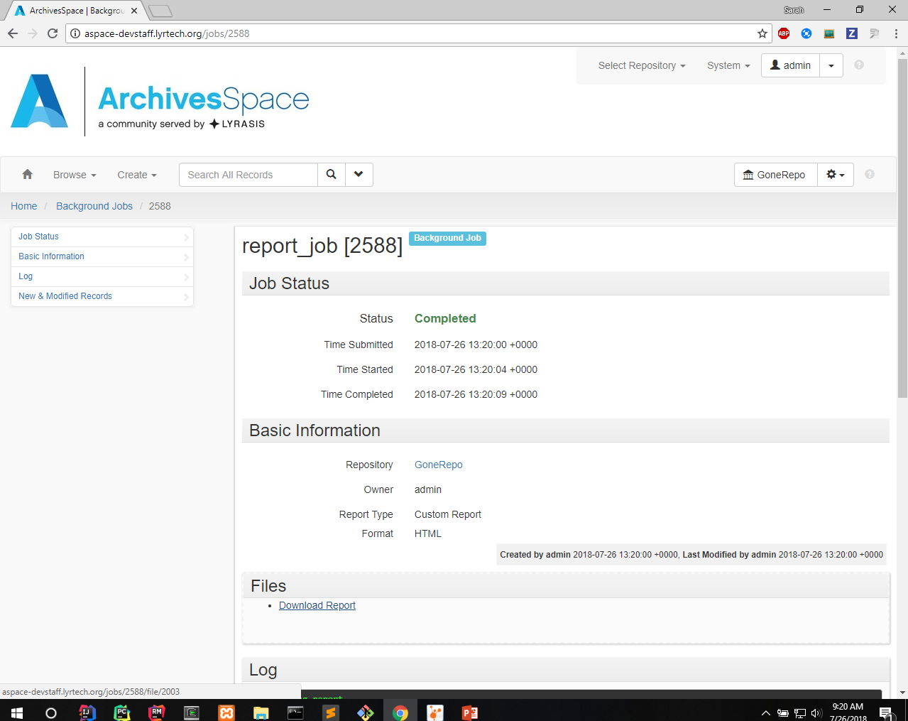
Notes:
- Download when its done

Slide 47
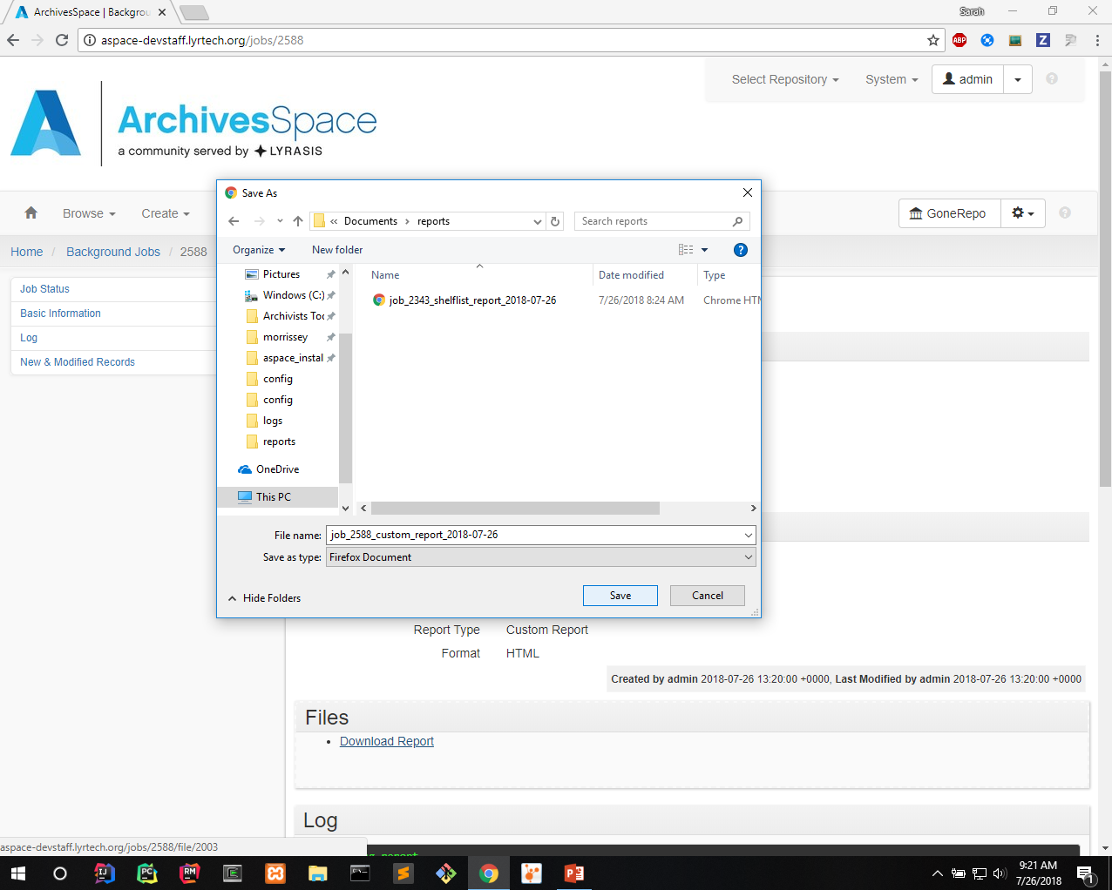

Slide 48
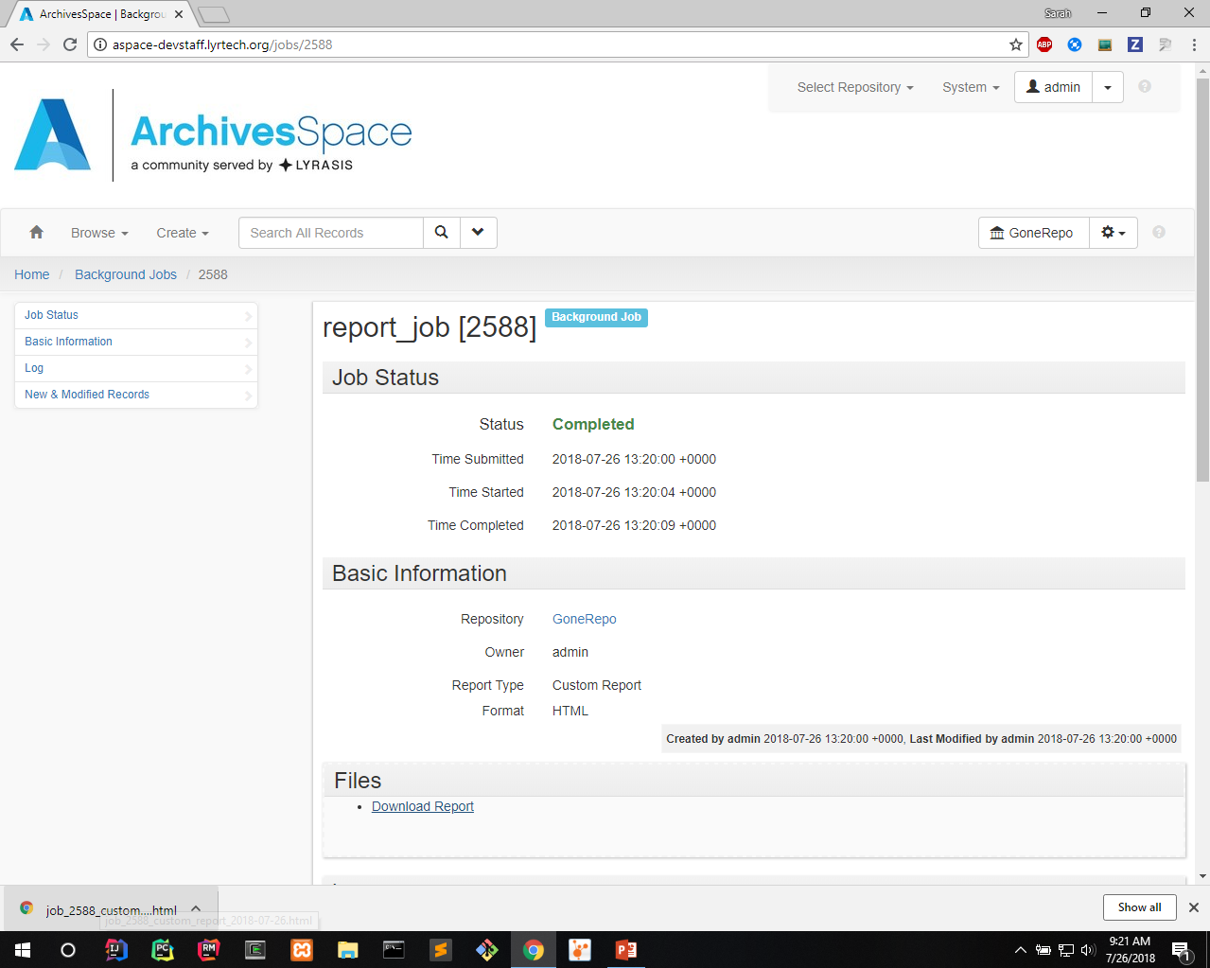

Slide 49
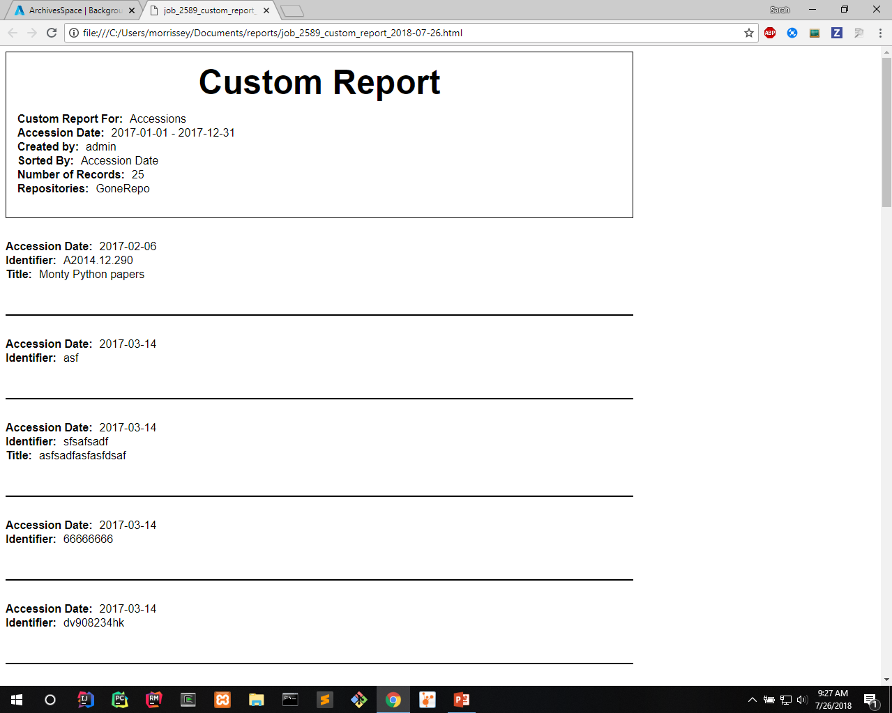
Notes:
Looks like this
Notice the header info
How it was narrowed (accession date and created by)
How it was sorted
How many results
Repository

Slide 50
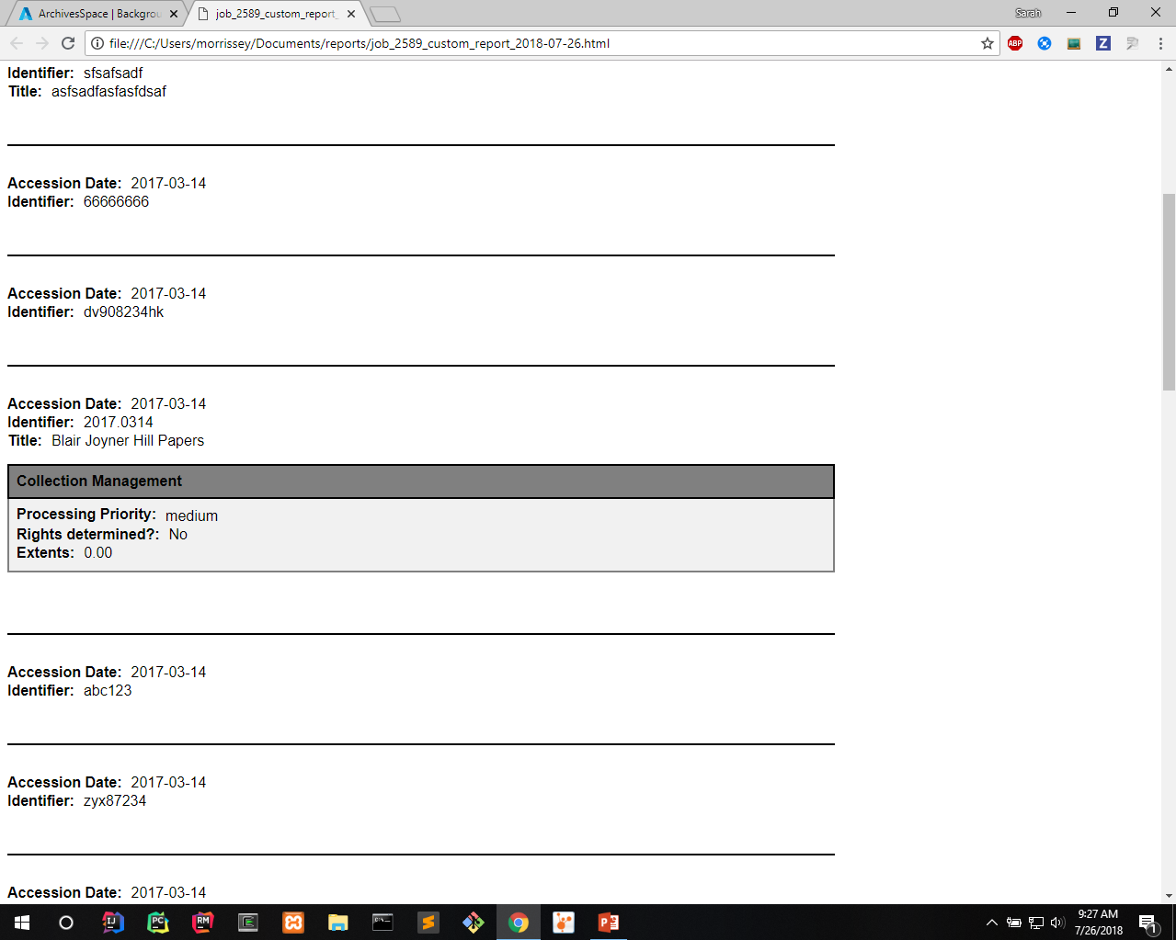
Notes:
- Example of how it looks

Slide 51
Questions?
Thank you for joining us today!

