Slide 1
ArchivesSpace in Cambridge: a consortial approach
ArchivesSpace Online Forum, 19 May 2020
Natalie Adams, Systems Archivist, Cambridge University Library

Slide 2
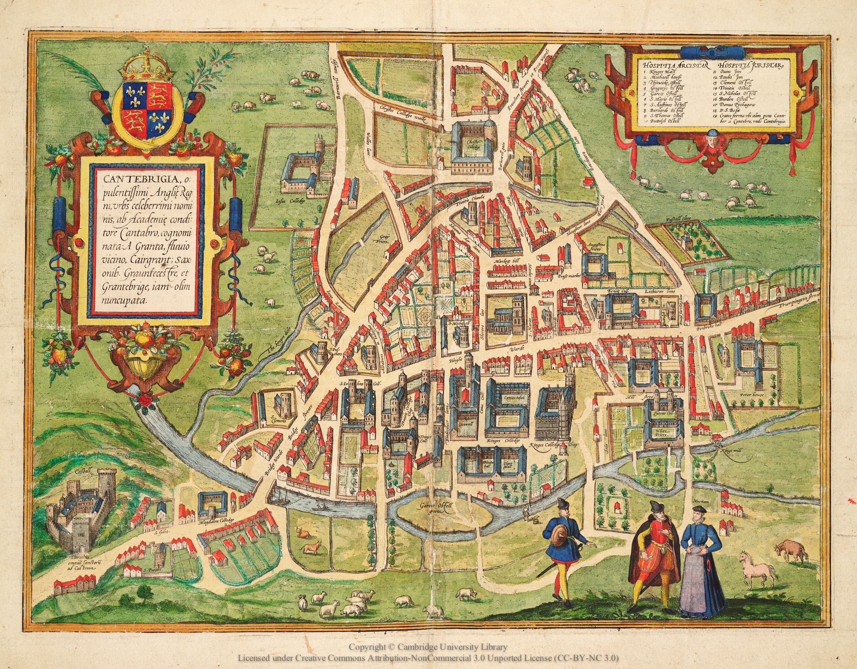
Archive Management System project
Consortium of 29 archival repositories led by Cambridge University Library
Migration of 27 legacy datasets
Benefits to research community- ‘one stop shop’ for discovery of archives in the city
Benefits to University Library: collection management, technical resilience and integration

Slide 3
Implementation challenges
Repository structure: together and separate at the same time?
Consortium issues:
Data Protection - agent records with contact details
Location records shared across ArchivesSpace instance
Customisations:
UK Archival Thesaurus
Reference codes/identifiers
Updates to ‘hover over’ text : ISAD(G), familiar examples.
Image Credit: Alice the Camera

Slide 4
Implementation challenges: migration
Mapping the data:
Crosswalk data elements from legacy systems to AS
Resources and archival objects
Advice from AS community (listserv and listserv archives)
Use customised labels for note fields
Migration tool to:
Extract data from source database
Put it into the format required by ArchivesSpace
Make agreed changes to the data and normalisations
Push data into ArchivesSpace
Image Credit: Alice the Camera

Slide 5
Migration tool: unstructured ->structured data
From this:
To this:
Extent text
“160 bundles of bound gatherings; 31 files; 513 volumes; [series /5 not accounted for]"

Slide 6
What’s next?
More data migrations!
Working from home/lockdown
Public User Interface
Integration with Primo and data aggregators
Implementation of collection management

Slide 7
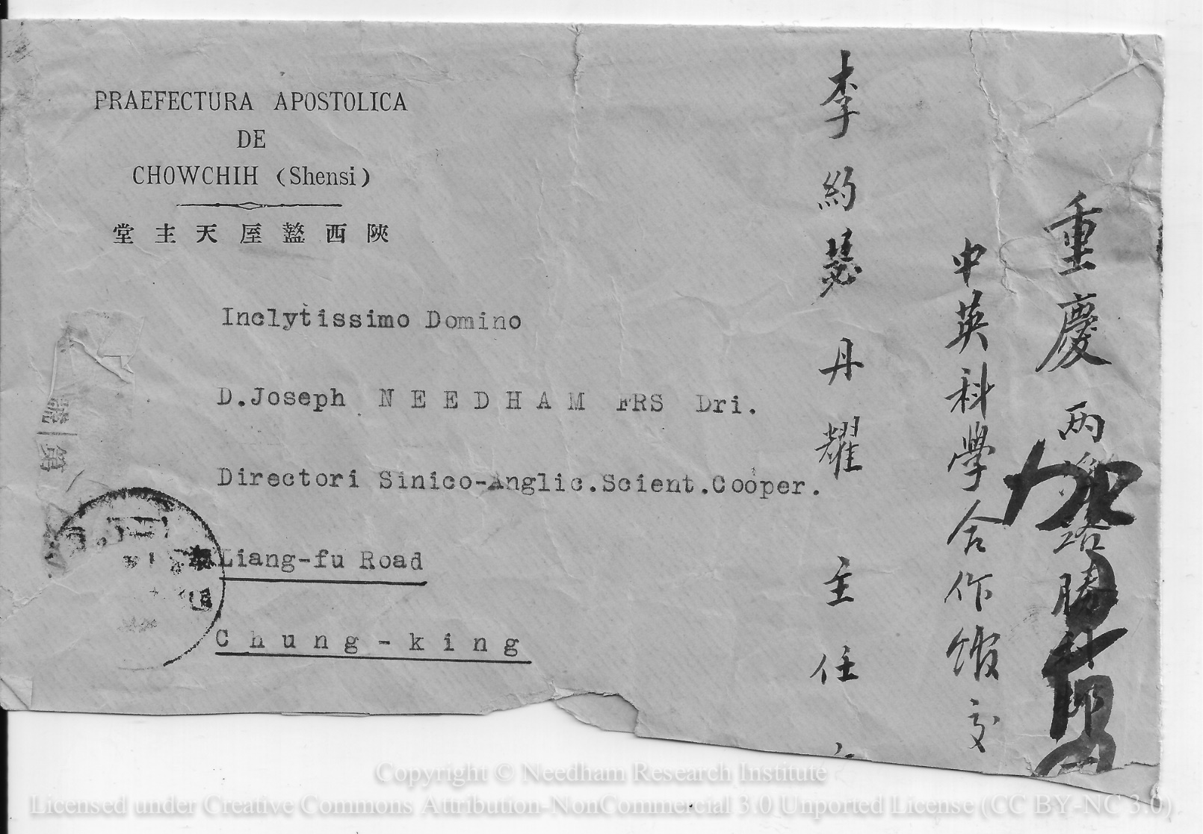
For further information:
Cambridge University Library Special Collections Blog: https://specialcollections-blog.lib.cam.ac.uk/
Natalie Adams: ams@lib.cam.ac.uk

