Slide 1
Radically Altering Plans for a Telecommute Environment
How One Large Academic Library
is Implementing ArchivesSpace
Notes:
My name is Bailey Hoffner and today I’d like to share what the last few weeks, and now months, have looked like for me and many of my colleagues in special collections and University Libraries at the University of Oklahoma (OU). I don’t think I need to say much about why we’ve arrived at this place where radically altering our plans was necessary, because we’re all living through the Covid-19 pandemic and crisis together.

Slide 2
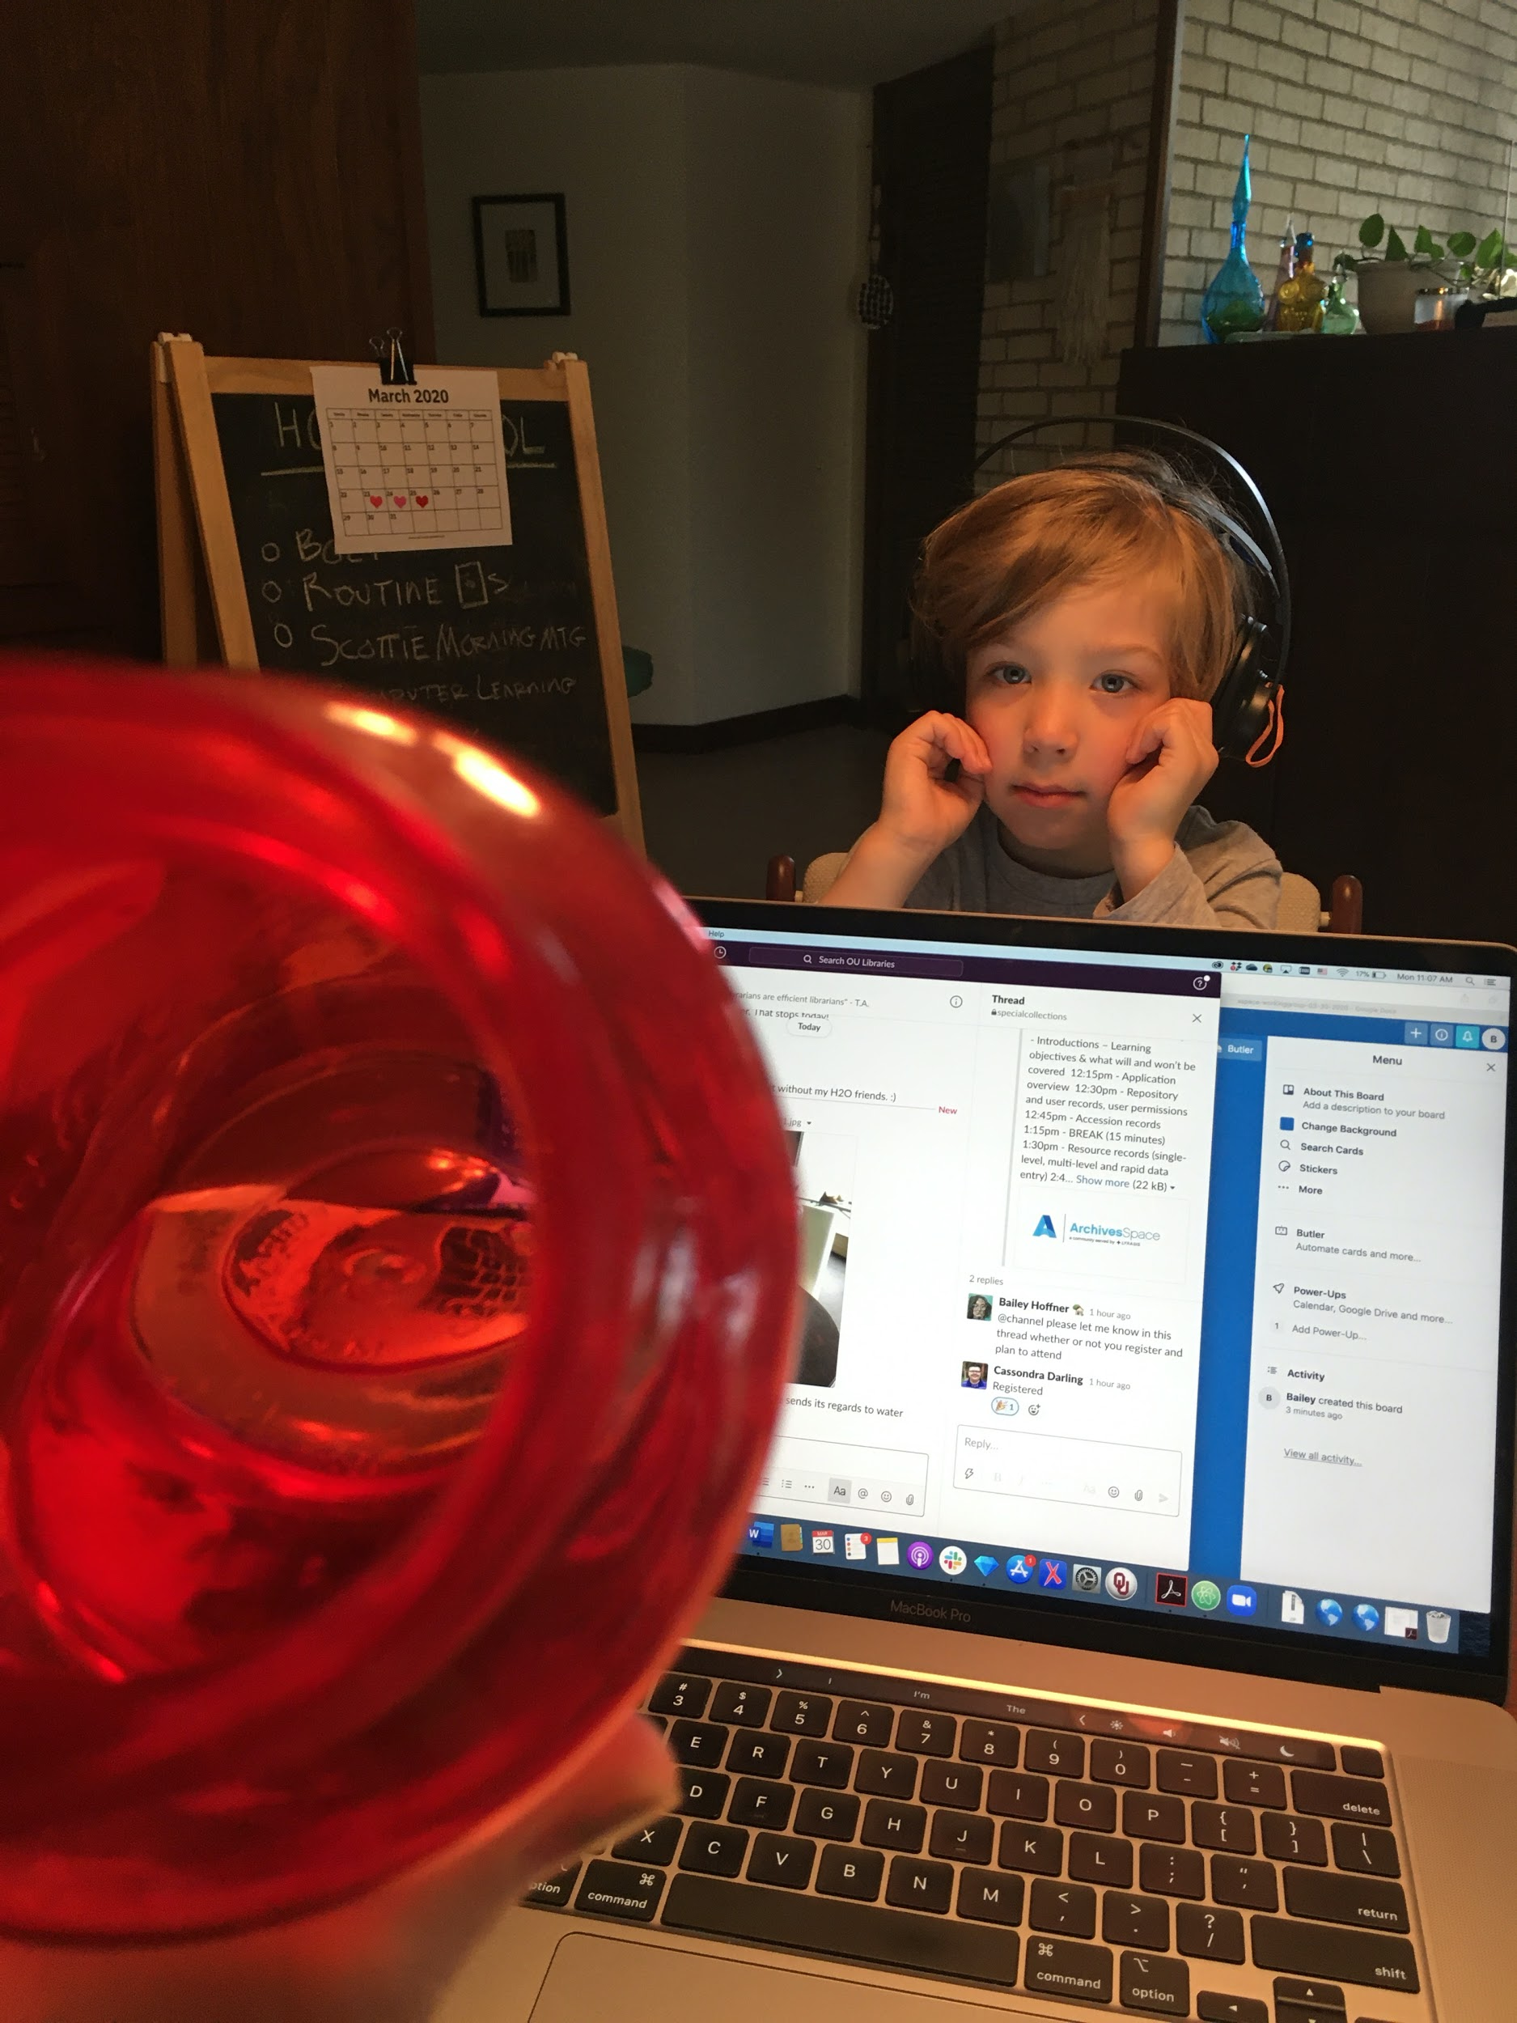
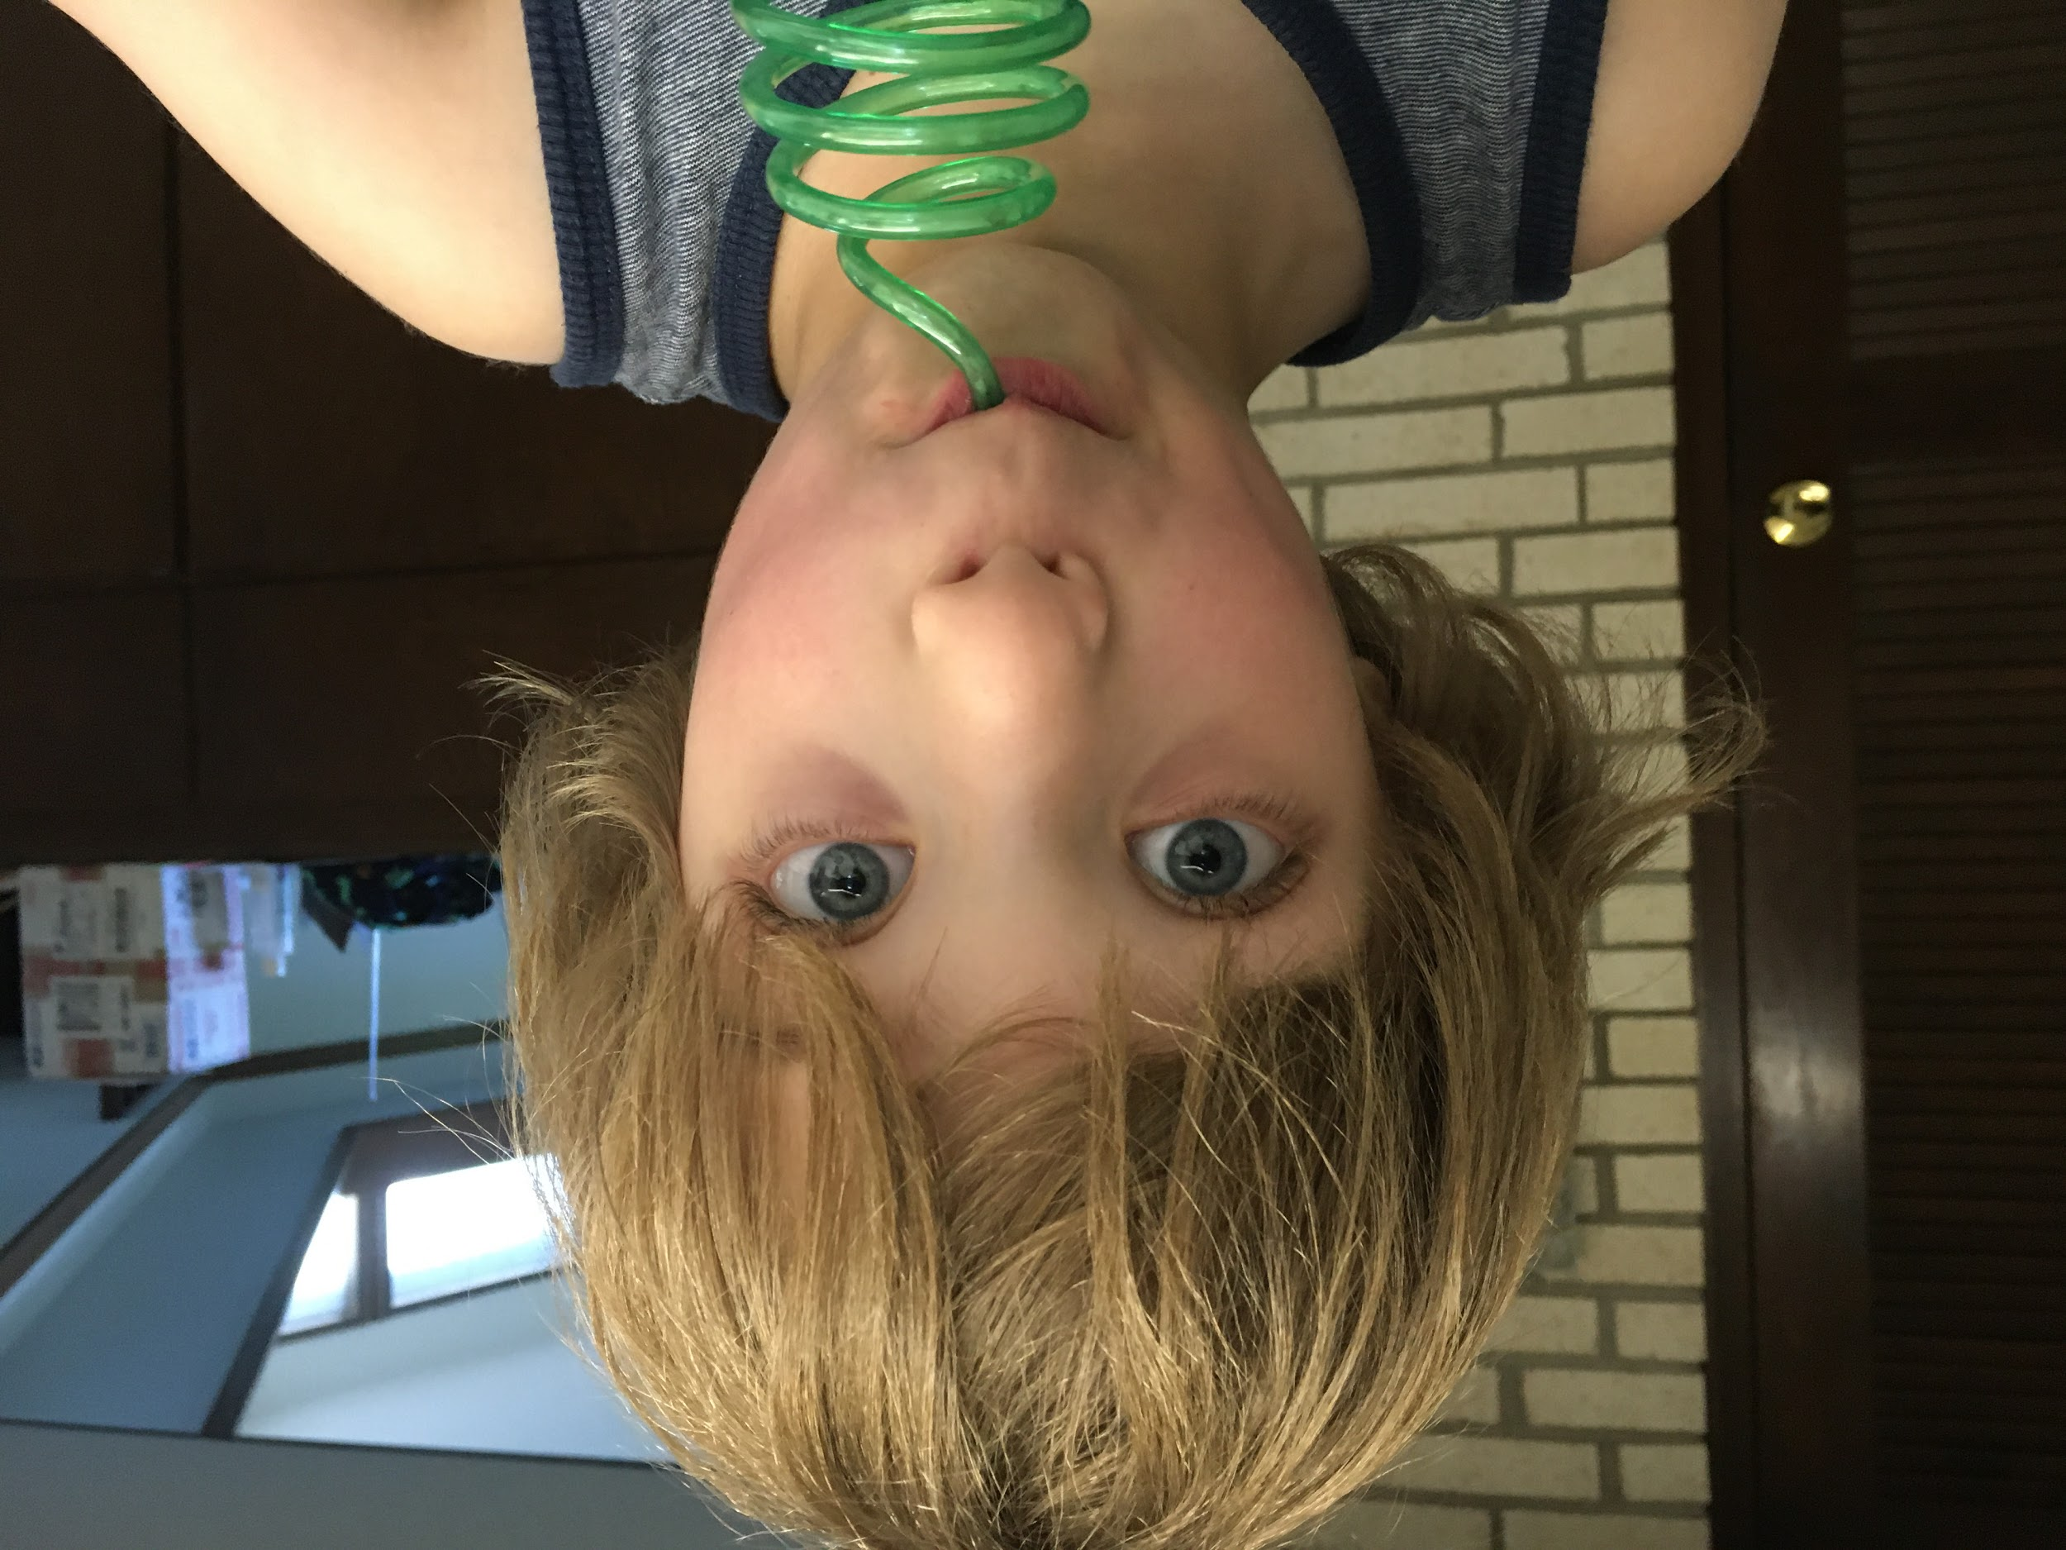
Working from Home
Notes:
On that note, I’ll give a quick shout-out to my new office mate and five-year-old son who may or may not make a surprise vocal appearance in this presentation. His constant presence is both keeping me sane and driving me mad, a sentiment that I’m sure is reciprocal, and one many of you can likely relate to.

Slide 3
Overview
The Project
Useful Tools
Implementing ArchivesSpace
Goal-Oriented
Human-Centered
Virtual Project Management
Data Cleanup
Data Ingest
Notes:
I hope that my presentation today provides some insights into how other institutions might create and work towards goal-oriented, and human-centered ArchivesSpace projects in a virtual environment. I will be speaking about some virtual project management, data cleanup, and data ingest tools that have been useful for us.

Slide 4
New Job
Metadata and Collections Management Archivist
First Day: February 1st, 2020
Notes:
For a little context, I am the Metadata and Collections Management Archivist for special collections at OU. On a normal day, we have the benefit of working from an exceptionally beautiful campus, and this particular picture is what I might have seen walking by my own well-loved, little office window.
I’m still surprised each time I say it out loud, but my first day on the job was February 1st of this year – so much has happened since then!

Slide 5
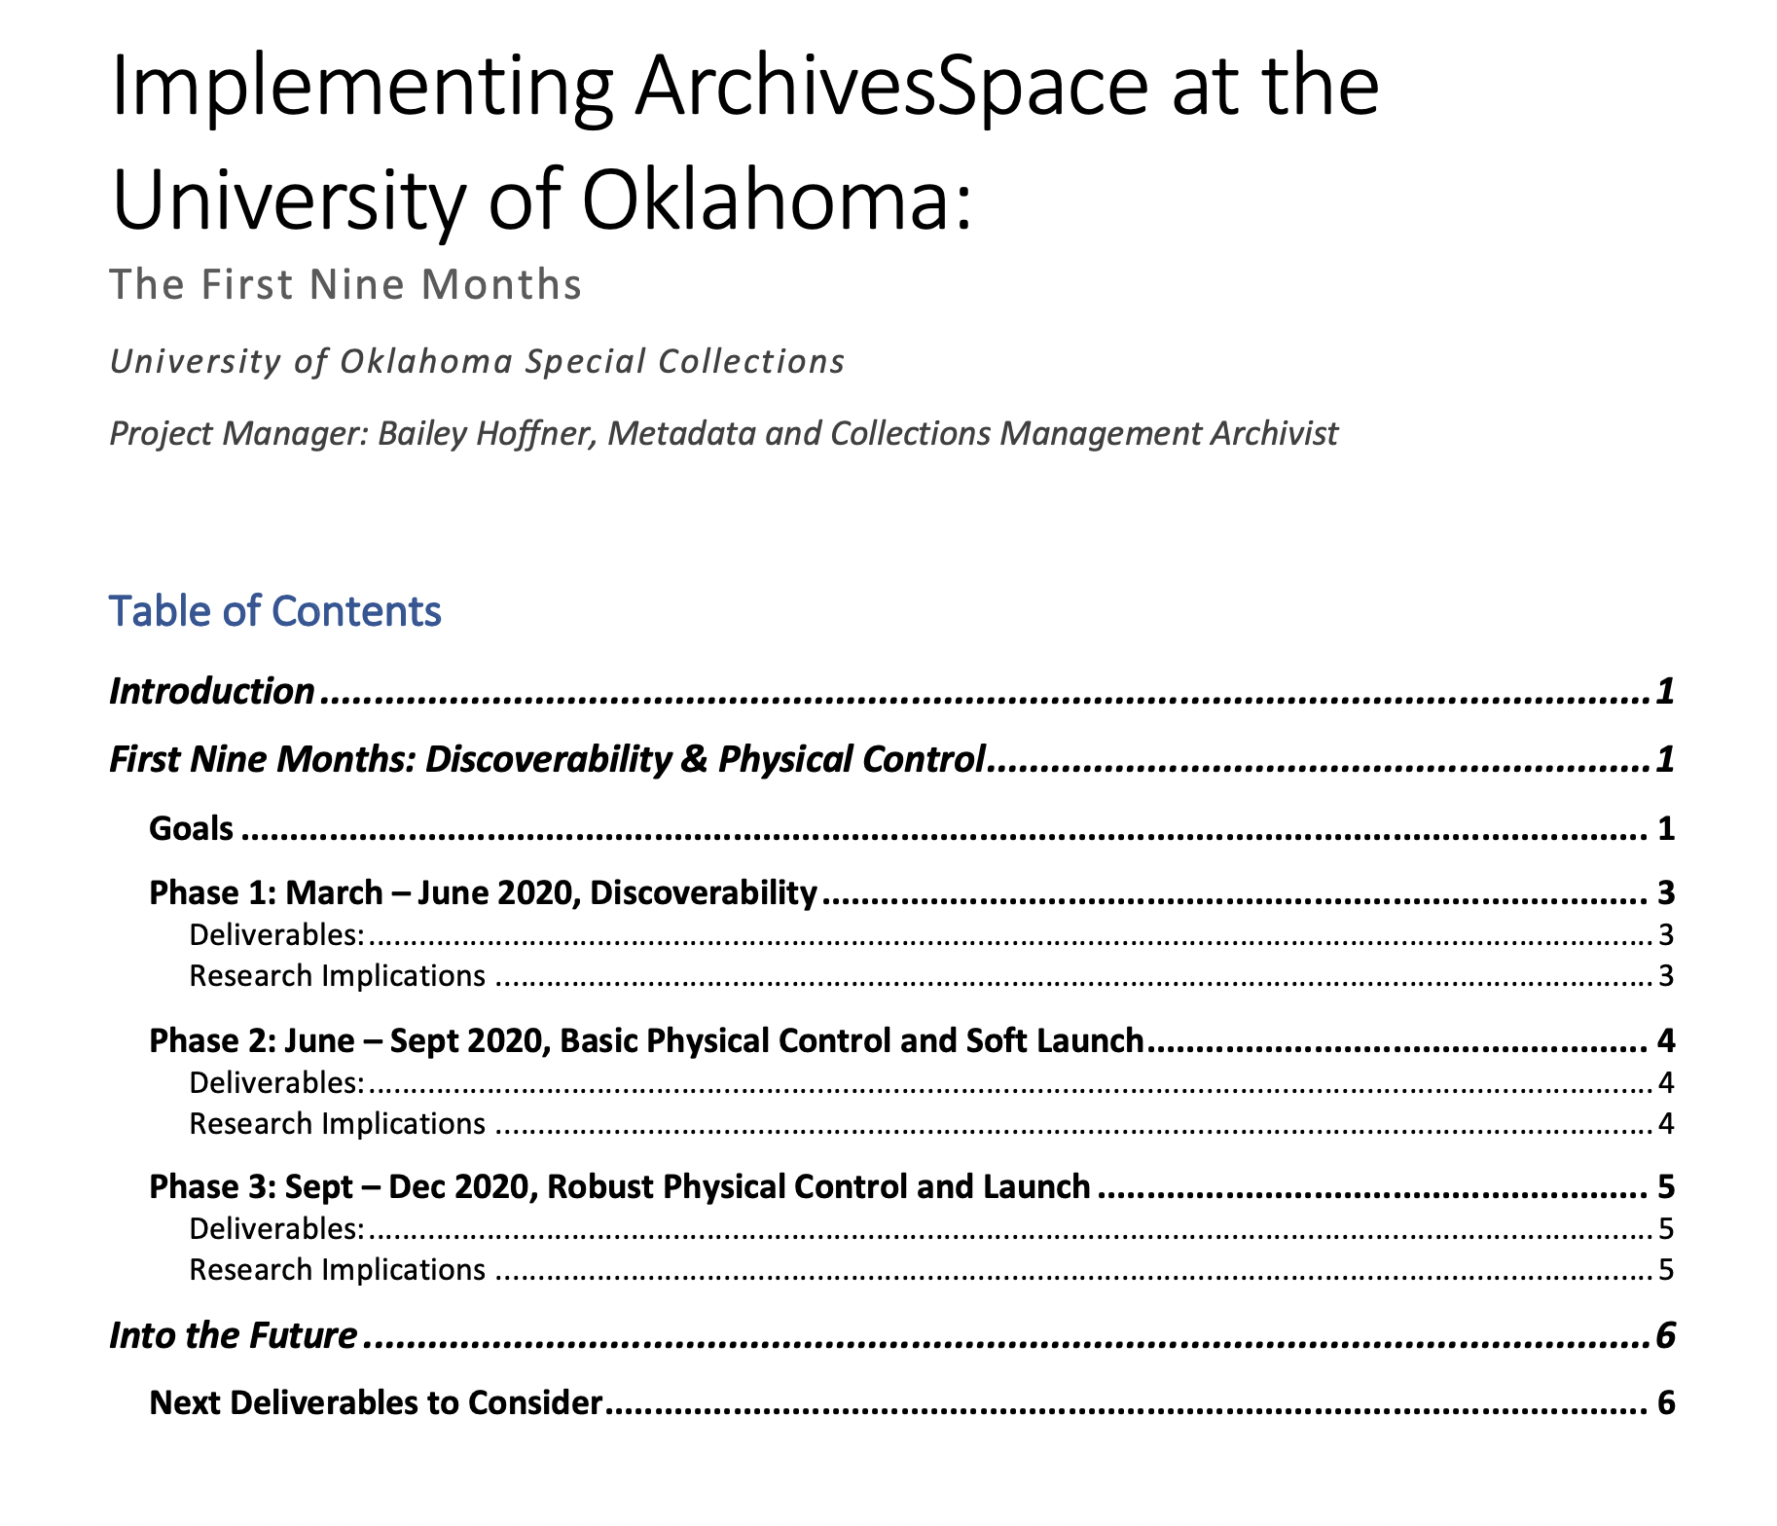
Goals & Planning Period
Implement ArchivesSpace
9-month initial plan
Increased discoverability and physical control
Notes:
A major goal for this new position was to implement ArchivesSpace, thereby gaining all of the wonderful standards-based benefits that come along with it.
I spent the majority of my first six weeks getting oriented and preparing a 9-month initial plan for implementing ArchivesSpace with a focus on increasing discoverability and physical control of our collections.

Slide 6
OU Libraries Special Collections
Chinese Literature Translation Archive
Harry W. Bass Collection in Business History
History of Science Collections
John and Mary Nichols Rare Books and Special Collections
Western History Collections (WHC)
Notes:
The OU special collections are comprised of 5 main units each renowned in their separate fields of study. I could spend this whole talk on all of the fascinating and wonderful things within these collections, but that’s another presentation.
The work I will be speaking about today, most directly relates to our Western History Collections...

Slide 7
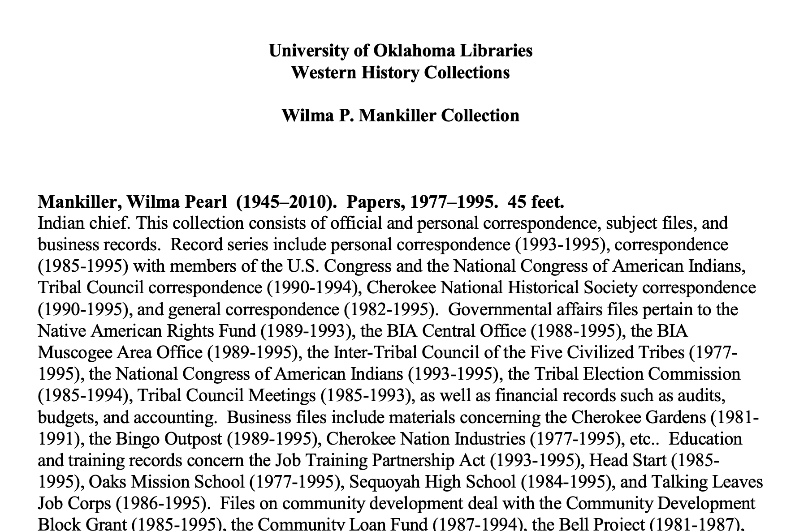
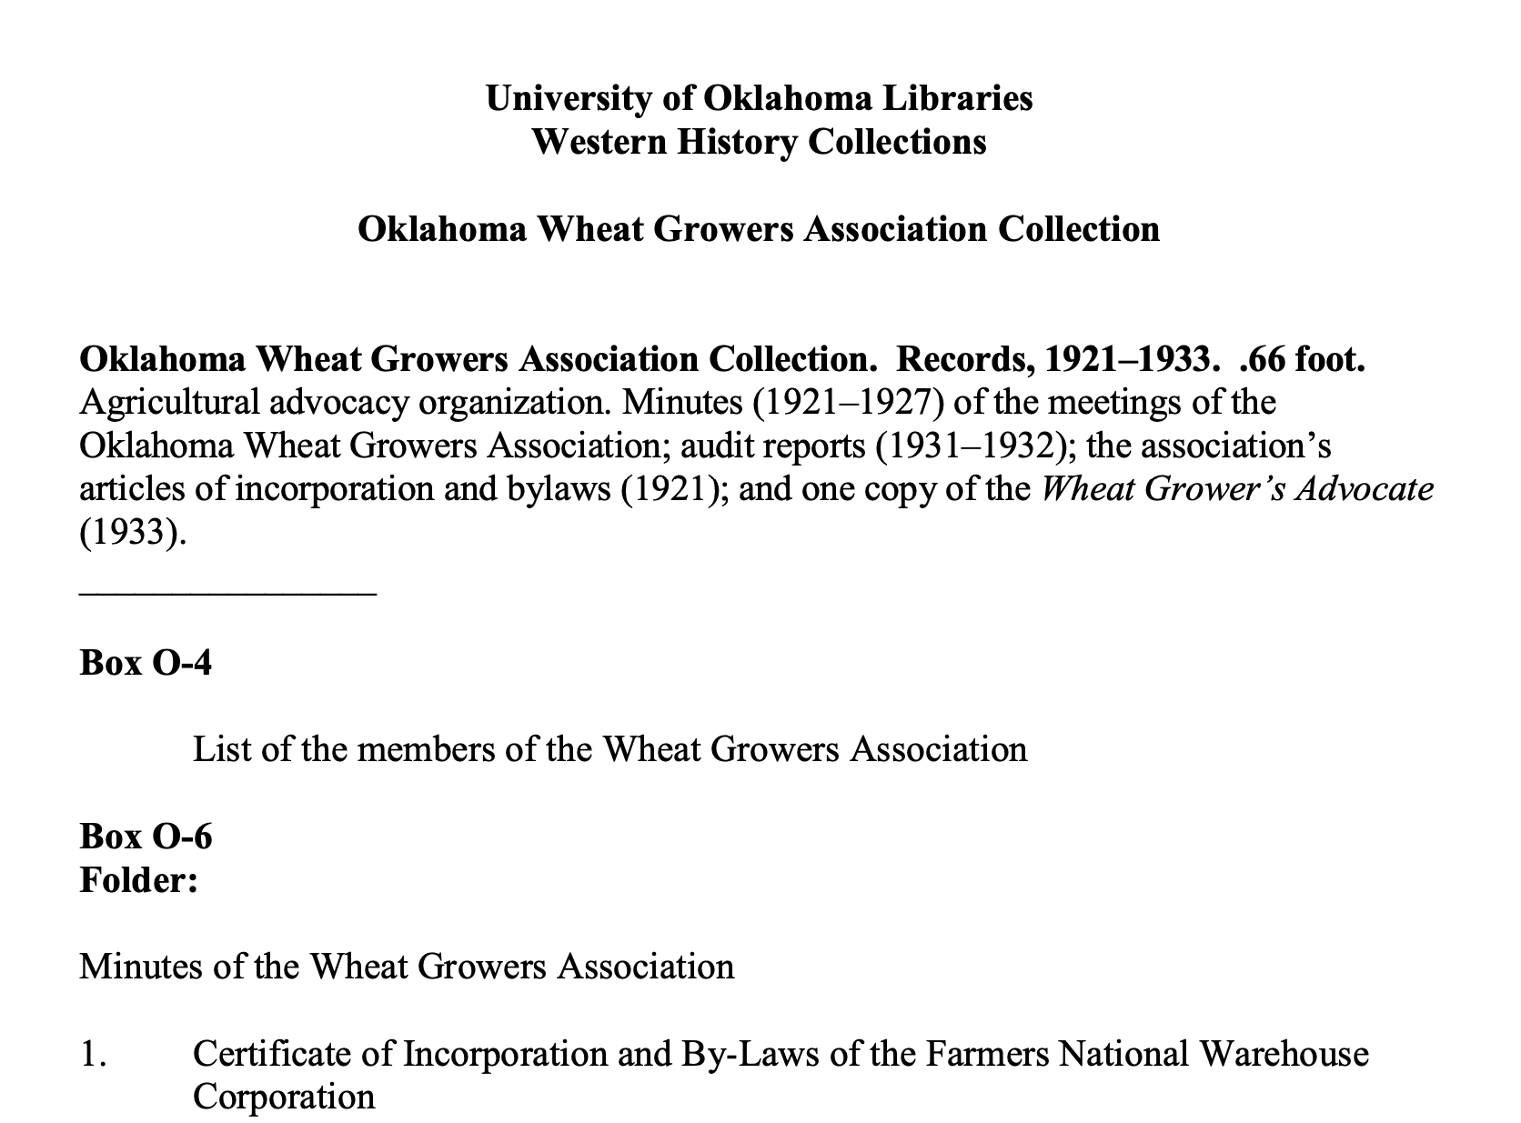
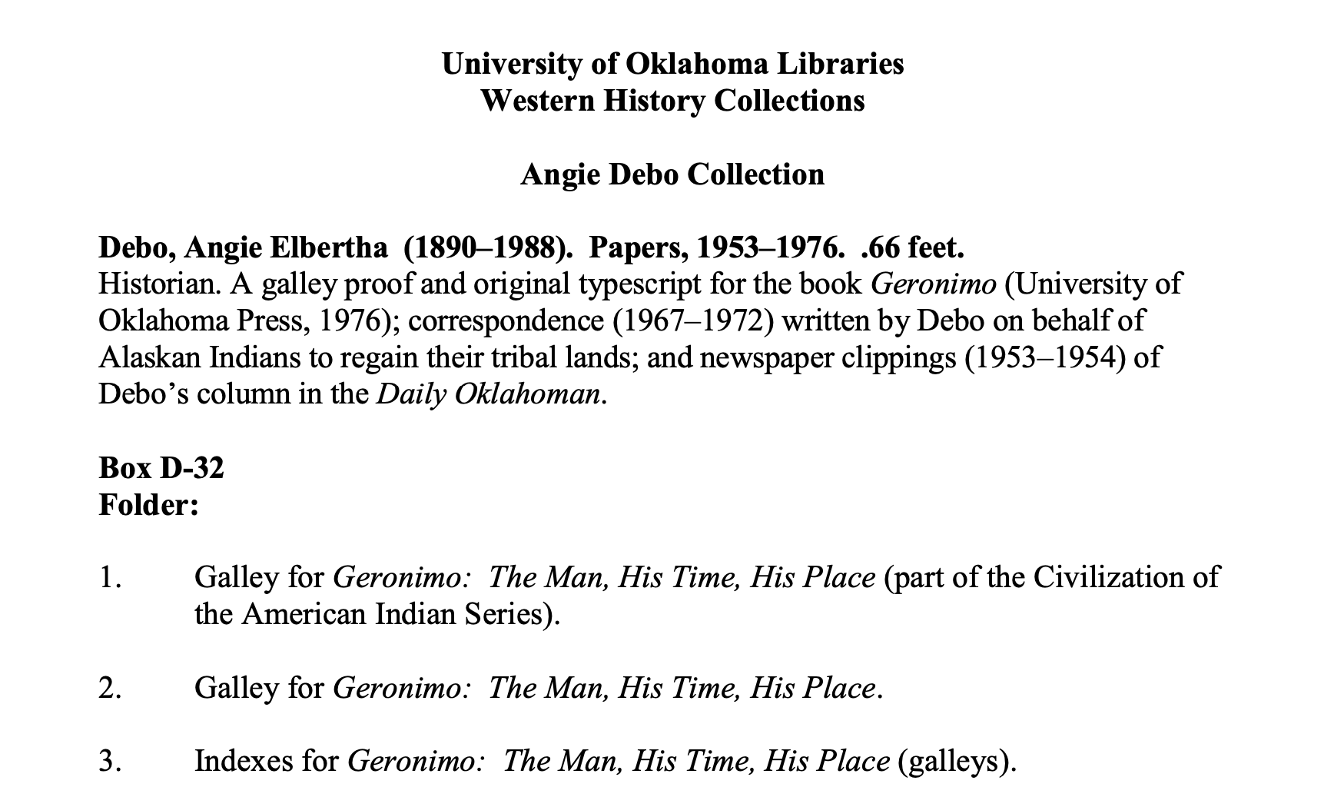
Existing WHC Finding Aids
Notes:
which already have finding aids in PDF and/or Microsoft word formats for more than 3500 collections. With a programmatic approach to ingesting these finding aids out of the question, the main part of my job for those first 9 months, would have been to clean-up, transform, and ingest many of these unstructured legacy finding aids into AS.
I completed my initial plan on Friday, March 13th – the last day before our campus and community went on lockdown.
At the beginning of that next week, the challenges we faced and the motivations behind our work had changed somewhat drastically, though the goal of successful implementation of the platform remained the same.

Slide 8
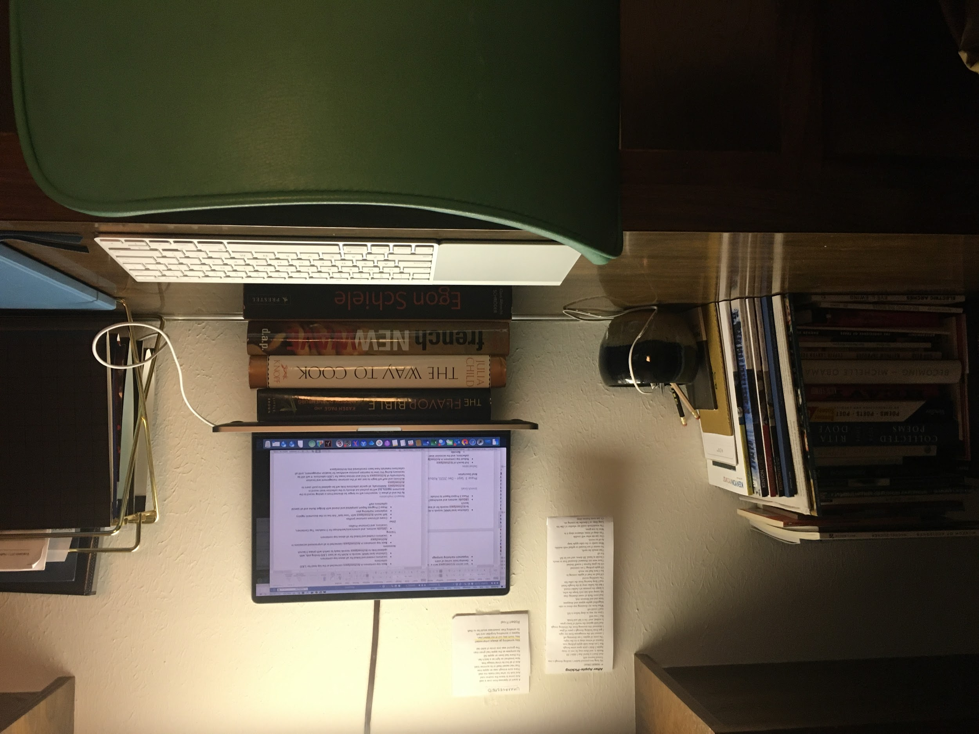
New Challenges
Working from home
How to identify goal-oriented work for a significantly increased online workforce
Budgetary constraints
Robust physical control no longer possible
Notes:
Our main challenge was how to identify goal-oriented work that could be carried out in this environment. I knew that I had lots of online work to do to transform those 3500+ finding aids, but I also knew that the daily work of many of my colleagues had suddenly become impossible to do from home. Opening the project up to other UL employees that would normally be otherwise occupied, meant that we could significantly shorten our timeline for implementation while providing meaningful virtual work. I know that it has been a huge boon for my own personal mental health, to have a sense of purpose in the work I am doing from home.
Also, suddenly facing new budgetary constraints, we needed to speed up implementation of AS to justify our continued use of the platform – even waiting 9-months to launch, would likely not work.
The initial plan’s focus on robust physical control was no longer possible in the short term considering our separation from the materials themselves. So a new plan was formed out of the old one. Or, it might be more accurate to say, a plan-as-you-go model, informed by, but necessarily divergent from, the original 9-month-plan, was adopted.

Slide 9
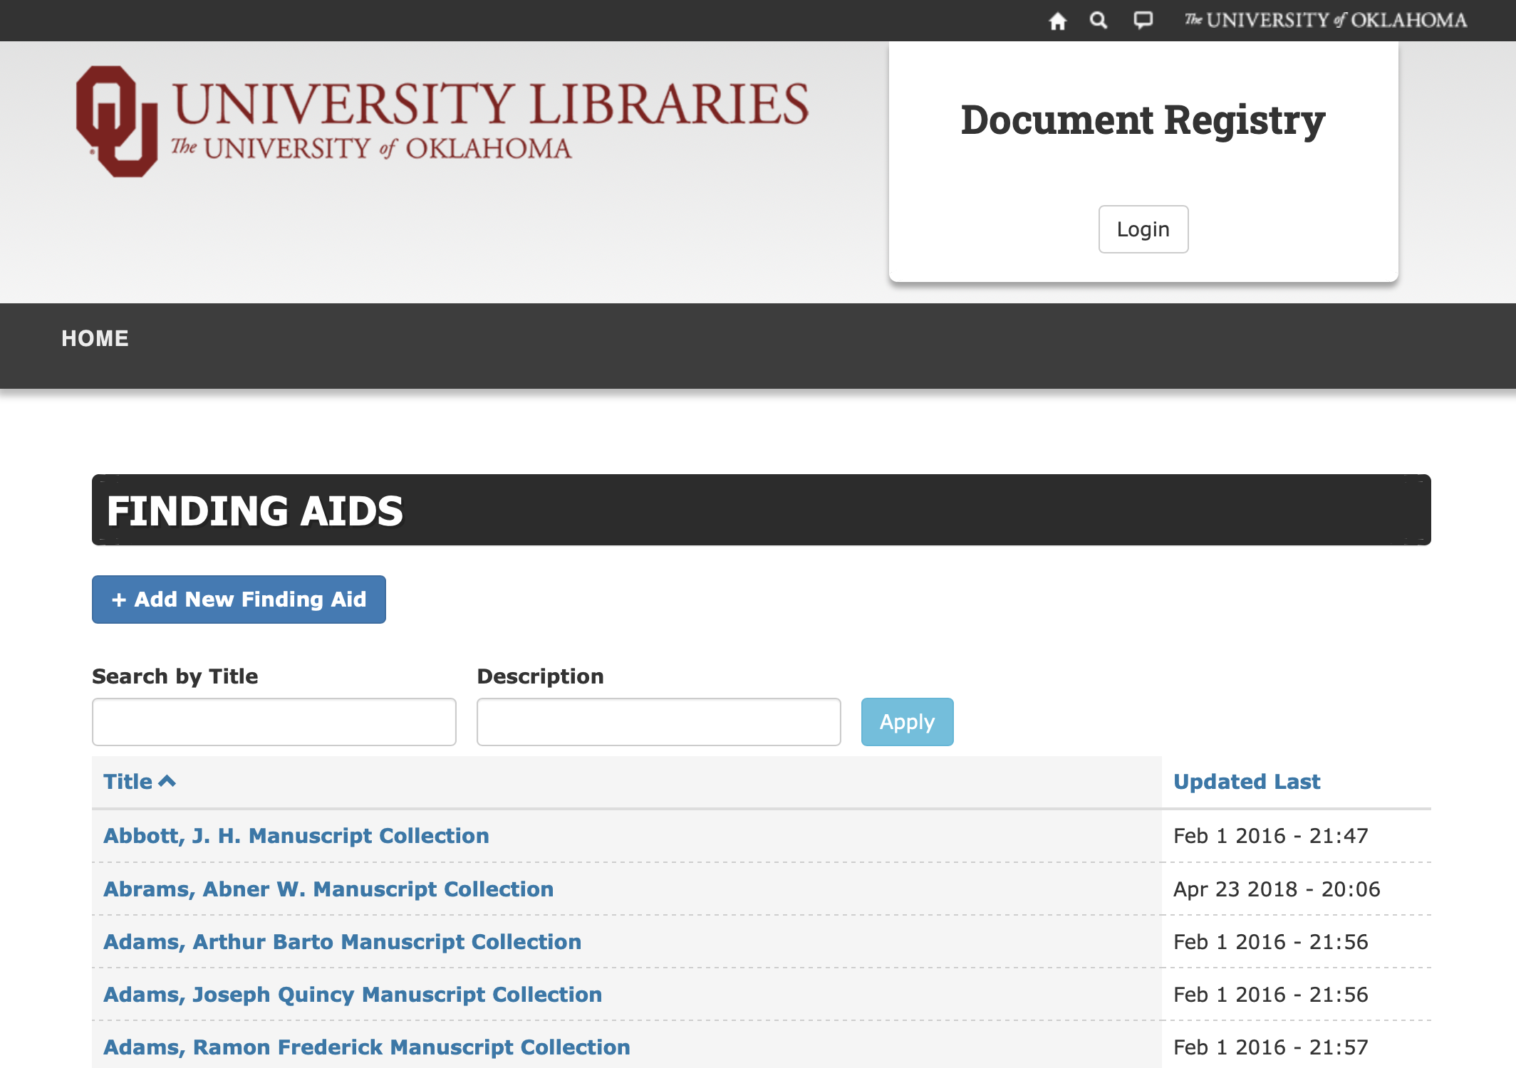
Increased Discoverability
1,820 Finding Aids in Document Registry
ArchivesSpace
Notes:
With the renewed push to “go live” as soon as possible, we decided to focus our efforts on the 1,820 finding aids that were and are available as PDFs in the library’s document registry. This is currently our main access point for special collections finding aids, and discoverability is limited to a very basic search of either collection titles or scope notes, meaning that researchers are heavily dependent on archivists and their knowledge of the collections.
[click, click]
Once these 1,820 finding aids were moved to AS we could “go live” with everything that was already available online to researchers, with better search functionality, and with the promise of additional resources and finding aids to be added regularly.

Slide 10
Dynamic Approach
Resource Records
PDF Links
temporary workaround
Components
Notes:
Many of the resource level records had already been created in AS through an earlier batch import of existing Marc records from the library catalog. Knowing that complete ingest of component records would take more time than we had, we came up with the following dynamic approach to record creation:
We would create the rest of the resource records (often problematic ones that didn’t easily batch import, or that did not yet exist as MARC records), meanwhile as a temporary workaround, we would add PDF links to each resource record, providing full finding aids for those collections that existed in the document registry prior to our ability to fully ingest the component records. All of these things could be happening to different collections at once, depending on where each was at in the process.

Slide 11
ArchivesSpace Implementation Working Group
19 Team Members & Consultants
Special Collections
Description & Access
Architecture Library
Staff and Graduate Assistants
Notes:
I’ll speak to our progress in the next slide, but first I need to speak a bit about the amazing group of people I’ve had the pleasure of working with over the last couple months.
In the beginning of our work-from-home phase, I formed an ArchivesSpace Implementation Working Group. This group is now comprised of 19 library staff members and graduate assistants, from a variety of areas within OU Libraries (list departments). (note on D&A) Because of this, we have access to a wonderful array of skills, but also vast differences in familiarity with archival description and metadata practices.
I’d like to give a snapshot of the progress we have made in just 9 short weeks and then I’ll get to how exactly we’ve managed this work.

Slide 12
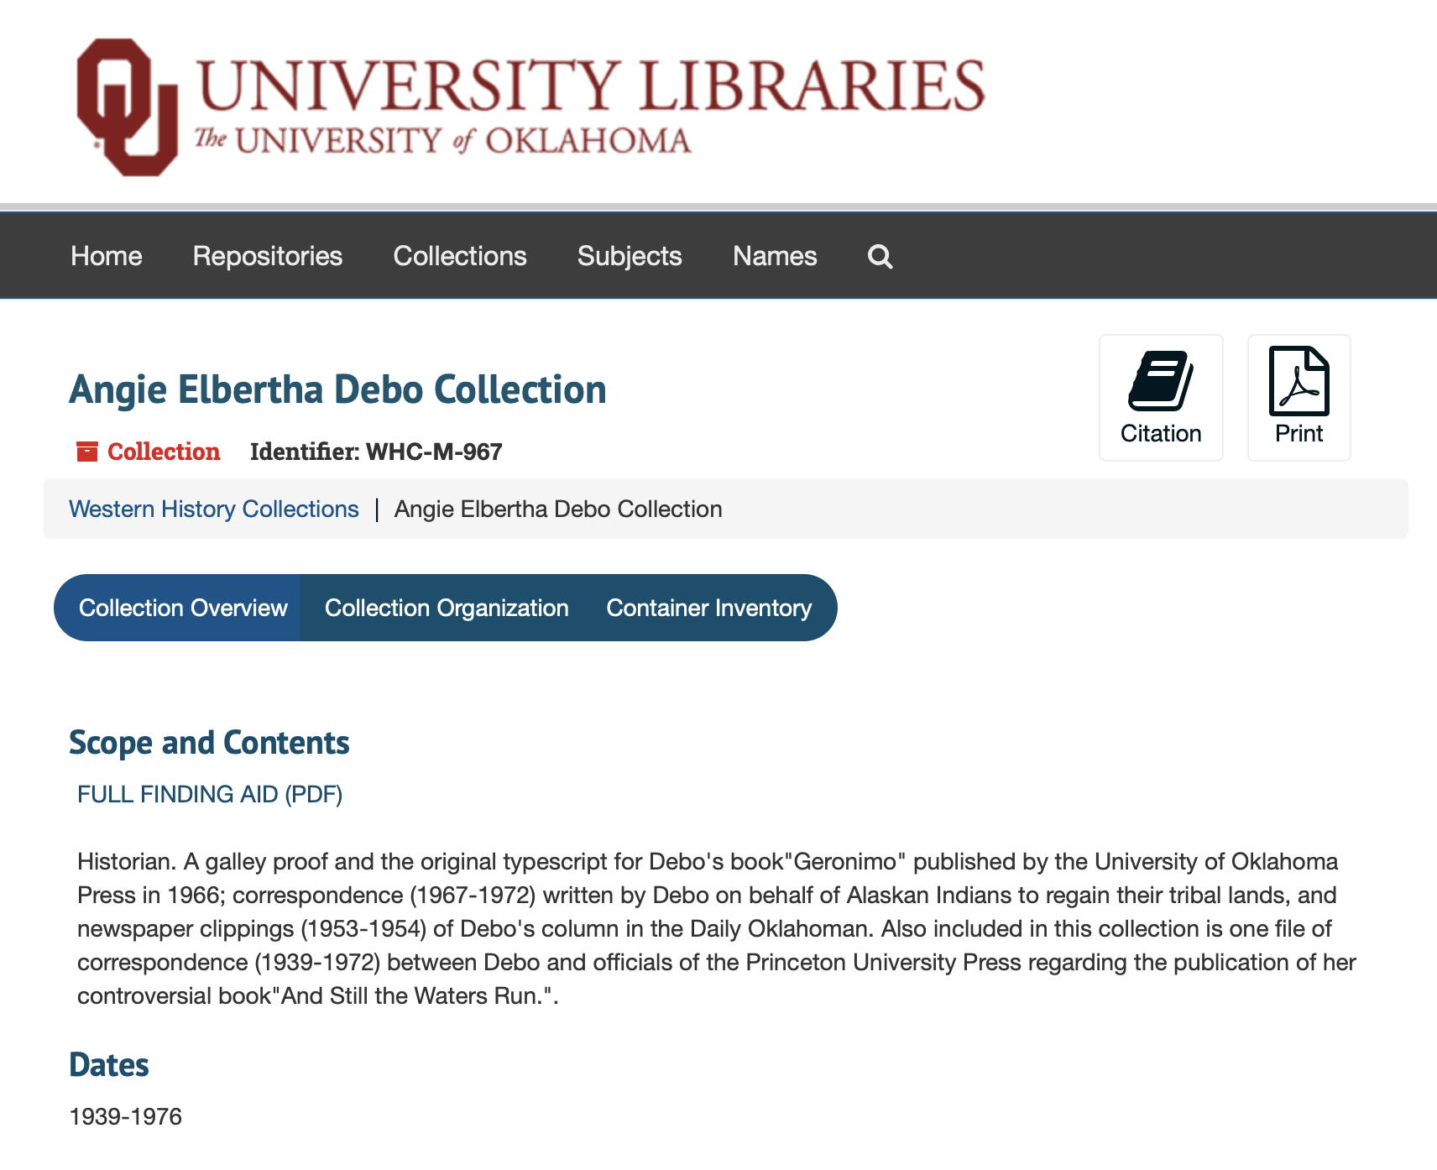
PDF Linking Workaround
Notes:
For the first few weeks, our main goal was to link those 1,820 PDFs. You can see an example of the simple html links we implemented – since this is a very temporary solution, we didn’t feel it was necessary or even worthwhile to dig in very deep on formatting, and this solution found within the ArchivesSpace User Group listserv archive was perfect for our purposes.
During the same time we also needed to review the length of finding aids to identify those collections that were 2 pages or shorter so that by the time PDF linking was nearly complete, we would be ready to shift into component ingest for shorter collections.

Slide 13
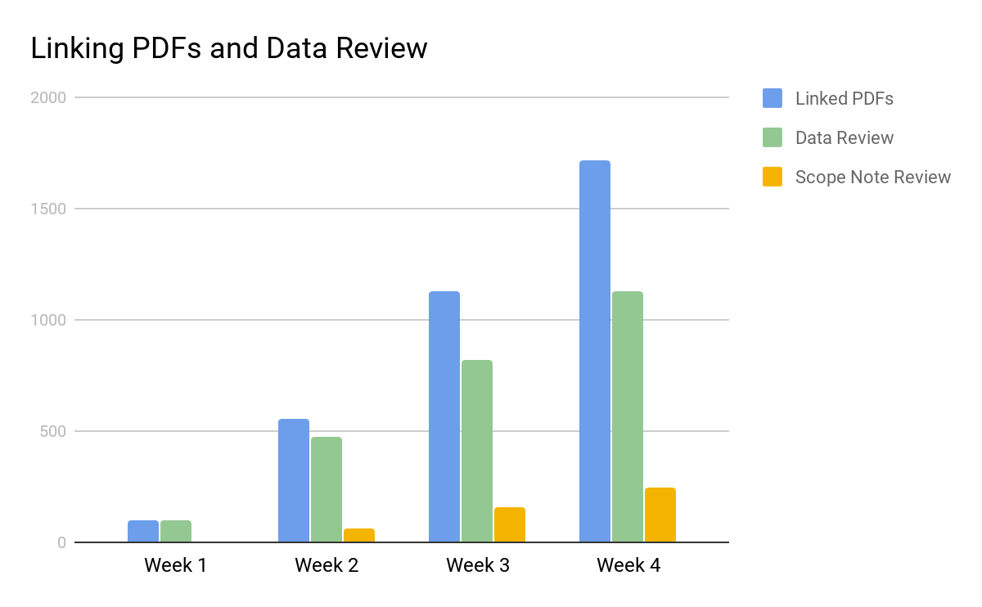
Notes:
In our first week we linked 99 PDFs within resource records, and by the end of week 4, were already to 1,720. Our review of finding aid lengths also moved along well during this time, providing us with 1,127 shorter finding aids to work with in the initial phase of component level ingest. Additionally two members of the working group began reviewing and proposing updates to scope notes that will eventually be applied to the resource records in AS.

Slide 14
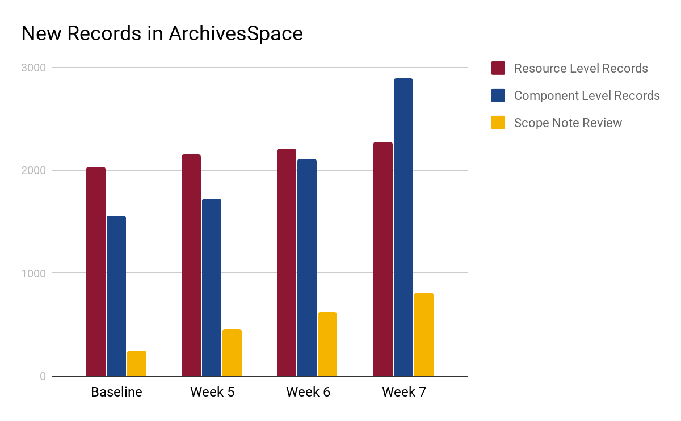
Notes:
After those first four weeks, two of our main metrics shifted, which you can see reflected here. We began with a baseline of 2,030 resource level records mostly from the initial batch import and by the end of last week had added another 242. Component records have shown the most significant increases, going from an initial 1,555 to 2,889, and I expect this number to increase significantly in the coming weeks as we begin work on longer finding aids.
This is all possible thanks to the dedicated work of this team – all of which have any number of other virtual projects that they are working on. To make this work possible, a foundation had to be put in place that would ensure standards compliance and a relatively straightforward way for a large group of people to carry out multiple different tasks, requiring different levels of permissions on 1000s of collections.

Slide 15
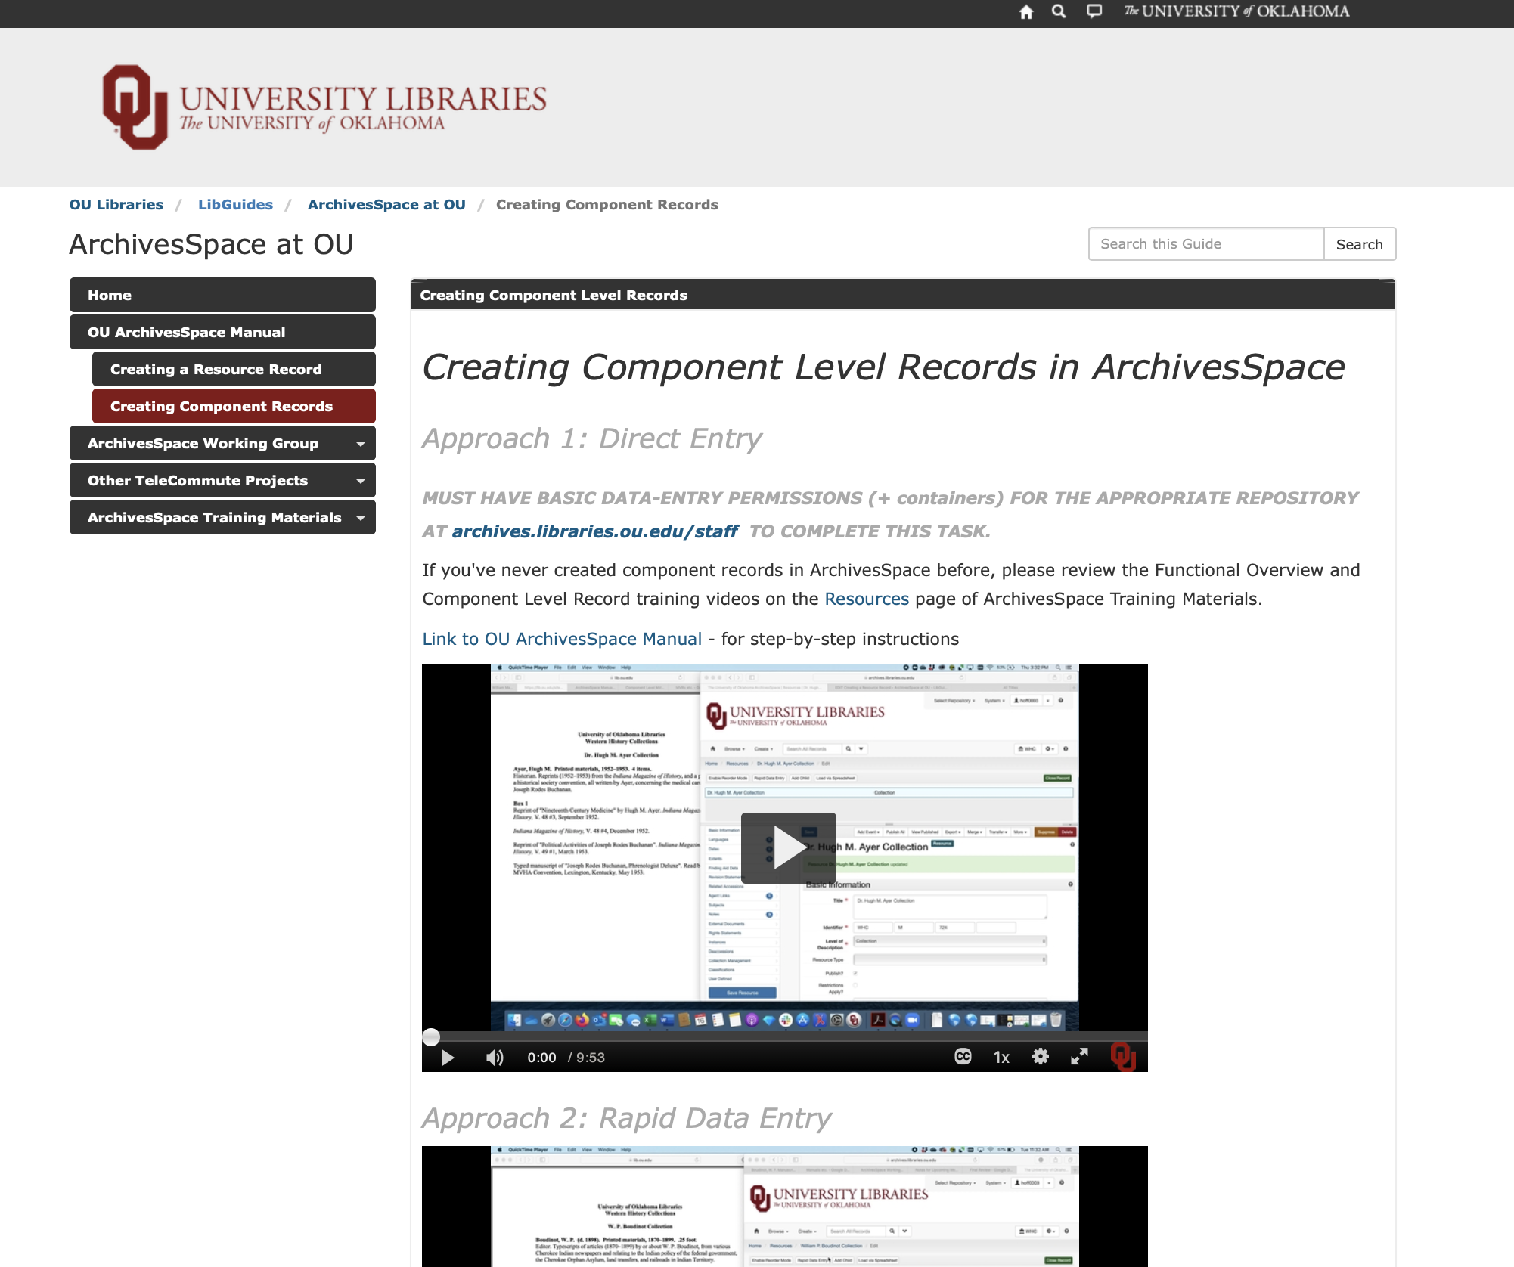
Virtual Project Management
Notes:
Here are a number of the virtual project management tools that have been most useful for our team:
A dedicated and evolving website w/ screencasts for training and workflows
Having this as the central training point, has meant that I can ask members to review appropriate screencasts and tutorials - often pulled directly from the AS Help Center – and then assign them their first few jobs. The site is updated regularly and will continue to be as we move forward.

Slide 16
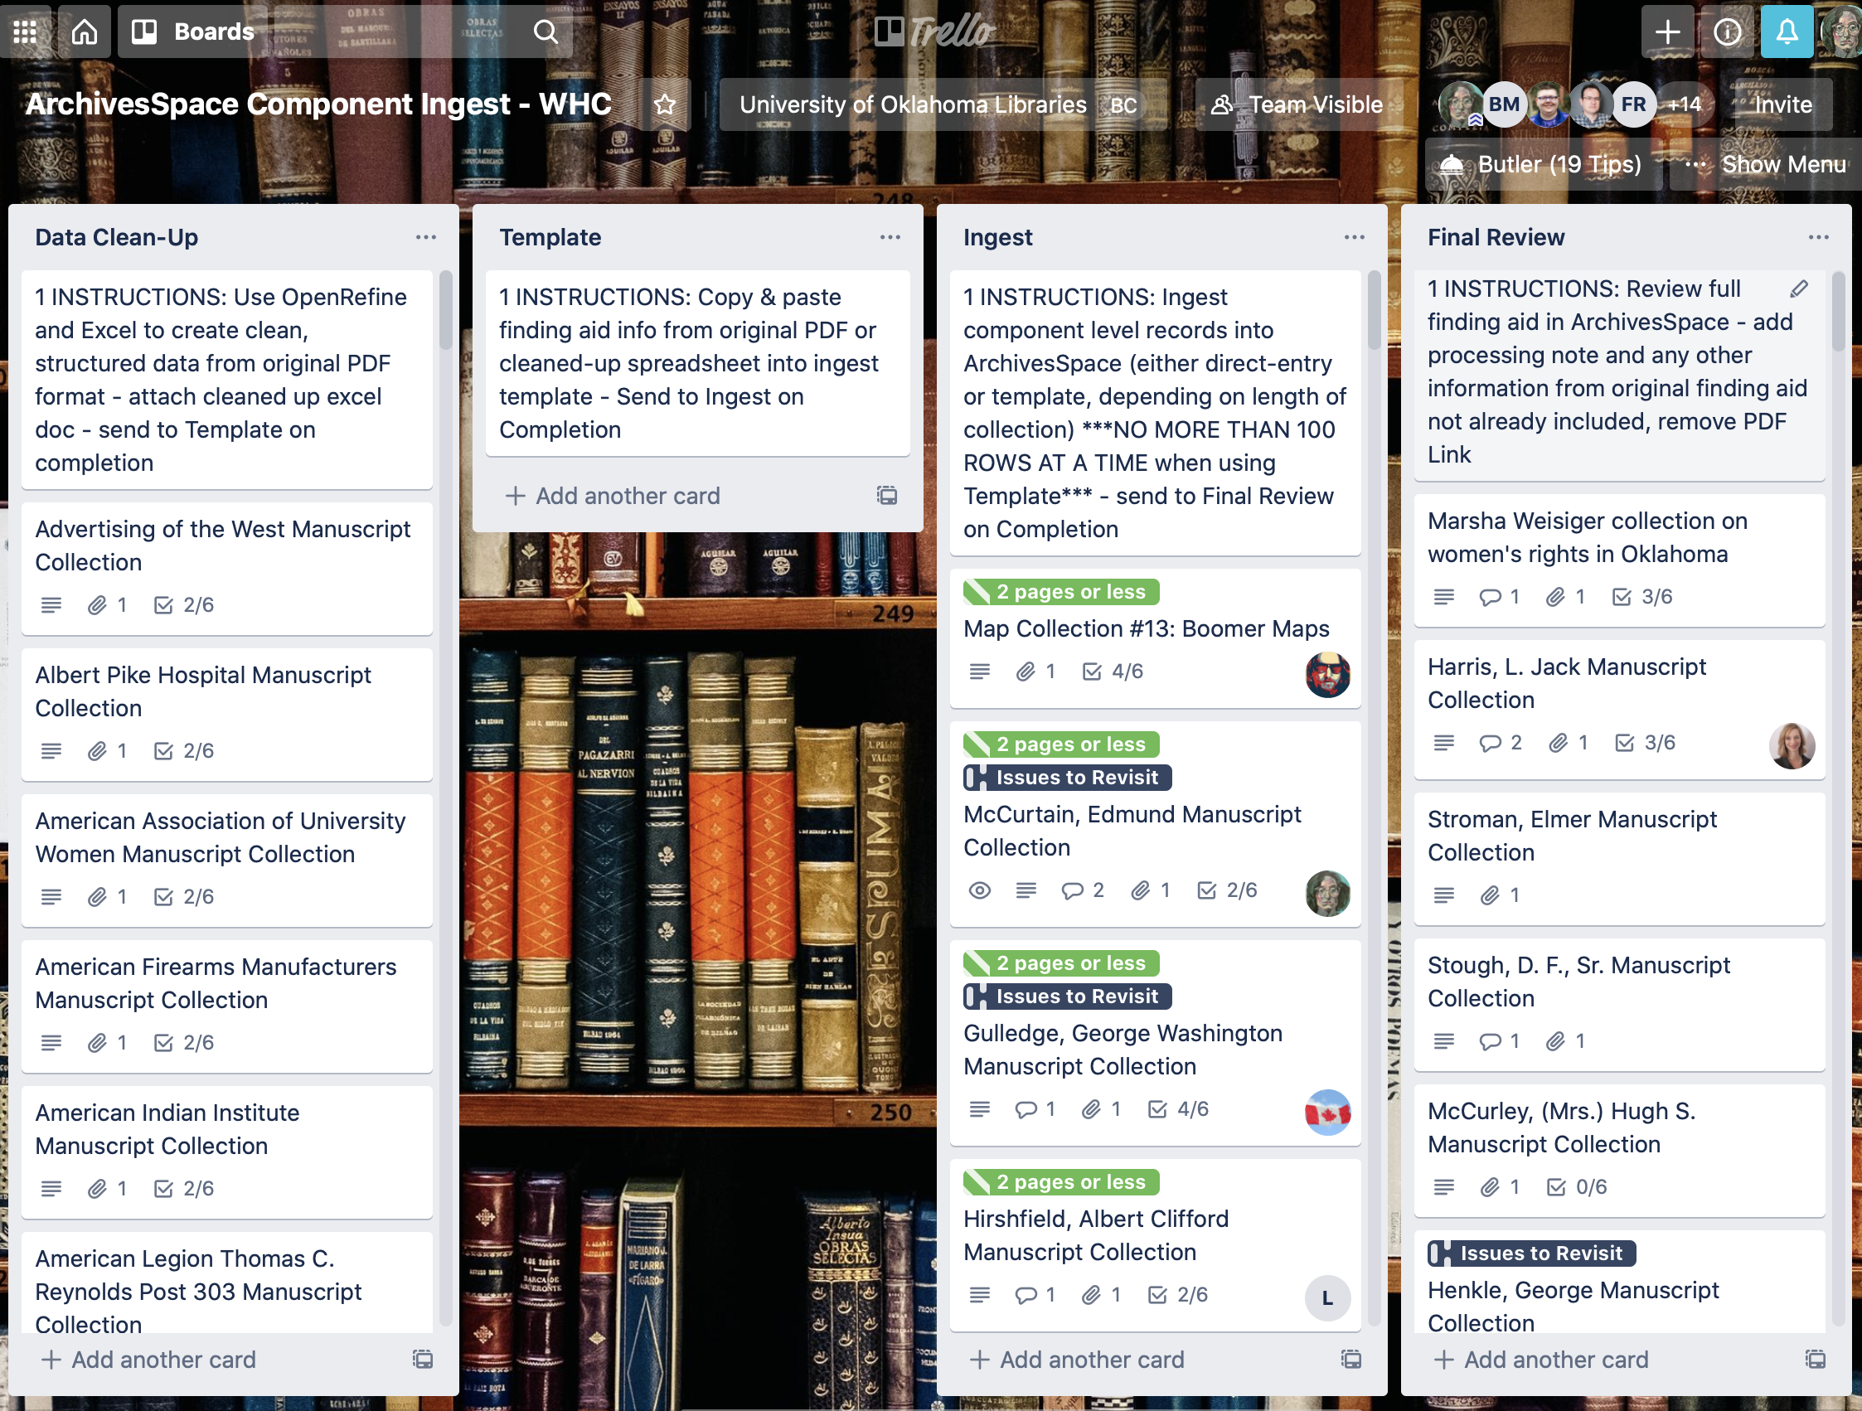
Virtual Project Management
Notes:
A Trello board with individual cards for all 1,820 collections, so that anyone working on a collection could easily claim that card and ensure we didn’t have more than one person working on a record in AS at a time
This has saved myself and the other Leads a huge amount of time that would otherwise have been used in assigning and re-assigning each collection for various tasks.

Slide 17
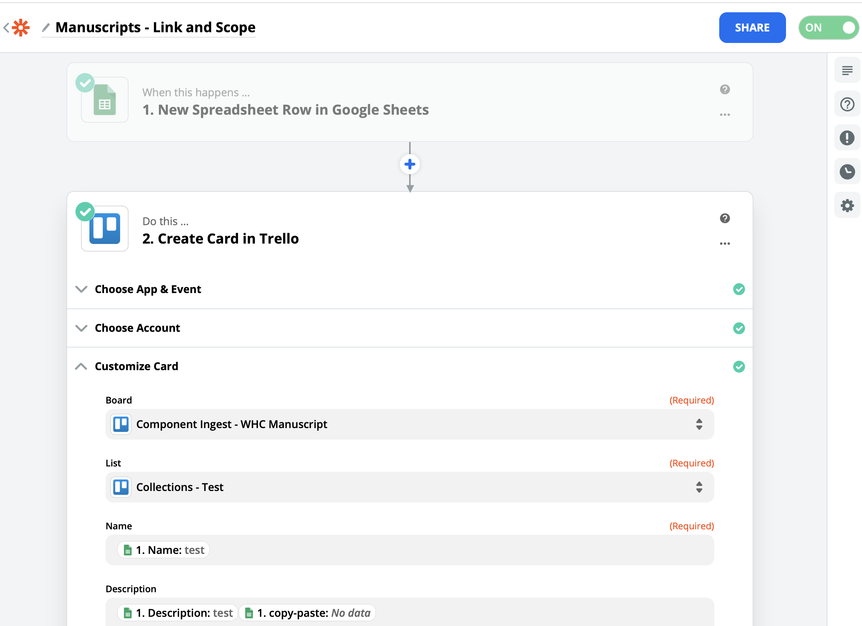
Virtual Project Management
Notes:
Zapier
One tool that was incredibly useful was an app that integrates with Trello called Zapier, which allowed us to batch load in collections from a spreadsheet, each with additional fields of information populating various areas of each trello card.

Slide 18
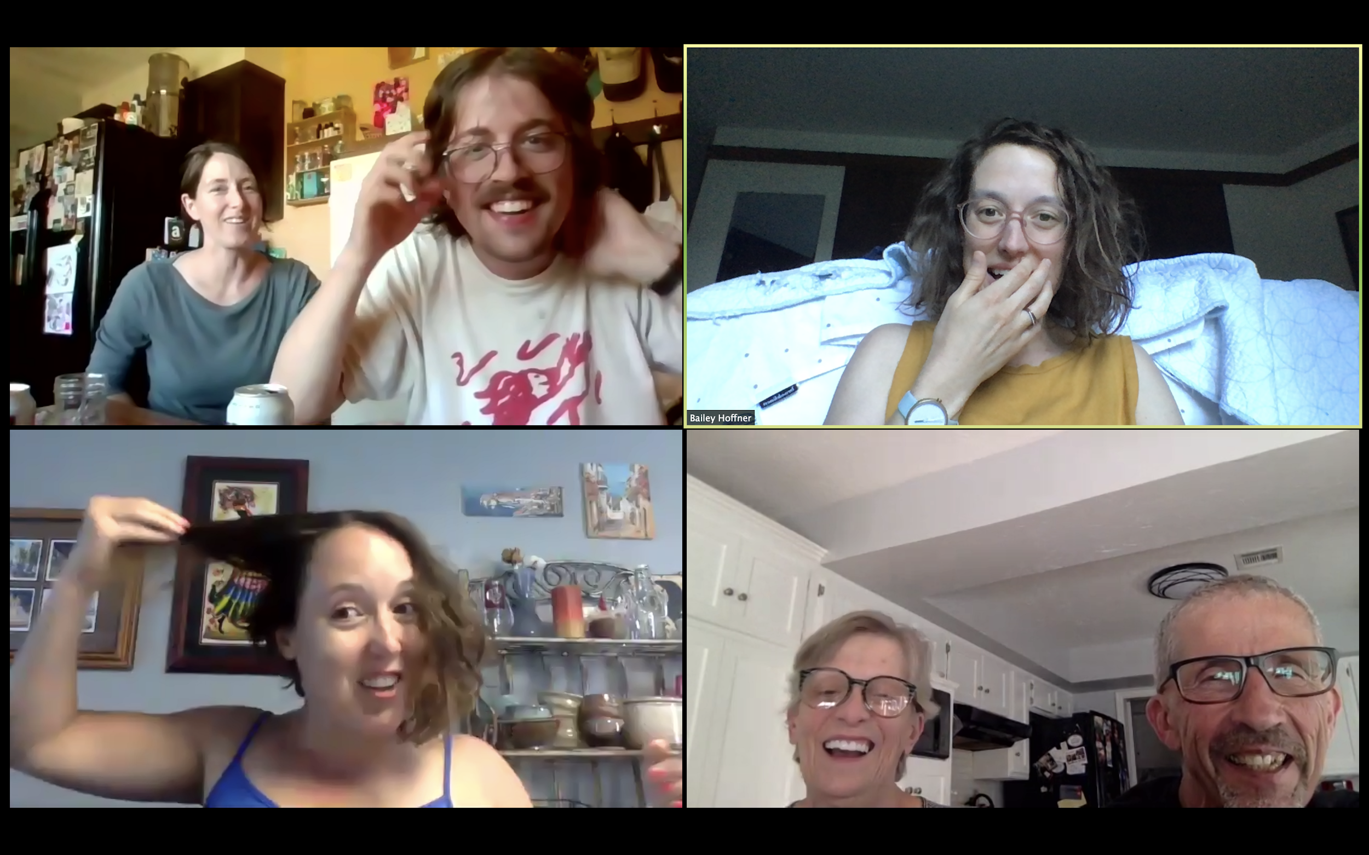
Virtual Project Management
Notes:
Slack
Additionally we use a channel in Slack as a central hub for questions and issues that arise (more than daily) so that myself and the other project Leads can help to keep things moving along. This has been a great way to keep most of our group’s communications, important links, and documents in one place but I will also say that it is really really really difficult to only communicate through text, so the screencasts as well as weekly video conferences have been very important. While I don’t have a picture of the working group in video conference, I do have this one of my family comparing quarantine hair growth for you to enjoy.

Slide 19
Flexibility is Key
https://github.com/fordmadox/Excel-to-DSC
https://github.com/harvard-library/aspace-import-excel
Notes:
One of the most important things throughout this process has been to remain flexible.
When the working group first formed, I had high hopes of training everyone to do data cleanup in OpenRefine and work directly with spreadsheets to import component level metadata using either the Harvard import plugin or Yale’s Excel to EAD oxygen project file. We still have plans to use these tools and I’m excited to begin that work in the coming weeks with the Description and Access team. For any institutions facing large and overwhelming backlogs of legacy finding aids that need to be ingested into AS, I highly recommend looking into these two tools.
But the reality is that, with such varied degrees of experience in working with special collections metadata and descriptive practices, it became apparent that it would be more important to start at the beginning rather than jump straight into a somewhat complex approach to component level ingest

Slide 20
Component Level Ingest
Direct Entry
Spreadsheets
& EAD
RDE
Notes:
Since everyone involved was either new to archival description or new to ArchivesSpace, and thanks to the suggestion of two of my fellow project leads, it was decided that everyone would start with direct entry of shorter collections into archivesspace, and once mastered, could be trained to use the RDE tool, and then move on from there.

Slide 21
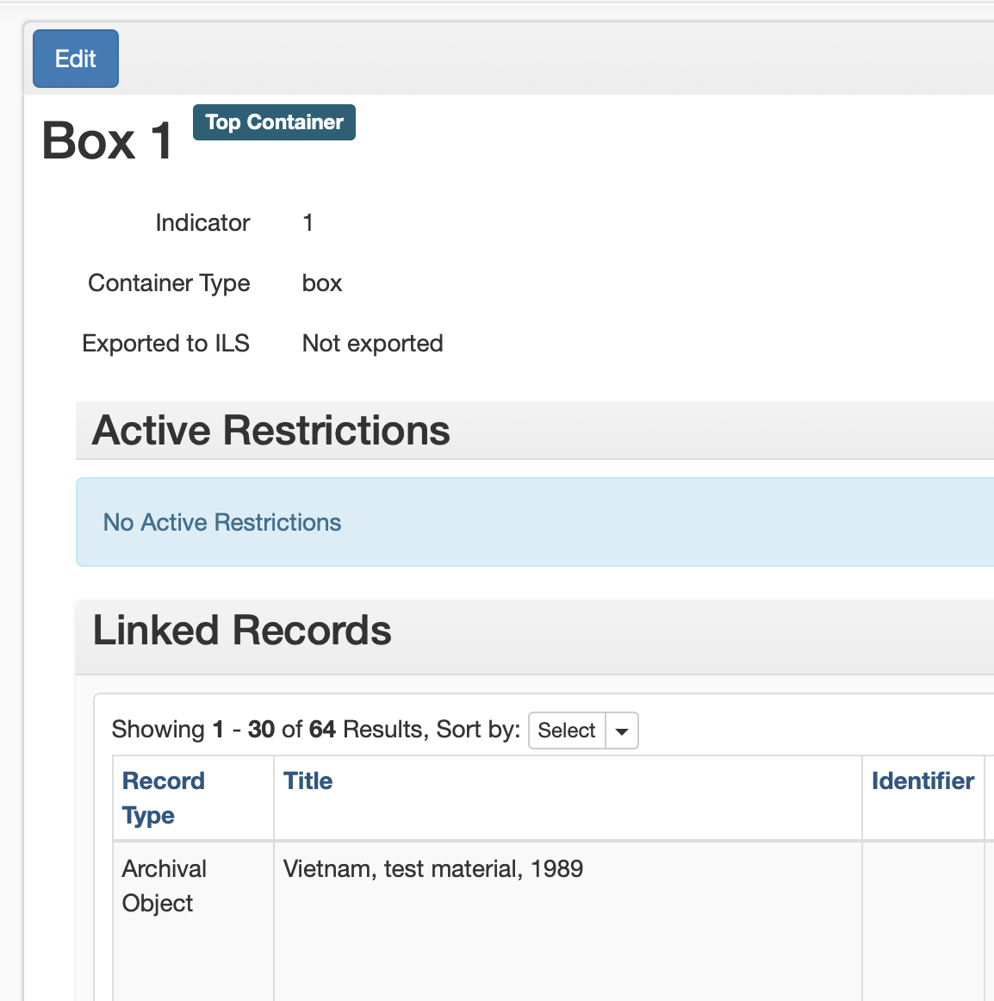
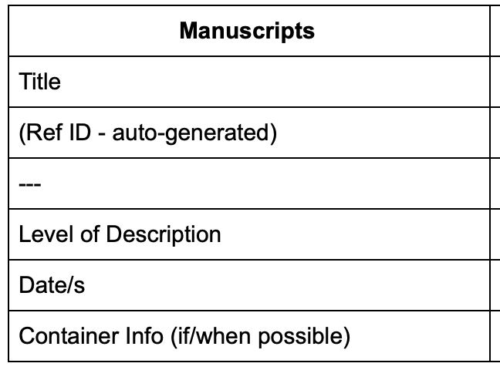
Minimally Viable Record
Notes:
The idea of the minimally viable record has informed all of this work, allowing for team members to understand that the required fields – not the method for their ingest – were what mattered most. Some of the most important required fields for us beyond the most obvious, related to container information.
I knew that we eventually wanted to use top containers and locations to gain robust physical control of our collections, but that we wouldn’t have all of the information we would need to do that anytime soon. I also knew that we didn’t want to be creating all of these component level records only to have to return to each and every one of them to associate it individually with a container. (remember, there are already 2,889 of them) So, knowing that the ability to merge containers was under development, and knowing that we would be able to rapidly apply barcodes and container profiles using the top container module, we opted to create very basic containers for each collection so that the majority of components wouldn’t need to be touched again but that instead the top containers they exist within could be appropriately updated once back on site. I am excited about this approach and, once we are able to implement robust physical control, I plan to present in some format on the challenges, benefits, and lessons learned.

Slide 22
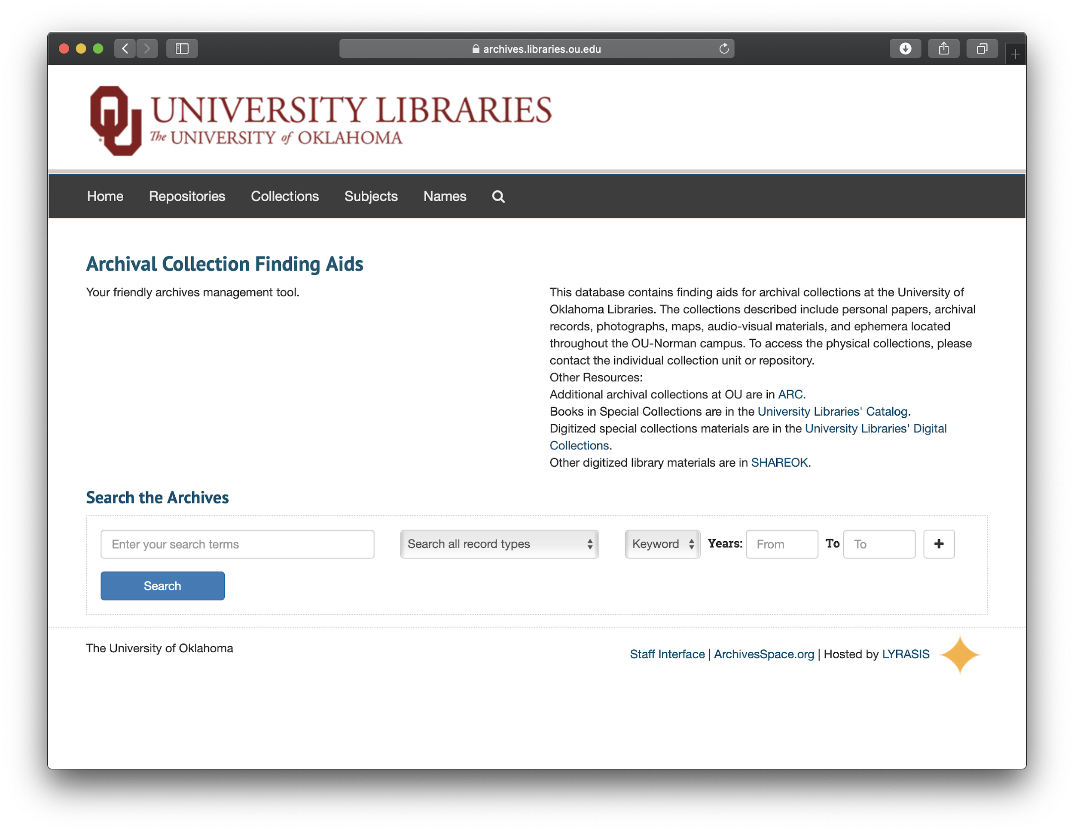
Beta Phase Launch
Tomorrow!
Notes:
In my initial 9-month plan for implementing AS, we were to launch into a beta phase for our instance by July of this year. Instead, thanks to an incredible group of dedicated information professionals, the beta phase launches tomorrow when we begin to point researchers towards our instance of AS, filled with a dynamic and constantly growing array of component level records. The increase in discoverability will be instant, and more finding aids and component records will be added each week with increases in discoverability (through AS and our library catalog) only growing.

Slide 23
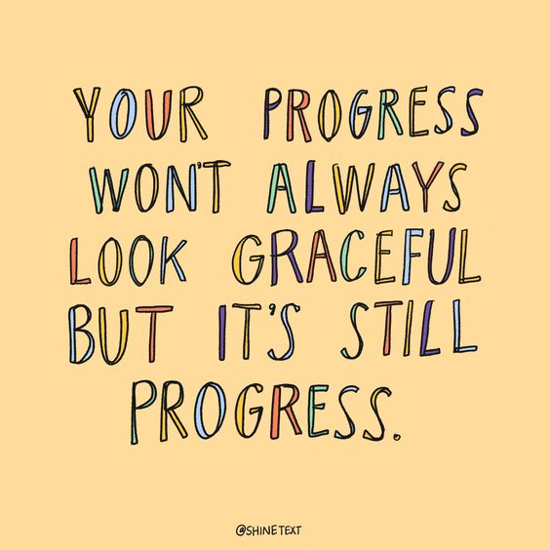
Perfection vs. Progress
Notes:
Nowhere in this process have we assumed that we won’t have a lot more work to do once back on site, nor have we completely avoided all sorts of odd-ball issues and future challenges. Quite the contrary: We have a spreadsheet titled “issues to revisit” which has columns (growing in number each week) to track everything from “title discrepancies” that must be compared with physical documents, to collections with shared containers that will eventually need to be merged.
But the pace at which the project is moving has forced us all to remain focused on the most essential challenges, allowing lesser challenges or those challenges we simply cannot deal with now, to be set aside for a later date.
For someone that is generally focused on perfection to the point of near-immobility, this has been an incredibly valuable experience. I hope that seeing just how much progress can be made when complete control is so clearly impossible, will help me to know in the future that complete control is never really possible, so we may as well get to work.

Slide 24
Human-Centered
Barb Mc Clurkin
Bridget Burke
Cassondra Darling
Fred Reiss
Jackie Reese
Jamie Dye
Jamison Clair
Jay Shorten
Kristina Southwell
Lauren Parker
Lina Ortega
Nathan Boyd
Rachael Lester
Rachel Johnson
Shuyu Lu
Todd Fuller
Tom Steele
Tracy Chapman
Xiaoyu Duan
Notes:
I strongly believe that the amount of progress we’ve been able to make, and continue to make, is directly correlated to the notion of a human-centered project, one with compassion as the central hub connecting everyone in the group, as opposed to a strict focus on productivity or exact hours committed to the project – dubious measures in these strange times.
We make progress as a group and I am deeply grateful for this opportunity to get to know so many of my new colleagues, and for their willingness to join me in this work.
If we were all in a room together, this is the point at which I’d ask everyone to give a round of applause for my fellow working group members. Their work is deeply valued and each day brings value to my own, which is a lovely cycle of validation to be a part of.

Slide 25
Thank You
Bailey Hoffner
Metadata and Collections
Management Archivist
baileys@ou.edu
Notes:
Thanks so much to Jessica and everyone with ArchivesSpace for organizing this event, and to all of your for sharing your time and attention. Please feel free to contact me with any questions.
And with that I’ll pass it on to Rachel.

