Slide 1
We’re on the Road to Somewhere
Navigating Your ArchivesSpace Implementation
ArchivesSpace Online Forum
May 18-21, 2020
Chad McDonald. “Road to Nowhere” https://www.flickr.com/photos/mcdonaldc/26063637404
Notes:
So welcome to this encore presentation of “We’re on the Road to Somewhere: Navigating Your ArchivesSpace Implementation.” An earlier version of this presentation was presented at last year’s online forum, and we decided to present it again based on interest shown from new registrants when we were soliciting ideas for new topics.
The title – we’re on the road to somewhere – was inspired by the Talking Head’s song, “The Road to Nowhere” – which might be how an implementation can sometimes feel. So we are here to put a positive spin on things and give you some tips to help get your implementation on a roadmap to somewhere.

Slide 2
Presenters
Anne Marie Lyons
Training and Library Solutions Consultant
Atlas Systems
Madeline Sheldon
Member Representative, Digital Technology Services
LYRASIS
This is an encore presentation, with updates since last presented on March 18, 2019.
Notes:
As I mentioned, this is an encore presentation, created by myself, Anne Marie Lyons, Madeline Sheldon, LYRASIS member representative. Madeline is unable to present this week, so I will be doing the presentation myself. The presentation has been updated with new information and to reflect changes in content since last year.

Slide 3
Agenda
Getting started with an ArchivesSpace implementation
Creating a project plan
Tools for importing legacy data
Training resources
Community resources
Topics will be discussed in lineal order; however, you will be working on these activities in tangent.
Notes:
We will get started with our ArchivesSpace implementation discussion by talking about how to identify your goals for ArchivesSpace.
We’ll then take those goals and put them into action by exploring project plans.
I’ll also discuss a number of different tools for getting your existing description data into ArchivesSpace.
If you’re new to ArchivesSpace, most likely you’ll want to take a look at some training materials.
And then I’ll wrap up with some supportive community resources to know about.
I’ll be discussing these topics in a very lineal order. You’ll probably be doing things at the same time because certain areas are going to inform other areas.

Slide 4
The ArchivesSpace System
Notes:
Before I get into the implementation part, I wanted to talk a little bit about acquiring ArchivesSpace.
This section is new material. The last time we presented, we picked up from the point after a decision would have been already made about how the ArchivesSpace system would be hosted – either self-hosted, or hosted by a third party.
For this presentation, since we have some extra time, I’m going to step back and talk about what I mean when I say self hosted or hosted by a third party.

Slide 5
About ArchivesSpace
ArchivesSpace is open-source. It can be downloaded from: https://github.com/archivesspace/archivesspace/releases
ArchivesSpace is installed on a machine or server.
The staff user interface is accessed via a browser using a staff user account
The public user interface (PUI) is accessed via a browser
All of the data is stored in a database
You can also access the data using the ArchivesSpace API (application programming interface)
Notes:
Anyone can use ArchivesSpace. You can download it on a machine that meets the minimum specifications, which I will show you on the next slide. I have a couple of ArchivesSpace versions downloaded on my laptop so that I can test things on different versions for our customers. So you are free to download ArchivesSpace and you can start using it as it is. Depending on how you want to use it – for example, if you want to make it available to your patrons, then you’ll need to a few configurations. But it basically works out of the box as it is.
The ArchivesSpace system consists of what I would call a backend – so that’s the application itself - all of the files that make up ArchivesSpace, and the database that contains all of the description data that you’re going to add to ArchivesSpace.
People will interact with that data through different interfaces.
Staff people can access the data using the staff interface, which is available as a web site.
Savvy staff people, who know how to write scripts, can access the data using the ArchivesSpace API service.
And then everyone can access public data using the public user interface, which is also available as a web site (if you choose to do that. You don’t have use the PUI. Some libraries use just the staff interface, and then they export finding aids - EAD files and upload them into a different search discovery system or consortial repository.).

Slide 6
Basic Needs
You will need (at minimum):
Linux, Mac OS X, or Windows machine
At least 1024 MB RAM for the ArchivesSpace application; at least 2GB for performance
A database, such as MySQL or Maria DB
Java 1.8
See: https://archivesspace.github.io/archivesspace/user/getting-started-with-archivesspace/
Notes:
If you want to run ArchivesSpace seriously, though, in a production environment – where it is available to multiple staff members and patrons, these are the minimum specifications you’re looking at.
I mentioned on the previous slide, that ArchivesSpace does come with a database, but you’ll need something more robust, like MySQL.

Slide 7
To host, or not to host
Do you have resources that meet the hardware and software requirements?
Ayyyyyye, matey….Are you tech-savvy?
Do you know your way around making an application go on a server/machine?
Are you familiar with .yml files, config files, .css files? (to name a few)
If problems arise, can you decode errors in activity logs to troubleshoot?
Do you have access to dedicated technical support?
Can you keep up with:
Server/machine maintenance?
Server/machine updates?
Server/machine security?
Server/machine backups/recovery?
ArchivesSpace version updates?
Notes:
So you have the option to host, or run and manage, your own ArchivesSpace server. Or you can have a third party do it for you. When deciding between your options, you’ll want to think about:
Do you have access to dedicated technical support?
For the library or archives
Responses in timely matter

Slide 8
The Verdict
If you answered yes to all of the questions on the previous slide, then hosting your own ArchivesSpace system could be a great option
ArchivesSpace can be downloaded from here: https://github.com/archivesspace/archivesspace/releases
A number of installation-related resources are available. Here’s a good place to start: https://archivesspace.github.io/archivesspace/user/getting-started-with-archivesspace/
If you answered no to some or all of the questions on the previous slide, then consider working with a registered service provider: https://archivesspace.org/registered-service-providers/current-rsps

Slide 9
One other thing…
Consider becoming an ArchivesSpace member
Member benefits: https://archivesspace.org/community/member-benefits
Support ArchivesSpace development
Shape the future of ArchivesSpace
Access to documentation and tutorials
Access to technical support
Access to other membership resources
Types and levels of membership: https://archivesspace.org/community/types-of-membership
“The most important reason to become an ArchivesSpace General Member is to ensure the continuing development and sustainability of the application. Membership protects your significant investment of staff time and other resources by ensuring that your archives information management system will be around and continuing to meet your needs for a long time.”

Slide 10
Getting Started with an ArchivesSpace Implementation

Slide 11
Identify Goals and Expectations
Why did you select ArchivesSpace?
Which features of ArchivesSpace do you like, or find valuable?
Take a look at ArchivesSpace here: http://archivesspace.org/application/sandbox
Will you be adding legacy data into ArchivesSpace, or starting from scratch?
Do you anticipate doing anything new?
Accession description
Inclusion of digital object metadata
Staff workflows/processes
Integrations with other systems
Notes:
First stop on our implementation road map is to identify your hopes and dreams for using ArchivesSpace. And one way you could do that is to ask yourself some questions.
Why did you decide to use ArchivesSpace? Perhaps you didn’t decide; someone just told you to. Or perhaps it’s because your current system will no longer be supported, think about what else you can gain from using ArchivesSpace. What features do you like about it? What functionality will add value to what you already do?
Can’t really answer these questions because you don’t know anything about ArchivesSpace at all? Check out the ArchivesSpace sandbox. It gives you access to both the staff and public interfaces. Practice inputting one of your finding aids. Take a look at how it displays on the public user interface.
Another question: do you plan on adding legacy data to ArchivesSpace, or will you start from scratch? Either way, will you finally have an opportunity to flesh out some description? Or to clean up some data beforehand?
Based on what you’re learning about ArchivesSpace, does it looks like you’ll be able to do anything new or improved, for either researchers or staff? For example, we’ve heard from a few archives that they decided to include accessioning as part of their ArchivesSpace tasks, when in the past, accession records had been kept in a separate system.
What about being able to link your description records to digital objects that you already have posted elsewhere, such as in CONTENTdm or on Flickr?
Could there be any changes to staff processes, such as more consistent and complete data entry?
ArchivesSpace could be an opportunity to integrate with other systems, such as a digital object system, your ILS, or Aeon.

Slide 12
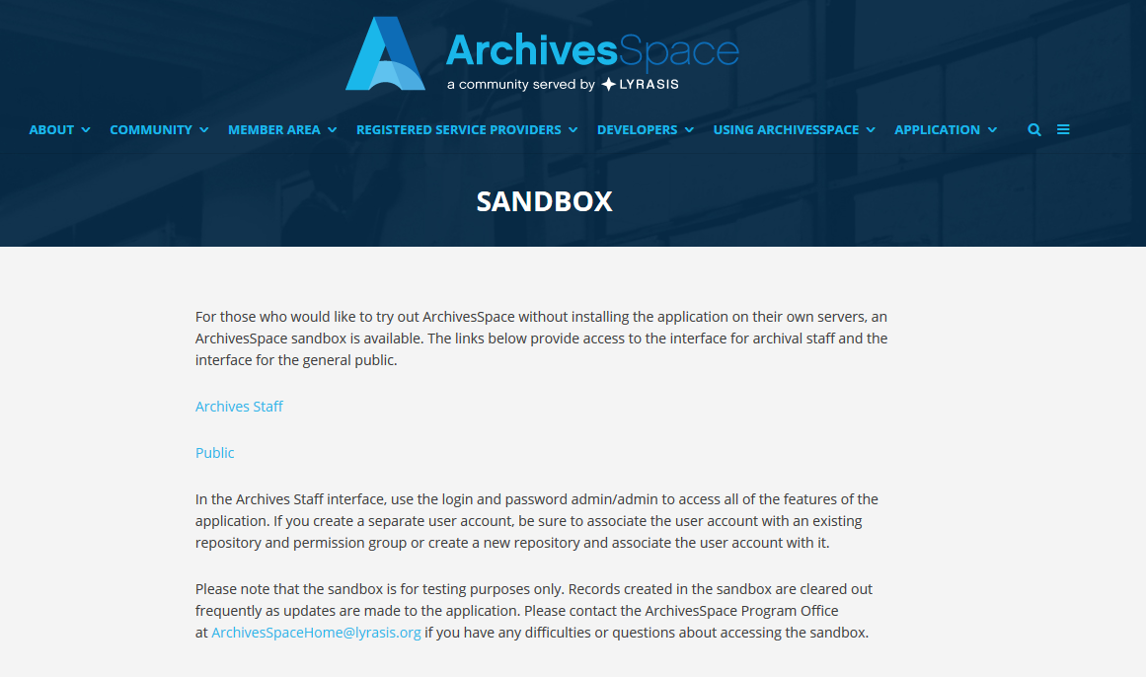
ArchivesSpace Sandbox
http://archivesspace.org/application/sandbox
Notes:
ArchivesSpace sandbox: http://archivesspace.org/application/sandbox
Also take a look at new version features

Slide 13
Or, download ArchivesSpace on a standalone machine
Latest version release: https://github.com/archivesspace/archivesspace/releases
Use the embedded database
Access the backend and test:
Data imports
PUI Customizations
Plugins
Notes:
If you are more tech-savvy

Slide 14
Create Specific Goal Statements
What new or improved service(s) are you planning to offer to researchers?
What new or improved functionality or processes are you planning to offer to archives staff?
1
2
Notes:
Once you’ve done some brainstorming on what you would like to gain from ArchivesSpace, flip those hopes and dreams into specific goal statements. These questions could help you specify exactly what your objectives are for ArchivesSpace.
What new or improved services can you offer to researchers?
And also, what new or improved functionality can you offer to archives staff? – substantial user group that Aspace will meet the needs of

Slide 15
Examples of Goal Statements
“One stop shop” archival management system that will manage accession records, resource records/finding aids, and links to digital objects
Front-end interface for patrons to perform self-directed research and discover collections easily and efficiently
Decrease staff time spent on repetitive reference questions
Notes:
Here are some examples of defined goal statements:
‘One stop shop’ archival management system that will manage accession records, resource records/finding aids, and links to digital objects all in one place
Provide a front-end interface for patrons to perform self-directed research, and discover collections easily and efficiently
Decrease staff time spent on answering repetitive reference questions
Goal statements should have some sort of measurability in – see improvement – think about what you can measure down the road to know if you met your goals

Slide 16
Identify and Prioritize
Most used collections and format types
Descriptions that only exist on paper
Descriptions or collections that are updated often
Digitized objects
Hidden collections
Most fragile collections and format types
Available funds for processing
“Easiest” collections to get into ArchivesSpace
Prioritize by format of material or type of data record
the content that will help you reach those goals
Notes:
Once you have your goals planned out, you’ll want to decide on what content you’ll get started with in ArchivesSpace that’s going to satisfy those goals.
Is cutting down on reference questions a goal for you? Then look to work on commonly used materials or descriptions that only exist on paper, or materials that your organization is known for.
Need to increase archives use? Then work on descriptions for hidden collections and digitized objects.
Just need to get some content into ArchivesSpace? Work on descriptions or collections that are updated often. Or perhaps a donor included some financial support for description work. Or what’s ‘easiest’ to get into ArchivesSpace based on its format or content?

Slide 17
Identify Types of Records
Assessment records
Accession records
Resource records
Agent (Name) records
Subject records
Classification records
Collection management records
Digital object records
Top container and location records
Event records
you will use to support your content
Notes:
Once you’ve prioritized the content you’re going to start with in ArchivesSpace, decide on which types of ArchivesSpace records that you’re going to use for that content…

Slide 18
Determine Additional Planning
Agent and subject records
Make time to learn the Library of Congress Name Authority File (LCNAF) plugin.
Top container records
Are your boxes barcoded?
Location records
Do you want to use the space calculator? Your locations should be mapped out ahead of time.
Event records
Plan for consistent use.
Notes:
… because that could also determine additional pit stops you’ll have to make along the way. Some pit stops might be short; some might longer
For example:
Interested in using name authorities and subject records in ArchivesSpace? Take a little bit of time to learn the LCNAF import plugin that comes built into ArchivesSpace. It allows you to import names and subjects from the Library of Congress directly into ArchivesSpace.
Do you have plans to use the top container records? Then you might want to consider barcoding your boxes and other containers if you would like to take full advantage of the functionalities available with top containers.
ArchivesSpace does math! The space calculator could figure out where there is free space in your archive for new acquisitions, increments, but one of the things you’ll have to do ahead of time is map out your storage area.
Event records are a great way to record actions that are taken upon ArchivesSpace records. Decide ahead of time which event records staff should work with to support consistent data entry and workflows.

Slide 19
Creating a Project Plan
Notes:
Next stop on our road map: creating a project plan

Slide 20
Creating a Project Plan
Goals and expectations
The content you want to put into ArchivesSpace
The types of ArchivesSpace records that you want to use
1
2
3
after you have determined:
You might want to consider creating a project plan
Notes:
After or while you’re figuring out your goals and deciding on the content that you want to put into ArchivesSpace, we highly recommend that you start writing up some form of a project plan.

Slide 21
Purpose of a Project Plan
Who
Identify who you need: internal and external expertise
What
Identify what you need: tools and resources
When
Do you have deadlines? Identify work schedule
How
Identify priorities: what will you work on first?
Why?
What goal does each priority satisfy?
Notes:
A project plan will identify:
Who – who will you need, in your department? In other departments? IT? Third party for server-hosting. Outside of your organization, especially if you are a lone arranger?
What – what you will need – what tools and resources
When – do you have deadlines? For legacy data input? For new content input? For ‘going live’ with the public interface? Identify your work schedule in the project plan.
How – How will you meet your goals? What will be your priorities? What will you work on first? What is your step-by-step process?
Why – Which goal is each of your priorities helping you satisfy?
And we’ll assume the Where is your work space

Slide 22
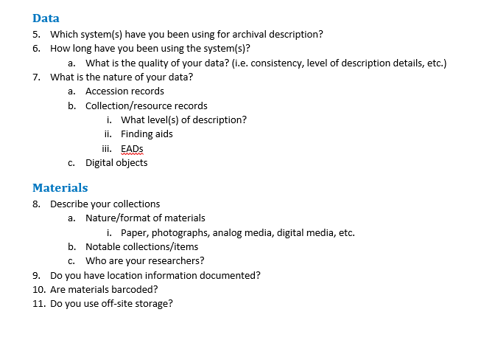
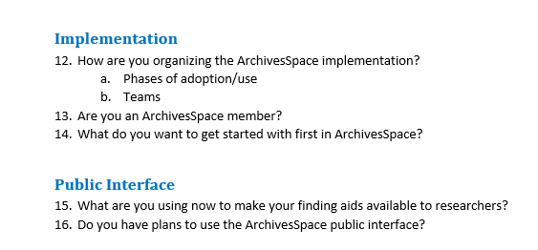
Assessment Questionnaire Sample
Notes:
This is a snippet from an assessment questionnaire that Atlas uses with institutions to start devising a project plan – we have questions in here about data expectations, types of materials we’ll be working with, how formally organized the implementation will be, timeline, and what the plans are for the public interface.

Slide 23
Scalable Project Plan
How many (willing) staff members are on hand to help?
How formal do you need or want your plan to be?
Checklists?
Detailed phases of adoption?
Task assignments?
Task forces?
Do you have deadlines or scheduled milestones to reach?
1
2
3
How large or small of a project plan do you need?
Notes:
Next, think about how much of a project plan do you need? Some questions to ask:
Do you have anyone else helping you?
How formal should you be? Do you have a large team of people helping out, who will be organized into tasks forces, responsible for phases of adoption? Need a formal plan.
Or is it just you?
Do you have deadlines or scheduled milestones that you have to be accountable for? A project plan will keep you on track.

Slide 24
Project Plan To-Dos
Create a project plan
Write your goal statement(s) at the top of your project plan
Organize your project plan according to the identified priorities that support each goal
Identify staff or other human resources
Lone arrangers could look to professional chapters and similar repositories
Make time, meet regularly
If you are a lone arranger, commit yourself to a schedule
regardless of your answers to the questions on the previous slide:
Notes:
So no matter what your answers are to the questions on the previous page, we highly recommend the following:
Definitely create a project plan
Write out your goal statements at the beginning of that project plan, because the plan is going to outline specifically how you will reach those goals. You can do a project plan per goal statement, if that makes sense.
Identify and order your priorities – you cannot work on everything at once, so decide how you will prioritize – what’s most important? What’s most convenient? What do you have funding for?
- Once you have your priorities straight, use them as the outline for your project plan.
4. Identify your human resources: staff members who will have roles in the implementation.
- Or if you are a lone arranger, who are your external contacts? Look to professional chapters, especially local ones. Can you do a site visit?
- Also identify other repositories that are similar to yours or have similar collections. How they are doing things? Look at their public interface. How are they doing description? Which ArchivesSpace fields are they using?
5. Finally, commit to a schedule to work on the implementation. Setting automatically recurring meetings is one of the best ways to do that. Get it on your calendar. Weekly, if possible.

Slide 25
Why?
Stay organized
Maintain momentum
Know where to pick up again if you have to put things on hold to work on other projects
Make your work visible
Document your decisions
A project plan should ultimately end in with written documentation that records your work
Examples: https://www2.archivists.org/groups/collection-management-section/archivesspace
Notes:
Why go through all of this trouble?
It keeps you organized
It keeps you moving
If you do have to stop implementation work because of other projects, it’ll be much easier to know where you left off when you can get back to ArchivesSpace
It makes your implementation work visible. Because it is work, and it will take up your time.
- And, you never know what could come of it: a journal article, a new implementation process to share with others?
5. You should also use the project plan to document your decisions, and that documentation will be one of your end products of your ArchivesSpace implementation.
SAA’s Collection and Management section has a collection of links to various manuals created by ArchiveSpace users

Slide 26
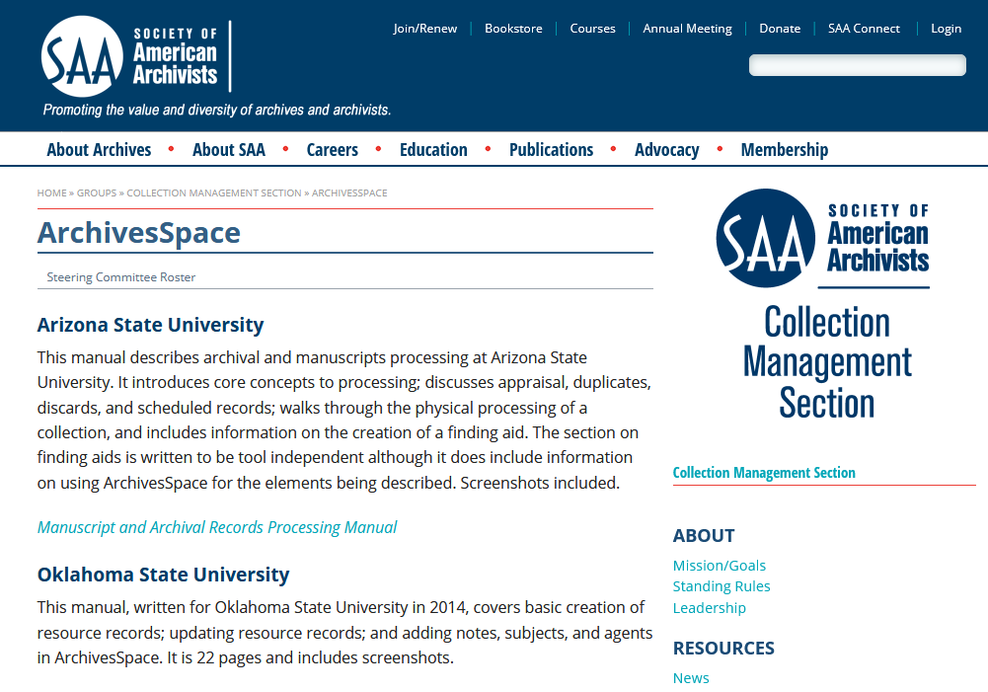
SAA Collection Management Section: ArchivesSpace
https://www2.archivists.org/groups/collection-management-section/archivesspace

Slide 27
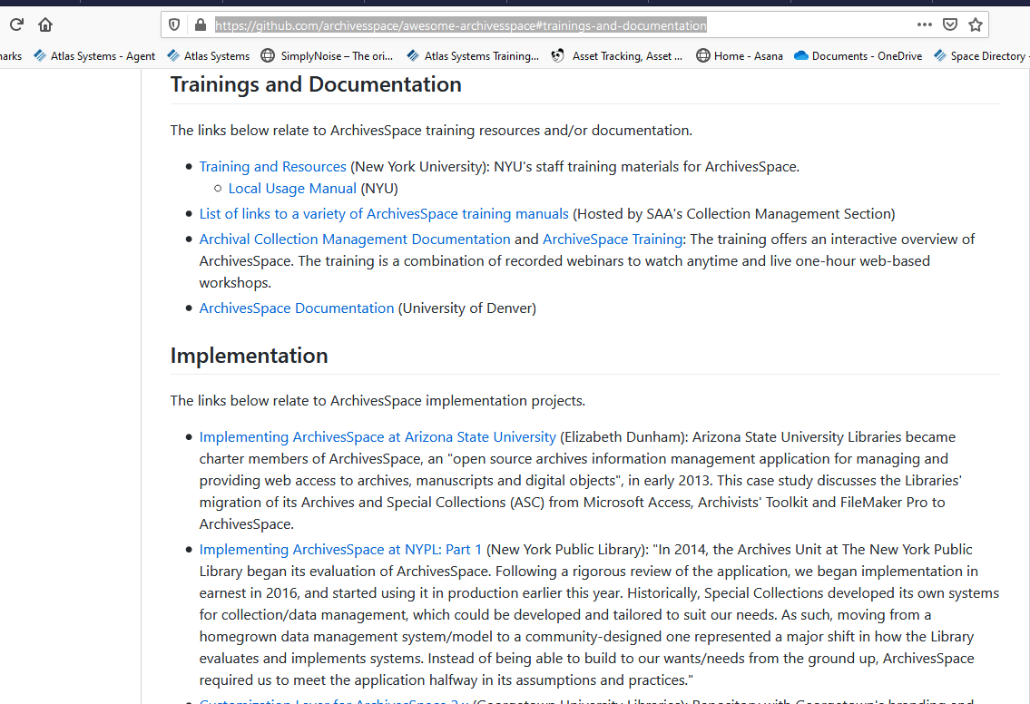
Awesome ArchivesSpace list
Trainings and Documentation; Implementation
https://github.com/archivesspace/awesome-archivesspace#trainings-and-documentation

Slide 28
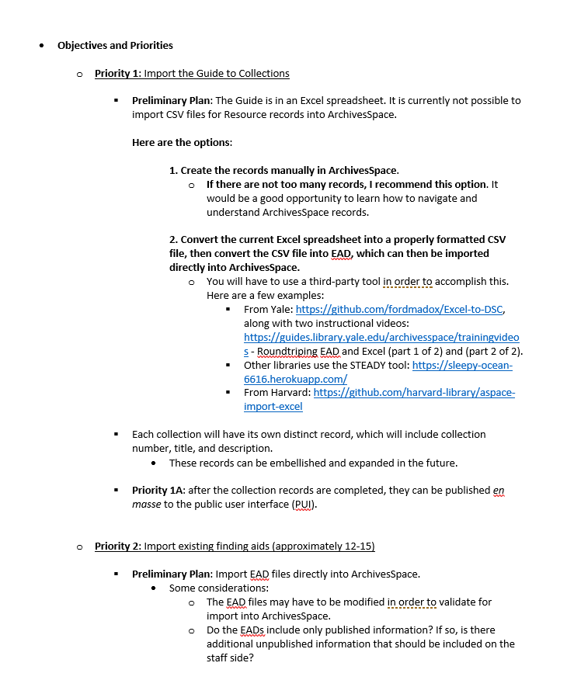
Project Plan Example
Notes:
So here is an example of a project plan, organized by priorities to support the goal of cutting down on time spent on reference requests. The library is starting off with one of their most requested resources, and then moving on to other requested resources with descriptions that only exist in print.

Slide 29
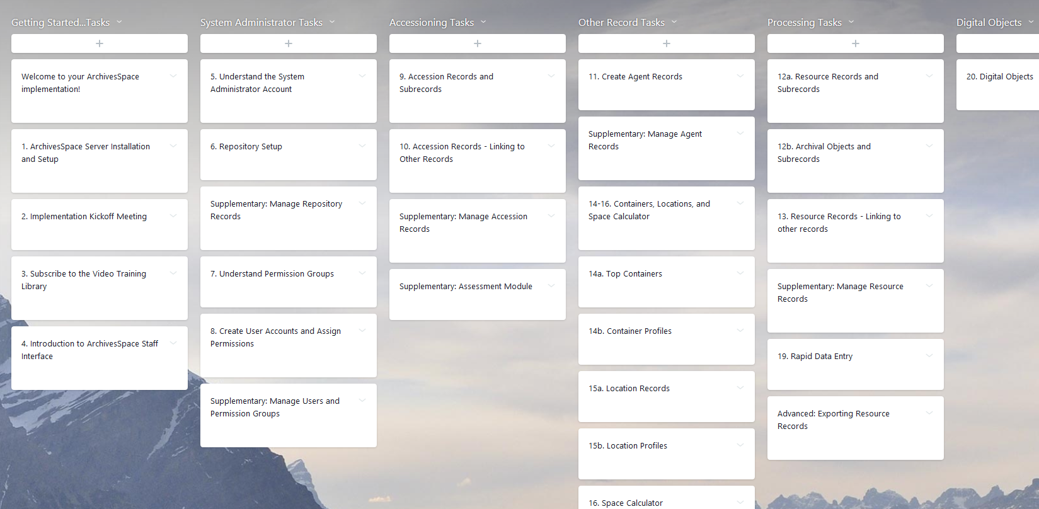
Tracking a Project Plan Progress
Asana, online project management tool
https://app.asana.com/
Notes:
We also use an online project management tool called Asana to track the progress of the project plan

Slide 30
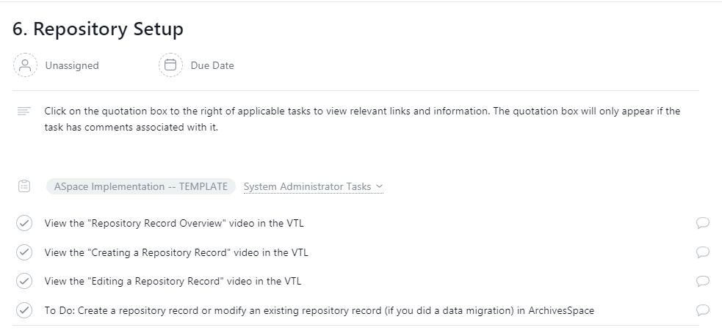
Tracking a Project Plan Progress
Asana, online project management tool
https://app.asana.com/
Notes:
And that provides us with a workspace to create individual tasks for each priority and assign them to staff members, along with due dates. We can also add comments and upload files.
And that is a nice segue into other tools you’ll want to take a look at on your implementation roadmap.

Slide 31
Tools for Importing Legacy Data
Notes:
Next stop on our implementation road map: tools for importing legacy data. You might, probably, have previous data that you want to get into ArchivesSpace in order to have your descriptions in one place.

Slide 32
Importing Legacy Data
What kinds of data can your legacy system export? For example, XML, CSV, other?
Is your data normalized or messy? For example, dates or names?
If messy, do you plan to perform clean-up prior to migration or after?
1
2
3
Before you begin, consider the following
Do you have backup copies of your legacy system or data?
Document the plan, phases or timelines for the project.
4
5
Notes:
Before you start importing legacy data, ask yourself the following questions:
What kinds of formats does my legacy system export? Some are easier to work with than others, in terms of their usability in other systems. CSV, XML, EAD can all potentially be imported into ArchivesSpace
Is my data normalized or messy? For example, are my dates described consistently? Use the ArchivesSpace sandbox to review required fields and their data formats. How does your data compare? What will be required to cleanup data to just get it to import into ArchivesSpace?
If I have messy data, do I want to clean up data first, or wait until everything is migrated into ArchivesSpace?
Do I have backup copies of my legacy system or data? – make sure you make some, if you don’t.
Think about a migration creating a migration plan and use the steps outlined at the beginning of this presentation to guide you. For example, create a plan, set goals, timelines, and to-dos.

Slide 33
Community-supported Tools
Archon or Archivists’ Toolkit users can explore the migration tools, instructions, and mapping documents at: http://archivesspace.org/using-archivesspace/migration-tools-and-data-mapping
Yale University migration example: https://campuspress.yale.edu/yalearchivesspace/2015/06/14/migration-step-by-step/
Data import maps for other legacy data: http://archivesspace.org/using-archivesspace/migration-tools-and-data-mapping
Accession, assessment, and digital object records can be imported as CSV files
Resource records can be imported as EADXML and MARCXML files
developed, sustained, and updated by the ArchivesSpace program
Notes:
Institutions with legacy data should consider the following community-supported and third-party developer tools when migrating from the previous system into ArchivesSpace.
If you are moving off of Archon and Archivists’ Toolkit, there are migration tools available for you on the ArchivesSpace website.
Community-supported tools covered in this section are developed, sustained, and updated by the ArchivesSpace Home. There are tools for legacy Archon or Archivists’ Toolkit users. See Yale University example.
Institutions with other legacy data can explore the CSV and XML import resources.

Slide 34
Third-party Tools
Harvard University “aspace-import-excel” plugin: https://github.com/harvard-library/aspace-import-excel
Supports the bulk uploading of resources and archival objects into ArchivesSpace using an Excel spreadsheet
Steady is an open-source, Ruby on Rails application developed by Jason Ronallo as part of NCSU Libraries: http://steady2.herokuapp.com/#about
Allows users to convert CSV files into EAD for import
Awesome ArchivesSpace – Migrations list: https://github.com/archivesspace/awesome-archivesspace#migrations
developed by members of the ArchivesSpace community, or other open-source contributions
Notes:
ArchivesSpace has no control over how often these tools are enhanced or updated.
The Harvard University “aspace-import-excel” plugin supports the bulk uploading of resources and archival objects into ArchivesSpace using an Excel spreadsheet. This will be included within the core code of ArchivesSpace.
Steady is an open-source solution, developed by Jason Ronallo, that allows users to convert CSV files into EAD for import

Slide 35
Additional Migration Resources
Application Programming Interface (API) – interact with the ArchivesSpace back end for data cleanup projects: https://archivesspace.github.io/archivesspace/api/
Must be an authenticated user to make requests
Bentley Historical Library: http://archival-integration.blogspot.com/2015/09/the-archivesspace-api.html
Duke University: https://blogs.library.duke.edu/bitstreams/2016/09/21/archivesspace-api-fun/
Awesome ArchivesSpace: https://github.com/archivesspace/awesome-archivesspace#apis-and-scripts
Hire an independent consultant
http://archivesspace.org/using-archivesspace/independent-consultants
Registered service providers:
https://archivesspace.org/registered-service-providers/current-rsps
Notes:
The Application Programming Interface (API) requires an authenticated user to interact with the ArchivesSpace back end for data cleanup projects. Bentley Historical Library and Duke University have very helpful blog posts that document their experiences with the API.

Slide 36
Benefits of Importing Legacy Data
Everything is in one place and accessible to your researchers and your staff
Opportunity to clean up data
Opportunity to standardize description and best practices going forward
Enjoying the fruits of your labor

Slide 37
Starting from Scratch
Rapid Data Entry (RDE) supports repeated entry of resource component records at the same level
For example, RDE can be used to populate multiple components of the same level (series, sub-series, folder, etc.) with basic data (title, date, extent, etc.) one after another
Watch the “Use the Rapid Data Entry (RDE) Tool to Create Resource Components” video located in the ArchivesSpace Help Center https://www.youtube.com/watch?v=ZL50NGOZ_Jg&feature=emb_logo
Set the Default Values field for repetitive data that is used frequently across the same records
For example, a repository identifier set as a default value for an accession or resource identifier will populate that identifier field in the accession or resource record whenever a new one is created
using tools native to the ArchivesSpace software
Notes:
Rapid Data Entry (RDE) supports repeated entry of resource component records at the same level. For example, RDE can be used to populate multiple components of the same level with basic data, one after another. If you’re like me and need a visual aid, there is a useful RDE video located in the ArchivesSpace Help Center.
Default Value fields can be set for repetitive data that is used frequently across the same records. For example, a repository identifier set as a default value will populate that identifier field in the accession or resource record whenever a new one is created

Slide 38
Training Resources
Notes:
You’ll of course, want to make sure that you make time on your road map for creating a training plan.

Slide 39
Training
How many people (staff, students, other) will be using ArchivesSpace?
What are your training or learning preferences?
Self-guided, using written documentation and video resources
Online training
In-person training
Conducting staff training en masse
“Train the trainer” – train key staff members, who would train others as needed
Creating documentation for specific description practices and workflows
1
2
Before you begin, consider the following
Notes:
How many people will be using ArchivesSpace?
How are your training or learning preferences? Do you like self-guided learning, online training, in-person instruction, etc.

Slide 40
Training
Who will be responsible for training new staff?
Who will maintain documentation and changes to processes?
3
4
Before you begin, consider the following
Notes:
3) Who will train new staff?
4) Who will maintain training documentation and training to workflows?

Slide 41
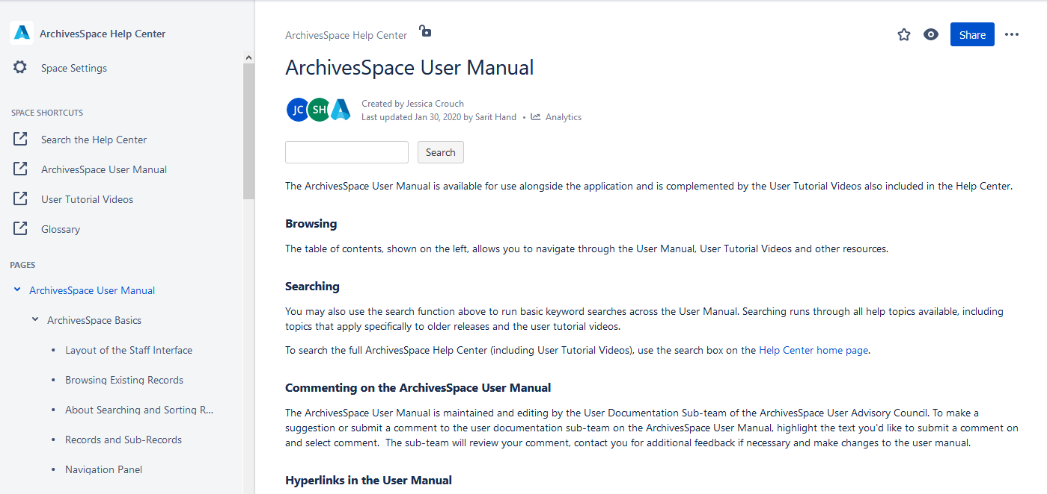
Training Resources
ArchivesSpace Help Center https://archivesspace.atlassian.net/wiki/spaces/ArchivesSpaceUserManual/overview
Notes:
There are a few training resources that you should consider. The ArchivesSpace Help Center is a great way to get started, specifically if your budget is restricted. It has an online user manual, glossary, and videos to learn the software.

Slide 42
Training Resources
SAA Collection Management Section (ArchivesSpace)
https://www2.archivists.org/groups/collection-management-section/archivesspace
Host an ArchivesSpace workshop
http://archivesspace.org/using-archivesspace/trainings
Hire an independent consultant/trainer
http://archivesspace.org/using-archivesspace/independent-consultants
Registered service providers:
https://archivesspace.org/registered-service-providers/current-rsps
Notes:
We’ve already mentioned the SAA Collection Management section - you can review the manuals other organizations have created.
If it’s in your budget, you can host a workshop for your organization (or share the cost with others), or hire an independent consultant/trainer.

Slide 43
Community Resources
Notes:
Next, we’re going to look at a few resources that you’ll find helpful as you navigate your ArchivesSpace implementation.

Slide 44
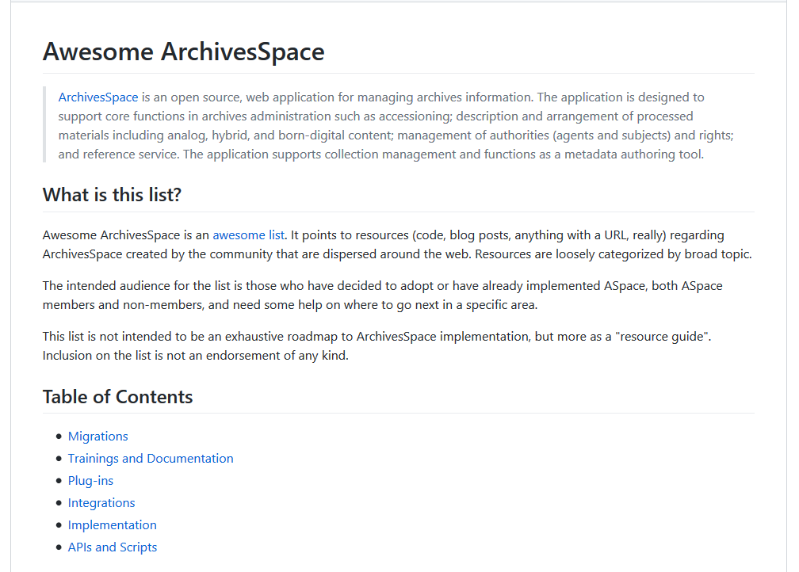
Community Resources
Awesome ArchivesSpace
https://github.com/archivesspace/awesome-archivesspace
Notes:
First is the Awesome ArchivesSpace list, which I have mentioned a few times. It is located on Github. This is a collection of linked resources from various ArchivesSpace users that covers a number of different topics, most notably…

Slide 45
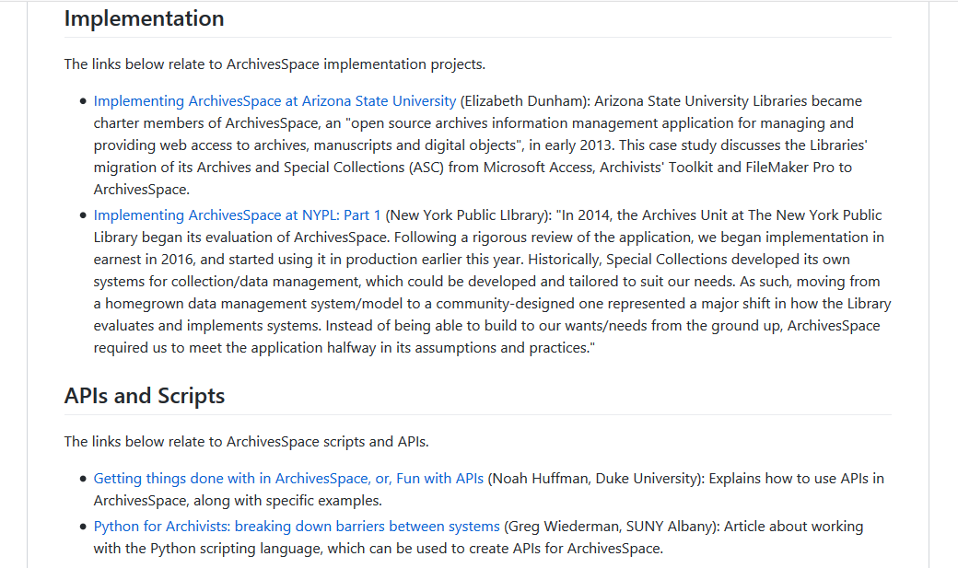
Community Resources
Awesome ArchivesSpace
https://github.com/archivesspace/awesome-archivesspace
Notes:
Implementations…so here we have some links to institutions who have shared their implementation processes…

Slide 46
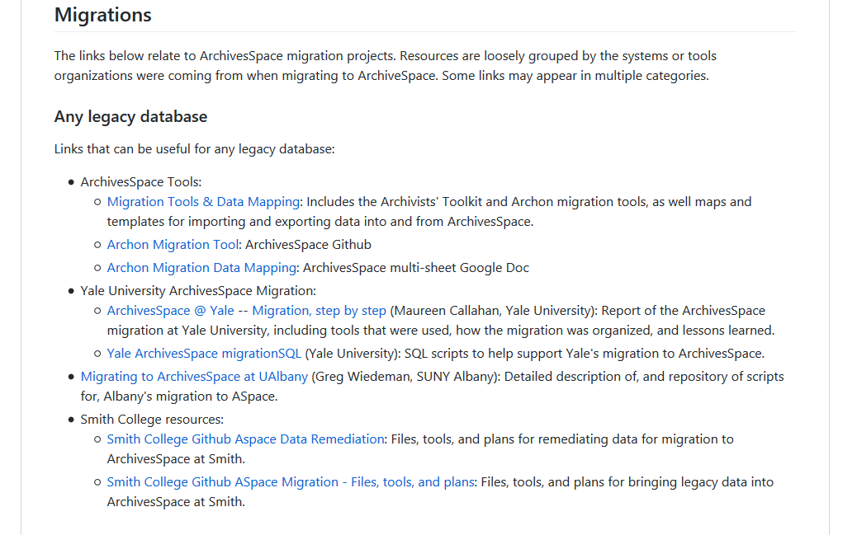
Community Resources
Awesome ArchivesSpace
https://github.com/archivesspace/awesome-archivesspace
Notes:
…and migrations

Slide 47
Community Resources
Awesome ArchivesSpace List
https://github.com/archivesspace/awesome-archivesspace
Notes:
The list is frequently updated by contributions from ArchivesSpace users. If you come up with an interesting system for implementation or migrating legacy data, or any of the other topics covered, then please do submit it to the list.

Slide 48
Community Resources
JIRA is an online “issue and project tracking” system
The ArchivesSpace program uses it to record bugs and product improvement requests
https://archivesspace.atlassian.net/secure/Dashboard.jspa?selectPageId=10000
ArchivesSpace JIRA
Notes:
Another resource to familiarize yourself with is the ArchivesSpace Jira page.
Jira is an online ‘issue and project tracking’ system that ArchivesSpace uses to collect and track bug reports and new request features

Slide 49
Community Resources
How to report a bug: https://archivesspace.atlassian.net/wiki/display/ADC/How+to+Report+a+Bug
How to submit a product improvement request: https://archivesspace.atlassian.net/wiki/display/ADC/How+to+Request+a+New+Feature
JIRA Resources
Notes:
These are links to instructions for reporting a bug and for submitting requests for new or improved product features

Slide 50
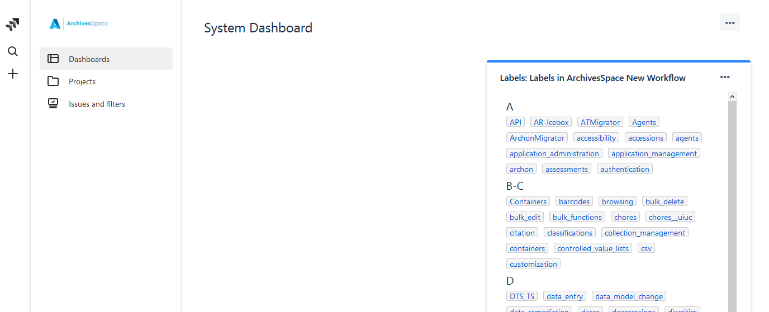
ArchivesSpace JIRA System Dashboard
Notes:
On the site, you’ll find a tag list of topics. You can also use the magnifying glass on the left for text searching

Slide 51
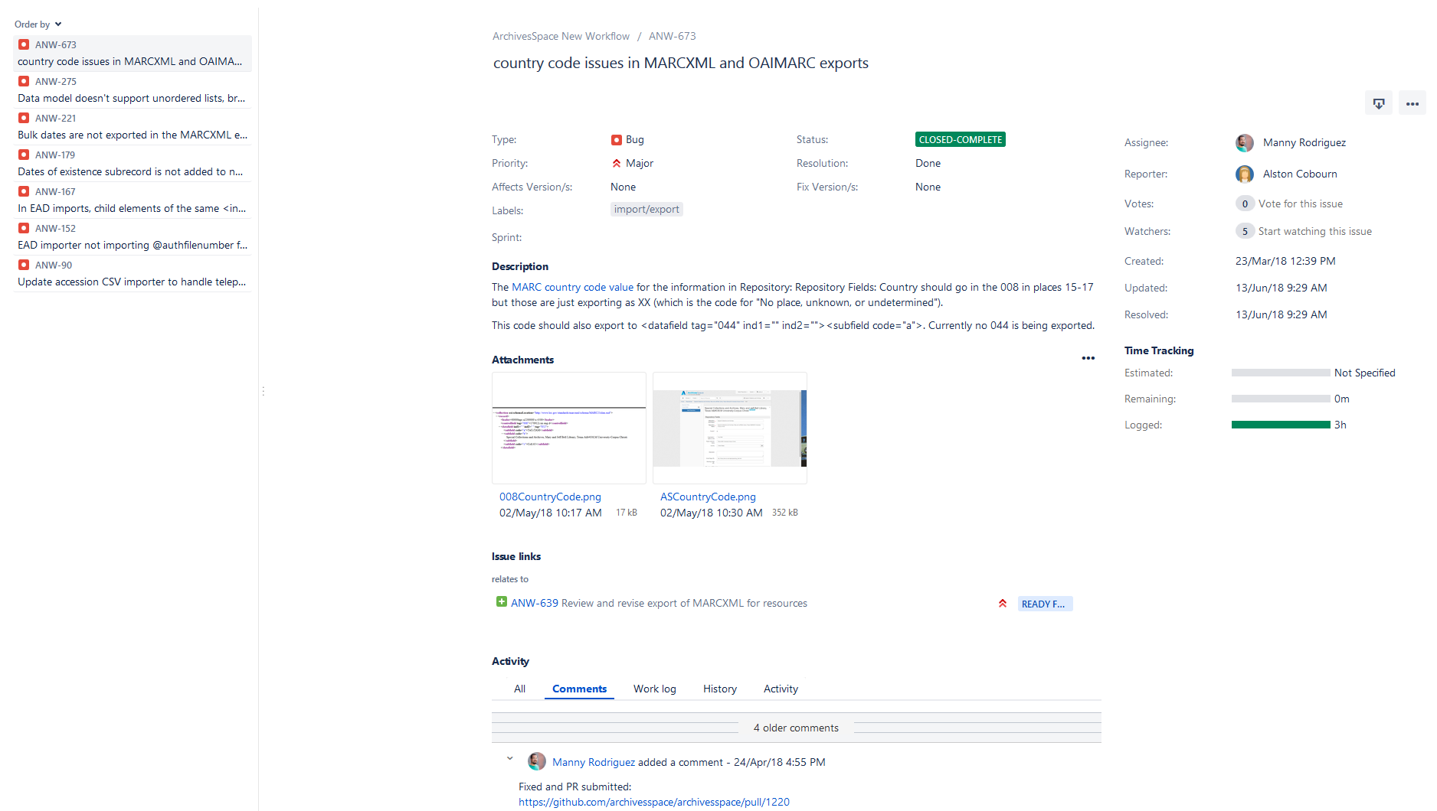
Notes:
Here is an example of a bug report in Jira
Other people can add comments if they’ve seen the issue, too.
Screenshots can be uploaded
People can vote for the issue or ‘watch’ the issue to follow its progress

Slide 52
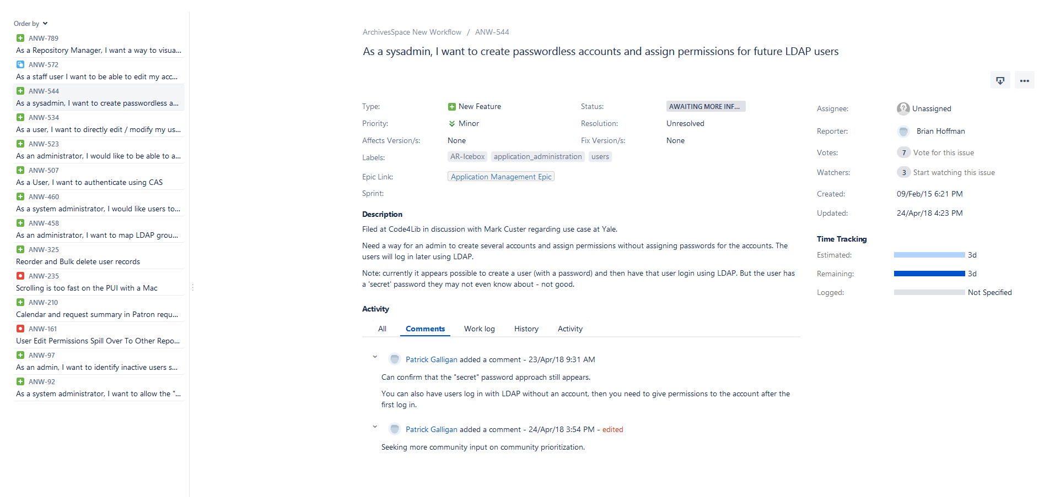
Notes:
This is an example of a new feature request…

Slide 53
Notes:
If you’ve submitted a bug or new feature request, or if you’ve chosen to ‘watch’ something, you’ll receive email updates.

Slide 54
Community Resources
ArchivesSpace PUI editing: http://archivesspace.github.io/archivesspace/user/the-archivesspace-public-user-interface/
ArchivesSpace theming and branding: http://archivesspace.github.io/archivesspace/user/theming-archivesspace/
Mark Custer, Pre-launch checklist: https://archivesspace.atlassian.net/wiki/spaces/ADC/pages/103526318/PUI+pre-launch+checklist
Rachel Trent, George Washington University, Implementing PUI (11/15/2018): http://lyralists.lyrasis.org/mailman/htdig/archivesspace_users_group/2018-November/006433.html
Public user interface (PUI)
Notes:
PUI: We didn’t have a chance to go into detail about the ArchivesSpace PUI, but wanted to share some resources that members of the community have contributed.

Slide 55
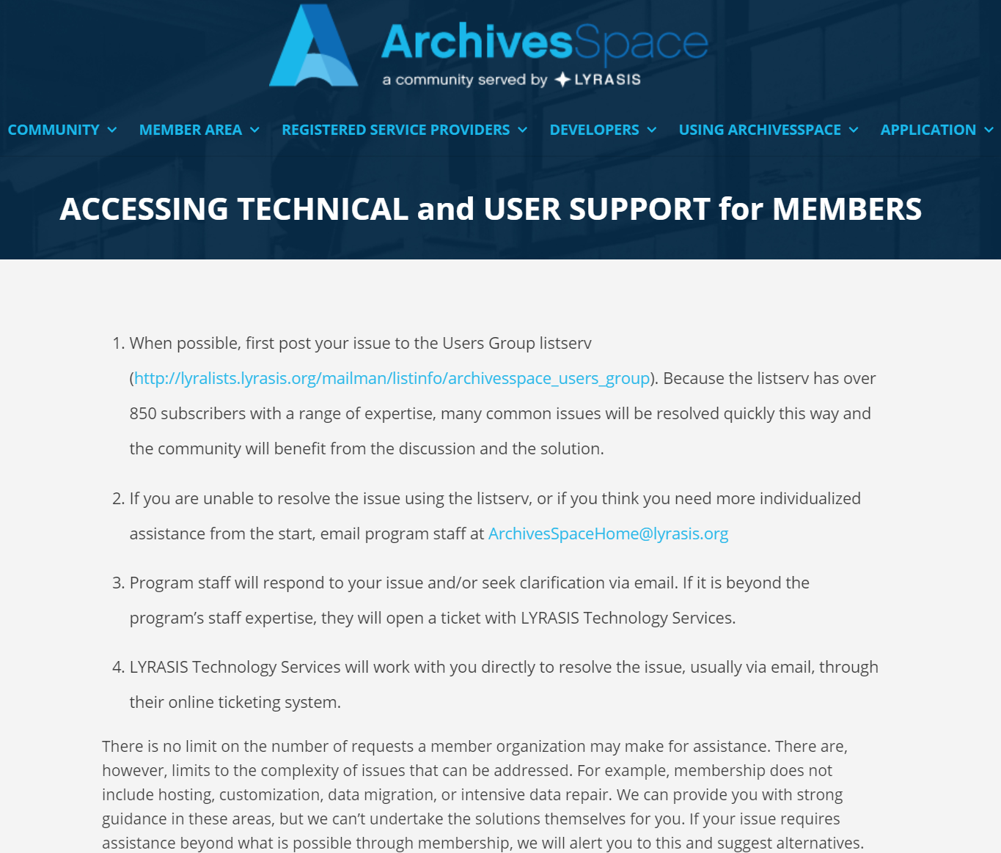
Community Resources
ArchivesSpace Technical support: http://archivesspace.org/member-area/technical-support
Notes:
ArchivesSpace Technical support:
Try the listserv first
then email ArchivesSpace Home for additional assistance.
If it is beyond the program’s staff expertise, they will open a ticket with LYRASIS Technology Services.

Slide 56
Community Resources
Join the ArchivesSpace Buddy Program: http://archivesspace.org/community/aspace-buddies
Listservs
ArchivesSpace Member listserv: http://lyralists.lyrasis.org/mailman/listinfo/archivesspace_users_group
ArchivesSpace Google Group (non-members): https://groups.google.com/forum/#!forum/archivesspace
ArchivesSpace Webinars: http://archivesspace.org/using-archivesspace/webinars
Notes:
ArchivesSpace Buddy Program: The ArchivesSpace Implementation Buddy program is our community program to help connect our ArchivesSpace community members so we can work through challenges together.
Listservs: Post your questions or issues to the ArchivesSpace Member listserv. There is a Google group available for non-members.

Slide 57
Community Resources
ArchivesSpace Wiki: https://archivesspace.atlassian.net/wiki/spaces/ADC/overview
ArchivesSpace YouTube Channel: https://www.youtube.com/channel/UCxR6D-UlSx6N6UWTeqHTjzA
Registered Service Providers: http://archivesspace.org/registered-service-providers/current-rsps
Notes:
ArchivesSpace Webinars: The ArchivesSpace program coordinates an ongoing program of webinars giving members of the ArchivesSpace community a chance to present about work in their own institutions and across the community. Check back frequently to see what other ArchivesSpace users are up to!
ArchivesSpace Wiki: Plethora of information for community resources (like the ones we’ve touched on in this presentation), governance, working groups, past forum notes, and more.
ArchivesSpace YouTube Channel: Member forum recording content available
Registered Services Providers: Work with a hosting provider if you decide you cannot host ArchivesSpace locally. They have resources, as well.

Slide 58
Thank you!
Anne Marie Lyons
Training and Library Solutions Consultant
Atlas Systems
amlyons@atlas-sys.com
800.567.7401 ext. 1
Madeline Sheldon
Member Representative, Digital Technology Services
LYRASIS
madeline.sheldon@lyrasis.org
800.999.8558 ext. 2930
Please contact Anne Marie or Madeline with any questions.

