Slide 1
ArchivesSpace Reports
Nancy Enneking and Nathan Stevens
ArchivesSpace Member Meeting
August 22, 2015
Cleveland Public Library

Slide 2
Basics
New to ASpace 1.3
Built on open-source Jasper Reports engine
Ongoing work performed and informed by ASpace staff and UAC members:
Nathan Stevens (ASpace); Nancy Enneking, Mark Custer, Carolyn Runyon (UAC: Reports Subteam); Alston Cobourn, Nikki Lynn Thomas (incoming UAC members)
We are looking for feedback and ideas for reports!

Slide 3
Report Considerations
System based:
ASpace data/table complexity, compared with AT and Archon
Initial difficulty embedding Jasper Reports engine
JasperSoft® Studio is free, but not easy for a non-programmer to work with
System evolution/ongoing development
System flexibility
More ways to accomplish the same task in the system (Collection Management vs. Event)
More flexibility in the system (example whole v. part extents)
Dirty source data ……….

Slide 4
Current Reports
Initial reports based on those used in Archivists’ Toolkit
Accessions (14)
Resources (9)
Agents (4)
Subjects (2)
Locations (1)
Digital Objects (4)
General (1 – RepositoryProfileReport)

Slide 5
Forthcoming Reports
Current issues in JIRA, scheduled for future releases:
Collection management
Events
Rights
Classifications
User-defined fields – may not be possible, too much potential variability of use

Slide 6
Known Issues with Current Default Reports
System performance
CSV and Excel output is not useful as currently formatted
Parameters (or lack thereof)
Should reports be another backend job??
Need for a detailed list of fields and criteria used in each report
Reality is, the default reports cannot meet everyone's needs.
For some (many), they may be no more than coding examples.

Slide 7
Other Reporting Options
Edit existing reports and reload into the backend (discussion follows)
If data is stored in-house
Connect alternate report generator to backend database (ODBC or other)
Crystal Reports
Access
Excel
Others
If data is hosted
Discuss options with Lyrasis
The community needs a report sharing platform, with a library of submitted reports (Jasper and other) and specifications.

Slide 8
How to Run a Report Within ASpace
To locate the canned reports which currently exist within ArchivesSpace, go to the drop-down gear next to the repository name and select Reports.
Staff users at a variety of levels can access the Reports page and run reports.

Slide 9
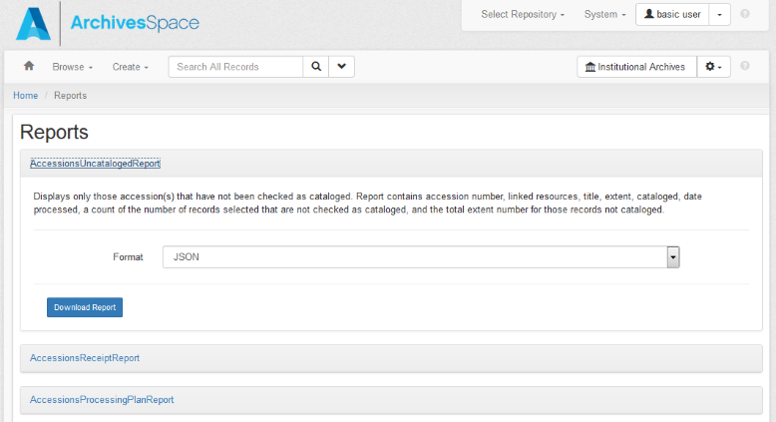
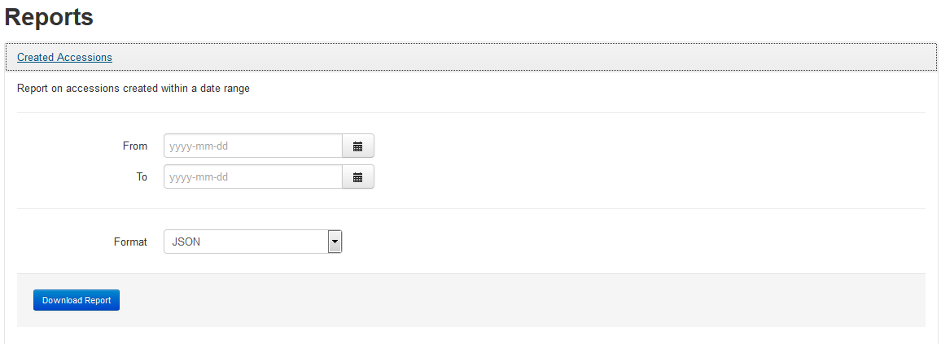
How to Run a Report Within ASpace
Click on the desired report to select it. Some reports will require you to enter parameters, such as a date range or other information. All reports are available for download in a variety of formats.
When a date parameter is required, enter the date using the format yyyy-mm-dd, or use the calendar tool to select a day.

Slide 10
Create/Modify a Jasper Report

Slide 11
Embed Report in ASpace Backend

