Slide 1
ArchivesSpace @ Yale +5 Recommendations
Mark Custer, 2015, Inaugural ArchivesSpace Member Meeting

Slide 2
Special Collections White Paper
Yale joins ArchivesSpace
Taskforce Final Report
Launch-Goals Finalized
Oct 31
May 13
First of many migration tests
In Production
2013
Mar
Apr
May
Jun
Jul
Aug
Sep
Oct
Nov
Dec
Jan
Feb
Mar
Apr
May
Jun
Jul
Aug
Sep
Oct
Nov
Dec
Jan
Feb
Mar
Apr
May
Jun
2015
ArchivesSpace Committee
Nov 27, 2013 - ongoing
Accessioning Development
Container Management Development
Official AT-to-ArchivesSpace Migrations
ArchivesSpace Training Sessions

Slide 3
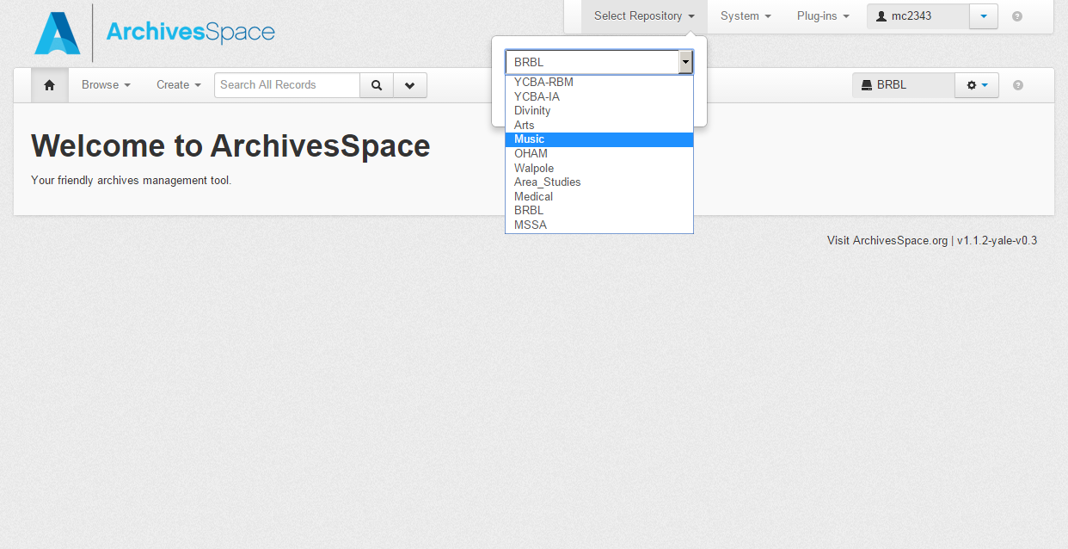

Slide 4
+5 Recommendations

Slide 5
Build A Team
1:

Slide 6
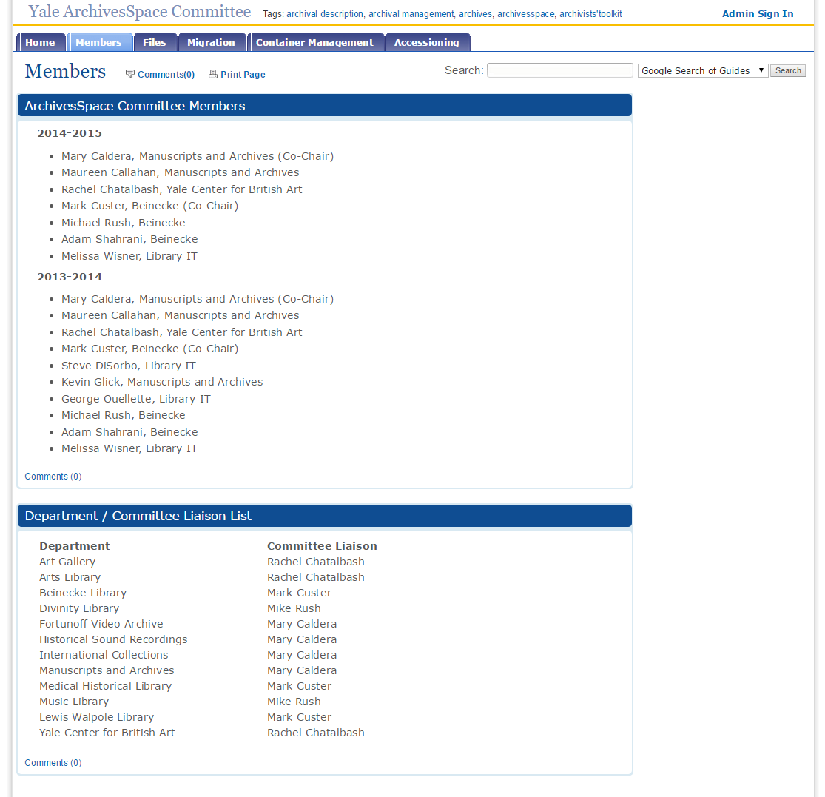
1:

Slide 7
Write an Implementation Plan
2:

Slide 8
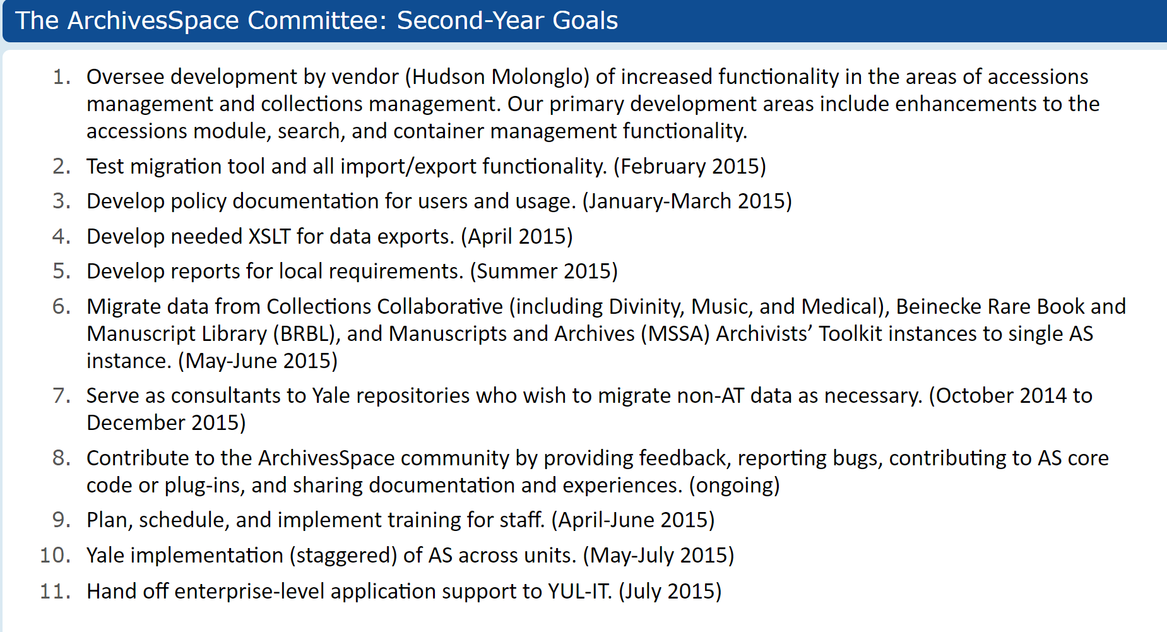
2:

Slide 9
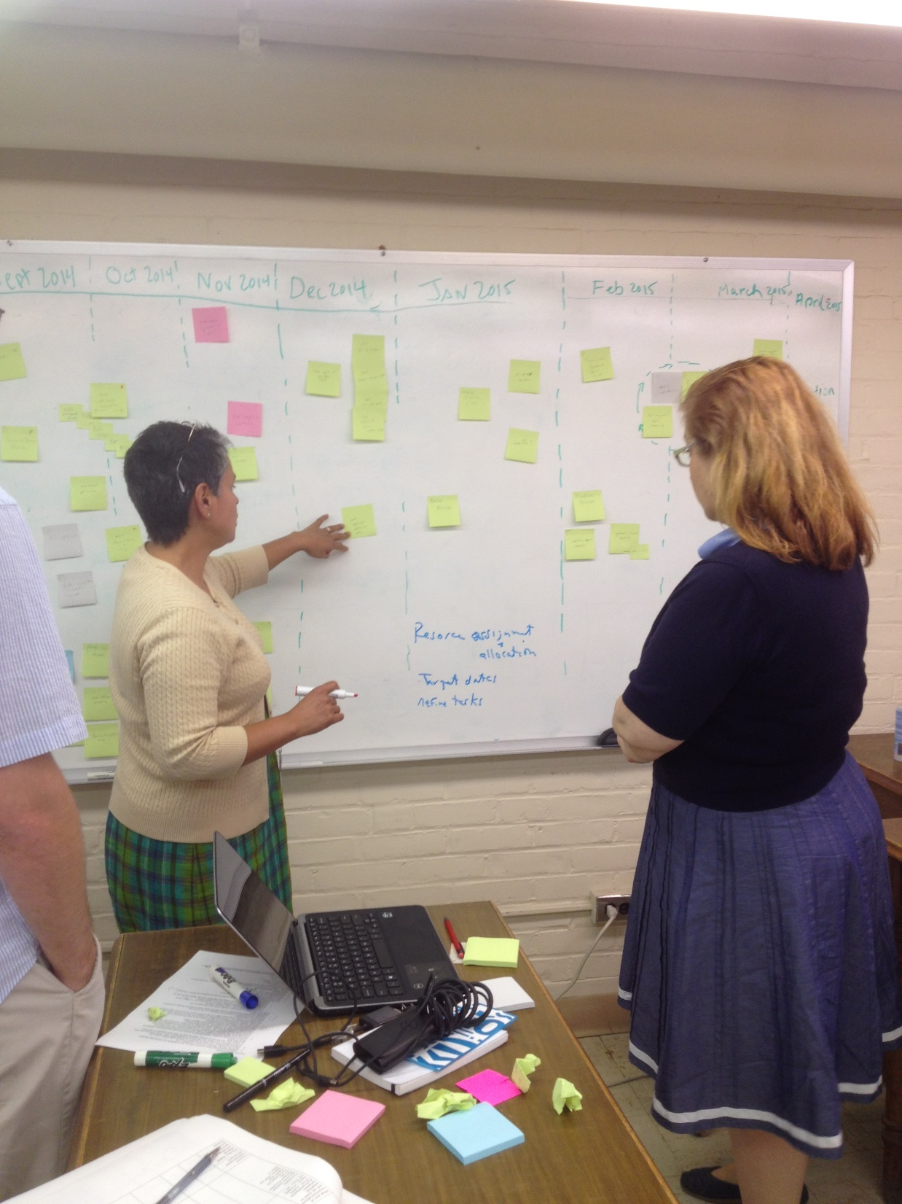
2:

Slide 10
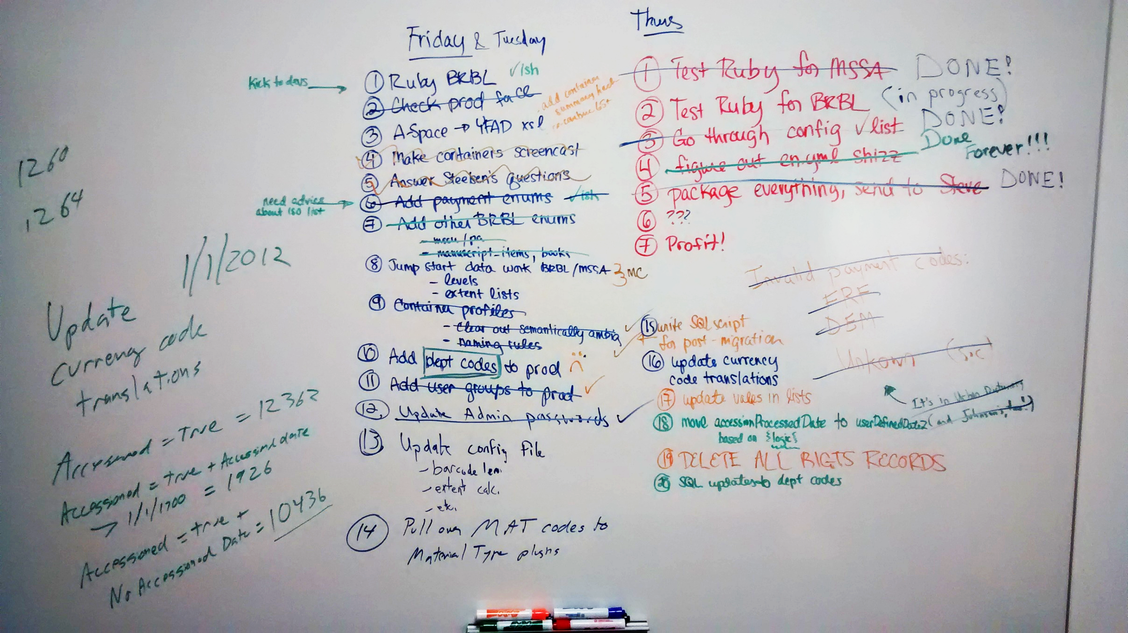
2:

Slide 11
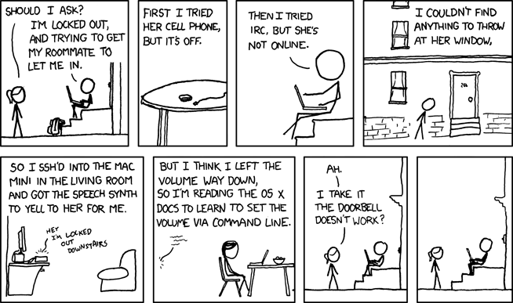
Get Training
3:

Slide 12
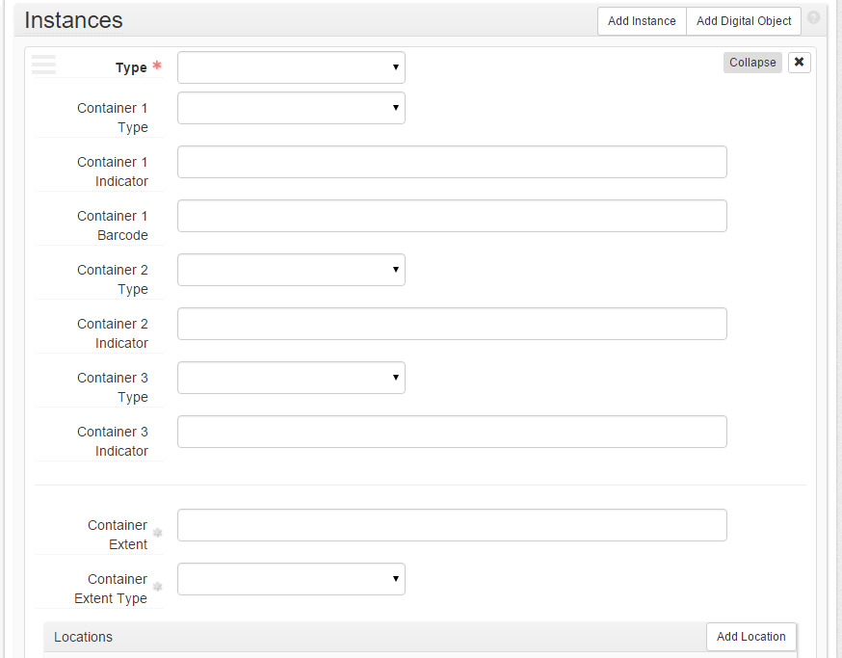
3:

Slide 13
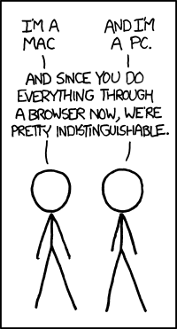
Engage with the Community
4:

Slide 14
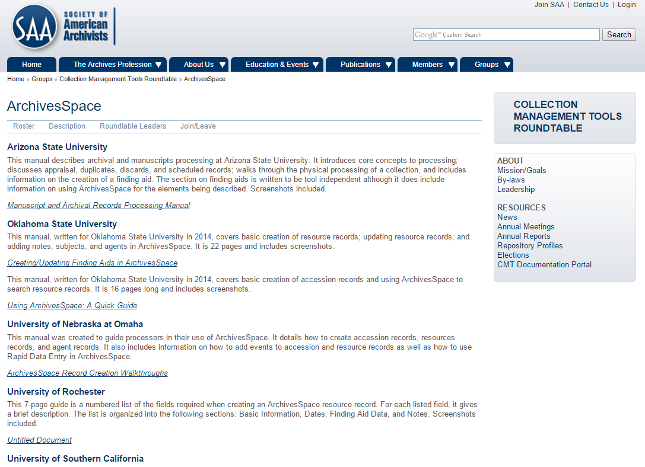
4:

Slide 15
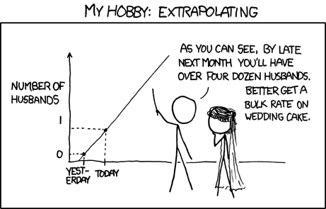
Evaluate Early, Evaluate Again
5:

Slide 16
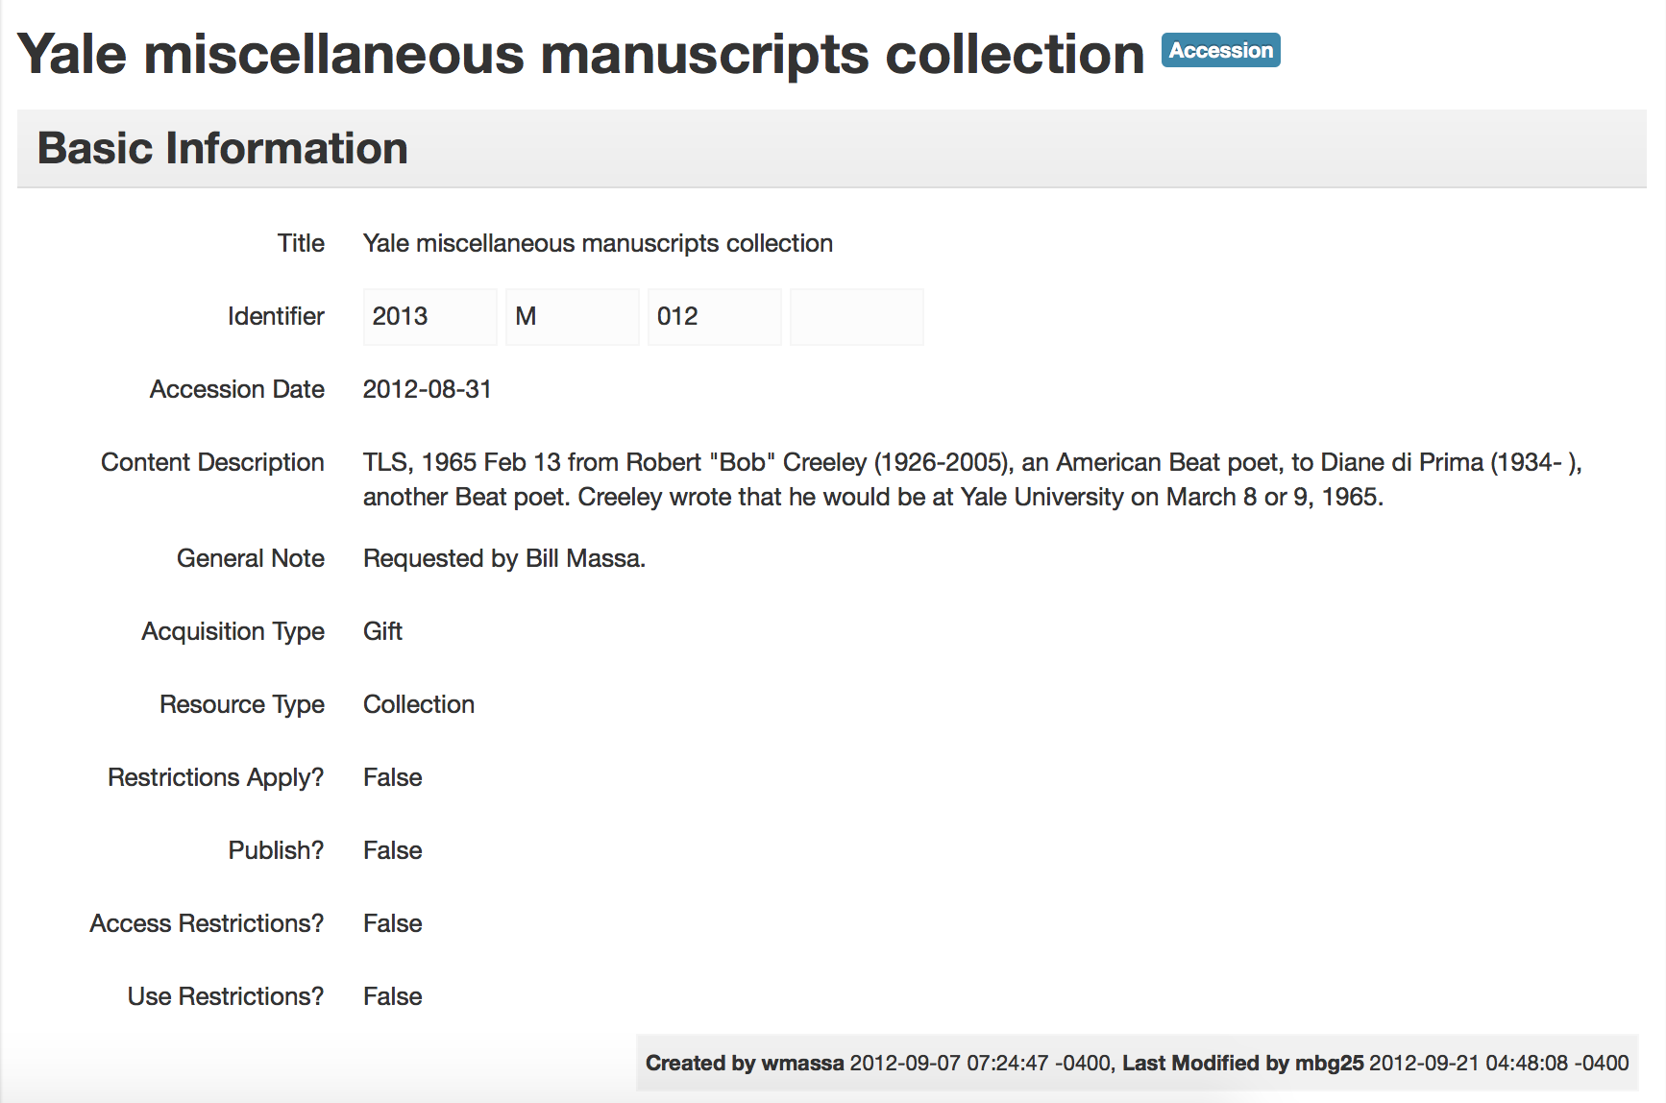
5:

Slide 17
Comics
Slide 05: http://xkcd.com/1562/
Slide 07: http://xkcd.com/726/
Slide 11: http://xkcd.com/530/
Slide 13: http://xkcd.com/934/
Slide 15: http://xkcd.com/605/

Slide 18
Questions?
http://campuspress.yale.edu/yalearchivesspace
https://github.com/YaleArchivesSpace
http://yale.v1.libguides.com/yalearchivesspace
email: mark.custer@yale.edu

