Slide 1
Software Performance testing
Or: Have We Got Bad Blood?

Slide 2
What is software performance Testing?
An approach to software testing that relies on pre-scripted or pre-recorded actions that simulate user behavior in an application, that can be executed automatically by a timer, through crontab, or on-demand, and report a set of results and measurements for comparison, troubleshooting and testing system performance

Slide 3
Why software performance testing?
Measure performance of peak usage without scheduling staff participation
Consistent review of core functions pre and post upgrade, or other system changes, including hardware changes
Capacity planning (data and users)
Concurrent users accessing/performing critical functions
Are users experiencing poor front end response?

Slide 4
What Types of software performance testing?
Unit/Component testing: a test on a discrete component of the application in the back end, front end, or both
Smoke testing: a test run under low load levels to demonstrate the application works as expected
Peak Load testing: a test to measure system performance with a simulated number of concurrent users
Soak testing: a test to assess system performance with average number of concurrent users, but over a prolonged timeframe

Slide 5
Don’t forget to Give it the Old Eyeball Test
If you see something, say something!
Often where non-functional requirements are measured (e.g. data integrity, general usability, failure management)

Slide 6
Five hundred twenty five thousand six hundred minutes--or how do you measure a workflow?
● ArchivesSpace backend 6 seconds to fetch the record from the database and produce its JSON representation.
● ArchivesSpace frontend 16 seconds to produce the HTML page for the edit form.
● User web browser 2+minutes to render the HTML page (which was around 10MB of HTML content) and to run the JavaScript required to initialize the edit form.

Slide 7
Using JMETER: free desktop tool
Test Name: Using JMeter to measure system performance while Editing/Saving an Archival Object record in AS.
Test Parameters: Test AS, 2 threads, 5 second ramp up, 1 loop
Test Steps:
Log into AS
Select “BRBL” repo
Search all records for ‘Melissa’
When search results appear, filter to Archival Objects record type
From filtered result list, select any record by clicking the Edit button
Wait for the record to display, then add TEST in the Title field.
Press Save and wait for changes to be applied to record.

Slide 8
Jmeter Report of Backend Response Time

Slide 9
Jmeter Report of Backend Response Time

Slide 10
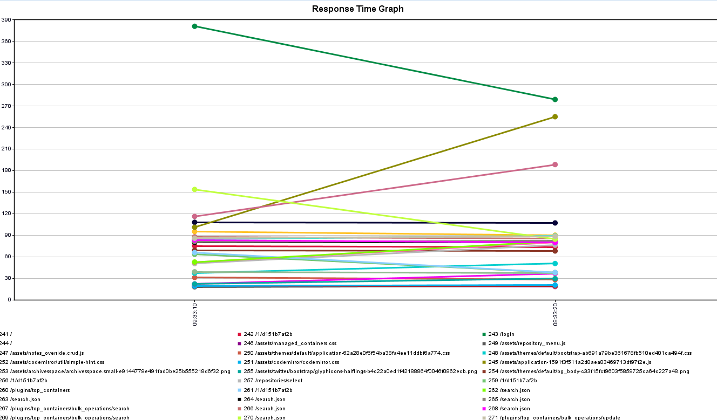
Jmeter Report of Backend Response Time

Slide 11
Using chrome developer tools-Free browser tool
Test Name: Using Chrome Developer Tools to measure system performance while Editing/Saving an Archival Object record in AS.
Test Parameters: Test AS, 1 manual user
Test Steps:
Log into AS
Select “BRBL” repo
Search all records for ‘Melissa’
When search results appear, filter to Archival Objects record type
From filtered result list, select any record by clicking the Edit button
Wait for the record to display, then add TEST in the Title field.
Press Save and wait for changes to be applied to record.

Slide 12
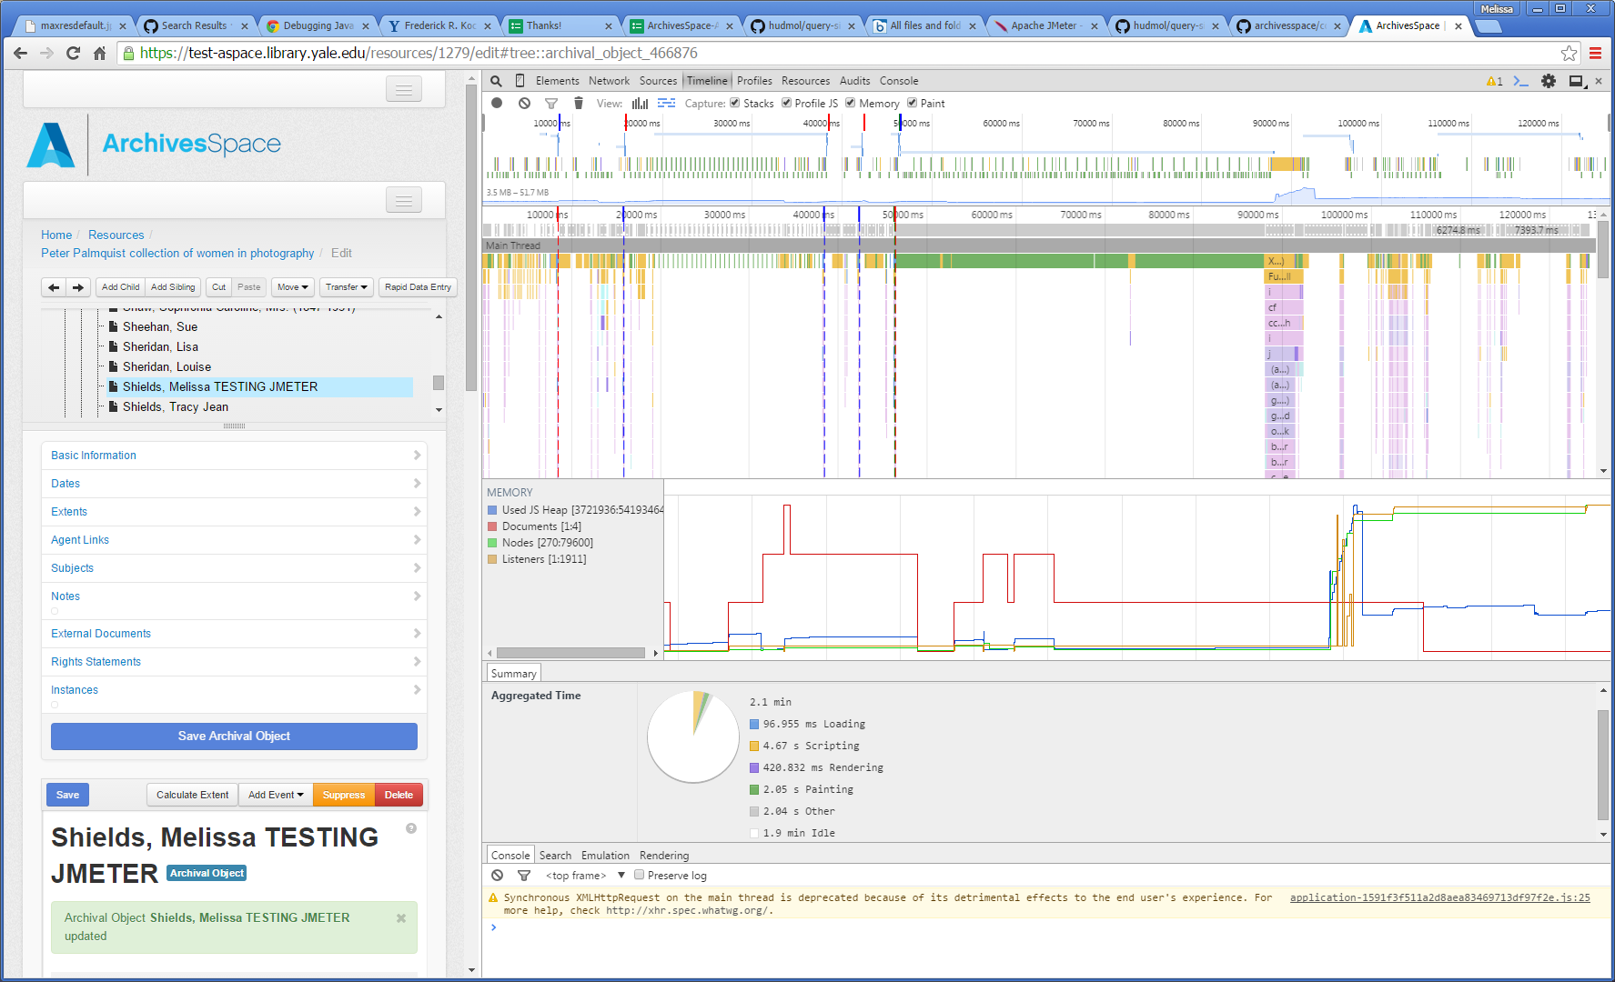

Slide 15
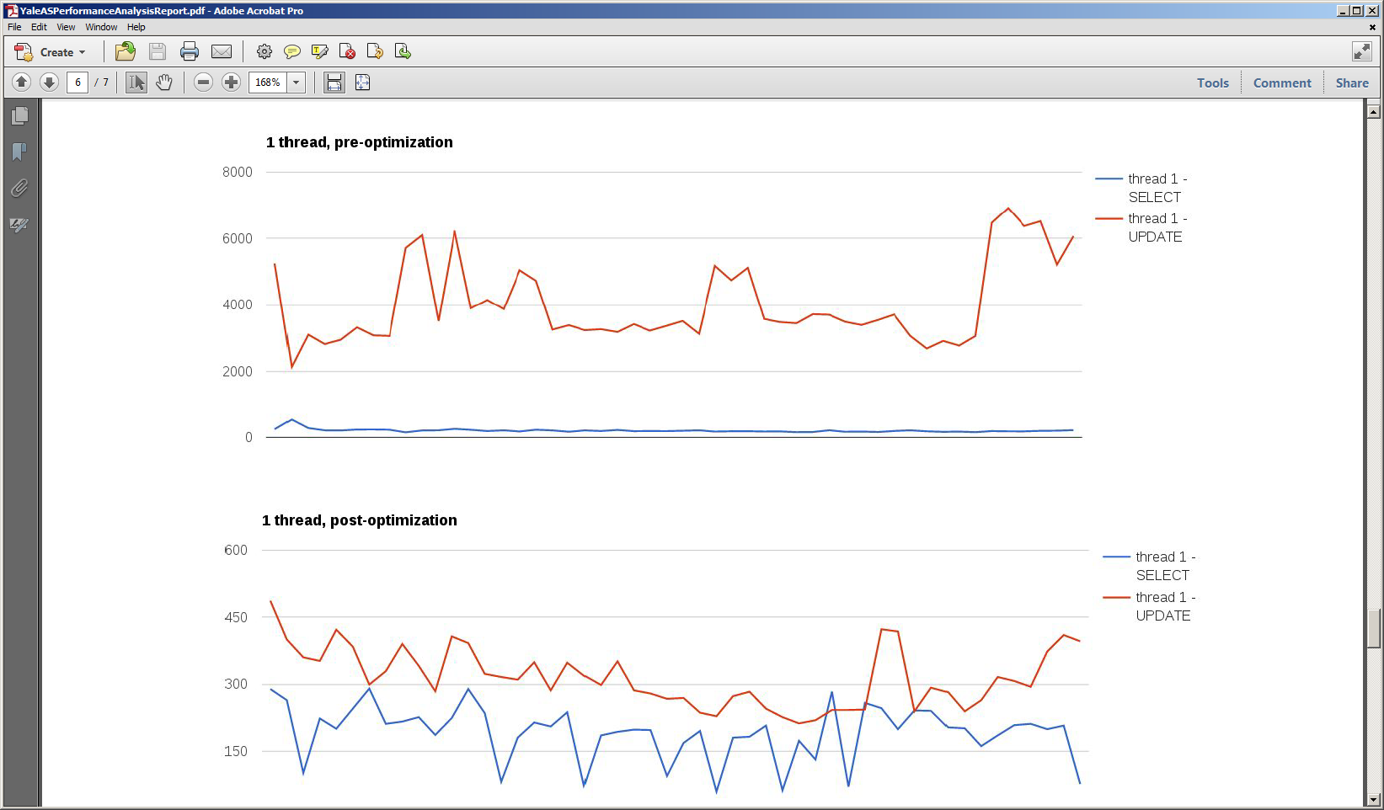
Apprx. Time: 7 seconds
Apprx. Time: .7 seconds

Slide 17
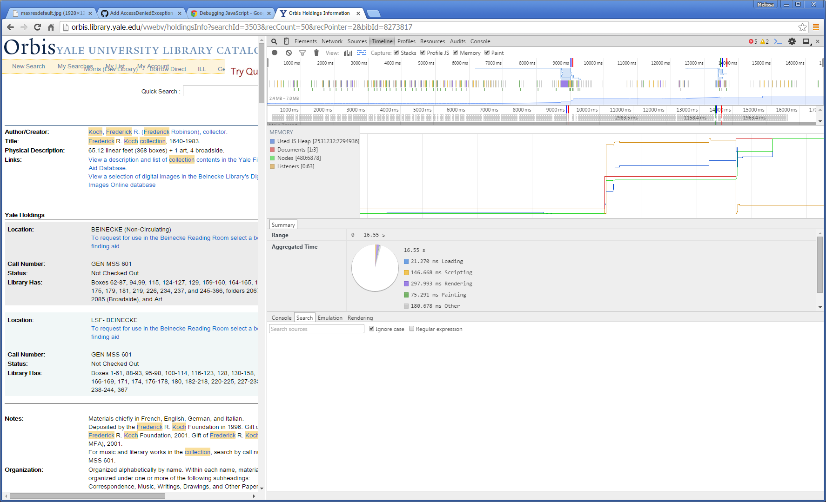

Slide 18
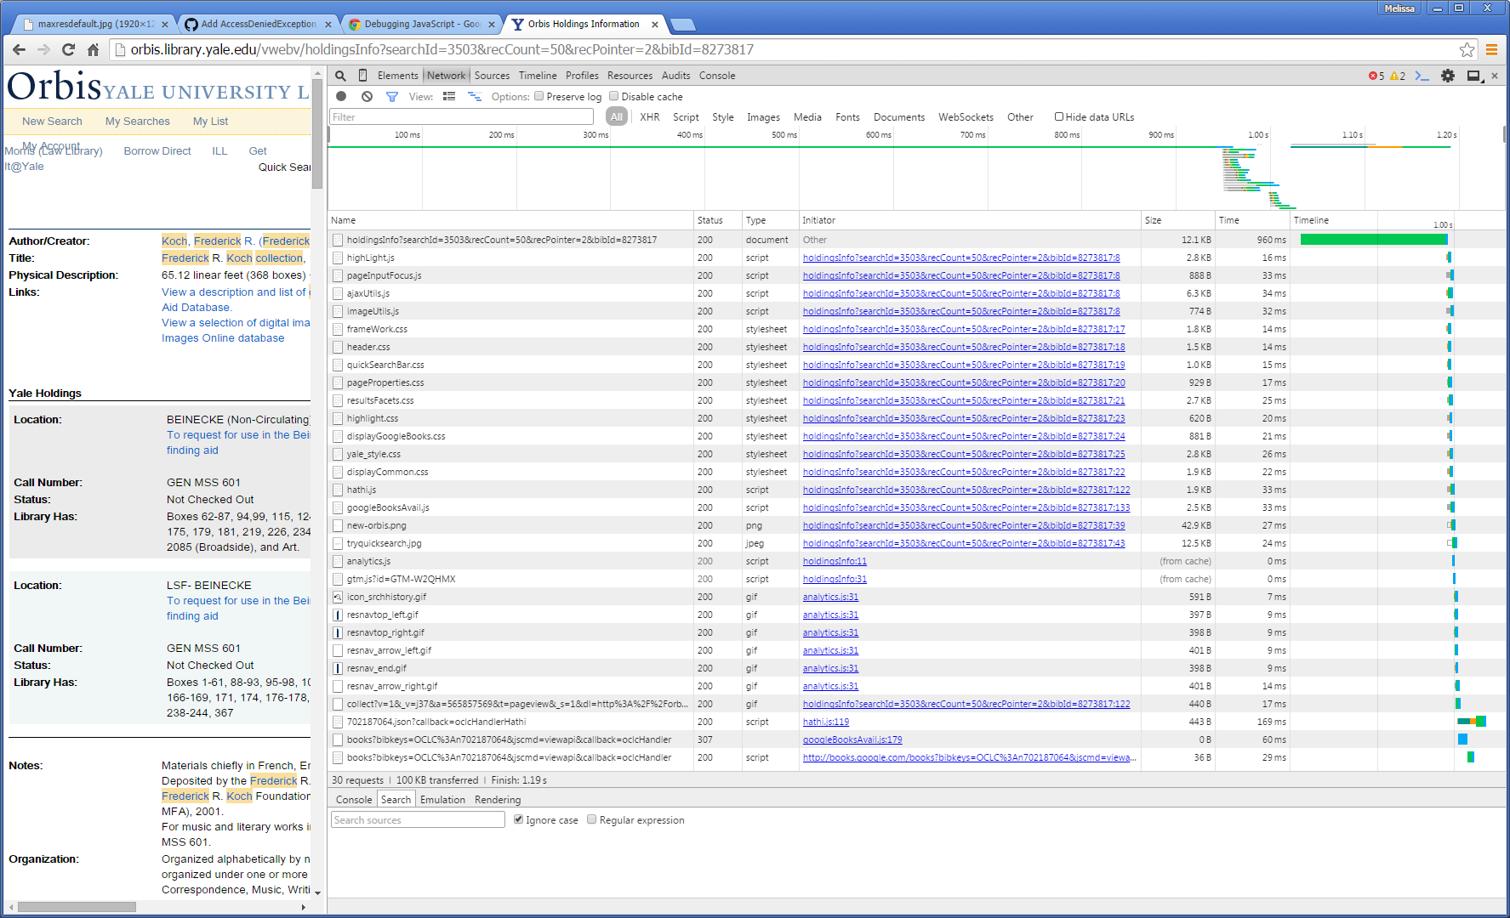

Slide 19
What Falls Outside the Scope of software measurement tools?
Knowledge of the application
Developing a set of steps to test automatically
Interpreting and resolving the test results
Establishing benchmarks for end user experience with the application
Infrastructure monitoring (e.g. tools like New Relic are designed to monitor CPU, memory, Heap Space, slow queries, etc.)

Slide 20
Good to ask/know
Like any piece of software- it may be designed to work with a specific browser or specific desktop environment
Does the tool provide analysis/output on the aspect of the application you need to test? (e.g. Can it measure backend db or solr response time, do you need it to point out HTML5 or javascript errors)
Does the tool allow you to write scripts to conduct tests, or does it provide a recorder to capture point and click behavior only?
Does the tool integrate with any other bug, incident, or development tools in use such as JIRA?
Tools may be free or $

Slide 21
Thank you!
Happy Testing!
melissa.wisner@yale.edu

