Slide 1
ArchivesSpace in Cambridge: the story so far
ArchivesSpace Annual Member Forum, 2 August 2021
Natalie Adams, Metadata Specialist
Tuan Pham, Digital Transformation Director presenting for Nick Butler, Software Developer

Slide 2
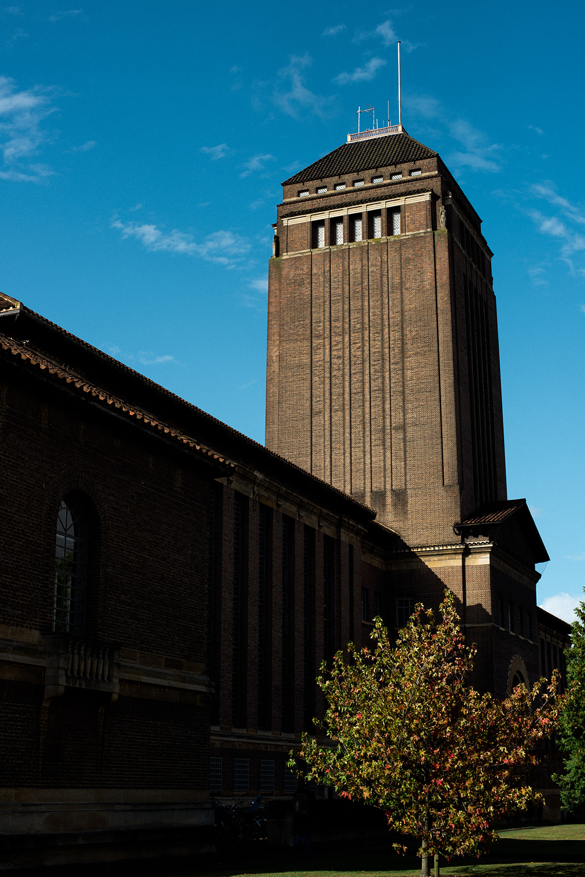
ArchivesSpace in Cambridge
ArchivesSpace implemented as an archive management system – 2-year project
Consortium of 30 archival repositories led by Cambridge University Library, 80+ users
Migration of 27 legacy datasets
Benefits to research community- ‘one stop shop’ for discovery of archives in the city
Benefits to University Library: collection management, technical resilience and integration
Image: Alice the Camera

Slide 3
Huge resources: improved functionality of archival object records
Adapt OAI feed (resource records only exported)
Export EAD and PDF from archival objects
‘Publish all’ at archival object level
Adapting ‘find and replace’ to be used with archival object records
Image: Alice the Camera

Slide 4
To support local/UK archival practice
Added identifiers (reference codes)
to the display of record trees on the SUI
in the collection organization pane of the PUI
so identifier is visible when selecting a record to link to an assessment record
Accessibility changes to public user interface- available at
https://archivesearch.lib.cam.ac.uk
Image: Alice the Camera

Slide 5
Our development process
Update plugin on GitLab
Update ref on Puppet
Archivist testing/issue reporting
More local plugin development/testing
Notes:
If changes still operational, upload new plugin version to development server and hand over to archivists for testing (handled by puppet - we update the commit hash, then the puppet run pulls down the relevant code version and restarts ArchivesSpace)
If archivists would like further changes, repeat plugin development - local testing - development server deployment - archivist handover cycle
Once archivists are happy, upload plugin to production (same puppet process as on dev), announce downtime and restart out of hours
Update README file to include new changes

Slide 6
Keeping up to date with core code changes
Diff AS versions to see what's changed
Identify sections of changed core code that are being extended or overridden in our plugin
Update plugin as required:
if the functionality in our plugin has been added to core code, remove from plugin
otherwise update code in our plugin to take core code changes into account
Update plugin README
Notes:
Run a diff of the AS code to check what's changed
With the help of our README file, identify any changes to core code which are being extended or overridden
If the functionality in our plugin has been added to core code, remove relevant parts of the plugin (e.g. if our functionality has been added to a view we should be able to remove the whole view file, if a route has been added we can remove it from our routes file, etc)
If we still need the files in our plugin, update them to take core code changes into account (e.g. when language functionality was changed in v2.8 we had to modify our copies of the frontend resource/archival object/digital object views to base our changes on the new core code versions)
Update our README file if any changes have been made

Slide 7
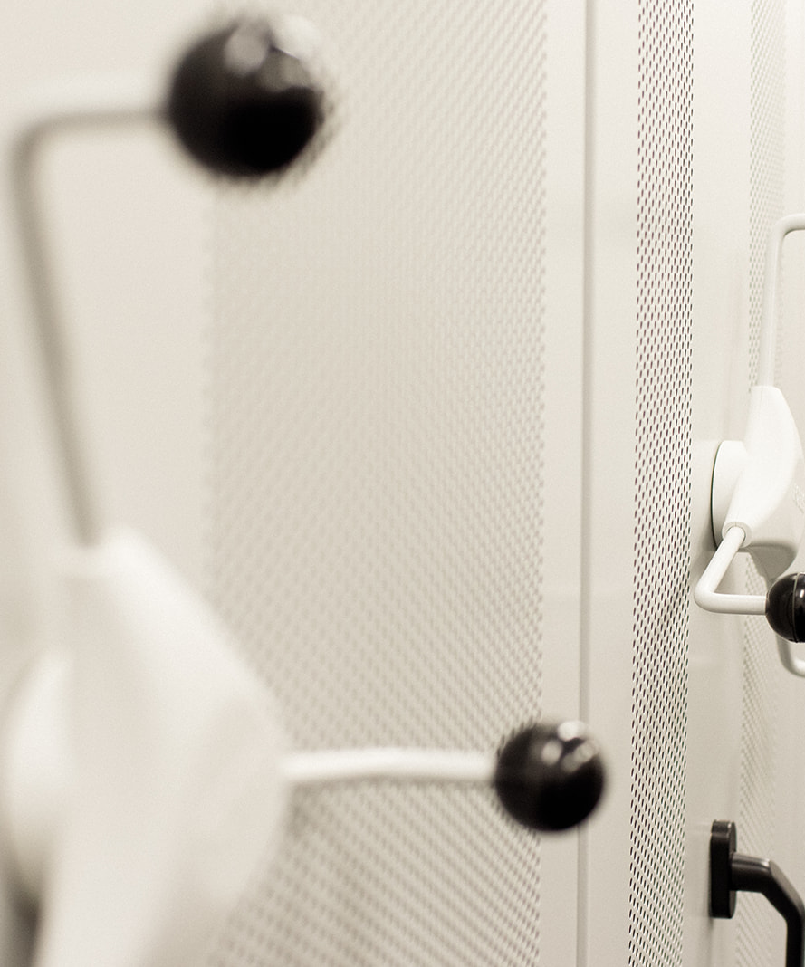
Submitting as core code
We have submitted three plugin changes as core code (so far!)
In response to, or inspired by, JIRA issues
Others can make use of our changes
Develop deeper understanding of ArchivesSpace
Maintenance benefits for us!
Image: Alice the Camera
Notes:
The three changes we've submitted as core code that started as plugins:
publish_partial_trees: allowed portions of record trees to be published or unpublished, instead of having to work only at resource level
Amendments to the find and replace job to allow finding and replacing within part of a record tree, instead of having to work only at resource level (not raised as an issue by others, but fits with the aims of allowing more flexibility in how to work with multiple records in the above issue)
tree_component_id: a plugin written by the University of Denver libraries that displayed record identifiers in the SUI tree, with Cambridge adaptions to display them also in the PUI tree
Main benefit: other institutions can make use of our work. Working together with other institutions to make enhancements that may not be considered priorities by the core ArchivesSpace team (e.g. based on local archival practice)
Benefits for our developers: modifying and adding to the unit tests allows for deeper understanding of how our changes interact with other elements of core code. Also having our changes as part of the core code means less of a maintenance burden for us – fewer plugin files to check/update when a new version of AS is released

Slide 8
Issues we're currently looking at
Some locally-specific (suitable for a plugin):
We only use the id_0 field for our reference codes/identifiers, so plan to remove the id_1, id_2 and id_3 fields from the frontend views to prevent confusion
Add a way for users to report issues with a finding aid as part of our "Decolonising the collections" initiative
We've added the ability to export lower-level EAD from the staff side, and PDFs from the PUI – still need to add functionality to export lower-level staff-side PDFs
Others more generally-applicable:
We've noticed that spreadsheet imports don't always update our index
Notes:
Spreadsheet imports, especially digital object imports, don't appear to update our index fully (only some of the digital object records are in the index and appear in the PUI, even when set identically in the spreadsheet). We've put in biweekly reindexes to mitigate this, but we still need to investigate to see whether it's an issue with our setup or with AS itself

Slide 9
Contact Us
Archivesspace@lib.cam.ac.uk

