Slide 1
Configuring Your ArchivesSpace Implementation
ArchivesSpace Online Forum
May 18-21, 2020
Notes:
Welcome to “Configuring your ArchivesSpace Implementation”

Slide 2
Anne Marie Lyons
Training and Library Solutions Consultant
amlyons@atlas-sys.com
Notes:
I work with libraries and archives that are implementing ArchivesSpace.

Slide 3
Configuration Topics
Administrator configurations
Data entry consistency
Staff guidance
Data importing
Public User Interface (PUI) customizations
Additional backend configurations
Other resources
Notes:
This presentation is going to be grab bag of selected configurations, advice, and some things to be aware of as you go about your ArchivesSpace implementation. It is definitely not an exhaustive list.
I will be mainly be discussing configurations that do not require plugins. So these are changes that you can make to the ArchivesSpace system using the included files. There are a few exceptions I will point out along the way where there might some plugins you want to consider based on how you are planning to use ArchivesSpace.
Also, many of the configurations I will cover can be made using your staff interface. There are some changes that would need to be made to ArchivesSpace server files. The changes are fairly simple, and I’ve provided instructions. For more complex configurations, I’ve provided some resources to get you started.
The powerpoint presentation is very utilitarian; I’ve included text and screenshots for everything. For the presentation, I’m going to spend most of my time in my ArchivesSpace system.

Slide 4
Please note
This information is current as of versions 2.7.0-2.7.1; some content might not apply to previous versions
The staff interface screenshots in this presentation were created while logged into the ArchivesSpace staff interface as a system administrator (unless otherwise noted)

Slide 5
Administrator configurations

Slide 6
Administrator Configurations: Repository Records
Required: Set up at least one repository record
This record provides contact info for your finding aids, and can be managed from one place
Make sure all required fields are filled out, including locally-required fields for EAD contributions elsewhere
Note:
The Publish button (will not affect subjects and published agents)
The Branding Image URL will add your logo to finding aid PDFs that are printed from the staff side
Notes:
You will next need to set up at least one repository. This is the record that provides the name and location of your repository so that it can be included in your finding aids. This information is managed in one place so that you don’t have to update individual records if that information ever changes.
I wanted to point out some things on the repository record to consider.
Make sure that you fill out required fields and meet local practices for wherever you share your EADs.
Note the publish button – this will hide all of the accessions, resources, and digital objects, but it won’t hide existing subjects and published agents.
The branding image URL allows you configure the staff-side PDF to use your logo. It will also display your logo on the repository record on the Staff side.
DEMO on 2.7.1 machine

Slide 7
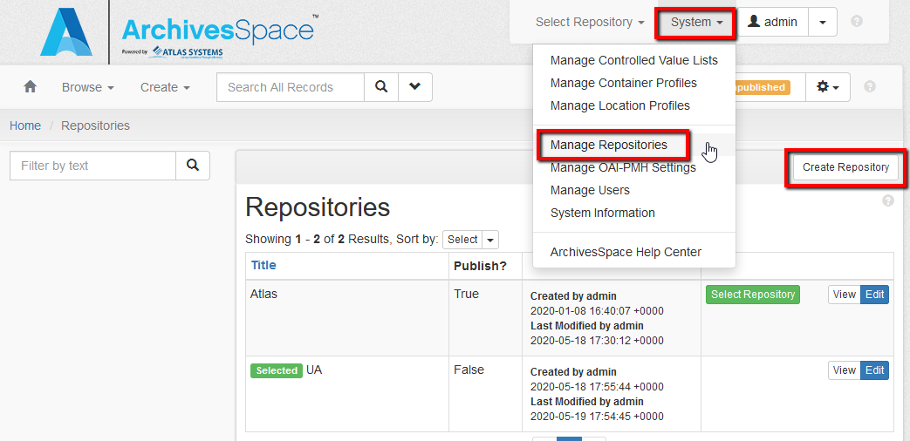

Slide 8
Staff User Preferences

Slide 9
Staff User Accounts: Preferences
Global Preferences
Can be overwritten by Repository and User Preferences
Repository Preferences
Will overwrite Global Preferences
Can be overwritten by User Preferences
User Preferences
Will overwrite Global and Repository Preferences
Notes:
Staff users need to permission to modify preferences
Demo where preferences are set
Bugginess pre-2.6.0

Slide 10
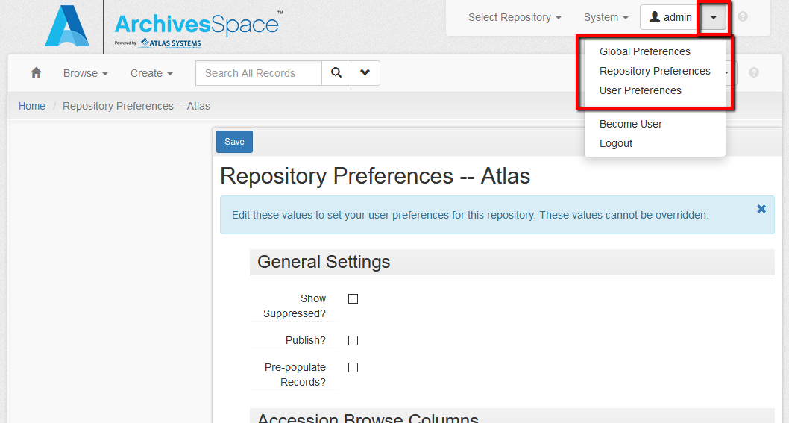

Slide 11
Staff User Accounts: Preferences (cont.)
Preferences include:
Show suppressed records in search results
Automatically check the Publish box in records
Pre-populate records with default values templates
Determine display columns for search results
Standard note order for finding aids
Access to preferences are determined by permissions
Test by using “Become a user” function
There can be a lag when updating!

Slide 12
Become a User Function

Slide 13
Data entry consistency

Slide 14
Data Entry Consistency: Default Values Templates
Default values templates are available for:
Accessions
Resources and archival objects
Digital objects and components
Agents
Subjects
Locations
Events
Classifications and terms

Slide 15
Data Entry Consistency: Default Values Templates (cont.)
Accessed from the Browse results page
The Pre-populate box must be checked in Repository Preferences for the staff user
These templates are only used for records that are created using the Create menu
These templates do not apply to Rapid Date Entry for archival objects
Notes:
Default values templates:
The Pre-populate box must be checked in Repository Preferences (and possibly User Preferences) for the staff user
(Note that User Preferences can overwrite Repository Preferences)
These templates are only used for records that are created using the Create menu
They do not apply to imported records
For resources components/archival objects, the templates do not apply when Rapid Data Entry (RDE) is used
(You can create a separate RDE tamplate)

Slide 16
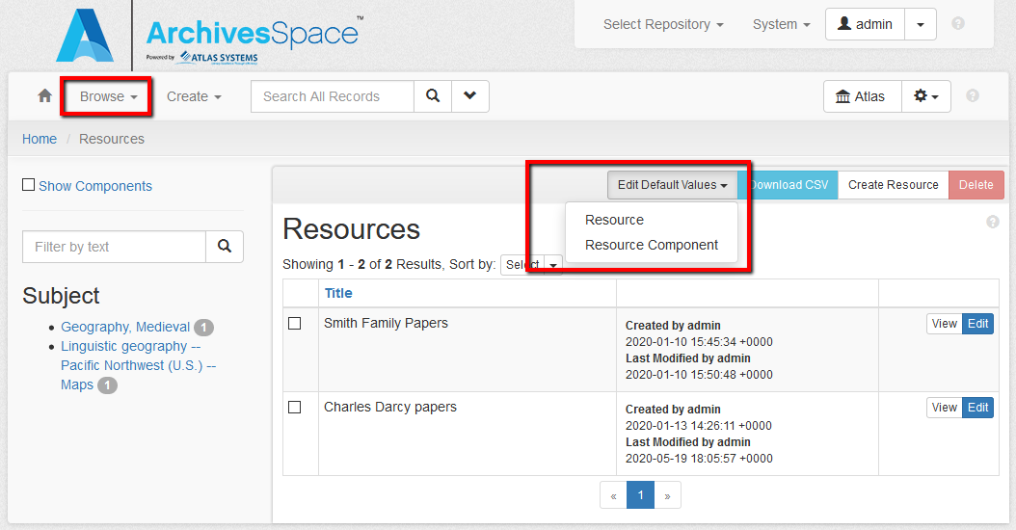

Slide 17
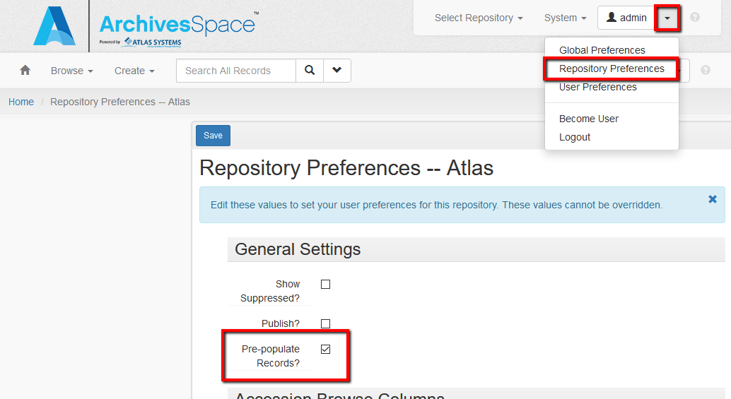

Slide 18
Data Entry Consistency: Required Fields Templates
Required fields templates are available for agent records:
Persons
Families
Corporate entities
Software

Slide 19
Data Entry Consistency: Required Fields Templates (cont.)
Accessed from the Browse results page for agents
The Pre-populate box must be checked in Repository Preferences for the staff user
These templates are only used for records that are created using the Create menu
Notes:
Required fields templates:
The Pre-populate box must be checked in Repository Preferences (and possibly User Preferences) for the staff user
(Note that User Preferences can overwrite Repository Preferences)
These templates are only used for records that are created using the Create menu
They do not apply to imported agents – including LCNAF

Slide 20
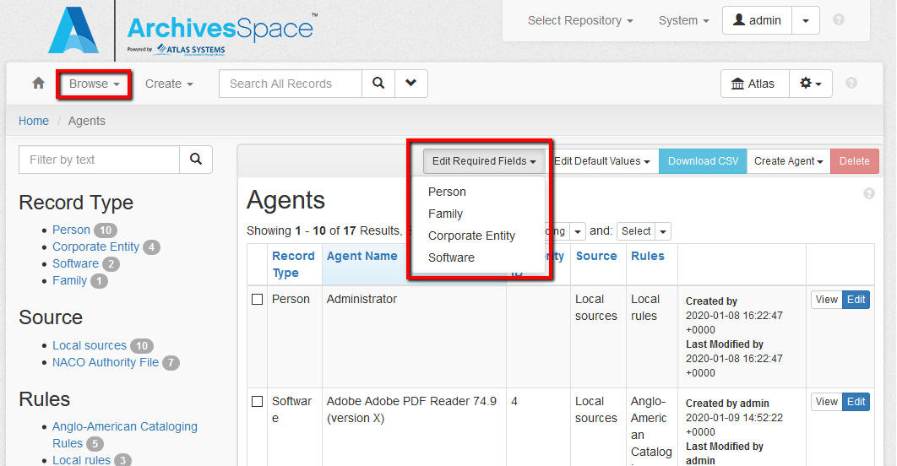

Slide 21
Data Entry Consistency: Rapid Data Entry
RDE provides a spreadsheet in the staff interface that can be used to add:
Archival objects to an existing resource record
Components to an existing digital object record
You must be in Edit mode to see the Rapid Data Entry button
An RDE template can be created to control data for the RDE spreadsheet
Notes:
A template can be created to control data for the RDE spreadsheet – you can create more than one template

Slide 22
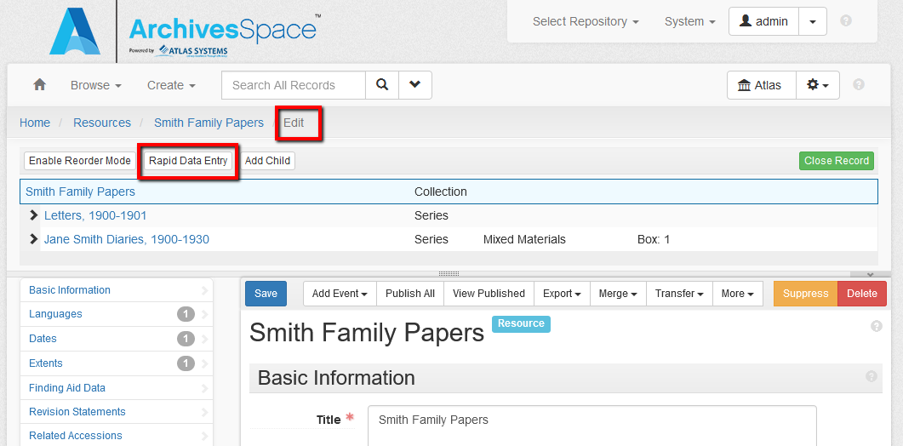

Slide 23
Data Entry Consistency: Rapid Data Entry (cont.)
RDE templates control:
Which columns are present
The order of the columns
Default values for fields
Default values that can self-calculate based on sequencing
E.g.: top containers: box 1, box 2, etc.

Slide 24
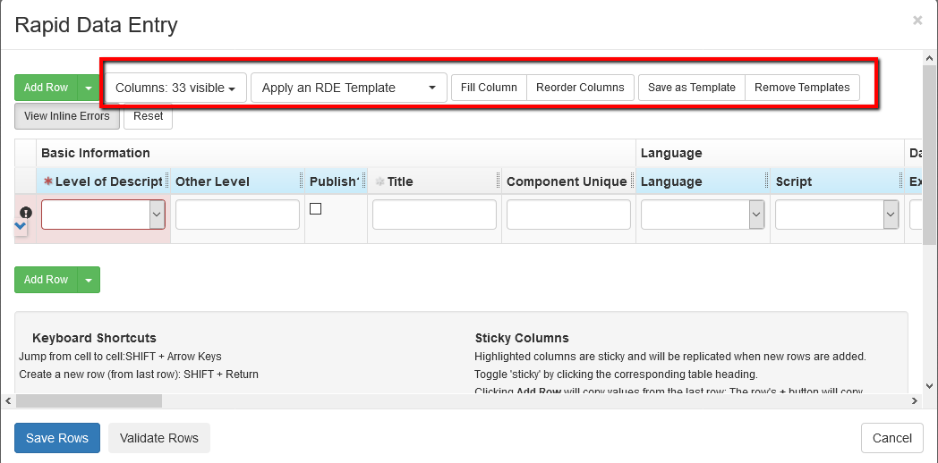

Slide 25
Data Entry Consistency: Rapid Data Entry (cont.)
RDE will insert all of the components at the same hierarchy level
Even if they have different levels of description (e.g. Series vs. Subseries vs. File)
RDE will add all of the components as children to whichever component you had selected before accessing RDE
You can always Enable Reorder Mode to arrange components
Notes:
Note:
RDE will insert the components at the same hierarchy level, even if they are different Levels of Description (e.g. Series vs. Subseries vs. File)
RDE will add the components as children to whatever component you have selected before accessing RDE
You can always “Enable Reorder Mode” if you need to rearrange components
Agents and subjects for specific components will need to be added afterwards
Only three notes can be entered for each component (which might be fine)
In versions 2.7.0 and 2.7.1, RDE templates are not helpful due to a bug. It will be fixed after 2.7.x, and it works fine pre-2.6.0

Slide 26
Data Entry Consistency: Rapid Data Entry (cont.)
Note:
Agents and subjects will need to be added afterwards
Only three notes can be entered
RDE template bug in 2.7.0 and 2.7.1
Notes:
Note:
Agents and subjects for specific components will need to be added afterwards
Only three notes can be entered for each component (which might be fine)
In versions 2.7.0 and 2.7.1, RDE templates are not helpful due to a bug. It will be fixed after 2.7.x, and it works fine pre-2.6.0

Slide 27
Data Entry Consistency: Importing Data
Harvard Excel Import plugin: https://github.com/harvard-library/aspace-import-excel
Allows you to import a spreadsheet of archival objects for an existing resource record
More robust than RDE: imports multiple levels of description at the configured hierarchical levels
You will need to install the plugin on the server
It will be part of the core code in the future

Slide 28
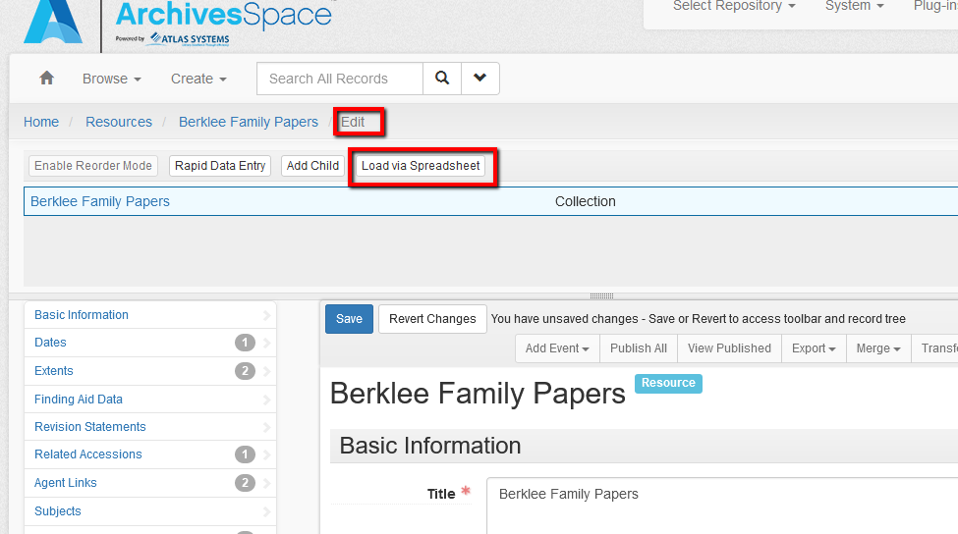

Slide 29
Data Entry Consistency: Standard Note Order
Notes can be added to:
Resource records and archival objects
Digital objects and components
Notes are listed in order of data entry within a description record
Clicking the Apply Standard Note Order button in a record will reorder notes
Standard Note Order is configured in Preferences
Notes:
Notes can be added to:
Resource records
Resource components / archival objects
Digital objects
Digital object components
Notes are listed in the order of data entry
The Standard Note Order button in the Notes sub-record will rearrange the note order according to the preferences
Standard Note Order is set in Repository Preferences (or User Preferences)
(Note that User Preferences can overwrite Repository Preferences)

Slide 30
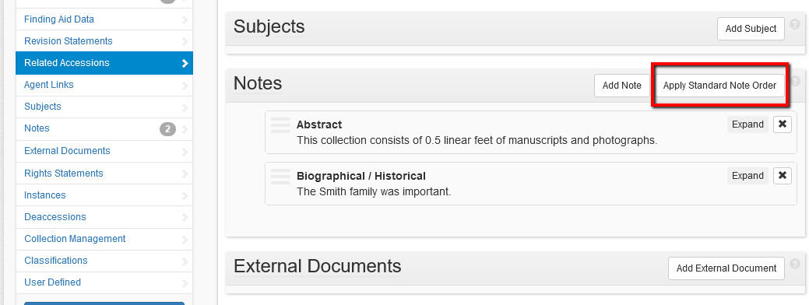

Slide 31
Data Entry Consistency: User-Defined Fields
These shared fields can be adapted to record additional description information
Accessions
Resources
Digital objects
25 user defined fields with different data types, including text boxes, date fields, controlled vocabulary fields, and Boolean fields
They will only appear on the staff interface
Notes:
The 25 fields are shared across records
If you are using one field for just accession records, it will also display in resource records (unless you create a plugin to hide it)

Slide 32
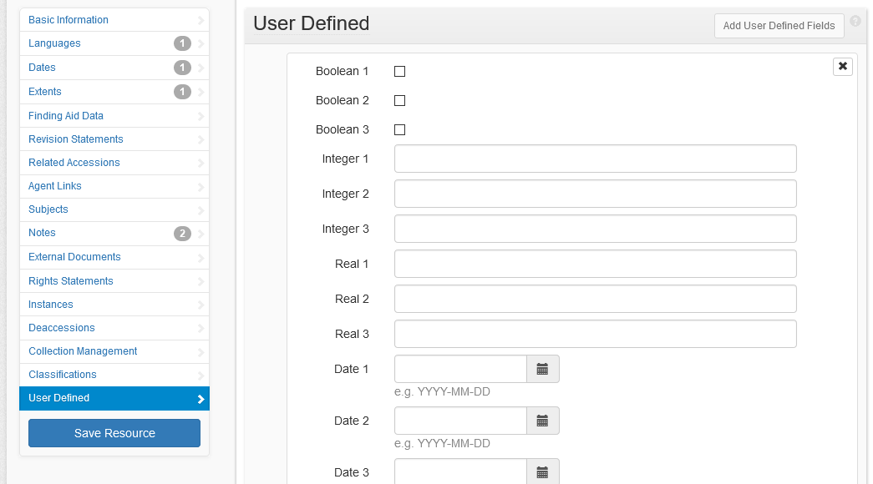

Slide 33
Data Entry Consistency: User-Defined Fields (cont.)
User-defined fields are configured on the backend
\archivesspace\locales\en.yml
Make a back-up of the file before making changes
Sample entry: Text_1: Text 1
Leave what’s to the left of the colon – this is the ArchivesSpace field name
“Text 1” can be changed to desired display on staff interface
Restart ArchivesSpace
Notes:
User-defined fields are configured on your ArchivesSpace server
\archivessapce\locales\en.yml
Best Practices
Make a back-up of the file before making changes:
Sample line: Text_1: Text 1
Leave what’s to the left of the colon – this is the ArchivesSpace field name
“Text 1” can be changed to how you would like the field to display to staff in the staff interface
Restart ArchivesSpace

Slide 34
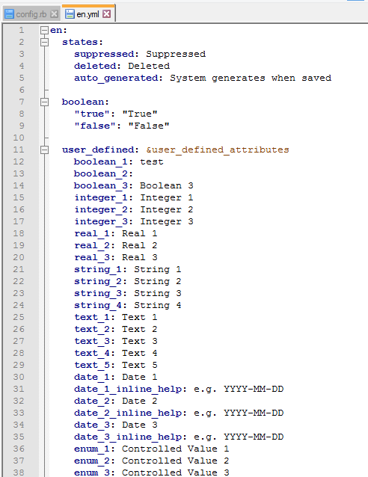

Slide 35
Staff Guidance

Slide 36
Staff Guidance: Customize Tool Tips
Tool tips can be modified on the server
Navigate to /archivesspace/locales/en.yml
Make a back-up copy
Modify desired tool tips and save
Can also create tool tips for user-defined fields
Restart ArchivesSpace

Slide 37
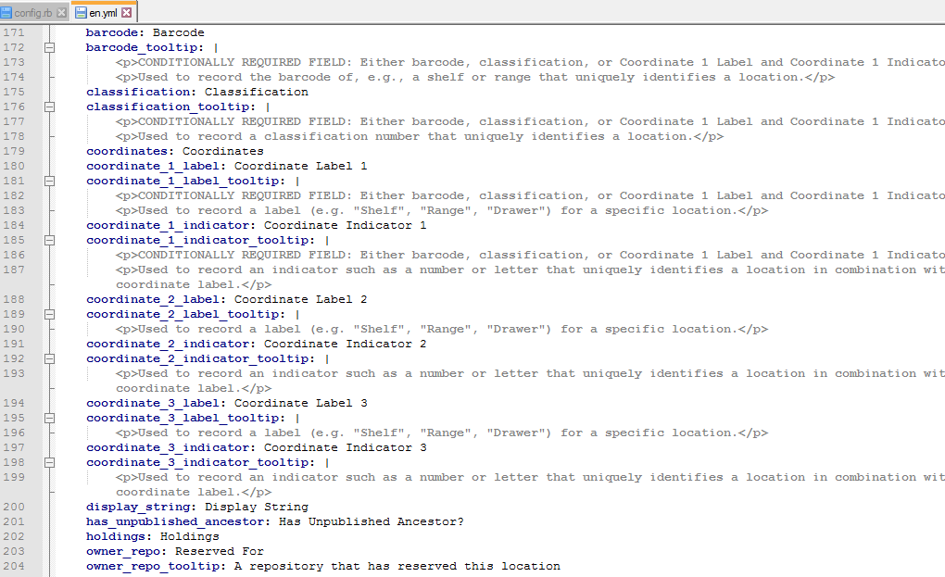

Slide 38
Staff Guidance: Controlled Values Lists
Set default options
Order values
Delete unused options

Slide 39
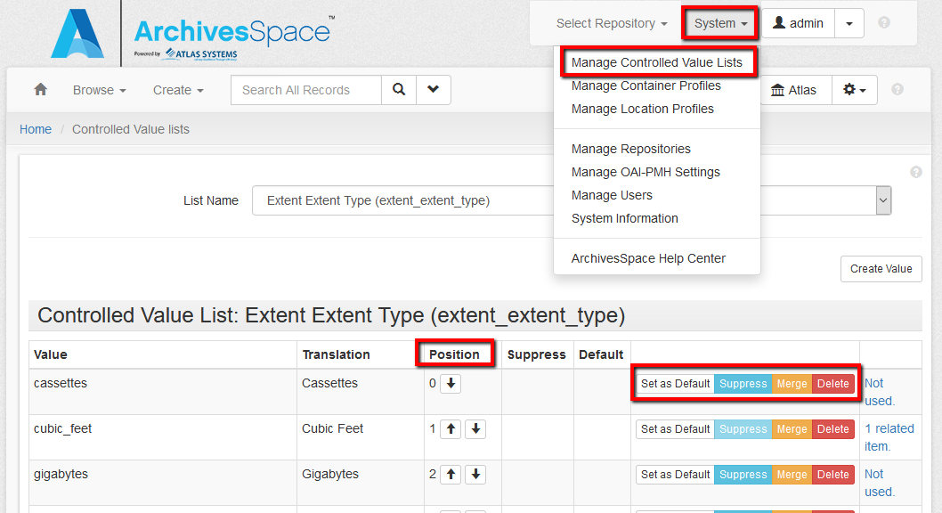

Slide 40
Staff Guidance: Searching and Browsing
In Preferences, set up to five information columns that display when searching and browsing:
Accessions
Resources
Digital objects

Slide 41
Staff Guidance: Searching and Browsing (cont.)
How to change the number of search results for staff (this is done on the backend)
Navigate to /config/config.rb
Make a back-up copy
Change this line and save:
#AppConfig[:default_page_size] = 10
Remove the # to uncomment out the line of code
Change ’10’ to the desired number
Restart ArchivesSpace

Slide 42
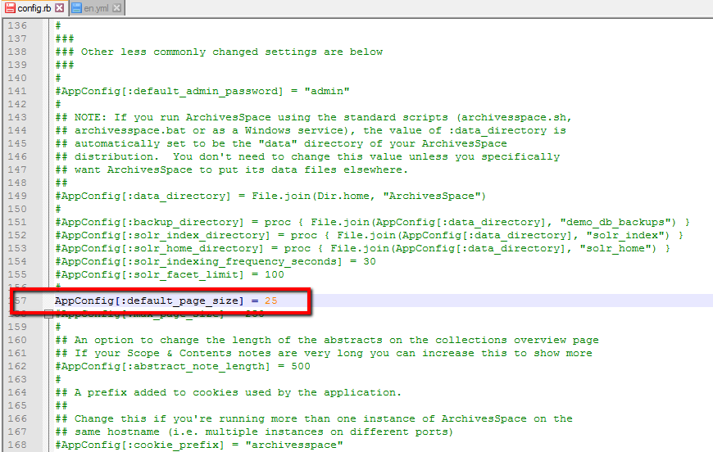
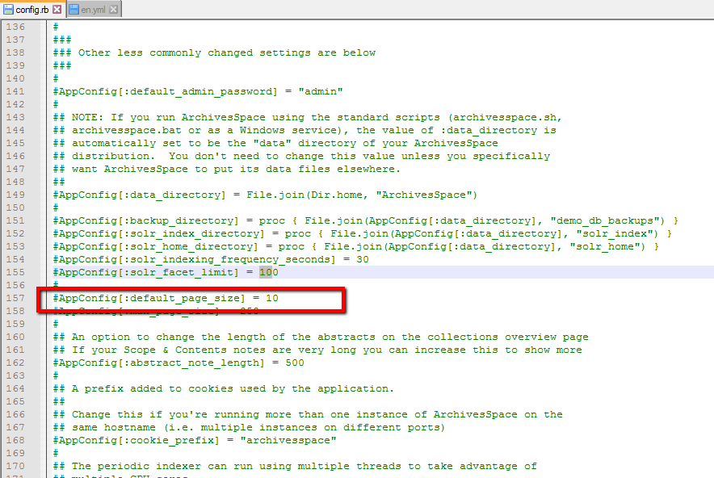

Slide 43
Importing and exporting data

Slide 44
Importing Data
Background Jobs – Import Data
Create – Background Jobs – Import Data
Variety of records and formats
Mappings and templates: http://archivesspace.org/using-archivesspace/migration-tools-and-data-mapping#importexport

Slide 45
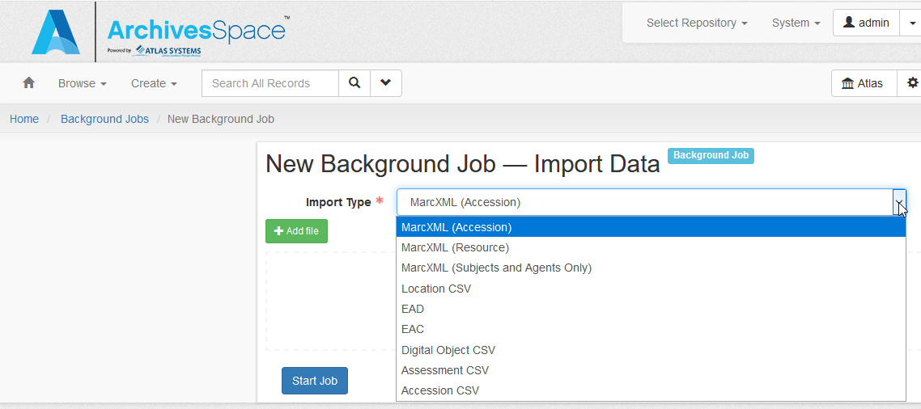

Slide 46
Advice for Importing Data
Be careful of importing duplicate controlled values that don’t match exactly
Troubleshoot by importing in iterations
Try exporting first to get an example

Slide 47
PUI customizations

Slide 48
PUI Customizations: Navigation Menu Options
You can hide certain menu options, such as “Unprocessed Materials” (which are published accession records)
You’ll need to modify both the menu and the repository badges
Note: you might need a custom plugin to change the PUI search filters (i.e. digital objects)

Slide 49
PUI Customizations: Navigation Menu Options (cont.)
These changes are made on the backend
Navigate to /archivesspace/config/config.rb
Make a backup copy
Uncomment out (remove the leading hashtags) the section following “The following determine which ‘tabs’ are on the main horizontal menu”
Change the appropriate lines from false to true, and save
Restart ArchivesSpace

Slide 50
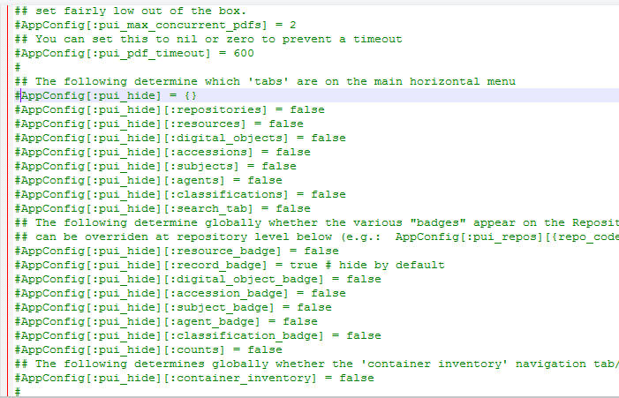
Default menu code

Slide 51
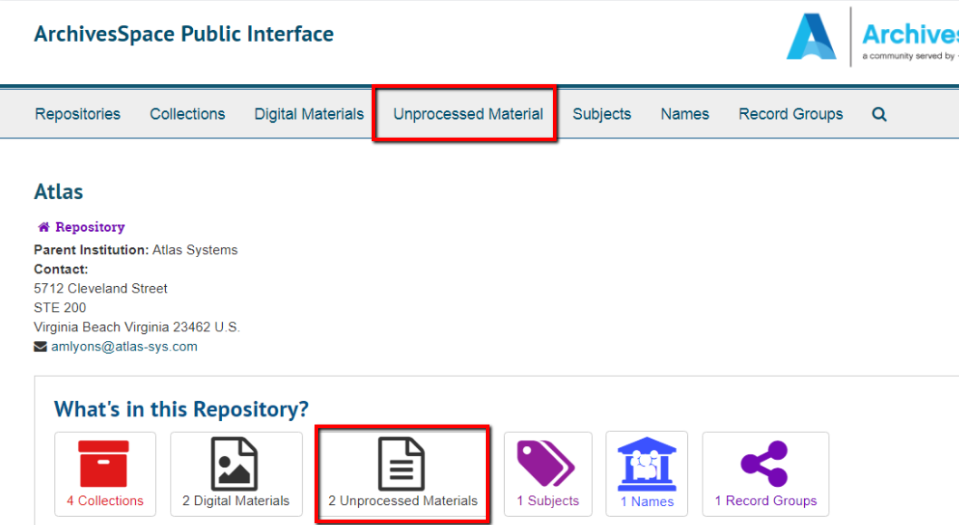

Slide 52
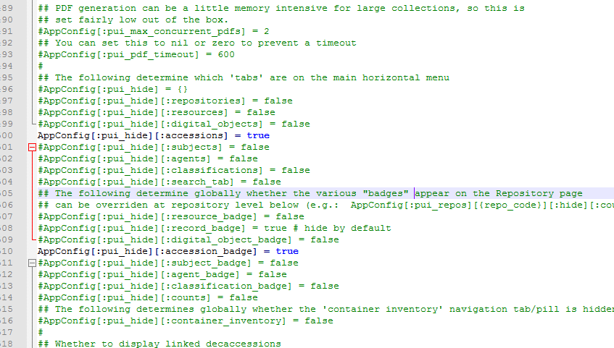
Accessions Suppressed

Slide 53
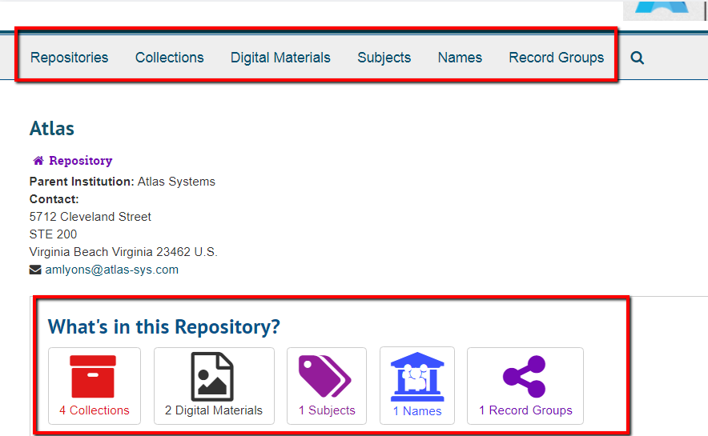

Slide 54
PUI Customizations: Add Your Logo
This is done on the backend
Navigate to /archivesspace/plugins/local/public, and create a new directory: /assets/images/
Save the logo file to /archivesspace/plugins/local/public/assets/images/
Change the config/config.rb file:
First make a back-up copy
#AppConfig[:pui_branding_img] = ‘/assets/images/logo.png’
Remove the # to uncomment out the line of code
Substitute “logo.png” with the name of the logo file you added
Restart ArchivesSpace
Notes:
Any other changes will require a plugin
A logo on the staff side will require either a plugin or creating a custom _branding.html.erb file

Slide 55
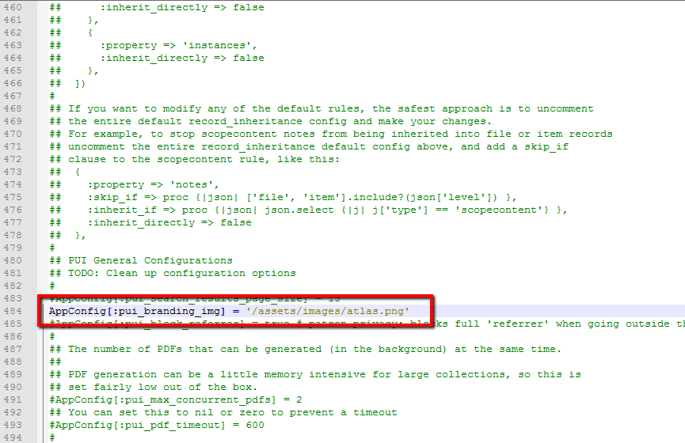

Slide 56
PUI Customizations: Edit the Welcome Page
These changes are made on the backend
Navigate to /archivesspace/locales/public/en.yml
Make a backup copy
See next two slides for possible changes
Make changes and save
Restart ArchivesSpace

Slide 57
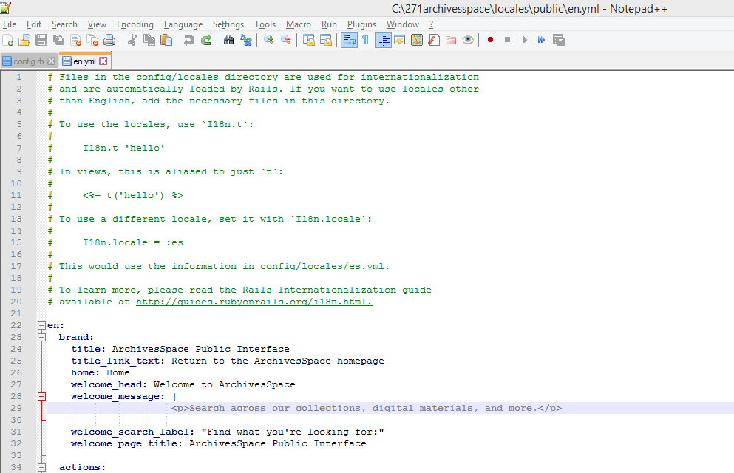

Slide 58
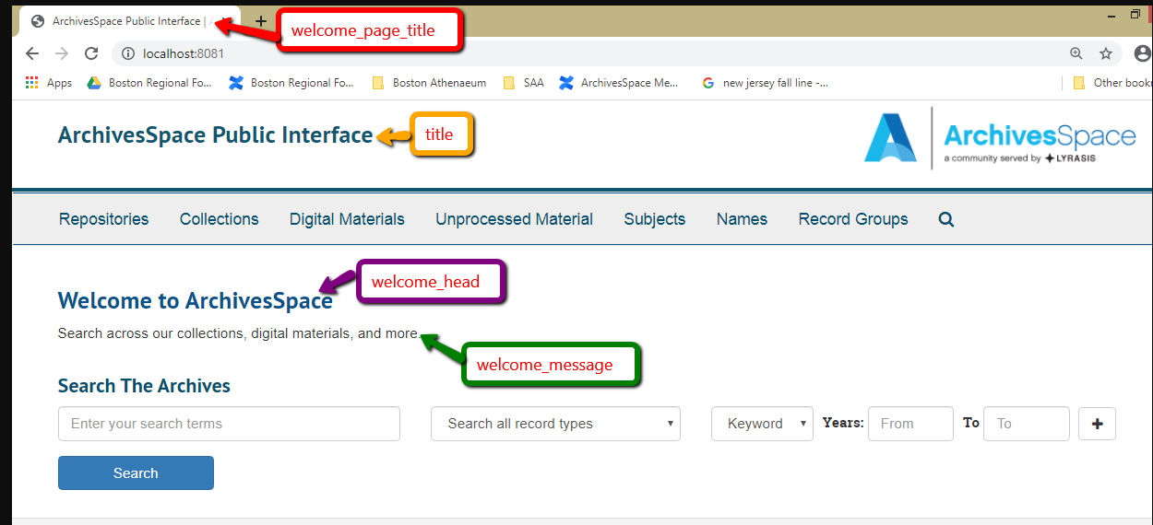
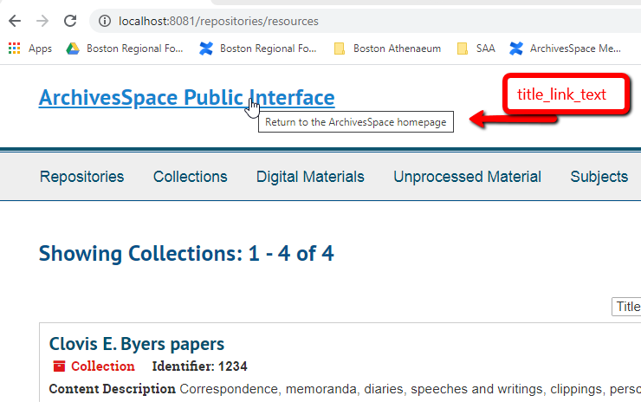

Slide 59
PUI Customizations: Patron Browsing
How to change the number of search results on the PUI (this is done on the backend)
Change the /config/config.rb file:
First make a back-up copy
#AppConfig[:pui_search_results_page_size] = 10
Remove the # to uncomment out the line of code
Change ’10’ to the desired number
Restart archivesspace
Notes:
Any other changes will require a plugin
A logo on the staff side will require a plugin

Slide 60
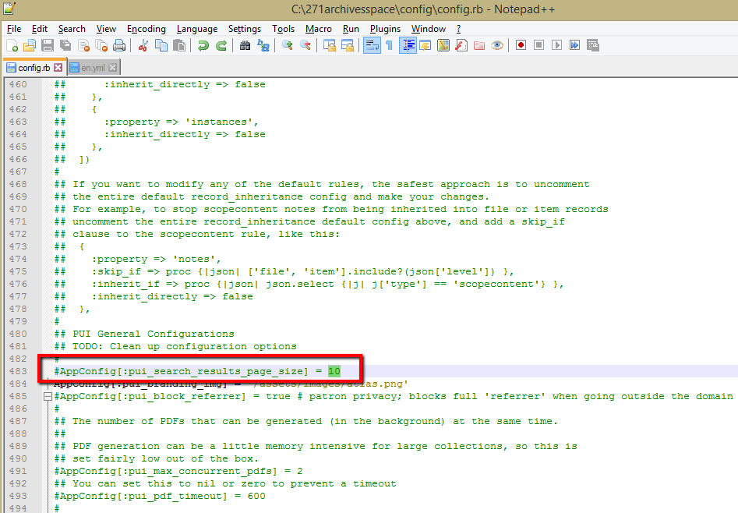

Slide 61
Additional backend configurations

Slide 62
IMPORTANT!
Keep careful track of any changes that you make to the server files
You will need to make the same changes when you update to a new version
Notes:
Any other changes will require a plugin
A logo on the staff side will require a plugin

Slide 63
Additional Backend Configurations: API
The ArchivesSpace API (Application Programming Interface) Service allows you to interact directly with your ArchivesSpace data
Clean up data
Make bulks changes
Export data for other uses or reporting
How to enable and use the API:
https://archivesspace.github.io/archivesspace/api/#introduction
API and scripting resources for ArchivesSpace:
https://github.com/archivesspace/awesome-archivesspace#apis-and-scripts

Slide 64
Additional Backend Configurations: OAI-PMH
OAI-PMH = Open Archives Initiative Protocol for Metadata Harvesting
Make your published ArchivesSpace data available to other systems, such as to make your records discoverable in your ILS

Slide 65
Additional Backend Configurations: OAI-PMH (cont.)
How to enable OAI-PMH on the backend:
https://archivesspace.github.io/archivesspace/user/oai-pmh-interface/
In the staff user interface, configure System – Manage OAI-PMH Settings
Choose what will be harvested in each repository – System – Manage Repositories
You’ll need to reach out to the vendor(s) who will be harvesting

Slide 66
Other Resources
Configuring ArchivesSpace:
https://archivesspace.github.io/archivesspace/user/configuring-archivesspace/
PUIs theming and plugins:
https://archivesspace.github.io/archivesspace/user/theming-archivesspace/
Awesome ArchivesSpace:
https://github.com/archivesspace/awesome-archivesspace
APIs and Scripts, Plugins, Integrations
Integrations:
https://archivesspace.atlassian.net/wiki/spaces/ADC/pages/17137746/Integrations

Slide 67
Any questions?
Anne Marie Lyons
Training and Library Solutions Consultant
amlyons@atlas-sys.com
800-567-7401 ext. 1
Thank you!

