Slide 1
ArchivesSpace Member Match Discussion: Show Us Your User Documentation
November 4, 2021 – Webinar

Slide 2
Presenters
Regina Carra American Folk Art Museum
ArchivesSpace User Documentation and Member Engagement subteams
Jessica Crouch ArchivesSpace Community Engagement Coordinator
Joanne Archer University of Maryland
ArchivesSpace User Documentation subteam
Liz Caringola University of Maryland

Slide 3
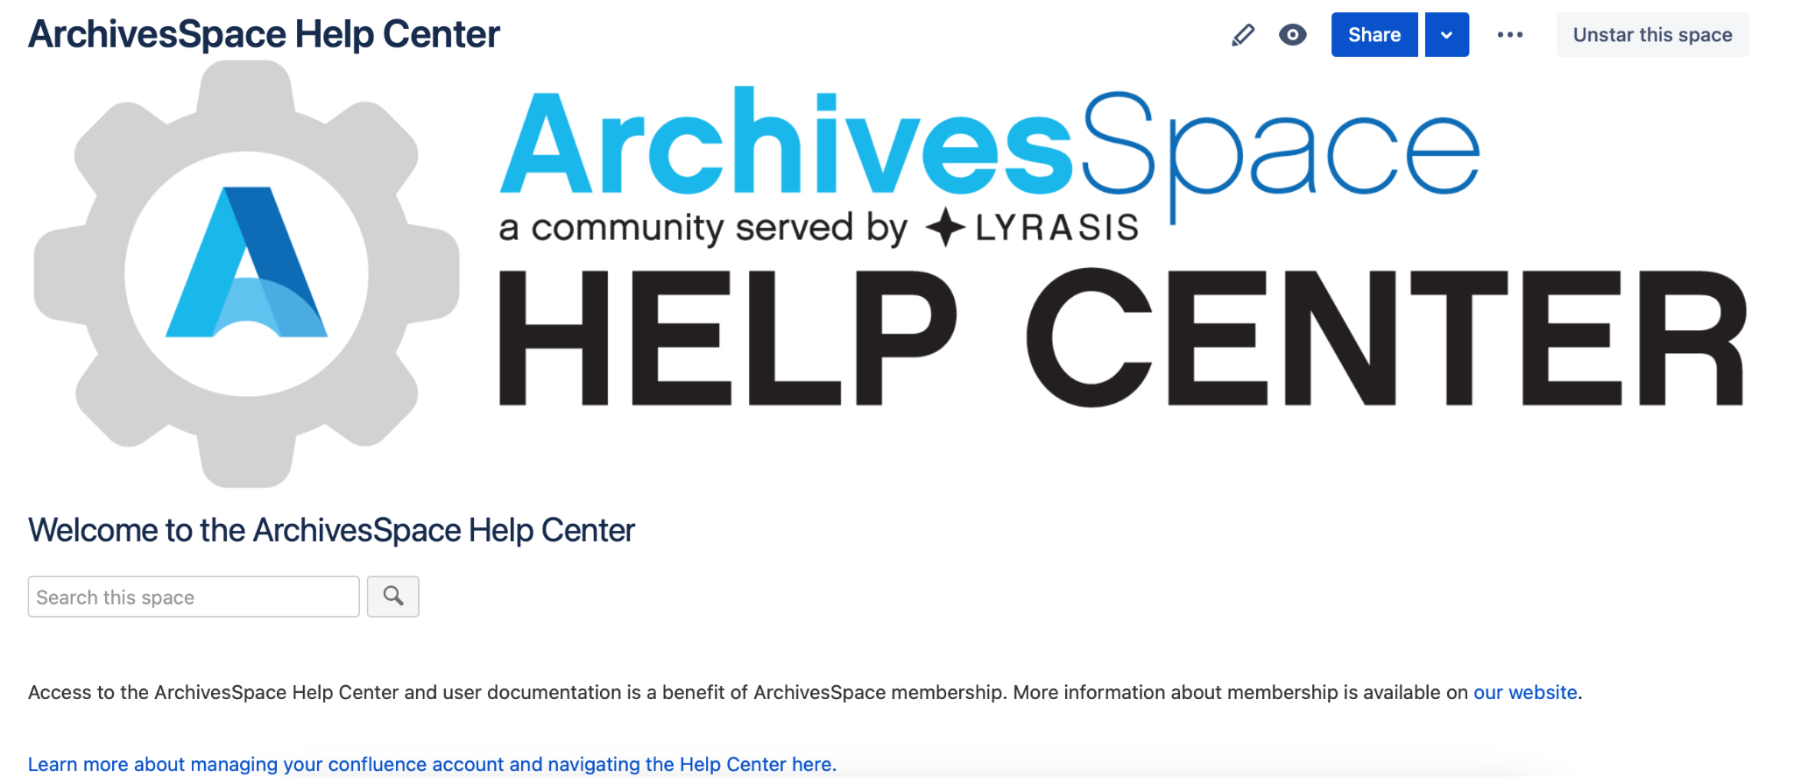
ArchivesSpace Documentation Overview: Program Generated Documentation

Slide 4
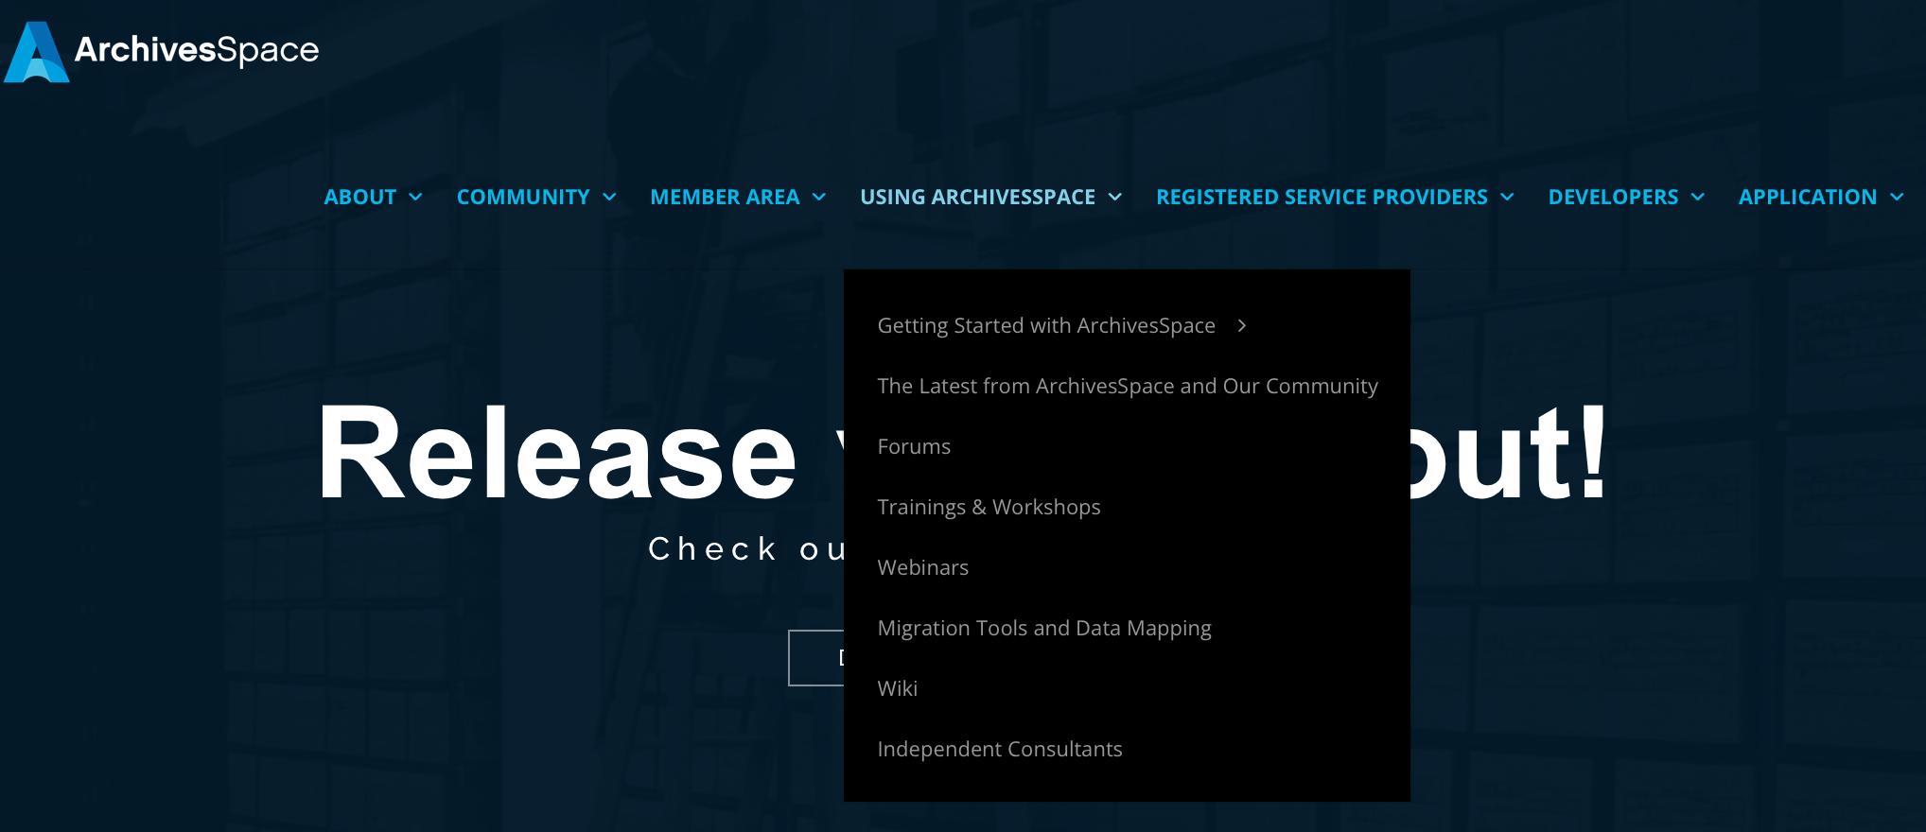
ArchivesSpace Documentation Overview: Program Generated Documentation

Slide 5
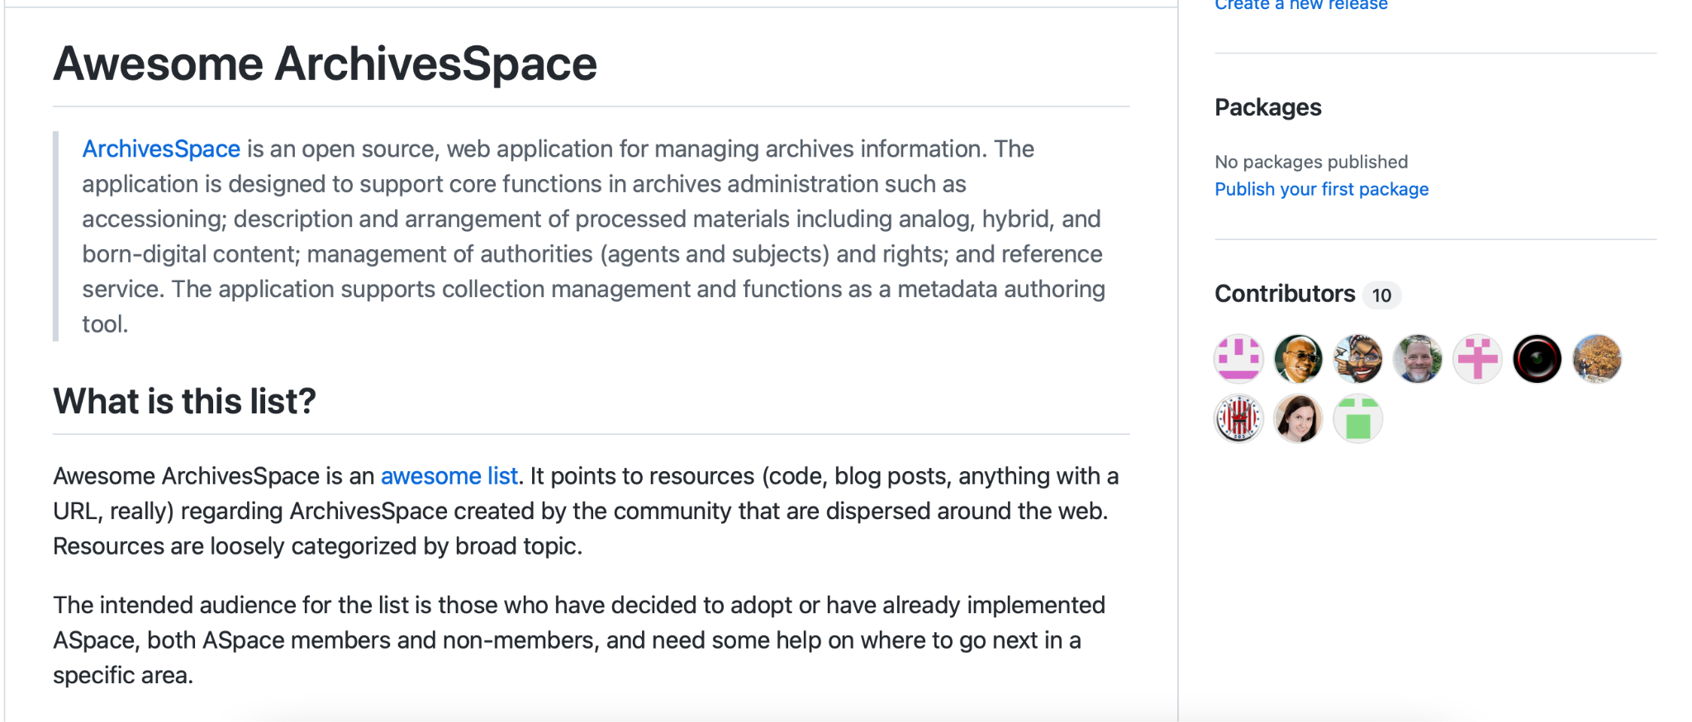
ArchivesSpace Documentation Overview: Community Generated
The ArchivesSpace Wiki
The ArchivesSpace Blog
ArchivesSpace Forums
ArchivesSpace YouTube channel
The Awesome ArchivesSpace List*
*Awesome ArchivesSpace List is the only resource mentioned above that you can’t access through the ArchivesSpace website. This can be found at https://github.com/archivesspace/awesome-archivesspace

Slide 6
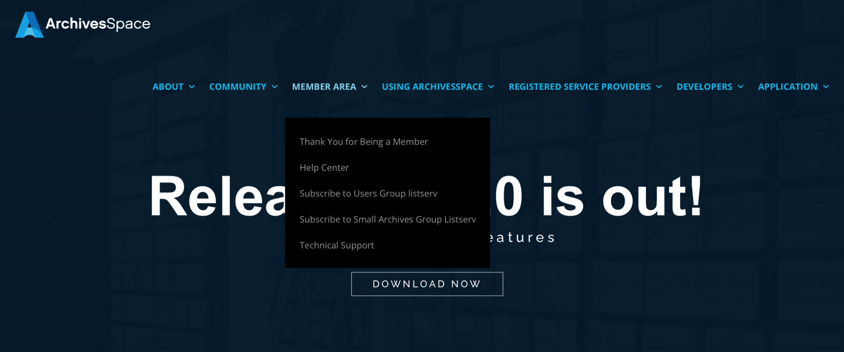
ArchivesSpace Documentation Overview: How can I contact others in the community
You can contact the ArchivesSpace Member Match listserv at archivesspace_member_match@lyralists.lyrasis.org
You can join and contact the ArchivesSpace User Group Listserv and/or Small Archives Listservs at the ArchivesSpace website

Slide 7
ArchivesSpace User Manual Overview
About the Manual
General guide to ArchivesSpace, its capabilities, and functions, written to benefit all ArchivesSpace member organizations
Found on the ArchivesSpace Wiki through the Help Center
Maintained by the User Documentation Subteam of the ArchivesSpace User Advisory Council (UAC)
The work to maintain and edit the Manual is iterative…
Responds to updates to the application, as well as community comments
Continually aims to make the Manual clearer, more accessible

Slide 8
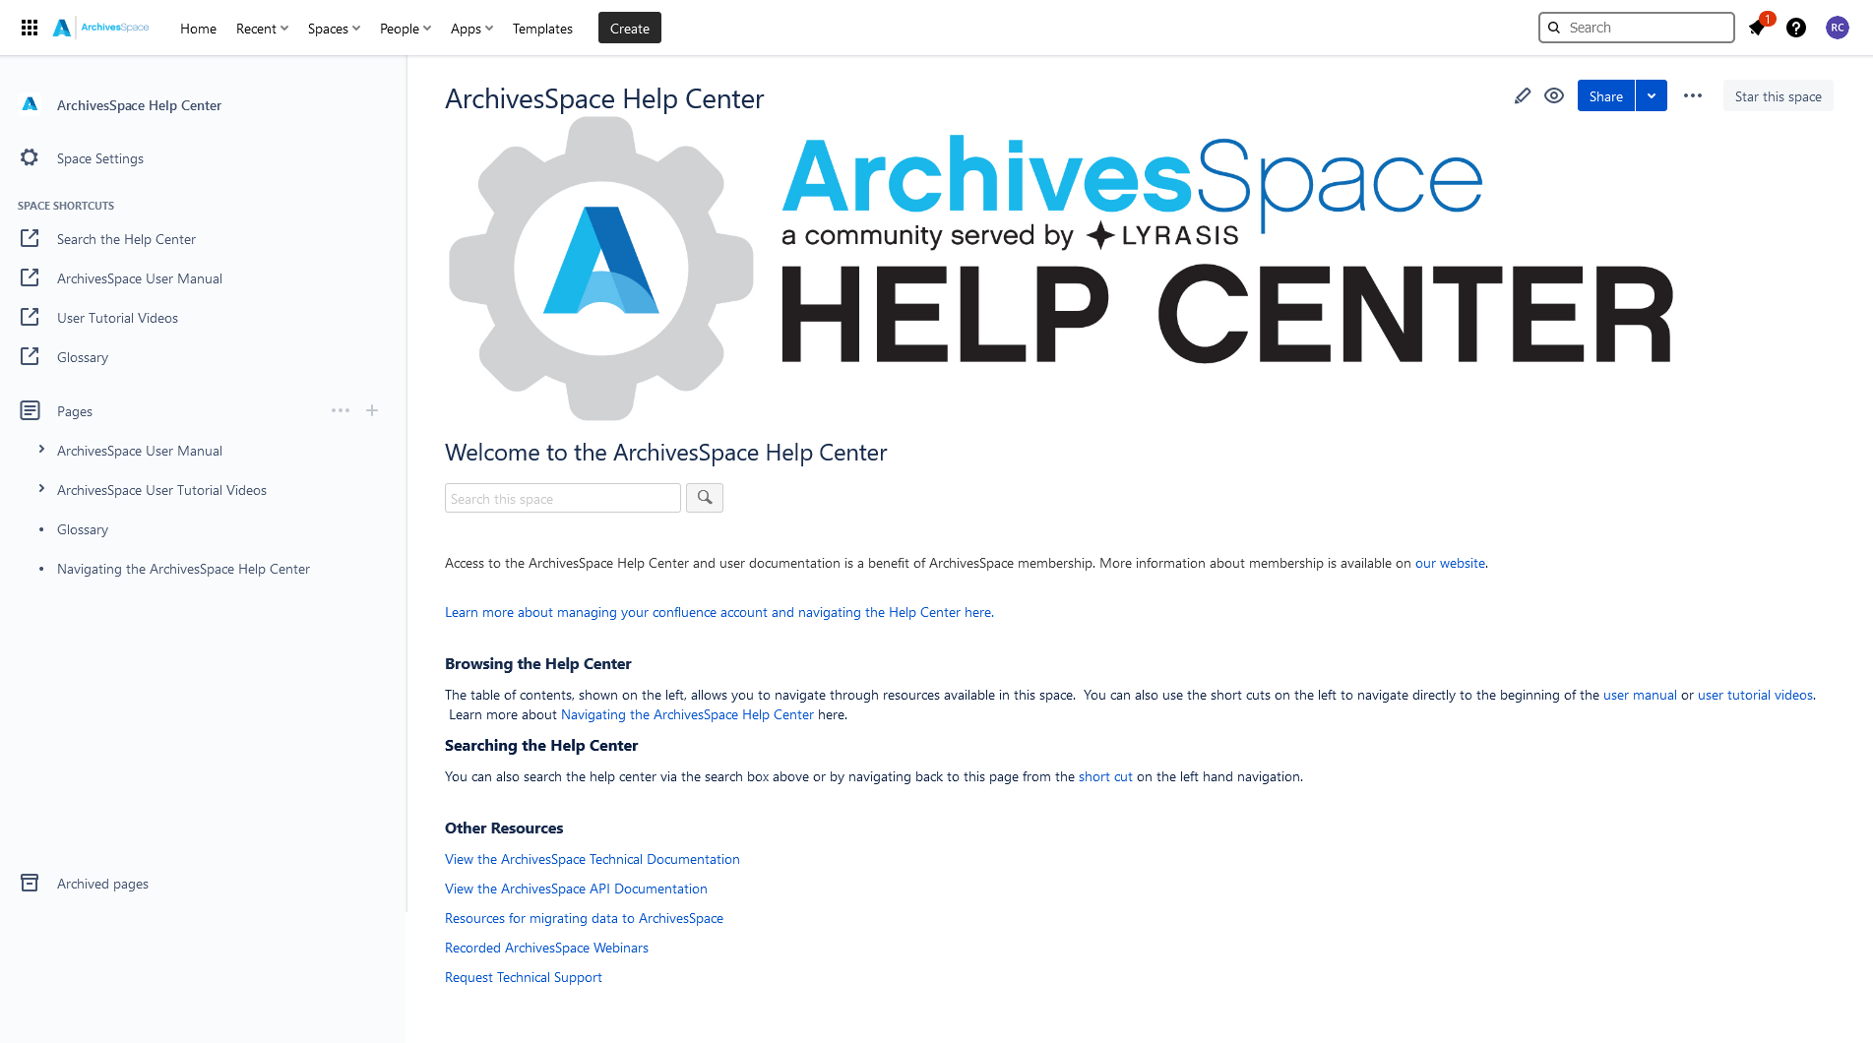
ArchivesSpace User Manual Overview
Quick Tour: Where is the Manual?
Accessible from the Help Center homepage on the left-hand side, under Pages

Slide 9
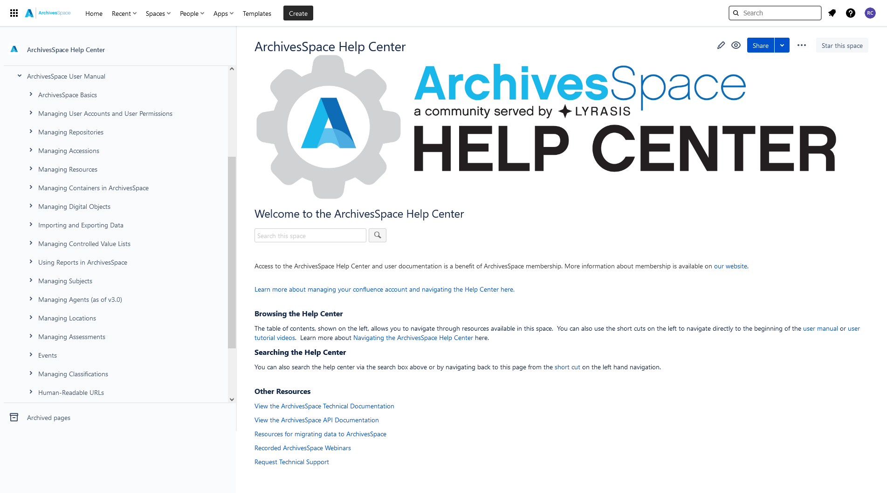
ArchivesSpace User Manual Overview
Quick Tour: How is it organized?
Structured based on the available modules and major functions of ArchivesSpace

Slide 10
ArchivesSpace User Manual Overview
Quick Tour: How is it organized?
Structured based on the available modules and major functions of ArchivesSpace

Slide 11
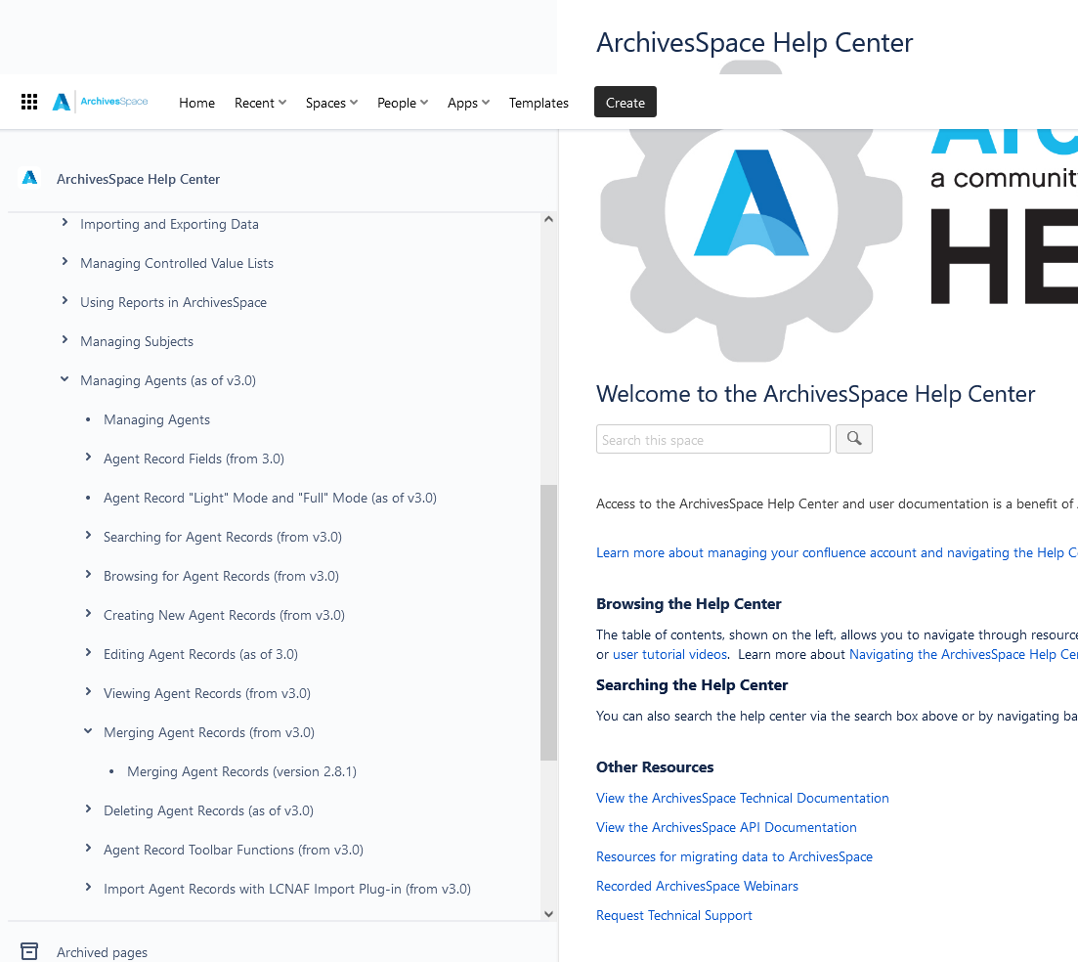
ArchivesSpace User Manual Overview
Quick Tour: How is it organized?
Documentation for older versions of ArchivesSpace are nested under documentation for most recent version

Slide 12
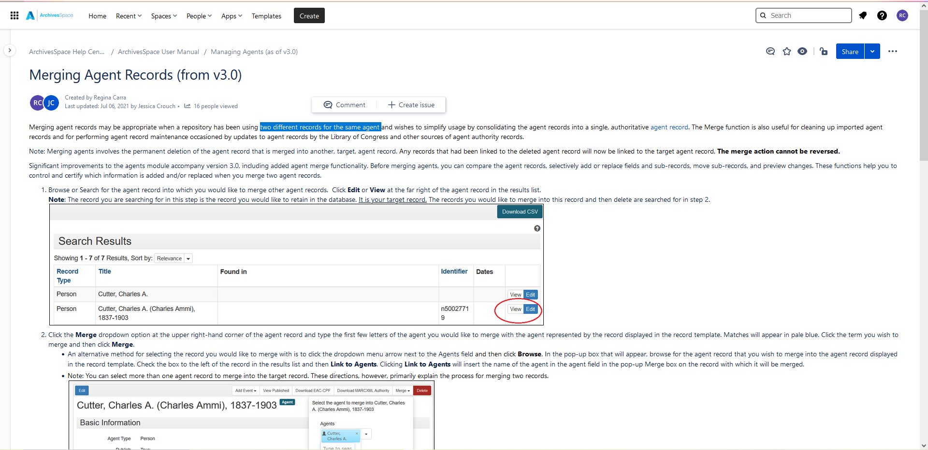
ArchivesSpace User Manual Overview
Quick Tour: Commenting on the Manual
Drag your cursor and highlight the content on which you want to
comment
Click Comment

Slide 13
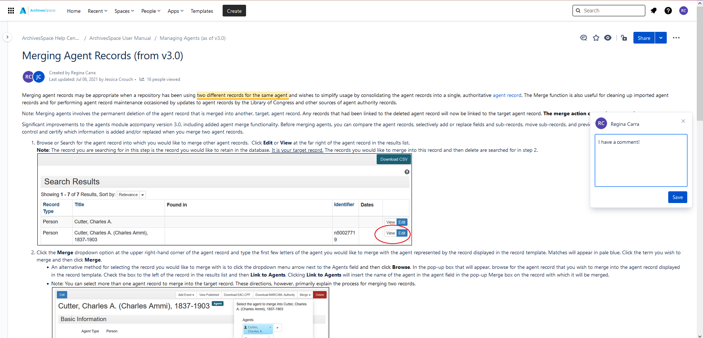
ArchivesSpace User Manual Overview
Quick Tour: Commenting on the Manual
Type your comment in the dialog box on the right
Click Save

Slide 14
Questions?
Contact the ArchivesSpace program team or the Member Engagement subteam any time at ArchivesSpaceHome@lyrasis.org

