Slide 1
Implementing ArchivesSpace from start to “finish”
ArchivesSpace Member Forum, August 24, 2022
Susannah Broyles
Texas State University

Slide 2
Who we are
Texas State University Libraries University Archives: Archival repository documenting the institutional history of Texas State University, and the local history of Hays County and San Marcos, Texas. The collections are primarily university record groups and faculty papers.
The Wittliff Collections: Archival repository documenting the creative output of Texas and the regional Southwest United States with a focus on literature, film, music and photography. The collections are primarily personal papers and manuscripts.

Slide 3
What we have
The Wittliff Collections
150+ processed manuscript collections with full archival inventories
Nearly 1,000 additional individual unprocessed accessions with preliminary inventories

Slide 4
The way it was...
Presentation of finding aids online
HTML with PDF/EAD links
Limitations
Did not adhere to archival descriptive standards
Did not play well with others
There were some things we liked [curatorial]
Archon
Incomplete
Obsolete

Slide 5
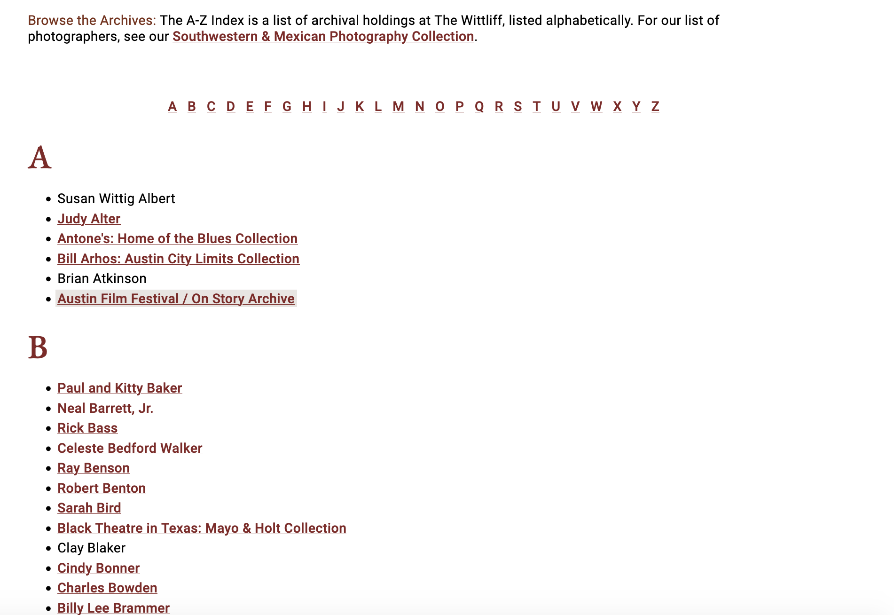

Slide 6
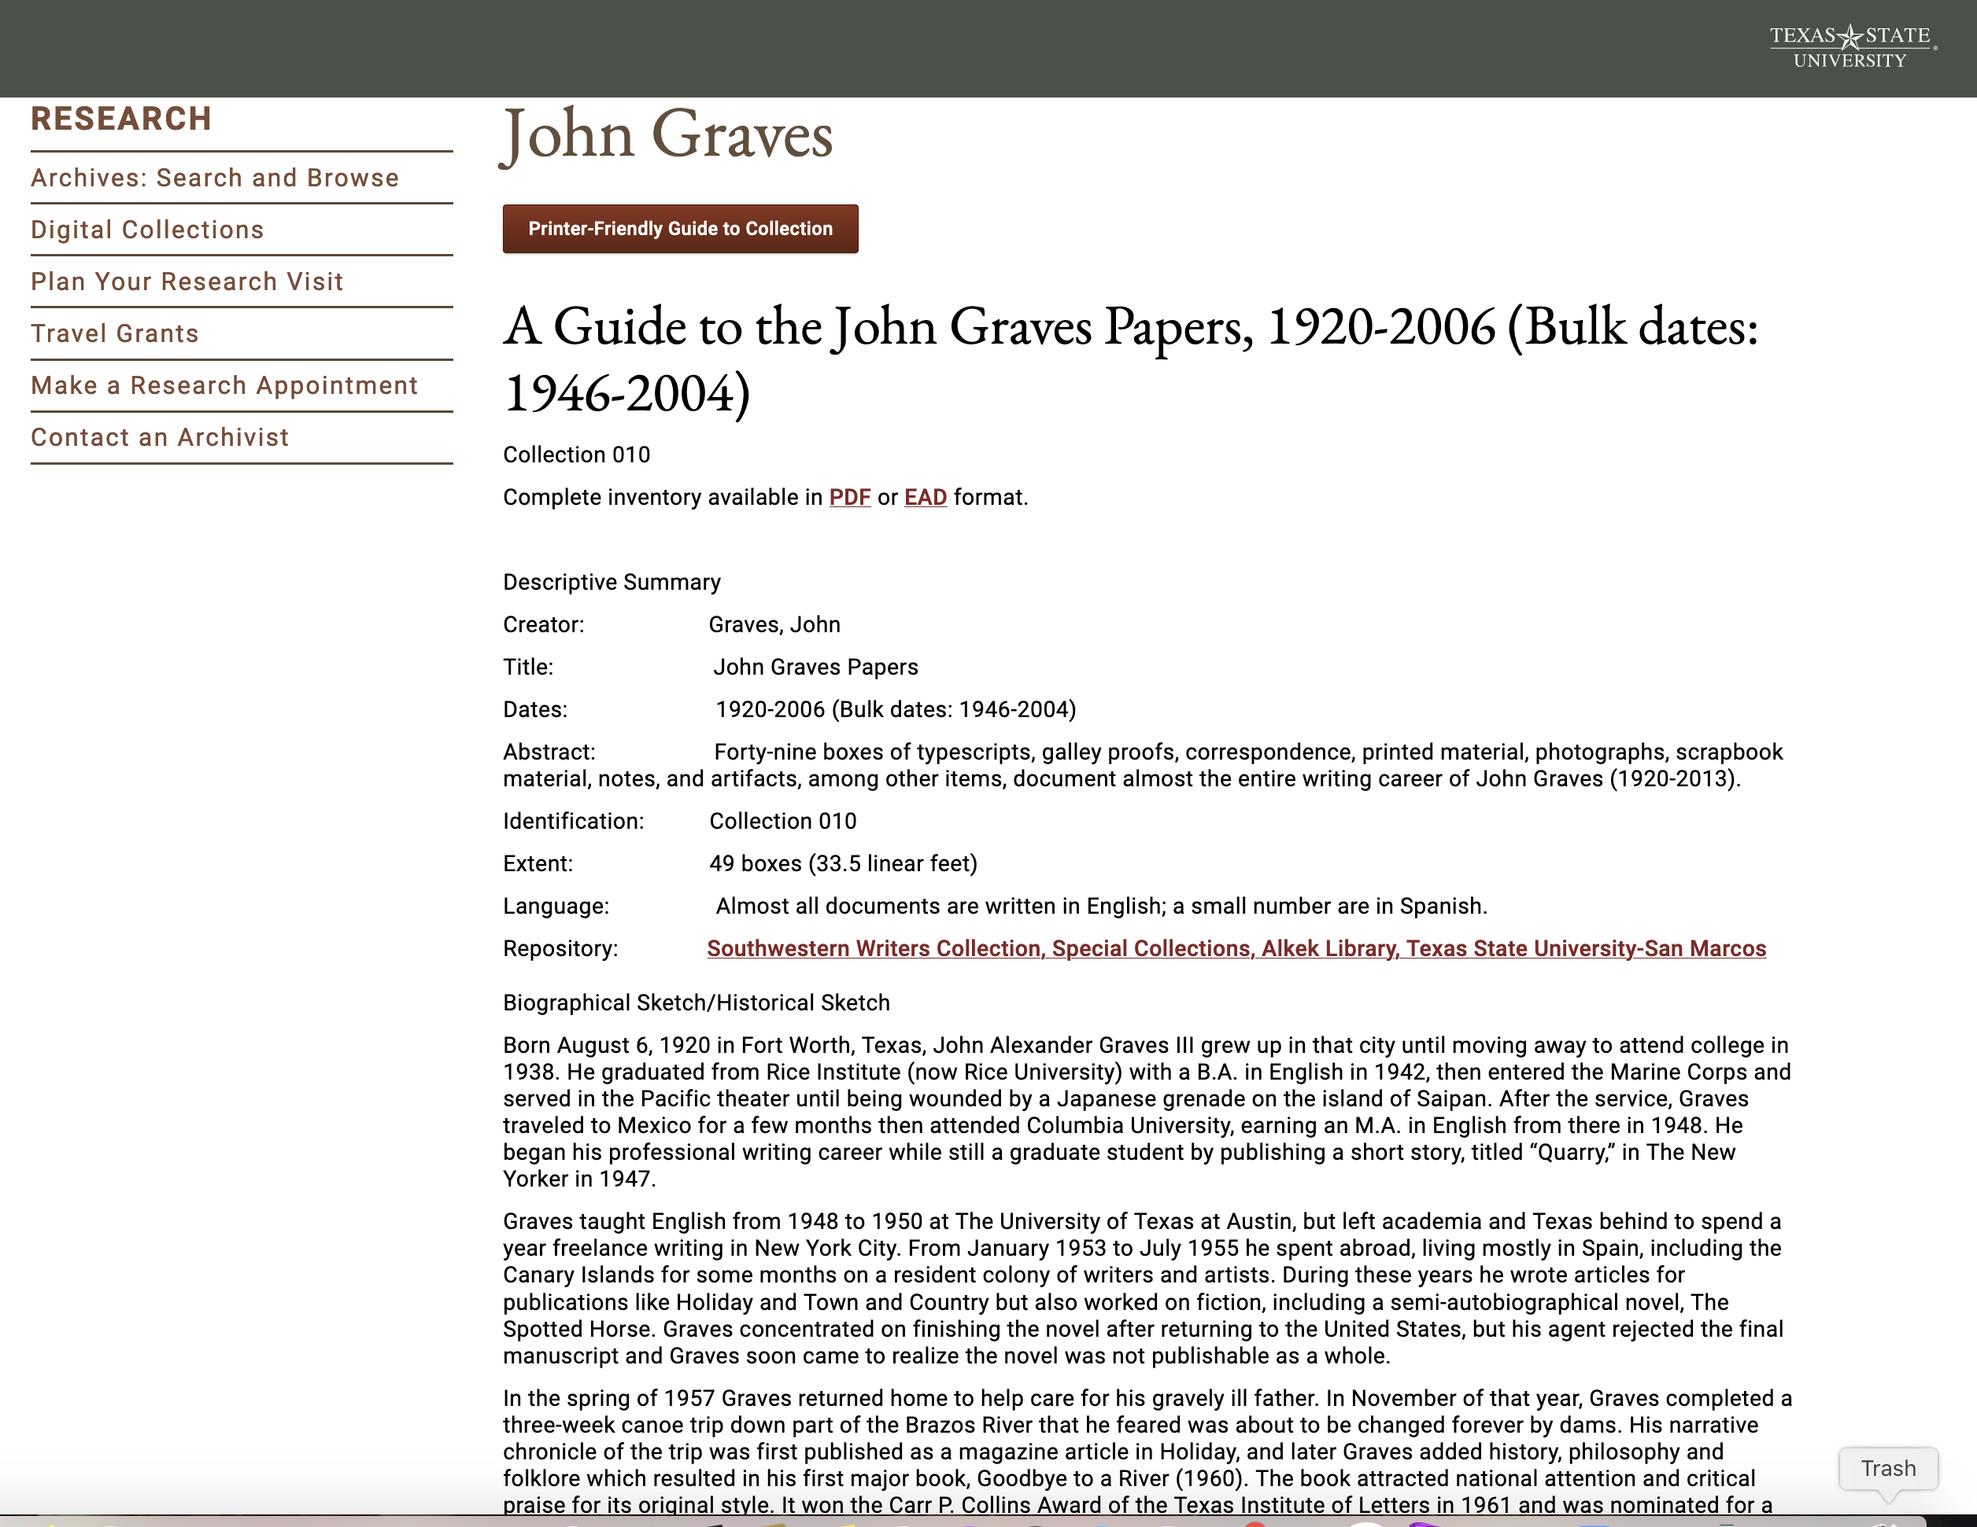

Slide 7
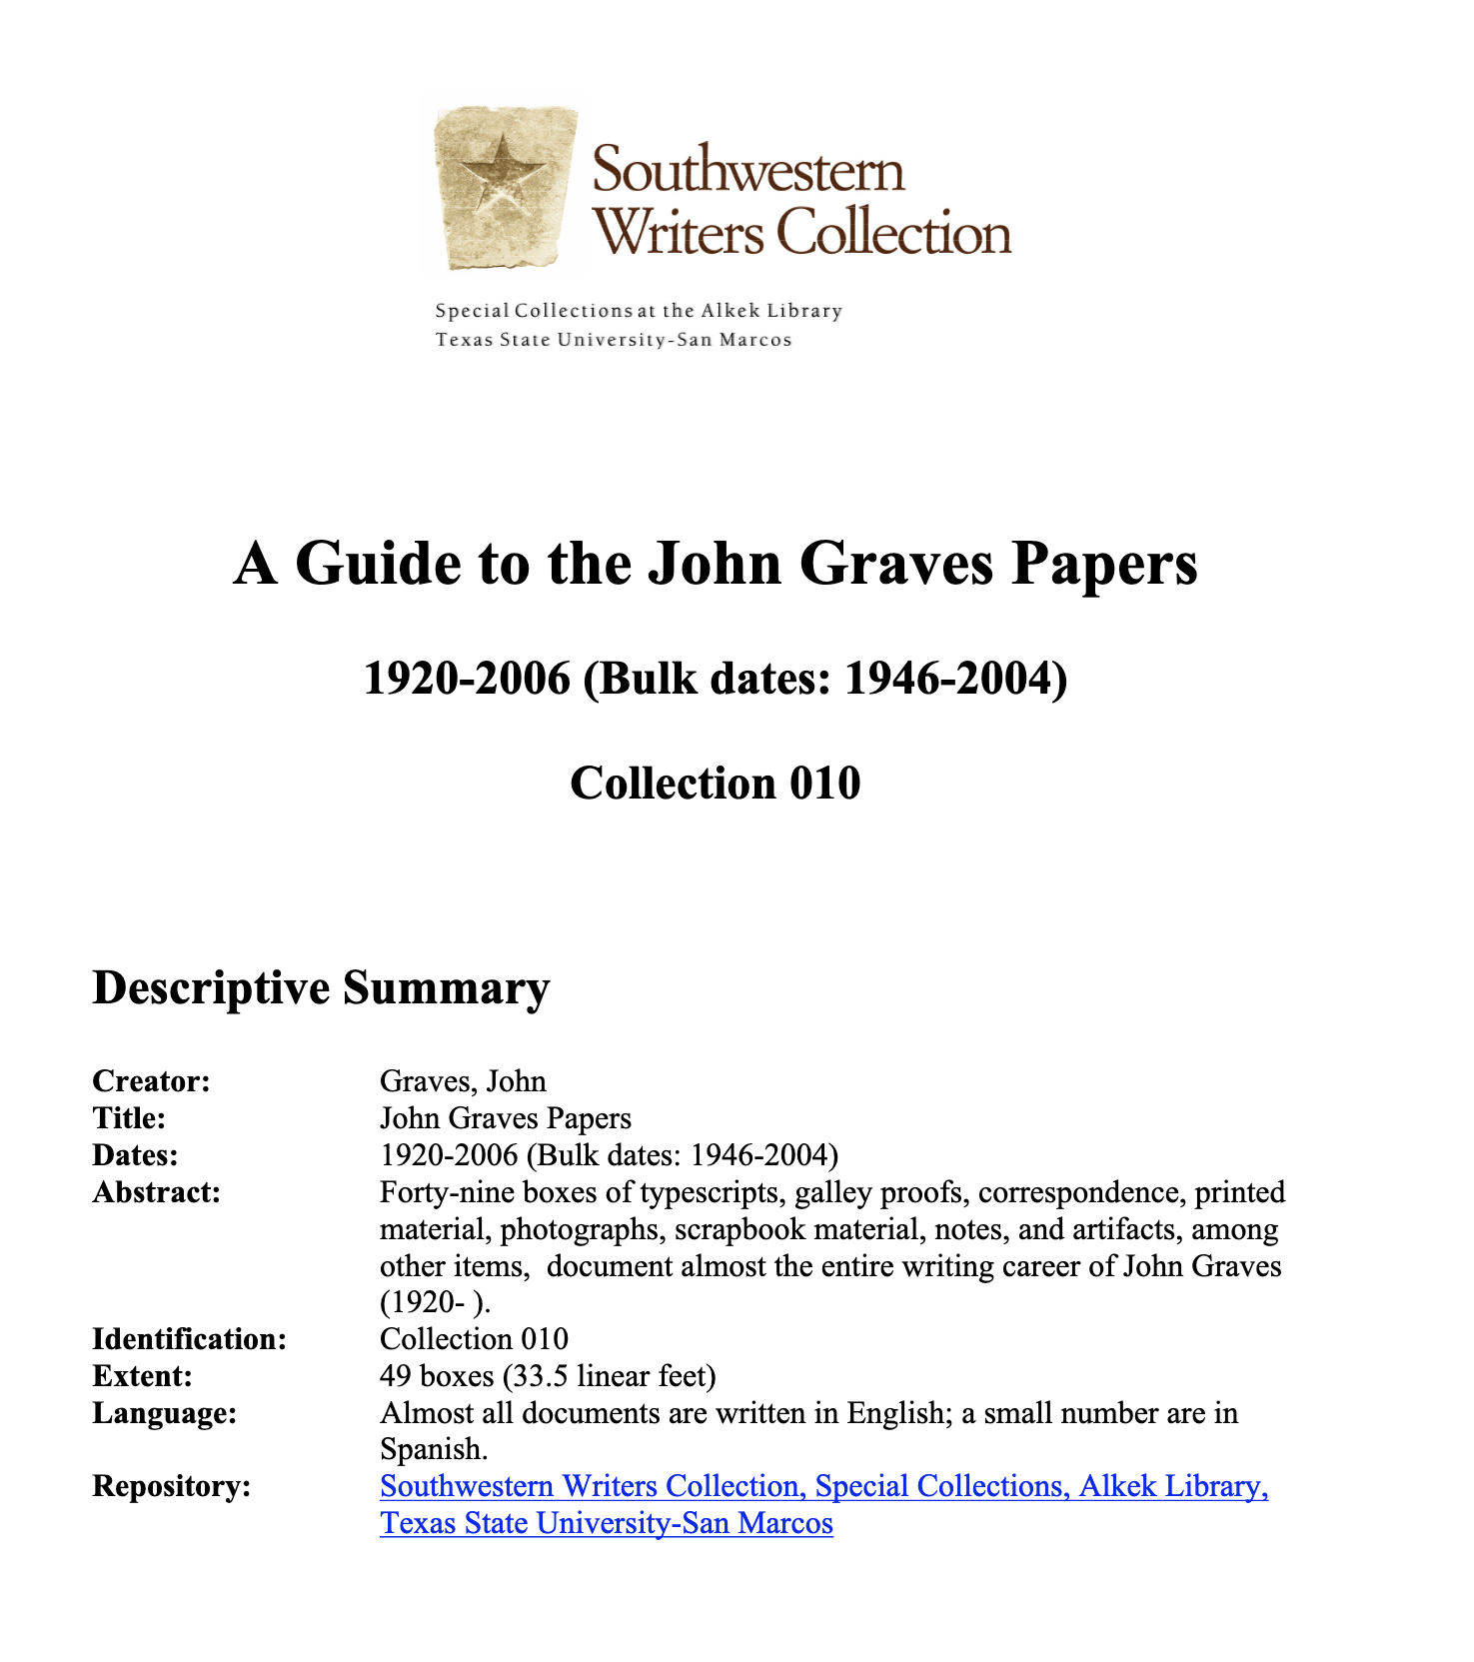

Slide 8
Building the team
The team:
Wittliff Collections: 3 archivists + 1 archives assistant
University Archives: 2 archivists
Digital Media & Web Services: 1 librarian + 1 programmer
Training
3-day online training through Lyrasis for team members + additional cataloging and curatorial staff.

Slide 9
Where to start?
Prioritizing collections
Priority 1: Replicate Texas Archival Resources Online content
All finding aids that are represented in TARO, regardless of new entry or Archon clean-up
Priority 2: Replicate A-Z list content
Entry of inventories with PDFs on the A-Z list
Entry of preliminary inventories on the A-Z list for which there is an existing Word document
Priority 3: Clean up and expand
Clean up all Archon migration records
Enter additional finding aids for processed collections
Enter additional preliminary inventories

Slide 10
What's the plan?
Setting benchmarks
November - December 2020
Research; plan implementation; begin developing best practices; configure ASpace
January - March 2021
Finalize decisions about best practices and local use; codify in Wittliff user manual
March - April 2021
Record clean-up and entry of finding aids; TARO upgrade
May-September 2021
Continuation of record clean-up and entry of finding aids; alignment with TARO; customization of PUI

Slide 11
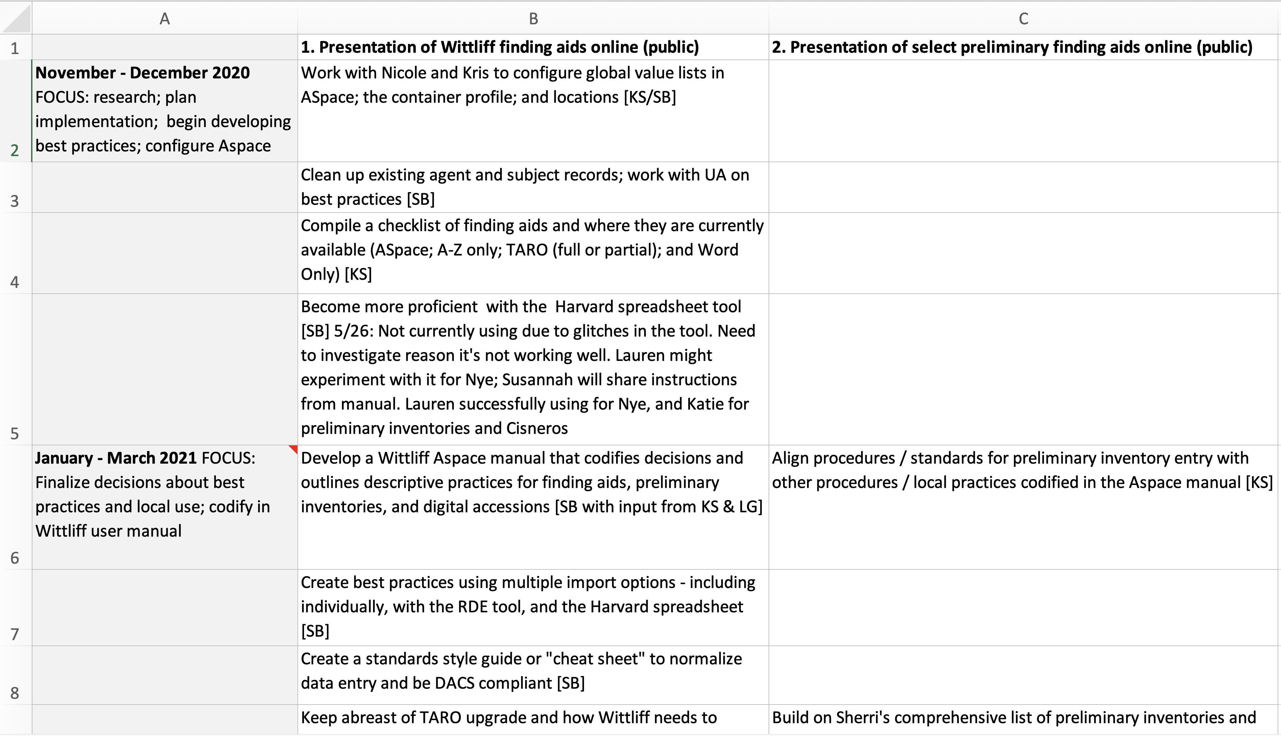

Slide 12
Implementation

Slide 13
Documentation – Part 1
Manual
Shared between The Wittliff and University Archives
High-level, broad overview of usage
Shared standards and best practices
DACS

Slide 14
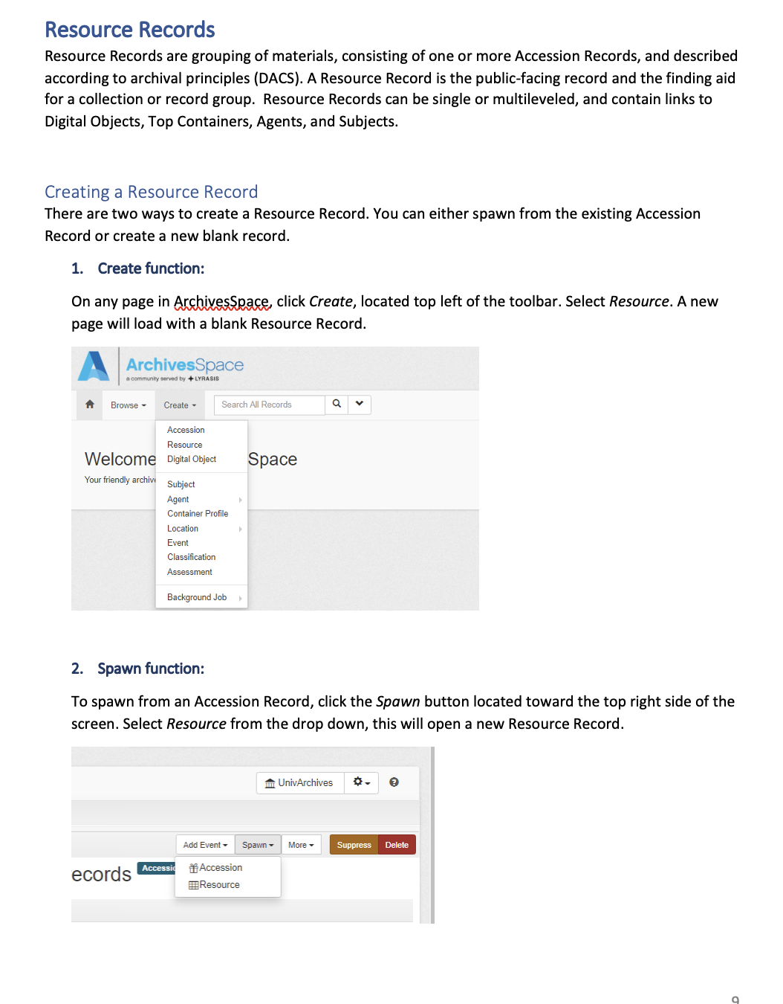

Slide 15
Documentation – Part 2
“Quick" guide
Wittliff standards and best practices
Documents local usage, gives examples, and required information for every field
Consistently updated FAQ section

Slide 16
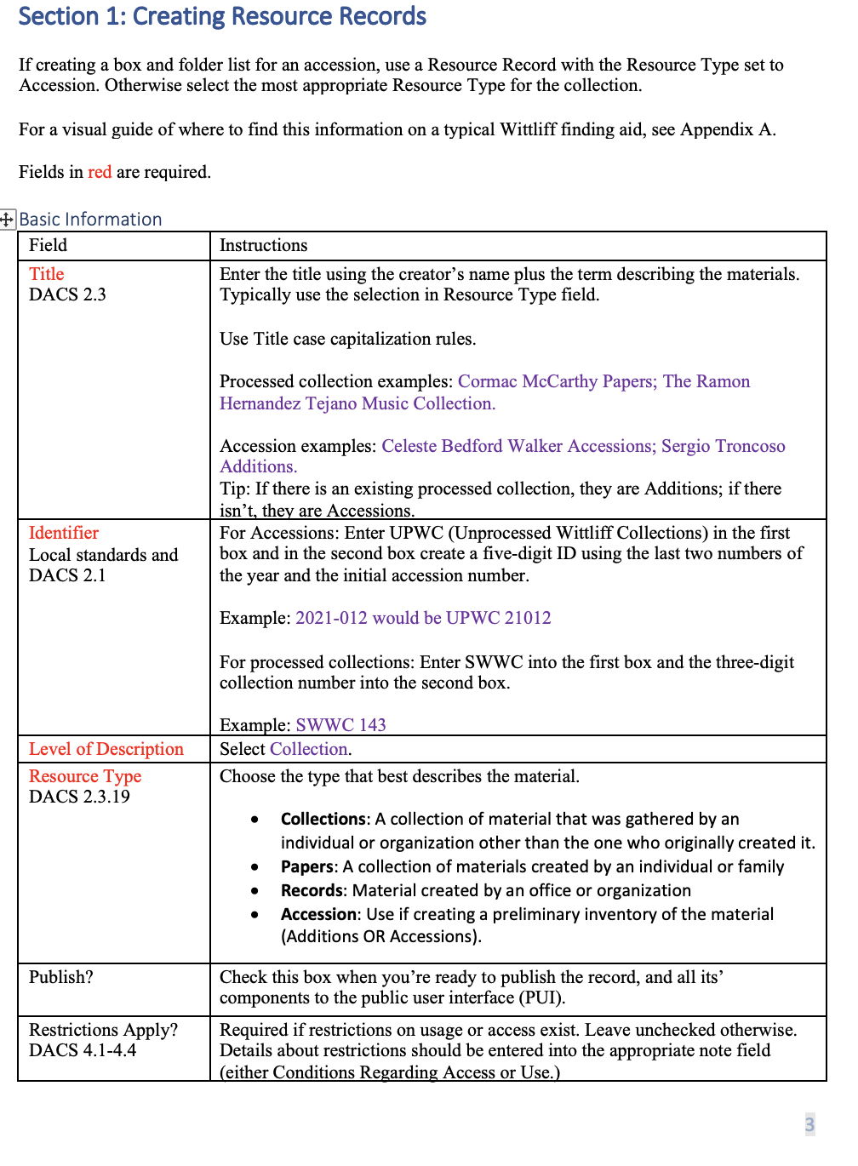

Slide 17
We have standards and best practices, but now what?
Instance-Wide Data Clean-Up
Shared Subjects and Agents records imported from 2 different systems from a variety of users
Added LCNAF and LSCH links (when applicable)
Deleted duplicates, misspellings, etc.
Used more inclusive vocabularies when able: Homosaurus

Slide 18
Challenges
Remediating The Wittliff’s imported finding aids
Migration from Archon led to inconsistencies in the metadata formatting and mapping
Deleting imported records and starting over was easier in the end
Legacy metadata is still present in the EAD files

Slide 19
Tips: Defaults make everything easier

Slide 20
Dream big. Branding and Customization

Slide 21
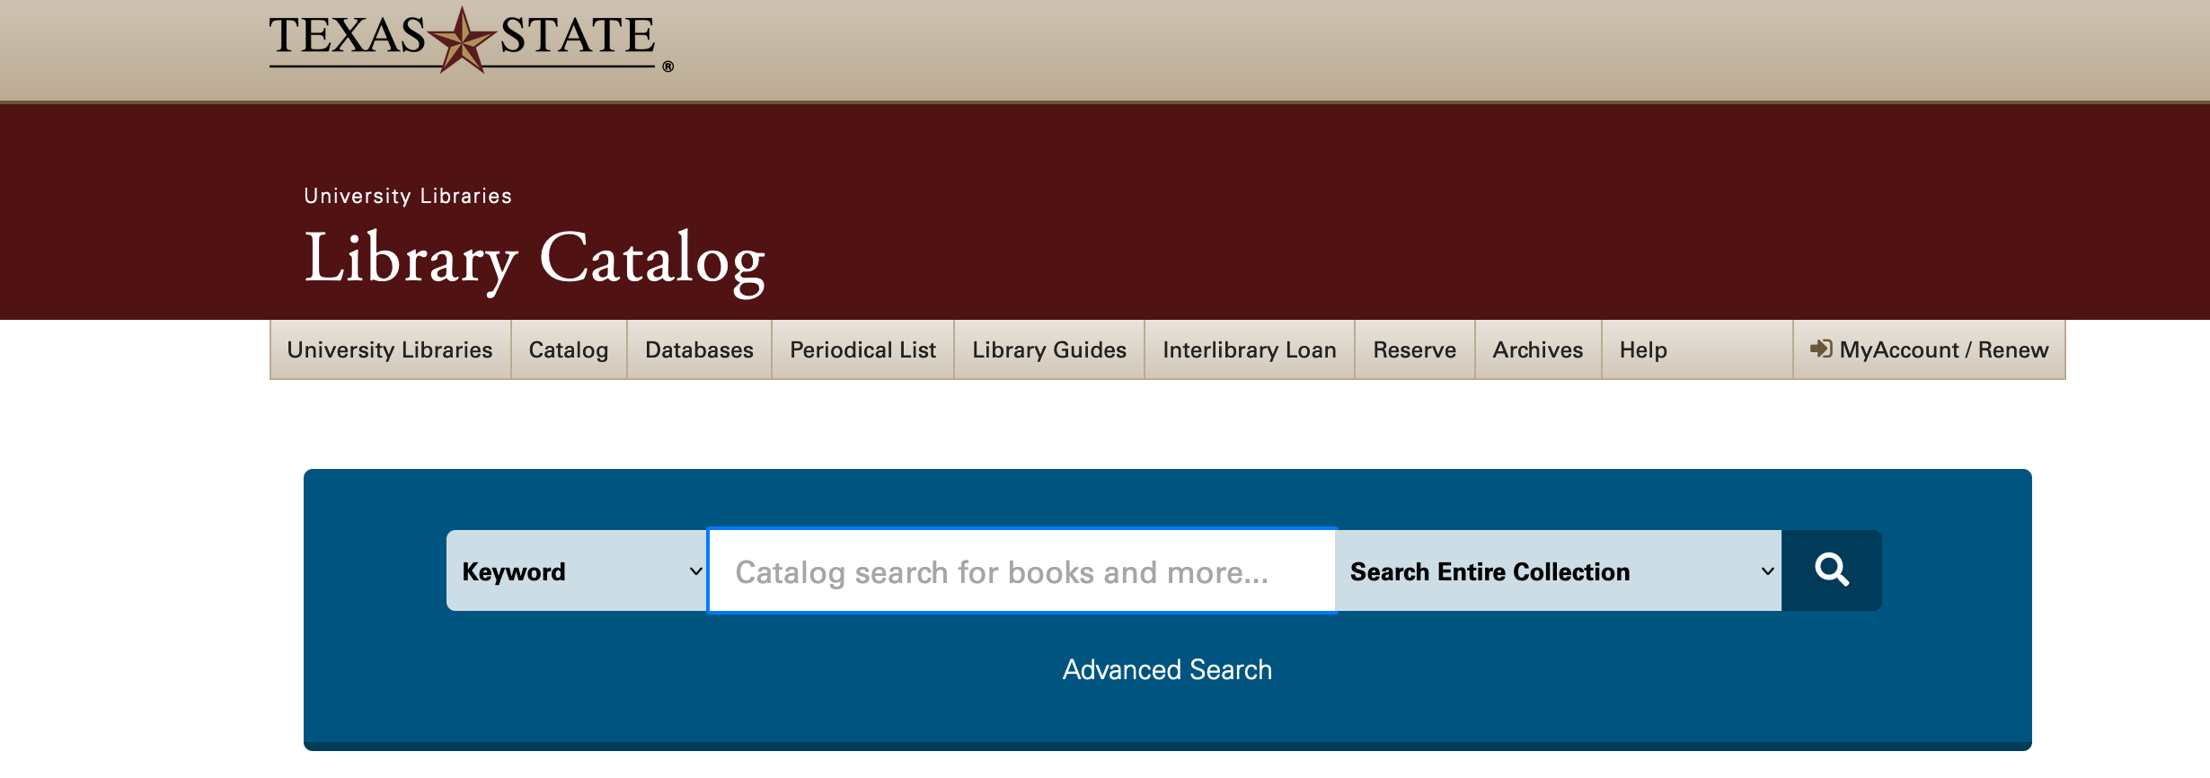

Slide 23
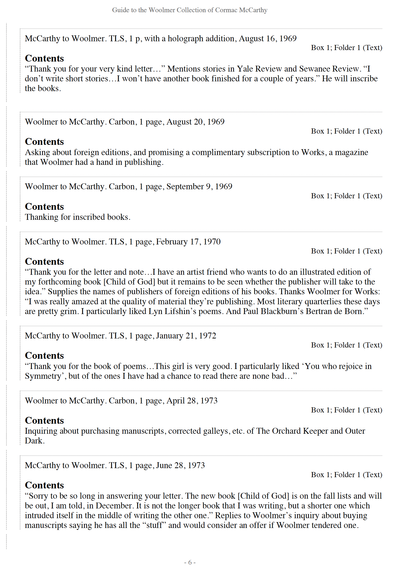
PDFs
Out of the package: hard to read, not user-friendly

Slide 24
Custom PDF plugin from Hudson Molongo
Our wish list:
Left-formatted box/folder information
Not displaying the materials format at every file level
Not displaying subject terms at the item or file level (only those at resource level)
Bolding of series and subseries labels
Generally, a cleaner, more human-readable look

Slide 25
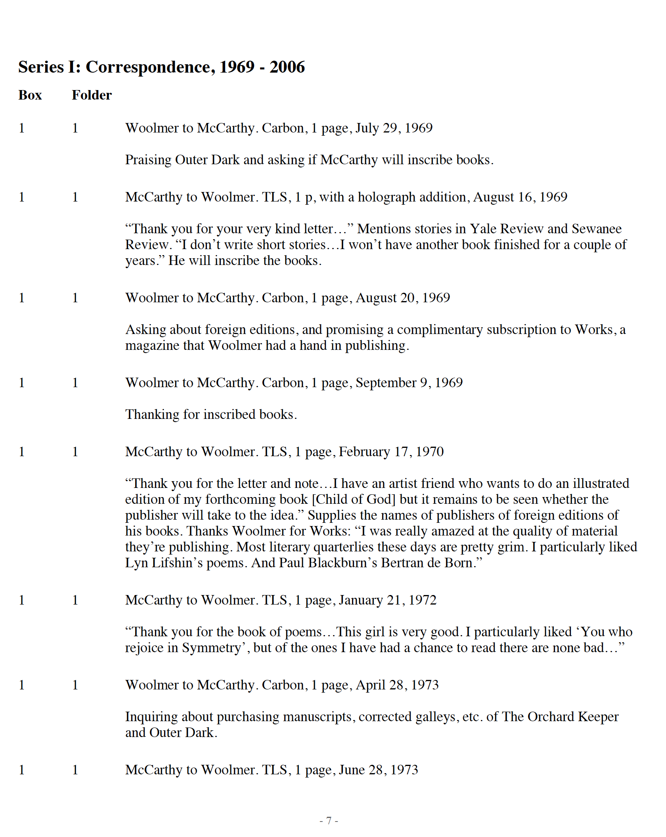
Magic!

Slide 26
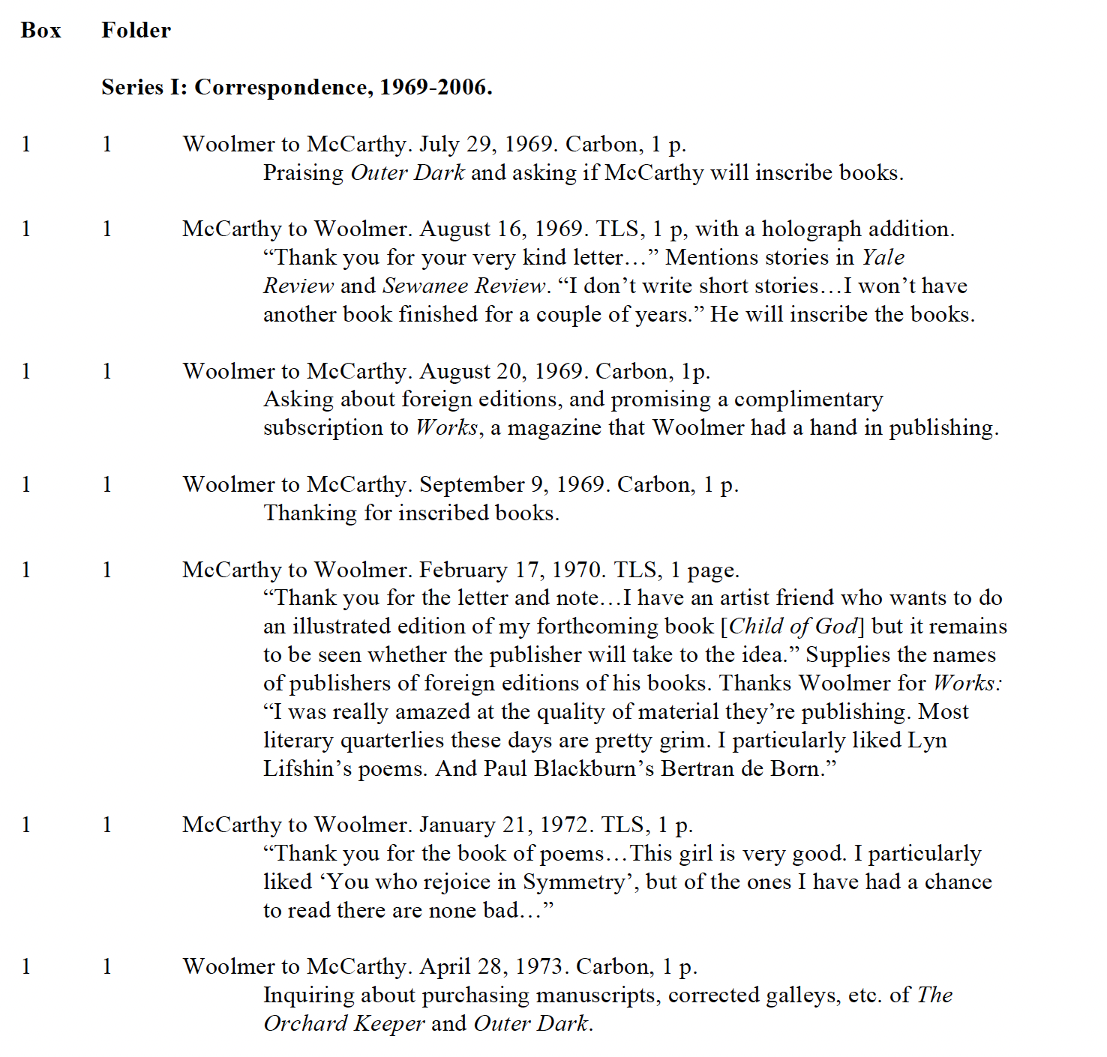

Slide 27
Dare to dream! If you find yourself wishing AS could do something, chances are it can be made to do it via a plugin - James Bullen @ Hudson Molongo
https://github.com/hudmol/as_txst_pdfs

Slide 28
Now what?

Slide 29
Finished?
Linking to our new Islandora digital platform
Continuing to add new finding aids
Prioritizing new accessions for ArchivesSpace
Changing the way we accession/inventory incoming accruals
Working with curators to replicate what we liked in the web-based A-Z listing

Slide 30
Questions?
Contact:
Susannah Broyles: s_b623@txstate.edu

