Slide 1
Integrations
A sub-team of the ArchivesSpace Technical Advisory Council (TAC)
Sarit Hand
shand@ap.org
Digital Archivist
Associated Press Corporate Archives

Slide 2
What we do
What we don’t do
Maintain public pages
Assemble resources
Survey
Development
Make recommendations
Testing

Slide 3
Integrations Pages
https://archivesspace.atlassian.net/wiki/spaces/ADC/overview?homepageId=14418091

Slide 4
NEW Integrations Survey - 2022
August 24th-November 30th
TBD: annually or biennial
Community driven
Users, Administrators or developers
Non-exhaustive
ASpace User Listservs
ASpace Google group
ASpace newsletter, Twitter and blog
SAA Collections Management section

Slide 5
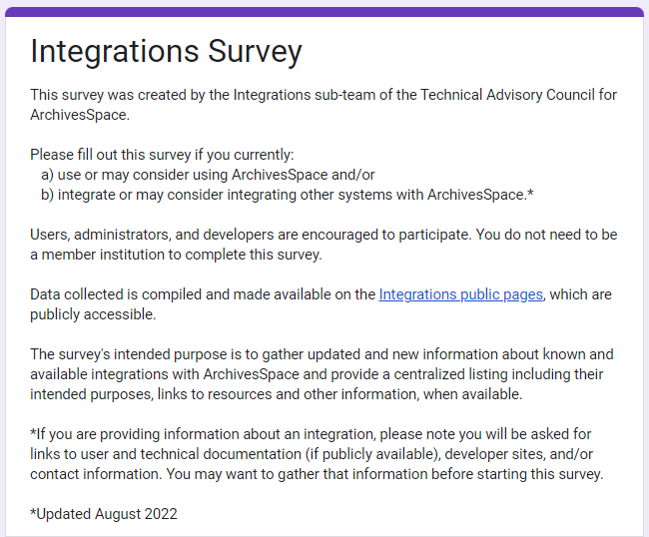
Integrations Survey

Slide 6
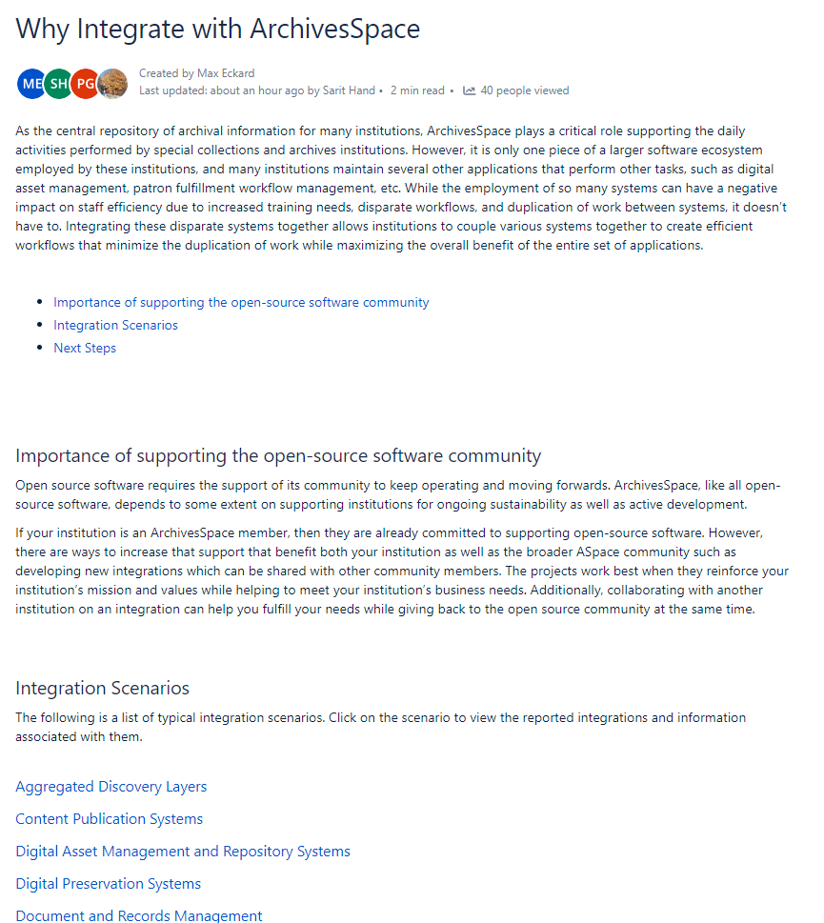
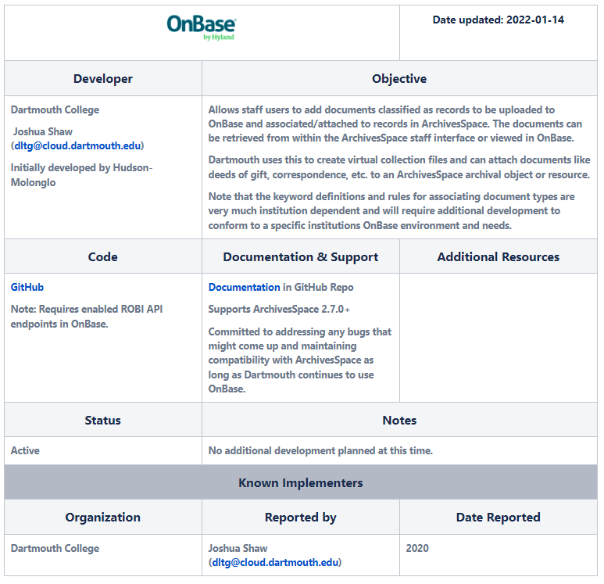
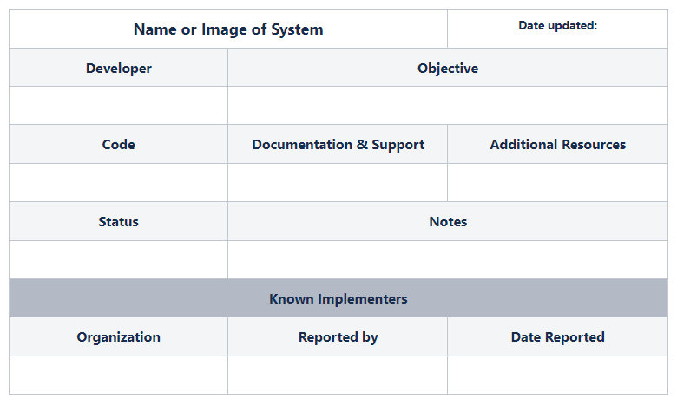
Survey Data
System Focused
Links to resources
Implementer contact info

Slide 7
Integrations
A sub-team of the ArchivesSpace Technical Advisory Council (TAC)
Q & A
2022-2023 Team Members
Sarit Hand, Digital Archivist, Associated Press Corporate Archives
Elizabeth Dunham, Associate Archivist, Arizona State University Libraries
Austin Munsell, Collections Manager, University of Oregon Libraries
Paige Monlux, Digital Archivist, Department of County Assets, Multnomah County, OR

