Slide 1
Implementing a Barcode and Scanning Inventory System for Improved Collection Management
Taylor Wolford (she/her/hers)
Special Collections Librarian
NC State University Libraries

Slide 2
Project Contributors:
Hannah Chapman, Collection Management Assistant at BYU
Hailey Mandel, Graduate Assistant
Phillip MacDonald, Special Collections Librarian
Cathy-Dorin Black, University Library Specialist
Kaetlyn Cuomo, Undergraduate Assistant
Isabel Bossing, Undergraduate Assistant
And others!

Slide 3
Project Goals
Implement barcode system to manage collections more effectively
Standardize locations and container profiles in ArchivesSpace
Conduct a shelf read and resolve any missing items if possible

Slide 4
Workflow
1.
2.
3.
Generate spreadsheet with all containers missing barcodes in ArchivesSpace
Apply barcodes to containers and scan into spreadsheet
Upload new barcodes into AS via the spreadsheet
4.
5.
6.
Review and resolve “mysteries”
Add container profiles to all objects barcoded
General cleanup on locations and container profiles

Slide 5
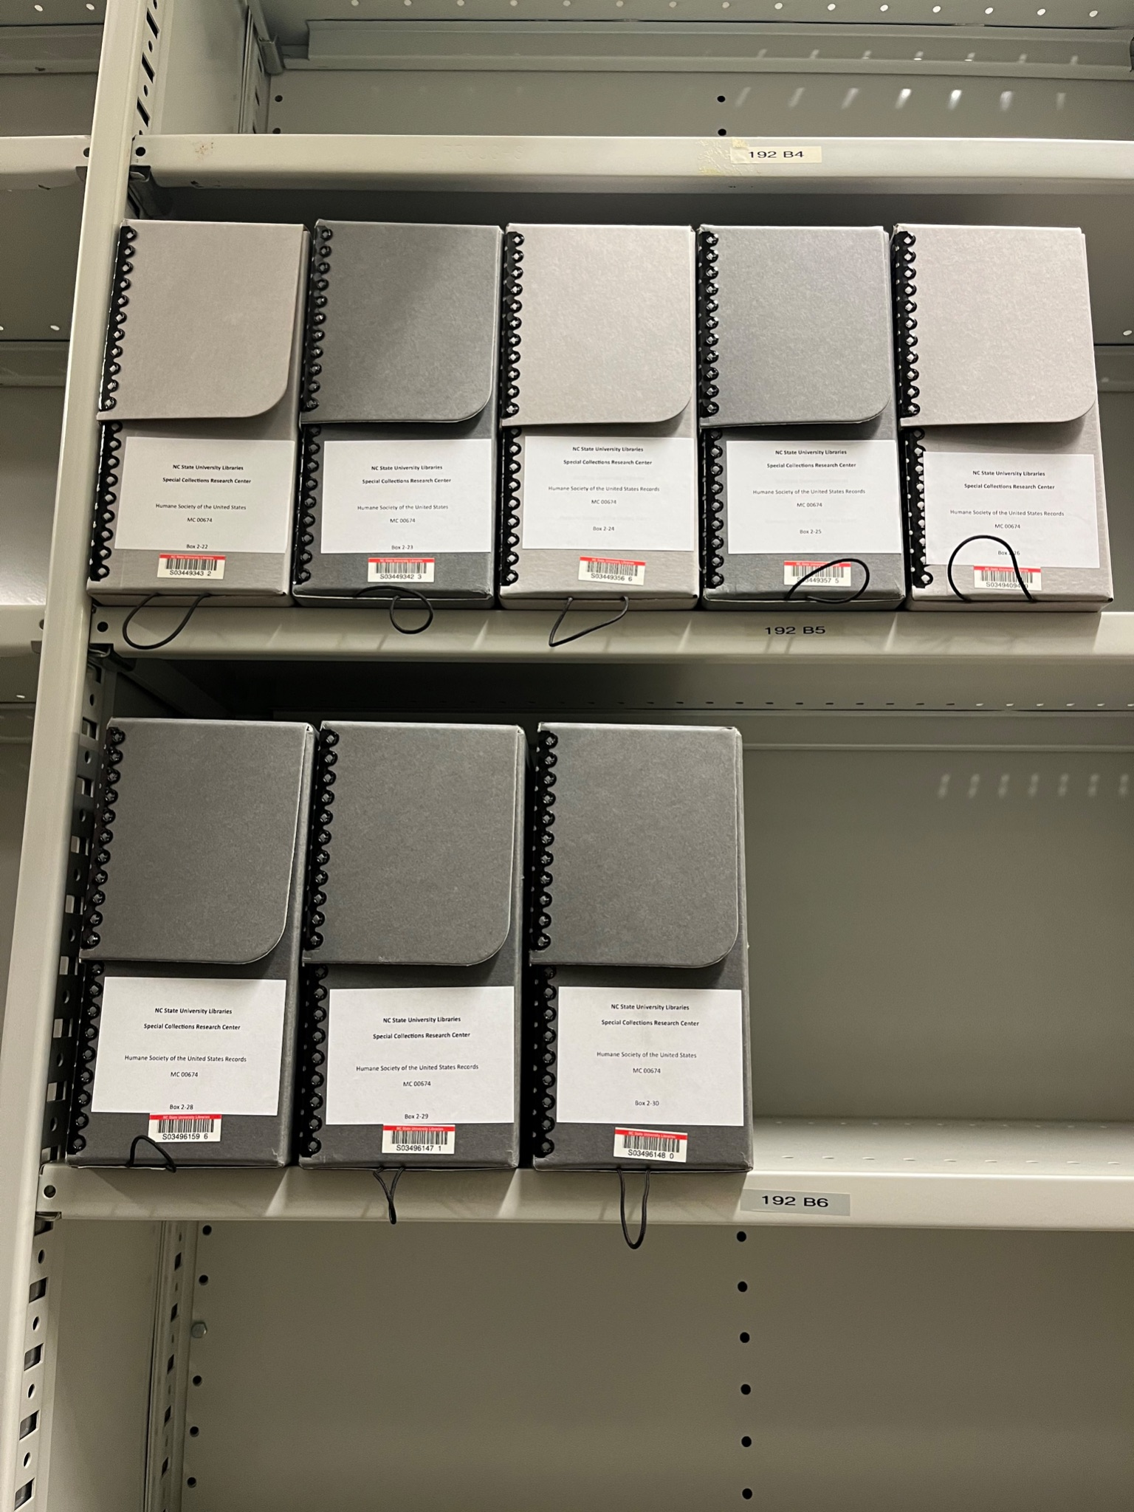
Barcode Scanning
Attach barcodes with unique identifiers to every container in our two main storage facilities
Integrate these barcodes into ArchivesSpace and the Libraries’ request management system

Slide 6
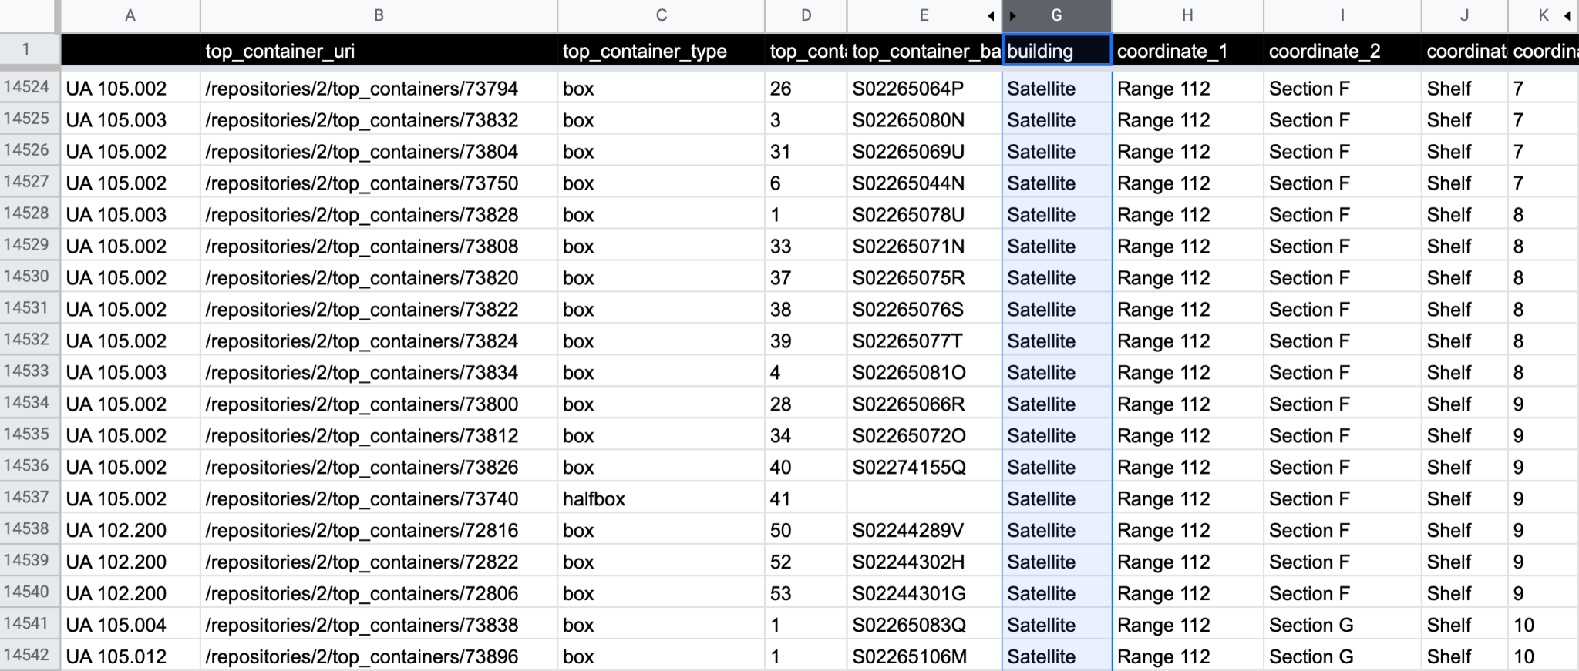
Working Spreadsheet for Barcode Integration

Slide 7
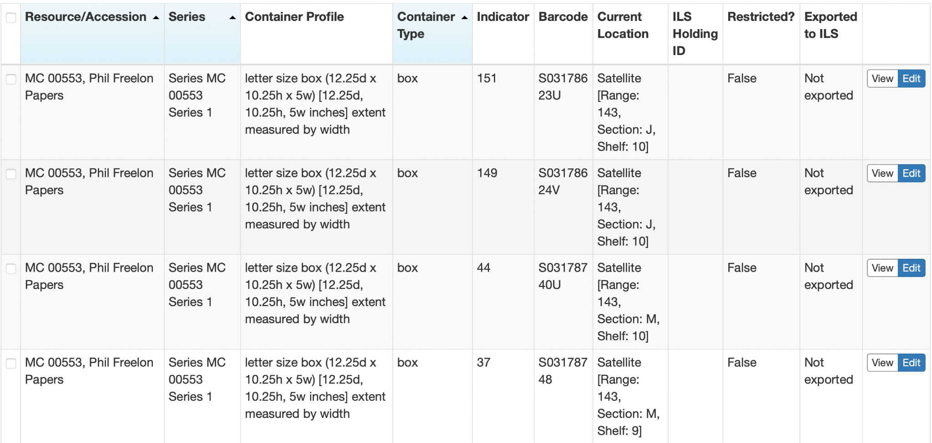
Barcodes in ArchivesSpace

Slide 8
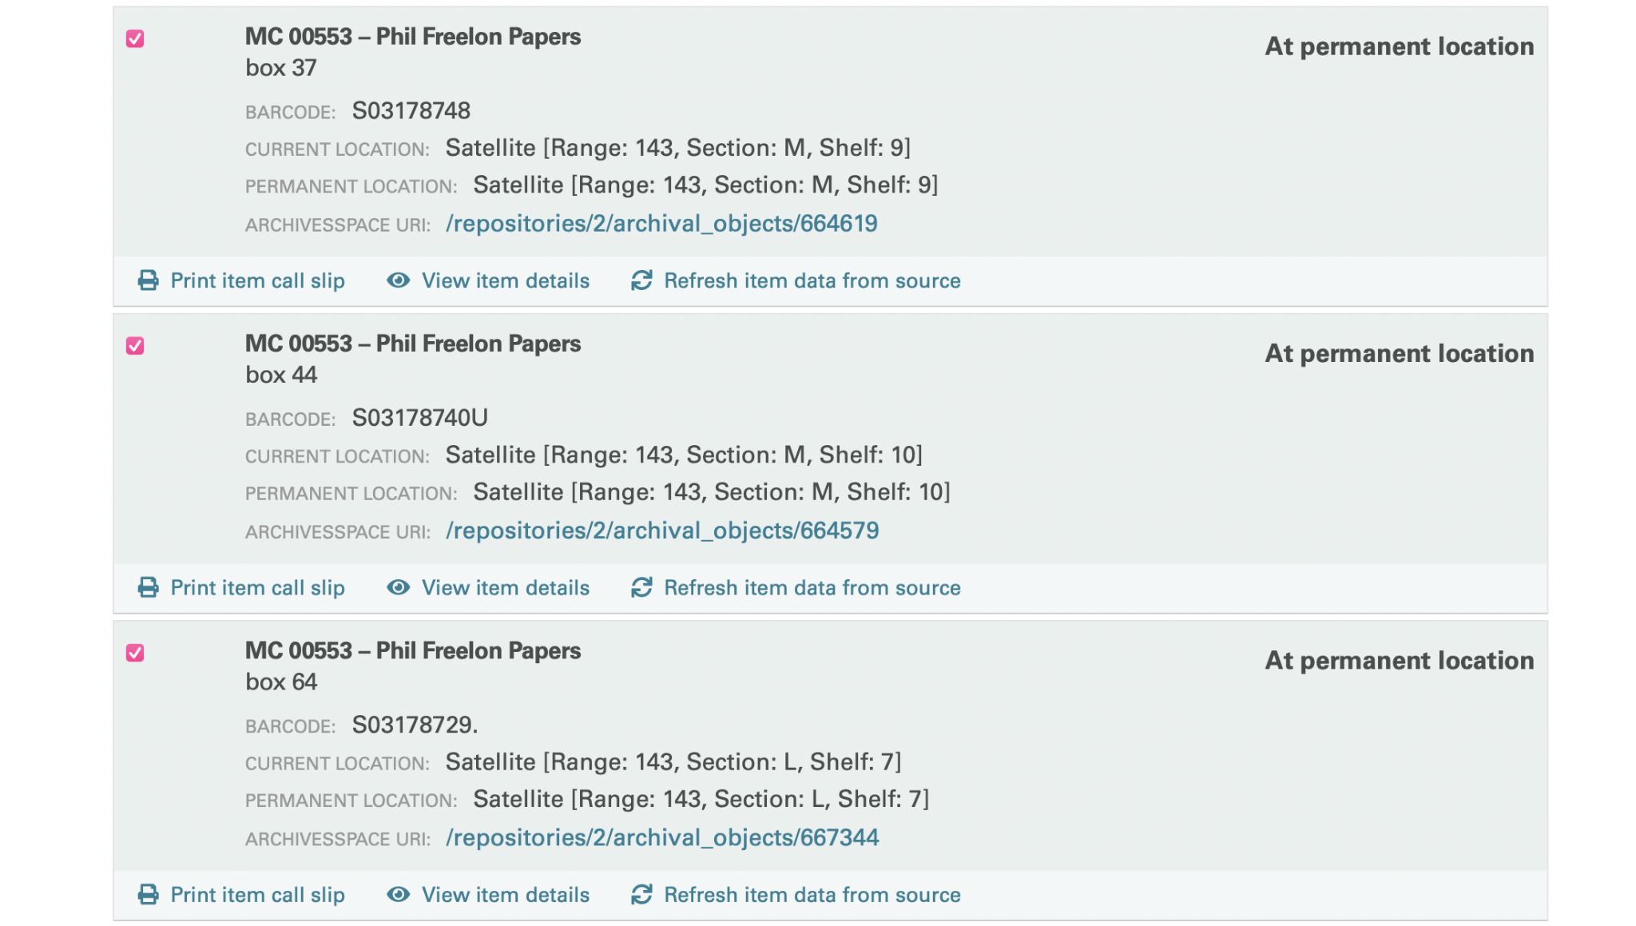
Barcodes in Retrieval Management System

Slide 9
Shelf Read
Conduct a shelf read to resolve any missing or mislabelled containers in both storage facilities
Required in some cases extensive searching and guess work

Slide 10
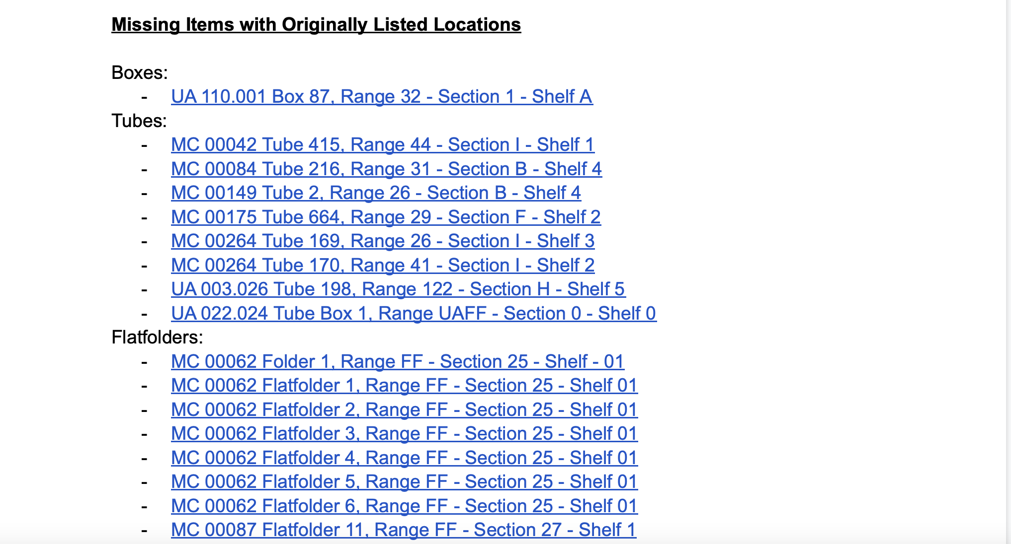
“Mysteries” Documentation

Slide 11
Updating Container Profiles
Update, merge, and/or create container profiles for all objects in ArchivesSpace
Utilize bulk operations in top containers and reporting capabilities
Enable staff to better utilize extent and space calculator tools in AS

Slide 12
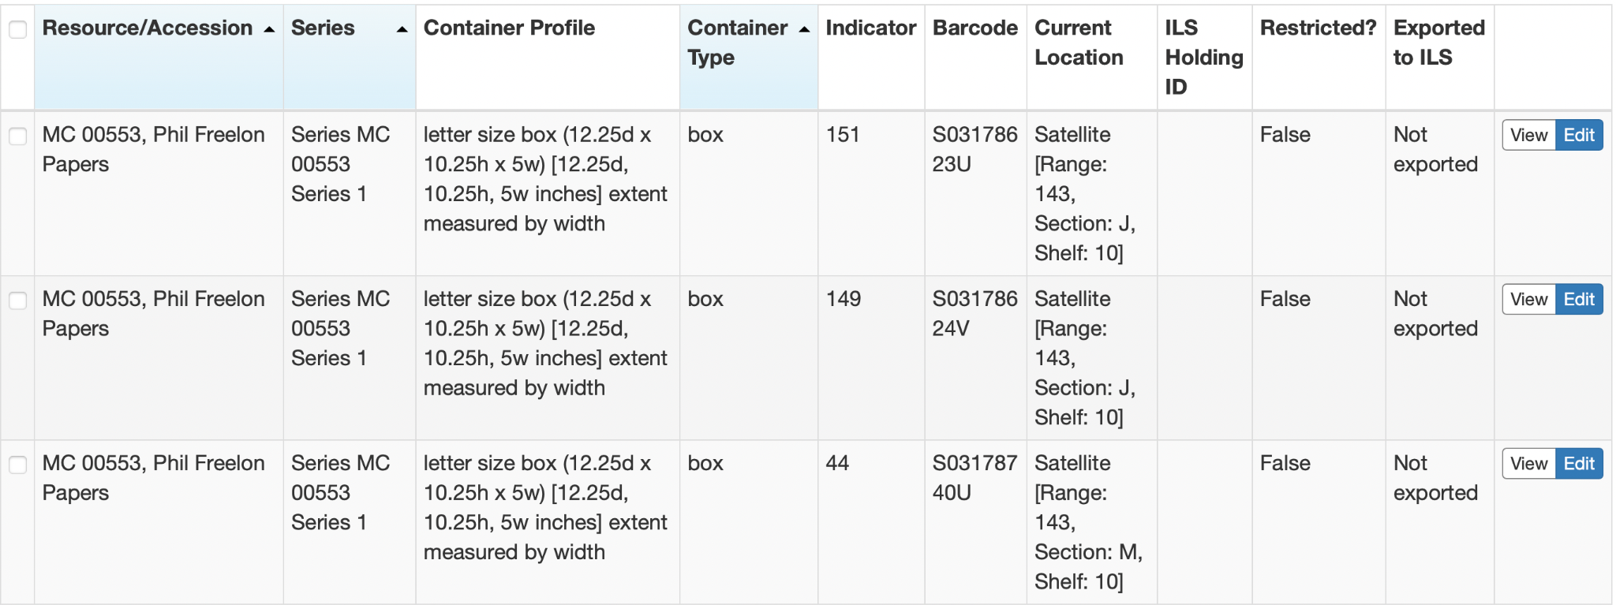
Container Profiles in ArchivesSpace

Slide 13
Current Project Status
Barcoded:
9,400 tubes
550 tube boxes
4,000 cartons
23,000 boxes
150 reel boxes
280 oversize boxes
230 oversize flat boxes
7,100 flatfolders
Mysteries Resolved: 600+
Mysteries remaining: 31

Slide 14
Next Steps
Finish barcoding in second storage facility
Standardize and/or create container profiles
merge feature in ArchivesSpace to combine similar container types
Bulk create container profiles with the project spreadsheet template
Measure and create container profiles for custom boxes

Slide 15
Challenges + Lessons Learned
Team effort requires multiple employees working together for a long period of time
Not all mysteries (missing items) can be resolved
Institutional knowledge can be a great resource
Processors need to be trained on adding barcodes and creating container profiles as a part of future workflows

Slide 16
Thank you!
Email: tawolfor@ncsu.edu
Website: https://www.linkedin.com/in/taylor-wolford-4234151

