Slide 1
Three's Company: Sharing a Unified ArchivesSpace Instance
Julia Corrice, Elizabeth Parker, and Katerina Dimitriadou-Shuster, Cornell University Library

Slide 2
Cornell University Library Repositories
3 main repositories
Rare and Manuscript Collections (RMC) located in Ithaca, NY
Kheel Center for Labor-Management Documentation & Archives (Kheel) located in Ithaca, NY
Weill Cornell Medical Library Archives (Weill) located in New York City
Possible future participants
Kroch Library Asia Collections
Mann Library Special Collections

Slide 3
Background of ASpace at RMC
Approximately 2 years, 7 staff members
Data cleanup from Voyager
Accession information in holdings
Documentation
Working files in Box
Workflows and procedures in Confluence
Regular all-staff presentations, trainings and updates
Troubleshooting workshops
Trial and error
ASpace handbook
Notes:
Katerina

Slide 4
RMC after the launch
June 2020 pause of updates to online catalog for FOLIO implementation
Keeping track of changes for future testing, upgrade testing
Systems talking to each other: Aspace, FOLIO, Aeon, Caiasoft
Onboarding and training sessions for all repository constituents
Shared governance in ongoing projects:
Repository-specific vs. projects affecting shared fields
Notes:
Katerina

Slide 5
Background of Kheel Implementation
KIDB: Kheel Integrated Database – heavily customized, boutique archives management system built in an Access database
Previous Kheel Center Technical Services Archivist was part of meetings with RMC in 2016 to determine if moving into Archives Space at that time made sense; ultimately decided to wait
In Spring 2021, started planning to implement Archives Space at the Kheel Center
Meetings with RMC project participants
Exporting and cleaning metadata in KIDB
Mapping KIDB fields to Archives Space
Slow-down of project work after majority of original project group left Cornell for other positions
External consultant to clean ~2600 EADs
New DevOps team members joined project in Fall 2022
Notes:
Liz

Slide 6
Current State of Kheel Implementation
Collaborating with Cornell Colleagues
Reaching out to colleagues who worked on RMC migration for help
Setting up joint trainings between RMC, Kheel Center, and Weill Cornell staff members over Zoom
Kheel staff specific trainings
Meetings between Technical Services Archivists of all 3 archival units to discuss workflows in Archives Space
State of the implementation
Live front end is being used in conjunction with KIDB for new accessions
Cleaned EADs have been uploaded to test server
Accession metadata has been cleaned and testing of the upload is currently on-going
Container profiles are being mapped/created
Plan for migrating "non-EAD" collections is being finalized

Slide 7
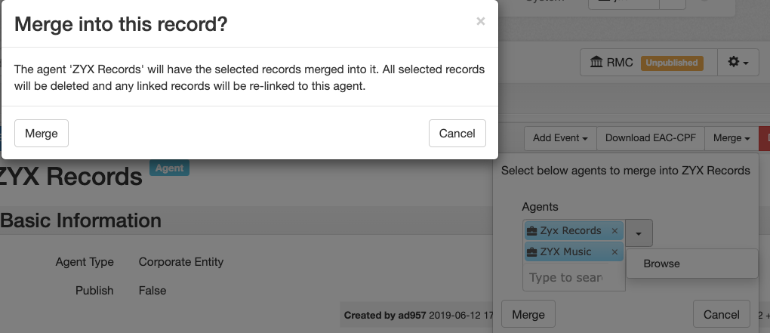
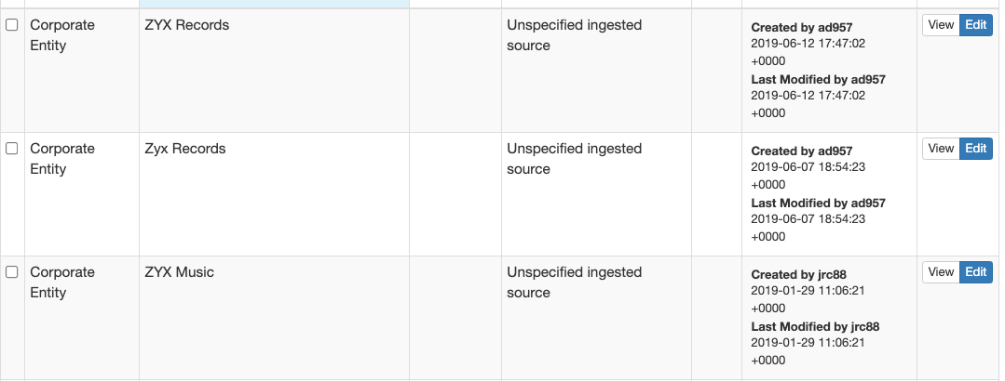
Data Considerations
Shared records/metadata
Agent & Subject Records
User Defined Fields
Data cleanup projects
Notes:
Julia

Slide 8
Data Considerations
Metadata mapping
Ensure fields/metadata are being used the same way across repositories (e.g. ”Date Unknown”)
Upgrades & Maintenance
Communication with shared test servers
Who performs administrative duties? (e.g. user accounts, permissions)
System upgrades need input from all users
Migration concerns
Source data may look very different between repositories (e.g. MARC records vs Access Database)
Different approaches to data migration may be needed for repositories
Notes:
Julia

Slide 9
Joint decisions
Shared fields
User defined
Location and Box profiles
Agent and Subject Records
Restrictions Staff Note
Training
Meetings for how RMC, Kheel, and Weill use ASpace with time for Q&A from constituents
Training new staff
Invited members from other campus stakeholders and interested parties (e.g. LTS, CUL-IT, Digital Preservation)
Documentation
Having a go-to person in charge of documentation, including decisions
Repository Specific Use Manual / Handbook
Migration specific documentation
Notes:
Katerina and Liz

Slide 10
Tips and advice
Document decisions
Communicate often!
Thoroughly investigate differences in data use between members, and recognize what data may be shared
Documentation of migration work
Expect the unexpected
Don't be afraid to hit the brakes
Make the most of it
https://github.com/archivesspace/awesome-archivesspace

Slide 11
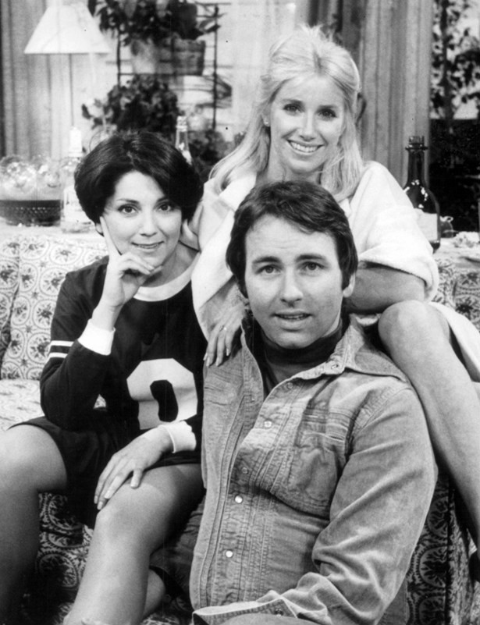
Questions?

