Slide 1
Using Archival and Digital Objects for Archived Websites
Emily Allen with assistance from Laura Montgomery, Andrew Arpey and Michelle Arpey
New York State Archives

Slide 2
Recent Implementation of ArchivesSpace
Rolled out in September 2021
Used following modules:
Resource
Accession
Events
Assessment
Published finding aids in XTF in October 2022
Notes:
The New York State Archives implemented ArchivesSpace in September 2021. The resource and accessions module were in production as of September 2021. And we began to roll out the Events Modules and Assessment modules throughout the year in 2022.
We bulk published finding aids from ArchivesSpace to XTF in October 2022.

Slide 3
What was the goal
Improve access to archived websites
Create concise description
Easy workflow for accessioning and description
Notes:
With the implementation of ArchivesSpace, we had the opportunity to look at how to easily provide access to some of our electronic records, starting with archived websites. Our management made it clear they wanted concise descriptions and make it easy for our users to find and access the websites in Archive-It. ArchivesSpace made it possible for us to streamline the workflow for their accessioning and description.

Slide 4
Web Crawl Work at NYSA
Crawl and preserve websites through Archive-It
Crawls of state government websites
Completed at end of gubernatorial terms
Notes:
The New York State Archives crawls and preserves websites through Archive-It. As we are a state government archives, we are responsible for crawling state government websites, including state agencies, commissions, committees, legislative and judicial branches of government and authorities.
NYSA policy is to crawl websites at the conclusion of each gubernatorial term, so every four years. We will also complete crawls when a major event is occurring, such as documenting governmental responses to covid; and if a state leader leaves or resigns their position.

Slide 5
Finding Aid before DAOs
New York State Archives archived website
https://iarchives.nysed.gov/xtf/view?docId=ead/findingaids/B2169.xml;chunk.id=fullfalink;brand=default#top
Notes:
Here is a look at the New York State Archives’ archived website series before we started to implement Digital Archival Objects.

Slide 6
Finding Aid after DAOs
NYS Education Department Office of Professions archived websites
https://iarchives.nysed.gov/xtf/view?docId=ead/findingaids/B2176.xml;query=
Notes:
And here is a look at the State Education Department’s Office of Professions archived website after we implemented Digital Archival Objects.

Slide 7
Process: Archive-It Information
Website title
Creator
Language
Series
Series number
Finding Aid link
Digital Object URL
Notes:
The Accessioning archivist and the Description archivist both play roles in the process. It begins with the Accessioning archivist.
We had to ensure consistency between the metadata in Archive-It and the information in ArchivesSpace. Statring with Archive-It, the accessioning archivist is responsible for ensuring the website title matched the title of the archival object and DAO records in ArchivesSpace. The creator, language, series and series number had to match the information in the resource record of ArchivesSpace. We included the URL for the finding aid published in XTF. And the Digital Object URL that would take users to the archived website in the Wayback Machine.

Slide 8
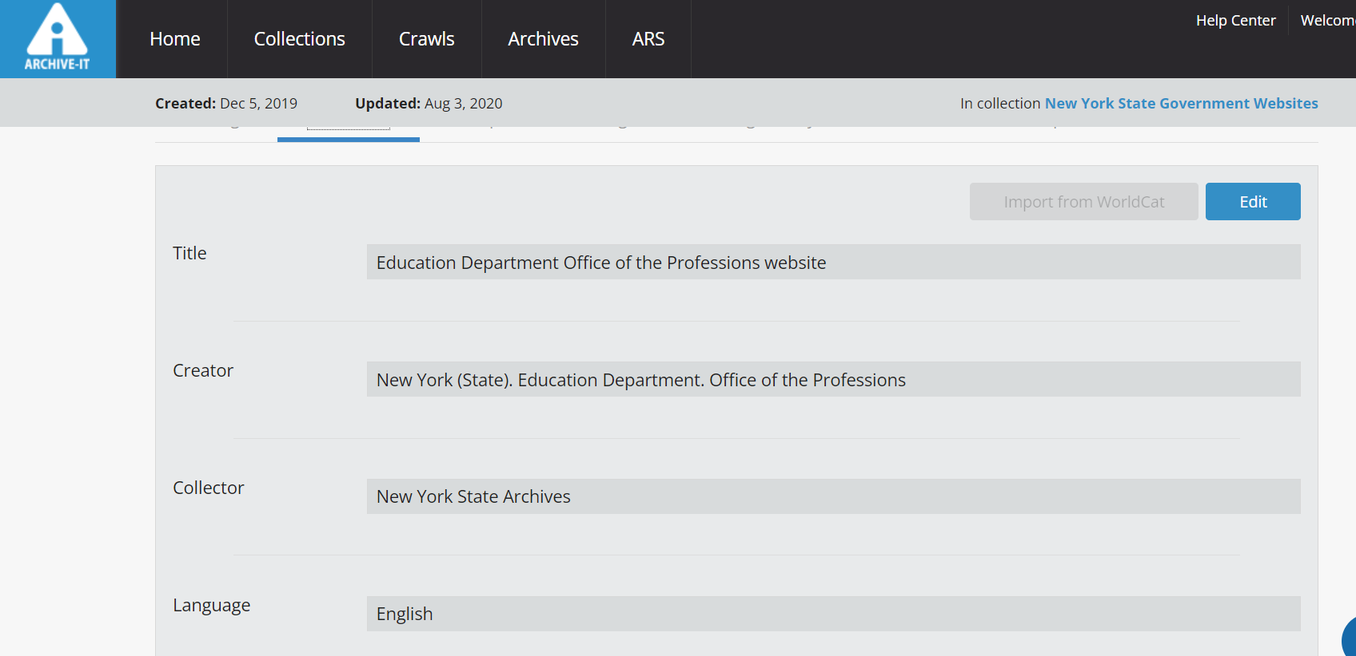
Archive-It metadata screenshot
Notes:
This is a snapshot of how the information would look in Archive-It.

Slide 9
Accessioning archivist: ArchivesSpace
Completes information in the:
Accessions module
Events module
Assessments module
Creates Digital Object record
Notes:
The Accessioning archivist is responsible for adding information in ArchivesSpace for the new accretion in the Accession module, the Events module and the Assessments module. The Accession module includes the basic information about the archived website including the date, the Crawl ID from Archive-It, designates the acquisition type as “Crawl,” and number of individual websites, not captures, in the accession.
In the Events module, the accessioning archivist documents who accessioned the record, and who captured the website in Archive-It, meaning, who set the crawl in motion.
The Assessment module needs to be filled out for each accretion. It documents the types of records in the accretion, along with any descriptive or physical needs of the records. With the crawled website preserved in Archive-It, the housing quality is as good as it can be. The record type is documented as a website and there are no conservation issues to be noted or addressed.
The Digital Archival Object (DAO) is an EAD-linking element used to connect the finding aid information to access copies of the described electronic record(s). In this context, the DAO creates a link from the website description to a copy of the archived website, currently preserved in Archive-It.
To do this, the accessioning archivist creates the DAO using the Digital Object function. And then document the corresponding item level information to the Digital Object record.
The accessioning archivist creates a scope and content note to describe the archived website. The description archivist will add this to the Archival Object.

Slide 10
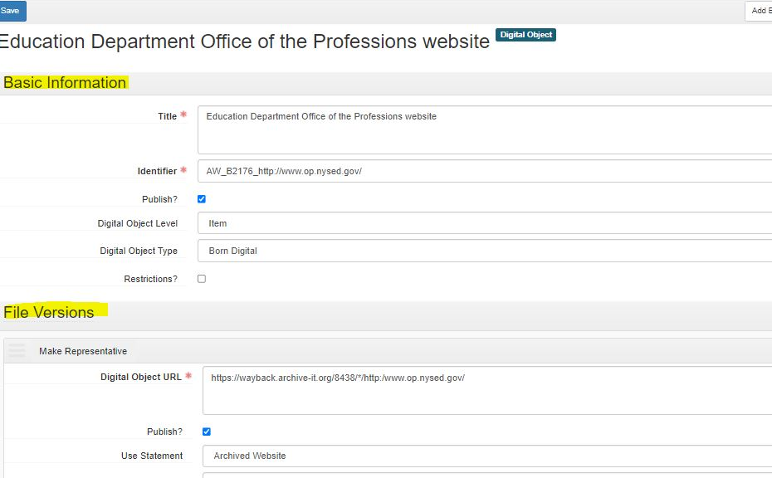
Digital Object screenshot
Notes:
In the Digital Object record, the title is the same as the title in Archive-It. The identifier includes 3 pieces of information: the DAO type, the series number and the seed URL. So, AW for Archived Website, the series number and the seed URL. The Digital Object level will always be item and the Digital Object type is Born Digital; both are in pull-down menus in ArchivesSpace.
Under the File Versions section is the URL for the archived website landing page in The Wayback Machine. The publish box gets checked and Archived Website is selected from the pull-down menu for the Use Statement field.

Slide 11
Descriptive Archivist: ArchivesSpace
Create or update Resource record
Create the Archival Object
Connect Digital Object to Archival Object
Publish finding aid
Notes:
The description archivist is responsible for creating or updating the resource record for the series or collection information. This is the descriptive information that gets published in the finding aid.
The Archival Object is used to create the subcomponent description. This is where the description of the website, provided by the accessioning archivist, is put into ArchivesSpace. The title, accession number, level of description, dates, quantity, custodial history, and material specific details fields are filled out in this section.

Slide 12
Archival Object screenshot
Notes:
Under Containers, the description archivist connects the Digital Object to the Archival Object record. Here is how the connection would look.
Once the Digital Object is connected to the Archival Object, click save Archival Object. The finding aid is ready for publication to the website. XTF formats the information to appear in the published finding aid, making it easy to view the descriptions of archived websites and link to the archived websites in The Wayback Machine.

Slide 13
Finding Aid with Digital Archival Objects

Slide 14
Thank You!
Emily Allen
New York State Archives
Emily.Allen@nysed.gov
518-473-0130

