Slide 1
The Digital Lab’s New Groove
EZMA plugin tool in ArchivesSpace
Marissa Bischoff, Nicole Lewis, Lindsey Memory
Notes:
Marissa- Digital Initiatives Supervisor
Lindsey- Digital Initiatives Manager
Nicole- Digital Metadata Librarian

Slide 2
EZMA
EZ Metadata Application
Captures and formats finding aid metadata into Dublin core
Converts into a loading text file for upload to DAM
Image Credit: https://villains.fandom.com/wiki/Yzma
Notes:
The Digital Lab at the Brigham Young University Library uses a homegrown “proper” plugin in ArchivesSpace to capture and format finding aid metadata into Dublin Core to use in our loading text file that accompanies our uploads to our Digital Asset Management System, CONTENTdm.

Slide 3
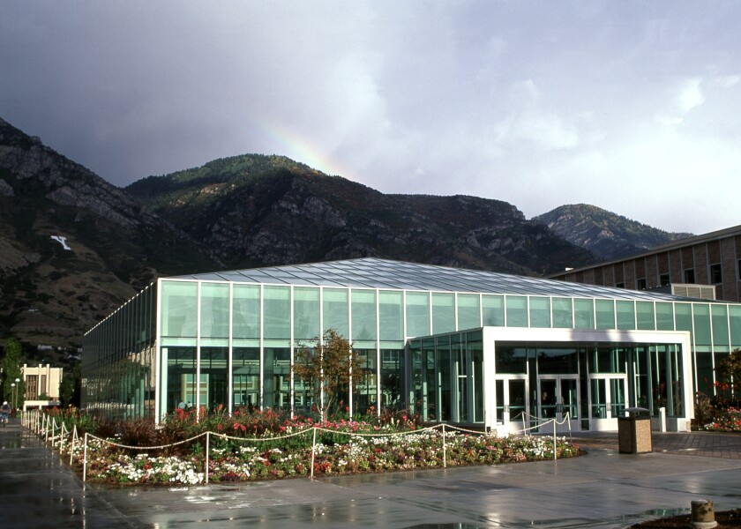
BACKGROUND
Brigham Young University
Digital Lab Staff
Digital Lab Workflow
Throughput:
120 books to IA per month
100 compound objects to CDM per month
Notes:
University and lab
35,000 students, primarily undergraduate, 2 full time and 15-20 student employees
Lab setup- scan and upload, package metadata in lab
Scan rates

Slide 4
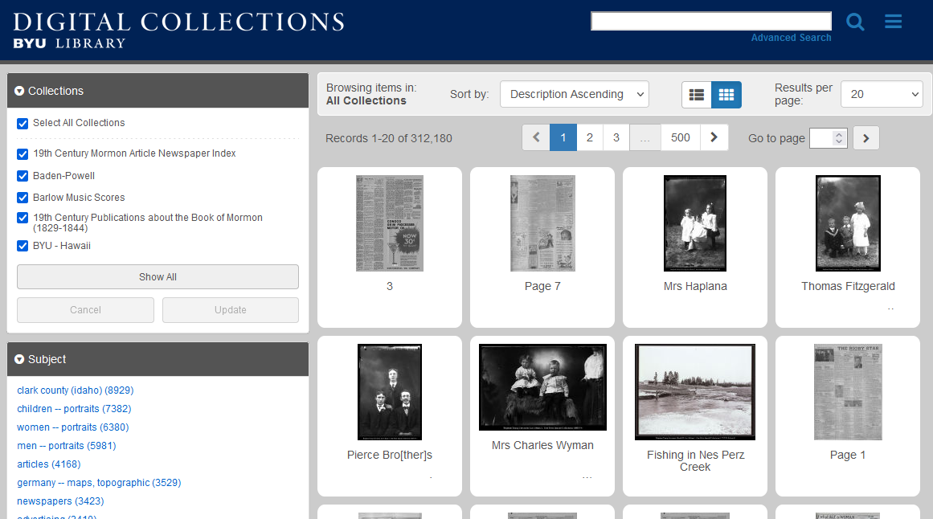
CONTENTdm
History
Initially boutique metadata creation
Changed to Dublin core based on MARC and Finding Aids
Allowed for much larger production
Notes:
CDM for very long time (2002). Like most digital libraries, our methods have evolved over time. The metadata used to be very boutique, with painstaking hand metadata creation. Early on, each collection had different metadata fields. Then, we have pivoted to a larger production lab and metadata is still the pinch point, bottleneck that we are waiting for.
Our process for metadata changed to be based off the Marc records and the finding aids, which had to be translated into Dublin core for CDM. We standardized the metadata profile for all collections so we could better utilize the existing metadata.

Slide 5
Reformatting
Reformatting Committee
All the stakeholders of the digitization process in one room
Set standard: finding aid needs to be complete BEFORE digitization
Notes:
We created a Reformatting committee that allowed all the stakeholders to talk.
One of the BEST things they did is set a standard that for archival collections, that the finding aid has to be done to the item or file level BEFORE we start digitization.
It makes it so there is an up-front wait, but it clears the way so we’re not just picking a few items from a collection but are doing at least a series at a time, so it’s much more cohesive.
Digital file names, identifier titles were based on call number and any changes in metadata that necessitated a change in call number would create downstream problems for the digital lab.
This made it important to be able to translate that metadata from the finding aid into Dublin Core the digital objects.

Slide 6
COMA
Homegrown Finding Aid system prior to ArchivesSpace
Utilized a command line tool to translate finding aid metadata into a text file
Touchy, difficult to use
GIF credit: https://tenor.com/view/lever-emperors-new-groove-why-yzma-crocodile-gif-5468487
Notes:
We had a homegrown system for finding aids. Findingaids.lib.byu.edu. 2019? was the switch to ArchivesSpace.
There was a lab-built command line tool to translate metadata from old finding aids into a text file. COMA. Touchy, lots of errors

Slide 7
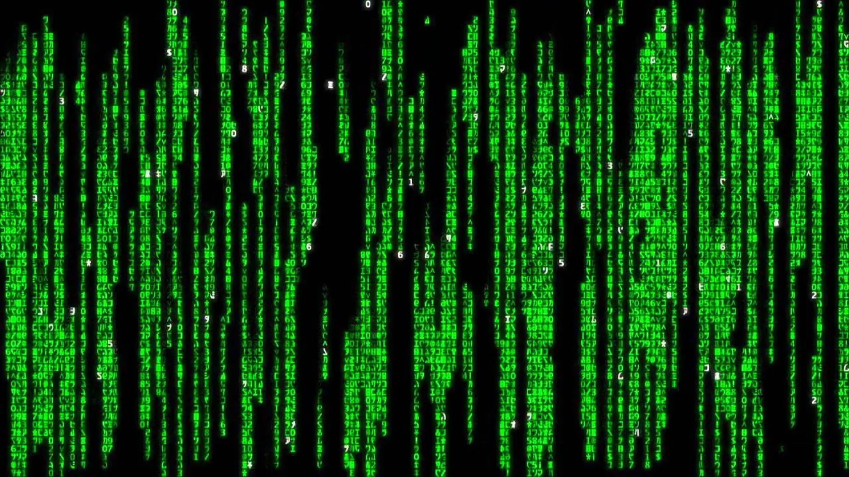
Notes:
Error code screen with COMA

Slide 8
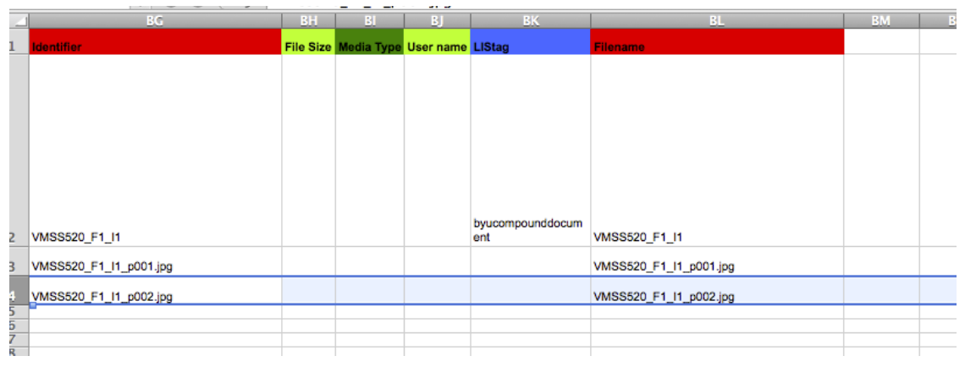
Envisioning EZMA
Migrated to ArchivesSpace
Hand made text files (Read: Copy and Paste)
COMA Rewrite Document
Notes:
Made them by hand once we switched to ArchivesSpace, so we needed a new program.
COMA Rewrite dreams document had our wishlist for a new program

Slide 9
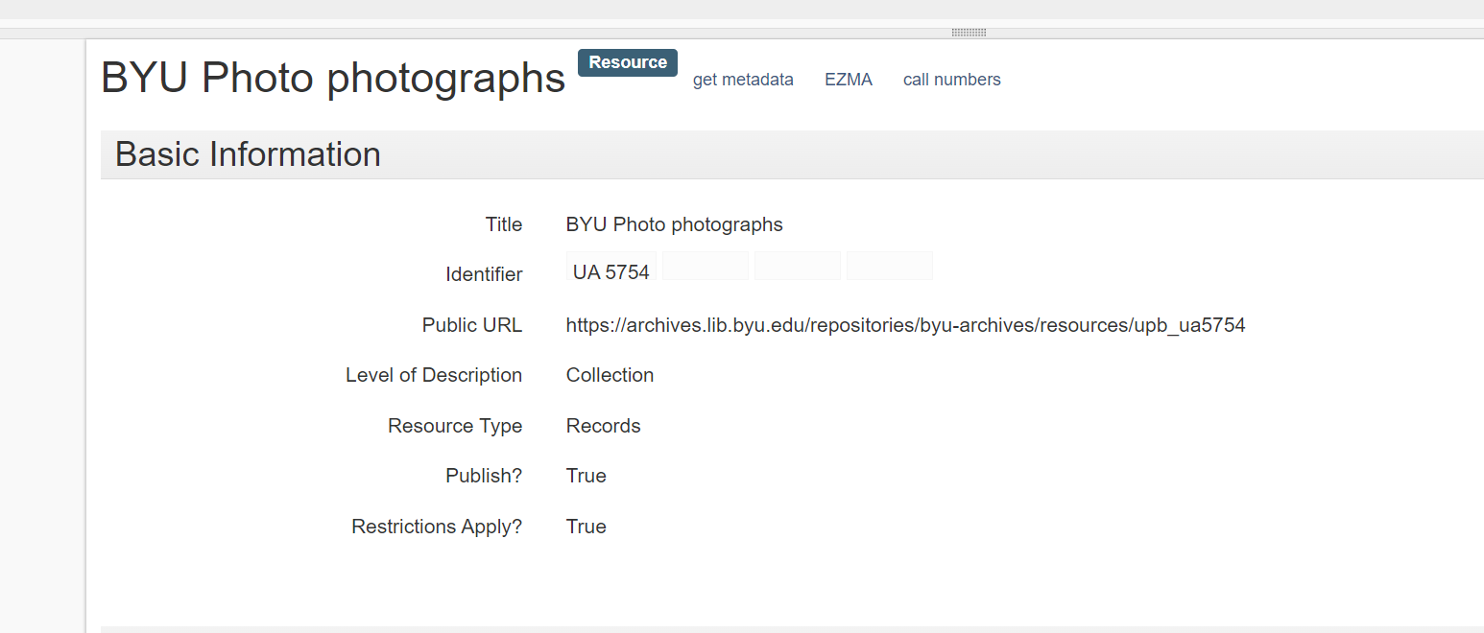
EZMA BASICs
61 fields of Dublin Core metadata
ExifTool
Pulled technical metadata from Preservation and Access Copies
Put camera make, model, and applications in text file
Identifier
Matched call number to truncated identifier
QC of file naming and number
Notes:
The plugin uses a large set of logical rules to convert various values in the finding aid into the 61 fields of Dublin Core metadata we use in our schema. Then, it utilizes the ExifTool and some scripts to gather item-level technical metadata for every image file for use in our loading text file.
Conversion specs: pulling exif data from both Preservation and Access. Added exif data check through commandline to read the camera make, model and application and put in text file
Looked at file names for identifier title.
Was able to deal with differing call number structures that matched what Archival Processing section called.- pulls from AS

Slide 10
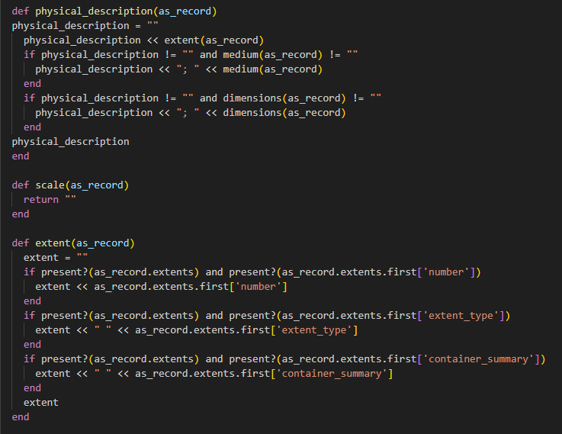
Code logic
Written in Ruby
~1 year of development work for 2 programmers: Spring 2019-May 2020
Pulls metadata from ArchivesSpace fields and maps them into CONTENTdm fields
Notes:
EZMA is written using Ruby to work with ArchivesSpace.
Developer- 1 IT person for “Get metadata” script, 1 IT person for the rest.
EZMA development, Spring 2019-May 2020, about a year of development work (pandemic, maternity leave, working on other things)
Generally speaking it copies information from certain ArchivesSpace fields and maps them into the corresponding CONTENTdm fields. Some ArchivesSpace fields will get combined or split. The top section of this code snippet will combine different elements of the Extents section into the CONTENTdm physical description field.

Slide 11
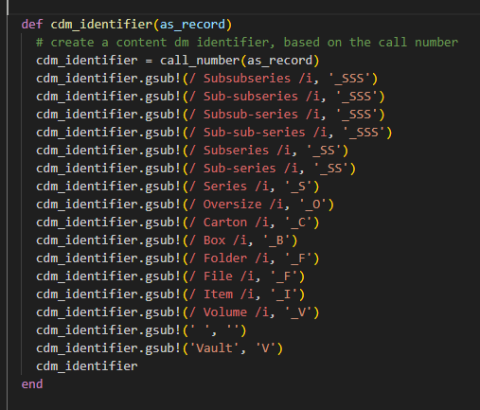
Code logic
It also creates an identifier and item call number
QC of file names
Prints tab-delimited text file for import
Notes:
1. Programmed it to create the identifier by creating a call number. You can see it grabbing the Series, sub-series, box, folder, item etc to concatenate it into a call number from which we truncate to form the digital identifier, which is the file name of the digital item.
Uses this to do QC of our digital file names
It compiles all of this into a tab-delimited text file for import into CDM

Slide 12
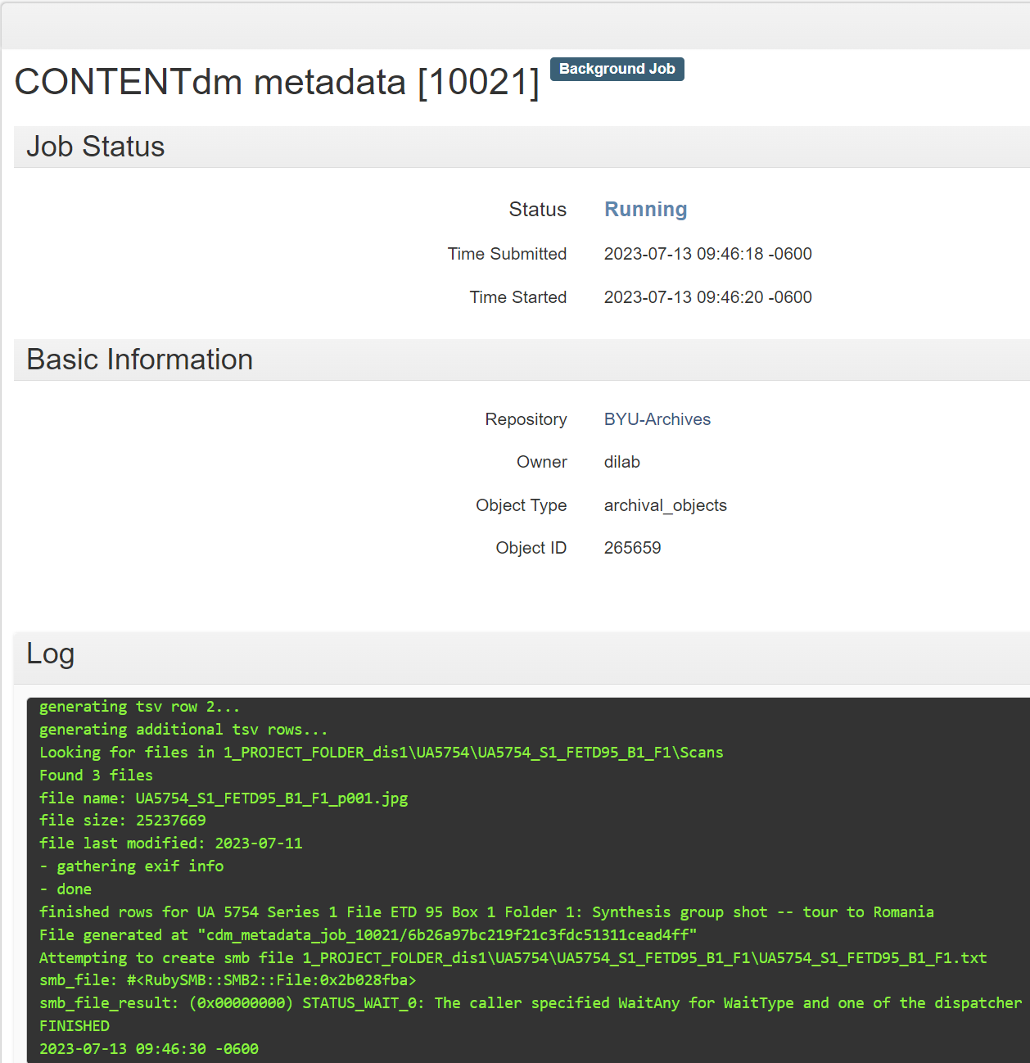
benefits
30-second script vs. 20 min. copy-paste
Rudimentary QC
Fewer errors
Notes:
This plugin turns a manual copy-and-paste process that used to take 20 minutes into a 30-second automation.
It also performs a rudimentary QC in that it checks that our preservation and access copies match and are named correctly.
Fewer errors- Copy and paste problems.

Slide 13
Iterations & maintenance
Continued rewrite of call number
Hierarchy and inheritance issues
Description and Language metadata added to General Notes erroneously
Exif issues with system change
Batch EZMA
Future DAM system migration
Notes:
We put EZMA through its paces with each collection in the beginning days.
Rewrite how it found the call number and pieced it together- had to make accommodations for different issues in call number. Series in different locations, Volumes, 1a, item level moved in a call number, had to give EZMA extra rules. If it finds a call number it doesn’t recognize, it just stops.
Hierarchy and inheritance issues- Inheritance Rules are setup in our instance of ArchivesSpace so some metadata isn’t entered into the archival object. EZMA is supposed to look at upper levels for certain metadata but this doesn’t always work. Creators, for example, don’t always get copied into the EZMA file if it’s not entered into the archival object, so these have to be manually added into the CONTENTdm item manually after loading.
The Description field and Language field metadata were being added to the General Notes field erroneously.
When we made changes to our process for making access or derivative copies of our preservation files, the exif was not embedded through exif-R[uby] so it didn’t show up in EZMA. EZMA is written in Ruby, which all plugs in need to be. Had to change the script to find this exif data.
Batch EZMA- Student employee made code that would iteratively run EZMA for each compound object, so that has turned the 20-seconds on each item into a much fast process that can run while we do other things. It automates the whole process.
Future iteration will be needed when we migrate to a new DAM in the not-so-distant future.

Slide 14
conclusion
Your institution
Two scripts:
Get metadata script
Text file creation script
Useful tool
marissa_bischoff@byu.edu
Image Credit: https://knowyourmeme.com/memes/oh-yeah-its-all-coming-together
Notes:
This might be a helpful tool at your institution. Consider talking to your digital managers who upload your digital content online. How are they capturing the metadata they display online? I’d love to hear from you about what you are doing.
Anyone wanting to use this would need to build a get metadata script and then another script that would package the metadata and enhance it, and add QC. Not on github yet but I broached it with LIT and we’ll see.
Very useful tool. Worth the headaches and issues to save countless hours on a repetitive task.

