Slide 1
Embedded Digital Object Viewers in the ArchivesSpace PUI
Kevin Clair ArchivesSpace Member Forum
2023 July 26

Slide 2
The Question
Can archival materials that have been digitized be made visible through the ArchivesSpace PUI, regardless of format?

Slide 3
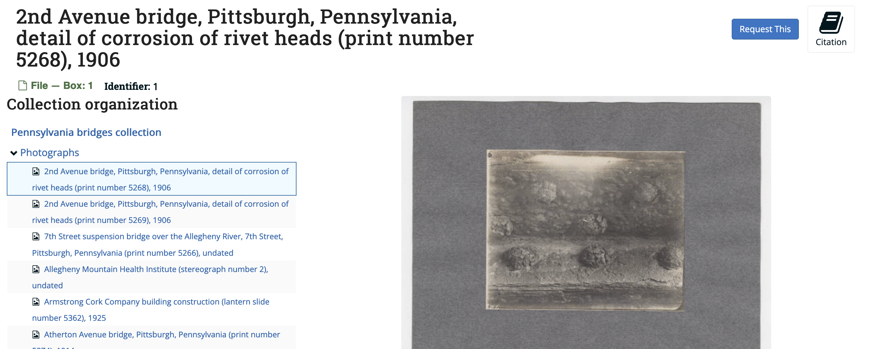
The Existing Approach
With the right metadata attributes, it is possible to display images in the PUI out of the box

Slide 4
The Shortcomings
It only works for images; it doesn't allow for interaction with the image or its metadata in CONTENTdm

Slide 5
The Additional Wrinkle
Penn State relies on Kaltura MediaSpace for management of A/V. It can be embedded anywhere; how about ArchivesSpace?

Slide 6
The Solution
CONTENTdm IIIF manifests + Mirador
Kaltura embed code
All contained in one plugin

Slide 7
The Logic
If the File URI is a IIIF manifest, display a Mirador viewer (if Mirador is enabled)
If the File URI is a kaltura.com address, embed a Kaltura viewer (if it is enabled)
Otherwise fall back to ArchivesSpace default behavior

Slide 8
How It Looks
https://aspace.libraries.psu.edu/repositories/3/archival_objects/235178

Slide 9
How It Looks
https://aspace.libraries.psu.edu/repositories/3/archival_objects/235241

Slide 10
The Problems to Fix
Display logic based on text fields (prone to errors) -- How to mitigate?
Should Kaltura and Mirador viewers be separate plugins? If not, ensure one can work without the other
Need to update a lot of digital object URLs

Slide 11
Thanks!
Kevin Clair
kmc35@psu.edu
@clairyroubaix.bsky.social

