Slide 1
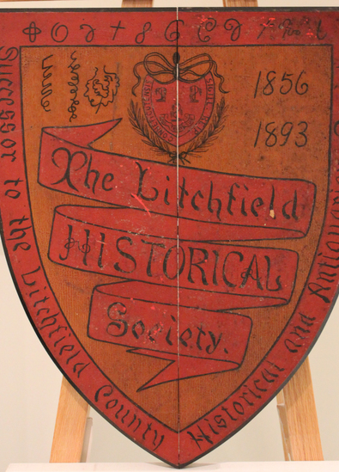
Litchfield Historical Society
Founded: 1856
Incorporated: 1893
Collecting: 1890s
Describing archives
in finding aids: 2002
Archon: 2009
ArchivesSpace: 2013

Slide 2
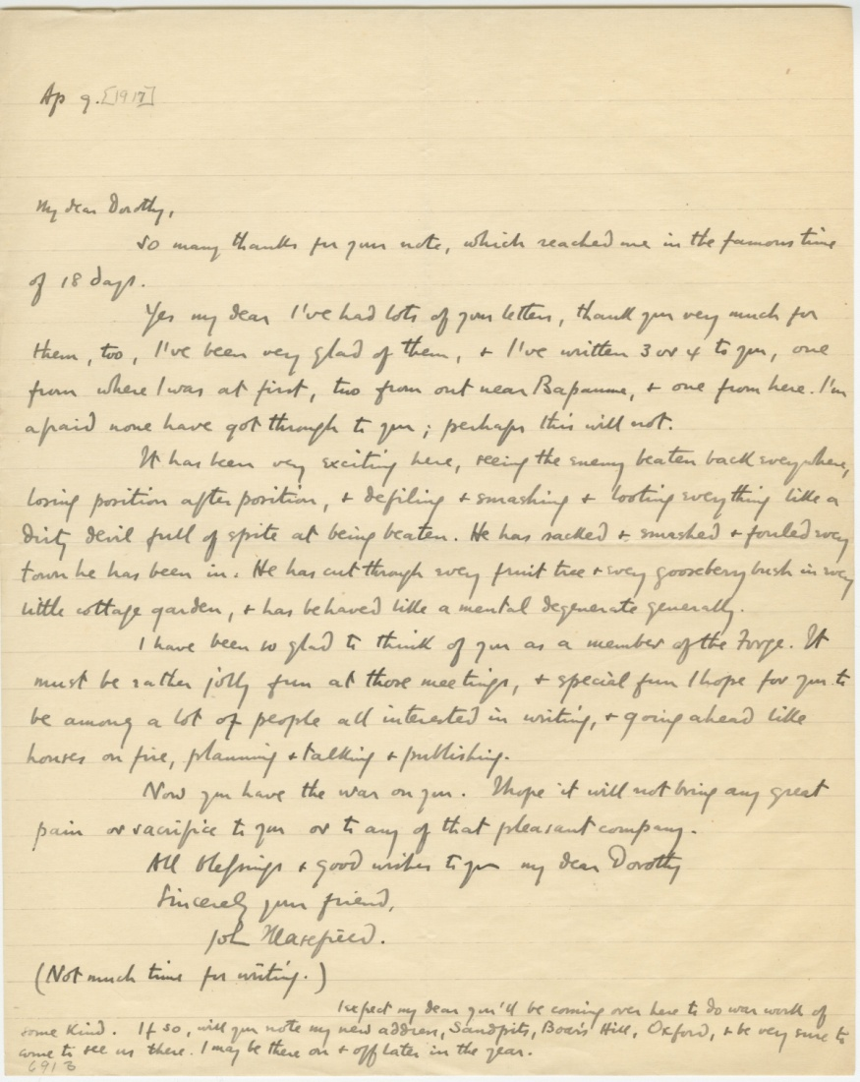
Legacy Description

Slide 3
Yes, we still have that.

Slide 4
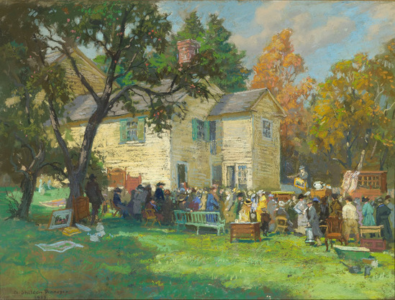

Slide 5
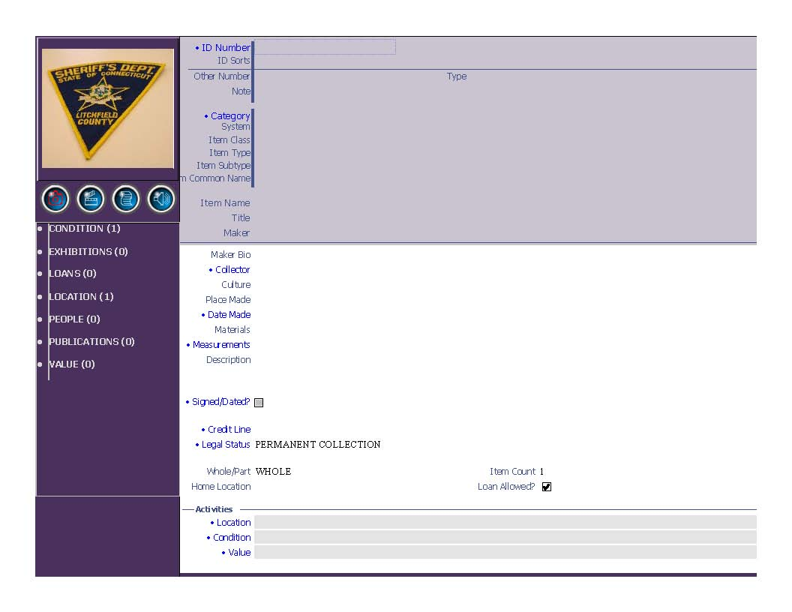
i/O Collections Database

Slide 6
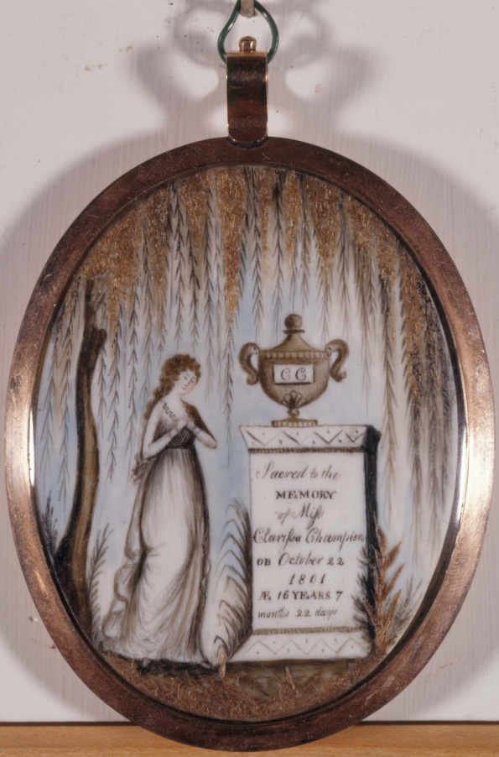
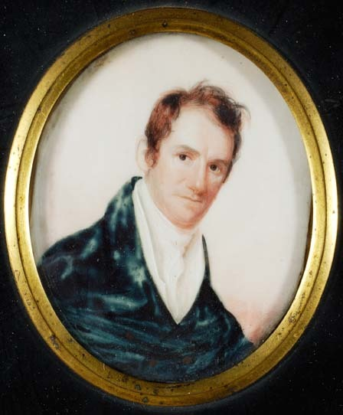

Slide 7
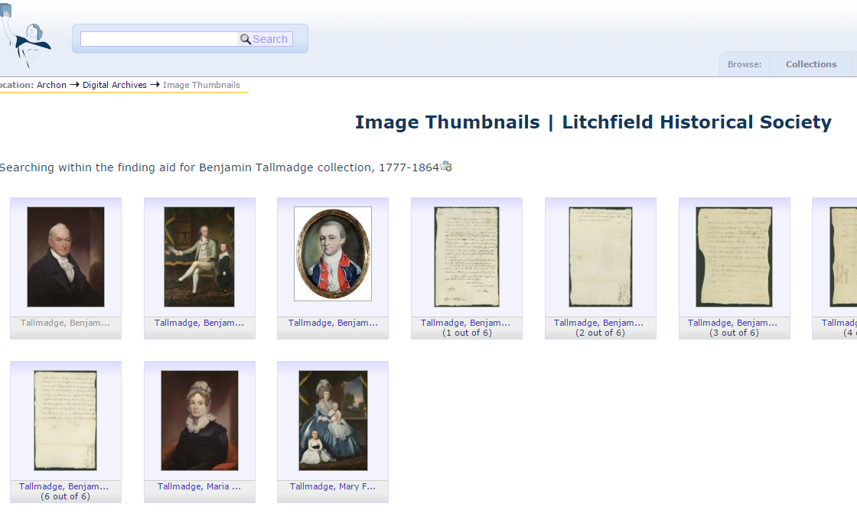
First Attempt at Unified Access

Slide 8
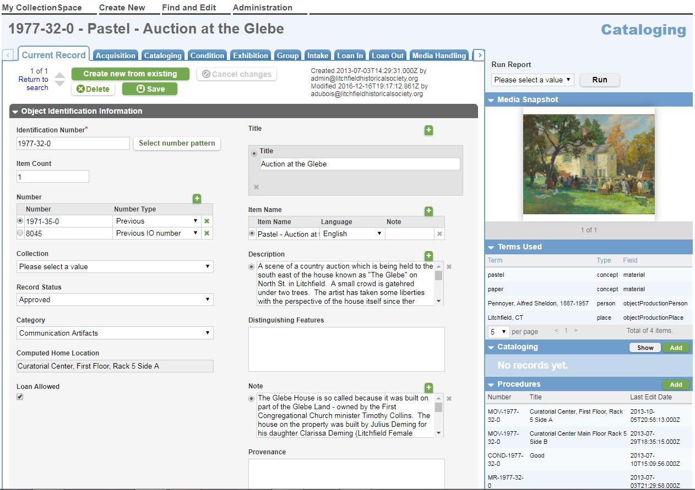
CollectionSpace Database

Slide 9
Development
Solr Indexing
Django Web Framework (Python Programming Language)
Bootstrap Front-end UI Framework
Modular Design to Support Multiple Instances of Cspace and/or ASpace
Intermediary Solr Index to Handle Multiple API Endpoints from Cspace
External Authority Source uses RESTful APIs and Native API to Read and Write Authority Files
Supports Batch Retrieval of Authority Files from a Source

Slide 10
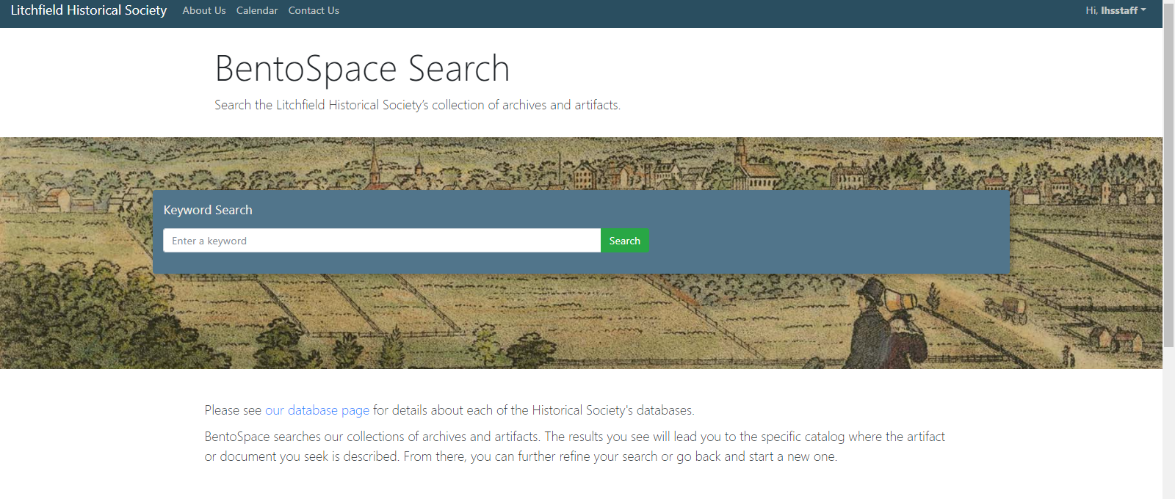
Single Search Interface
http://beta.collection.litchfieldhistoricalsociety.org/bento/search/

Slide 11
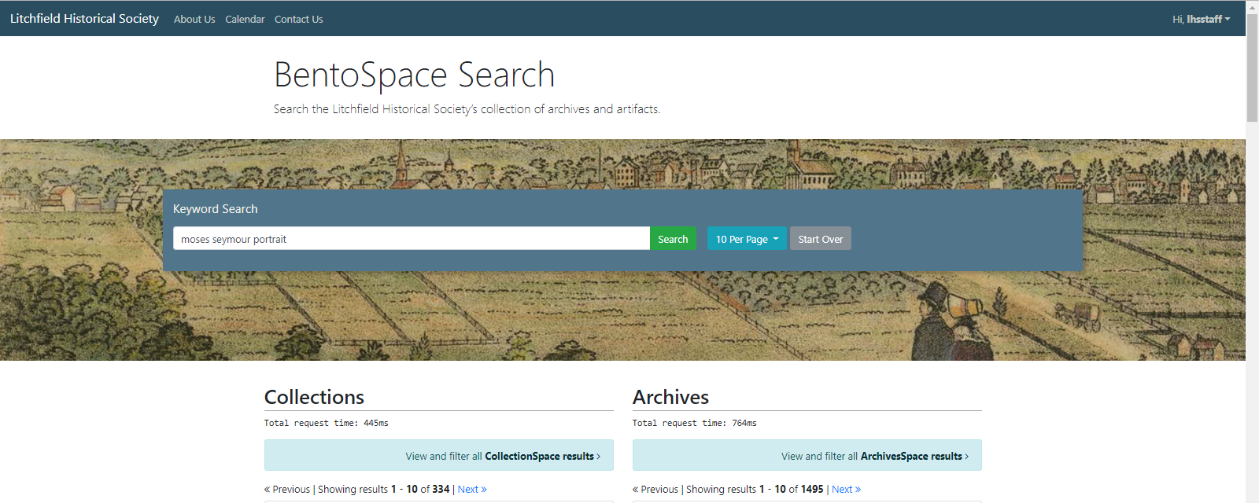
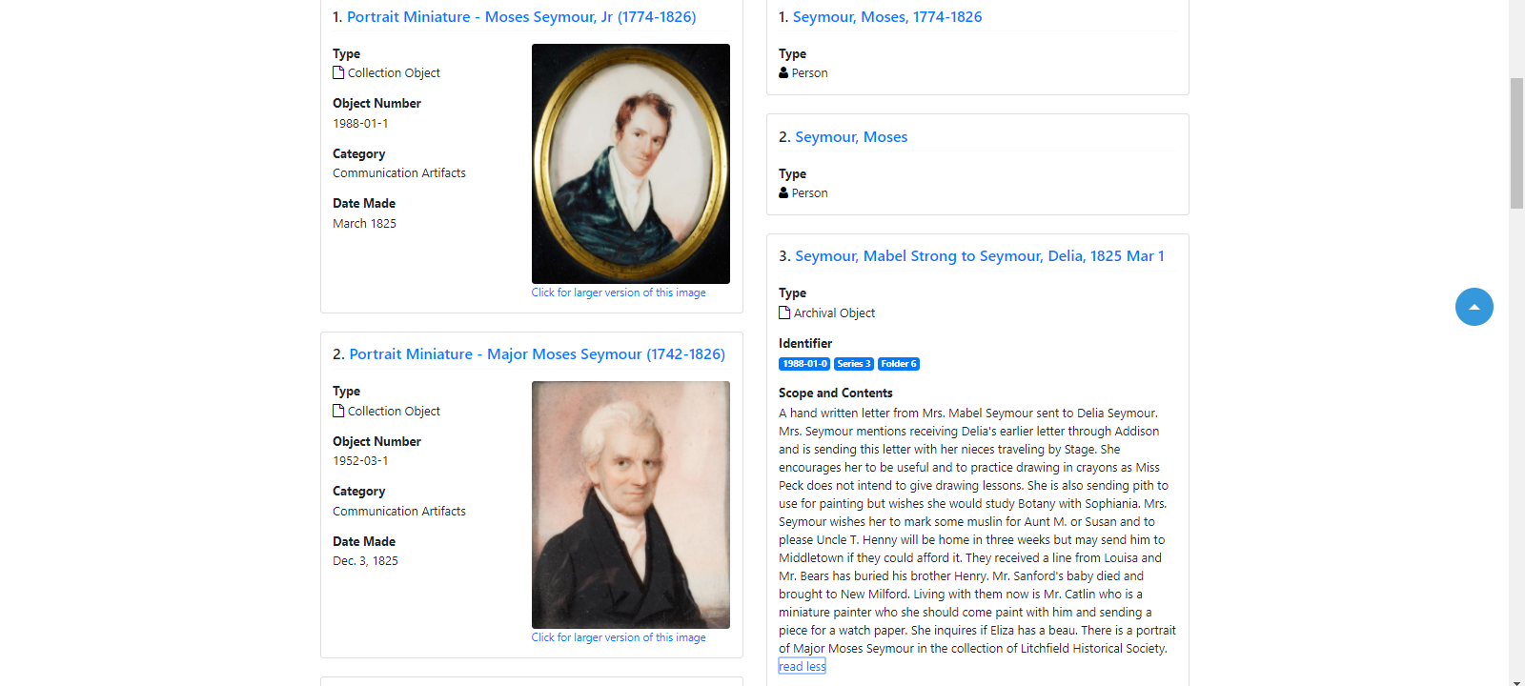

Slide 12
Social Tagging

Slide 13
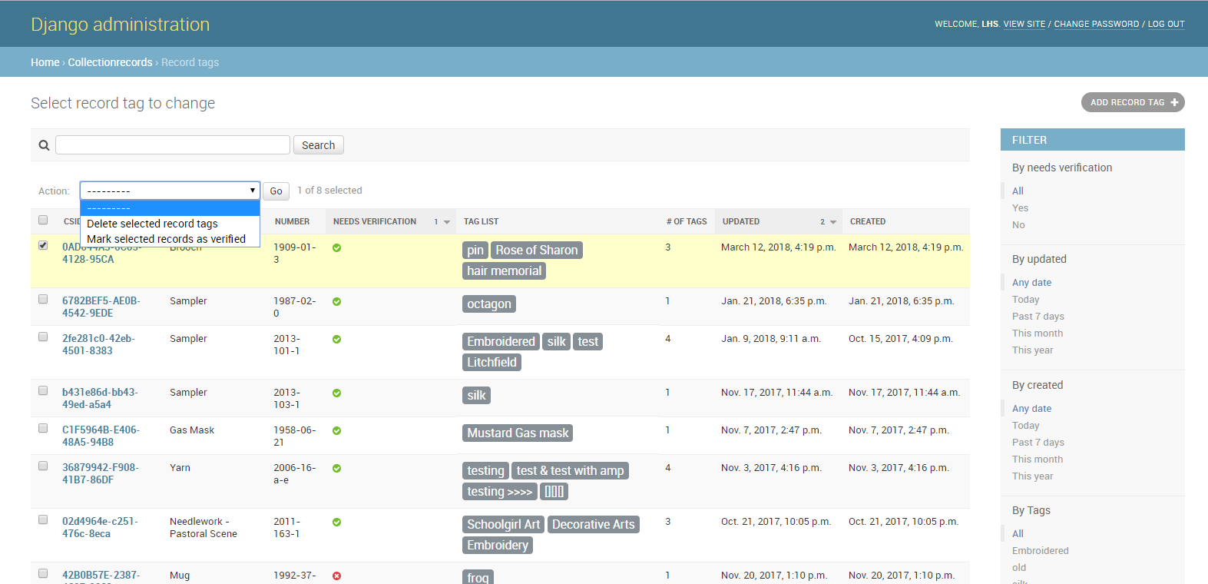

Slide 14
Single Source Authority File

