Slide 1
We’ve Come So Far!
Data Migration and Cleanup at the Kenneth Spencer Research Library
Marcella Huggard
Manuscripts coordinator
ArchivesSpace 2023 Member Forum
July 26, 2023, Washington, D.C.

Slide 2
Agenda
About the Kenneth Spencer Research Library
Where we started
Importing and cleaning up accessions
Importing EADs
Cleaning up resource records
Cleaning up other data
Where we’re going

Slide 3
About us
Kenneth Spencer Research Library
Collecting areas:
Kansas Collection (started around 1901)
Special Collections (started in 1950s)
University Archives (established 1969)
Wilcox Collection of Contemporary Political Movements (established 1965)

Slide 4
Where We Started
2013: created locally hosted instance
By 2014, importing accession records and EADXML finding aids

Slide 5
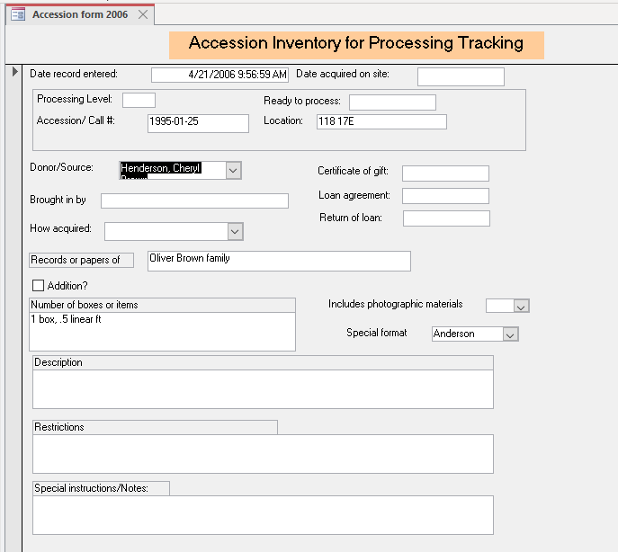
Accessions

Slide 6
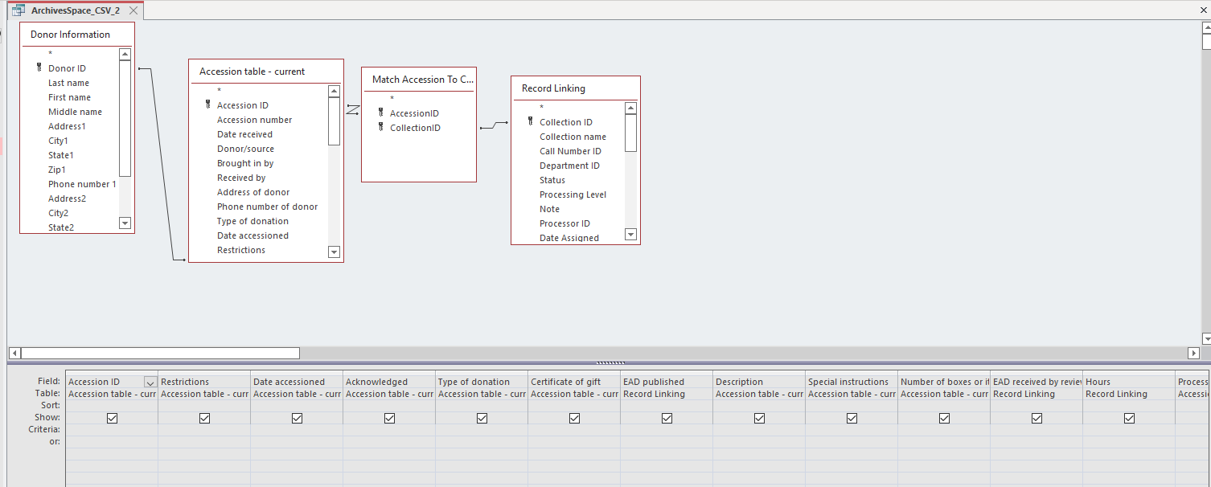
Accessions

Slide 7
Accessions

Slide 8
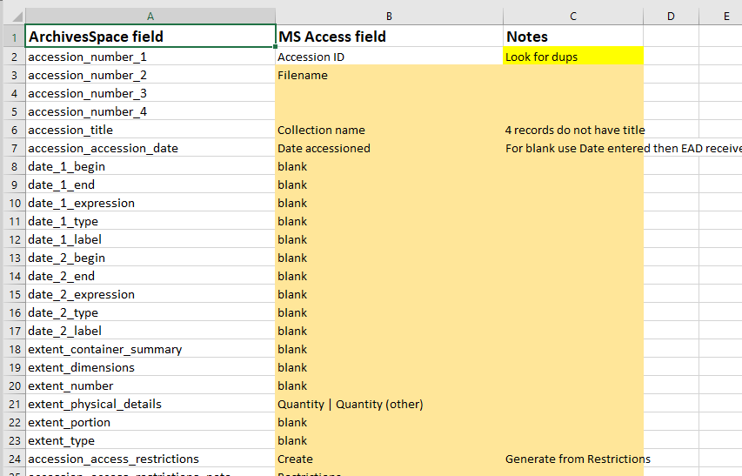
Accessions

Slide 9
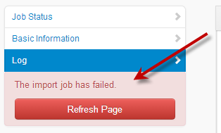
EADXML import

Slide 10
Why import errors?
NoteTab Pro
Templates and students playing Telephone
Forgetting about stylesheets
Physical and intellectual hierarchy issues

Slide 11
EAD import failures
Extents issues:
Error: #<:ValidationException: {:errors=>{"extents"=>["At least 1 item(s) is required"]}}>
Hierarchy issues:
Error: #<:ValidationException: {:errors=>{"dates"=>["one or more required (or enter a Title)"], "title"=>["must not be an empty string (or enter a Date)"]}}>
Container types issues:
Error: Problem creating 'Correspondence': Invalid value: item

Slide 12
EAD import failures Extents
<physdesc><extent label="Quantity:" encodinganalog="300$a"> 1p. 28cm. <physfacet>Typewritten, signed by Walt Snell, President. Enclosure: brochure on the Kansas Wildlife Federation. </physfacet></extent></physdesc>
<physdesc><extent label="Quantity:" encodinganalog="300$a"> 2v. (unpaged) sizes vary. </extent></physdesc>

Slide 13
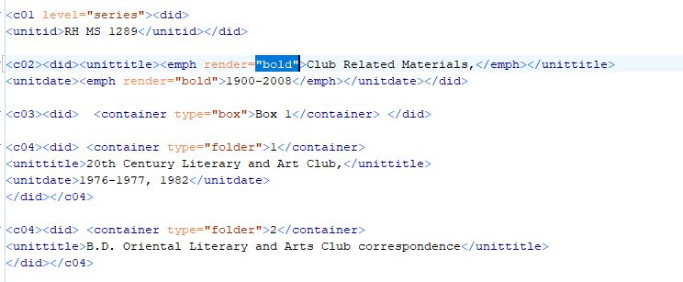
EAD import failures Hierarchy issues

Slide 14
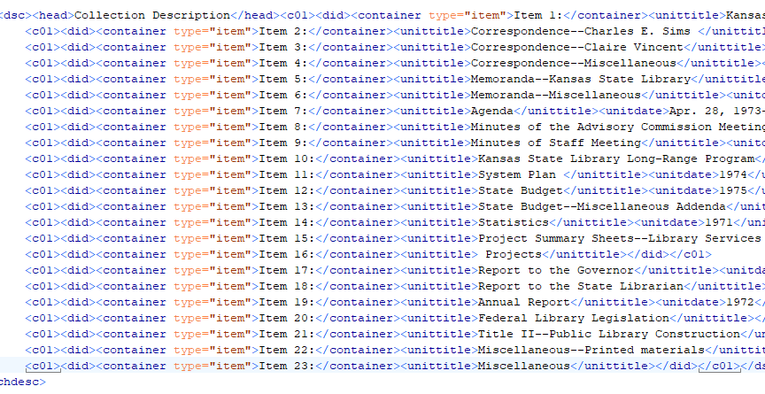
EAD import failures Container types
Workaround:
<container type=“item “> - note the space before the second quotation!
(but also, why were these being listed as items…?)

Slide 15
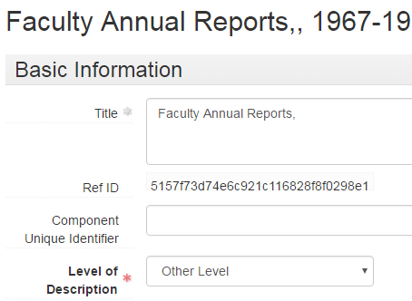
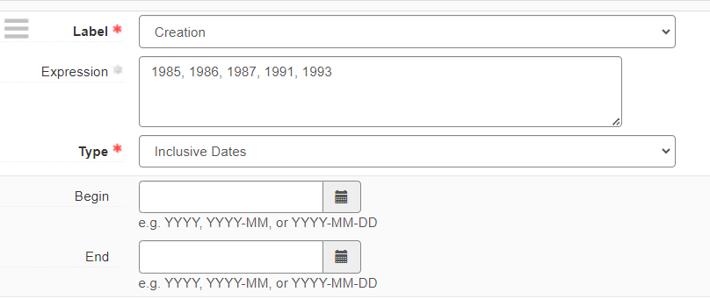
Not failures, just issues

Slide 16
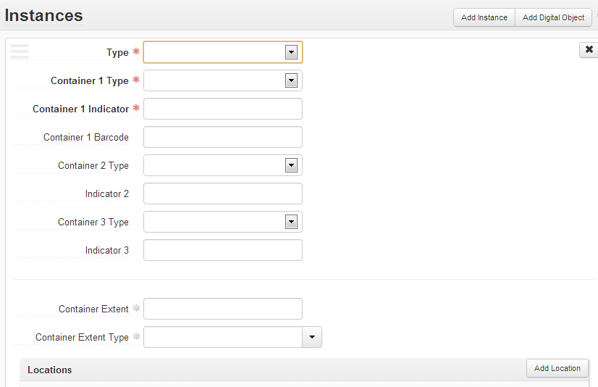
AS 1.5 container update

Slide 17
Instances cleanup

Slide 18
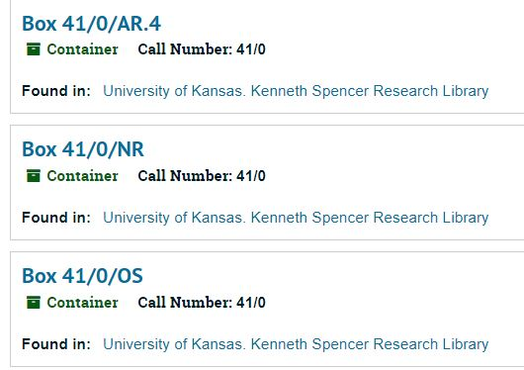
Instances cleanup

Slide 19
Lack of containers

Slide 20
Other cleanup needed
Subject headings
Agent records
Collection management issues external to ArchivesSpace

Slide 21
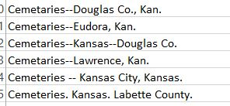
Subject headings

Slide 22
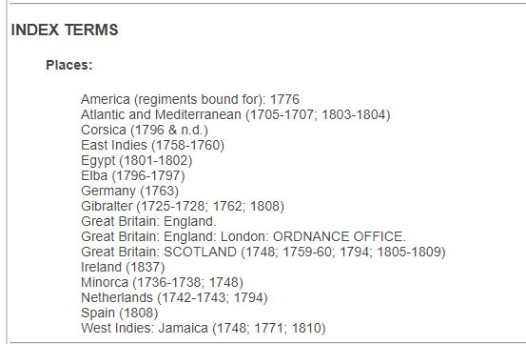
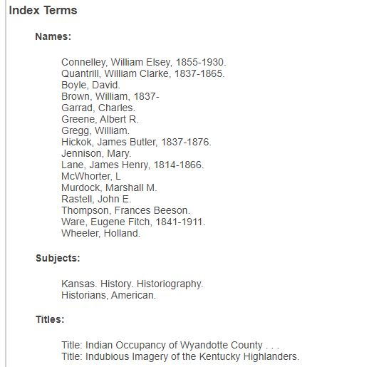
Subject headings

Slide 23
And then the pandemic happened

Slide 24
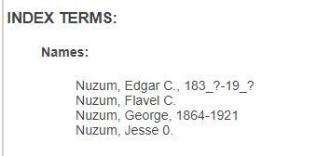
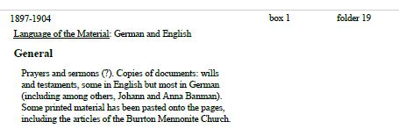
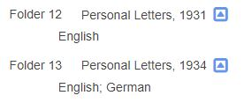
Cleanup ramped up

Slide 25
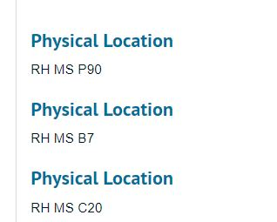
Cleanup ramped up
Check out ArchivesSpace’s YouTube channel
for “Someday is Here! ArchivesSpace Projects for Working from Home,” recorded June 3, 2020

Slide 26
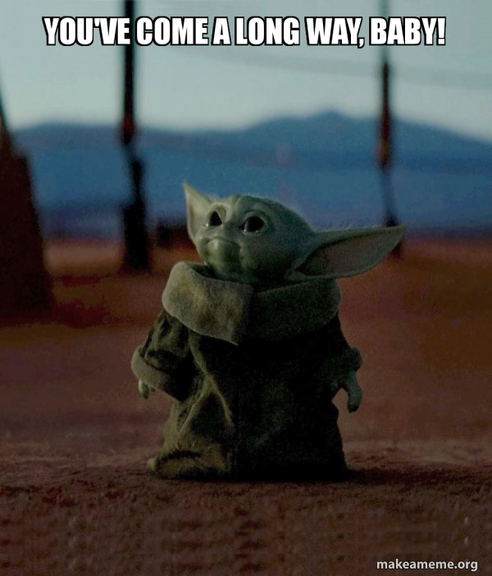
Going forward

Slide 27
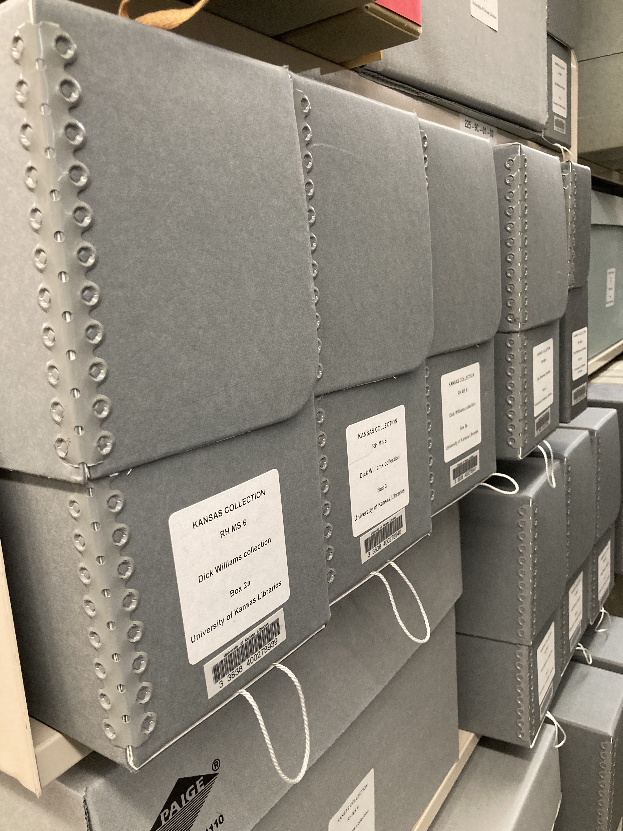
Future projects

Slide 28
Thank you!
Marcella Huggard
mhuggard@ku.edu

