Slide 1
Temporary Spaces:
Leveraging ArchivesSpace Container Management Functionality to Develop New Circulation Workflows
ArchivesSpace 9th Annual Member Forum
July 26, 2023
Kate Morris, James Madison University

Slide 2
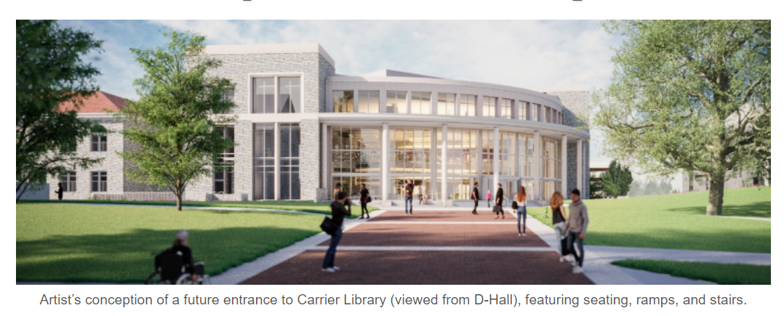
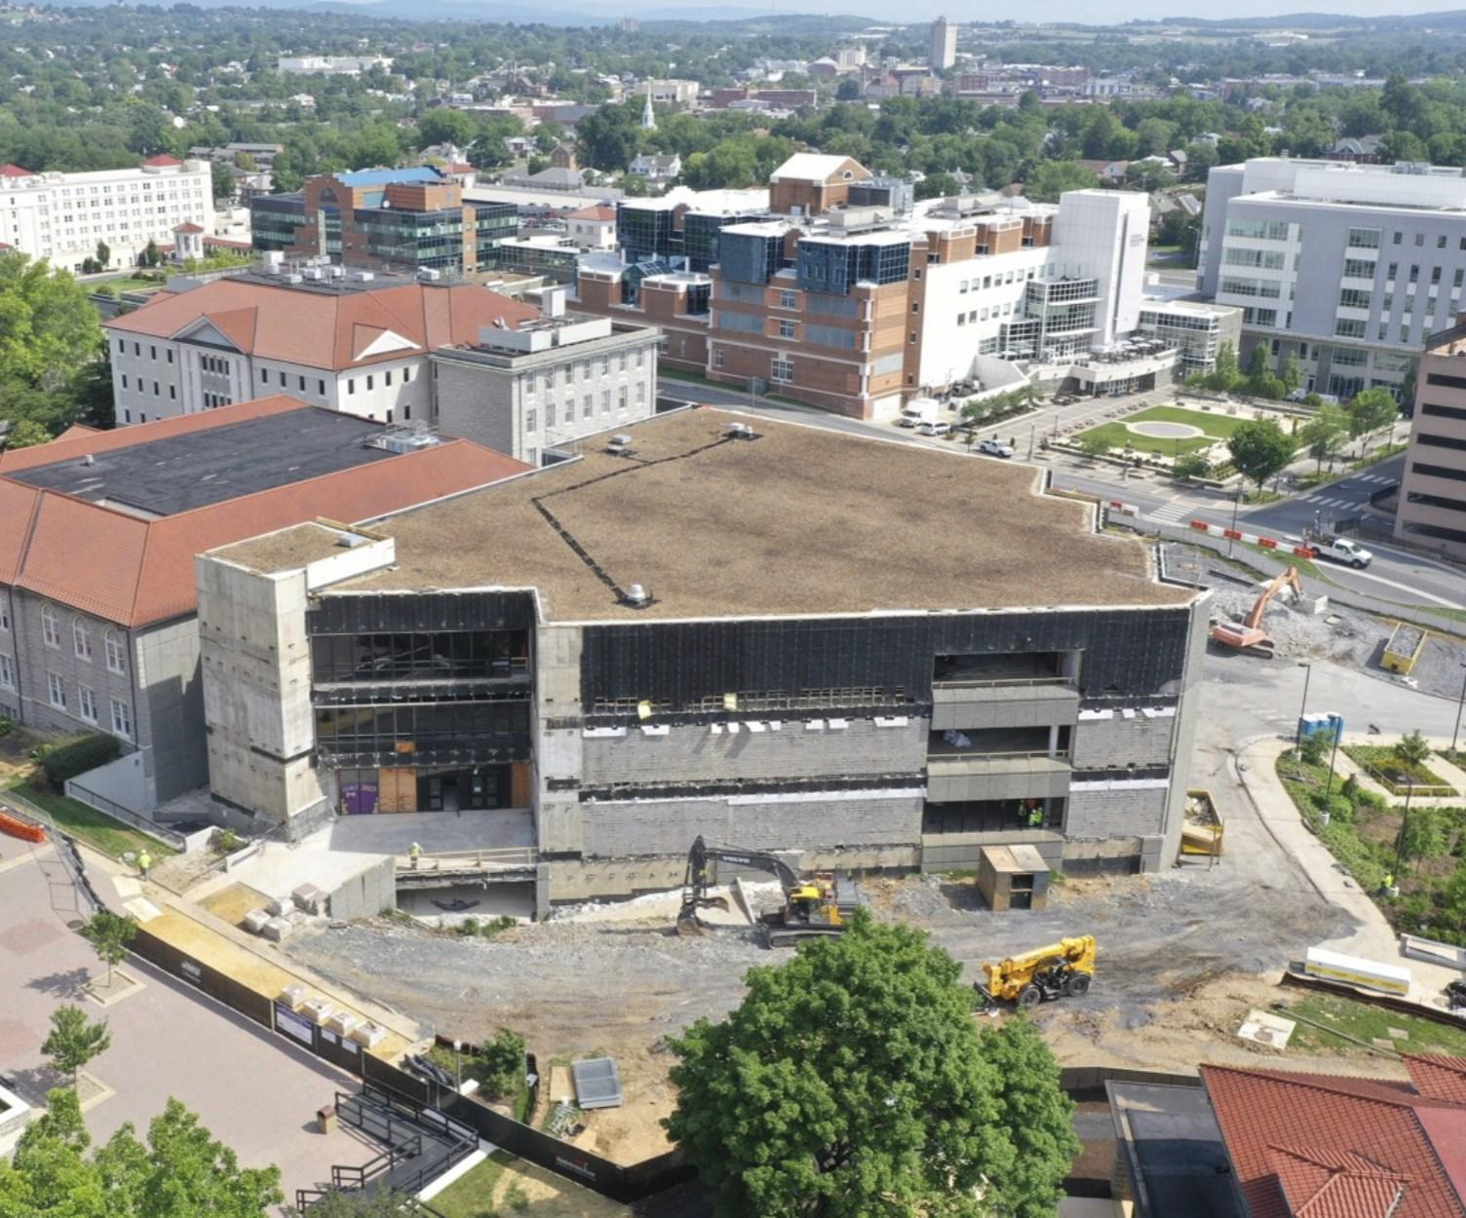
Carrier Library Renovation and Expansion

Slide 3
Recap: previous project accomplishments
August 2022 through April 2023:
Created and applied container profiles to all top containers + image glossary of 60+ top containers
Barcoded all top containers
Merged top containers for boxed-with collections
Selectively created locations
Completed data remediation to correct locations as top containers

Slide 4
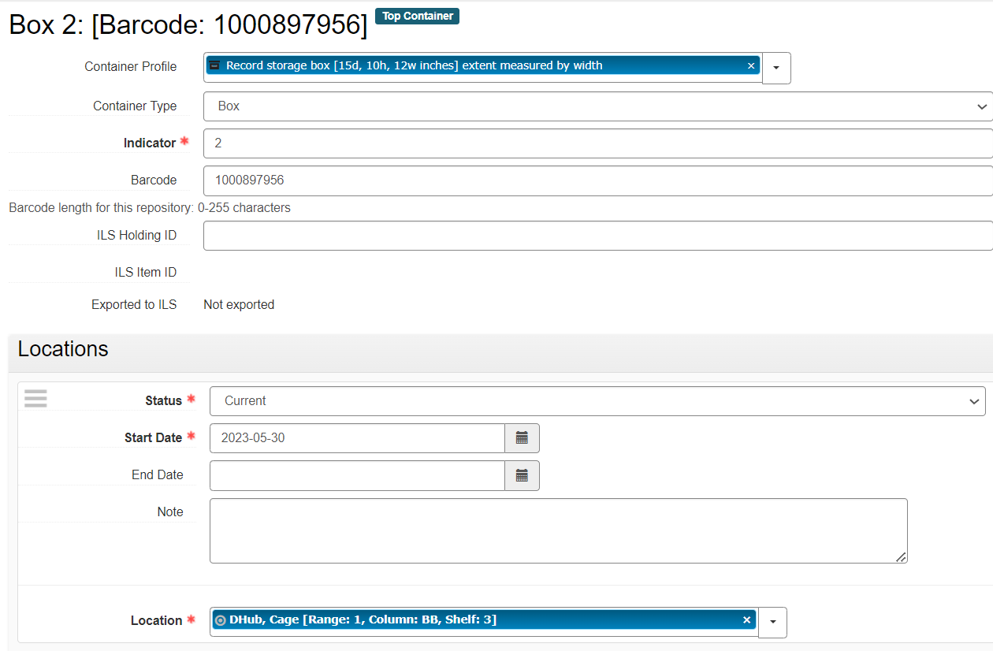
Container profiles & location data

Slide 5
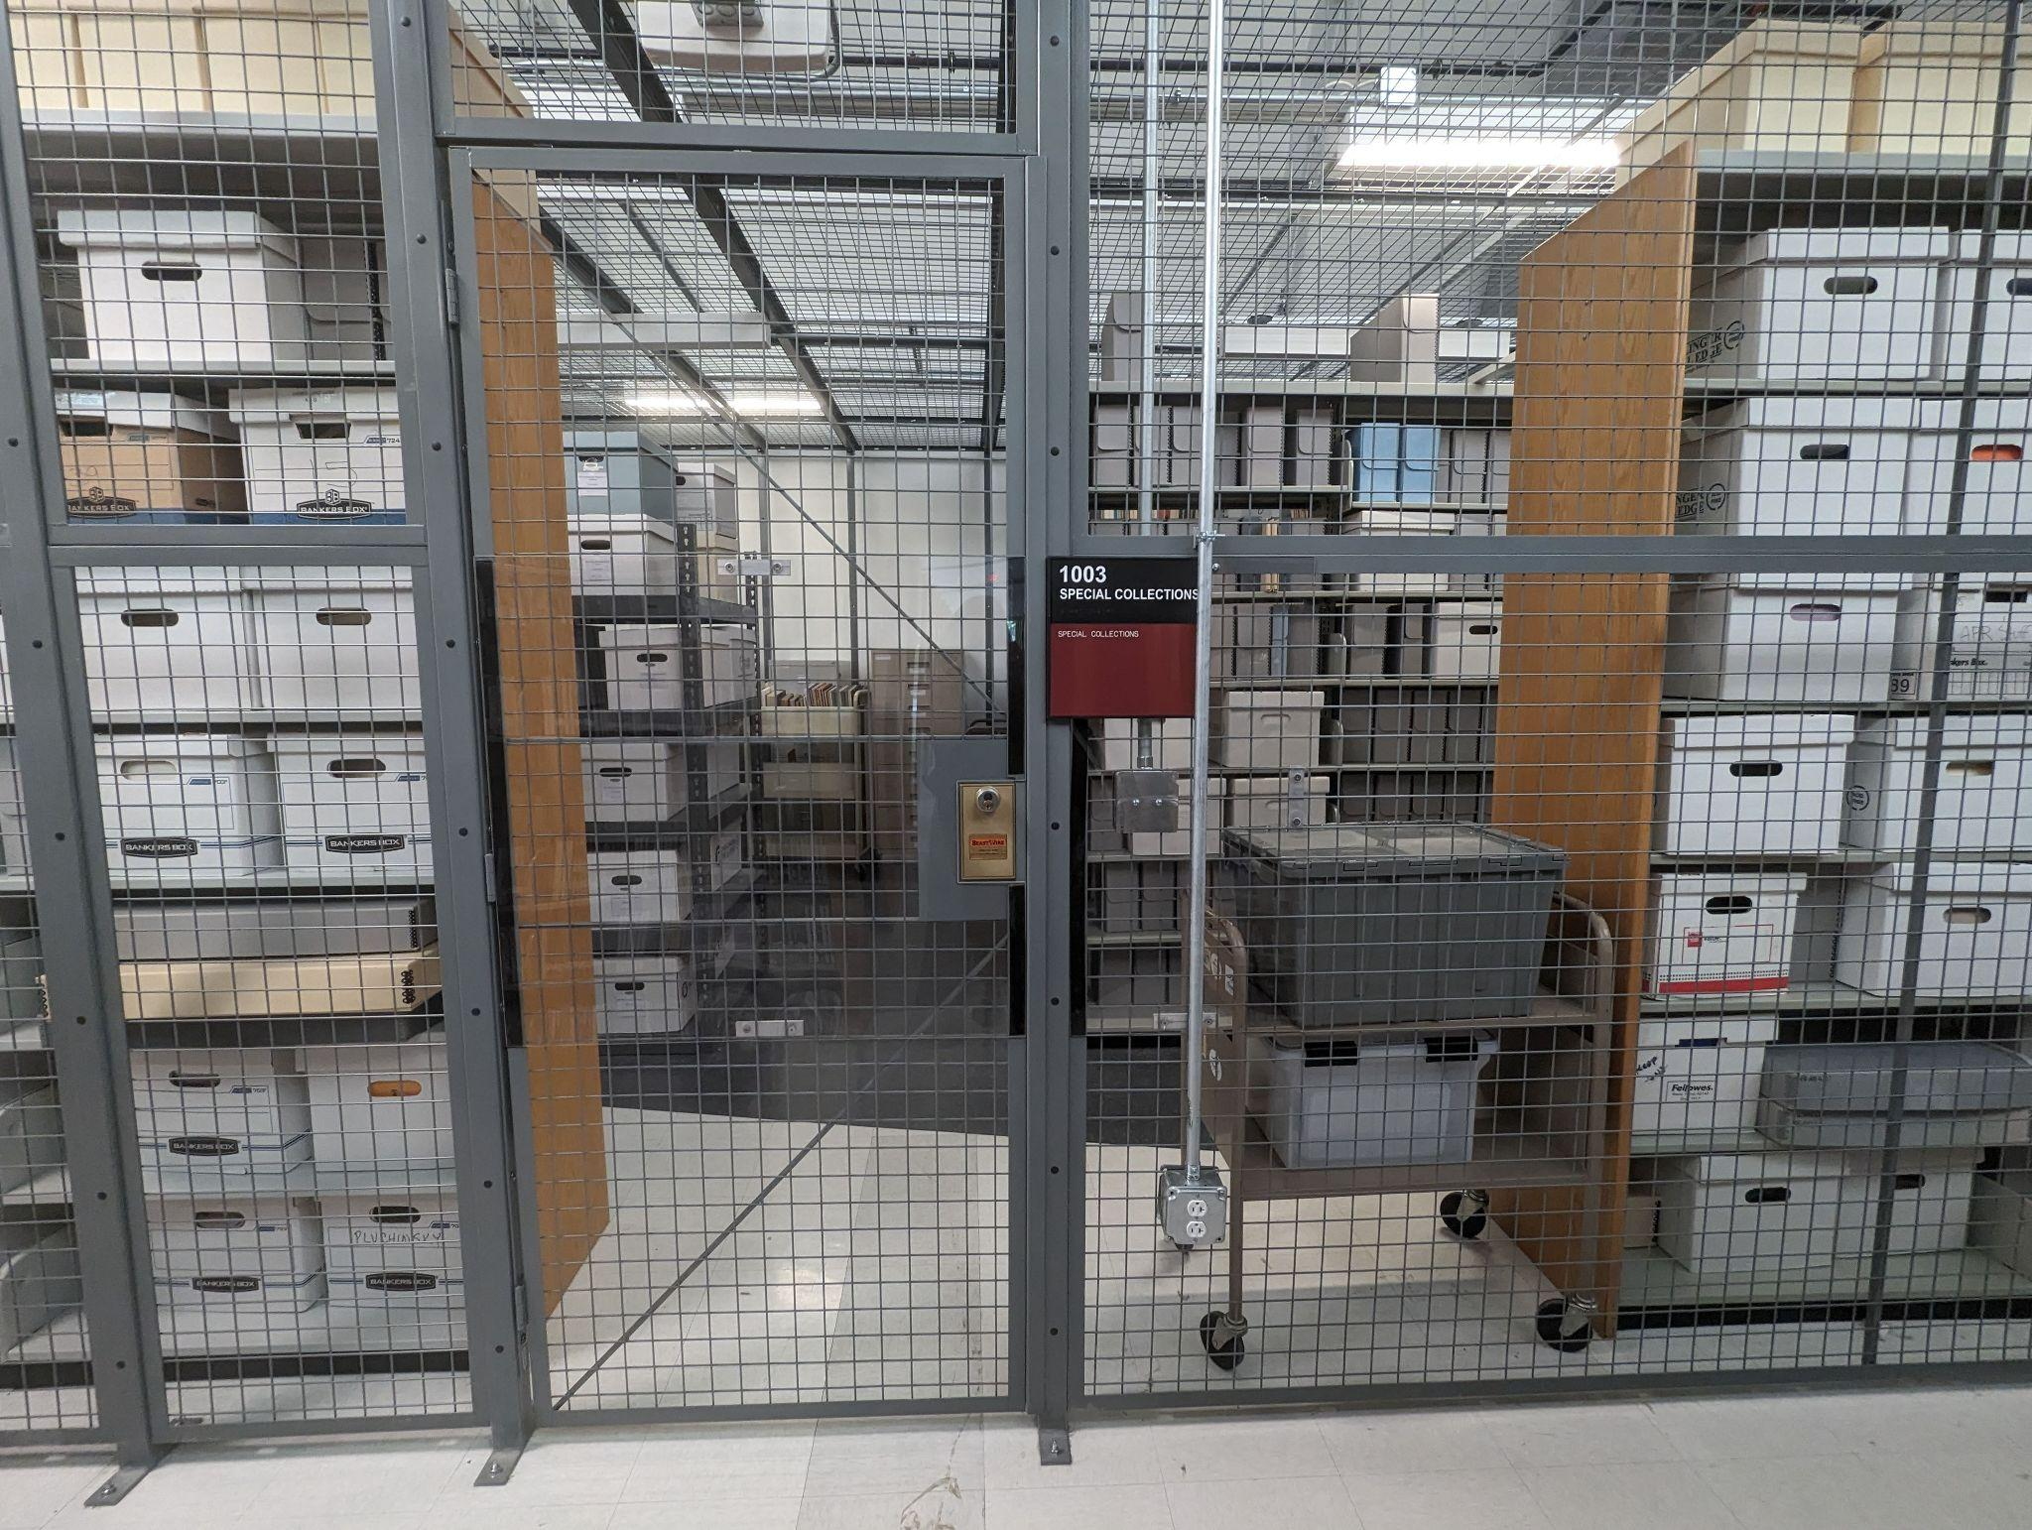
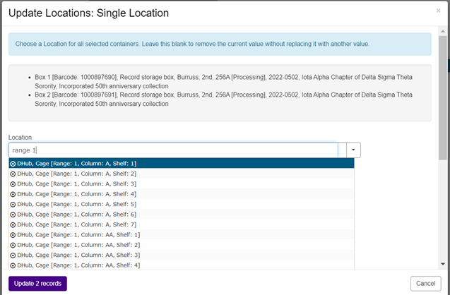
Update Locations: Single Location

Slide 6
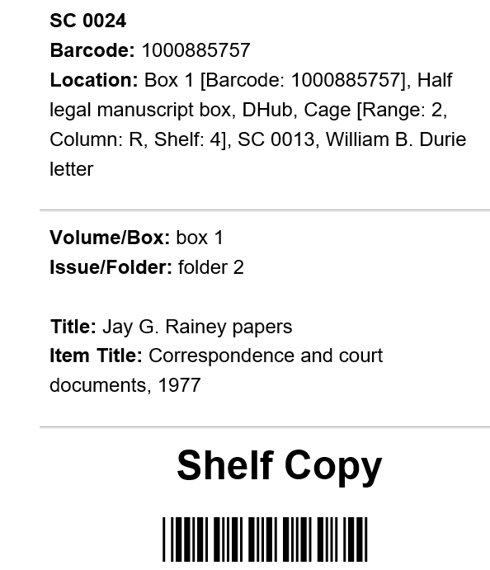
Location data within Aeon call slip
Location:
Box 1 [Barcode: 1000885757],
Half legal manuscript box,
Dhub, [Range: 2, Column: R, Shelf: 4],
SC 0013, William B. Durie letter

Slide 7
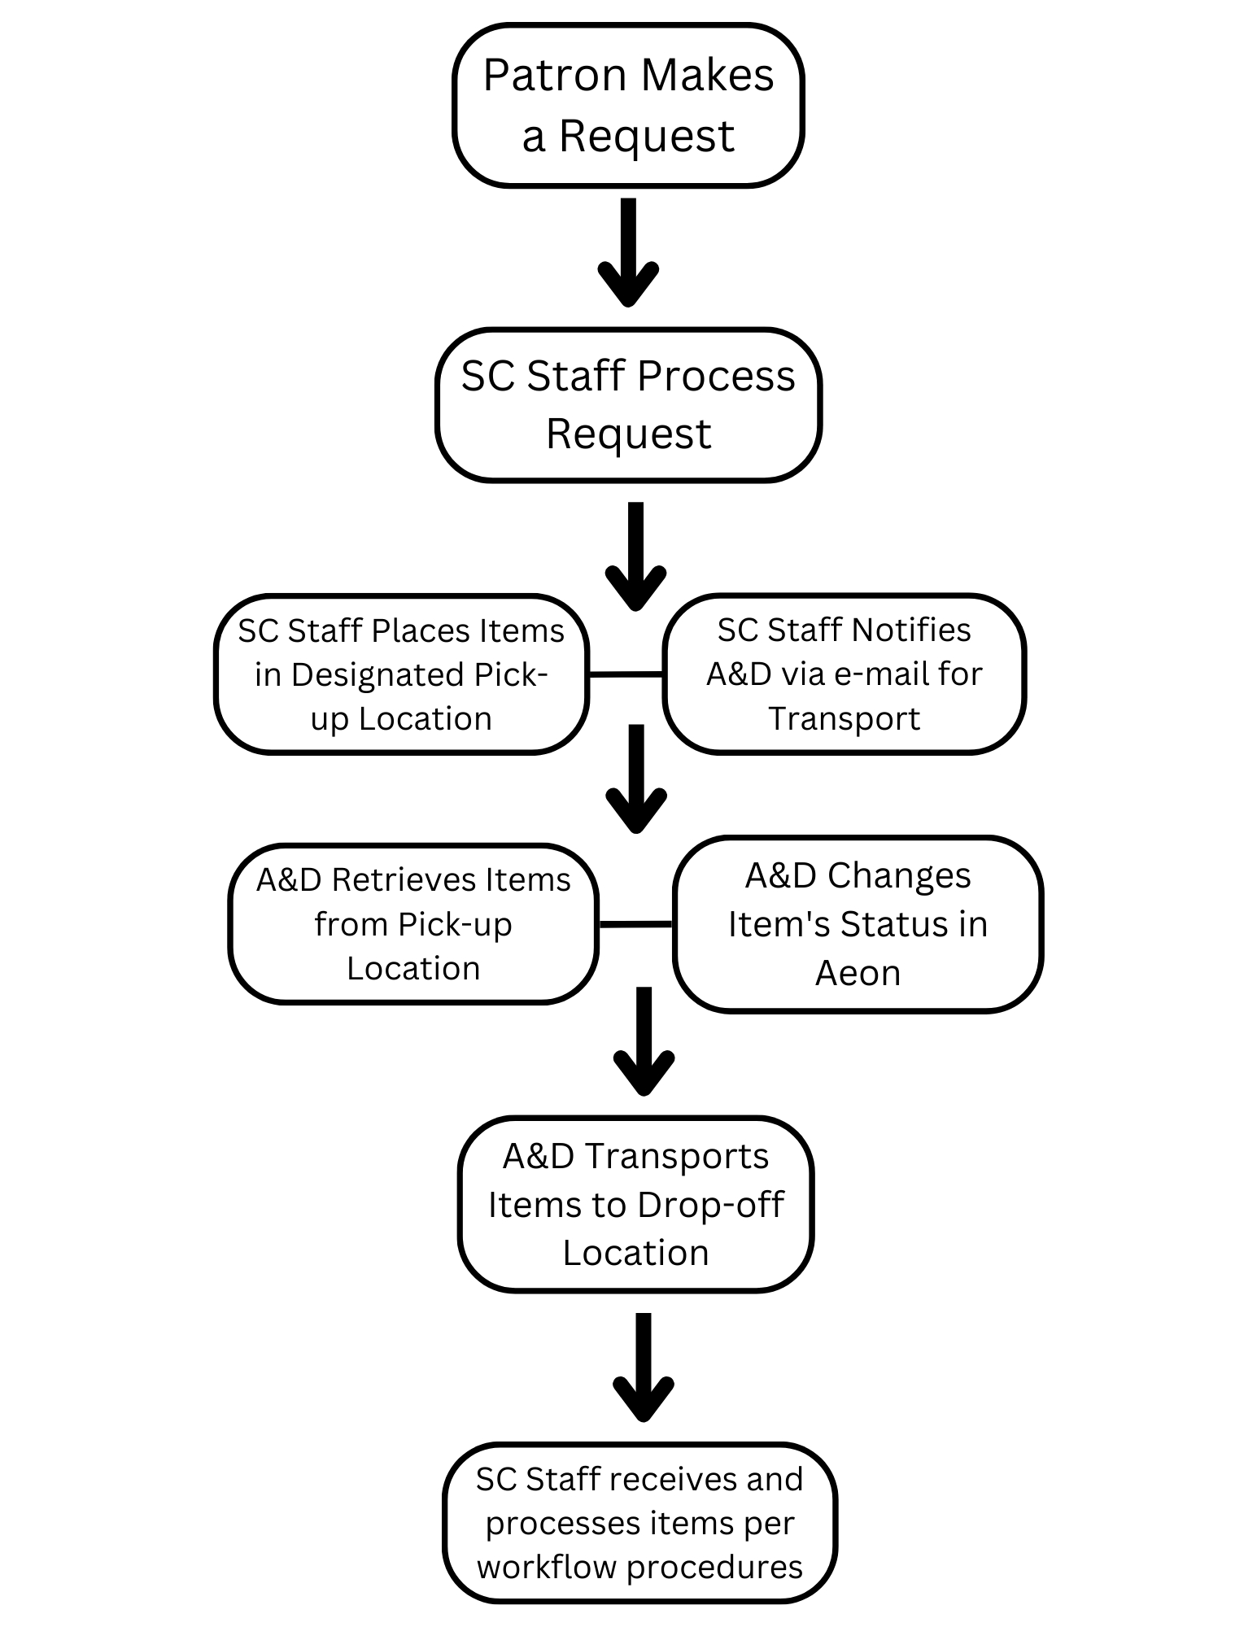
New circulation workflow

Slide 8
Aeon email template
Dear Access & Delivery department,
Aeon TN: <#Request.TransactionNumber>
Container information: <#Request.Location>
Call Number: <#Request.CallNumber>
Title: <#Request.ItemTitle>
A Special Collections request is ready for pickup in The Hub.

Slide 9
Aeon email notification
Aeon TN: 5548
Container information: Box OV 1 [Barcode: 1000898446], Oversize flat box 4, DHub [Range: 2, Column: M, Shelf: 7], UA 0007, Student Government Association Records, Series 10
Call Number: UA 0007
Title: Student Government Association Records

Slide 10
Aeon email notification
Aeon TN: 5548
Container information: Box OV 1 [Barcode: 1000898446], Oversize flat box 4, DHub [Range: 2, Column: M, Shelf: 7], UA 0007, Student Government Association Records, Series 10
Call Number: UA 0007
Title: Student Government Association Records

Slide 11
Aeon email notification
Aeon TN: 5548
Container information: Box OV 1 [Barcode: 1000898446], Oversize flat box 4
Call Number: UA 0007
Title: Student Government Association Records

Slide 12
What’s next?
Testing the circulation workflow!
Aeon ArchivesSpace Client Addon - integrates the ArchivesSpace staff interface into the Aeon Client request form so that staff can search the records of their ArchivesSpace instance and import details into Aeon requests.

Slide 13
Thank you.
Questions or suggestions are welcome:
morriskn@jmu.edu

