Slide 1
Training and managing multiple ArchivesSpace repositories at a very large institution
Bri McLaughlin, she/her
Digital Collections Librarian
Indiana University
brijmcla@iu.edu

Slide 2
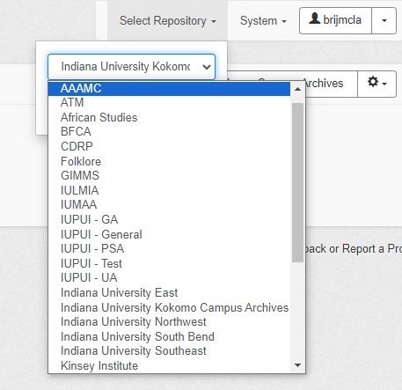
Indiana University
7 campuses*
31 repositories
* 9 campuses including regional centers in Columbus and Fort Wayne Image from https://collegeready.indiana.edu/resources/passport/index.html

Slide 3
Training materials timeline

Slide 4
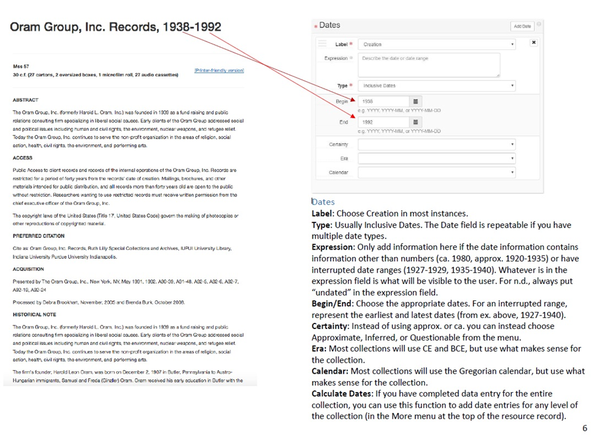
Basic documentation

Slide 5
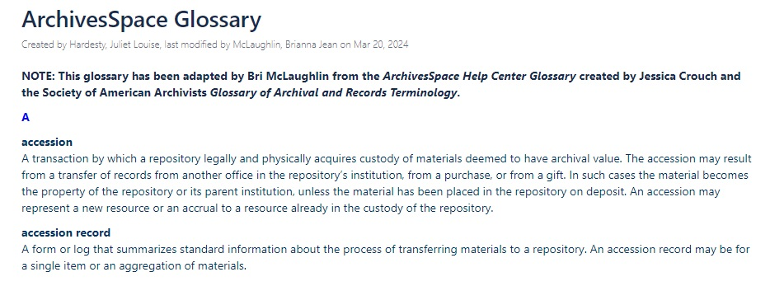
glossary

Slide 6
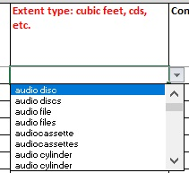
Spreadsheet importer

Slide 7
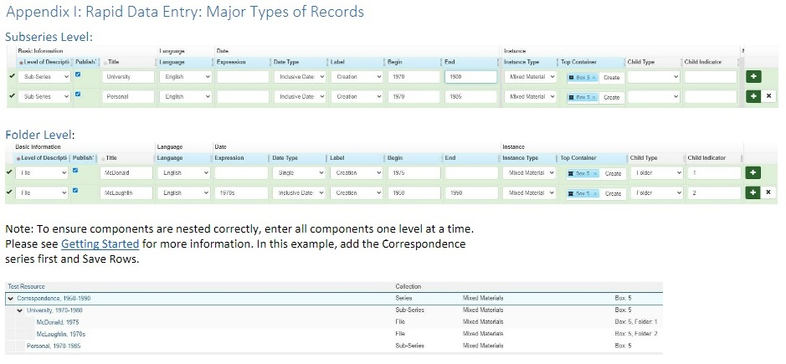
Rapid Data entry

Slide 8
Demo videos

Slide 9
What data entry tool should I use? method should I use? Decision tree

Slide 10
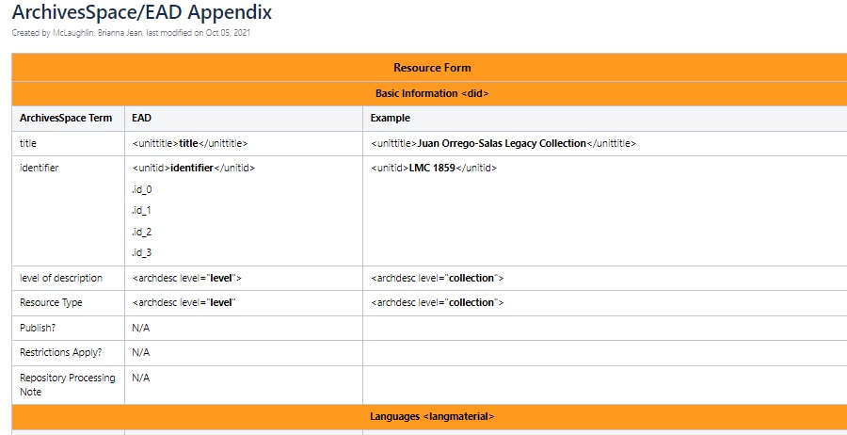
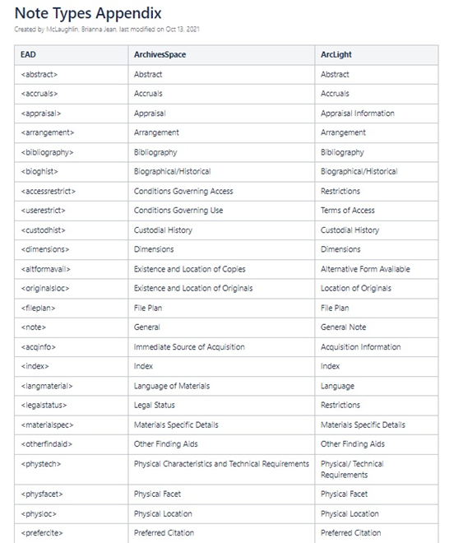
Ead appendices

Slide 12
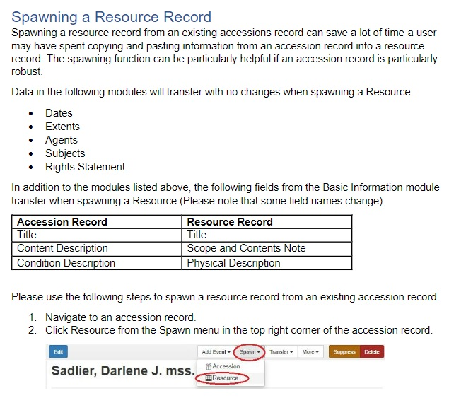
Accessions

Slide 13
PHEW!

Slide 14
Training schedule
Introduction meeting—getting to know you and your collections
Give access to ArchivesSpace home repository and training repository
Provide ALL the resources
Guided tour through ArchivesSpace
Sandbox time
Follow up as needed

Slide 15
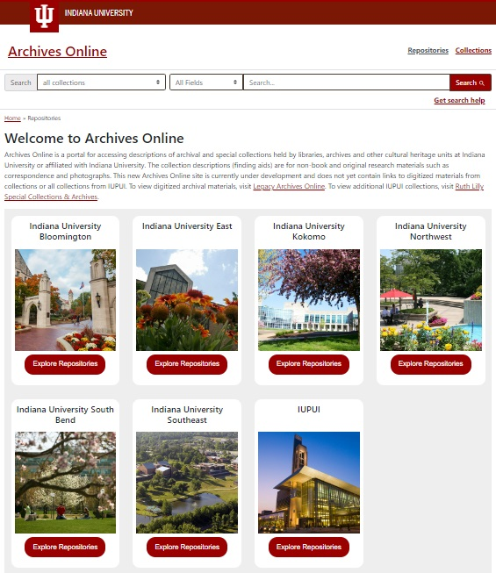
IU archives and special collections community

Slide 16
Links to documentation
ArchivesSpace documentation and demo videos
Basic ArchivesSpace
Spreadsheet importer
RDE documentation
Managing Component Lists
Accessions
Which data entry method should I use? decision tree
Should I create a new subject or agent in ArchivesSpace? decision tree
Demo/tutorial videos
Note types appendix
ArchivesSpace to EAD appendix

Slide 17
Thank you!
Bri McLaughlin, she/her
Indiana University
Email: brijmcla@iu.edu

