Slide 1
Writing ArchivesSpace plugins: a reasonably comprehensive introduction
Kevin Clair (@jackflaps)
University of Denver
ArchivesSpace User Group Meeting
2016 August 2

Slide 2
Housekeeping
ArchivesSpace is set up on all the lab computers (folder is on the desktop)
Or follow along on your personal computers if you have them

Slide 3
Agenda
What plugins are
Overview of ArchivesSpace application structure
Break
Plugin example #1: Adding a custom logo to your site
Plugin example #2: Extending ArchivesSpace data models
Break
Some other stuff
Open lab and questions

Slide 4
What plugins can do
Notes:
Plugins are extensions to the ArchivesSpace code base, used for local customizations to your ArchivesSpace instance. They can be used for:
Implementing changes to the look and feel of your frontend or public interface
Adding new elements to an ArchivesSpace data model, or new data models entirely
Adding new functionality to an ArchivesSpace instance

Slide 5
What plugins can do
Implement changes to the appearance of your site
Notes:
Plugins are extensions to the ArchivesSpace code base, used for local customizations to your ArchivesSpace instance. They can be used for:
Implementing changes to the look and feel of your frontend or public interface
Adding new elements to an ArchivesSpace data model, or new data models entirely
Adding new functionality to an ArchivesSpace instance

Slide 6
What plugins can do
Implement changes to the appearance of your site
Add new elements to an ArchivesSpace JSON schema
Notes:
Plugins are extensions to the ArchivesSpace code base, used for local customizations to your ArchivesSpace instance. They can be used for:
Implementing changes to the look and feel of your frontend or public interface
Adding new elements to an ArchivesSpace data model, or new data models entirely
Adding new functionality to an ArchivesSpace instance

Slide 7
What plugins can do
Implement changes to the appearance of your site
Add new elements to an ArchivesSpace JSON schema
Add new functionality to an ArchivesSpace instance
Notes:
Plugins are extensions to the ArchivesSpace code base, used for local customizations to your ArchivesSpace instance. They can be used for:
Implementing changes to the look and feel of your frontend or public interface
Adding new elements to an ArchivesSpace data model, or new data models entirely
Adding new functionality to an ArchivesSpace instance

Slide 8
Pre-requisites
(in decreasing order of importance)
HTML/CSS
Ruby
JavaScript

Slide 9
What you’ll need
Permission to write to your plugins folder

Slide 10
What you’ll need
Permission to write to your plugins folder
Permission to write to your config/config.rb file

Slide 11
What you’ll need
Permission to write to your plugins folder
Permission to write to your config/config.rb file
… or a friendly system administrator with those things

Slide 12
plugins folder
kevinclsmacbook:plugins jackflaps$ ls
aspace-public-formats | lcnaf | next_accession
cat_in_a_box | local | next_resource
digital_object_manager | newrelic | refid_rules

Slide 13
config/config.rb file
# Plug-ins to load. They will load in the order specified
AppConfig[:plugins] = [‘local’, ‘lcnaf’, ‘aspace-public-formats’, ‘next_resource’, ‘next_accession’, ‘digital_object_manager’]

Slide 14
A tour of the plugin folder structure

Slide 15
[+] backend
[+] frontend
[+] public

Slide 16
[+] backend
[+] frontend
[+] public
Controls access to backend functions of ArchivesSpace:
Constructing customized API calls
Database queries

Slide 17
[-] backend
[+] controllers
[+] model
plugin_init.rb
[+] frontend
[+] public
controllers: Define calls to the ArchivesSpace API

Slide 18
[-] backend
[+] controllers
[+] model
plugin_init.rb
[+] frontend
[+] public
model: Database mapping models
(Example: exporting serializations of ArchivesSpace records)

Slide 19
[-] backend
[+] controllers
[+] model
plugin_init.rb
[+] frontend
[+] public
plugin_init.rb: I’ll get to this one in a second

Slide 20
[+] backend
[+] frontend
[+] public
Controls display of the ArchivesSpace staff interface

Slide 21
[+] backend
[-] frontend
[+] assets
[+] controllers
[+] locales
[+] views
plugin_init.rb
routes.rb
[+] public
assets: Static files used by the application (images, CSS, etc.)

Slide 22
[+] backend
[-] frontend
[+] assets
[+] controllers
[+] locales
[+] views
plugin_init.rb
routes.rb
[+] public
controllers: functions that the staff interface performs

Slide 23
[+] backend
[-] frontend
[+] assets
[+] controllers
[+] locales
[+] views
plugin_init.rb
routes.rb
[+] public
locales: Controls application form field labels

Slide 24
[+] backend
[-] frontend
[+] assets
[+] controllers
[+] locales
[+] views
plugin_init.rb
routes.rb
[+] public
views: Templates for displaying pages in the staff interface

Slide 25
[+] backend
[-] frontend
[+] assets
[+] controllers
[+] locales
[+] views
plugin_init.rb
routes.rb
[+] public
plugin_init.rb: A ruby script to initialize the plugin, if needed

Slide 26
[+] backend
[-] frontend
[+] assets
[+] controllers
[+] locales
[+] views
plugin_init.rb
routes.rb
[+] public
routes.rb: A ruby script to make sure links to controller actions go to the right place

Slide 27
routes.rb example
https://github.com/duspeccoll/next_accession/blob/master/frontend/routes.rb

Slide 28
plugin_init.rb example
https://github.com/duspeccoll/next_accession/blob/master/frontend/plugin_init.rb

Slide 29
[+] backend
[+] frontend
[+] public
Controls the appearance and behavior of your ArchivesSpace public site

Slide 30
[+] backend
[+] frontend
[-] public
[+] assets
[+] controllers
[+] locales
[+] views
plugin_init.rb
... this is structured almost identically to the frontend sub-folder

Slide 31
Break

Slide 32
First plugin: Adding a custom logo to your site

Slide 33
First plugin: Adding a custom logo to your site
Copy the desired logo to frontend/assets/images:
kevinclsmacbook:local jackflaps$ mkdir –p frontend/assets/images
kevinclsmacbook:local jackflaps$ cp ~/UniversityOfDenver-Signature.png frontend/assets/images
kevinclsmacbook:local jackflaps$ ls –l frontend/assets/images
total 16
-rw-r—r-- 1 jackflaps staff 7517 Jul 1 11:41 UniversityOfDenver-Signature.png
kevinclsmacbook:local jackflaps$

Slide 34
First plugin: Adding a custom logo to your site
frontend/views/site/_branding.html.erb:
<div class=“container branding”>
<img src=“/assets/images/UniversityOfDenver-Signature.png”/>
</div>

Slide 35
First plugin: Adding a custom logo to your site
Before…

Slide 36
First plugin: Adding a custom logo to your site
…and after

Slide 37
First plugin: Adding a custom logo to your site
…and after
(don’t forget to change the public site, too!)

Slide 38
Second plugin: Creating custom record exports

Slide 39
Second plugin: Creating custom record exports
Use case: Populating an 001 local control field in the MARC representation of a Resource with its ILS local identifier for matching

Slide 40
1. Assign the local control number to a field
We use user_defined => string_2:

Slide 41
2. Extend the default ArchivesSpace MARC exporter
backend/model/du_marc_exporter.rb:
def _root(marc, xml)
[…]
xml.controlfield(:tag => ‘001’) {
xml.text marc.local_controlfield_string
} unless marc.local_controlfield_string.nil?
[…]
end

Slide 42
2. Extend the default ArchivesSpace MARC exporter
backend/model/du_marc_exporter.rb:
def _root(marc, xml)
[…]
xml.controlfield(:tag => ‘001’) {
xml.text marc.local_controlfield_string
} unless marc.local_controlfield_string.nil?
[…]
end
The model is where marc.local_controlfield_string is populated, so…

Slide 43
3. Connect the exporter’s local_controlfield_string variable to our user defined string
backend/model/du_marc_model.rb:
attr_accessor :leader_string
attr_accessor :controlfield_string
attr_accessor :local_controlfield_string

Slide 44
3. Connect the exporter’s local_controlfield_string variable to our user defined string
backend/model/du_marc_model.rb:
def self.from_resource(obj)
[…]
if obj.has_key?(‘user_defined’)
marc.local_controlfield_string = obj[‘user_defined’][‘string_2’] if obj[‘user_defined’].has_key?(‘string_2’)
end
[…]
end

Slide 45
4. Success!
kevinclsmacbook:~ jackflaps$ curl –s –H “X-ArchivesSpace-Session:[SESSION]” http://localhost:8089/repositories/2/resources/marc21/681.xml
<?xml version=“1.0” encoding=“UTF-8”?>
<collection>
<record>
<leader>00000npcaa22000000 i 4500</leader>
<controlfield tag=“001”>99154021502766</controlfield>
[a bunch more MARCXML]
</record>
</collection>

Slide 46
4. Success!
kevinclsmacbook:~ jackflaps$ curl –s –H “X-ArchivesSpace-Session:[SESSION]” http://localhost:8089/repositories/2/resources/marc21/681.xml
<?xml version=“1.0” encoding=“UTF-8”?>
<collection>
<record>
<leader>00000npcaa22000000 i 4500</leader>
<controlfield tag=“001”>99154021502766</controlfield>
[a bunch more MARCXML]
</record>
</collection>

Slide 47
Third plugin: Extending a data model

Slide 48
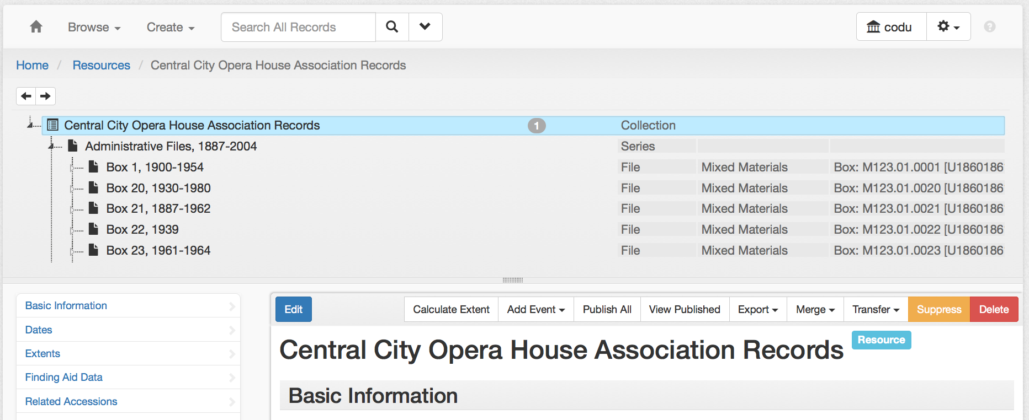
Third plugin: Extending a data model
Use case: Displaying component IDs in the tree view for all archival objects

Slide 49
1. Add a component_id field to the resource_tree data model

Slide 50
1. Add a component_id field to the resource_tree data model
Consult ArchivesSpace schema: https://github.com/archivesspace/archivesspace/tree/master/common/schemas

Slide 51
1. Add a component_id field to the resource_tree data model
resource_tree.rb
{
:schema => {
"$schema" => "http://www.archivesspace.org/archivesspace.json",
"version" => 1,
"type" => "object",
"uri" => "/repositories/:repo_id/resources/:resource_id/tree",
"parent" => "record_tree",
"properties" => {
"finding_aid_filing_title" => {"type" => "string", "maxLength" => 65000},
"level" => {"type" => "string", "maxLength" => 255},
"component_id" => {"type" => "string", "maxLength" => 255},
"instance_types" => {"type" => "array", "items" => {"type" => "string"}},
"containers" => {"type" => "array", "items" => {"type" => "object"}},
"children" => {
"type" => "array",
"additionalItems" => false,
"items" => { "type" => "JSONModel(:resource_tree) object" }
}
},
},
}

Slide 52
1. Add a component_id field to the resource_tree data model
schemas/resource_tree_ext.rb:
{ “component_id” => {“type” => “string”, “maxLength” => 65000 }

Slide 53
2. Populate the field in the backend directory
backend/model/mixins/resource_trees.rb
def load_node_properties(node, properties, ids_of_interest = :all)
[…]
properties[node.id][:component_id] = node.component_id
[…]
end

Slide 54
2. Populate the field in the backend directory
backend/model/mixins/resource_trees.rb
def load_root_properties(node, properties, ids_of_interest = :all)
[…]
properties[:component_id] = self[:id_0]
[…]
end

Slide 55
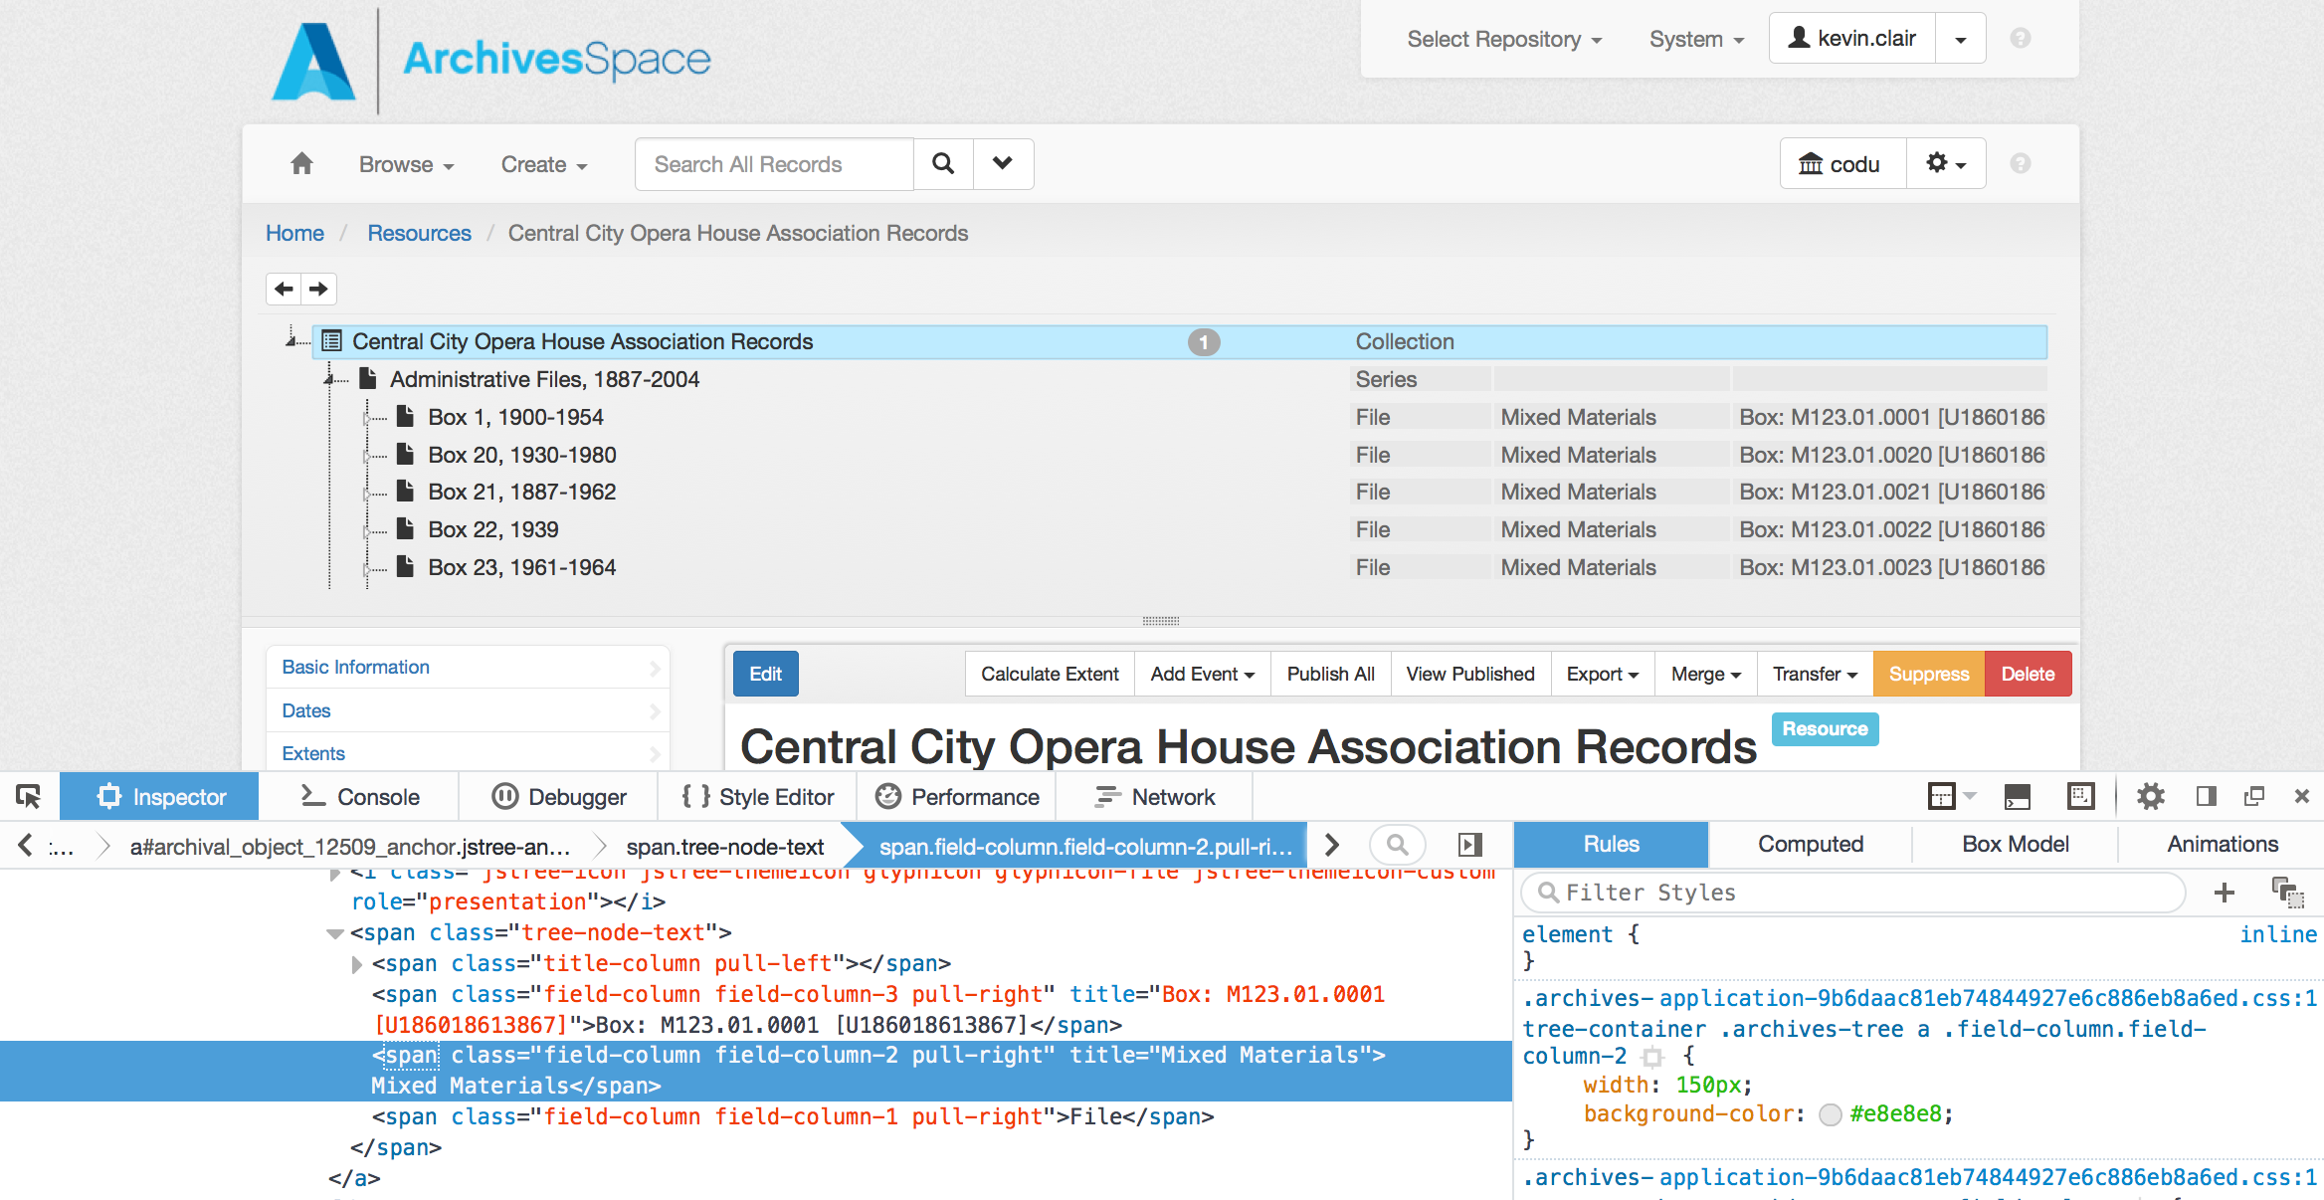
3. Display the component IDs in the frontend directory
Inspect the page to find the source code you want to change

Slide 56
3. Display the component IDs in the frontend directory
frontend/views/shared/_tree.html.erb
[…]
<span class="tree-node-text">
<span class="title-column pull-left">${AS.stripHTML(node.title)|h}</span>
<span class="field-column field-column-3 pull-right" title="${AS.encodeForAttribute(render_container_summary(node))}">${render_container_summary(node)"}</span>
<span class="field-column field-column-2 pull-right" title="${AS.encodeForAttribute(render_instance_types(node))}">${render_instance_types(node)}</span>
<span class="field-column field-column-1 pull-right">${node.level||"&#160;"}</span>
</span>
[…]

Slide 57
3. Display the component IDs in the frontend directory
frontend/views/shared/_tree.html.erb
[…]
<span class="tree-node-text">
<span class="title-column pull-left">${AS.stripHTML(node.title)|h}</span>
<span class="field-column field-column-3 pull-right" title="${AS.encodeForAttribute(render_container_summary(node))}">${render_container_summary(node)"}</span>
<span class="field-column field-column-2 pull-right" title="${AS.encodeForAttribute(render_instance_types(node))}">${render_instance_types(node)}</span>
<span class="field-column field-column-1 pull-right">${node.level||"&#160;"}</span>
</span>
[…]

Slide 58
3. Display the component IDs in the frontend directory
frontend/views/shared/_tree.html.erb
[…]
<span class="tree-node-text">
<span class="title-column pull-left">${AS.stripHTML(node.title)|h}</span>
<span class="field-column field-column-3 pull-right" title="${AS.encodeForAttribute(node.component_id)}">${node.component_id||"&#160;"}</span>
<span class="field-column field-column-2 pull-right" title="${AS.encodeForAttribute(render_instance_types(node))}">${render_instance_types(node)}</span>
<span class="field-column field-column-1 pull-right">${node.level||"&#160;"}</span>
</span>
[…]

Slide 59
4. Allow IDs to refresh in the frontend tree when a record is edited
frontend/views/resources/_edit_inline.html.erb
<% if @refresh_tree_node
node_data = {
[…]
‘component_id’ => @resource.id_0
[…]
}
%>

Slide 60
4. Allow IDs to refresh in the frontend tree when a record is edited
frontend/views/archival_objects/_edit_inline.html.erb
<% if @refresh_tree_node
node_data = {
[…]
‘component_id’ => @archival_object.component_id
[…]
}
%>

Slide 61
5. Success! (hopefully)

Slide 62
Pause for questions

Slide 63
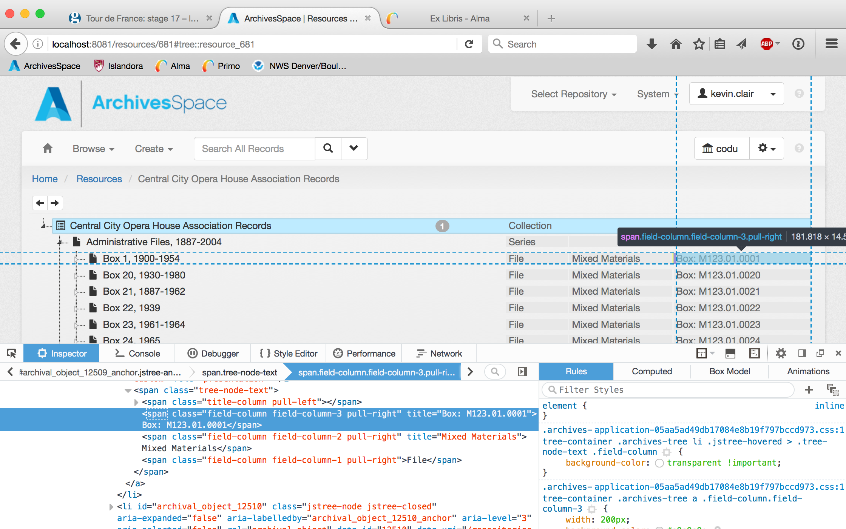
Tips for designing your own
Familiarize yourself with the pages you want to edit

Slide 64
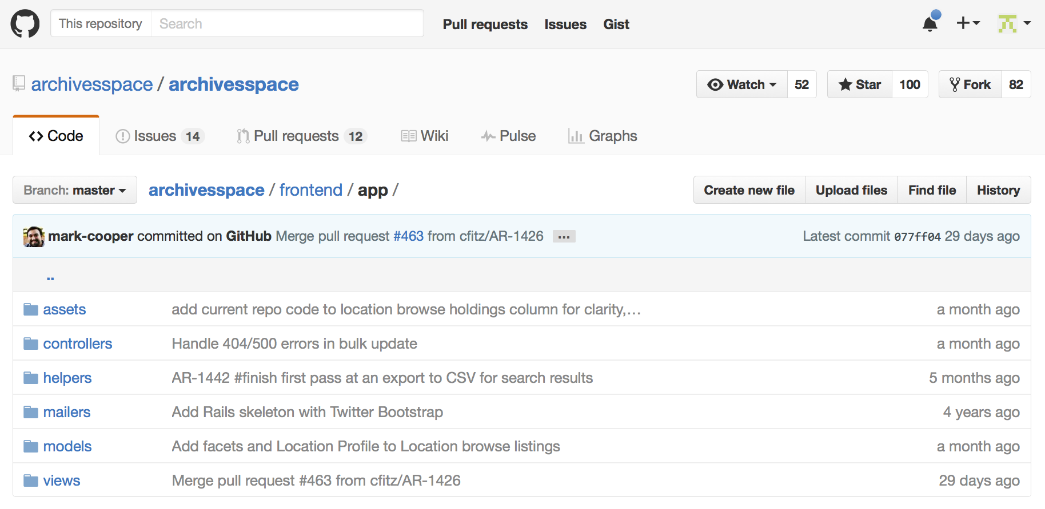
Tips for designing your own
Familiarize yourself with the ArchivesSpace source code

Slide 65
Tips for designing your own
Read this Mark Triggs post: https://teaspoon-consulting.com/articles/archivesspace-plugins.html
See what other people have written: https://archivesspace.atlassian.net/wiki/display/ADC/Plugins+and+Scripts
(ours: https://github.com/duspeccoll)
Ask questions on the lists

