Slide 1
print.css
ArchivesSpace Members Forum
2016-08-02
Mark Custer

Slide 2
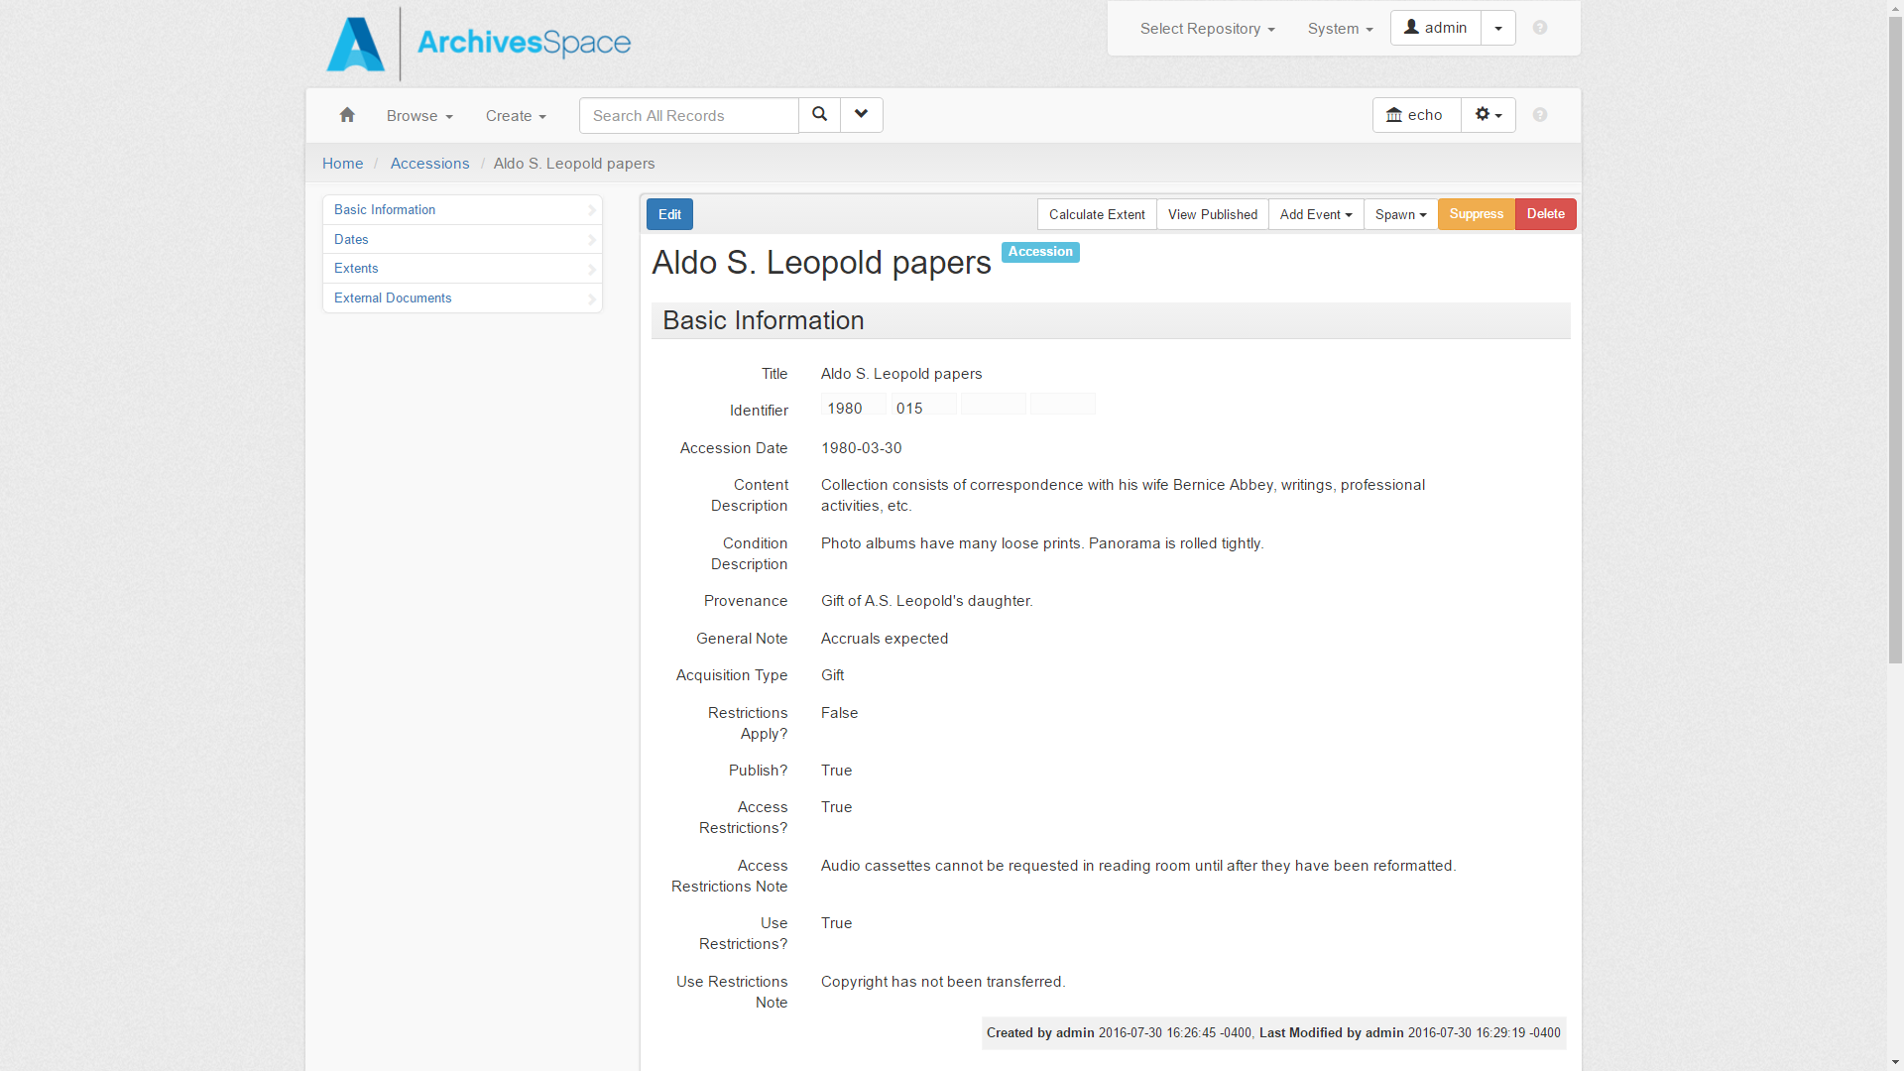

Slide 3
CTRL + P

Slide 4
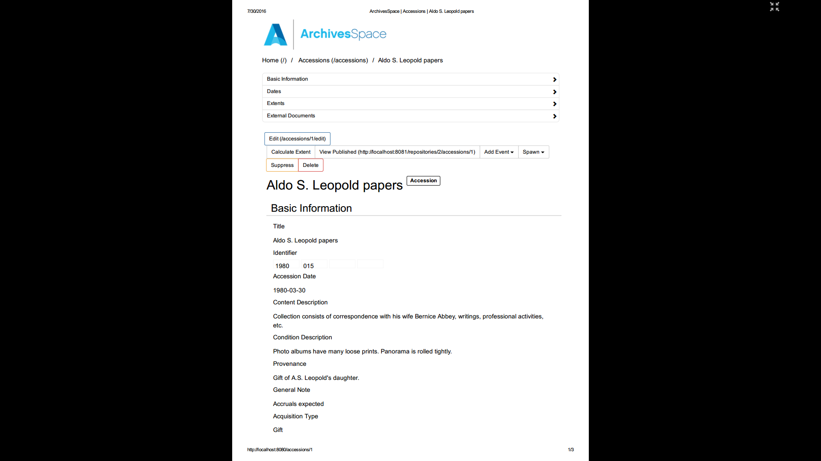

Slide 5
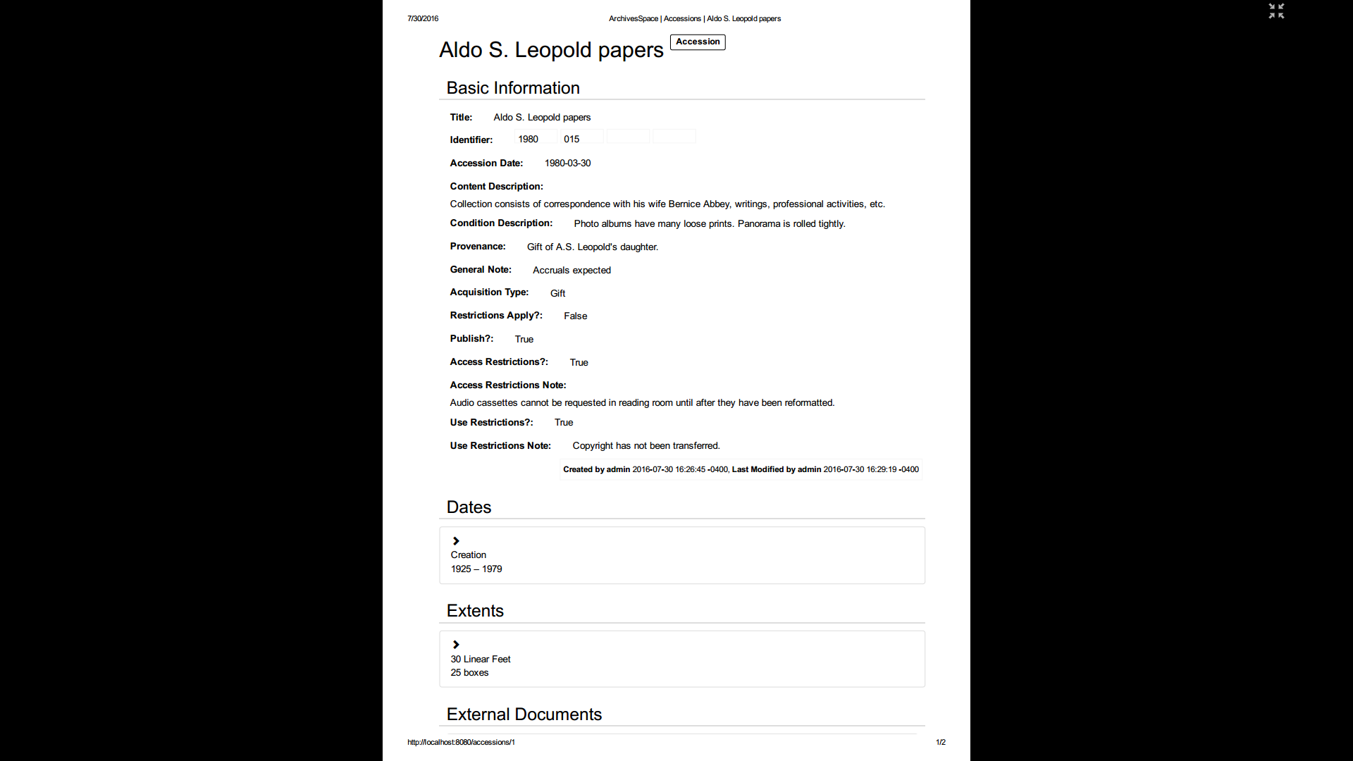

Slide 6
Steps
You need two files to change the behavior. That’s it.
You have to turn on the plugin (unless you put those two files into the “local” plugin directory instead).
You have to restart ArchivesSpace in order to load the two files from your plugin.
You can edit the print.css file to make changes without restarting ArchivesSpace. That’s pretty handy.

Slide 7
Now you can print (less)
https://github.com/YaleArchivesSpace/print
http://campuspress.yale.edu/yalearchivesspace/2015/11/26/reports-in-three-phases/#more-230

