Slide 1
Migrating, merging, and curating: a case study at Miami University
Jacky Johnson & marcus ladd
Archivesspace member forum
August 2, 2016

Slide 2
Miami Lots of reading and Some Responsibility
In arriving in the Archives in 2009 I inherited an old system, Filemaker Pro
Filemaker Pro was not available to the public
There were limited records available via the Archives website
In 2013 a working group was formed to find ways to make the material in the University Archives available to the public via a web-based information management system
The challenge the group faced was merging multiple repositories operating under different formats and metadata standards (Archon vs. Filemaker Pro) into ArchivesSpace

Slide 3
Minor Oversight
Minor Mistake! Archives staff did not receive training prior to migrating from Archon into ArchivesSpace
This was not a disaster due to the skill of the Special Collections Digital Librarian, and IT staff members
Suggestion: Receive training prior to implementation

Slide 4
Miami University Technical Information
Staff had to create a template for migration from Filemaker Pro into Archon and then into ArchivesSpace
Technical problem due to multiple transfers of materials from Filemaker Pro, Archon and finally ArchivesSpace
Transfer of information into the appropriate fields such as accession dates, provenance dates and creation dates

Slide 5
Data Cleanup
Three day training session at Miami in October 2016
Data cleanup consists of staff and student workers creating resource records from the accession records that were created during initial transfer of records in ArchivesSpace, correcting information in that accession records, adding appropriate subject/topical headings, eliminating duplicate records, clean up the local authority file for topical headings

Slide 6
Tech perspective: initial assessment & attempt
Multiple standards & formats
Non machine-readable dates

Slide 7
Tech perspective: initial assessment & attempt

Slide 8
Tech perspective: initial assessment & attempt

Slide 9
Tech perspective: initial assessment & attempt

Slide 10
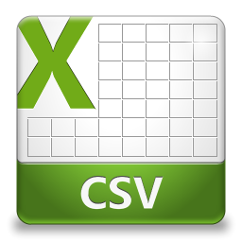
Tech perspective: initial assessment & attempt

Slide 11
Tech perspective: initial assessment & attempt

Slide 12
CSV Problems
Character limits in fields
Empty fields/illegal field order
Formatting errors
Error: #&lt;Argument
Error: invalid byte sequence in UTF-8&gt;

Slide 13
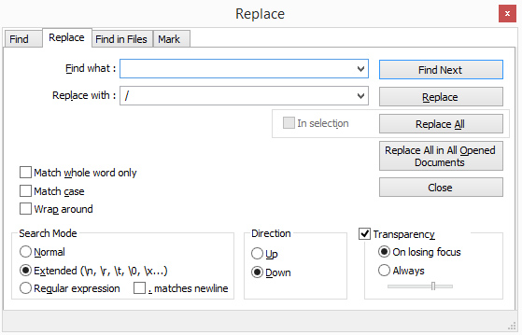
CSV Solutions
Goal was to have everything in one place (minimal work in .csv desired)
Create valid .csv file & migrate
Advanced searching in Notepad ++ to find carriage returns etc

Slide 14
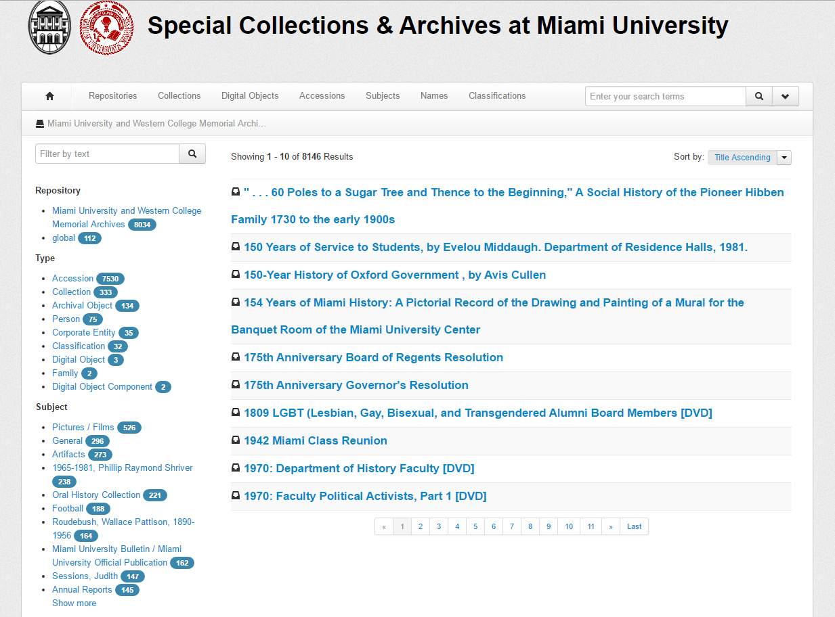
Post-Migration
ArchivesSpace record structure
Date formats
Overall review

Slide 15
Micro vs macro
Some work must be done on an individual record level (i.e. data review)
What can be done on the macro scale

Slide 16
Micro vs macro
Some work must be done on an individual record level (i.e. data review)
What can be done on the macro scale

Slide 17
Date clean-up
Dates in various formats
93-9-5
2/1/2002
98-8-2 [part]; 2000-10-3
95-7-1 [Nos. 7-22]
Feb 2 ‘91

Slide 18
Date clean-up
Dates in various formats
93-9-5
2/1/2002
98-8-2 [part]; 2000-10-3
95-7-1 [Nos. 7-22]
Feb 2 ‘91
YYYY-MM-DD

Slide 19
DATE CLEANUP
“It can’t be just me”
Simplest place to start: strtotime()
Standard PHP command

Slide 20
DATE CLEANUP: warnings
HAVE A TEST SERVER/BACKUP
THERE IS NO SIMPLE UNDO WITH PHP/SQL
WORK IN BATCHES

Slide 21
Looking ahead
Use batch processing options for macro problems
Rely on Archives staff & students for the micro-level review
Use newly established standards & template for Special Collections records
Eventually have material from 4 existing repositories + new records in one instance of ArchivesSpace

Slide 22
Questions?
Jacky Johnson
JOHNSOJ@MIAMIOH.EDU
MARCUS Ladd
laddmm@miamioh.edu

