Slide 1
ArchivesSpace-Archivematica-DSpace Workflow Integration Dallas Pillen August 2, 2014

Slide 2
Project Goals/Overview
Facilitate creation/reuse of metadata
Streamline the ingest and deposit of content in a repository
Streamline appraisal, arrangement, and description of content
Share project outcomes/code with the community

Slide 3
ArchivesSpace-Archivematica-DSpace
Archival management system
Create accession records, track locations, generate archival description
Ingest tool: produces Archival Information Packages
Extensive technical and preservation metadata
Preservation and access: persistent URLs, secure/ managed storage, access controls

Slide 4
Systems of Record
Administrative, descriptive, and rights metadata
Technical and preservation metadata, reconstructing the AIP
Manage content and enforce access restrictions

Slide 5
Key Development Tasks
Archivematica Appraisal and Arrangement tab
Characterize transfers, identify sensitive data, preview/tag content, add description
Archivematica-ArchivesSpace integration
ArchivesSpace pane within Archivematica interface
Create/edit ASpace archival objects (using AS API)
Drag and drop content to associate with description
Archivematica-DSpace integration
Deposit content
Update ASpace digital objects with handles

Slide 6
Project Status
January 2015: Artefactual Systems site visit
January-April 2015: Workflow refinement, user stories, and development prioritization
April 2015: Development begins
March 2016: No-cost extension (October 2016)
Current: DSpace integration, Appraisal tab refinement

Slide 7
APPRAISAL

Slide 8
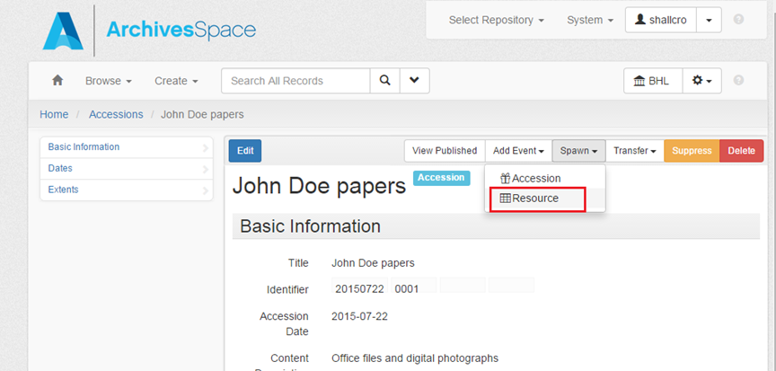
Create ArchivesSpace Accession

Slide 9
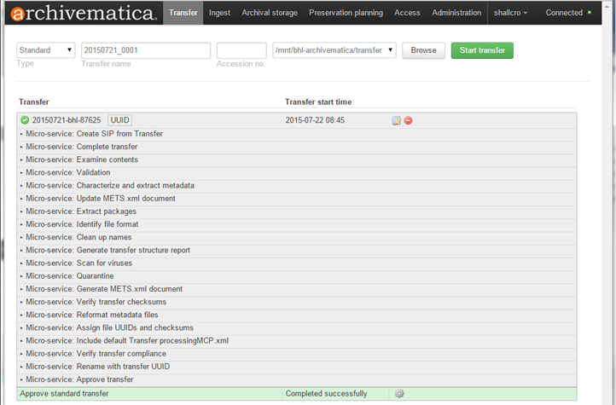
Transfer Content (AM)

Slide 10
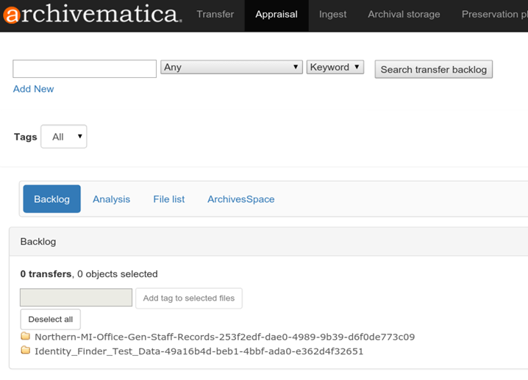
Search AM Transfer Backlog

Slide 11
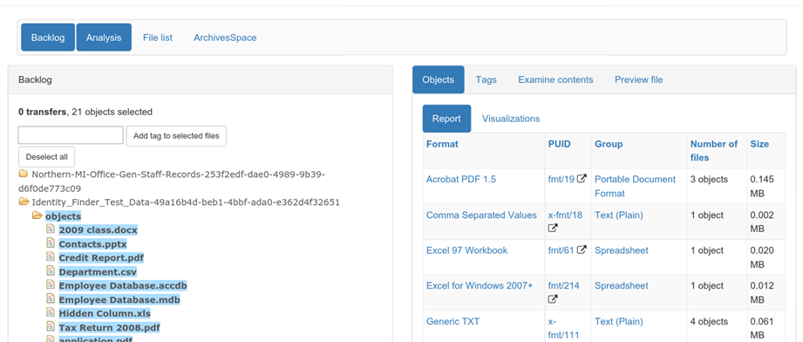
Characterize Content

Slide 12
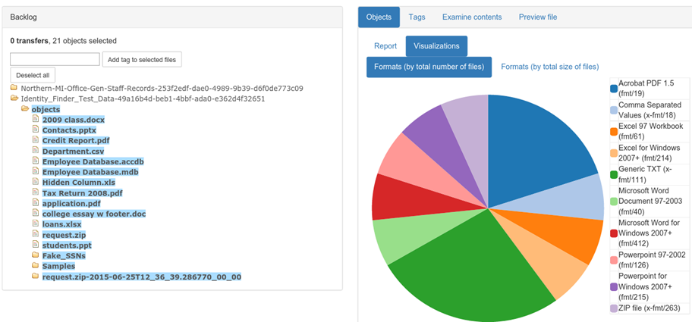
Characterize Content

Slide 13
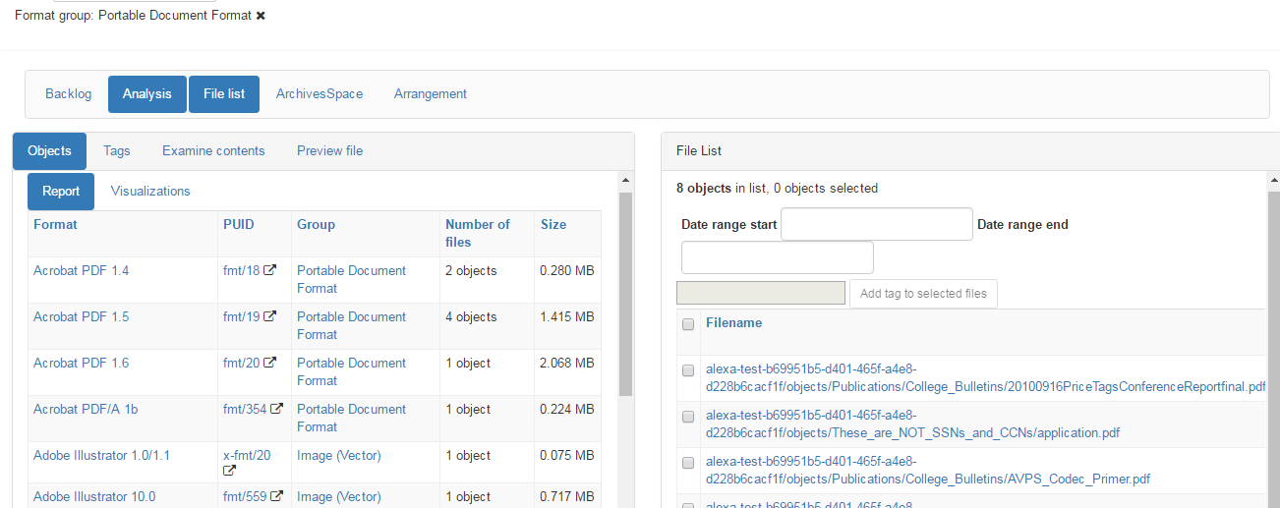
File List Faceting

Slide 14
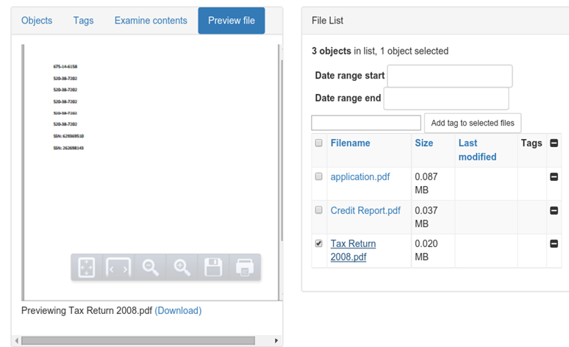
Preview Content

Slide 15
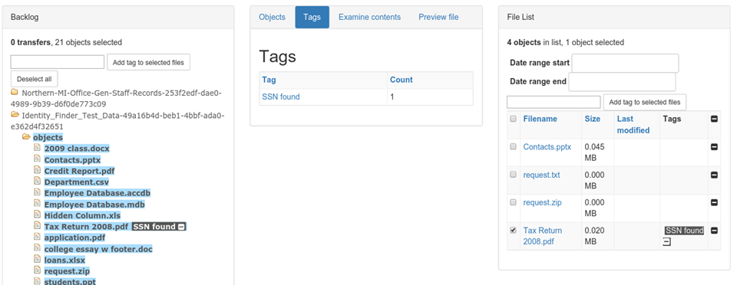
Tag Content

Slide 16
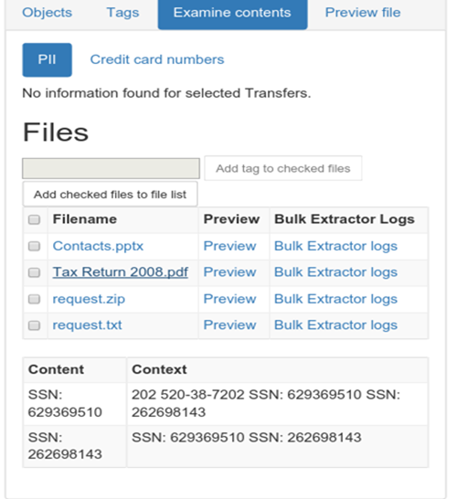
ID Sensitive Info

Slide 17
ARRANGEMENT AND DESCRIPTION

Slide 18
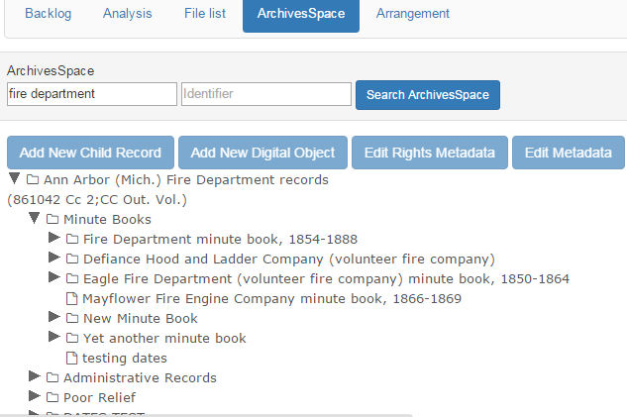
ArchivesSpace Pane

Slide 19
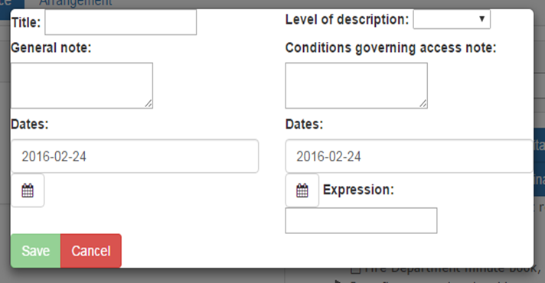
Create Archival Objects

Slide 20
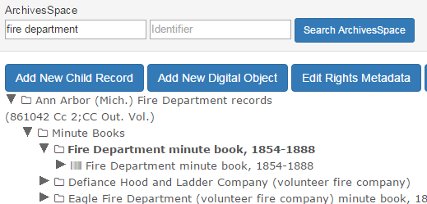
Create Digital Objects

Slide 21
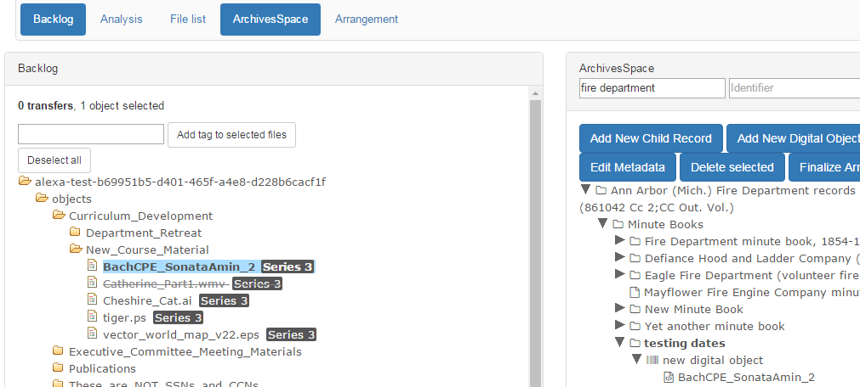
Associate Content

Slide 22
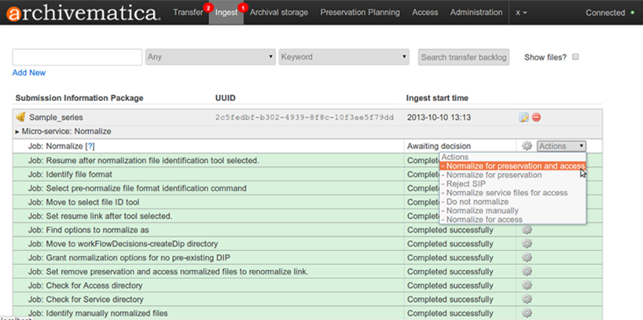
Ingest SIPs

Slide 23
Create ArchivesSpace Archival/Digital Objects
Archival objects are written to ArchivesSpace as they are created
Finalize Arrangement will create the new digital object and add as a digital object instance to the archival object

Slide 24
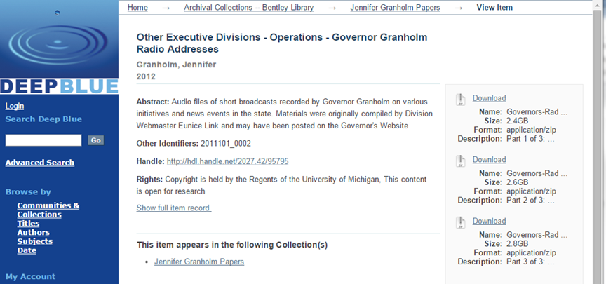
Deposit

Slide 25
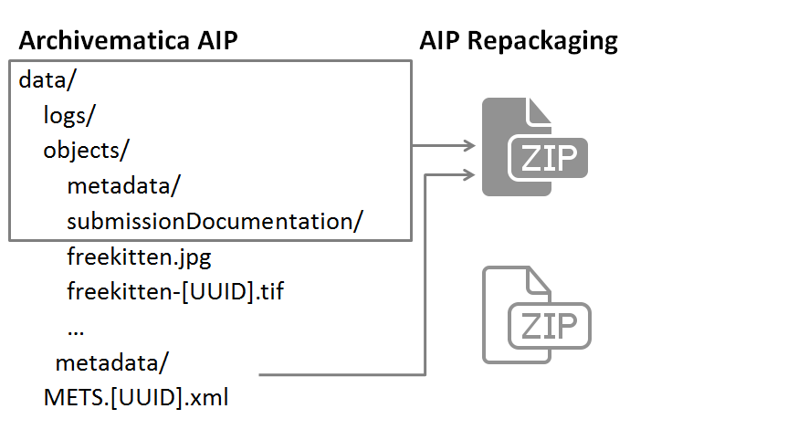
Archivematica AIP

Slide 26
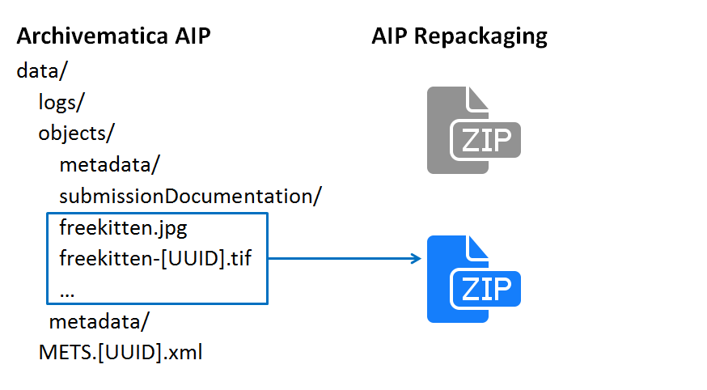
Archivematica AIP

Slide 27
A LOOK AHEAD

Slide 28
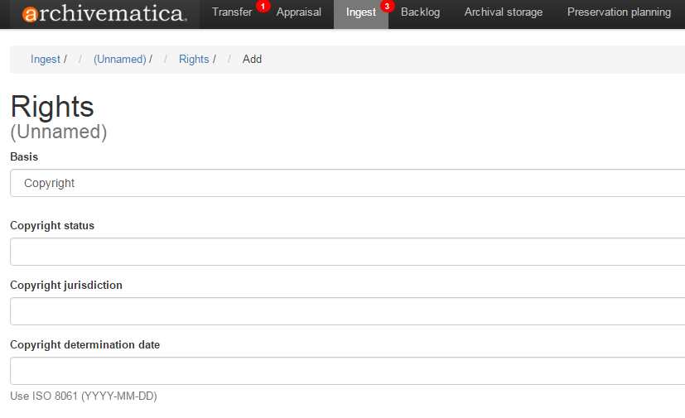
Archivematica Rights

Slide 29
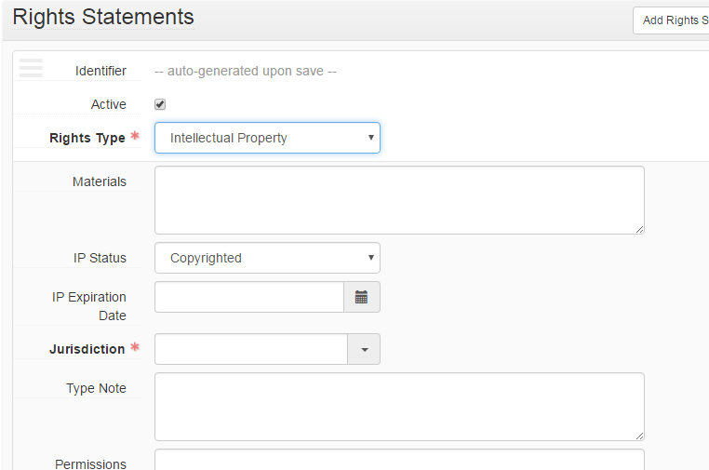
ArchivesSpace Rights Statements

Slide 30
Enhancing the ArchivesSpace Rights Module
PREMIS-compliance
Acts
Reporting

Slide 31
Thanks!
•Artefactual Systems appraisal & arrangement wiki
•Artefactual Labs Github
•Jira user stories
•Archivematica Camp: August 2016 (Ann Arbor, MI)
•Project blog: http://archival-integration.blogspot.com/
•Twitter: @umbhlcuration

