Slide 1
Aeon Integrations
2016 ArchivesSpace User Forum, Atlanta

Slide 2
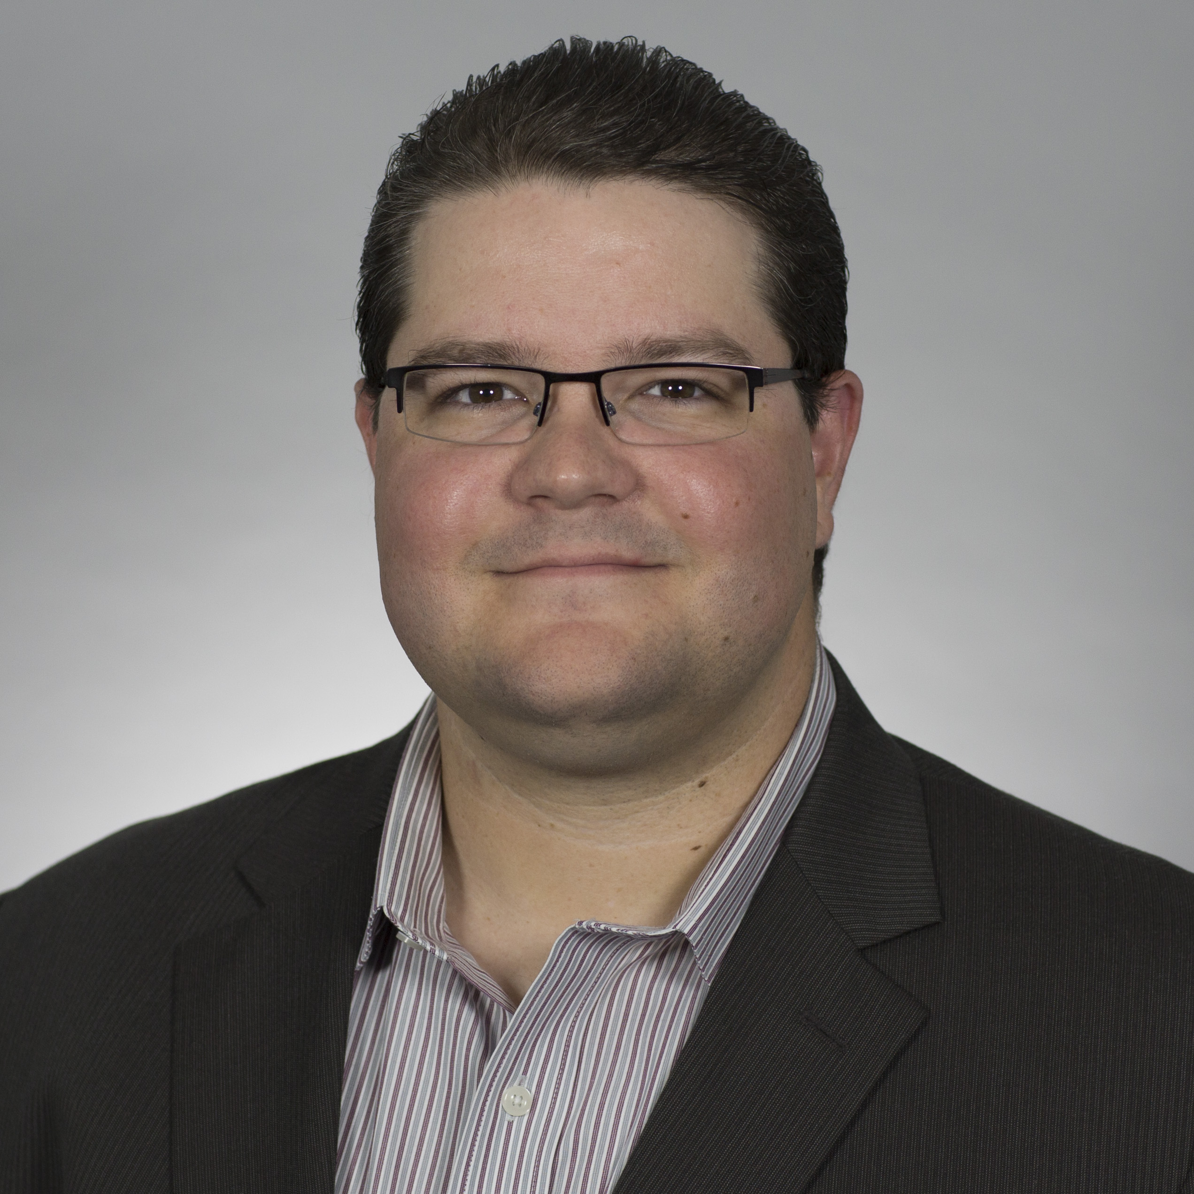
2016 ArchivesSpace User Forum
Who am I?
Dustin Stokes
Development Team Leader and
Partner Solutions Manager
dstokes@atlas-sys.com
https://www.linkedin.com/in/stokesd
Notes:
I’ve been at Atlas for almost 10 years.
I started as the very first Aeon developer!

Slide 3
2016 ArchivesSpace User Forum
Who is Atlas Systems and what is this Aeon thing?
Developers of software that revolutionizes the way that libraries manage their operations.
ILLiad, Ares, and Aeon
ArchivesSpace Registered Service Provider
Workflow management software for Archives and Special Collections
Service, Security, Statistics!
Used by more than 60 Institutions!

Slide 4
2016 ArchivesSpace User Forum

Slide 5
2016 ArchivesSpace User Forum
ArchivesSpace in the Aeon Client? Yes we can!

Slide 7
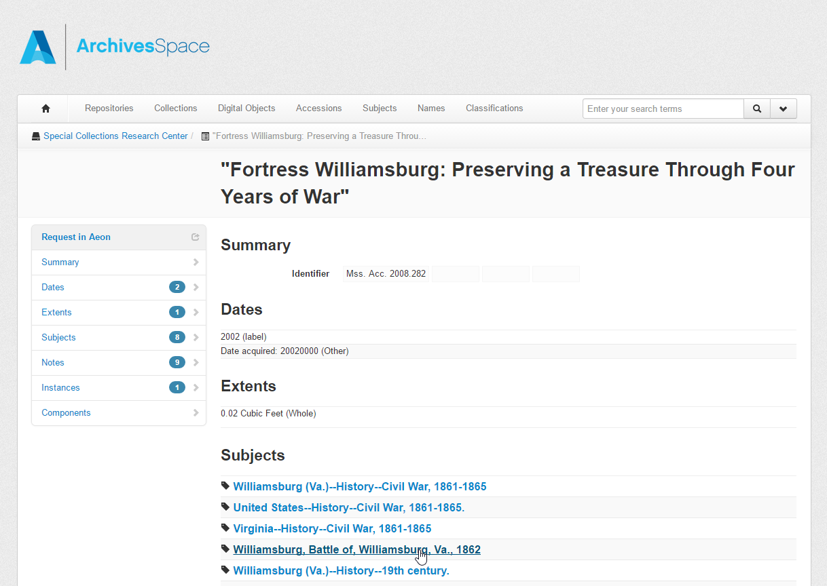
2016 ArchivesSpace User Forum
And the other way around? We can do that too!

Slide 9
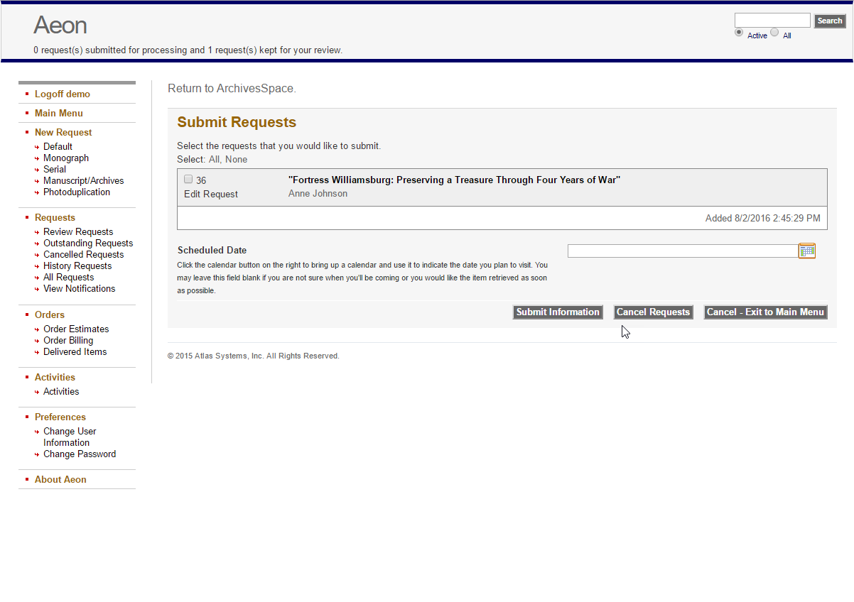

Slide 10
2016 ArchivesSpace User Forum
What about the ArchivesSpace Public UI project?
We’re on it and we’re looking for feedback from Aeon institutions!
We’re working with Mark Custer and the Public UI team to make sure we are staying informed and involved.
Aeon 3.9 contains significant improvements to Aeon’s integration endpoints. (Keep in review, bulk requesting, etc.).
We’re looking for Aeon institutions to keep us on the path that YOU guys want!

Slide 11
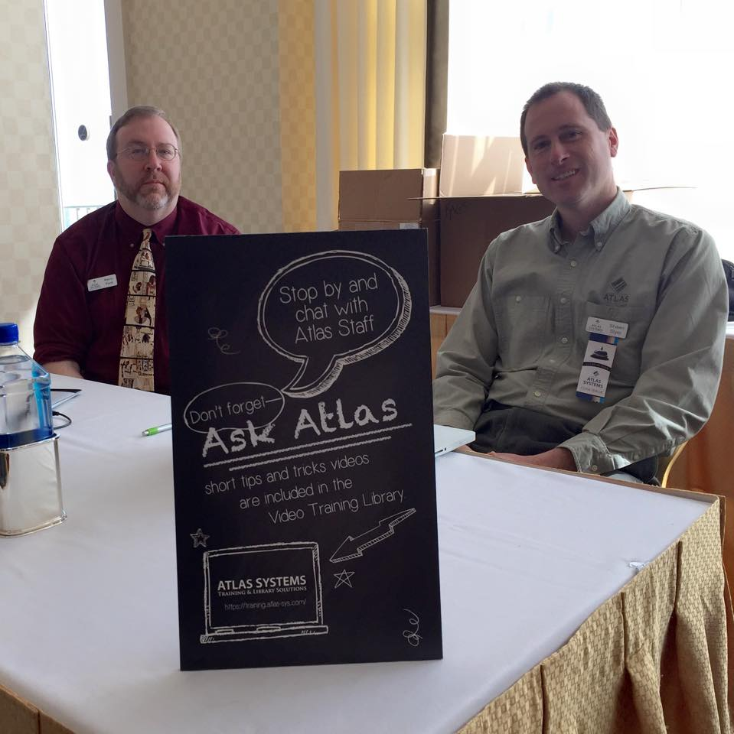
2016 ArchivesSpace User Forum
I want the plugins! How do I get them?
That’s the easy part!
Simply contact the Aeon support team!
1-800-567-7401 ext 1
Support@atlas-sys.com
http://www.atlas-sys.com/support/
We want to help make sure your system
works the way YOU want it to work!
Notes:
As a member of the development team, I’m sure none of you have ever had to call the support number so I’ve provided it here.

Slide 12
2016 ArchivesSpace User Forum

Slide 13
2016 ArchivesSpace User Forum
A shameless plug (and more)!
SAA Mini-Theater Presentation
Friday 1:00 – 1:30pm, Exhibit Hall
One small step for Brandeis University, one giant leap for archives and special collections: growing visibility on the Web with Linked Data
Aeon/ArchivesSpace Reception
Tuesday 5:30 – 7:00pm
Atlanta Hilton, Room 407
Aeon Users Group
Wine & Cheese Social
Thursday 3:30 – 5:00pm
Atlanta Hilton, Room 407

