Slide 1
Export Cleanup: Meeting Best Practices for
Rebecca Romanchuk
Texas State Archives and Library Commission
August 2, 2019
ArchivesSpace Member Forum
Austin TX
Notes:
Good morning! I’ll be giving a brief overview of an approach we’re beginning to take at the Texas State Archives to gain all the benefits of creating finding aids using ArchivesSpace while keeping one foot in the world of EAD. Our goal is to spend a minimal amount of time keeping these two parallel processes going.

Slide 2
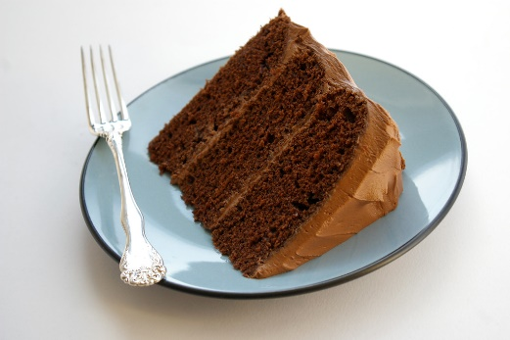
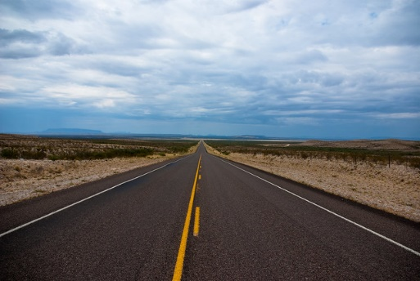
ArchivesSpace @
Accessions
Appraisal
Resources (a.k.a. “finding aids”)
This Photo by Unknown Author is licensed under CC BY-NC-ND
This Photo by Unknown Author is licensed under CC BY-SA
This Photo by Unknown Author is licensed under CC BY
Notes:
We began using the Accessions module in 2017 and consider that to be a success, and almost a piece of cake—we still have legacy data we’re working on importing. We’ve also developed a great way to enter appraisal reports into ArchivesSpace, and my colleague Anna Reznik will be talking about that here later this morning. Resources are still a long road we have yet to travel, but we’re preparing for that in several ways.

Slide 3
ArchivesSpace @
Notes:
We’ve started testing out how we’ll create Resources while keeping in mind how we’ll export and transform those into EAD finding aids that we’ll continue to contribute to the statewide EAD consortium, Texas Archival Resources Online, of which TSLAC is one of the founding members.

Slide 4
In Texas, =
(a.k.a. TARO)
Statewide EAD consortium since 1999
As of August 2019: over 50 institutional members
One of 14 active EAD consortia (or “aggregators”) in the U.S. that together cover 25 states
Institutional home: University of Texas Libraries, The University of Texas at Austin
Current NEH implementation grant underway for improvements to website, search function, and EAD metadata (index terms)
Notes:
If you’re creating EAD at an archives in Texas, chances are about 100% that you’re contributing those EAD finding aids to TARO. TARO has existed for 20 years and keeps adding new members—it’s up to about 50 members now. TARO is one of the 14 active EAD consortia in the nation and is based here at UT. It was recently awarded an NEH implementation grant to make many improvements to its system and display that hasn’t changed much in those 20 years.

Slide 5
In Texas, =
Operates with EAD 2002 Schema
No U.S. EAD aggregators have yet migrated to EAD3
Exploring ways to ease future migration to EAD3
ASpace import of EAD 2002 data then export as EAD3 may be most efficient migration strategy
Encourages members using ASpace and Archon to continue submitting EAD files to TARO
Notes:
TARO accepts only EAD 2002 Schema files, which is still the norm for EAD aggregators in the US. This probably makes our export cleanup process a bit more complicated than if we could export EAD3 Schema files, but it’s where we’re at right now. Although if we decided not to take these clean-up steps for our files, that wouldn’t be a problem in TARO. TARO wants to keep repositories using ASpace and Archon as active TARO members, so it has a few simple instructions to ensure exported EAD from those systems work in TARO.

Slide 6
& ArchivesSpace
Notes:
And TARO shares these instructions on its TARO Today blog, which is publicized to its members.

Slide 7
ArchivesSpace guidelines for TARO participation
Part 1: TARO-friendly settings in your “repository” in ArchivesSpace
Repository Fields
Organization/Agency Code
Country
Makes sure <eadid> attributes are correctly set
Part 2: For each finding aid
Finding Aid Data – EAD ID
Makes sure <eadid> text entry is correct for TARO
urn:taro:tslac.xxxxx
Export as numbered <c> tags, make repository-specific decisions about including unpublished and <dao> tags.
Notes:
For ASpace, making sure that certain Repository Fields and the EAD ID field have correct data entered is really all that needs to be done, in addition to exporting as numbered <c> tags and making local decisions about unpublished tags and <dao> tags. Though we’ve found some data may export as invalid EAD, such as agent and subject source attribute values. For some reason we’re having trouble with merging those invalid values into the valid ones. We also use links in certain parts of our finding aids, to cite sources and related material, and those need to have xlink attributes added to be valid in EAD 2002.

Slide 8
TARO EAD Best Practice Guidelines
Written by TARO Standards subcommittee (2016, revised as needed)
Heavily influenced by Online Archive of California and ArchivesWest EAD best practice guidelines
Publicly available: http://texastaro.pbworks.com/w/file/113029186/TARO_EADbpg.pdf
Baseline Requirements vs. Required, Preferred, and Optional elements and attributes
Notes:
Even so, the simple instructions for making exported EAD valid don’t bring the code at all close to the EAD Best Practice Guidelines that TARO asks, but doesn’t require, its members to comply with.
The BPG, as we call it, follows standards used by the major national EAD aggregators, which themselves follow national and international descriptive standards. The bar is still set very low for EAD files to be accepted by TARO. Only Baseline Requirements need to be met—basically, is it a well-formed and valid EAD/XML file, does it have a valid file name, and does it have certain attributes set in the <eadheader> and <eadid>? Aside from a few other rules, that’s good enough. But if an ASpace member like TSLAC wants to submit EAD files that conform to the BPG, a lot more intervention is needed post-export.

Slide 9
ArchivesSpace guidelines for TARO participation
Achieves compliance with Baseline Requirements
Does not comply with Best Practice Guidelines (BPG)
Attributes missing from
<eadheader>, <eadid>
Attributes missing throughout
@encodinganalog, @label
Attributes added but not wanted
@id, @altrender, @authfilenumber, @rules
Attribute values not valid EAD
@level (capitalized), @source (full form)
Elements added but not wanted
<num>
Notes:
At various parts of the EAD file, attributes are missing that make the file not comply with the BPG, or ASpace-specific attributes appear that aren’t needed and may be problematic in the future, though that can’t be known yet. It may be that some of these things can be resolved within ASpace, but until we make those discoveries, we need to do those clean-up tasks post-export.

Slide 10
ArchivesSpace guidelines for TARO participation
Does not comply with Best Practice Guidelines (BPG)
<controlaccess>
<relatedmaterial>
Display preferences
Commas and spaces
Benefits to be gained from complying with the BPG?
Mostly potential ones, in future TARO search function
Wait and see, or take the plunge now?
Notes:
While only some of this must be fixed before uploading the file to TARO, we wonder how code that wouldn’t appear in our hand-encoded EAD files will play in a future search function that TARO will be constructing within the next three years. Should we wait to find out if it’ll be a problem, or develop a way to clean up the code now to keep it more consistent with our past encoding?

Slide 11
Needs @
Streamline workflow for finding aid creation and review
Create Resource
Circulate printed Resource for peer review
Edit Resource to prepare for cataloging
Share Resource with cataloging staff (and perhaps digital program staff)
Provide version of Resource for upload to TARO (and print copies for reading room and administrative files)
PUI not yet provided to patrons @ TSLAC or online;
version relied on for editing and display
Notes:
We decided to go ahead and take the plunge.
Multiple staff from different work units are engaged in this workflow. The goal is to be doing most of our work in the ASpace Resource and export an EAD version only when necessary, and to make post-export clean-up as quick and simple as possible.
The EAD finding aid is still the public version of the finding aid—we’re not using the public interface yet as such.

Slide 12
Needs @
Streamline workflow for finding aid creation and review
Create Resource
Circulate printed Resource for peer review as ?
Edit Resource to prepare for cataloging
Share Resource with cataloging staff as ?
Share cataloged Resource with digital program staff as
Provide version of Resource for upload to TARO (and print copies for reading room and administrative files)
Editing takes place almost solely in Resource (minimal manual clean-up steps after applying stylesheet)
Notes:
So, we’d still be more comfortable using the EAD version for peer review, but we may decide to give up doing that. We may also rely on a MARC record exported from ASpace for cataloging purposes instead of the full EAD finding aid. We’ll probably stick with sharing the EAD finding aid with our digital program staff since the EAD inventory display is more streamlined.
At every step, editing should happen only in the Resource record, with only minimal manual clean-up steps needed after applying the stylesheet that transforms the exported EAD into more BPG-compliant EAD.

Slide 13
The solution @
Stylesheet to transform Resource exported as EAD 2002 Schema to encoding that conforms to TARO EAD Best Practice Guidelines
Removes conflicting and unnecessary ASpace attributes
Deletes redundant elements and replaces others with preferred version
Deals with pesky commas and spaces
Improves TARO display and (potential) search functionality
Notes:
Our brilliant technical support staff member, Brian Thomas, wrote an XSL stylesheet to perform these clean-up steps for us. Our goal is to conform as closely as we can with TARO’s BPG and perhaps reap more benefits of TARO’s future improved search function.

Slide 14
The solution @
Using <oXygen/> XML Editor:
Open exported EAD, add transform stylesheet declaration, and save file.
Perform Transformation Scenario.
Save transformed version of file.
Open transformed file and replace transform stylesheet declaration with local display stylesheet declaration.
Apply Format/Indent.
Notes:
The steps the archivists will take to apply the transform stylesheet are simple, quick, and already familiar to them.

Slide 15
The solution @
Using <oXygen/> XML Editor, perform minor manual edits as needed:
Add xlink attributes to <extref>, <archref>, <bibref>, and <ref> elements.
Add attributes to Single dates (attributes absent because “single” is not valid EAD @type for date tags).
Add periods as needed to end of Index Terms and remove spaces on either side of double-dashes.
Add <genreform> as pairing with <extent>.
Notes:
The manual edits needed afterward are minor. Since we’re using EAD 2002, we need to add xlink attributes to linking elements. Single dates need attributes added post-export. Punctuation and spacing for Index Term entries is adjusted. We’ve been pairing <genreform> with <extent> as a measure to ease migration to EAD3, though this may be unnecessary if we migrate to EAD3 by exporting our Resources as that version.

Slide 16
The solution @
Still testing for additional automated changes
MPLP / Extensible processing approach
Simpler finding aids
Less description = Less intervention post-export
Sharing tools for other TARO members and beyond
https://www.southwestarchivists.org/archives-space-resources/
Notes:
We’re still testing this method to make it as efficient as possible. And, we’ll be using more efficient processing techniques as we go forward, which should also help to minimize time spent on creating our EAD files.
Once we have our tools and instructions for this method more finalized, we’ll share them in the space reserved on the Society of Southwest Archivists website for ArchivesSpace Resources. We’ve already shared our accessioning and appraisal instructions there. If anyone here is in the SSA region and would like to share their own instructions and tools, you can go to this web page to find out how. An actually, you’ll see my own email listed there as the contact.

Slide 17
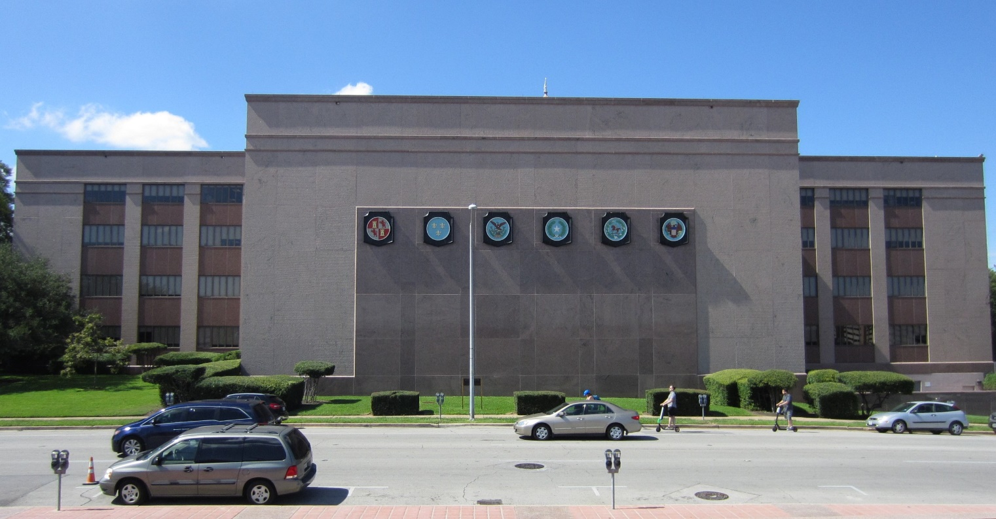
Questions? Advice?
Rebecca Romanchuk, Archivist III
rromnchk@tsl.texas.gov
Notes:
As Jessica said, we’re holding questions until the end of the Plenary presentations. And if anyone wants to offer advice on improving this method we’ve developed, I’d really welcome that, so please feel free to find me later today and share your thoughts. Thank you!

