Slide 1
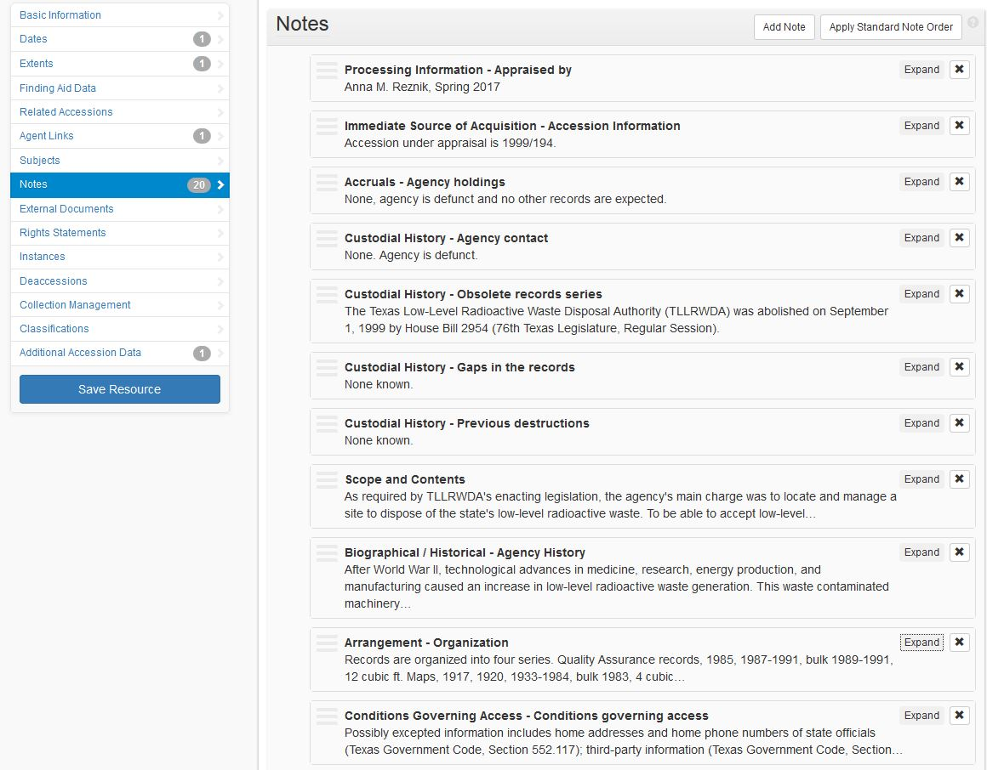
Resources: They’re Not Just for Finding Aids Anymore
Anna M. Reznik, Archivist
areznik@tsl.texas.gov
Notes:
Good morning, y’all! Welcome to Austin. I’m Anna Reznik and I am an archivist at the Texas State Library and Archives Commission (TSLAC).
Today I will be sharing how my institution is using the Resources module in ArchivesSpace to create appraisal reports.

Slide 2
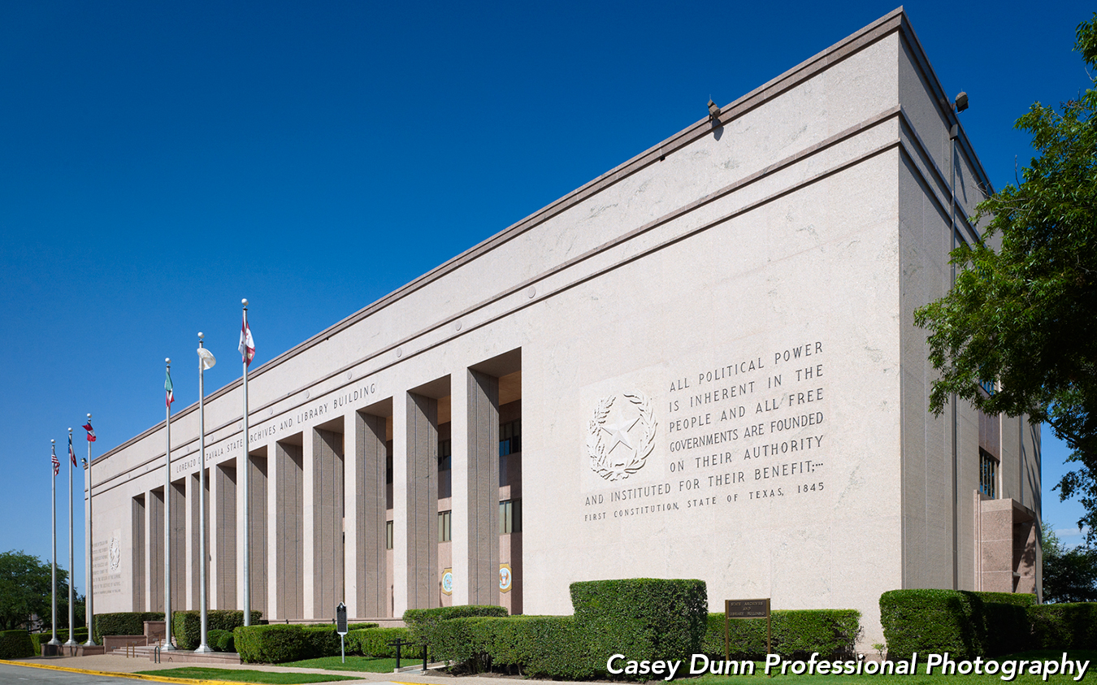
Texas State Library and Archives Commission
1201 Brazos Street, Austin, Texas 78701
Hours of Operation: Monday – Friday, 8 am to 5 pm
and Second Saturdays 9 am to 4 pm
Reading Room Hours: Monday – Friday, 8 am to 4:45 pm
and Second Saturdays 9 am to 3:45 pm
Notes:
We are located in between the JW Merriott and the Thompson Convention Center; next to the State Capitol. As the state library and archive for Texas, my institution primarily collect records of enduring value created and/or maintained by state governmental bodies, though we do accept manuscript donations to fill-in information gaps.

Slide 3
Notes:
At present, we have slightly more than 82,000 cubic ft. of physical materials and several terabytes in our holdings. Like other archives, we have a limited amount of available empty physical storage space.
In late 2017, my institution made the decision was made to make appraisal a higher priority for all archivists with processing duties, opposed to a handful of staff conducting reviews. Our appraisal push included addressing our backlog appraisals, meaning records we accepted and accessioned with the intention to appraisal later . . .

Slide 4
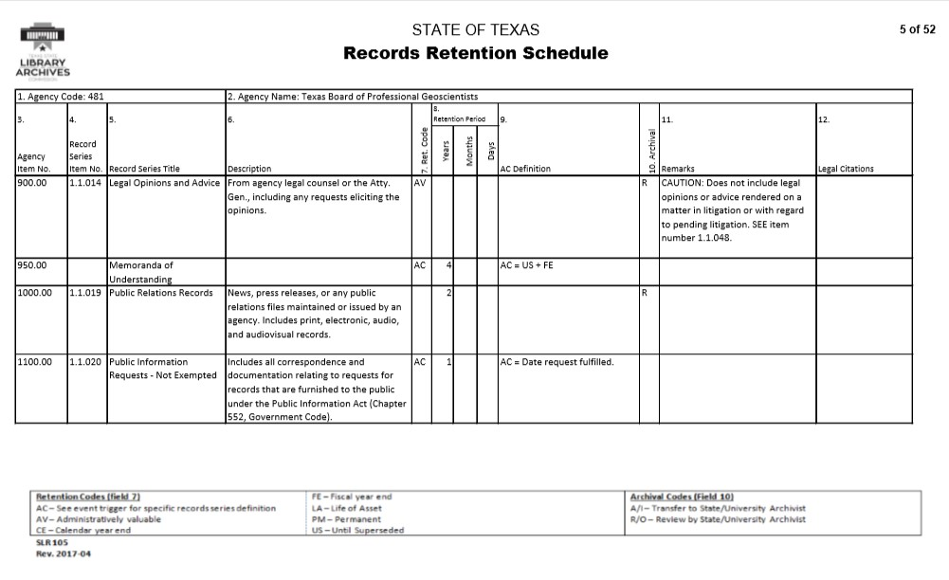
Notes:
as well as making decisions on state government records series that had an archival review note on a given agency’s retention schedule.
The latter is noted with a R in the Archival column. These are known as “incoming” appraisals because the creating body maintains legal custody of the records until the final decision has been made.

Slide 5
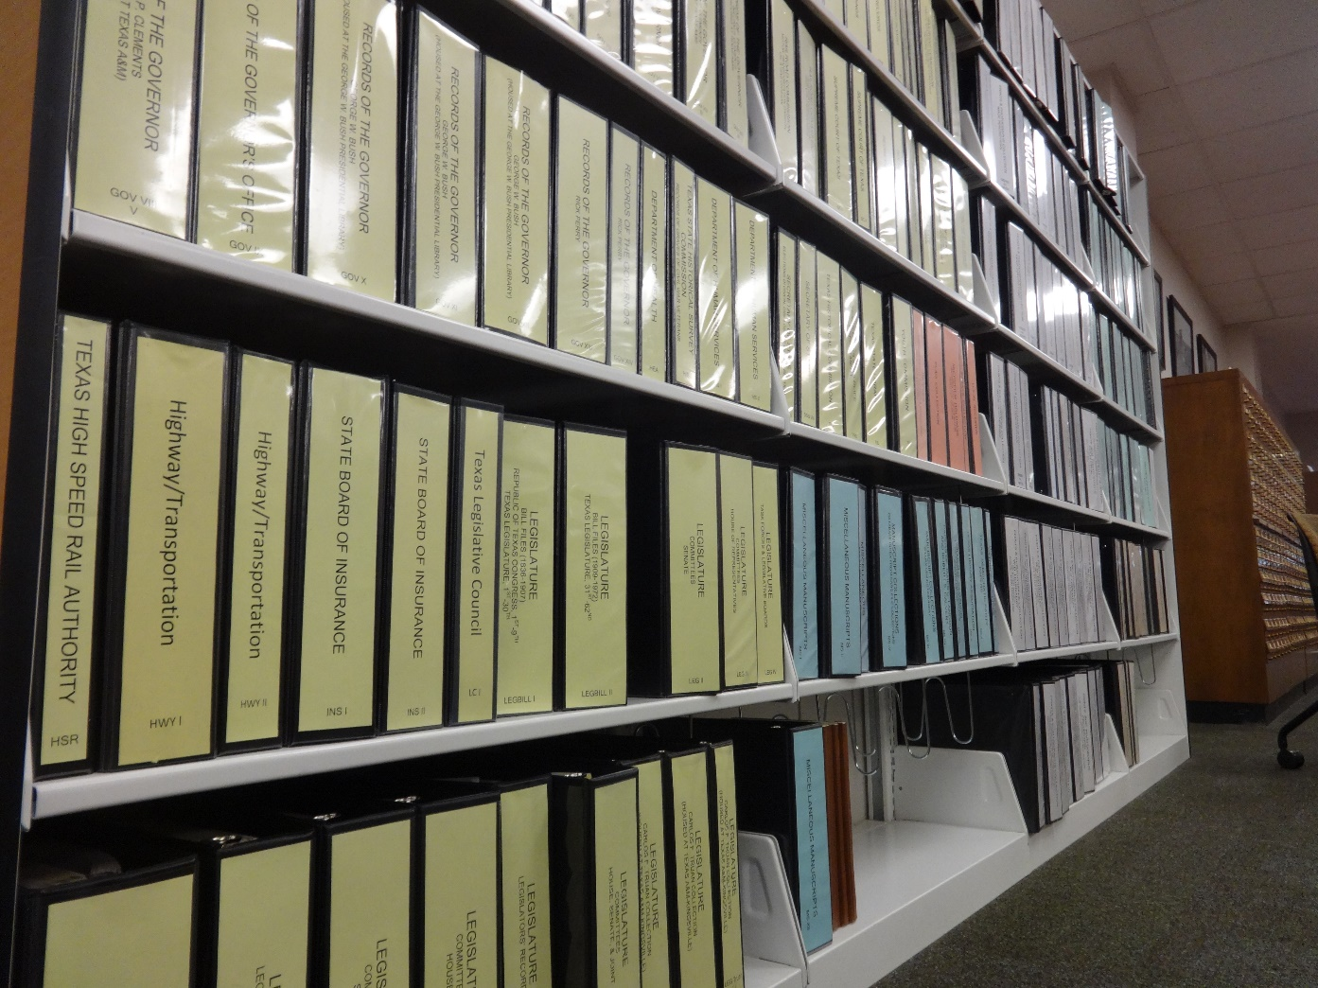
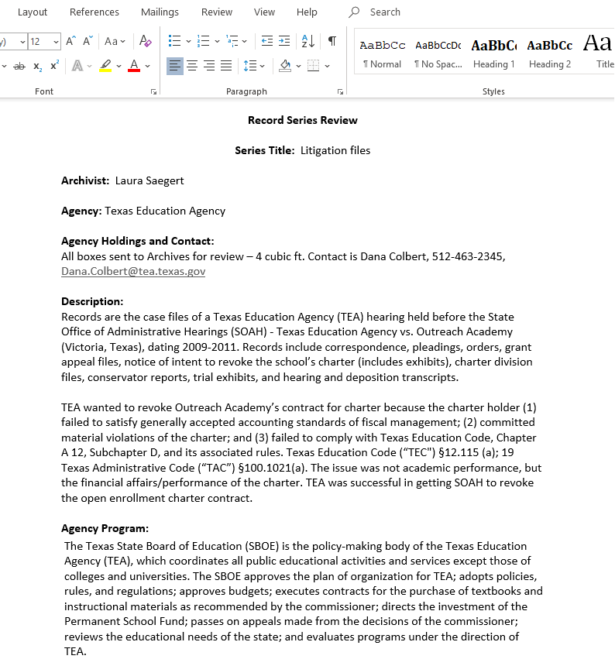
Appraisal in ArchivesSpace
Notes:
Prior to late 2017, our appraisal reports were written in Word, with some mounted on our agency website. We also make our reports available in our archives reading room browse-able binders.
When we received executive approval to implement ASpace, the decision was made to have the system as a one-stop-shop for all of our archives tasks. This included documenting our appraisal decisions and actions as well as keeping our reports in a centralized “space.”

Slide 6
Appraisal in ArchivesSpace
Must-haves
Like-to-haves
Way to circulate export report for comment.
Need to be able to have specific fields available.
Little technical expertise needed.
Templates to standardize format.
Way to allow for collaboration.
Streamline process for incoming reviews.
Notes:
We could not depend on developing an in-house plug-in to customize our instance of ASpace, so we needed an “out-of-the-box” solution. Before we could dive into using ASpace for appraisals, we differentiated our must-haves from our like-to-haves to determine the best path forward.
For must-haves, we needed a way to output the report in a way that all the necessary fields were visible. These fields provide context on the records under review addition to outlining the recommendation. Some of our reviews have an impact on records retention schedules, so we are likely more through in our appraisals than other types of repositories.
Also, we wanted to avoid dealing with character limit issues when lengthy context was necessary. Additionally, staff had varying comfort levels with ASpace and appraisal, so our end-process needed to be user-friendly and flexible.
Ideally, we wanted a way to standardize our reports. Occasionally, an appraisal project involved teams of archivists and we hoped ASpace would support this collaboration. And minimized the existence of multiple copies and versions of a report.
Finally, this posed an opportunity to we consider how we appraise government records.
Let’s look at the options we considered -

Slide 7
Events?
Notes:
The first option we explored was to create a new event and select appraisal for the type. This options for appraisal focused on the final decision, and not how we arrived at this decision.
We could see this being adequate for some institution’s needs, especially if they attached the appraisal report as an external document. For this project, we wanted something that improved our processes instead of continuing the status quo.

Slide 8
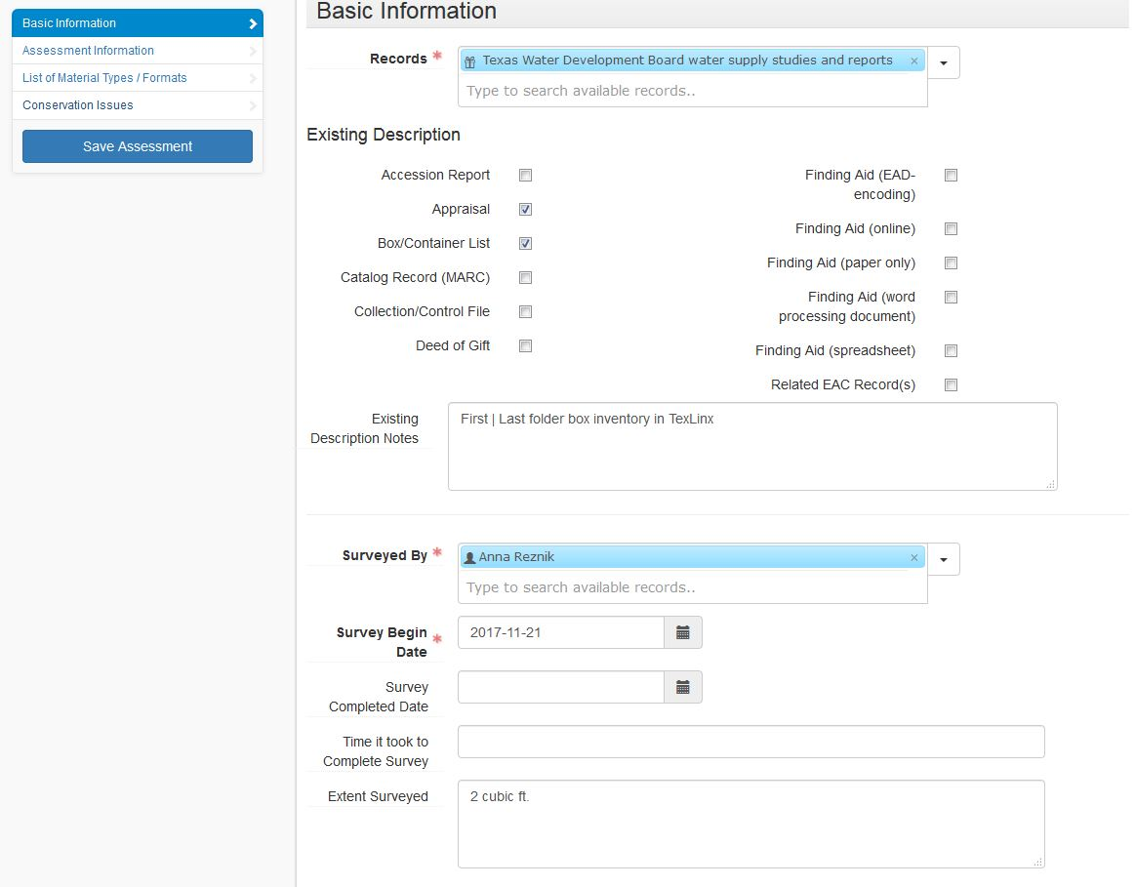
Assessment Module?
Notes:
Early in the appraisal push, the Assessments Module was released. Maybe it would allow us to systematically appraise records?
The biggest drawback with the Assessments Module is that we could not export the information captured into a report to circulate for comment. The module is not visible on the Public Interface (for good reason), so printing from the Public Interface view was not a viable alternative.
The assessment module’s strength is assisting with prioritization, not documenting the nitty-gritty of why an appraisal decision has been made.

Slide 9
Accessions Module?
Notes:
What about the Accessions Module?
The major pros included: staff were most familiar with this module, templates could be created to minimize repeated data entry, and some of the information we wanted to capture fit into our use of the Accessions Module.
Early on, we realized that the Accessions Module did not quite meet our needs. Fields such as the Content Description have character limits, the relationship between the series under review and archival series/publication could not be easily described in the available fields, most of the fields in the User Defined Data section had been reserved for capturing additional “accession” data, and many fields that did capture appraisal information are hidden in the Public Interface view. As printing from the Public Interface view was the easiest way to create reports from accession records, the latter was a major problem.
Another strike against using the Accessions Module was we expected a sizeable percentage of series under reviewed to be appraised as non-archival. Would a large number of completely deaccessioned entries be a bare to work with for reporting or searching purposes? What message would a large amount of completely deaccessioned “accessions” send to stakeholders?

Slide 10
Resource Module?
Notes:
It became obvious that the Resources Module best met our needs. Reports could be exported as PDFs, with all fields visible. There were no character limits and notes could be repeated. Although we have not implemented the Resources Module for finding aid creation, staff were familiar with EAD and the Accessions Module, which helped minimize the expertise necessary to create appraisal reports in ASpace.
To better track and manage our appraisals, both for incoming and backlog reviews, we created a “repository” named Review. A template specific to appraisals was created for this repository.
Also in the Review repository, we have accession record stubs to capture information about records in the queue to be reviewed.

Slide 11
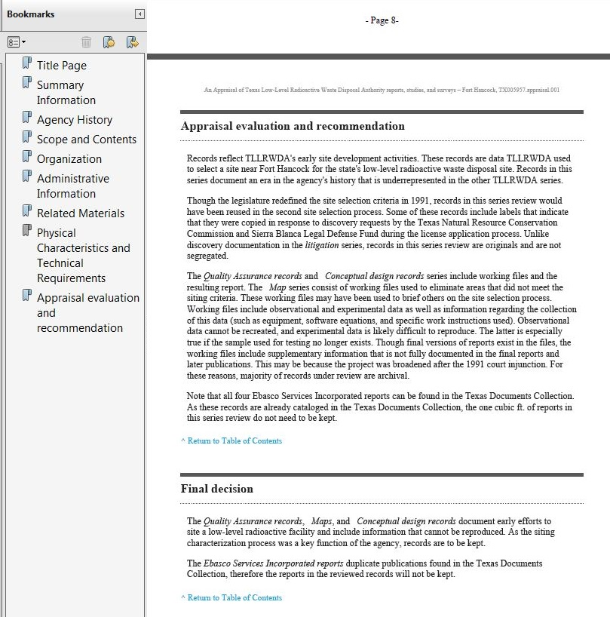
Results
Notes:
We wrote all the fields that we wanted and considered the possible note type equivalent. For some, such as arrangement, there was an obvious choice. For others, such as gaps in records, took more careful consideration.
As the appraisal note type output in the middle of the PDF report, we decided to use general for the note type, so the content appeared at the end of the report.
For testing, I used a finished backlog appraisal to tweak the instructions. If you would like to know more about my appraisal work related to the TLLRWDA, I’ll be presenting about that topic at tomorrow’s Science/Technology/Health Care section at 10 am!

Slide 12
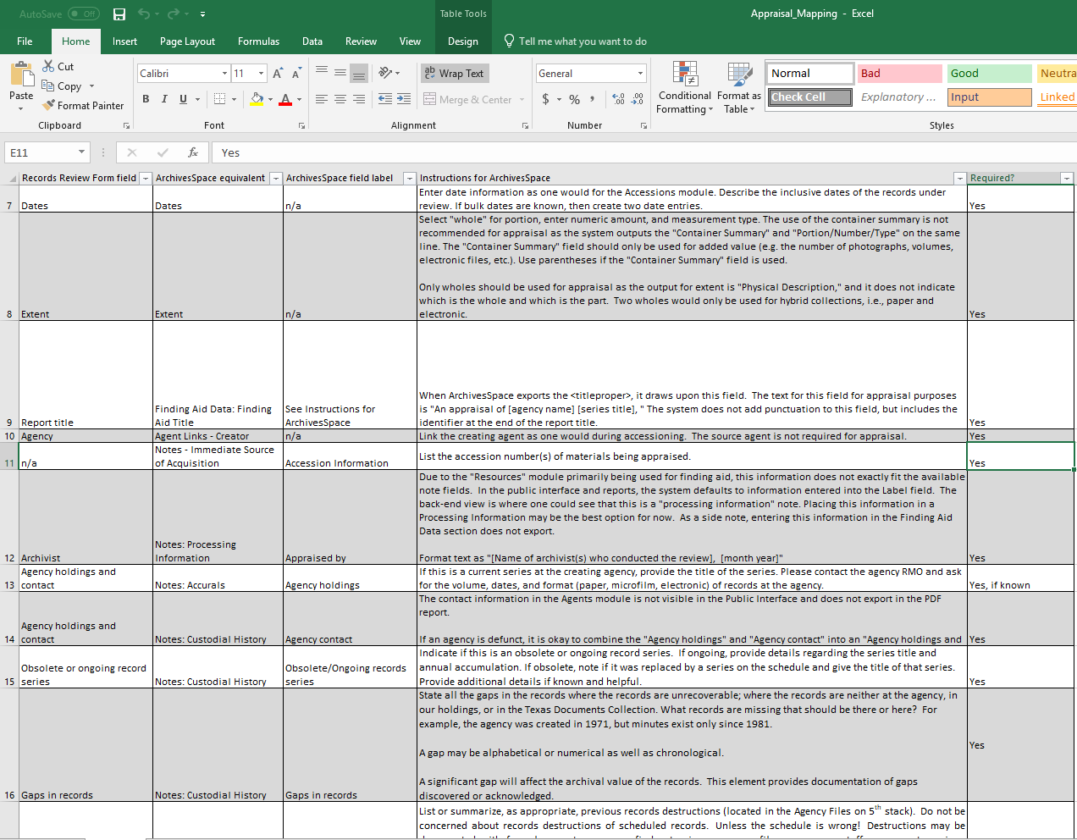
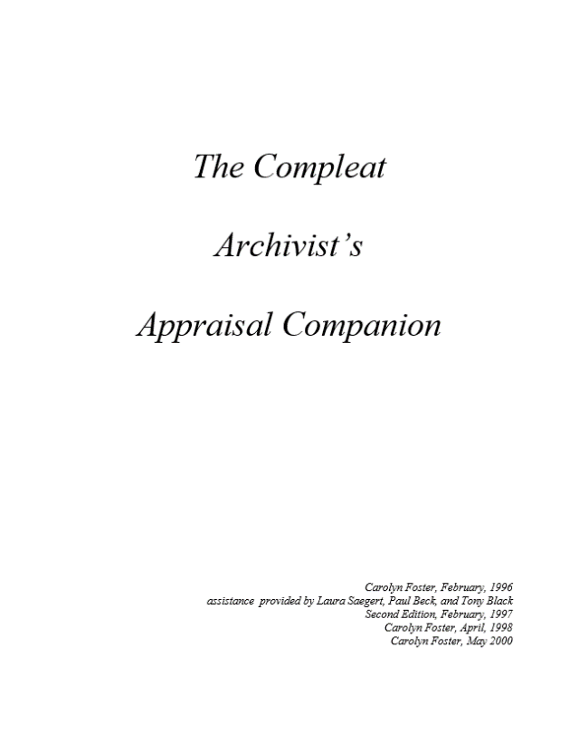
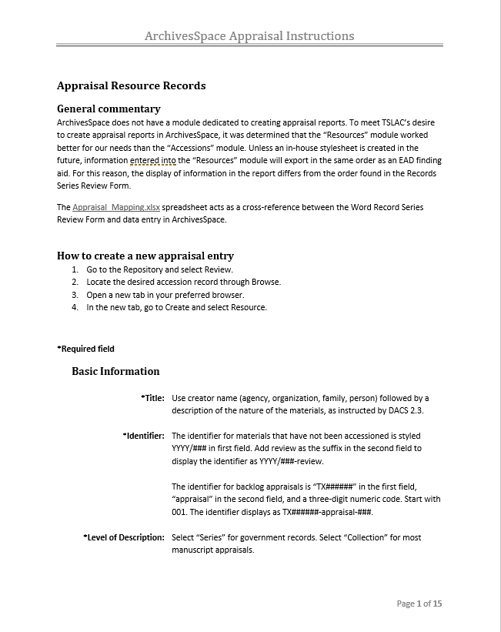
Instructions and Workflows
Notes:
We integrated ASpace into our appraisal manuals and created a cross-walk from the old template to the ASpace field. Field-specific instructions largely mirrored our Word instructions except where we decided to condense fields. We also indicted which fields were required and which were optional for incoming appraisals.

Slide 13
Staff Response
Increased standardization
Reports created more quickly and look more “polished”
Easier collaboration on team appraisal
Appraisal work visible and easier to track
Notes:
Some of the benefits of using the Resources Module to create appraisal reports were expected: more standardization, reports look more “polished,” and quicker to create reports.
Additional unexpected benefits include it is easier to collaborate when multiple people are working on a project and we can see the archivists’ work in a more visible way.

Slide 14
Questions?
Anna M. Reznik: areznik@tsl.texas.gov
https://www.southwestarchivists.org/archives-space-resources/
Notes:
If you would like to see our instructions and cross-walk, it is available through on the Society of Southwest Archivists ArchivesSpace Resources page. And if you are in the SSA region and have materials to share, please feel free to contact Rebecca.

