Slide 1
User and Technical Documentation Conversation
Led by Kevin Clair and Christine Di Bella
ArchivesSpace Annual Member Forum
August 2019

Slide 2
Our Agenda
Overview of the User Documentation sub-team and resources for user documentation
Overview of the Technical Documentation sub-team and resources for technical documentation
Open discussion - questions, comments, ideas about anything related to ArchivesSpace documentation

Slide 3
User Documentation
Maintains the ArchivesSpace User Manual, working with the Community Engagement Coordinator to update information for each new release
Works with TAC Documentation subteam on areas of common concern to both advisory councils
Looks for ways to improve the User Manual and associated documentation on behalf of the ArchivesSpace community

Slide 4
User Documentation
Projects for 2018/19:
Audit the existing user manual to determine where it needed to be updated, or where outdated information needed to be removed, in order to bring it in line with the current release of the application
Survey ArchivesSpace community members who maintain their own documentation, to find areas where it aligns with or is complementary to the User Manual, and to identify ways in which the User Manual can better integrate with user-generated documentation

Slide 5
User Documentation
New documentation platform:
Allows for multiple users
Makes UAC Docs’ lives easier -- can update the User Manual directly instead of coordinating with LYRASIS
On the way soon!

Slide 6
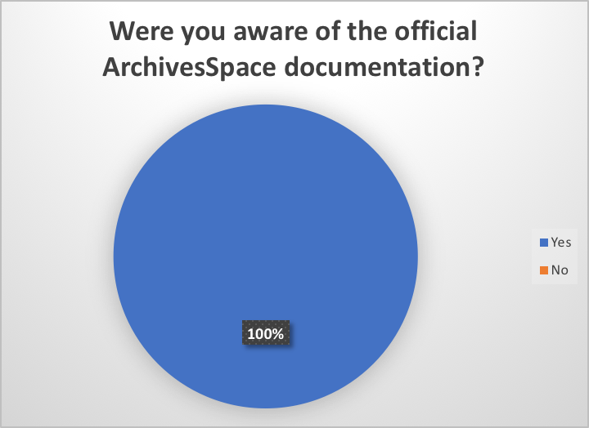
User Documentation

Slide 7
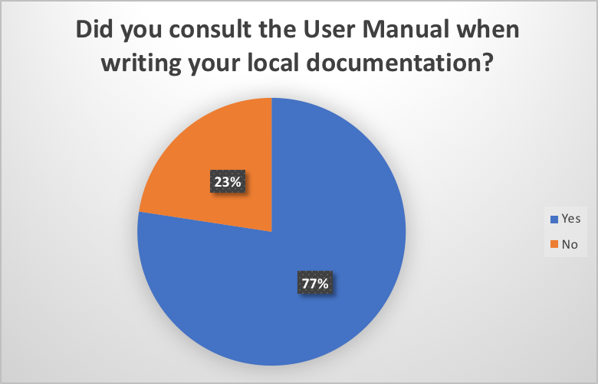
User Documentation

Slide 8
User Documentation
Notes:
Most people who didn’t were unaware of it or didn’t have access at their institution.

Slide 9
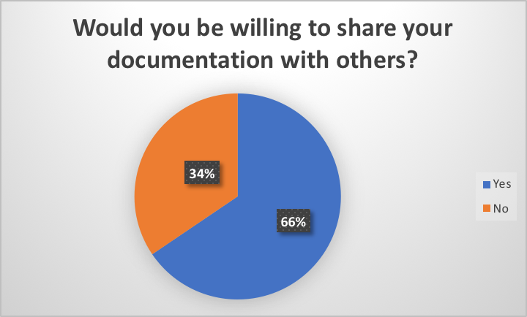
User Documentation
Notes:
Reasons why: commitment to openness and sharing, contribution to the community. A lot of ambivalence, some desire for easier ways for community members to contribute to the User Manual rather than too much proliferation of local docs (which should be possible soon…)
Reasons why not: too local, too unpolished -- willing to share as needed

Slide 10
Technical Documentation
Provides instructions for deploying ArchivesSpace from a technical standpoint
Intended to be useful for installing, configuring, updating, and otherwise maintaining the ArchivesSpace application
Also encompasses information for accessing ArchivesSpace via the API or doing development work related to the application (such as building plugins).
Mostly in written form, but includes videos on YouTube that supplement/illustrate technical concepts
Publicly available - does not require membership to access

Slide 11
Technical Documentation Sub-Team
Maintains and facilitates contributions to the technical documentation
Identifies gaps and conducts surveys of the community to identify additional technical documentation needs.
Works closely with the ArchivesSpace Technical Lead
Recent projects
Converting technical documentation from being embedded in core code of application to its own Github repository
Approving improvements submitted by others
Building a list of people interested in contributing to the documentation

Slide 12
Some links
Searchable technical documentation: http://archivesspace.github.io/archivesspace/
Github repository for technical documentation: https://github.com/archivesspace/tech-docs
API documentation: http://archivesspace.github.io/archivesspace/api/
Developer screencasts (by Hudson Molonglo, original developers for ArchivesSpace): https://www.youtube.com/playlist?list=PLJFitFaE9AY_DDlhl3Kq_vFeX27F1yt6I
Other screencasts: https://www.youtube.com/watch?v=yFJ6yAaPa3A&list=PL3cxupmXL7Wioy2zMaE4KQP8yf8wVXR9l

Slide 13
Open discussion (with some questions to get us going)
How many have used the user documentation for ArchivesSpace? How many have used the technical documentation for ArchivesSpace?
Do you know where to look (or where to point your system administrator or developer) when you have a question about how to do something in ArchivesSpace?
What kinds of questions do you (or your system administrator or developer) have that could be answered in documentation but aren't currently?
What do you think could be better about the documentation?

Slide 14
Open discussion (with some questions to get us going)
Do you keep local documentation?
Would you be interested in improving the ArchivesSpace documentation for the community? What would make it easier to do so?

