Slide 1
The ASpace API in Action
The short, short version
ArchivesSpace Member Forum
Washington DC
2018-08-14
Valerie Addonizio
vaddoniz@jhu.edu

Slide 2
Essentials
Same data, different view
Lets you work at scale
Enables applications to communicate directly

Slide 3
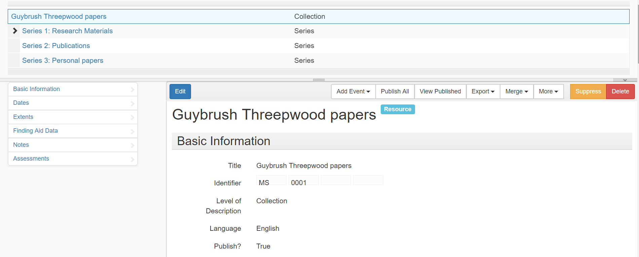
Same data, different view
Staff interface:

Slide 4
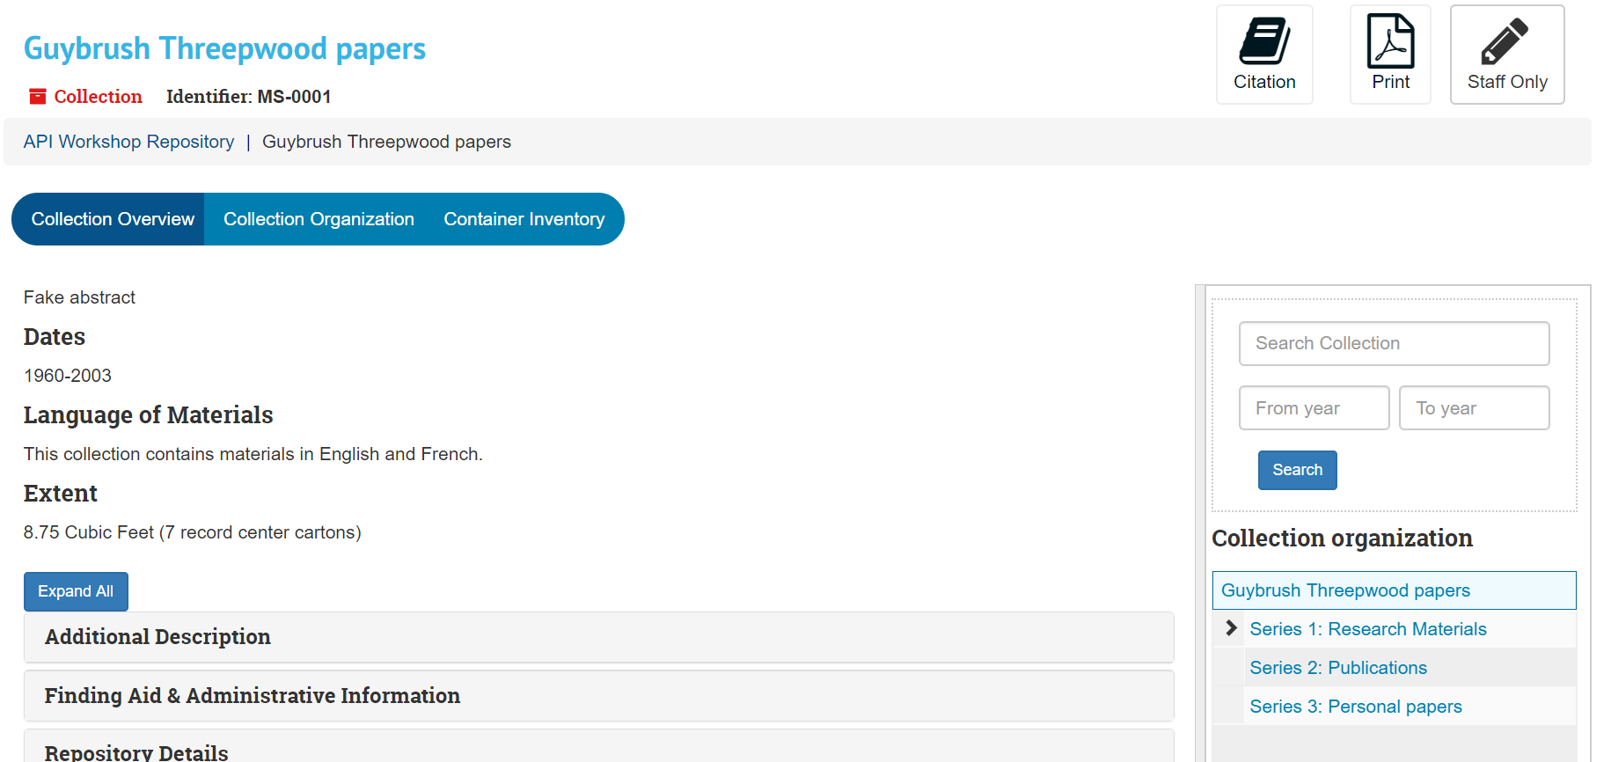
Same data, different view
Public interface:

Slide 5
Same data, different view
JSON record, through the API:

Slide 6
Essentials
Same data, different view
Lets you work at scale
Enables applications to communicate directly

Slide 7
Lets you work at scale
What if you could:
Get every record of a certain type out of ASpace at once?
Create records by the dozens/hundreds/thousands?
Modify existing records without having to click through each record?

Slide 8
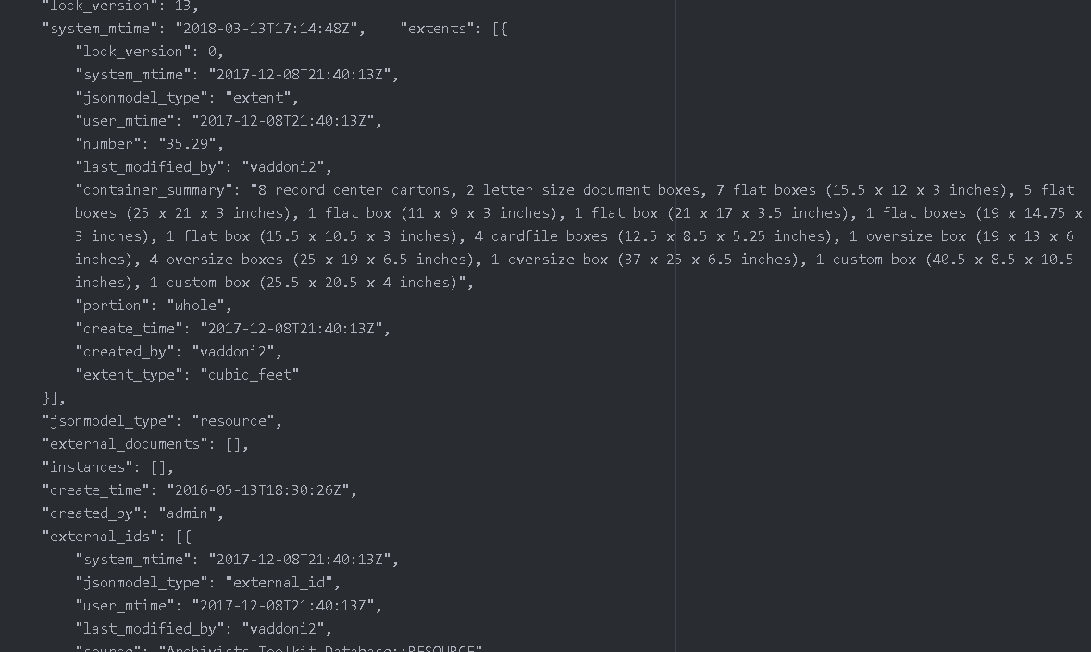
Lets you work at scale
Get every record of a certain type out of ASpace at once:

Slide 9
Lets you work at scale
Create records by the dozens/hundreds/thousands:

Slide 10
Lets you work at scale

Slide 11
Lets you work at scale
Create records by the dozens/hundreds/thousands:
Boom!

Slide 12
Lets you work at scale
Modify existing records:

Slide 13
Essentials
Same data, different view
Lets you work at scale
Enables applications to communicate directly
Hold that thought!

Slide 14
Concepts
Flip the ice cream switch
Every record is an endpoint
JSON is your new best friend

Slide 15
Flip the ice cream switch
Yum!
It is definitely August in DC.

Slide 16
Flip the ice cream switch
One thing

Slide 17
Flip the ice cream switch
One thing

Slide 18
Flip the ice cream switch
Multiple things

Slide 19
Flip the ice cream switch
One thing

Slide 20
Flip the ice cream switch
8 subjects
7 agents
17 archival objects
15 digital objects
4 top containers
1 resource record
Multiple things

Slide 21
Concepts
Flip the ice cream switch
Every record is an endpoint
JSON is your new best friend

Slide 22
Every record is an endpoint
8 subjects
7 agents
17 archival objects
15 digital objects
4 top containers
1 resource record
Multiple things

Slide 23
Every record is an endpoint
/archival_objects/1
/archival_objects/2
/archival_objects/3
/archival_objects/4
/archival_objects/5
/archival_objects/6
/archival_objects/7
/digital_objects/1
/digital_objects/2
/digital_objects/3
/digital_objects/4
/digital_objects/5
/agents/1
/agents/2
/agents/3
/agents/4
/subjects/1
/subjects/2
/subjects/3
/subjects/4
/top_containers/1
/top_containers/2
/top_containers/3
/top_containers/4
/resources/1
Endpoints

Slide 24
Concepts
Flip the ice cream switch
Everything is an endpoint
JSON is your new best friend

Slide 25
JSON is your friend
JSON is a standardized format like others you’ve probably encountered:
<unittitle>Guybrush Threepwood papers</unittitle>
“Title”: “Guybrush Threepwood papers”

Slide 26
JSON is your friend
Guybrush Threepwood papers
MS.0001
Collection-level record
Extent is 8.75 cubic feet
Consists of 7 record center cartons

Slide 27
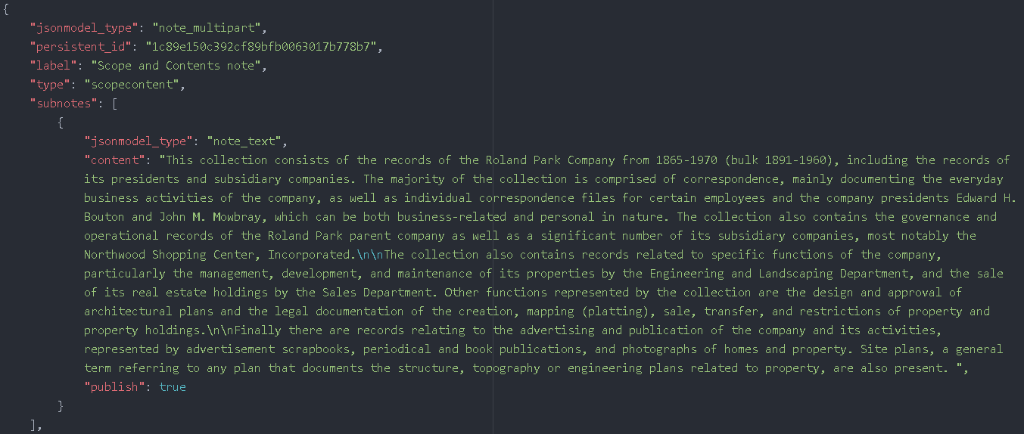
JSON is your friend
Here’s the Scope and Content note:

Slide 28
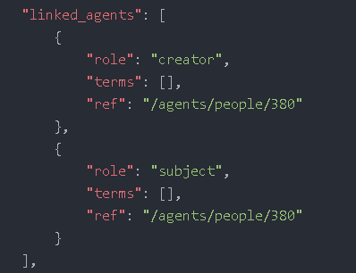
JSON is your friend
This record is linked to two agent records

Slide 29
Find me and ask me questions!
Valerie Addonizio
vaddoniz@jhu.edu

