Slide 1
ARCHIVESSPACE PLUGINS AT NYU
Rachel Searcy
ArchivesSpace Member Forum, 2019 August 2

Slide 2
https://guides.nyu.edu/archivesspace

Slide 3
MARC Export Plugin
Modifies ArchivesSpace MARC export to enforce local content standard, address gaps in functionality, and extend mapping.
Creates 863/949 fields for item records (container information, including barcodes).
Facilitates loading into ILS (Aleph), OCLC Connexion, and offsite workflows.

Slide 4
MARC Export Plugin
Enforce local content standard
Suppress specified notes (e.g., Biographical/ Historical, Scope and Contents)
Address gaps in functionality
Change subfield indicators for Uniform Titles
Add subfield for local agent headings
Create 863/949 item pairs
Create item records for top containers with box number, barcode, and local codes for offsite workflows

Slide 5
MARC Export Plugin
863/949 pair per top container:
863 field: basic bibliographic unit
949 field: item record

Slide 6
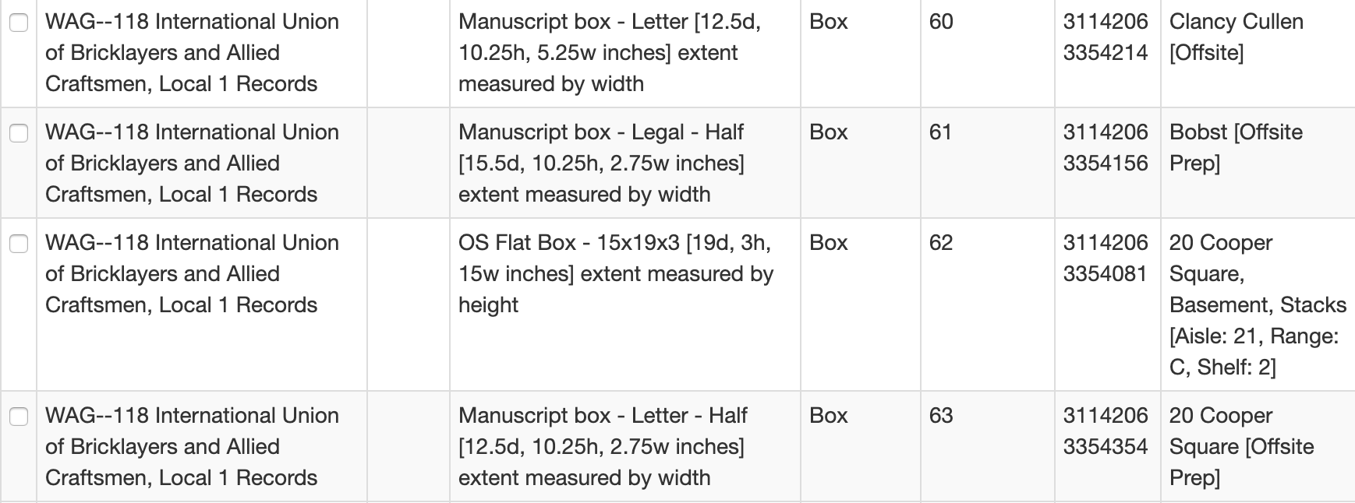

Slide 8
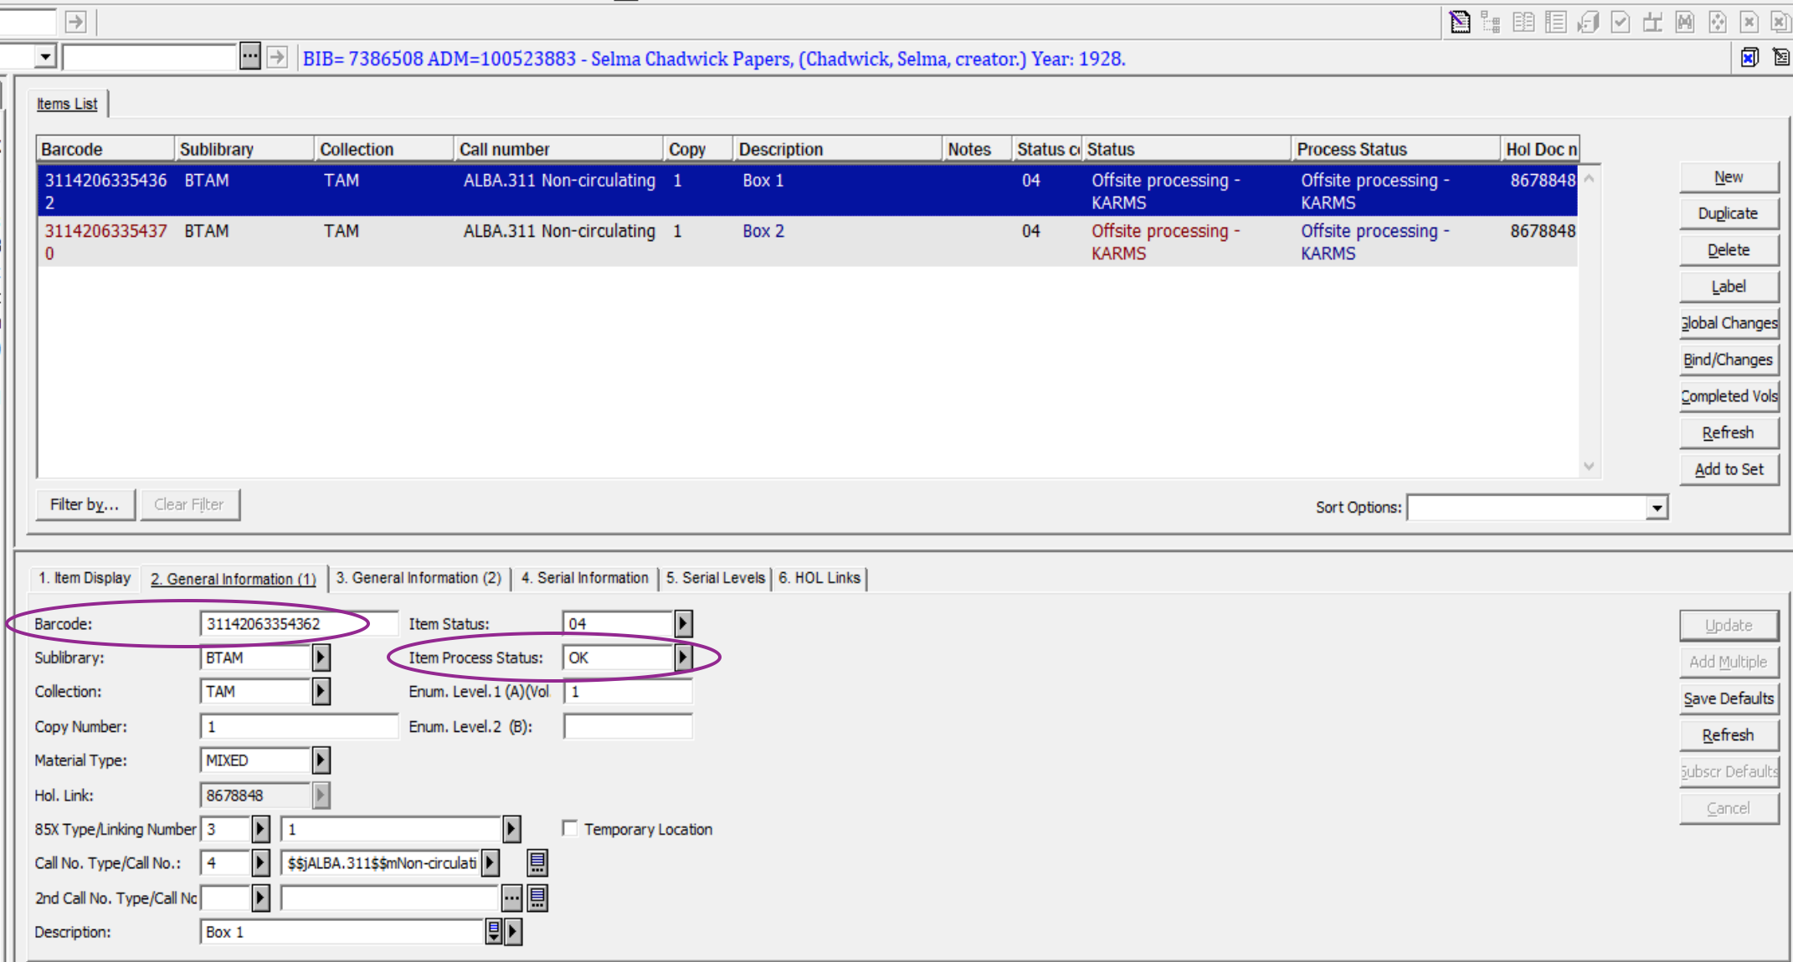
MARC Export Plugin

Slide 9
MARC Export Plugin
Limits manually editing and clean-up.
Facilitates record load into Aleph and OCLC.
Facilitates large-scale workflow to send materials to offsite facility.

Slide 10
Work Order Plugin
Creates tsv of descriptive metadata for selected components in a resource record.
Optionally creates simple Component Unique Identifier (cuid).
Used in inter-departmental workflows for reformatting and digitization, but adaptable for other uses.

Slide 11
Work Order Plugin

Slide 13
Work Order Plugin
Facilitates workflows and file naming for in-house reformatting and digitization.
Often used with local script to create and post new digital object records to ArchivesSpace API.
Plugin includes option to create tsv without assigning cuids.
Other uses: packing manifest, spreadsheet for donor, exhibition inventory, item-level control for special storage.

Slide 14
https://guides.nyu.edu/archivesspace

Slide 15
THANKS!
Any questions?
You can find me at:
rachel.searcy@nyu.edu

