Slide 1
ArchivesSpace 5th Annual Member Forum Thompson Conference Center University of Texas at Austin August 2, 2019

Slide 2
Working Group Members
Kevin Clair, University of Denver
Miranda Mims, University of Rochester
Anna Reznik, Texas State Library and Archives Commission
Rebecca Romanchuk, Texas State Library Archives and Commission
Olivia Solis, University of Texas – Austin
Kelly Spring, East Carolina University
David Zapeda, University of Texas – Austin
Jessica Crouch – ArchivesSpace

Slide 3
Thank you to our presenters
Kevin Clair, University of Denver
Leilani Dawson, University of Hawaii-Manoa
Christine Di Bella, ArchivesSpace
Nancy Enneking, Getty Research Institute
Maggie Hughes, Huntington Library
Karla Irwin, University of Nevada Las Vegas
Miloche Kottman, University of Kansas
Laney McGlohon, ArchivesSpace
Miranda Mims, University of Rochester
Matthew Neely, University of Oxford
Dallas Pillen, University of Michigan

Slide 4
Thank you to our presenters
Anna M. Reznik, Texas State Library and Archives Commission
Rebecca Romanchuk, Texas State Library and Archives Commission
Rachel Searcy, New York University
Linda Sellars, NC State University
Joshua Shaw, Dartmouth College
Weatherly Stephan, New York University Libraries
Lydia Tang, Michigan State University
Caitlin Wells, University of Michigan
Greg Wiedeman, University of Albany
Nick Zmijewski, Industrial Archives and Library

Slide 5
Code of Conduct
We seek to provide a welcoming, fun, and safe conference experience and ongoing community for everyone. We do not tolerate harassment in any form. Discriminatory language and imagery (including sexual) is not appropriate for any event venue, including talks, or any community channel such as the chatroom or mailing list.
Harassment is understood as any behavior that threatens another person or group, or produces an unsafe environment. It includes offensive verbal comments or non-verbal expressions related to gender, gender identity, gender expression, sexual orientation, disability, physical appearance, body size, race, age, religious beliefs, sexual or discriminatory images in public spaces (including online), deliberate intimidation, stalking, following, harassing photography or recording, sustained disruption of talks or other events, inappropriate physical contact, and unwelcome sexual attention.
- CodeofConduct4Lib (Short link: http://bit.ly/coc4lib)

Slide 6
To Connect to UT Guest WIFI:
1) Click on your device’s WiFi icon.
2) Click on UTGuest from your list of available Wi-Fi
connections.
3) Select “Connect”.
4) Open your preferred browser and enjoy your complimentary WiFi.

Slide 7
Christine Di Bella
Program Manager
ArchivesSpace

Slide 8
Lightning Round Presentations
ArchivesSpace 5th Annual Member Forum Thompson Conference Center University of Texas at Austin August 2, 2019

Slide 9
EAD Export Cleanup: Meeting Best Practices for Texas Archival Resources Online
Rebecca Romanchuk, Texas State Library and Archives Commission
Supporting Internal Workflows with Plugins at the Bentley Historical Library
Dallas Pillen, University of Michigan
Implementing ArchivesSpace at the Bodleian Libraries
Matthew Neely, University of Oxford
Beyond Top Containers: Leveraging ArchivesSpace for Offsite Storage
Weatherly Stephan, New York University Libraries
Resources: They’re Not Just for Finding Aids Anymore
Anna M. Reznik, Texas State Library and Archives Commission
’ Queue
We can do it! Introducing the Community Developers’ Queue Maggie Hughes, Huntington Library, and Lydia Tang, Michigan State University

Slide 10
Export Cleanup: Meeting Best Practices for
Rebecca Romanchuk
Texas State Archives and Library Commission
August 2, 2019
ArchivesSpace Member Forum
Austin TX
Notes:
Good morning! I’ll be giving a brief overview of an approach we’re beginning to take at the Texas State Archives to gain all the benefits of creating finding aids using ArchivesSpace while keeping one foot in the world of EAD. Our goal is to spend a minimal amount of time keeping these two parallel processes going.

Slide 11
ArchivesSpace @
Accessions
Appraisal
Resources (a.k.a. “finding aids”)
This Photo by Unknown Author is licensed under CC BY-NC-ND
This Photo by Unknown Author is licensed under CC BY-SA
This Photo by Unknown Author is licensed under CC BY
Notes:
We began using the Accessions module in 2017 and consider that to be a success, and almost a piece of cake—we still have legacy data we’re working on importing. We’ve also developed a great way to enter appraisal reports into ArchivesSpace, and my colleague Anna Reznik will be talking about that here later this morning. Resources are still a long road we have yet to travel, but we’re preparing for that in several ways.

Slide 12
ArchivesSpace @
Notes:
We’ve started testing out how we’ll create Resources while keeping in mind how we’ll export and transform those into EAD finding aids that we’ll continue to contribute to the statewide EAD consortium, Texas Archival Resources Online, of which TSLAC is one of the founding members.

Slide 13
In Texas, =
(a.k.a. TARO)
Statewide EAD consortium since 1999
As of August 2019: over 50 institutional members
One of 14 active EAD consortia (or “aggregators”) in the U.S. that together cover 25 states
Institutional home: University of Texas Libraries, The University of Texas at Austin
Current NEH implementation grant underway for improvements to website, search function, and EAD metadata (index terms)
Notes:
If you’re creating EAD at an archives in Texas, chances are about 100% that you’re contributing those EAD finding aids to TARO. TARO has existed for 20 years and keeps adding new members—it’s up to about 50 members now. TARO is one of the 14 active EAD consortia in the nation and is based here at UT. It was recently awarded an NEH implementation grant to make many improvements to its system and display that hasn’t changed much in those 20 years.

Slide 14
In Texas, =
Operates with EAD 2002 Schema
No U.S. EAD aggregators have yet migrated to EAD3
Exploring ways to ease future migration to EAD3
ASpace import of EAD 2002 data then export as EAD3 may be most efficient migration strategy
Encourages members using ASpace and Archon to continue submitting EAD files to TARO
Notes:
TARO accepts only EAD 2002 Schema files, which is still the norm for EAD aggregators in the US. This probably makes our export cleanup process a bit more complicated than if we could export EAD3 Schema files, but it’s where we’re at right now. Although if we decided not to take these clean-up steps for our files, that wouldn’t be a problem in TARO. TARO wants to keep repositories using ASpace and Archon as active TARO members, so it has a few simple instructions to ensure exported EAD from those systems work in TARO.

Slide 15
& ArchivesSpace
Notes:
And TARO shares these instructions on its TARO Today blog, which is publicized to its members.

Slide 16
ArchivesSpace guidelines for TARO participation
Part 1: TARO-friendly settings in your “repository” in ArchivesSpace
Repository Fields
Organization/Agency Code
Country
Makes sure <eadid> attributes are correctly set
Part 2: For each finding aid
Finding Aid Data – EAD ID
Makes sure <eadid> text entry is correct for TARO
urn:taro:tslac.xxxxx
Export as numbered <c> tags, make repository-specific decisions about including unpublished and <dao> tags.
Notes:
For ASpace, making sure that certain Repository Fields and the EAD ID field have correct data entered is really all that needs to be done, in addition to exporting as numbered <c> tags and making local decisions about unpublished tags and <dao> tags. Though we’ve found some data may export as invalid EAD, such as agent and subject source attribute values. For some reason we’re having trouble with merging those invalid values into the valid ones. We also use links in certain parts of our finding aids, to cite sources and related material, and those need to have xlink attributes added to be valid in EAD 2002.

Slide 17
TARO EAD Best Practice Guidelines
Written by TARO Standards subcommittee (2016, revised as needed)
Heavily influenced by Online Archive of California and ArchivesWest EAD best practice guidelines
Publicly available: http://texastaro.pbworks.com/w/file/113029186/TARO_EADbpg.pdf
Baseline Requirements vs. Required, Preferred, and Optional elements and attributes
Notes:
Even so, the simple instructions for making exported EAD valid don’t bring the code at all close to the EAD Best Practice Guidelines that TARO asks, but doesn’t require, its members to comply with.
The BPG, as we call it, follows standards used by the major national EAD aggregators, which themselves follow national and international descriptive standards. The bar is still set very low for EAD files to be accepted by TARO. Only Baseline Requirements need to be met—basically, is it a well-formed and valid EAD/XML file, does it have a valid file name, and does it have certain attributes set in the <eadheader> and <eadid>? Aside from a few other rules, that’s good enough. But if an ASpace member like TSLAC wants to submit EAD files that conform to the BPG, a lot more intervention is needed post-export.

Slide 18
ArchivesSpace guidelines for TARO participation
Achieves compliance with Baseline Requirements
Does not comply with Best Practice Guidelines (BPG)
Attributes missing from
<eadheader>, <eadid>
Attributes missing throughout
@encodinganalog, @label
Attributes added but not wanted
@id, @altrender, @authfilenumber, @rules
Attribute values not valid EAD
@level (capitalized), @source (full form)
Elements added but not wanted
<num>
Notes:
At various parts of the EAD file, attributes are missing that make the file not comply with the BPG, or ASpace-specific attributes appear that aren’t needed and may be problematic in the future, though that can’t be known yet. It may be that some of these things can be resolved within ASpace, but until we make those discoveries, we need to do those clean-up tasks post-export.

Slide 19
ArchivesSpace guidelines for TARO participation
Does not comply with Best Practice Guidelines (BPG)
<controlaccess>
<relatedmaterial>
Display preferences
Commas and spaces
Benefits to be gained from complying with the BPG?
Mostly potential ones, in future TARO search function
Wait and see, or take the plunge now?
Notes:
While only some of this must be fixed before uploading the file to TARO, we wonder how code that wouldn’t appear in our hand-encoded EAD files will play in a future search function that TARO will be constructing within the next three years. Should we wait to find out if it’ll be a problem, or develop a way to clean up the code now to keep it more consistent with our past encoding?

Slide 20
Needs @
Streamline workflow for finding aid creation and review
Create Resource
Circulate printed Resource for peer review
Edit Resource to prepare for cataloging
Share Resource with cataloging staff (and perhaps digital program staff)
Provide version of Resource for upload to TARO (and print copies for reading room and administrative files)
PUI not yet provided to patrons @ TSLAC or online;
version relied on for editing and display
Notes:
We decided to go ahead and take the plunge.
Multiple staff from different work units are engaged in this workflow. The goal is to be doing most of our work in the ASpace Resource and export an EAD version only when necessary, and to make post-export clean-up as quick and simple as possible.
The EAD finding aid is still the public version of the finding aid—we’re not using the public interface yet as such.

Slide 21
Needs @
Streamline workflow for finding aid creation and review
Create Resource
Circulate printed Resource for peer review as ?
Edit Resource to prepare for cataloging
Share Resource with cataloging staff as ?
Share cataloged Resource with digital program staff as
Provide version of Resource for upload to TARO (and print copies for reading room and administrative files)
Editing takes place almost solely in Resource (minimal manual clean-up steps after applying stylesheet)
Notes:
So, we’d still be more comfortable using the EAD version for peer review, but we may decide to give up doing that. We may also rely on a MARC record exported from ASpace for cataloging purposes instead of the full EAD finding aid. We’ll probably stick with sharing the EAD finding aid with our digital program staff since the EAD inventory display is more streamlined.
At every step, editing should happen only in the Resource record, with only minimal manual clean-up steps needed after applying the stylesheet that transforms the exported EAD into more BPG-compliant EAD.

Slide 22
The solution @
Stylesheet to transform Resource exported as EAD 2002 Schema to encoding that conforms to TARO EAD Best Practice Guidelines
Removes conflicting and unnecessary ASpace attributes
Deletes redundant elements and replaces others with preferred version
Deals with pesky commas and spaces
Improves TARO display and (potential) search functionality
Notes:
Our brilliant technical support staff member, Brian Thomas, wrote an XSL stylesheet to perform these clean-up steps for us. Our goal is to conform as closely as we can with TARO’s BPG and perhaps reap more benefits of TARO’s future improved search function.

Slide 23
The solution @
Using <oXygen/> XML Editor:
Open exported EAD, add transform stylesheet declaration, and save file.
Perform Transformation Scenario.
Save transformed version of file.
Open transformed file and replace transform stylesheet declaration with local display stylesheet declaration.
Apply Format/Indent.
Notes:
The steps the archivists will take to apply the transform stylesheet are simple, quick, and already familiar to them.

Slide 24
The solution @
Using <oXygen/> XML Editor, perform minor manual edits as needed:
Add xlink attributes to <extref>, <archref>, <bibref>, and <ref> elements.
Add attributes to Single dates (attributes absent because “single” is not valid EAD @type for date tags).
Add periods as needed to end of Index Terms and remove spaces on either side of double-dashes.
Add <genreform> as pairing with <extent>.
Notes:
The manual edits needed afterward are minor. Since we’re using EAD 2002, we need to add xlink attributes to linking elements. Single dates need attributes added post-export. Punctuation and spacing for Index Term entries is adjusted. We’ve been pairing <genreform> with <extent> as a measure to ease migration to EAD3, though this may be unnecessary if we migrate to EAD3 by exporting our Resources as that version.

Slide 25
The solution @
Still testing for additional automated changes
MPLP / Extensible processing approach
Simpler finding aids
Less description = Less intervention post-export
Sharing tools for other TARO members and beyond
https://www.southwestarchivists.org/archives-space-resources/
Notes:
We’re still testing this method to make it as efficient as possible. And, we’ll be using more efficient processing techniques as we go forward, which should also help to minimize time spent on creating our EAD files.
Once we have our tools and instructions for this method more finalized, we’ll share them in the space reserved on the Society of Southwest Archivists website for ArchivesSpace Resources. We’ve already shared our accessioning and appraisal instructions there. If anyone here is in the SSA region and would like to share their own instructions and tools, you can go to this web page to find out how. An actually, you’ll see my own email listed there as the contact.

Slide 26
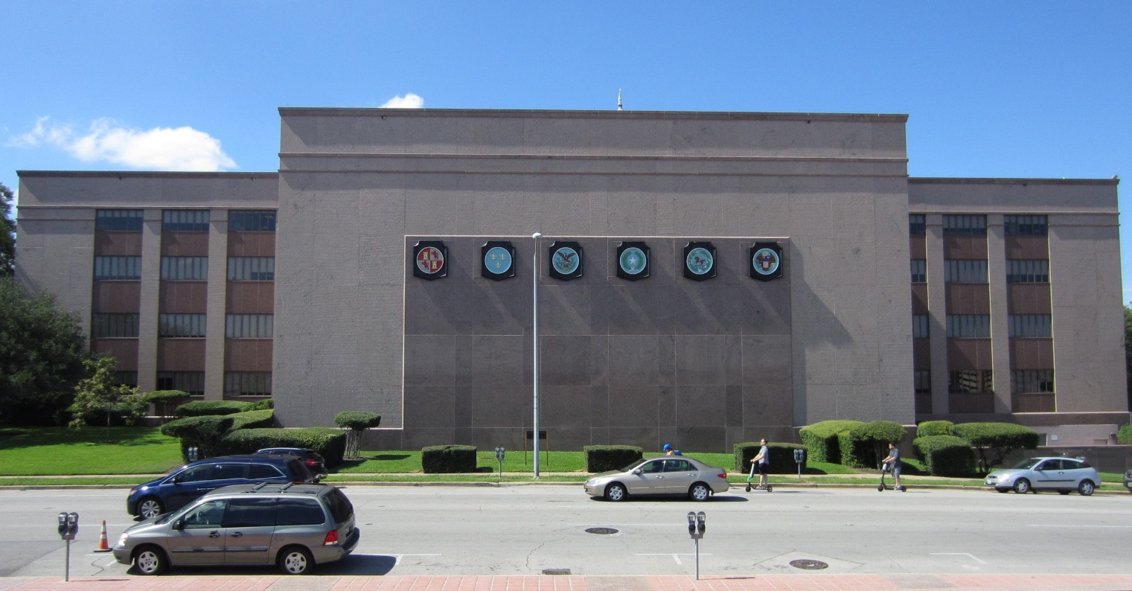
Questions? Advice?
Rebecca Romanchuk, Archivist III
rromnchk@tsl.texas.gov
Notes:
As Jessica said, we’re holding questions until the end of the Plenary presentations. And if anyone wants to offer advice on improving this method we’ve developed, I’d really welcome that, so please feel free to find me later today and share your thoughts. Thank you!

Slide 27
Supporting Internal Workflows with Plugins at the Bentley Historical Library
Dallas Pillen
Archivist for Metadata and Digital Curation
University of Michigan Bentley Historical Library
djpillen@umich.edu

Slide 28
Why Focus on Internal Workflows?

Slide 29
ArchivesSpace Does a Lot!
Accessions
Resources
Controlled vocabularies
Container/location management
Reports
Rapid Data Entry
Import/export

Slide 30
The Community Does a Lot!
Staff Interface Enhancement Working Group (SIEWG)
Public User Interface enhancement
Dev. Pri.
Yale container management plugin
Harvard Excel import plugin
Systems integrations
User and Technical Advisory Councils

Slide 31
And yet...
Generalizable ArchivesSpace core code improvements and community projects can’t support all local needs
BHL identified several needs during and since implementation that are very local
Interviewed users of the application
Turned results into user stories
Evaluated whether or not users’ needs were supported by default application functionality, community-supported enhancements, or local modifications

Slide 32
Why Plugins?

Slide 33
Plugins are Powerful
ArchivesSpace has a robust plugin architecture
http://archivesspace.github.io/archivesspace/user/archivesspace-plug-ins/
Can modify most aspects of the application
Plugins can benefit all users, regardless of technical ability or system-specific expertise
ArchivesSpace API is also powerful, but requires specialized knowledge and technical ability

Slide 34
Important Caveats
Plugin development itself requires specialized knowledge and technical ability
Depending on what you want to do, might require: Ruby, JavaScript, HTML, CSS, SQL
New ArchivesSpace releases might be incompatible with existing plugins
If possible, adapt local practice to match default functionality and use plugins for small, specific, non-critical functionality

Slide 35
Identifying and Supporting Local Needs

Slide 36
As a collections manager/processing archivist I need to know the donor number so that I can identify all accessions by a donor/reference the donor file/include the donor number in a finding aid/catalog record

Slide 37
As a development officer I need to update agent records with a unique identifier from the university’s donor relations database

Slide 38
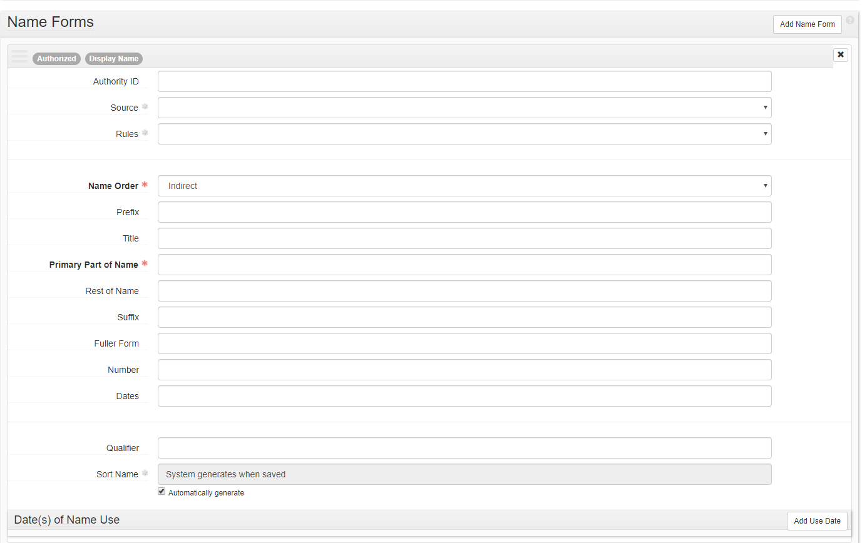

Slide 39
Donor Details Plugin
https://github.com/bentley-historical-library/donor_details
Adds 3 unique identifiers for donors of archival materials
Donor number
Local unique identifier. Corresponds to donor files with gift agreements, correspondence, etc.
DART LID
U-M Donor Alumni Relations Tool identifier
BEAL Contact ID
Legacy accessions/donor management system

Slide 41
As a collections manager I need to search/view specific fields within an accession record so that I can find specific material and types of material

Slide 42
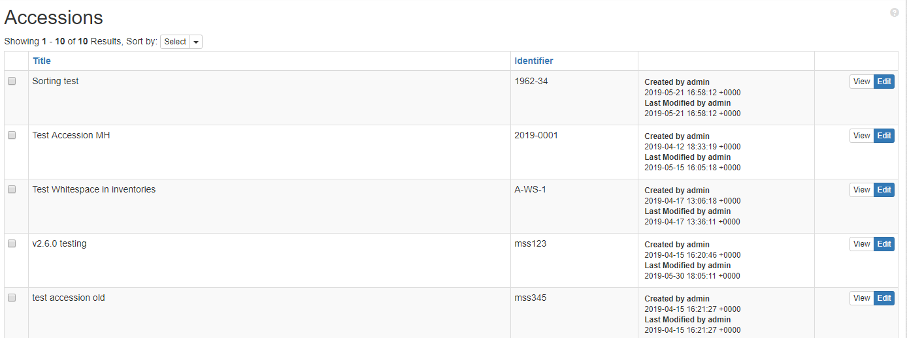

Slide 43
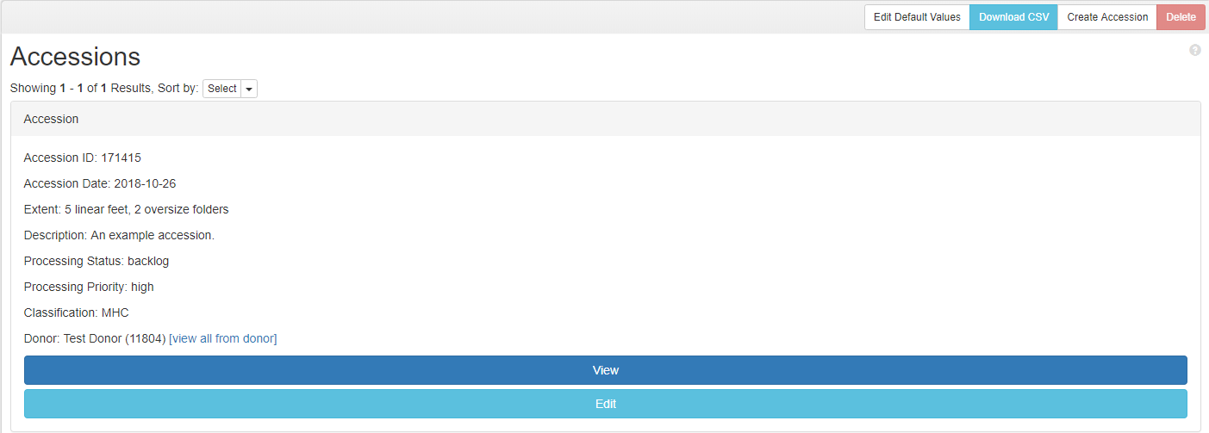
BHL Accession Search Results
https://github.com/bentley-historical-library/bhl_accession_search

Slide 44
As a field archivist/processing archivist I need to know the staff member responsible for accessioning/transferring material so I can generate reports for materials accessioned by a particular field archivist/ask questions related to content, context, and provenance

Slide 45
Accession Events
Legacy system had a “staff received” field
Uncontrolled, free text field
Decided to use an ArchivesSpace Event linked to staff member’s user agent record
Desire was expressed to streamline the creation of those Events
Accession events plugin: https://github.com/bentley-historical-library/accession_events
Fork of https://github.com/hudmol/accession_events
Automatically creates specified Events when a new Accession record is created

Slide 46
As an accessioning/processing archivist, I need to know that I am entering all required, locally preferred, and optional information correctly so that I can make sure I do not leave out pertinent information

Slide 47
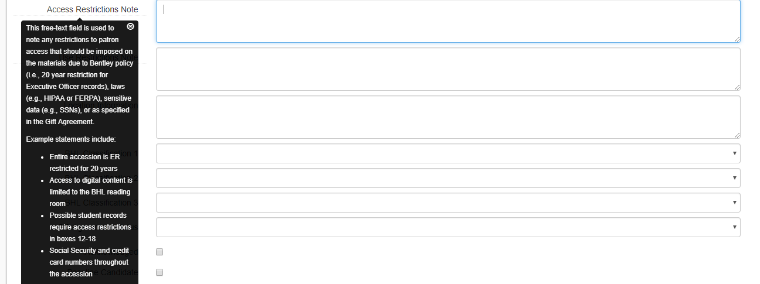
General Interface Modifications
BHL ASpace Translations: https://github.com/bentley-historical-library/bhl_aspace_translations
Modifies field names and tool tips to match BHL’s local documentation

Slide 48
General Interface Modifications
User Defined in Basic: https://github.com/bentley-historical-library/user_defined_in_basic
Fork of https://github.com/hudmol/user_defined_in_basic
Moves specified user defined fields into the Basic Information section
BHL Accession Read Only Fields: https://github.com/bentley-historical-library/bhl_accession_readonly_fields
Makes unused legacy fields read only

Slide 49
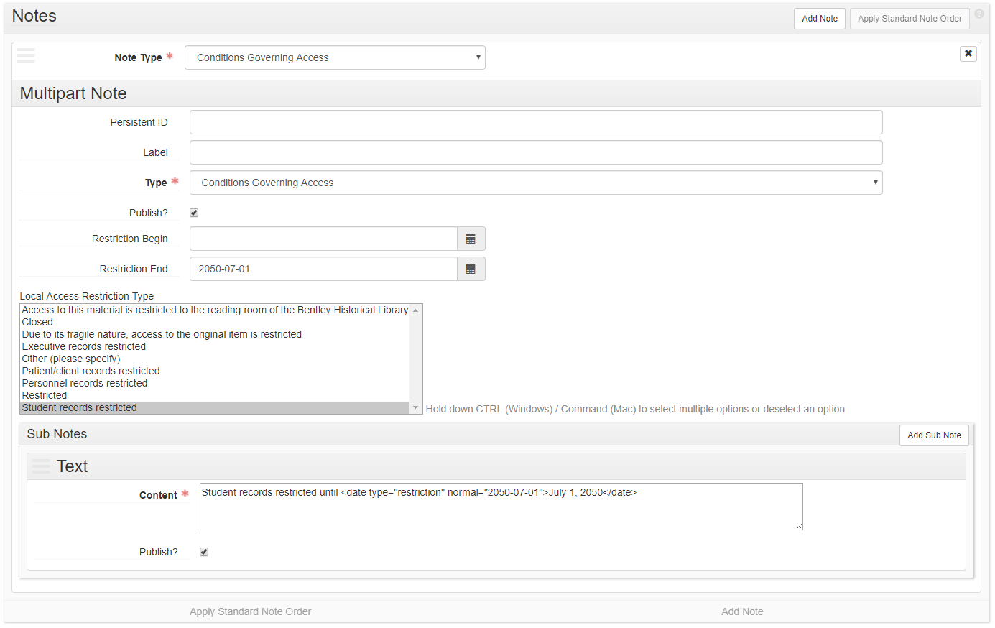
General Interface Modifications
BHL ASpace accessrestrict Text: https://github.com/bentley-historical-library/bhl_aspace_accessrestrict_text
Populates Conditions Governing Access note based on Local Restriction Type/Restriction End

Slide 50
As a field/university archivist I need to aggregate accession data for a given donor/university unit by donor number so that I can track and compile multiple accessions for a given donor/university unit
As a field/university archivist I need to aggregate accession data for general collecting areas so that I can prioritize and manage the backlog and generate statistics for business intelligence purposes
As a development officer I need to produce reports from ArchivesSpace to add information to the university’s donor relations database

Slide 51
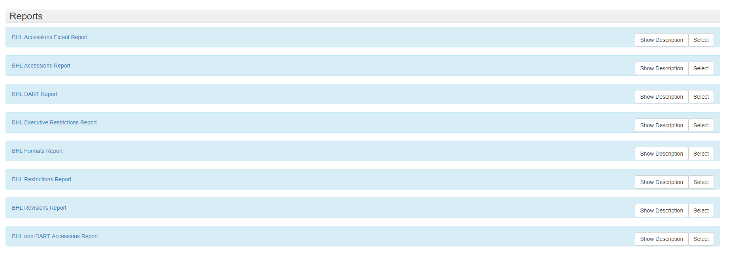
Reporting
BHL ASpace Reports: https://github.com/bentley-historical-library/bhl_aspace_reports

Slide 52
Select Other Plugins
BHL EAD Importer: https://github.com/bentley-historical-library/bhl-ead-importer
For migrating legacy EADs
BHL EAD Exporter: https://github.com/bentley-historical-library/bhl-ead-exporter
Modifies EADs for BHL’s finding aid platform (DLXS)
BHL Barcode: https://github.com/bentley-historical-library/bhl_barcode
Adds several API endpoints to return information for Aeon and digitization workflows
BHL Browse Pages: https://github.com/bentley-historical-library/bhl_browse_pages
Updates list of finding aids on BHL’s WordPress site
BHL ASpace Print Template: https://github.com/bentley-historical-library/bhl_aspace_print_template
Modifies print stylesheet for accession records
Heavily influenced by https://github.com/YaleArchivesSpace/print

Slide 53
Final Thoughts
We’re using a lot of plugins!
We also have a lot of justifications:
We’ve identified specific local needs
Most plugins do one small, specific thing
Most plugins are not supporting critical functionality or modifying the ArchivesSpace data model, but make the application generally easier for BHL staff to use
Important to document what plugins are being used, how they work, which aspects of the core application they modify

Slide 54
Implementing ArchivesSpace at the Bodleian Libraries
Matthew Neely, Senior Archivist

Slide 55
Archival Description at the Bodleian: A very brief history
Encoded Archival Description (EAD) adopted by the Bodleian in 1996.
First EAD catalogue published online in 1997.
Online catalogue of Archives and Manuscripts webpages gave undergone very little development work since early 2000s.
Search technology is very dated and relies on basic HTML search– CTRL F.
Difficult to see connections between archive collections for readers.
Poor user experience.
Reliant on a complex and time consuming XML to HTML transformation process for catalogue publication.
EAD catalogues were handcrafted in XML until 2013 when Archivists’ Toolkit was adopted as our cataloguing tool.
Severe lack of standardisation across Bodleian EAD catalogues. Flexibility of EAD was seen as a positive for the Bodleian’s complex catalogues when first adopted, but this approach created significant problems for the management of our metadata.
c. 96,500 boxes / volumes of Bodleian Libraries archives and manuscripts are included in an EAD-based online description

Slide 56
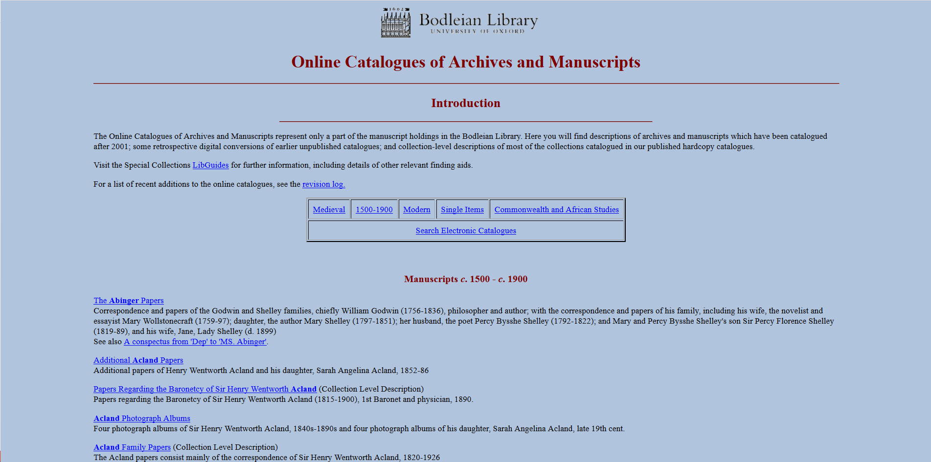
Online Discovery

Slide 58
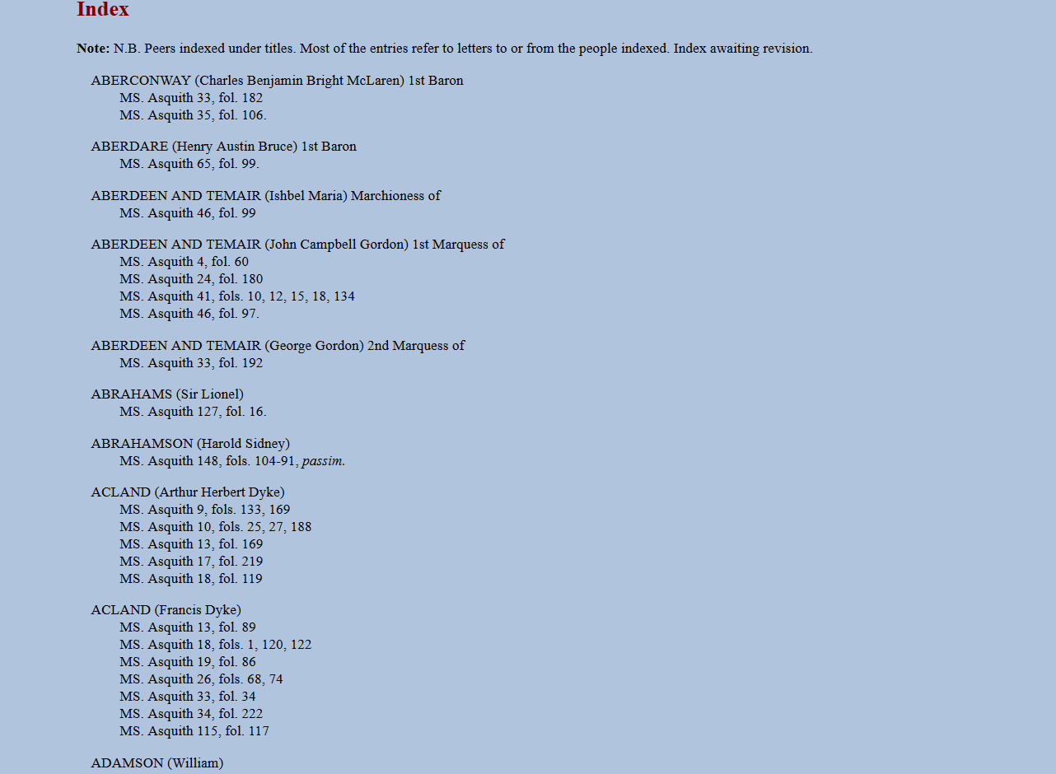
‘Back of the book’ indexes

Slide 59
Metadata audit and migration
Audit of over 3000 EAD catalogues to gain overview and consolidate storage of distributed data
Migration of EAD catalogues: EAD 1.0 > EAD 2002 standard
Trainee Digital Archivists and NQ Project Archivists - funded by Carnegie Corporation/HLF
Trainee Digital Archivists and Newly Qualified Project Archivists - funded by Carnegie Corporation and the Heritage Lottery Fund.
Software developer funded by Carnegie Corporation grant.
Some catalogues published online for the first time.
New Bodleian Archives metadata standard and cataloguing rules adopted.
Some catalogues going online for the first time.
Identify issues which future metadata migration must tackle
Standardisation of metadata – what data recorded and how
Gaps in ISAD(G) compliance
Identify issues which future metadata migration must tackle
Standardisation of metadata – what data recorded and how
Gaps in ISAD(G) compliance

Slide 60
Implementing ArchivesSpace
Out of the box implementation with some customisation of the PUI.
Migration of all EAD catalogues of archives and manuscripts currently published online.
Internal staff testing of the PUI.
Establish user roles and permissions.
Internal staff launch of the PUI in August 2019.
Public launch of the PUI in September 2019.

Slide 61
Archives Bodleian

Slide 62
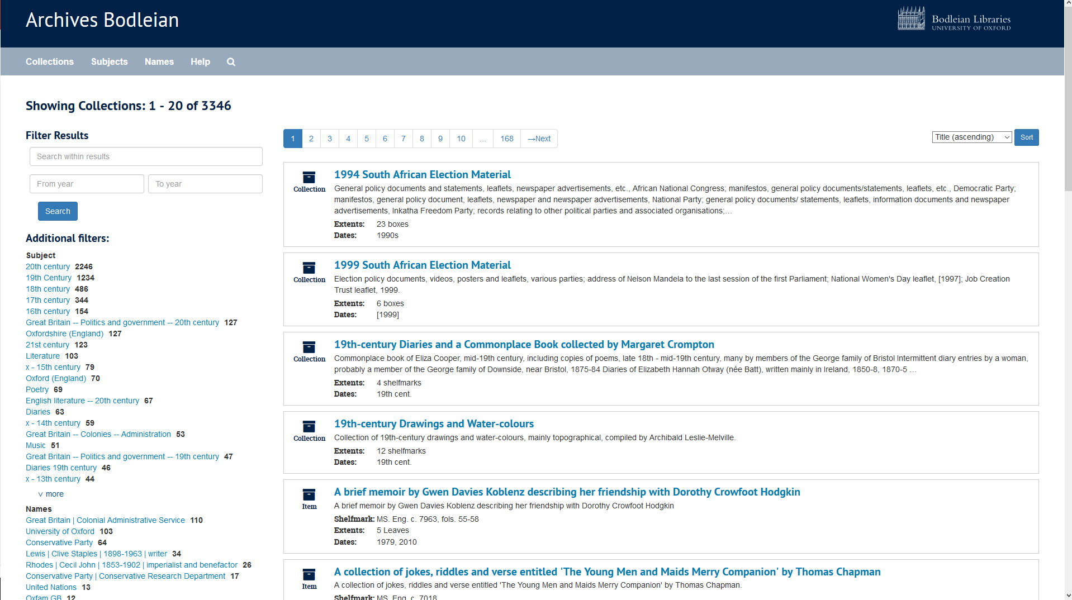

Slide 63
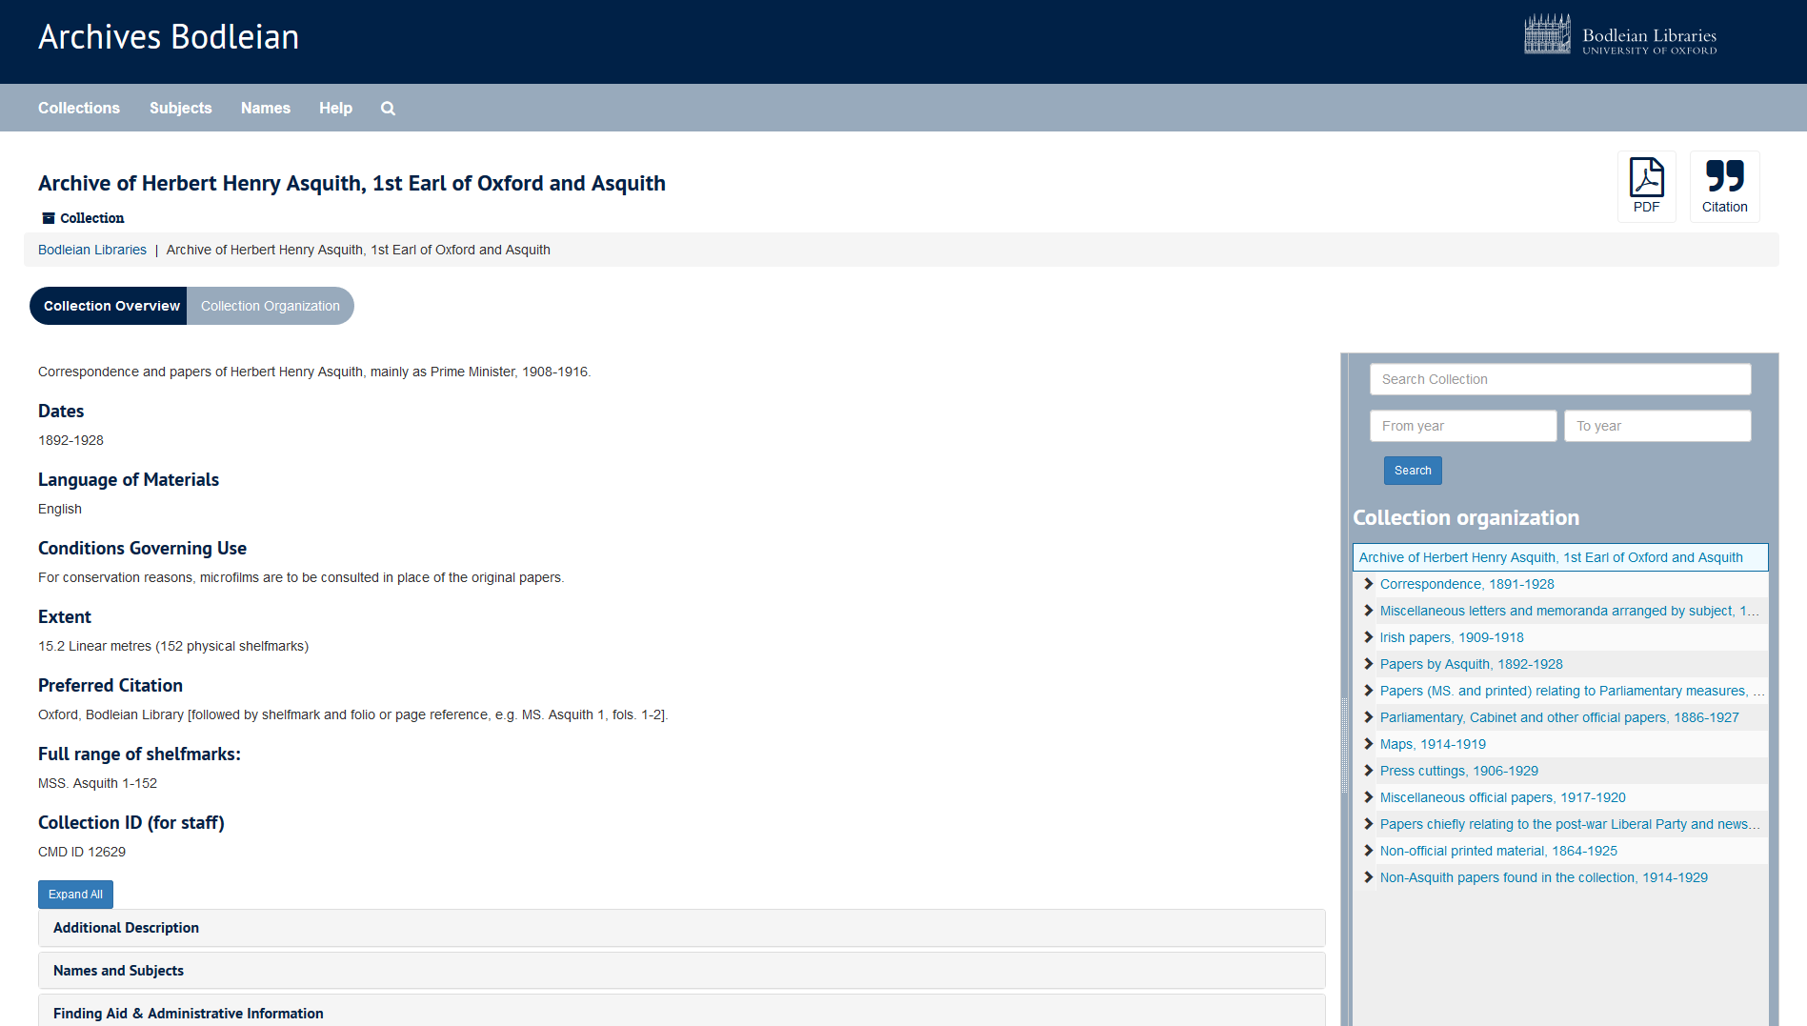

Slide 64
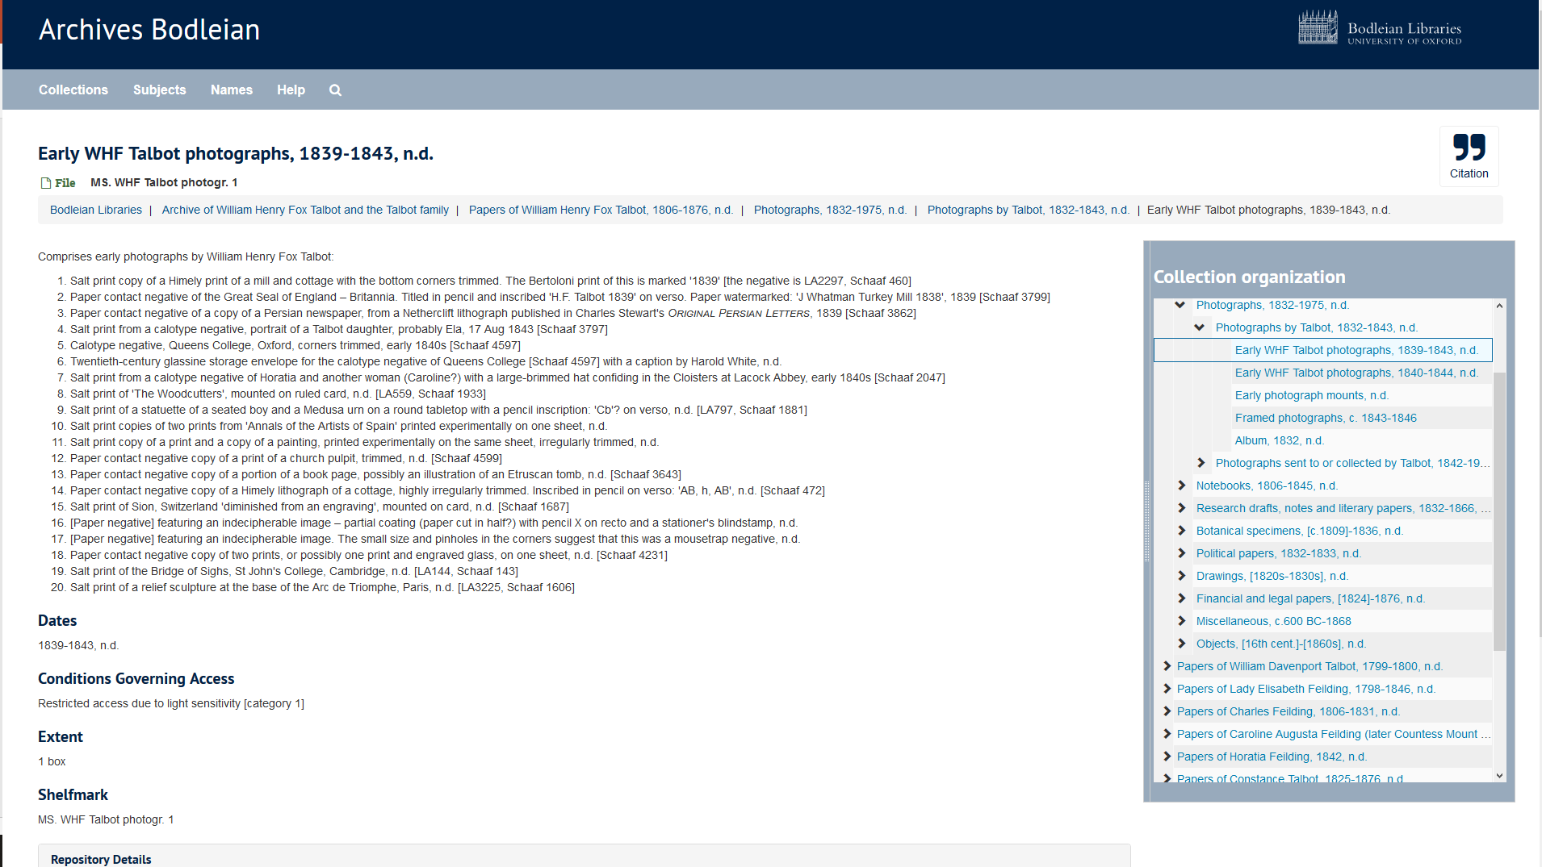

Slide 65
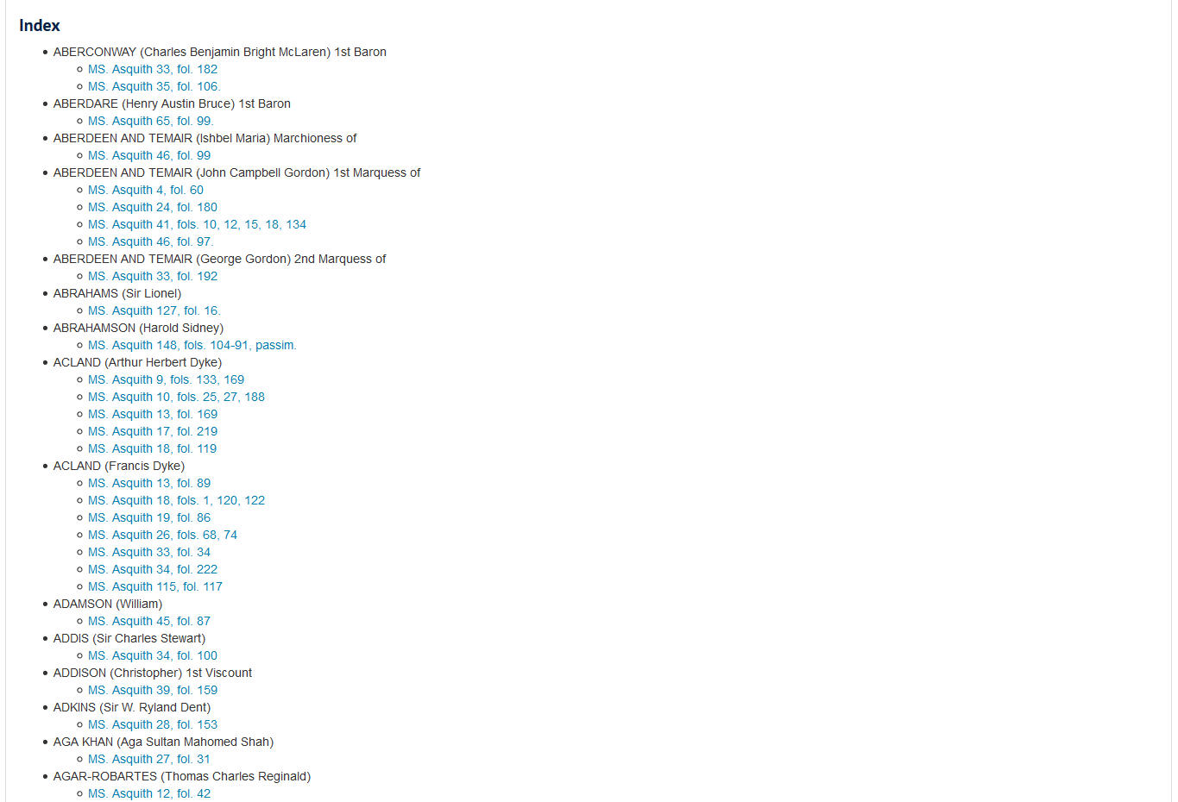

Slide 66
The road ahead
Public and (further) staff user testing.
User interface design enhancements based on user feedback.
Further search functionality modifications based on user feedback.
Develop procedural guidelines and local standards for staff.
Develop and deliver staff training.
Migration of active cataloguing projects.
Name and Subject authority file consolidation.
Retrospective conversion of the Bodleian Summary Catalogue (c.50,000 boxes).
Barcoding of all Bodleian archives and manuscripts.
Integration with circulation system for archives and manuscripts.
Persistent URLs.
Investigate handling of born-digital and digitised collection metadata.
Identification and integration of further plugins to enhance reader and staff functionality.

Slide 67
Email: matthew.neely@bodleian.ox.ac.uk
Web: www.bodleian.ox.ac.uk/weston

Slide 68
Beyond Top Containers
Weatherly Stephan
ArchivesSpace Member Forum 2019 August 2

Slide 69
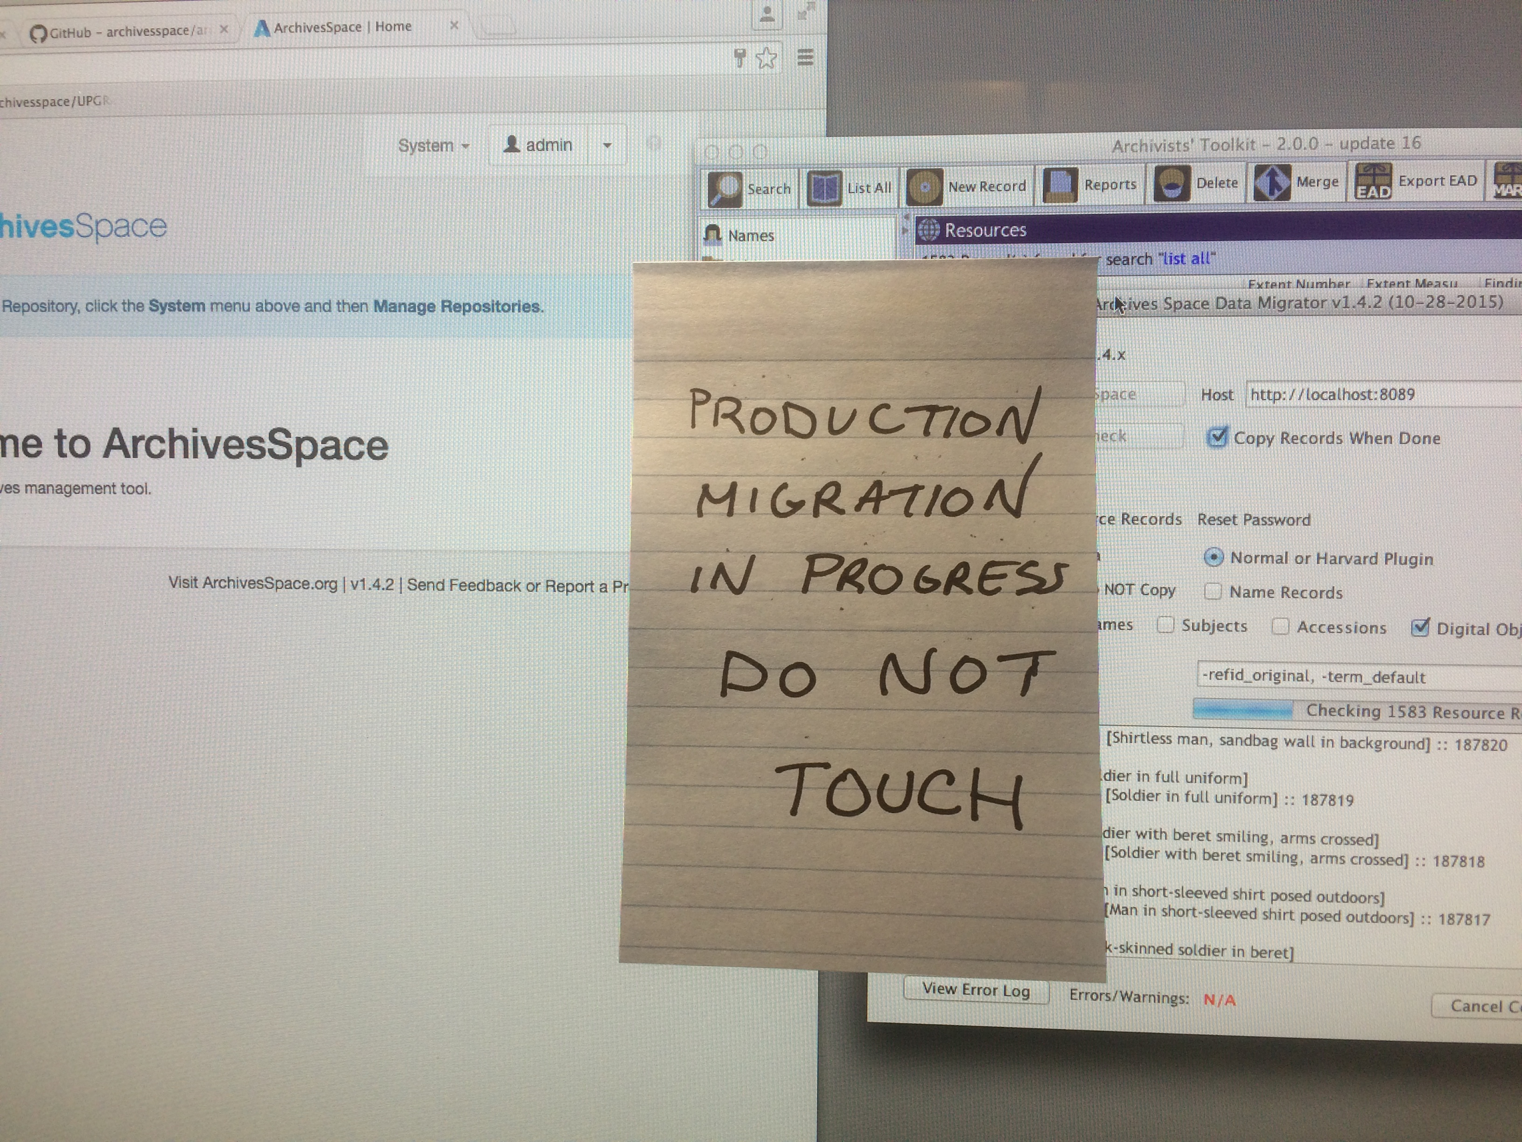
ArchivesSpace at NYU: The Beginnings

Slide 70
Plugins for Offsite Workflows
Digitization Work Order Plugin
github.com/hudmol/ digitization_work_order
NYU MARC Export Plugin
github.com/NYULibraries/nyu_marcxml_export_plugin

Slide 71
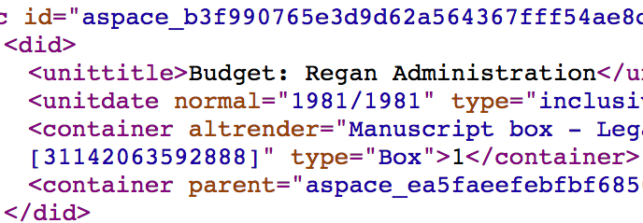
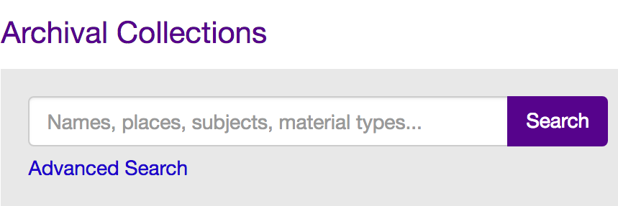
Archival Systems at NYU*
*a simplified view

Slide 72
Offsite Archival Storage
box by Rockicon from the Noun Project

Slide 73
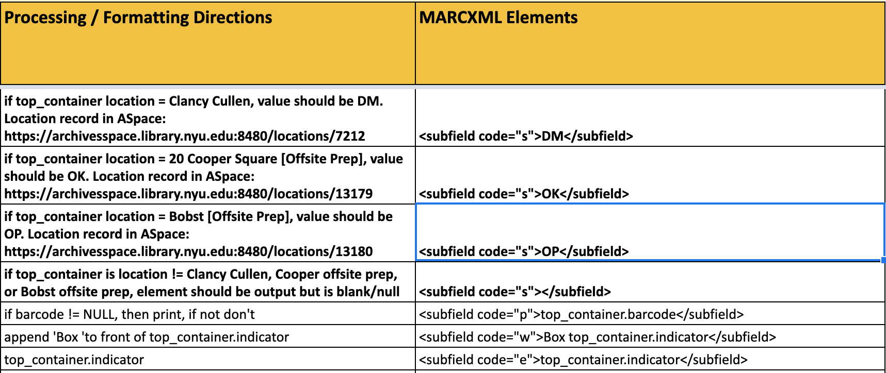
MARC Plugin Development

Slide 74
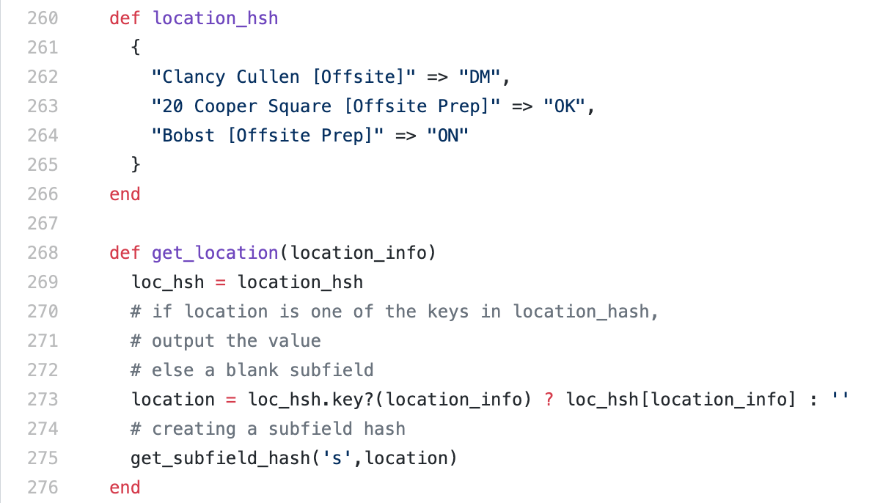
MARC Plugin Development

Slide 75
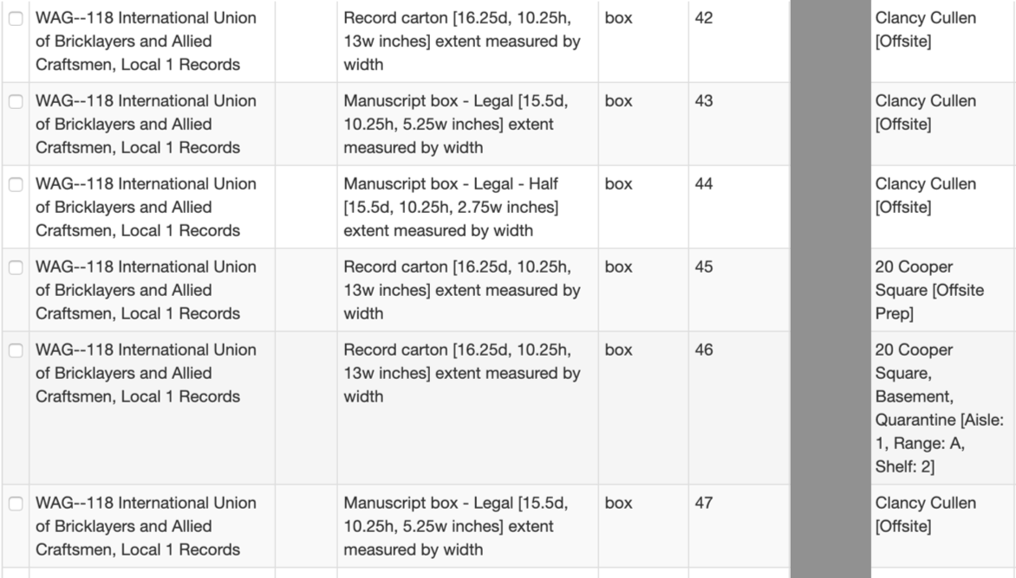
Handling Multiple Locations

Slide 76
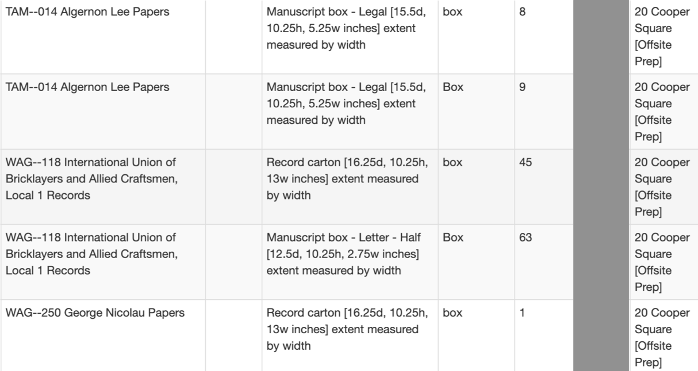
Estimating Pickup Size

Slide 77
Offsite Art Storage
bust by Dairy Free Design from the Noun Project

Slide 78
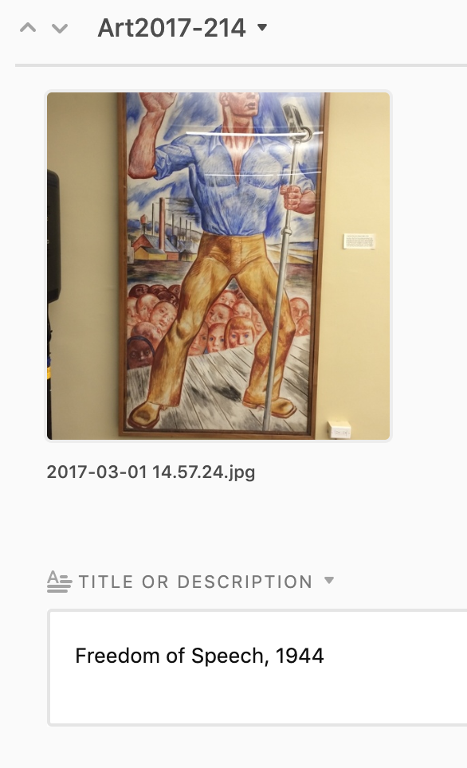
Object Identification

Slide 79
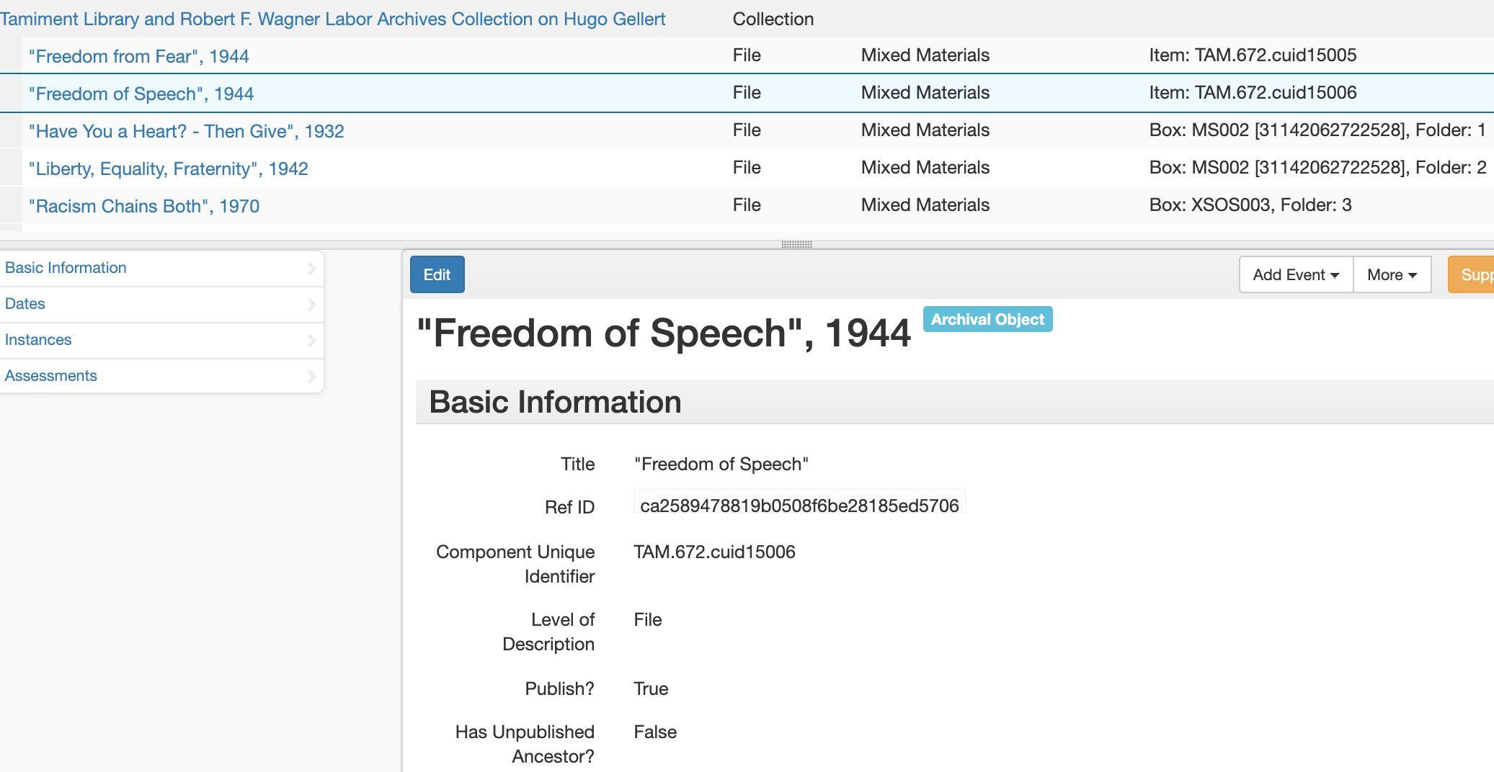
File Level Description

Slide 80
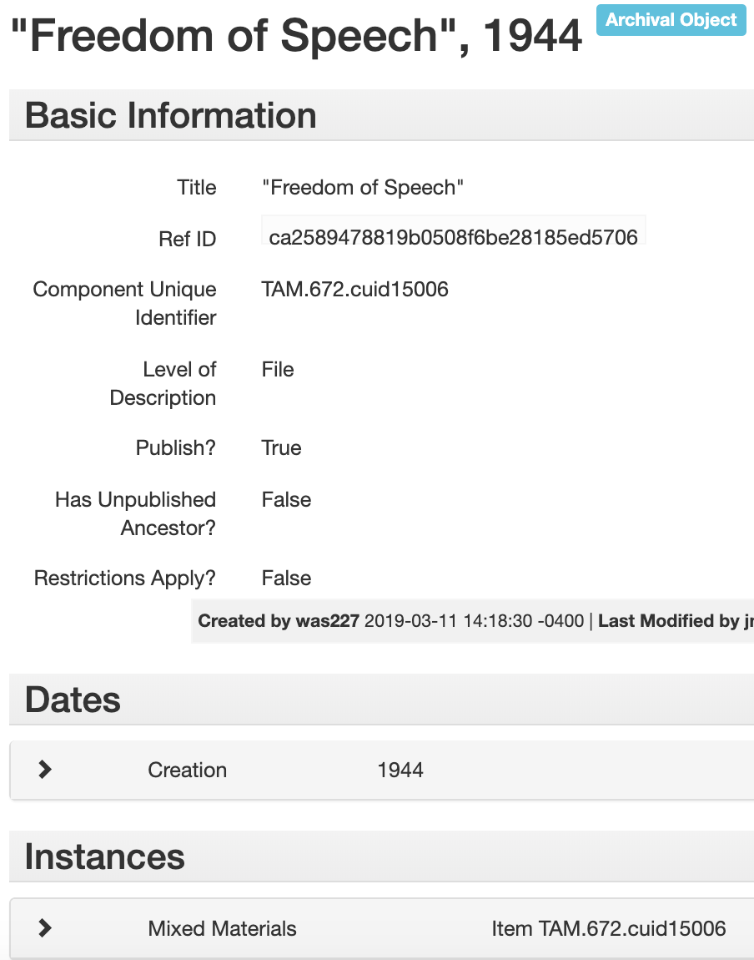
File Description + Instance

Slide 81
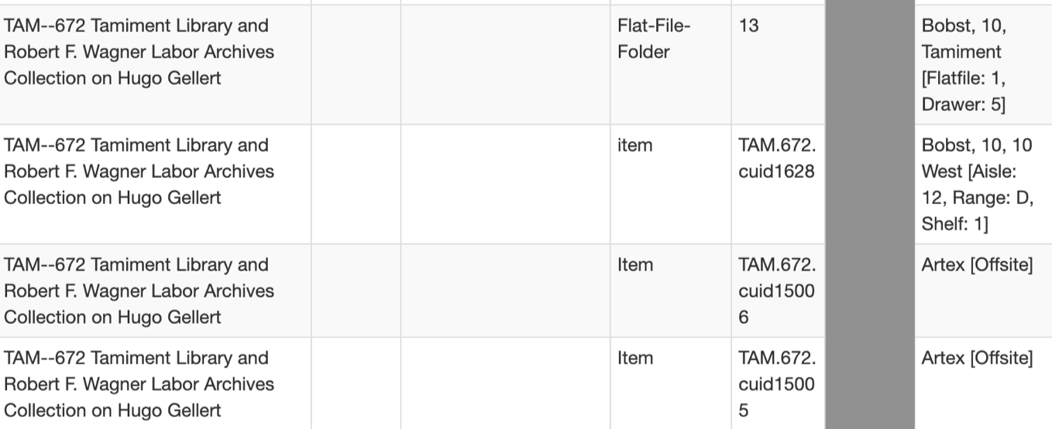
Collection Top Containers

Slide 82
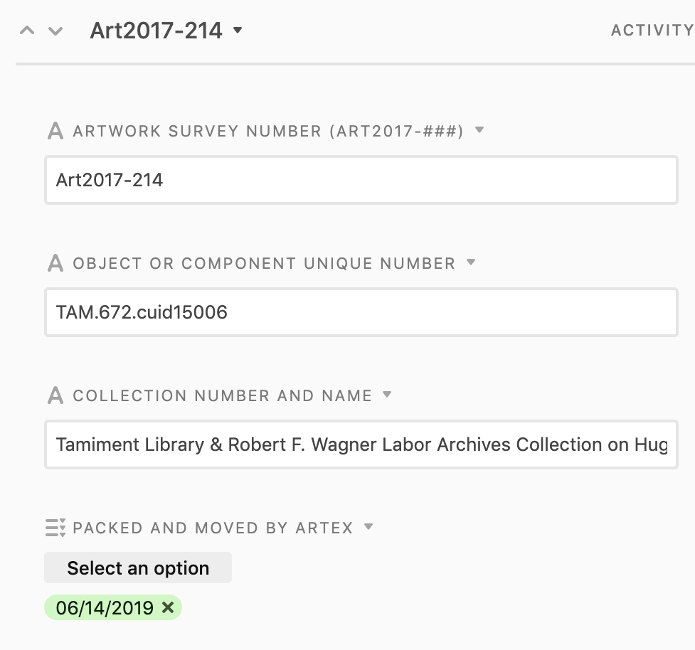
Tracking in Airtable

Slide 83
Offsite Analysis
join by Danielle Torres from the Noun Project

Slide 84
Data Integration in the Library Data Warehouse

Slide 85
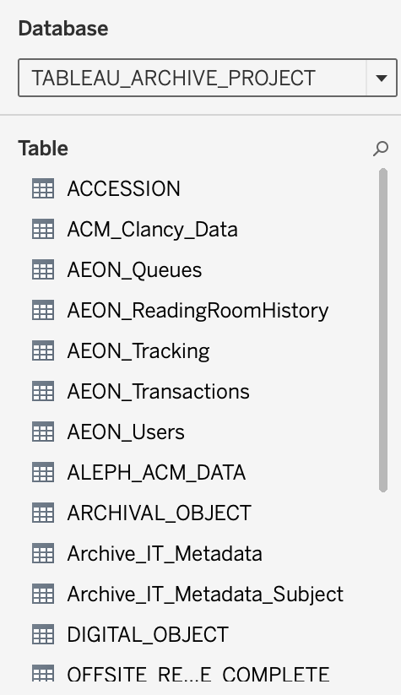
Archival Data Integration

Slide 86
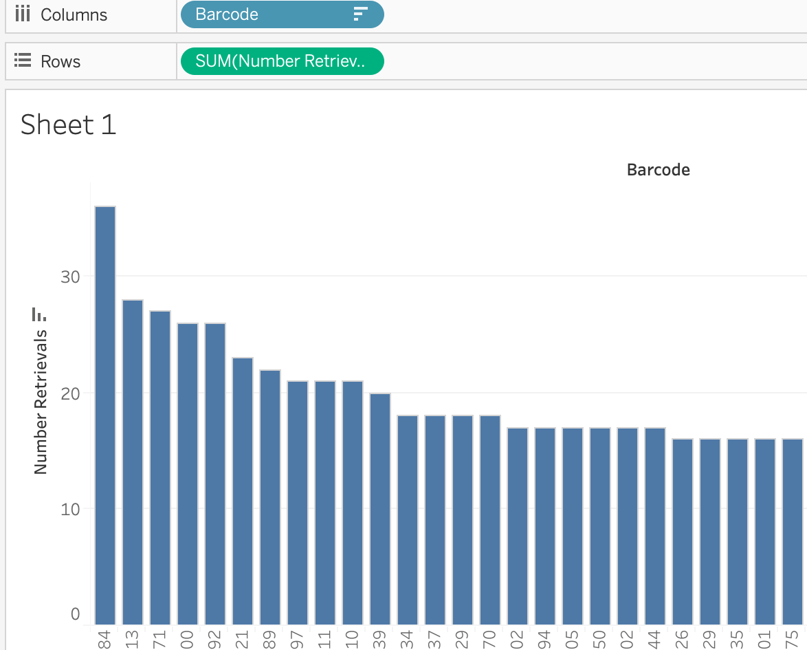
Data for Further Prioritization

Slide 87
Impact of New Workflows via ArchivesSpace
Collection Management Statistics | 2015-2016 | 2016-2017 | 2017-2018 | 2018-2019
Linear footage sent offsite | 834 | 1900.17 | 2171.85 | 2911.10
Collection count sent offsite | 54 | 99 | 185 | 439
Art objects sent offsite | n/a | 187 | 43 | 191

Slide 88
Thank you!
was227@nyu.edu
guides.nyu.edu/ArchivesSpace
guides.nyu.edu/ArchivalCollectionsManagement

Slide 89
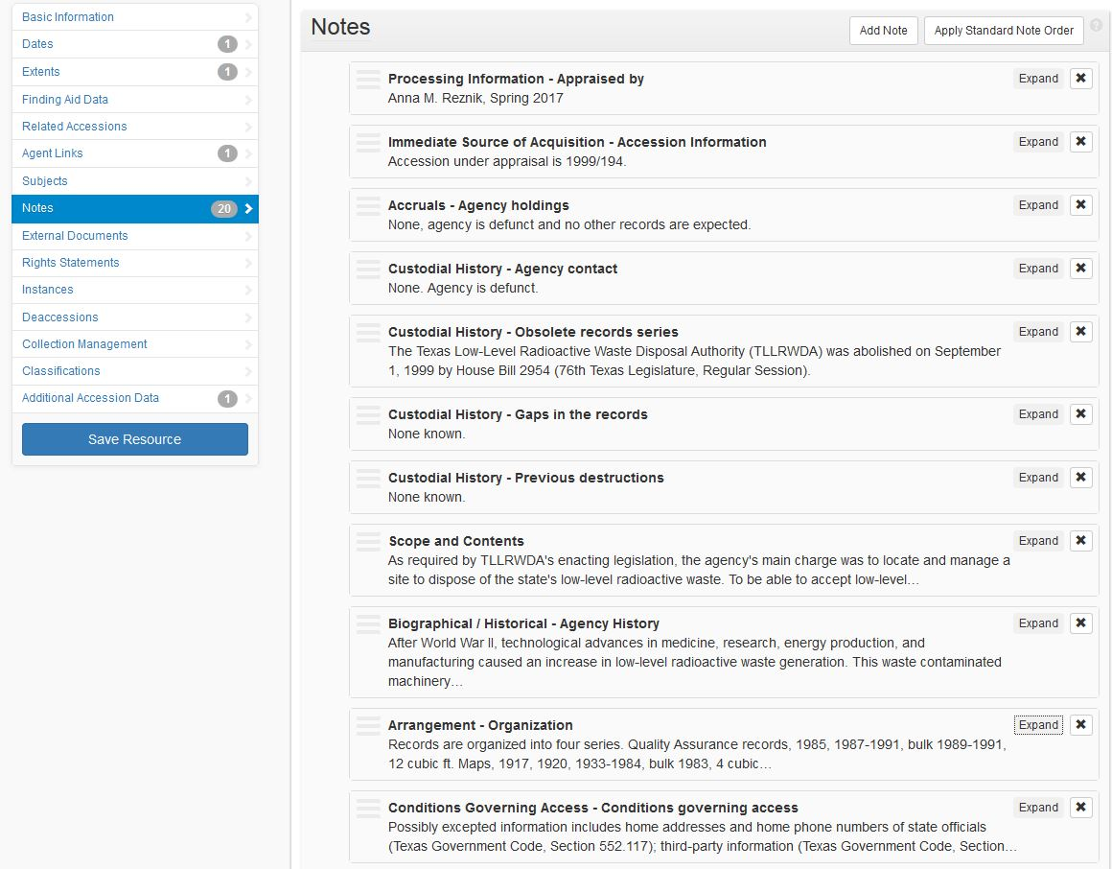
Resources: They’re Not Just for Finding Aids Anymore
Anna M. Reznik, Archivist
areznik@tsl.texas.gov
Notes:
Good morning, y’all! Welcome to Austin. I’m Anna Reznik and I am an archivist at the Texas State Library and Archives Commission (TSLAC).
Today I will be sharing how my institution is using the Resources module in ArchivesSpace to create appraisal reports.

Slide 90
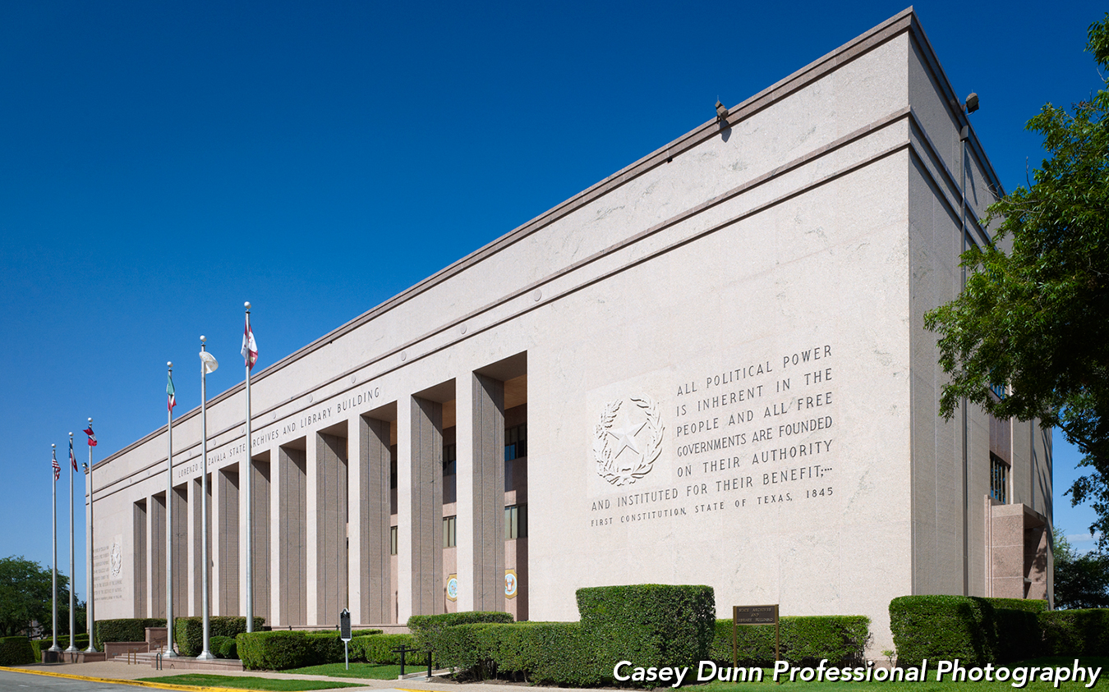
Texas State Library and Archives Commission
1201 Brazos Street, Austin, Texas 78701
Hours of Operation: Monday – Friday, 8 am to 5 pm
and Second Saturdays 9 am to 4 pm
Reading Room Hours: Monday – Friday, 8 am to 4:45 pm
and Second Saturdays 9 am to 3:45 pm
Notes:
We are located in between the JW Merriott and the Thompson Convention Center; next to the State Capitol. As the state library and archive for Texas, my institution primarily collect records of enduring value created and/or maintained by state governmental bodies, though we do accept manuscript donations to fill-in information gaps.

Slide 91
Notes:
At present, we have slightly more than 82,000 cubic ft. of physical materials and several terabytes in our holdings. Like other archives, we have a limited amount of available empty physical storage space.
In late 2017, my institution made the decision was made to make appraisal a higher priority for all archivists with processing duties, opposed to a handful of staff conducting reviews. Our appraisal push included addressing our backlog appraisals, meaning records we accepted and accessioned with the intention to appraisal later . . .

Slide 92
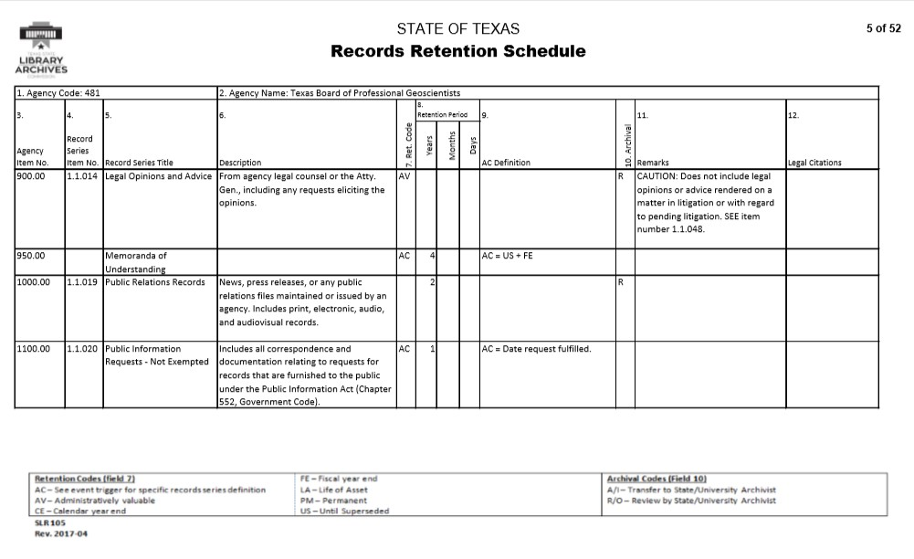
Notes:
as well as making decisions on state government records series that had an archival review note on a given agency’s retention schedule.
The latter is noted with a R in the Archival column. These are known as “incoming” appraisals because the creating body maintains legal custody of the records until the final decision has been made.

Slide 93
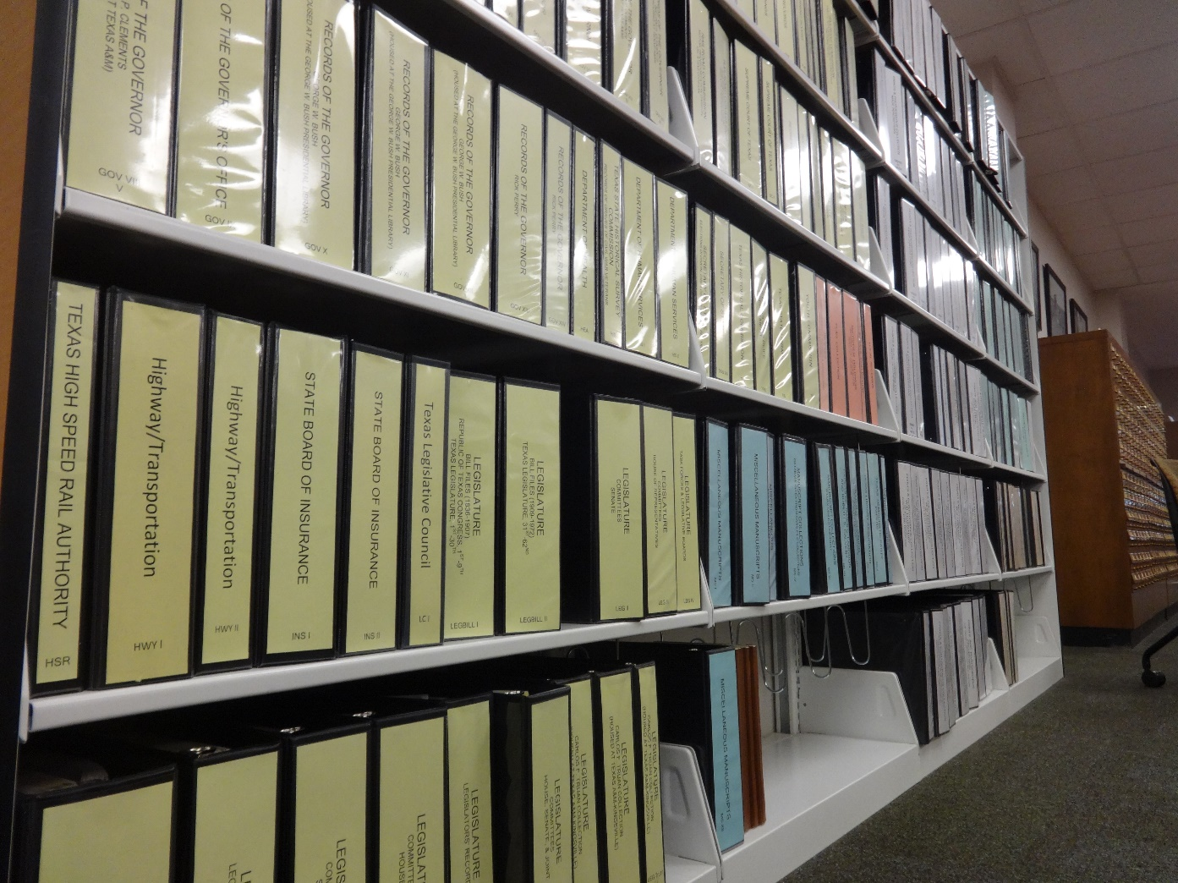
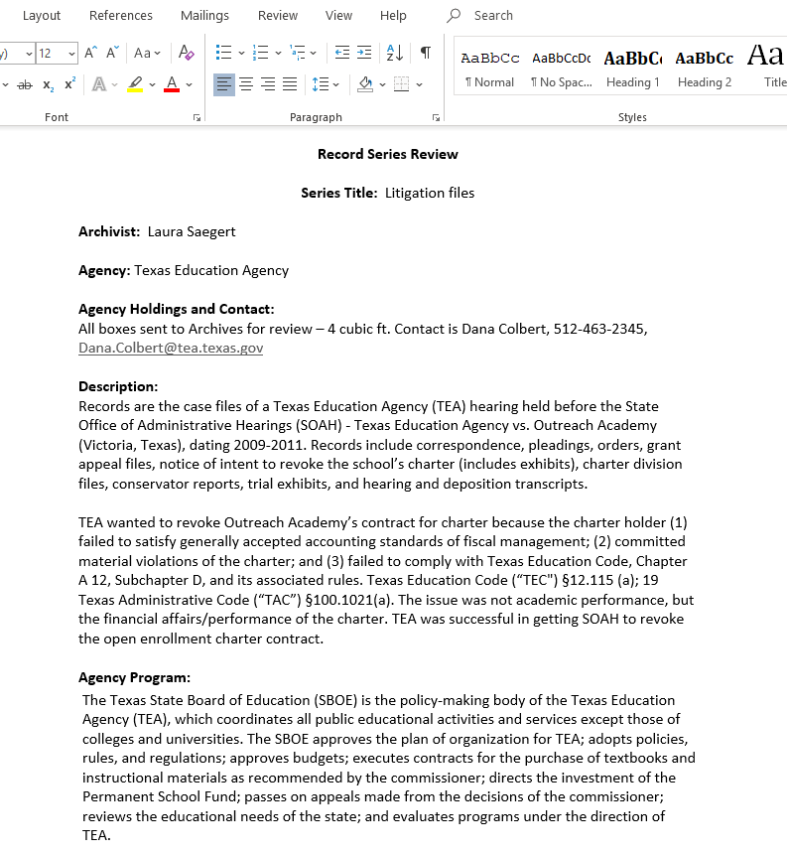
Appraisal in ArchivesSpace
Notes:
Prior to late 2017, our appraisal reports were written in Word, with some mounted on our agency website. We also make our reports available in our archives reading room browse-able binders.
When we received executive approval to implement ASpace, the decision was made to have the system as a one-stop-shop for all of our archives tasks. This included documenting our appraisal decisions and actions as well as keeping our reports in a centralized “space.”

Slide 94
Appraisal in ArchivesSpace
Must-haves
Like-to-haves
Way to circulate export report for comment.
Need to be able to have specific fields available.
Little technical expertise needed.
Templates to standardize format.
Way to allow for collaboration.
Streamline process for incoming reviews.
Notes:
We could not depend on developing an in-house plug-in to customize our instance of ASpace, so we needed an “out-of-the-box” solution. Before we could dive into using ASpace for appraisals, we differentiated our must-haves from our like-to-haves to determine the best path forward.
For must-haves, we needed a way to output the report in a way that all the necessary fields were visible. These fields provide context on the records under review addition to outlining the recommendation. Some of our reviews have an impact on records retention schedules, so we are likely more through in our appraisals than other types of repositories.
Also, we wanted to avoid dealing with character limit issues when lengthy context was necessary. Additionally, staff had varying comfort levels with ASpace and appraisal, so our end-process needed to be user-friendly and flexible.
Ideally, we wanted a way to standardize our reports. Occasionally, an appraisal project involved teams of archivists and we hoped ASpace would support this collaboration. And minimized the existence of multiple copies and versions of a report.
Finally, this posed an opportunity to we consider how we appraise government records.
Let’s look at the options we considered -

Slide 95
Events?
Notes:
The first option we explored was to create a new event and select appraisal for the type. This options for appraisal focused on the final decision, and not how we arrived at this decision.
We could see this being adequate for some institution’s needs, especially if they attached the appraisal report as an external document. For this project, we wanted something that improved our processes instead of continuing the status quo.

Slide 96
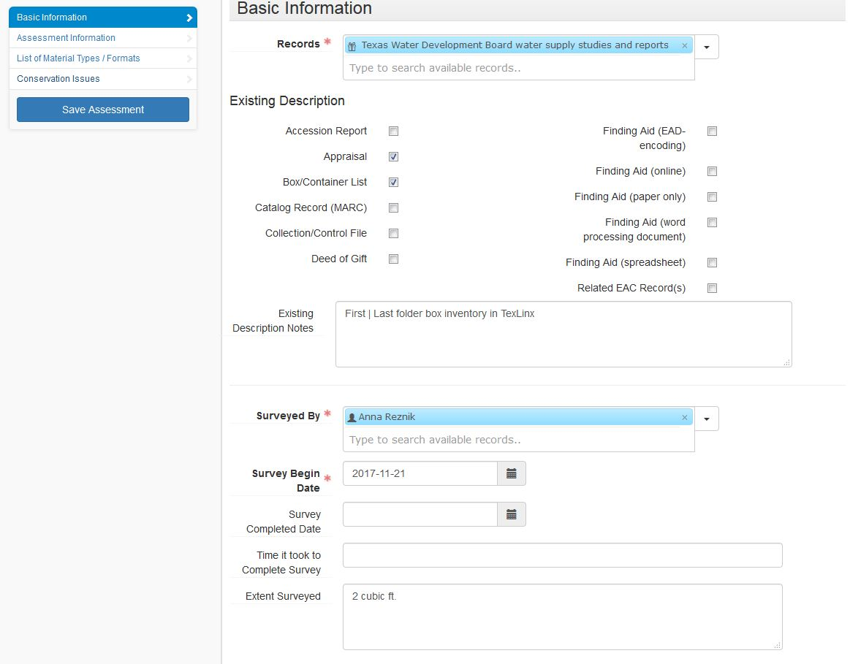
Assessment Module?
Notes:
Early in the appraisal push, the Assessments Module was released. Maybe it would allow us to systematically appraise records?
The biggest drawback with the Assessments Module is that we could not export the information captured into a report to circulate for comment. The module is not visible on the Public Interface (for good reason), so printing from the Public Interface view was not a viable alternative.
The assessment module’s strength is assisting with prioritization, not documenting the nitty-gritty of why an appraisal decision has been made.

Slide 97
Accessions Module?
Notes:
What about the Accessions Module?
The major pros included: staff were most familiar with this module, templates could be created to minimize repeated data entry, and some of the information we wanted to capture fit into our use of the Accessions Module.
Early on, we realized that the Accessions Module did not quite meet our needs. Fields such as the Content Description have character limits, the relationship between the series under review and archival series/publication could not be easily described in the available fields, most of the fields in the User Defined Data section had been reserved for capturing additional “accession” data, and many fields that did capture appraisal information are hidden in the Public Interface view. As printing from the Public Interface view was the easiest way to create reports from accession records, the latter was a major problem.
Another strike against using the Accessions Module was we expected a sizeable percentage of series under reviewed to be appraised as non-archival. Would a large number of completely deaccessioned entries be a bare to work with for reporting or searching purposes? What message would a large amount of completely deaccessioned “accessions” send to stakeholders?

Slide 98
Resource Module?
Notes:
It became obvious that the Resources Module best met our needs. Reports could be exported as PDFs, with all fields visible. There were no character limits and notes could be repeated. Although we have not implemented the Resources Module for finding aid creation, staff were familiar with EAD and the Accessions Module, which helped minimize the expertise necessary to create appraisal reports in ASpace.
To better track and manage our appraisals, both for incoming and backlog reviews, we created a “repository” named Review. A template specific to appraisals was created for this repository.
Also in the Review repository, we have accession record stubs to capture information about records in the queue to be reviewed.

Slide 99
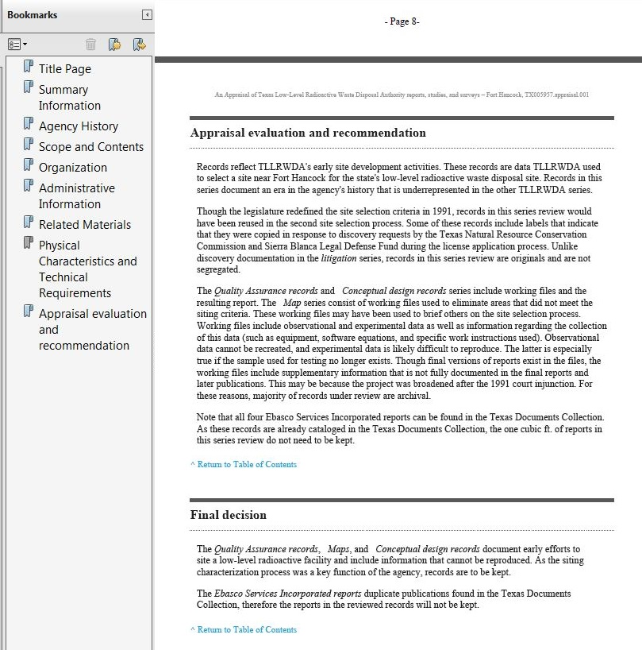
Results
Notes:
We wrote all the fields that we wanted and considered the possible note type equivalent. For some, such as arrangement, there was an obvious choice. For others, such as gaps in records, took more careful consideration.
As the appraisal note type output in the middle of the PDF report, we decided to use general for the note type, so the content appeared at the end of the report.
For testing, I used a finished backlog appraisal to tweak the instructions. If you would like to know more about my appraisal work related to the TLLRWDA, I’ll be presenting about that topic at tomorrow’s Science/Technology/Health Care section at 10 am!

Slide 100
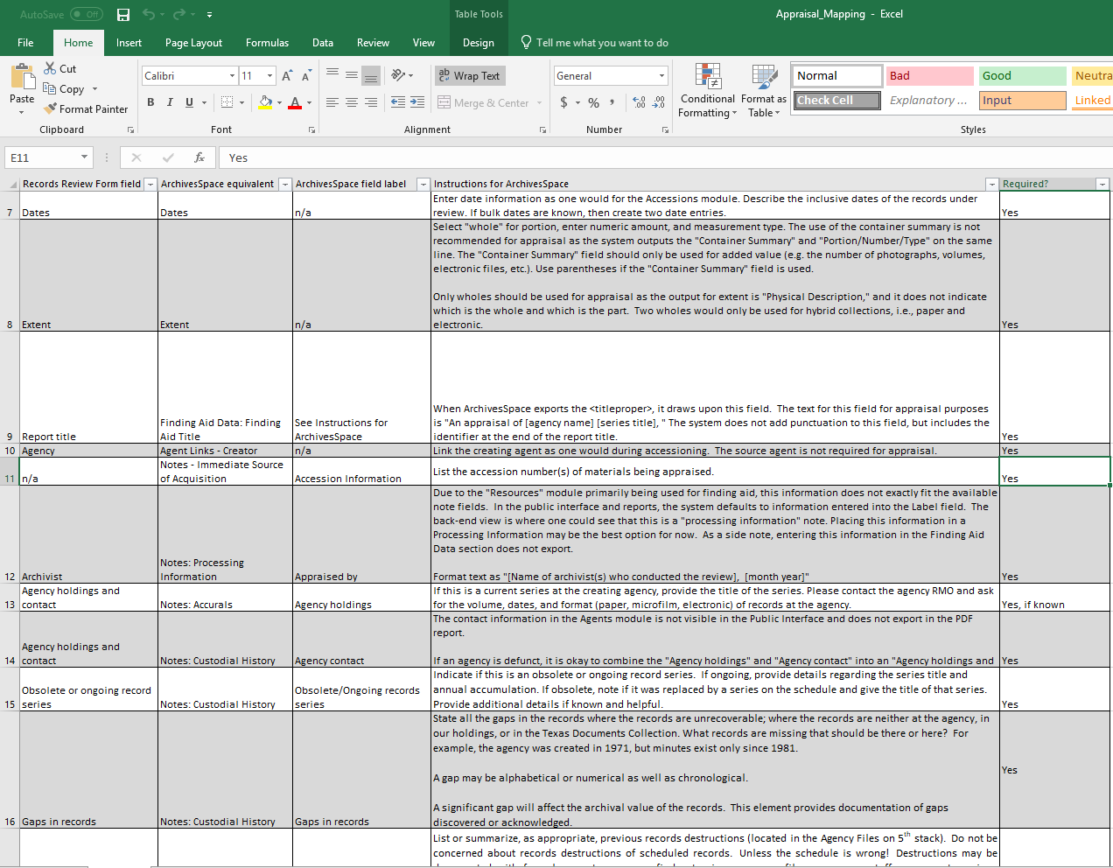
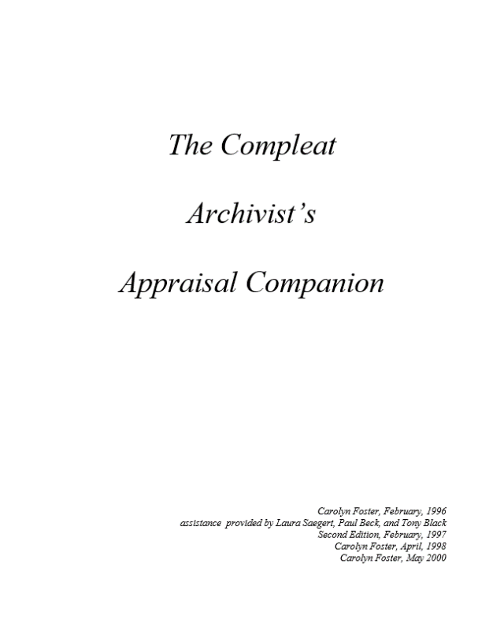
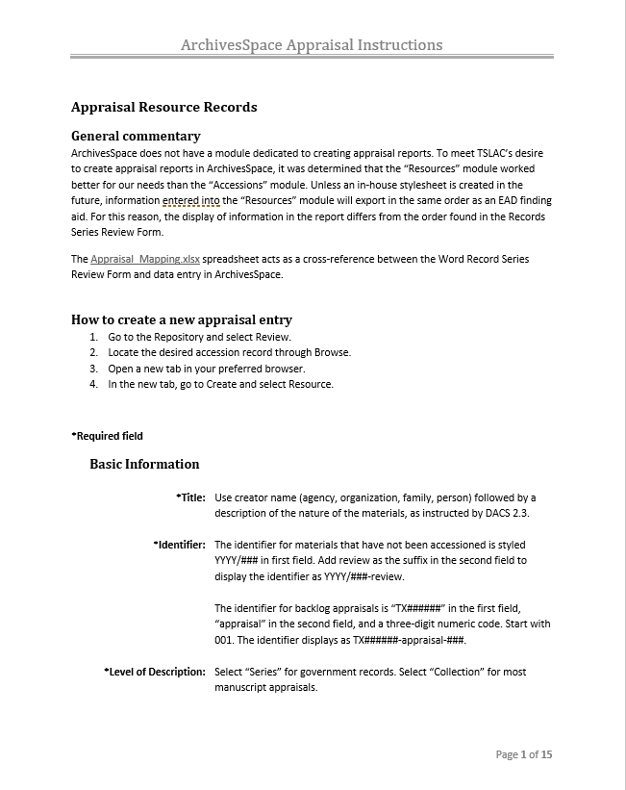
Instructions and Workflows
Notes:
We integrated ASpace into our appraisal manuals and created a cross-walk from the old template to the ASpace field. Field-specific instructions largely mirrored our Word instructions except where we decided to condense fields. We also indicted which fields were required and which were optional for incoming appraisals.

Slide 101
Staff Response
Increased standardization
Reports created more quickly and look more “polished”
Easier collaboration on team appraisal
Appraisal work visible and easier to track
Notes:
Some of the benefits of using the Resources Module to create appraisal reports were expected: more standardization, reports look more “polished,” and quicker to create reports.
Additional unexpected benefits include it is easier to collaborate when multiple people are working on a project and we can see the archivists’ work in a more visible way.

Slide 102
Questions?
Anna M. Reznik: areznik@tsl.texas.gov
https://www.southwestarchivists.org/archives-space-resources/
Notes:
If you would like to see our instructions and cross-walk, it is available through on the Society of Southwest Archivists ArchivesSpace Resources page. And if you are in the SSA region and have materials to share, please feel free to contact Rebecca.

Slide 103
We can do it!
Introducing the Community Developers’ Queue
Maggie Hughes and Lydia Tang
Development Prioritization subteam
Notes:
[Lydia] Introduction
We’re here today to introduce a new status in the ArchivesSpace JIRA kanban boards, and explain how it can help you get involved.

Slide 104
Development Prioritization review process
Awaiting Prioritization
Awaiting More Information
Ready for Implementation
Started
Dev Pri review
Will Not Do
Notes:
[Lydia] Quick review of how Dev Pri works
We’re co-leaders of the Development Prioritization sub-team, which is a sub-team consisting of members from both the Users Advisory Council and Technical Advisory Council.
In collaboration with the ArchivesSpace Program Team, Dev Pri prioritizes feature requests and bug reports for developers working on future releases of the ArchivesSpace program and is preparing a survey which you will see soon!
Throughout our monthly Dev Pri subteam meetings, we review hundreds of JIRA tickets, verifying whether the issue is still relevant, gathering additional information, confirming or reevaluating the priority ranking of the ticket, and routing the tickets to one of the following queues:
Awaiting More Information if the ticket has questions, needs more specification, and isn’t ready for a developer quite yet
Will Not Do if the ticket should be closed (such as if the ticket is a duplicate, or the request is too institution-specific); or
Ready for Implementation if the ticket is ready to be worked on by a developer.

Slide 105
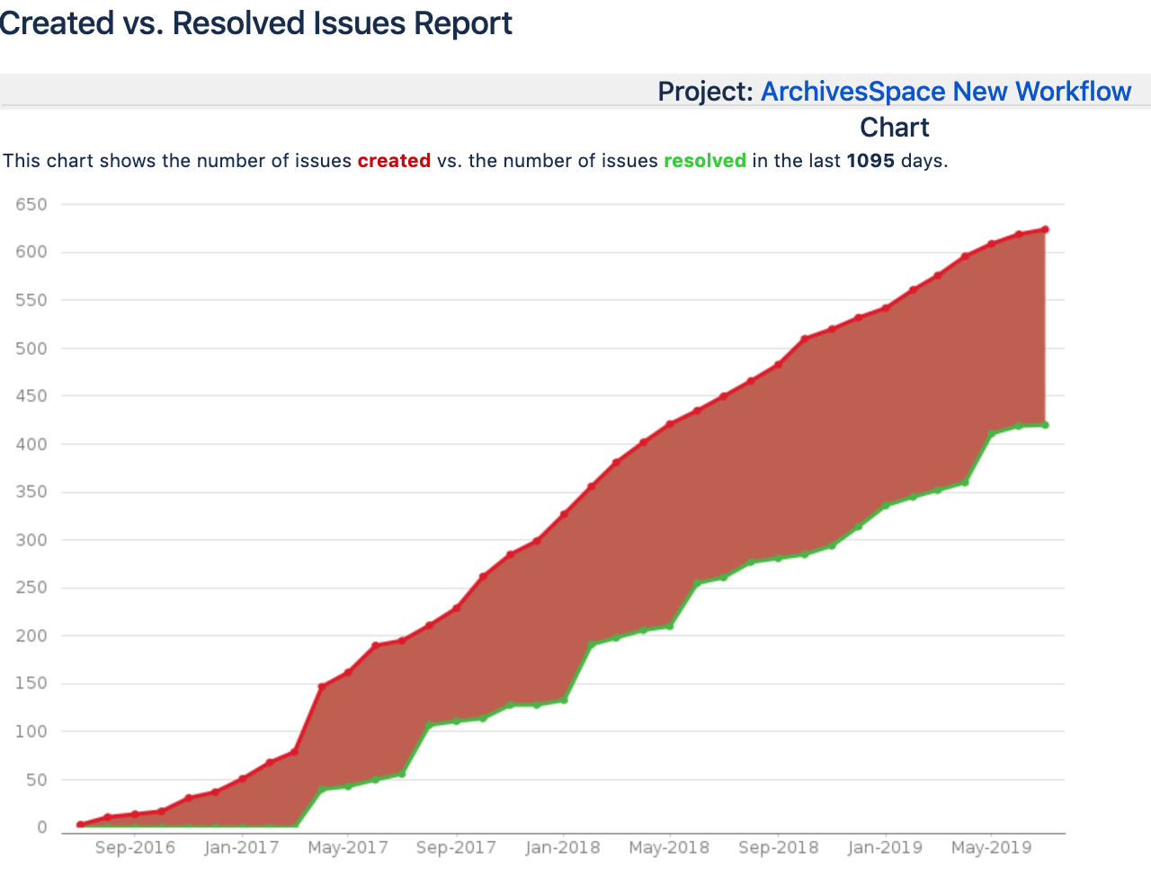
Notes:
[Lydia] Why the new status
While Dev. Pri. has been working hard to increase our capacity for fielding tickets, the program still had a sticking point.
There were so many tickets now in the Ready for Implementation queue that developers needed a prioritization process to prioritize the prioritized!
With so many tickets in the development backlog, it made it hard for the ASpace program team to prioritize which tickets should get their developers’ attention.
As you can see from this graphic, even though Dev Pri prioritizes tickets, the ASpace developers have a limited capacity. The top line is the amount of tickets that are created and the bottom line is when the tickets have funneled through their entire lifespan, a pull request has been submitted, and the ticket is closed.

Slide 106
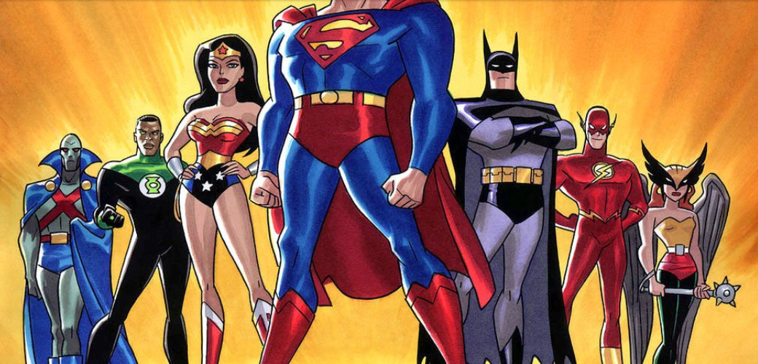
Goal:
The Technical Advisory Council (TAC) "provide[s] technical guidance and encourage[s] an active community of developers"
Notes:
[Maggie]
Meanwhile, the Technical Advisory Council had been having ongoing conversations during their meetings about how to encourage an “an active community of developers” (a charge from the ASpace Governance bylaws).

Slide 107
Ready for Community Developer
Awaiting Prioritization
Awaiting More Information
Started
Dev Pri review
Ready for Implementation
Will Not Do
Notes:
MAGGIE
To remedy the unprioritized backlog and to accomplish TAC’s goal, in collaboration with Christine, we developed a Ready for Community Developer queue! This status is for smaller and more straightforward changes to the application – changes that are nice to have, but not critical, probably don’t touch a lot of parts of the application, and basically would be perfect to highlight as opportunities for community coder participation.
The new status also aligns nicely with TAC’s role in the ASpace community.
We hope that this new status will shorten the backlog of tickets for the ASpace program and developer teams, allowing them to prioritize more efficiently, as well as work towards the TAC goal of encouraging an “active community of developers” by making it easier for people to identify tickets and contribute code.

Slide 108
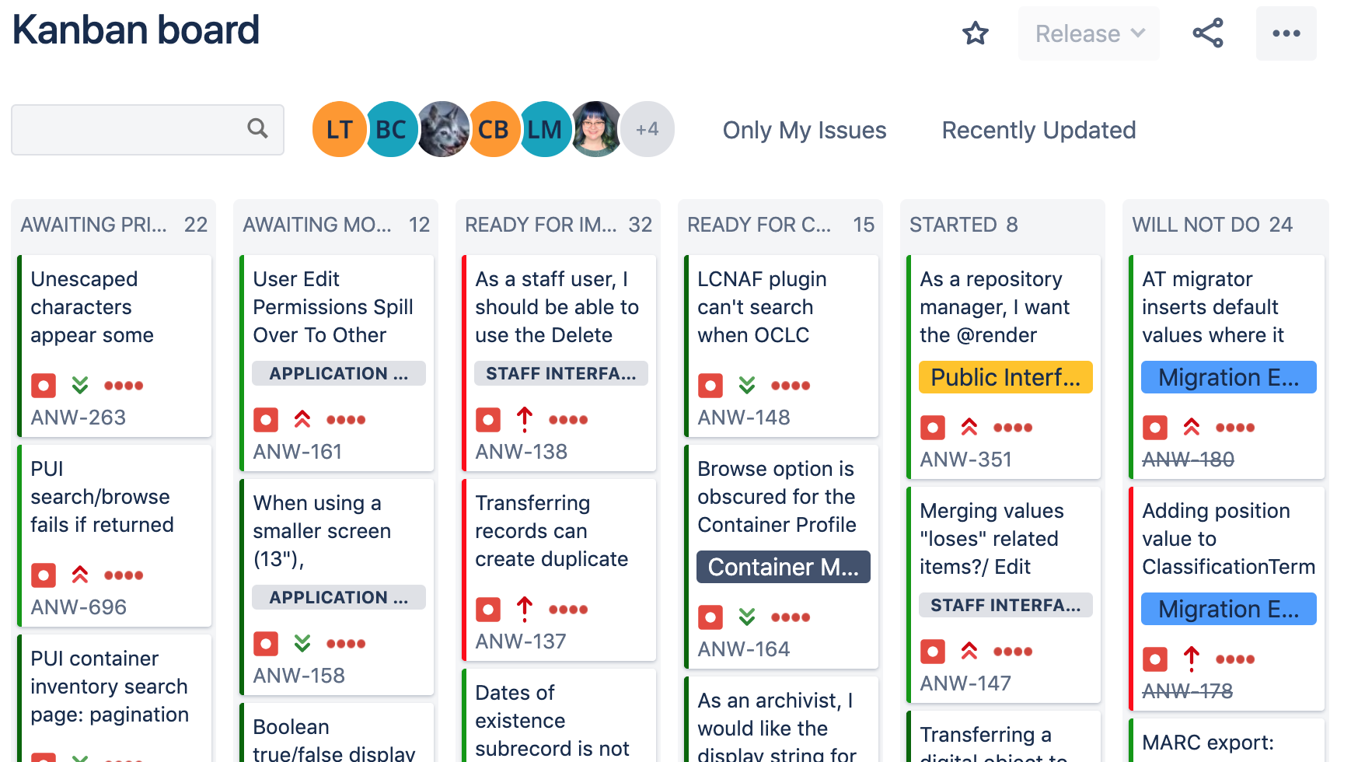
Ready for Community Developer
Notes:
MAGGIE
How we’re implementing the new status [SWITCH TO SLIDE 5]
We decided to start implementing the new Ready for Community Developer status by going through the JIRA tickets that had already been passed by Dev Pri, and were waiting in the Ready for Implementation queue and evaluate each ticket in terms of its candidacy for the new status.
We took the summer to review tickets that were in the Ready for Implementation lists of both boards (the bug and feature request) and route tickets to the Ready for Community Developer status.
As of now, we have 20 tickets in Ready for Community Developer.

Slide 109
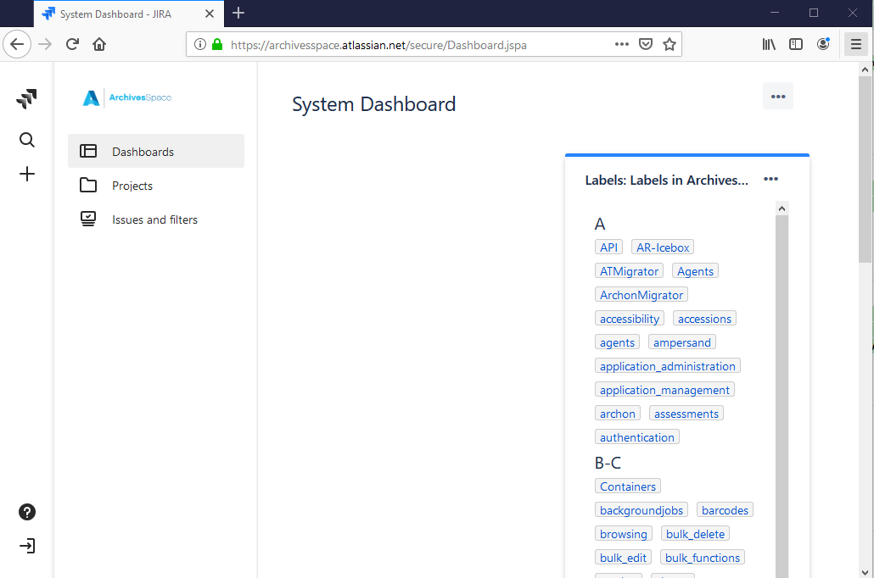
Create/log into JIRA account
Notes:
MAGGIE
How to use the new status [SWITCH TO SLIDE 6]
To get started, you will need to create a JIRA account to create or comment on tickets or be eligible to be assigned tickets. Anyone can create a JIRA account for themselves – you don’t need to contact anyone at ASpace for approval or anything.
Click on the little door with an arrow on the bottom right of JIRA to create your new account.

Slide 110
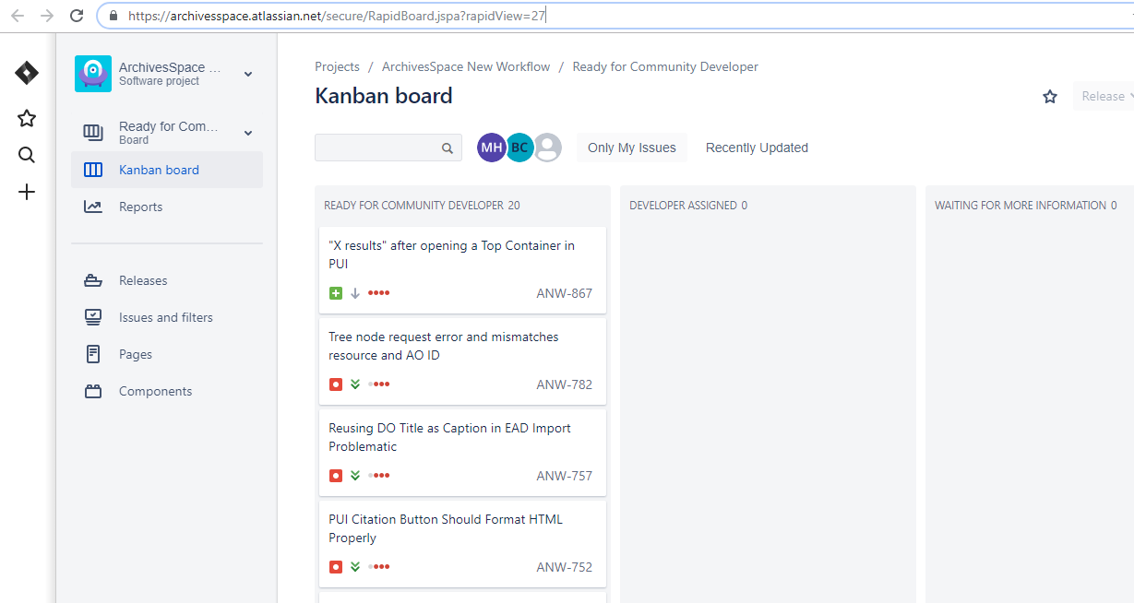
New Kanban Board: https://bit.ly/2GvqFB1
Notes:
MAGGIE
There’s a new Kanban board for the Ready for Community Developer status, where you can see all the tickets in this queue together
The link to the board is here: https://archivesspace.atlassian.net/secure/RapidBoard.jspa?rapidView=27.

Slide 111
https://bit.ly/2SFIEJR
Notes:
[Lydia] (source)
Anyone is welcome to submit a pull request to improve ArchivesSpace. But, before assigning yourself to a ticket for the first time it would be best to have a short orientation first. To do so, you can contact Laney, ArchivesSpace Tech Lead, to go over general expectations and mechanics of developing for ArchivesSpace.
Once you’ve gone through the brief orientation, Laney will add you to the developer group and you’ll be able to grab a ticket whenever you want.
Development for ArchivesSpace is conducted in sprints, during which new features are implemented, bugs are fixed, and chores, such as updating part of the application stack, are completed.
Developers and others willing to update or create documentation are welcome to contribute in any given sprint. If you have experience with ArchivesSpace and are willing to take on work considered a priority by the community, you are welcome to join an ArchivesSpace scrum call and commit to take on open issues raised in sprint planning. Please contact ArchivesSpace Tech Lead Laney McGlohon if you are interested in getting involved.

Slide 112
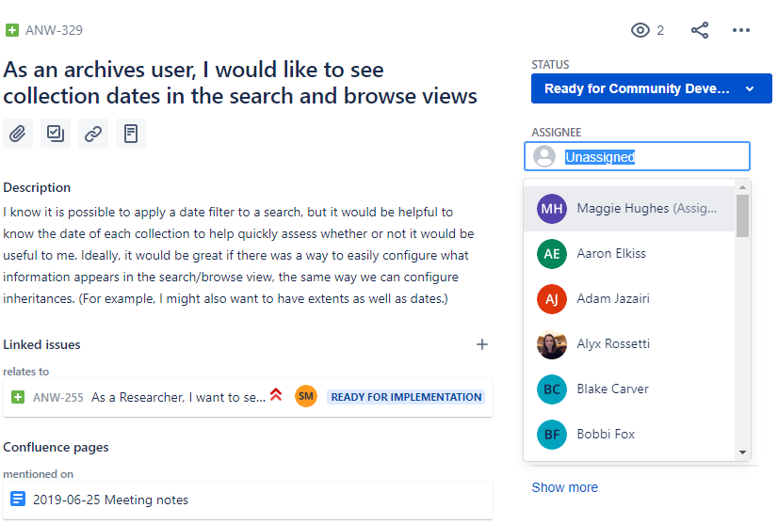
Notes:
[Lydia] People who want to take a ticket should assign themselves to it. Note: It’s important that you assign yourself a ticket before you start working on it so that people aren’t working on the same thing and duplicating effort.

Slide 113
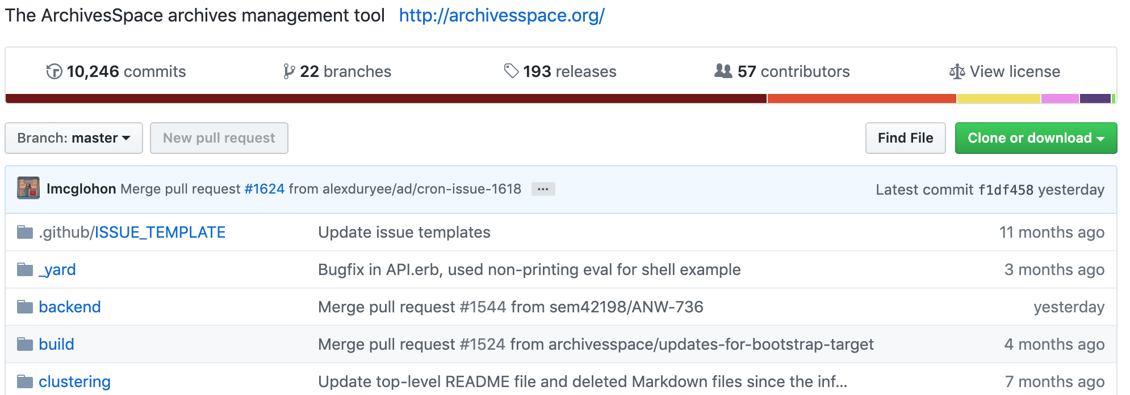
GitHub
Notes:
[Lydia]
The ArchivesSpace source code is available on Github. To contribute code, please see the step-by-step instructions on the wiki.
Steps include:
First, forking the ArchivesSpace repository into your personal Github account, then downloading it.
Second, making code edits. If you are resolving a bug or feature reported on JIRA then your branch name and commit message should reference the JIRA issue number (otherwise name appropriately)
Finally, make a pull request at github.
All code contributions should include unit tests and will follow the best practices and standards as outlined in the Contributors' Guidelines.
If you or your institution would like to make a larger code contribution, like developing a new feature and adding it the core code, please review their evaluation process documentation and contact ArchivesSpace Program Manager Christine Di Bella with any questions or to begin the process.

Slide 114
Questions? Thank you!
Maggie Hughes: mhughes@huntington.org
Lydia Tang: ltang5@msu.edu
Notes:
[Maggie] We hope the new Community Developer status is helpful for Aspace community developers. If you have feedback on improvements or questions, please reach out!

Slide 115
Questions?

