Slide 1
Change Text on Delete Button
A Plugin
ArchivesSpace Annual Forum
2 August 2019
Linda Sellars
Head of Technical Services for
Special Collections
NC State University Libraries
Notes:
I’m here to tell you about a very small change that has been effective in solving what was becoming a big problem.
Before I go any further, I want to say-- Many thanks to Trevor Thornton, Applications Developer, Digital Library Initiatives, at NC State for suggesting and writing this plugin.

Slide 2
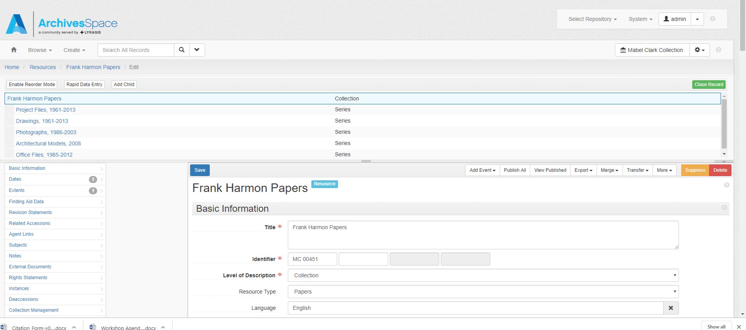
Notes:
The problem was that staff were accidentally deleting resource records. Not every day but way more frequently than we would like. They would open a resource record, scroll down to the component they wanted to delete, click on the delete button and watch their whole resource record disappear. And of course it seemed that the resource records they were deleting were the big ones, ones with thousands of components.

Slide 3
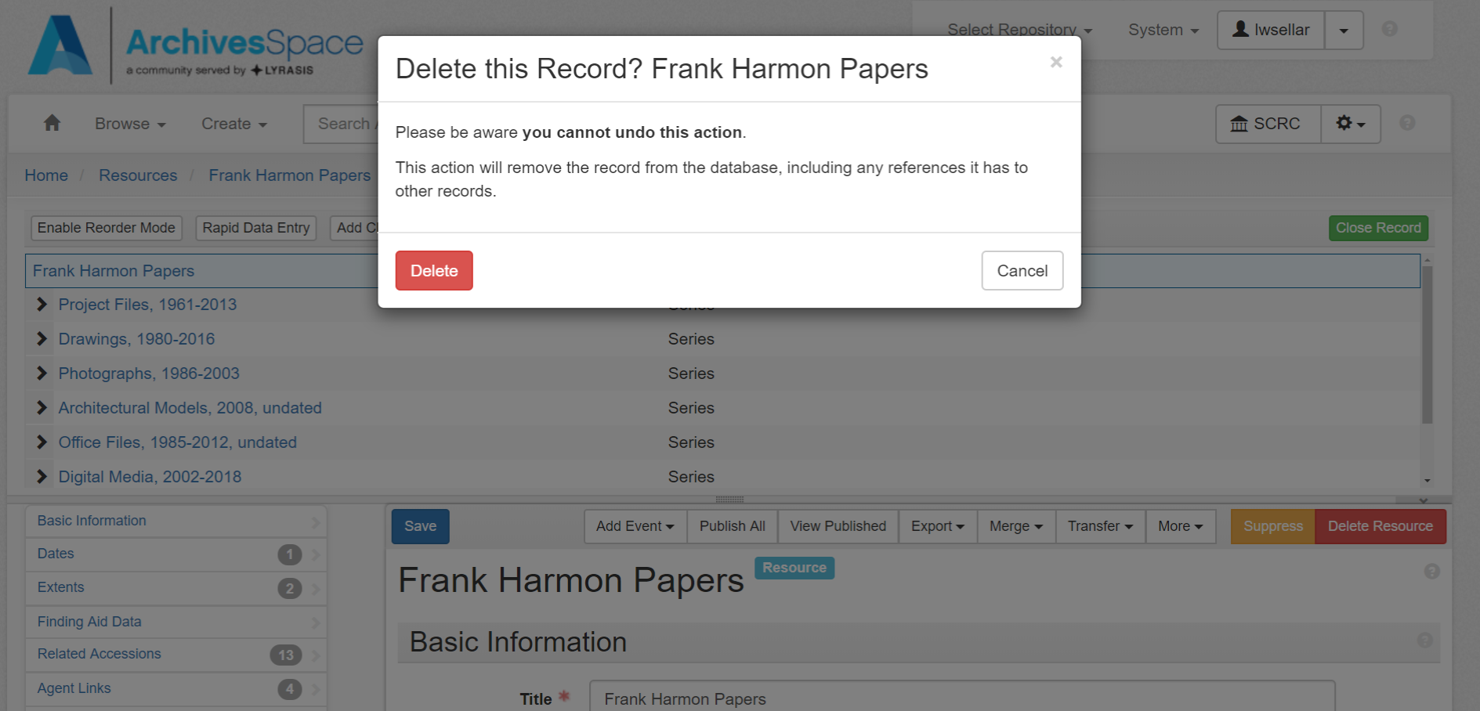
Notes:
Yes, we did get a confirmation request and warning (Delete this Record? Title)? We would say when Trevor reasonably asked. Of course we did, but everybody knew that yes they did want to delete the record so they didn’t read the request or warning and they didn’t notice what they were about to delete.

Slide 4
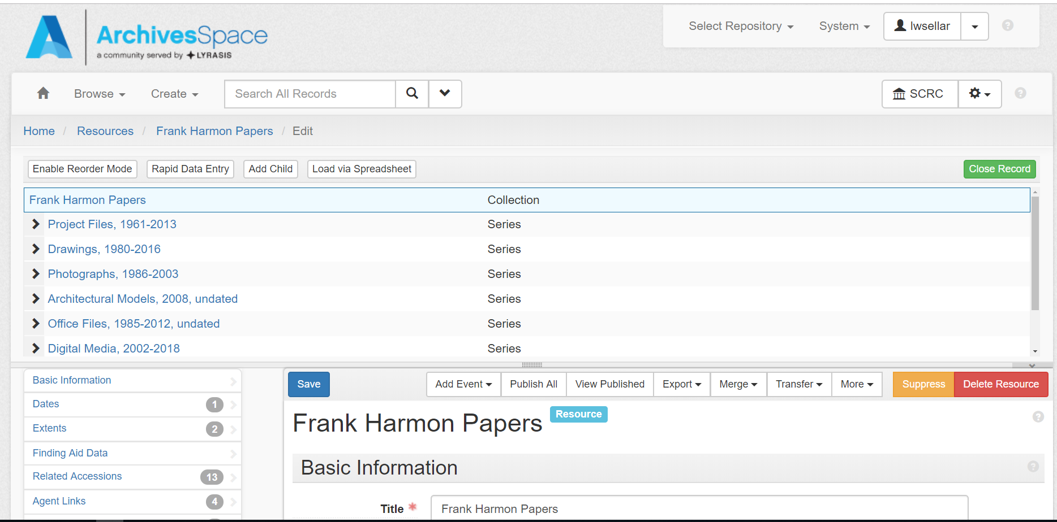
Notes:
I can only guess that Trevor was tired of fielding panicked phone calls and having to restore deleted resource records when he suggested this change in the text on the delete button.
And now, when we want to delete something, the delete button tells us what we are about to delete. I can delete resource

Slide 5
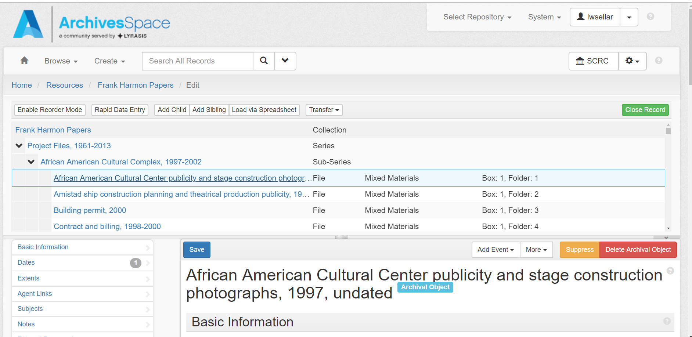
Notes:
Or I can Delete archival object.
Changing the text on the delete button, of course, does not stop anybody from deleting a resource record but it gives them an extra opportunity to notice what’s about to happen. I can’t tell you why people are more likely to read the text on the button than the text in the confirmation box, but it seems that they are.

Slide 6
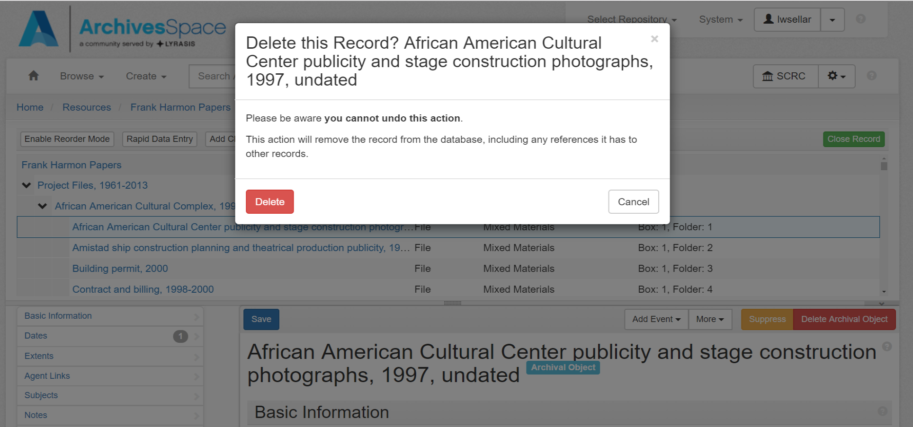
Notes:
They do still have another chance to notice exactly what they are deleting but it seems to be that first opportunity that keeps them from doing the deed.
And that’s the story of a very successful little plugin.

Slide 7
https://github.com/NCSU-Libraries/archivesspace_delete_button_context_plugin
Trevor Thornton
Digital Libraries Initiative
NC State University Libraries
trthorn2@ncsu.edu
Notes:
The code is available in github and Trevor is willing to talk to you.

Slide 8
THANK YOU
Linda Sellars
Special Collections Research Center
NC State University Libraries
lwsellar@ncsu.edu

