Slide 1
We can do it!
Introducing the Community Developers’ Queue
Maggie Hughes and Lydia Tang
Development Prioritization subteam
Notes:
[Lydia] Introduction
We’re here today to introduce a new status in the ArchivesSpace JIRA kanban boards, and explain how it can help you get involved.

Slide 2
Development Prioritization review process
Awaiting Prioritization
Awaiting More Information
Ready for Implementation
Started
Dev Pri review
Will Not Do
Notes:
[Lydia] Quick review of how Dev Pri works
We’re co-leaders of the Development Prioritization sub-team, which is a sub-team consisting of members from both the Users Advisory Council and Technical Advisory Council.
In collaboration with the ArchivesSpace Program Team, Dev Pri prioritizes feature requests and bug reports for developers working on future releases of the ArchivesSpace program and is preparing a survey which you will see soon!
Throughout our monthly Dev Pri subteam meetings, we review hundreds of JIRA tickets, verifying whether the issue is still relevant, gathering additional information, confirming or reevaluating the priority ranking of the ticket, and routing the tickets to one of the following queues:
Awaiting More Information if the ticket has questions, needs more specification, and isn’t ready for a developer quite yet
Will Not Do if the ticket should be closed (such as if the ticket is a duplicate, or the request is too institution-specific); or
Ready for Implementation if the ticket is ready to be worked on by a developer.

Slide 3
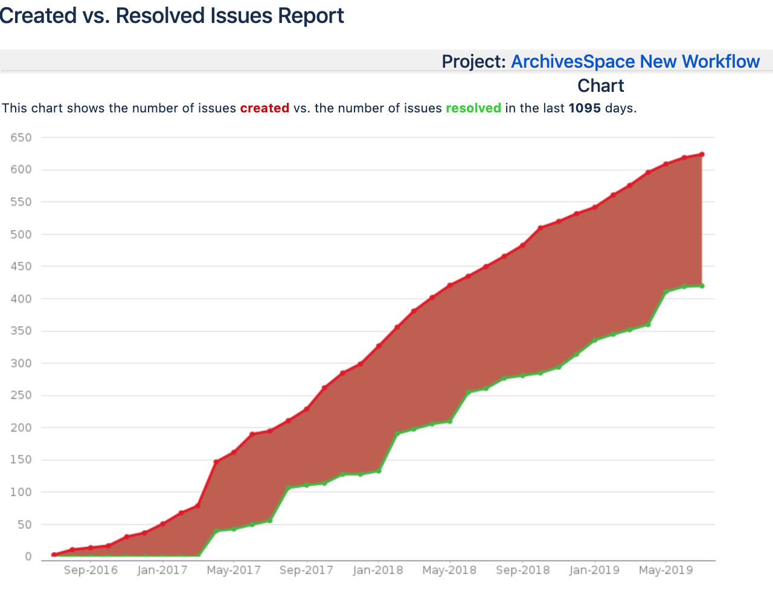
Notes:
[Lydia] Why the new status
While Dev. Pri. has been working hard to increase our capacity for fielding tickets, the program still had a sticking point.
There were so many tickets now in the Ready for Implementation queue that developers needed a prioritization process to prioritize the prioritized!
With so many tickets in the development backlog, it made it hard for the ASpace program team to prioritize which tickets should get their developers’ attention.
As you can see from this graphic, even though Dev Pri prioritizes tickets, the ASpace developers have a limited capacity. The top line is the amount of tickets that are created and the bottom line is when the tickets have funneled through their entire lifespan, a pull request has been submitted, and the ticket is closed.

Slide 4
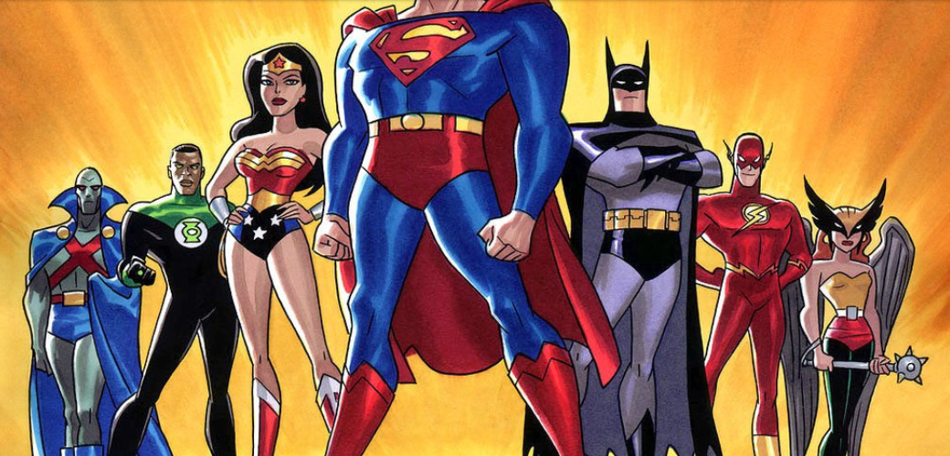
Goal:
The Technical Advisory Council (TAC) "provide[s] technical guidance and encourage[s] an active community of developers"
Notes:
[Maggie]
Meanwhile, the Technical Advisory Council had been having ongoing conversations during their meetings about how to encourage an “an active community of developers” (a charge from the ASpace Governance bylaws).

Slide 5
Ready for Community Developer
Awaiting Prioritization
Awaiting More Information
Started
Ready for Implementation
Dev Pri review
Will Not Do
Notes:
MAGGIE
To remedy the unprioritized backlog and to accomplish TAC’s goal, in collaboration with Christine, we developed a Ready for Community Developer queue! This status is for smaller and more straightforward changes to the application – changes that are nice to have, but not critical, probably don’t touch a lot of parts of the application, and basically would be perfect to highlight as opportunities for community coder participation.
The new status also aligns nicely with TAC’s role in the ASpace community.
We hope that this new status will shorten the backlog of tickets for the ASpace program and developer teams, allowing them to prioritize more efficiently, as well as work towards the TAC goal of encouraging an “active community of developers” by making it easier for people to identify tickets and contribute code.

Slide 6
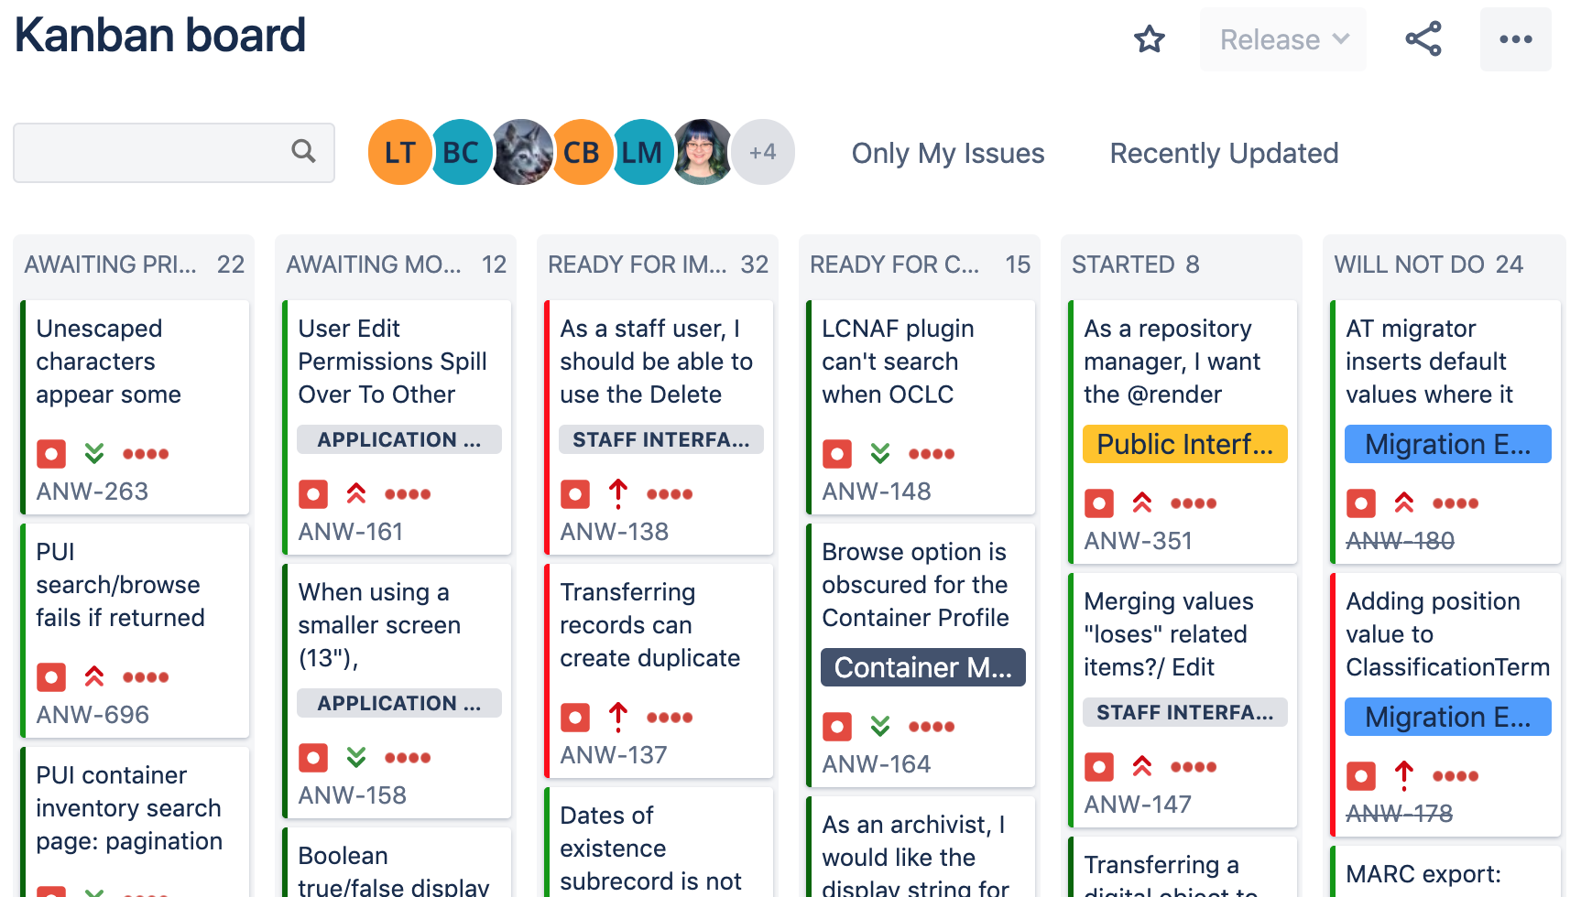
Ready for Community Developer
Notes:
MAGGIE
How we’re implementing the new status [SWITCH TO SLIDE 5]
We decided to start implementing the new Ready for Community Developer status by going through the JIRA tickets that had already been passed by Dev Pri, and were waiting in the Ready for Implementation queue and evaluate each ticket in terms of its candidacy for the new status.
We took the summer to review tickets that were in the Ready for Implementation lists of both boards (the bug and feature request) and route tickets to the Ready for Community Developer status.
As of now, we have 20 tickets in Ready for Community Developer.

Slide 7
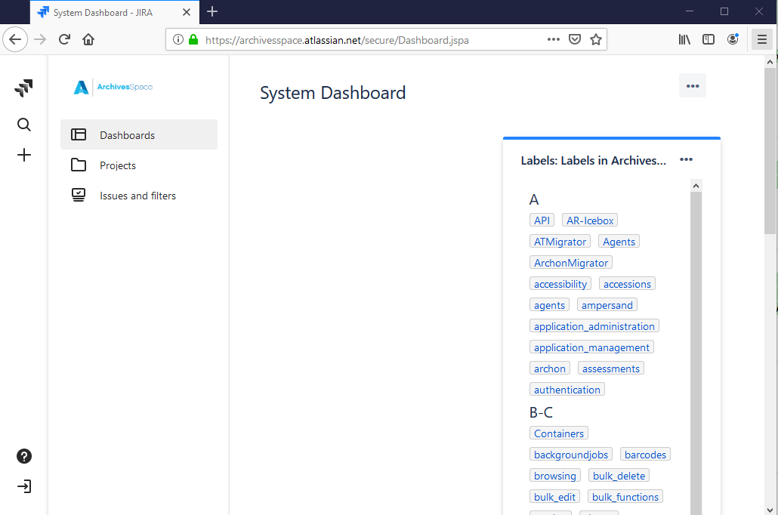
Create/log into JIRA account
Notes:
MAGGIE
How to use the new status [SWITCH TO SLIDE 6]
To get started, you will need to create a JIRA account to create or comment on tickets or be eligible to be assigned tickets. Anyone can create a JIRA account for themselves – you don’t need to contact anyone at ASpace for approval or anything.
Click on the little door with an arrow on the bottom right of JIRA to create your new account.

Slide 8
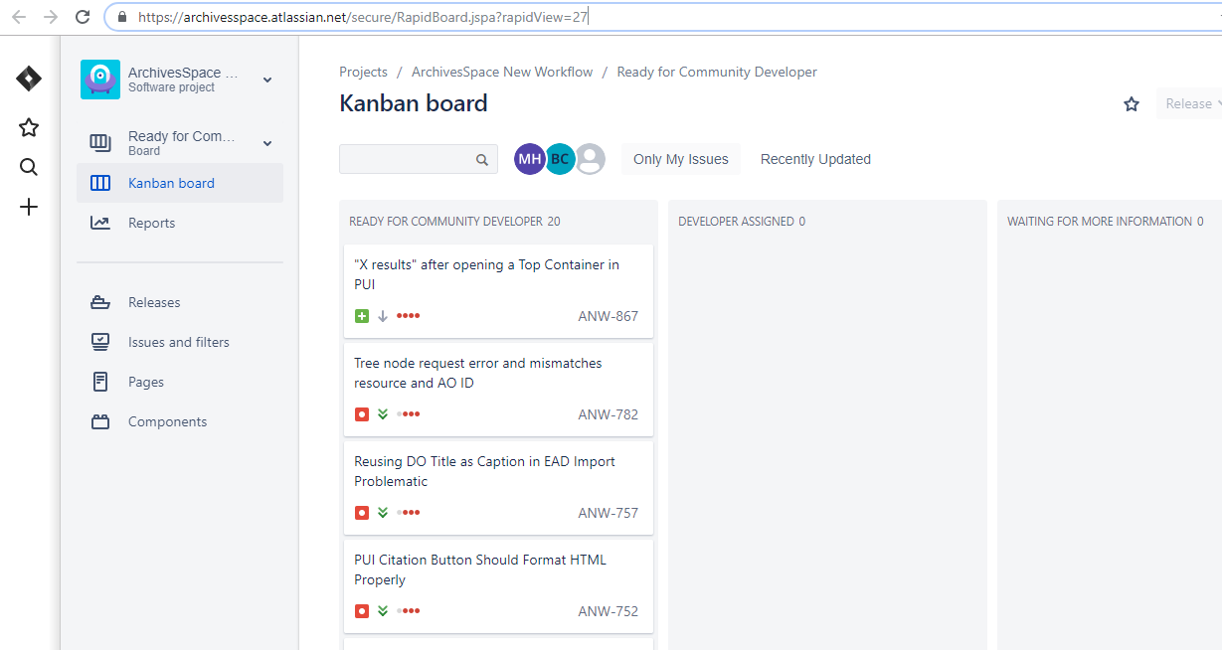
New Kanban Board: https://bit.ly/2GvqFB1
Notes:
MAGGIE
There’s a new Kanban board for the Ready for Community Developer status, where you can see all the tickets in this queue together
The link to the board is here: https://archivesspace.atlassian.net/secure/RapidBoard.jspa?rapidView=27.

Slide 9
https://bit.ly/2SFIEJR
Notes:
[Lydia] (source)
Anyone is welcome to submit a pull request to improve ArchivesSpace. But, before assigning yourself to a ticket for the first time it would be best to have a short orientation first. To do so, you can contact Laney, ArchivesSpace Tech Lead, to go over general expectations and mechanics of developing for ArchivesSpace.
Once you’ve gone through the brief orientation, Laney will add you to the developer group and you’ll be able to grab a ticket whenever you want.
Development for ArchivesSpace is conducted in sprints, during which new features are implemented, bugs are fixed, and chores, such as updating part of the application stack, are completed.
Developers and others willing to update or create documentation are welcome to contribute in any given sprint. If you have experience with ArchivesSpace and are willing to take on work considered a priority by the community, you are welcome to join an ArchivesSpace scrum call and commit to take on open issues raised in sprint planning. Please contact ArchivesSpace Tech Lead Laney McGlohon if you are interested in getting involved.

Slide 10
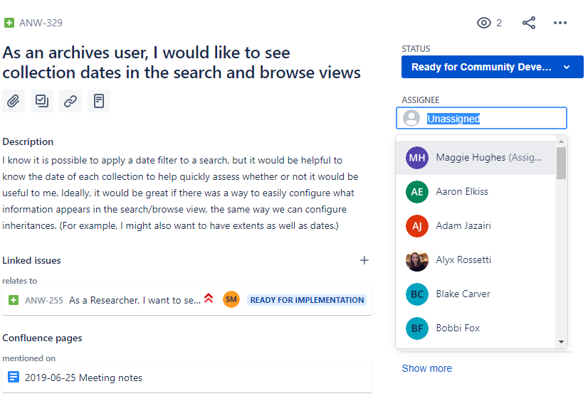
Notes:
[Lydia] People who want to take a ticket should assign themselves to it. Note: It’s important that you assign yourself a ticket before you start working on it so that people aren’t working on the same thing and duplicating effort.

Slide 11
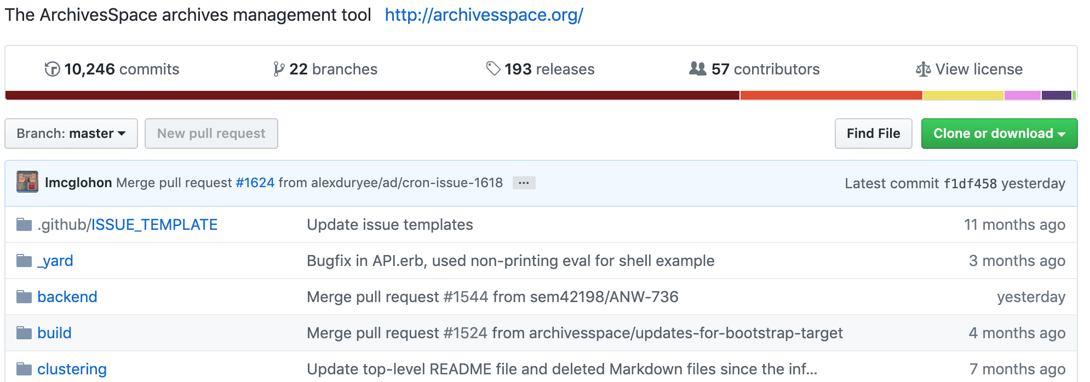
GitHub
Notes:
[Lydia]
The ArchivesSpace source code is available on Github. To contribute code, please see the step-by-step instructions on the wiki.
Steps include:
First, forking the ArchivesSpace repository into your personal Github account, then downloading it.
Second, making code edits. If you are resolving a bug or feature reported on JIRA then your branch name and commit message should reference the JIRA issue number (otherwise name appropriately)
Finally, make a pull request at github.
All code contributions should include unit tests and will follow the best practices and standards as outlined in the Contributors' Guidelines.
If you or your institution would like to make a larger code contribution, like developing a new feature and adding it the core code, please review their evaluation process documentation and contact ArchivesSpace Program Manager Christine Di Bella with any questions or to begin the process.

Slide 12
Questions? Thank you!
Maggie Hughes: mhughes@huntington.org
Lydia Tang: ltang5@msu.edu
Notes:
[Maggie] We hope the new Community Developer status is helpful for Aspace community developers. If you have feedback on improvements or questions, please reach out!

