Slide 1
Beyond Top Containers
Weatherly Stephan
ArchivesSpace Member Forum 2019 August 2

Slide 2
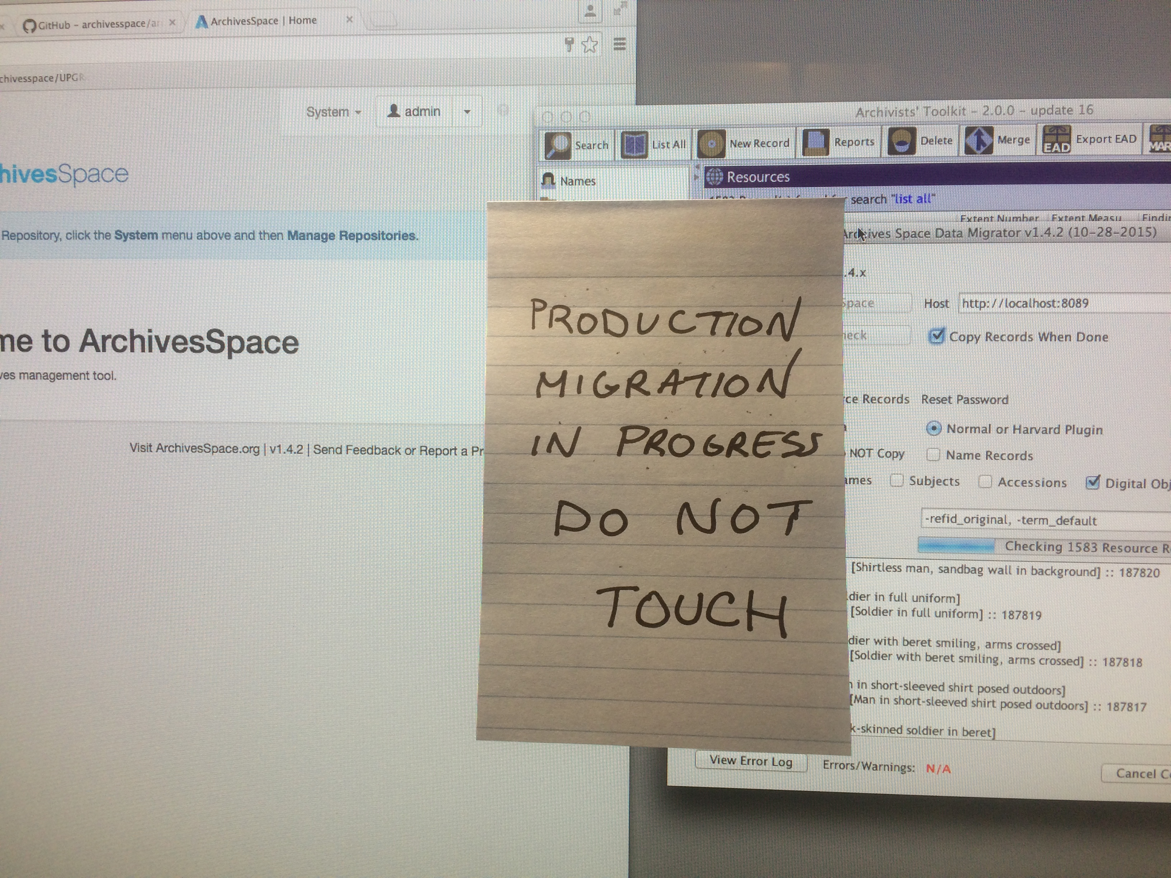
ArchivesSpace at NYU: The Beginnings

Slide 3
Plugins for Offsite Workflows
Digitization Work Order Plugin
github.com/hudmol/ digitization_work_order
NYU MARC Export Plugin
github.com/NYULibraries/nyu_marcxml_export_plugin

Slide 4
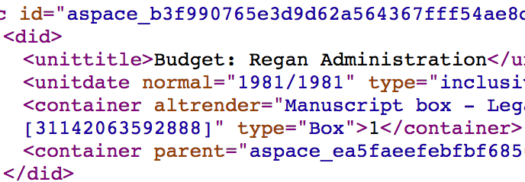
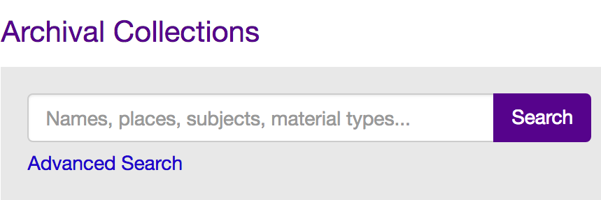
Archival Systems at NYU*
*a simplified view

Slide 5
Offsite Archival Storage
box by Rockicon from the Noun Project

Slide 6
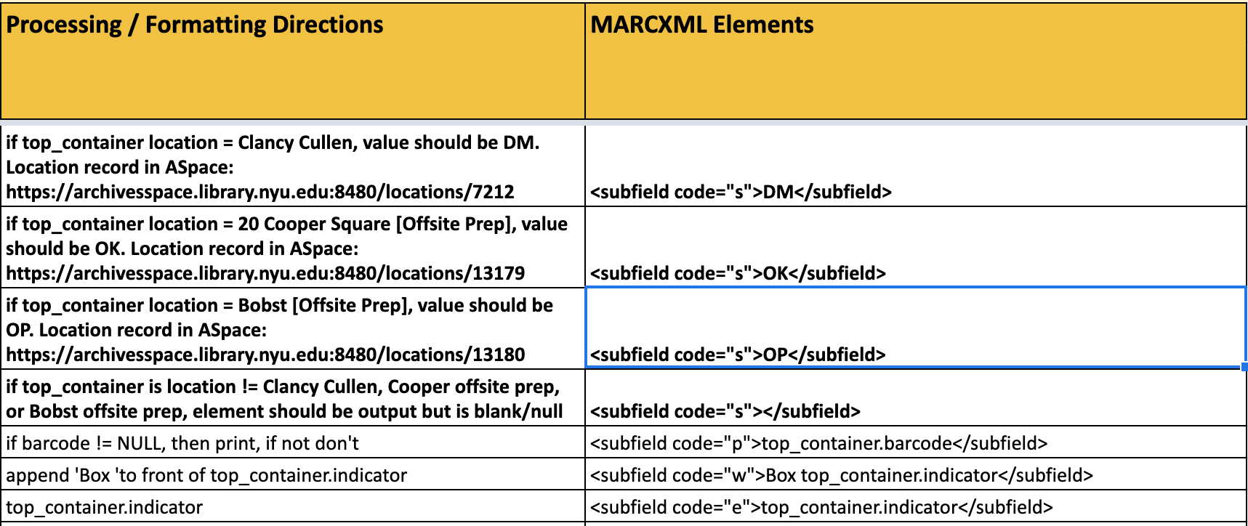
MARC Plugin Development

Slide 7
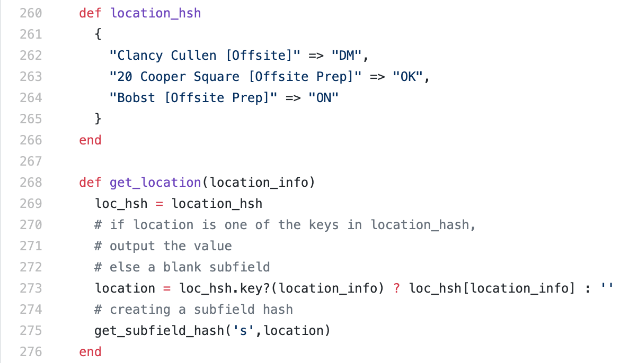
MARC Plugin Development

Slide 8
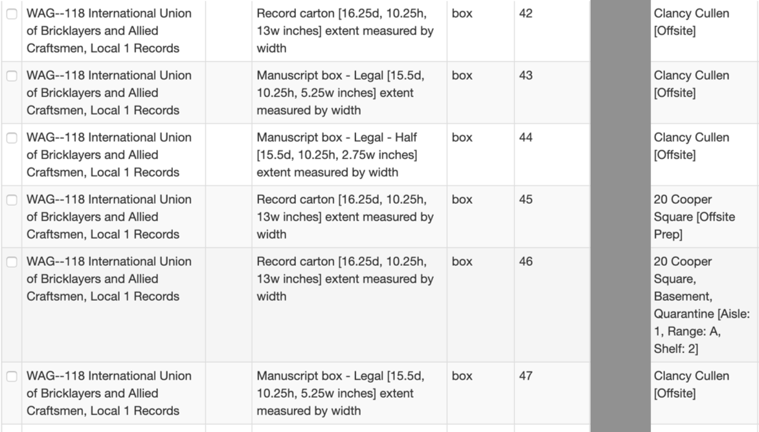
Handling Multiple Locations

Slide 9
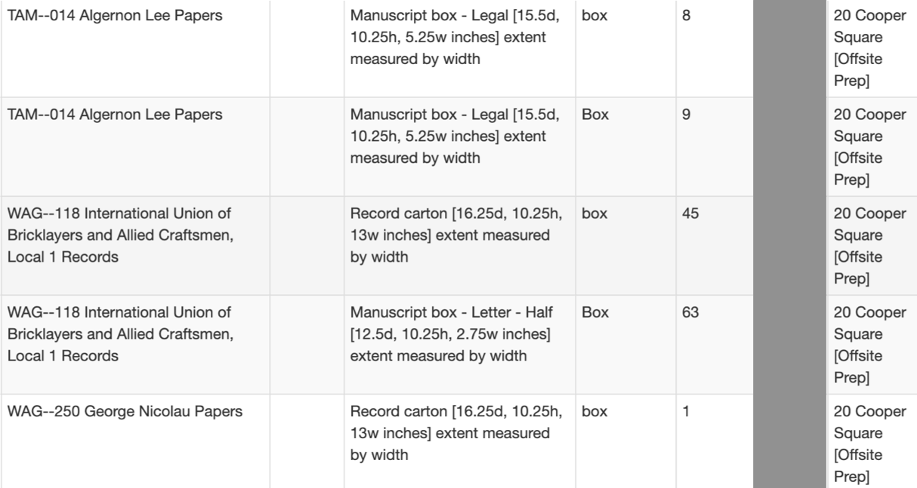
Estimating Pickup Size

Slide 10
Offsite Art Storage
bust by Dairy Free Design from the Noun Project

Slide 11
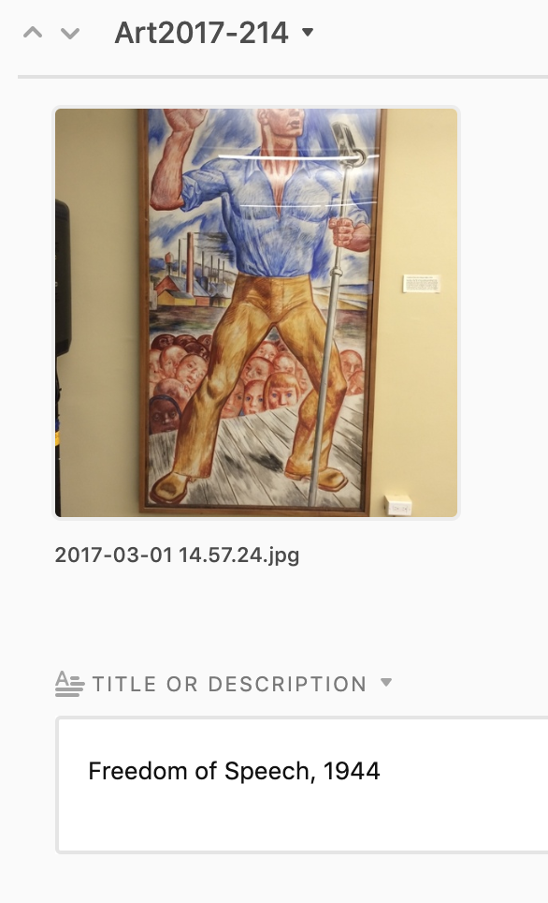
Object Identification

Slide 12
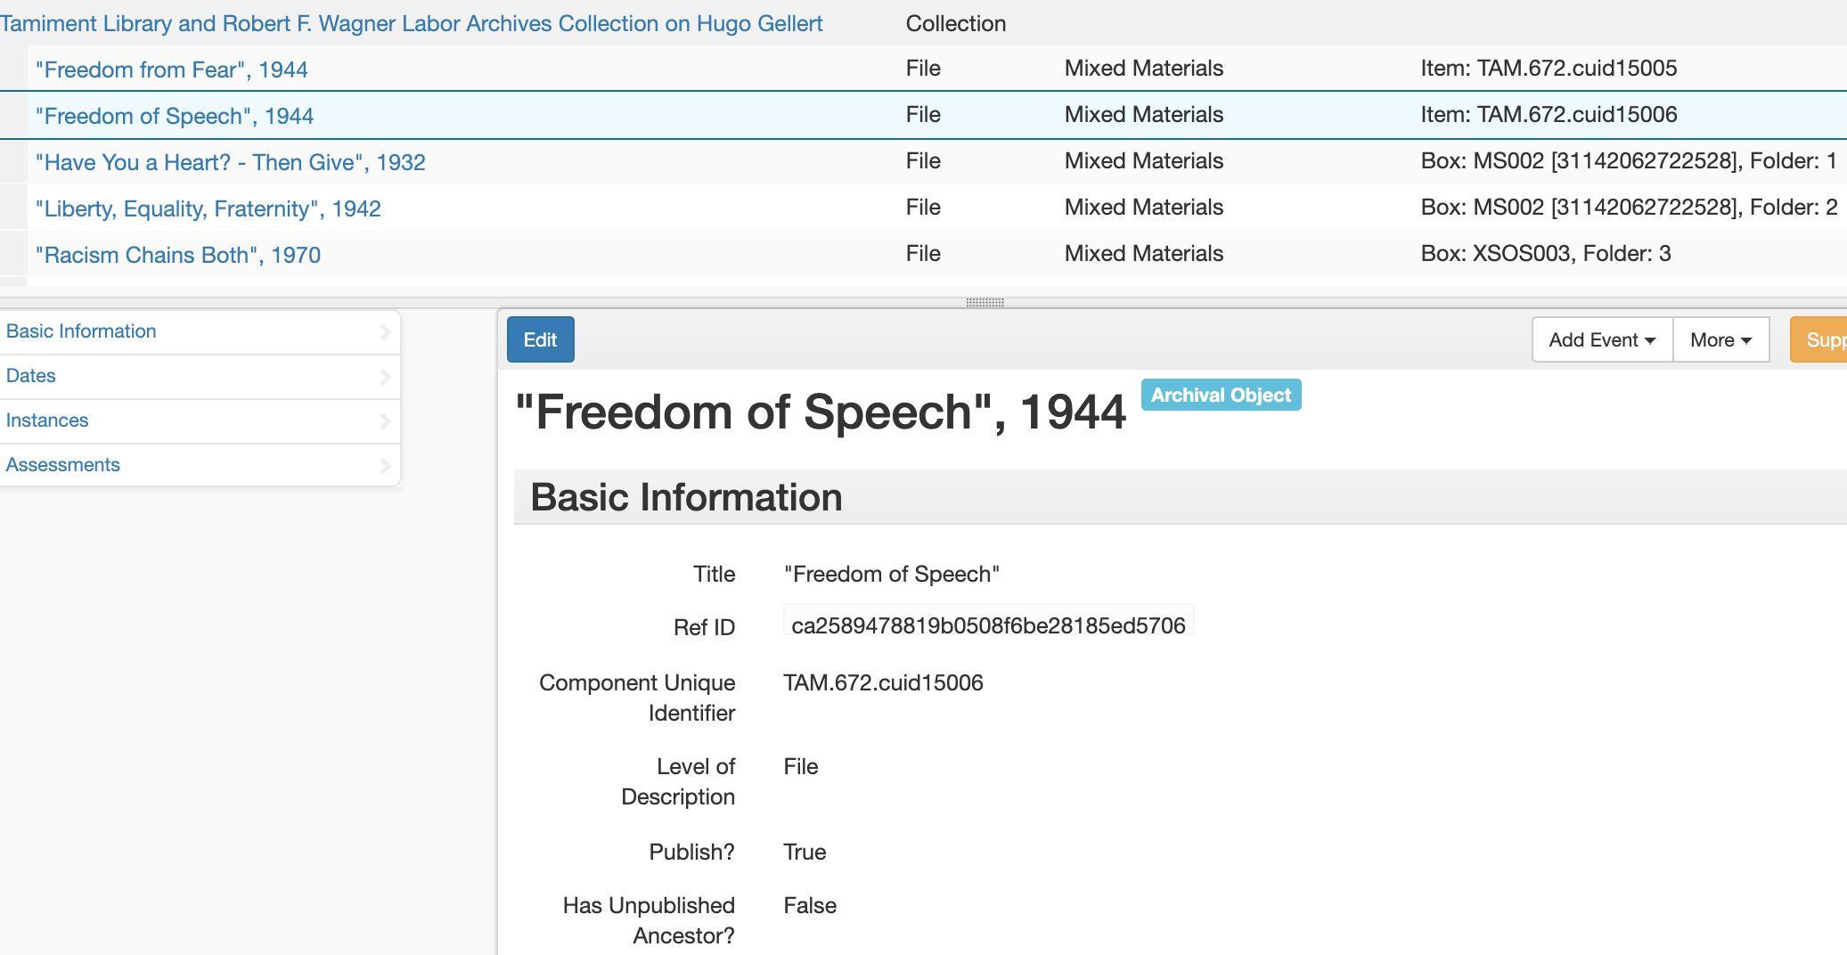
File Level Description

Slide 13
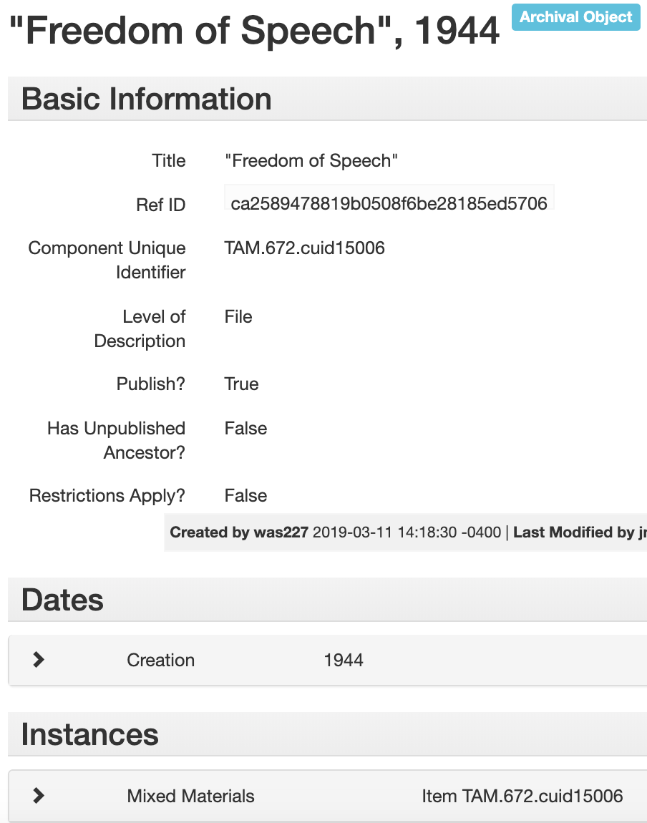
File Description + Instance

Slide 14
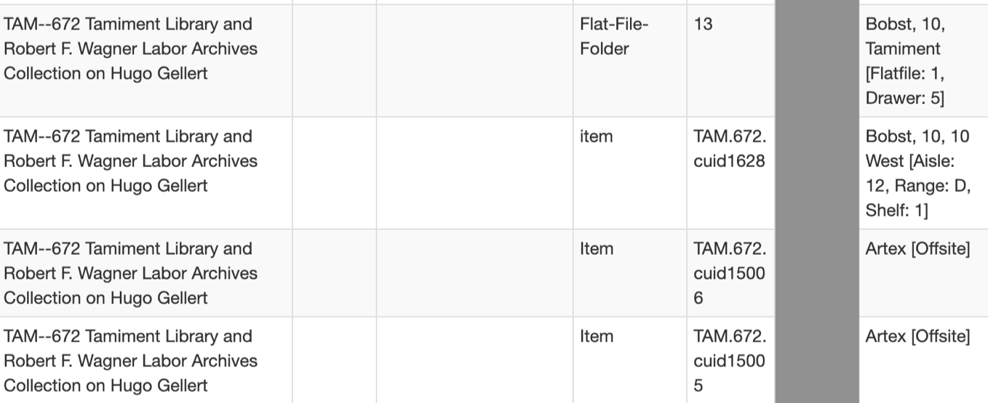
Collection Top Containers

Slide 15
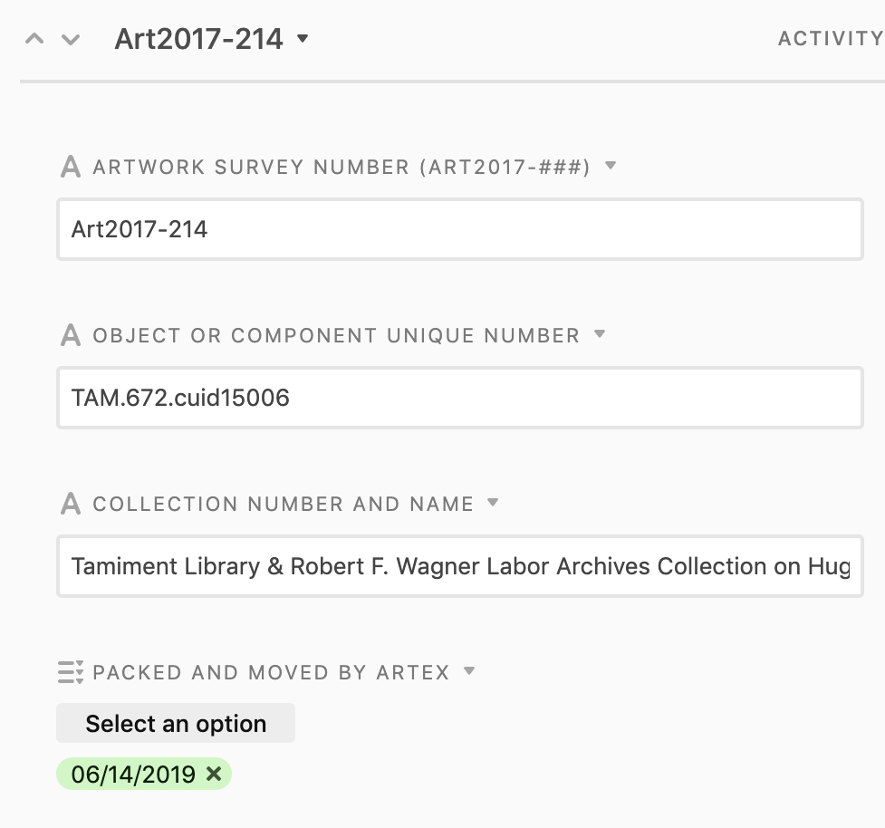
Tracking in Airtable

Slide 16
Offsite Analysis
join by Danielle Torres from the Noun Project

Slide 17
Data Integration in the Library Data Warehouse

Slide 18
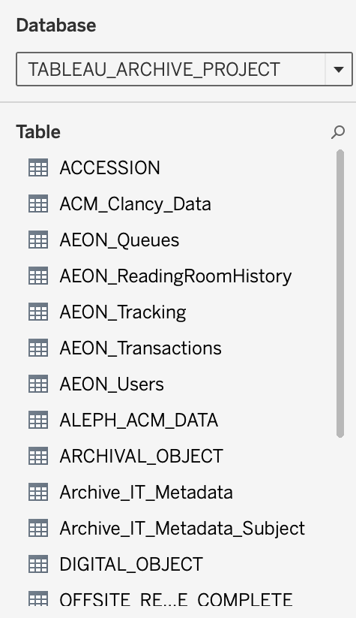
Archival Data Integration

Slide 19
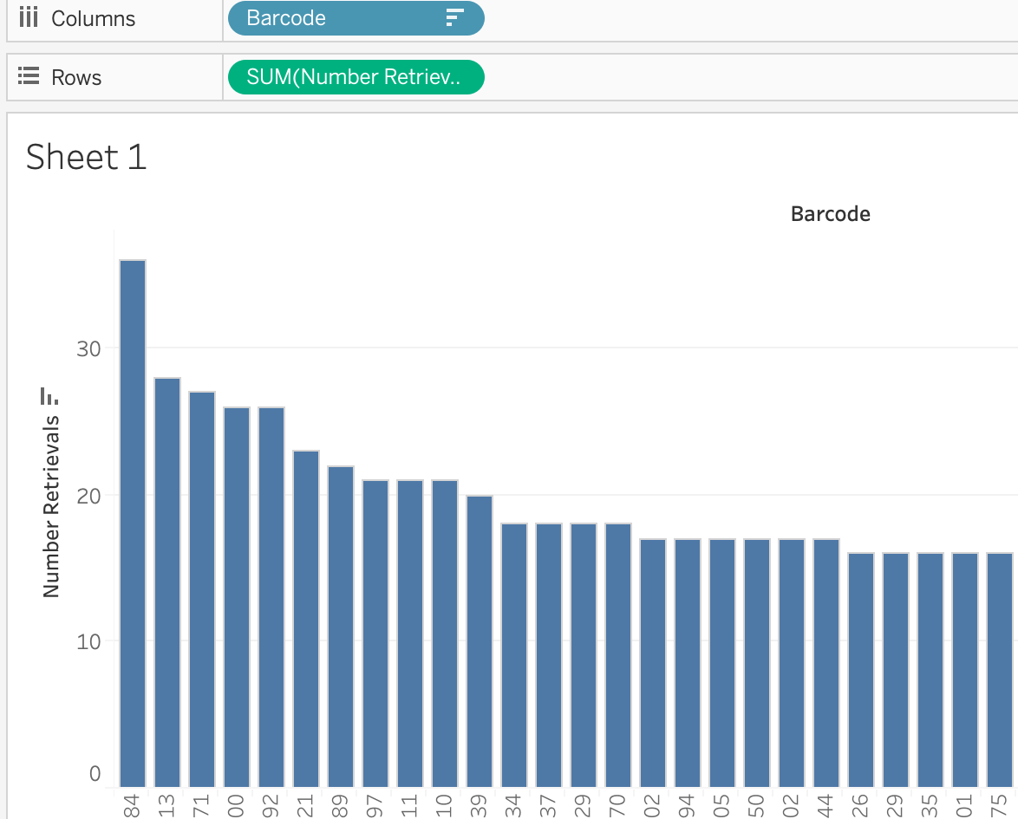
Data for Further Prioritization

Slide 20
Impact of New Workflows via ArchivesSpace
Collection Management Statistics | 2015-2016 | 2016-2017 | 2017-2018 | 2018-2019
Linear footage sent offsite | 834 | 1900.17 | 2171.85 | 2911.10
Collection count sent offsite | 54 | 99 | 185 | 439
Art objects sent offsite | n/a | 187 | 43 | 191

Slide 21
Thank you!
was227@nyu.edu
guides.nyu.edu/ArchivesSpace
guides.nyu.edu/ArchivalCollectionsManagement

