Slide 1
Implementing ArchivesSpace at the Bodleian Libraries
Matthew Neely, Senior Archivist

Slide 2
Archival Description at the Bodleian: A very brief history
Encoded Archival Description (EAD) adopted by the Bodleian in 1996.
First EAD catalogue published online in 1997.
Online catalogue of Archives and Manuscripts webpages gave undergone very little development work since early 2000s.
Search technology is very dated and relies on basic HTML search– CTRL F.
Difficult to see connections between archive collections for readers.
Poor user experience.
Reliant on a complex and time consuming XML to HTML transformation process for catalogue publication.
EAD catalogues were handcrafted in XML until 2013 when Archivists’ Toolkit was adopted as our cataloguing tool.
Severe lack of standardisation across Bodleian EAD catalogues. Flexibility of EAD was seen as a positive for the Bodleian’s complex catalogues when first adopted, but this approach created significant problems for the management of our metadata.
c. 96,500 boxes / volumes of Bodleian Libraries archives and manuscripts are included in an EAD-based online description

Slide 3
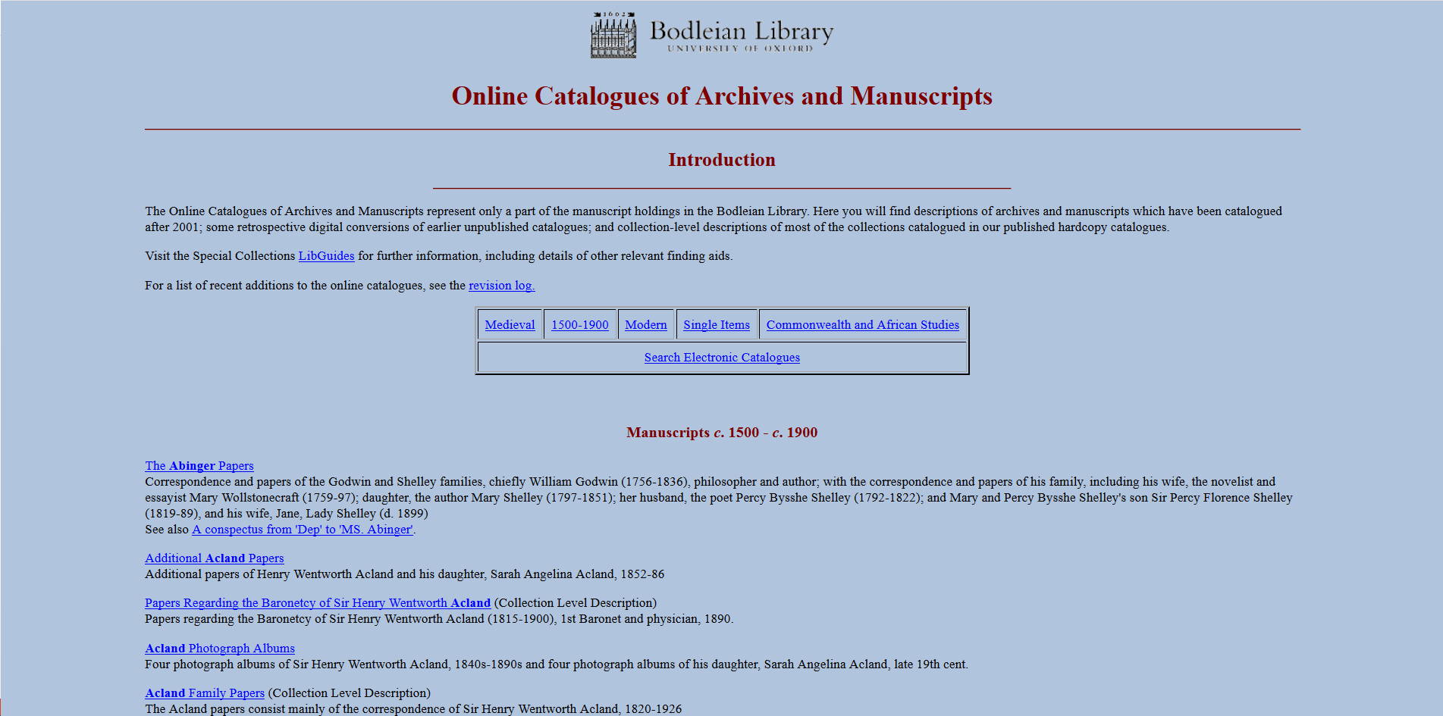
Online Discovery

Slide 5
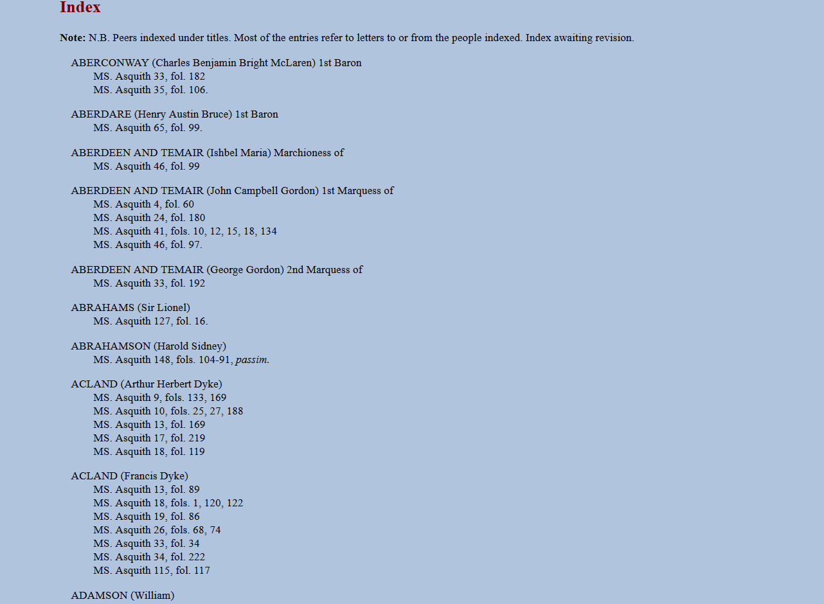
‘Back of the book’ indexes

Slide 6
Metadata audit and migration
Audit of over 3000 EAD catalogues to gain overview and consolidate storage of distributed data
Migration of EAD catalogues: EAD 1.0 > EAD 2002 standard
Trainee Digital Archivists and NQ Project Archivists - funded by Carnegie Corporation/HLF
Trainee Digital Archivists and Newly Qualified Project Archivists - funded by Carnegie Corporation and the Heritage Lottery Fund.
Software developer funded by Carnegie Corporation grant.
Some catalogues published online for the first time.
New Bodleian Archives metadata standard and cataloguing rules adopted.
Some catalogues going online for the first time.
Identify issues which future metadata migration must tackle
Standardisation of metadata – what data recorded and how
Gaps in ISAD(G) compliance
Identify issues which future metadata migration must tackle
Standardisation of metadata – what data recorded and how
Gaps in ISAD(G) compliance

Slide 7
Implementing ArchivesSpace
Out of the box implementation with some customisation of the PUI.
Migration of all EAD catalogues of archives and manuscripts currently published online.
Internal staff testing of the PUI.
Establish user roles and permissions.
Internal staff launch of the PUI in August 2019.
Public launch of the PUI in September 2019.

Slide 8
Archives Bodleian

Slide 9
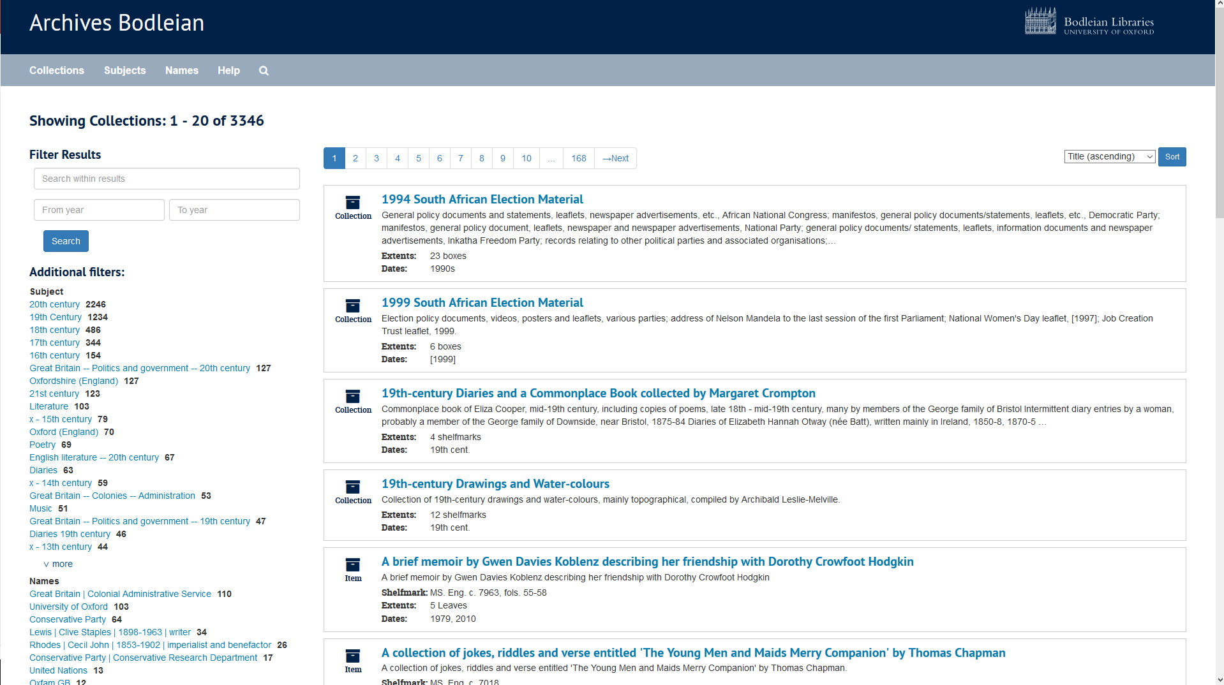

Slide 10
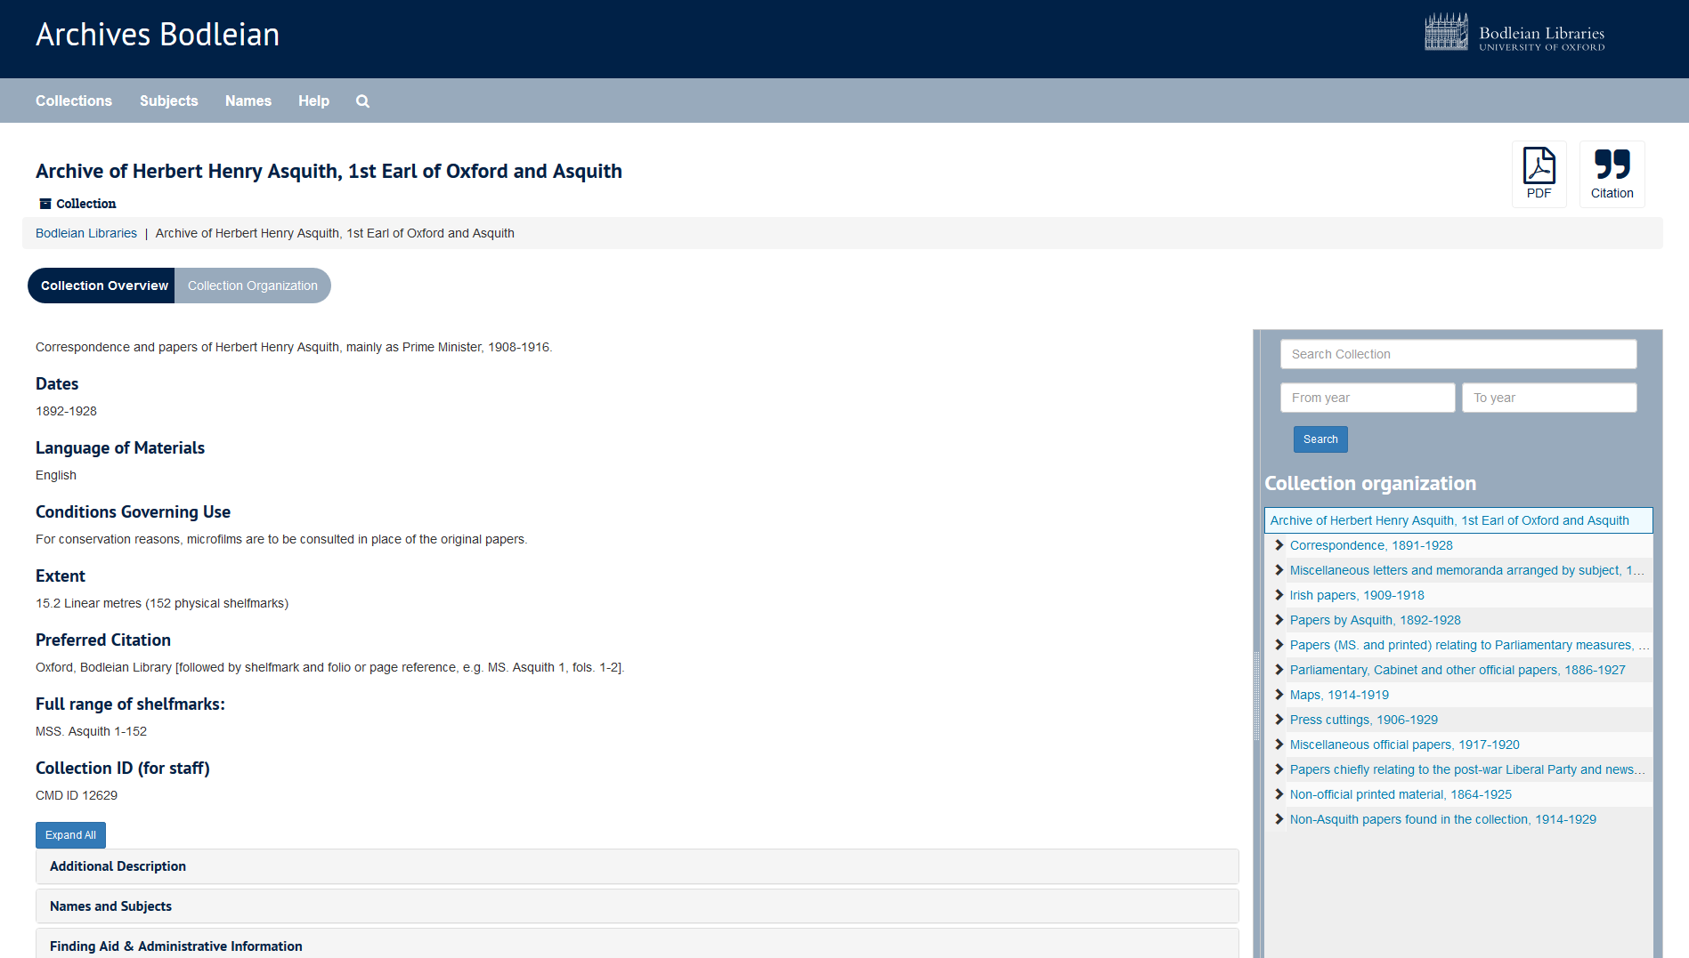

Slide 11
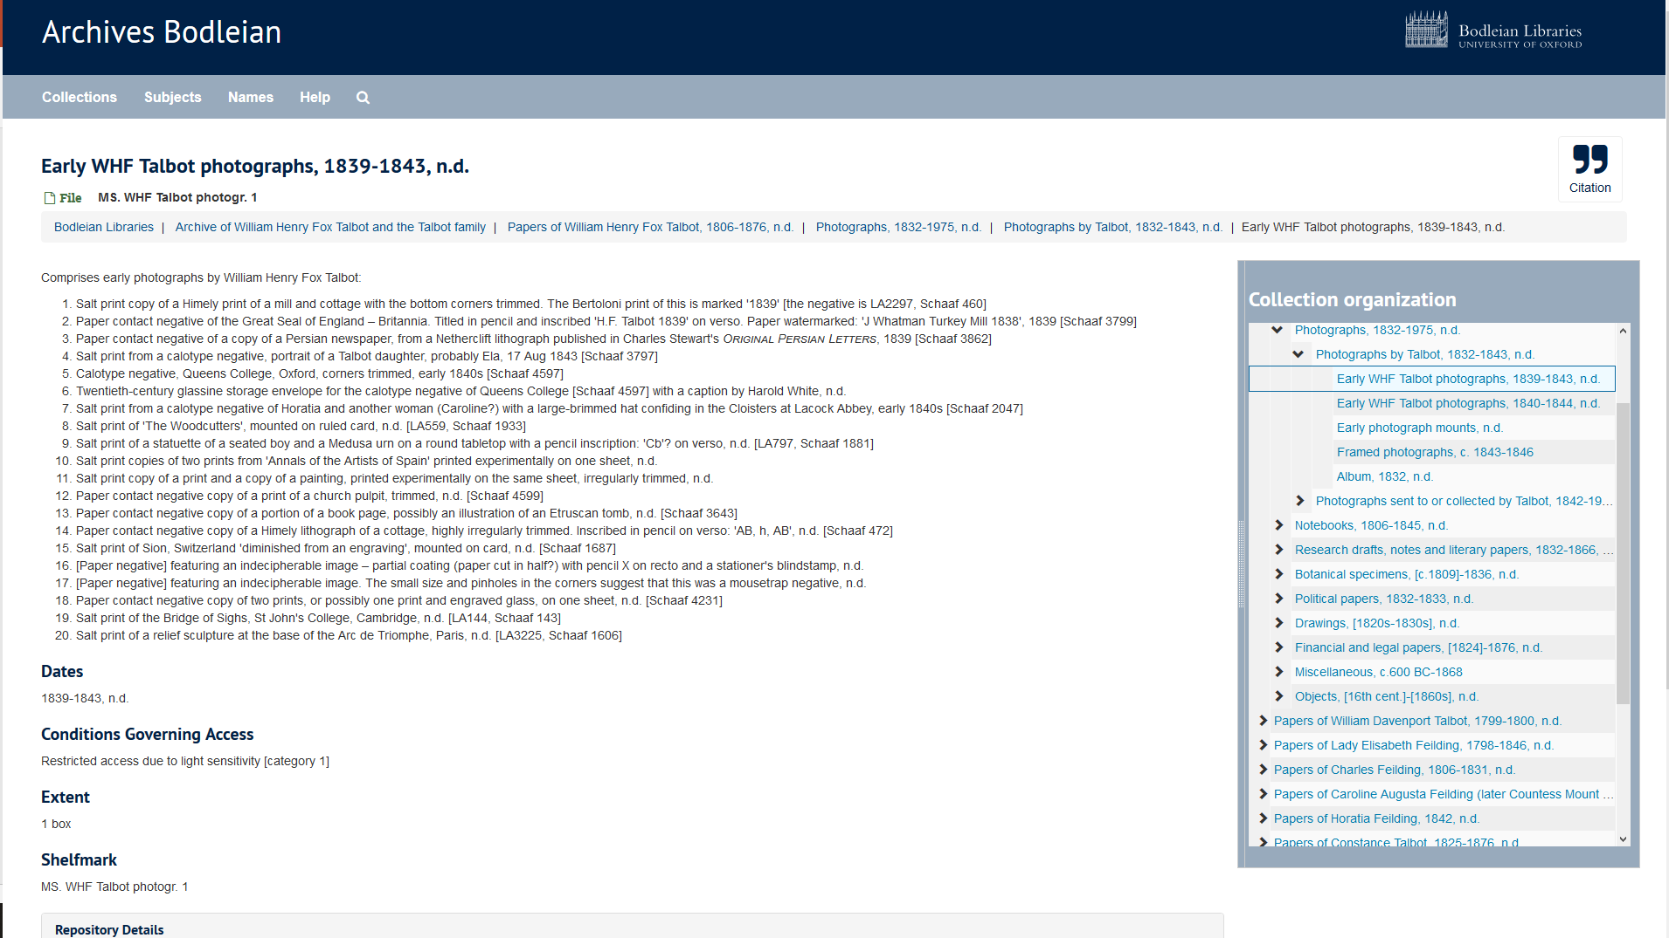

Slide 12
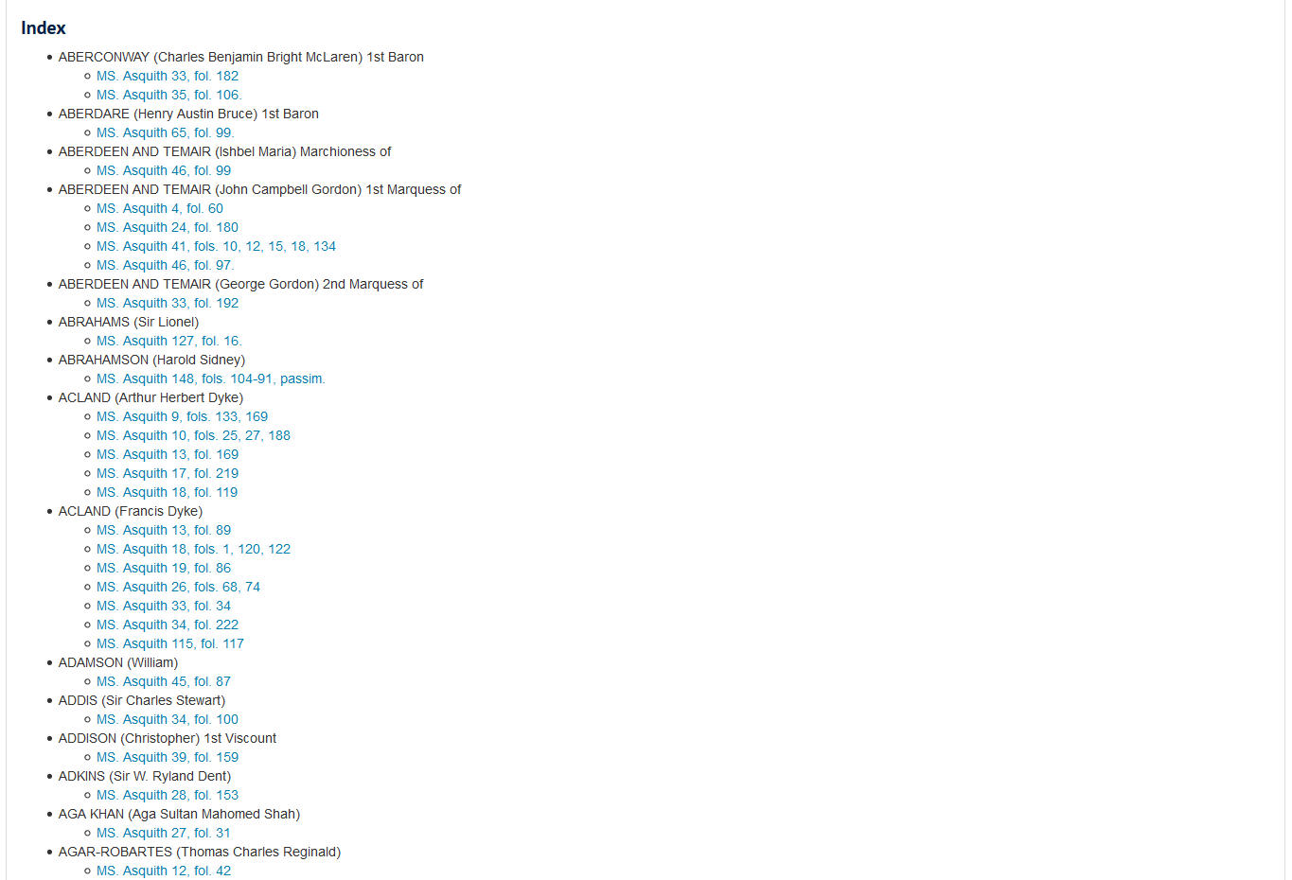

Slide 13
The road ahead
Public and (further) staff user testing.
User interface design enhancements based on user feedback.
Further search functionality modifications based on user feedback.
Develop procedural guidelines and local standards for staff.
Develop and deliver staff training.
Migration of active cataloguing projects.
Name and Subject authority file consolidation.
Retrospective conversion of the Bodleian Summary Catalogue (c.50,000 boxes).
Barcoding of all Bodleian archives and manuscripts.
Integration with circulation system for archives and manuscripts.
Persistent URLs.
Investigate handling of born-digital and digitised collection metadata.
Identification and integration of further plugins to enhance reader and staff functionality.

Slide 14
Email: matthew.neely@bodleian.ox.ac.uk
Web: www.bodleian.ox.ac.uk/weston

