Slide 1
Implementation of ArchivesSpace at the University of Edinburgh
ArchivesSpace Online Forum, 19 May 2020
Aline Brodin – Aline.Brodin@ed.ac.uk

Slide 2
Overview.
Launched in June 2015
First European institution to become a member
Team of archivists, software developers, project and innovation staff, IT support
Version 1.5 (now on version 2.6)

Slide 3
Why ArchivesSpace?
All archivist functionality in one place
Successor to Archivist’s Toolkit
All the information on collections in one place
Open source
Web-delivered
Established support network

Slide 4
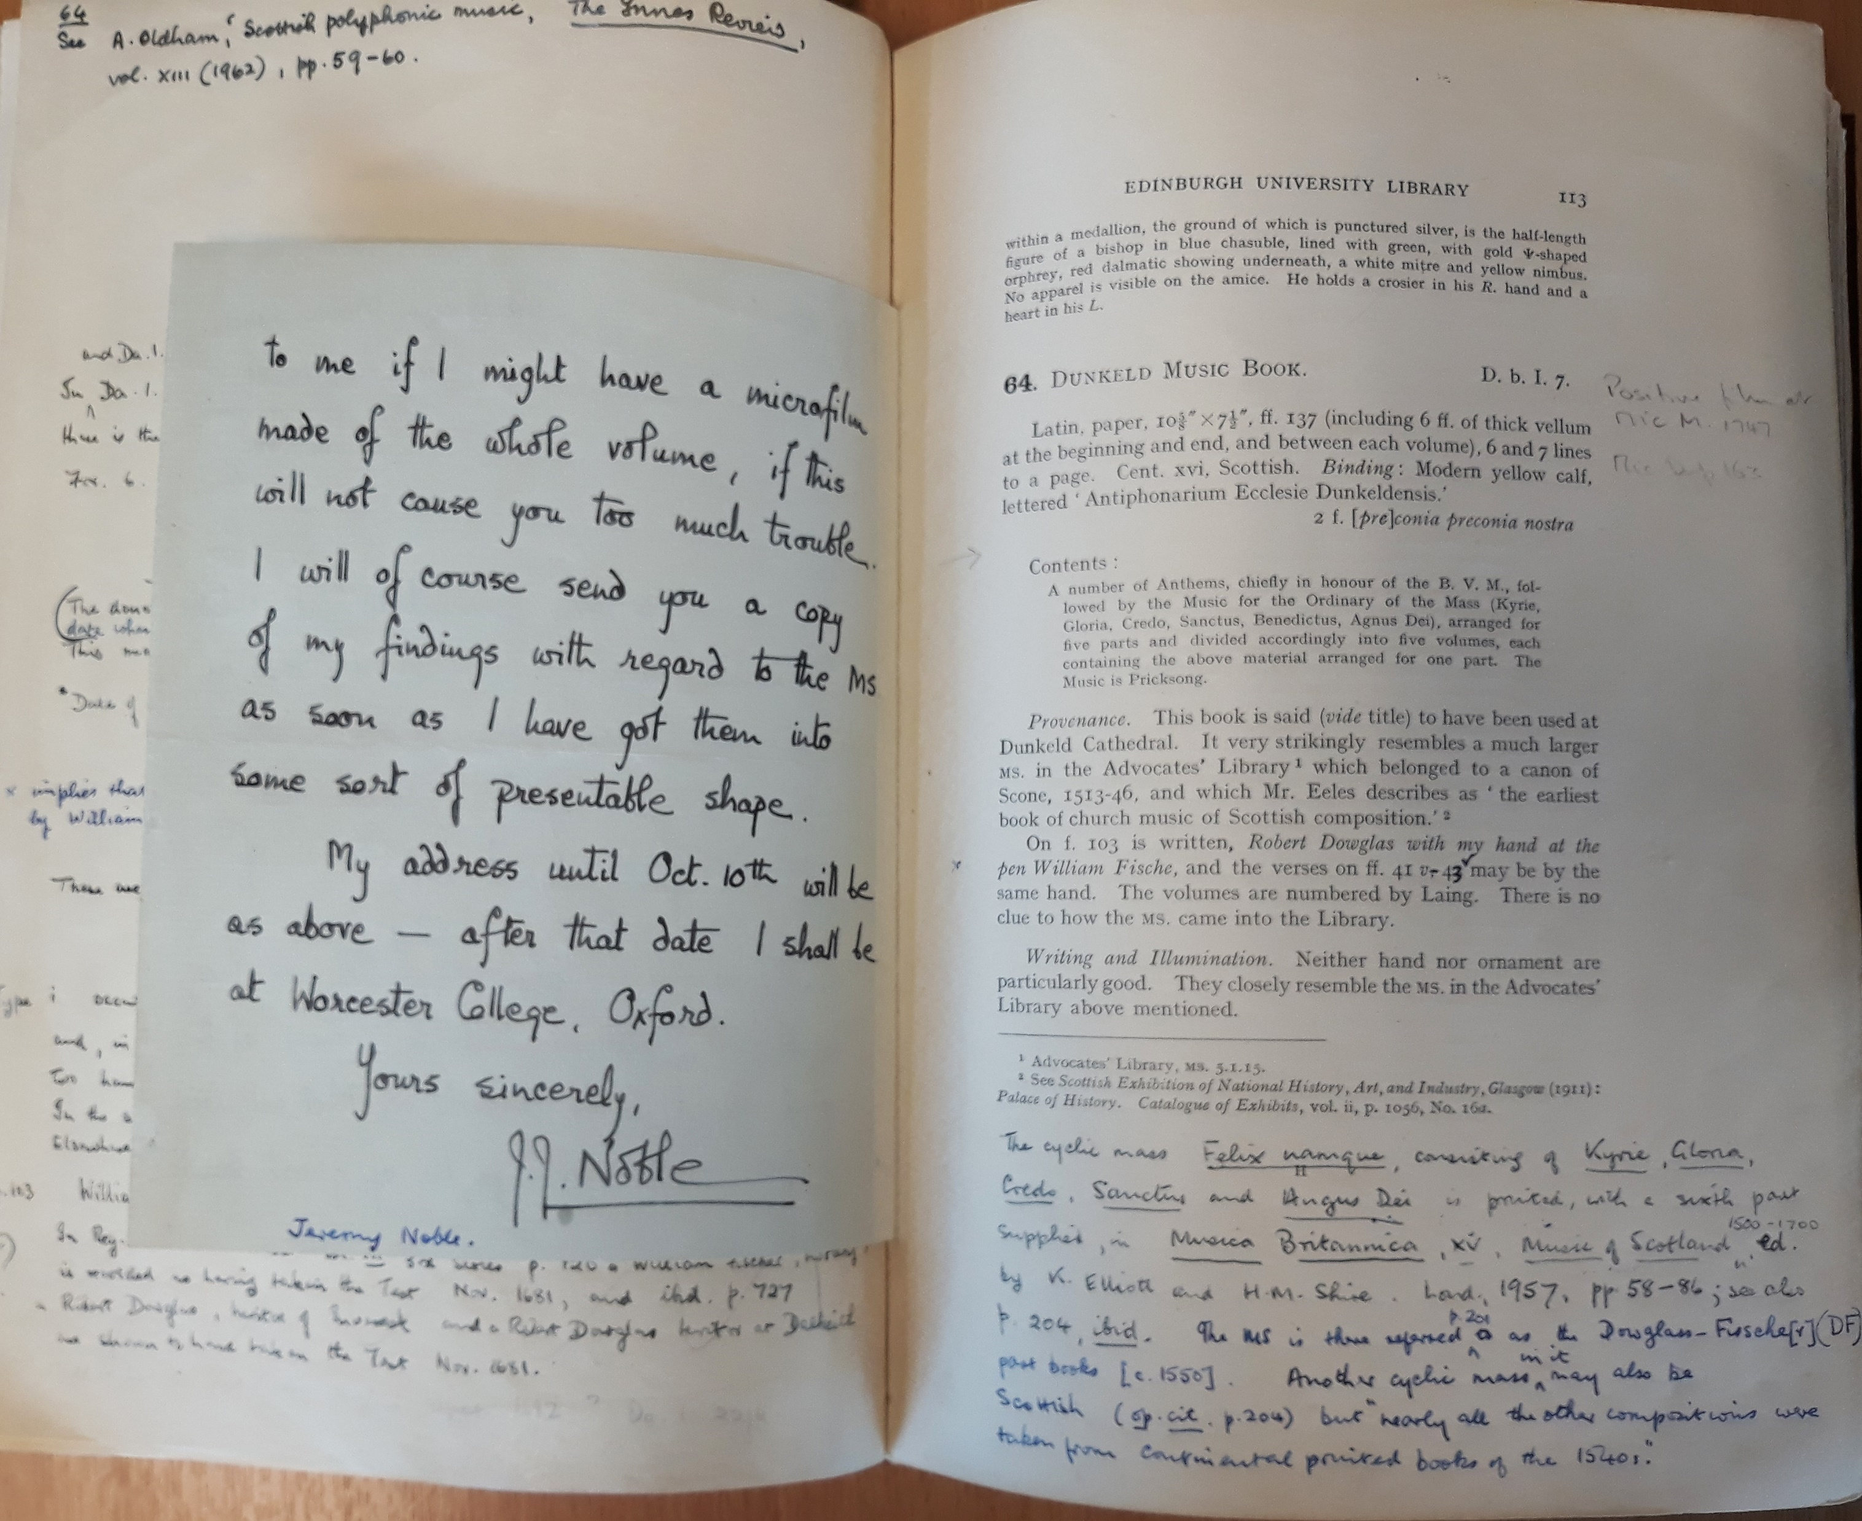
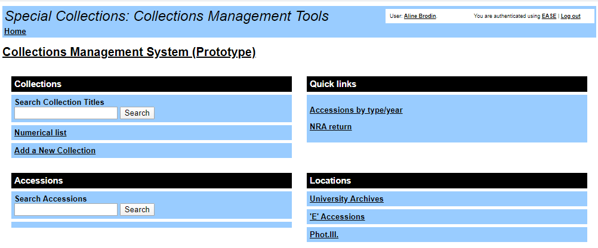
What did we use before?
In-house built web-delivered collections management system (MySQL/PHP)
Externally-funded cataloguing and preservation projects: EAD schema (XML), ISAD(G) standards
ArchivesHub for top-level archival descriptions
Spreadsheets, databases, scan of older handlists
Printed catalogues and indexes

Slide 5
Data migration.
EAD/xml files gradually imported into ArchivesSpace
Retro-conversion of spreadsheets, databases, etc.
Authorities imported separately
End of phase 1: nearly 17,000 catalogue records along with over 22,000 authority terms.
Accessions (Rare Books and Archives) imported as a CSV file

Slide 6
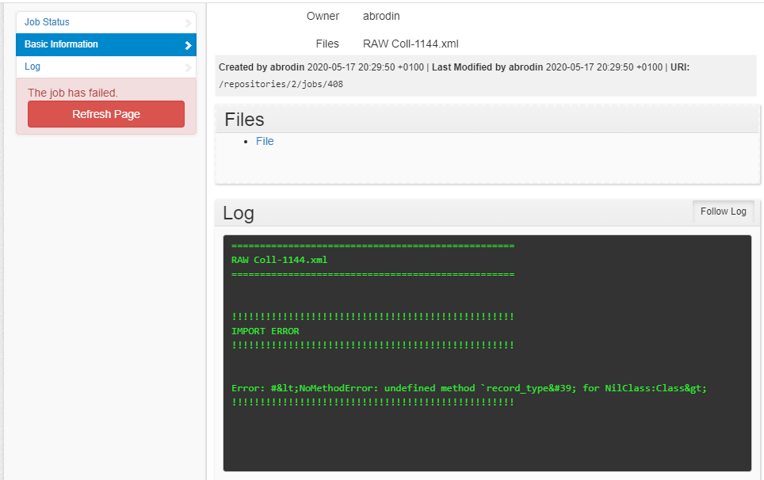
Hurdles and issues
Authorities would not link up with the resources
Authorities would not map to ArchivesSpace table structure
EAD migration was huge task as EAD importer is very strict

Slide 7
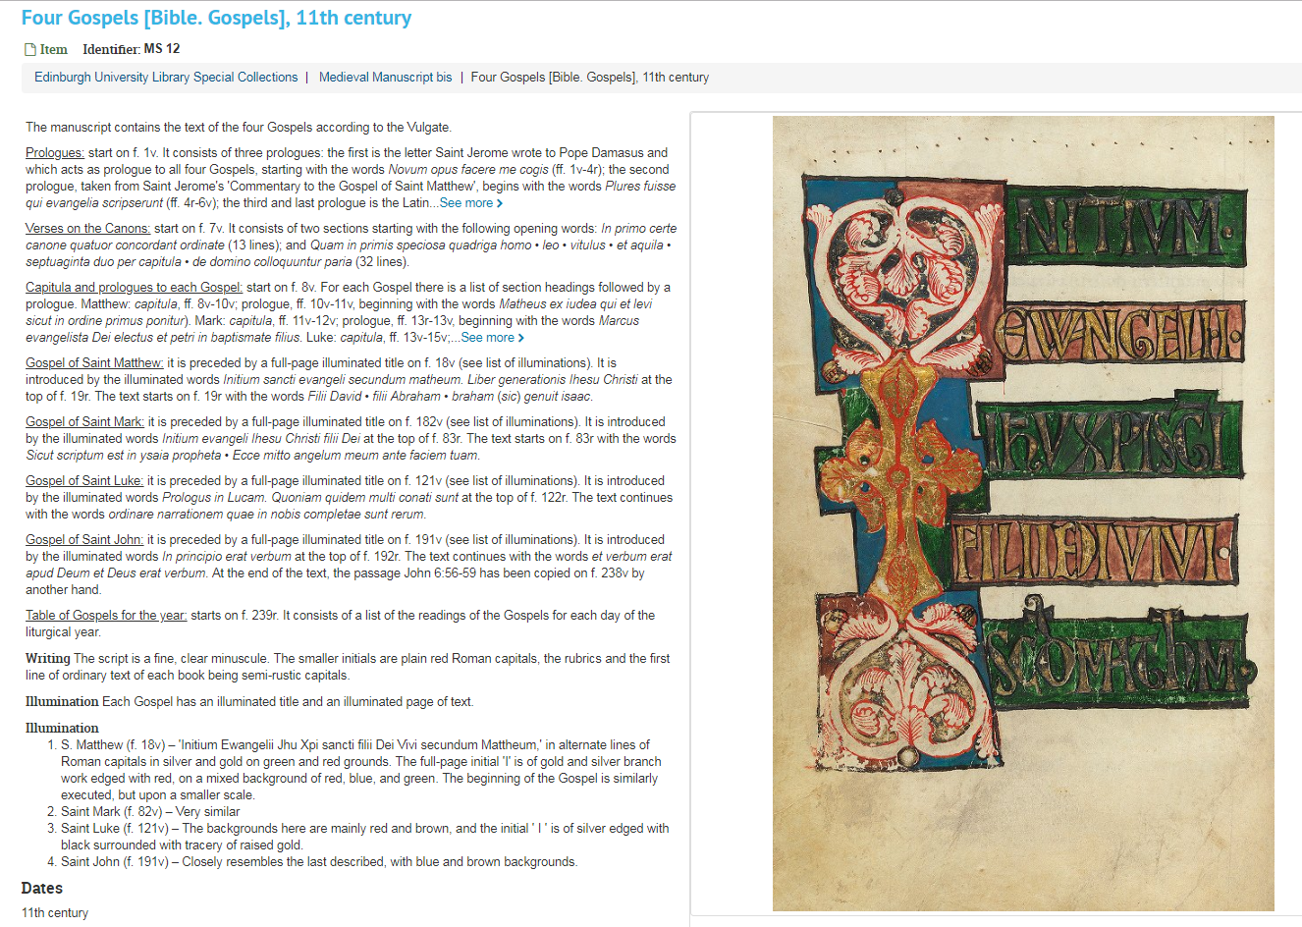
ArchivesSpace and IIIF.
Used Digital Objects from the start
From our high-resolution image platform LUNA
Work in progress to find a way to integrate IIIF to ArchivesSpace.

Slide 8
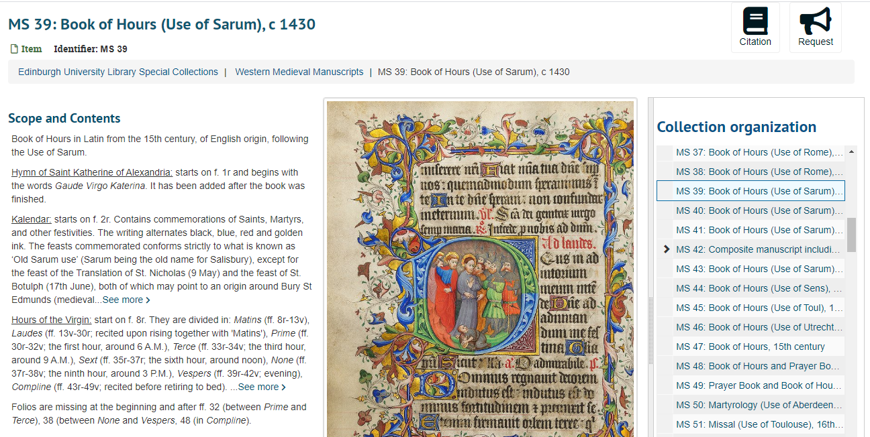
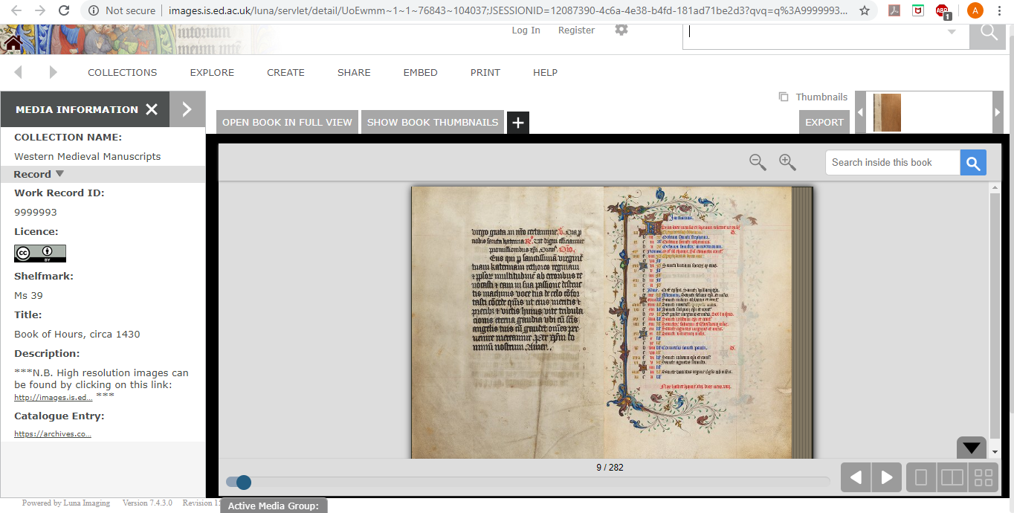
AS entry with Digital Object: https://archives.collections.ed.ac.uk/repositories/2/archival_objects/147780
High-res images on LUNA:
https://images.is.ed.ac.uk/luna/servlet/s/i9p61e

Slide 9
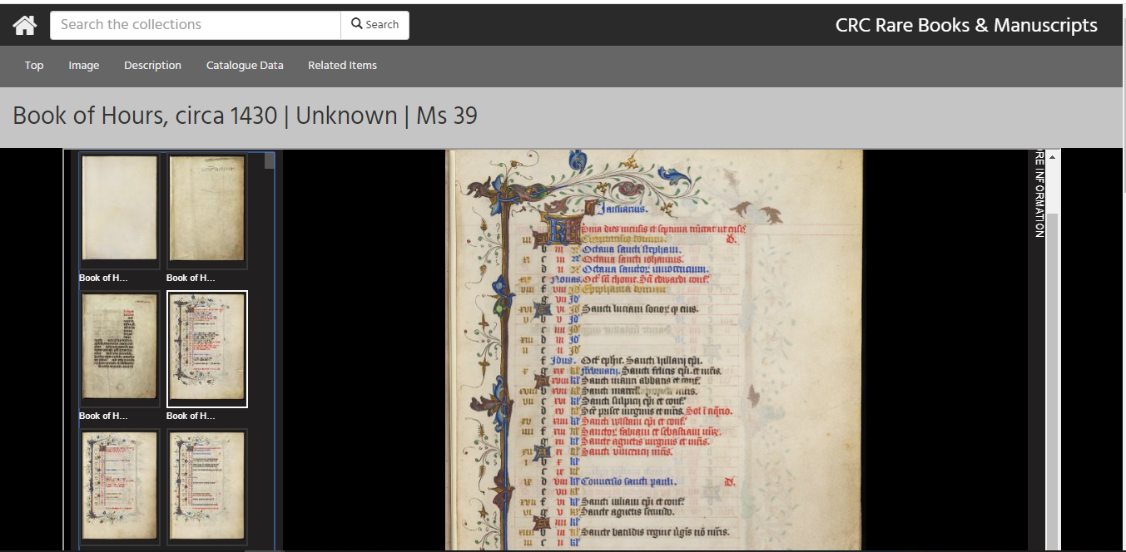
IIIF viewer:

Slide 10
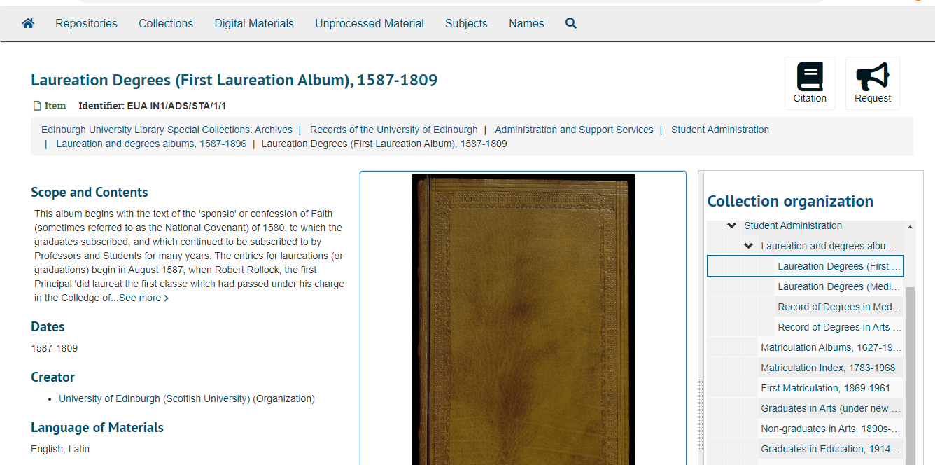
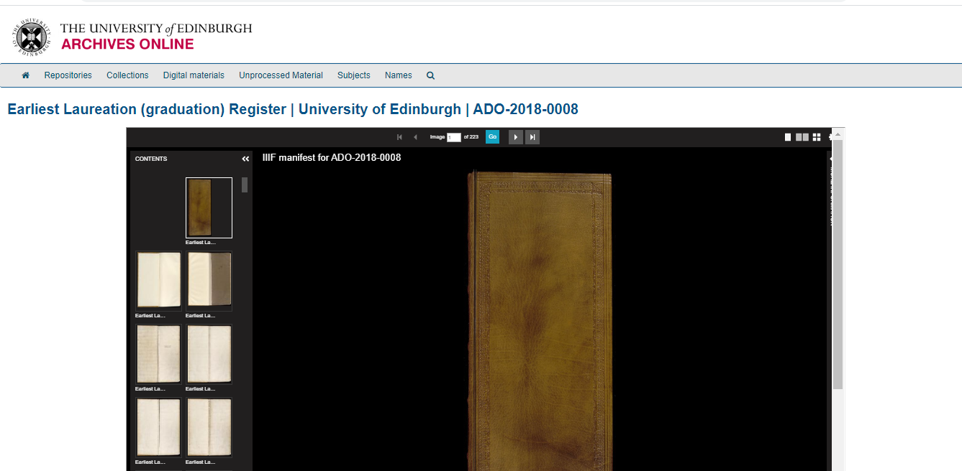
ASpace entry with Digital Object linking out to IIIF manifest:
IIIF viewer configurated to look like ASpace.

Slide 11
Thank you for listening!
Aline.Brodin@ed.ac.uk
https://github.com/UoEMainLibrary/ASPlugins
https://tinyurl.com/implementingAStechieside
https://tinyurl.com/implementingASblog

